Slide 1
感恩遇见，相互成就，本课件资料仅供您个人参考、教学使用，严禁自行在网络传播，违者依知识产权法追究法律责任。
更多教学资源请关注
公众号：溯恩高中英语
知识产权声明

Slide 2
让人物在你的笔端鲜活
外貌描写

Slide 3
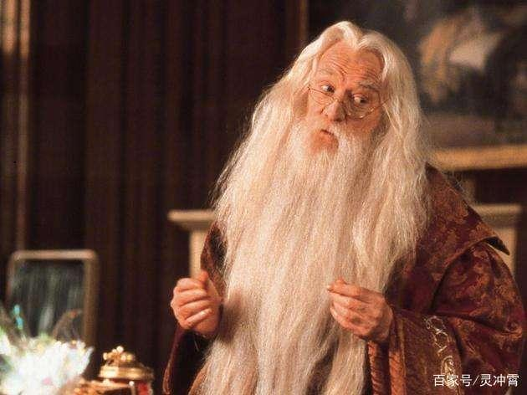
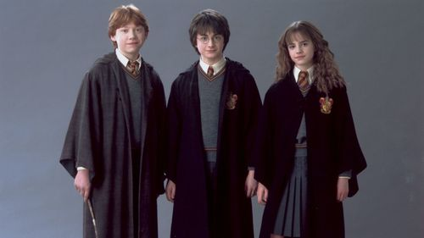
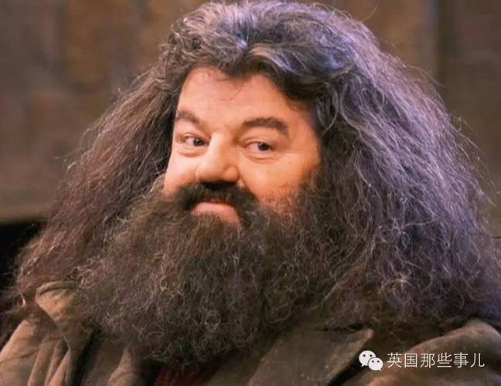
外貌描写
外貌描写是从人物的体貌特征(包括人物的容貌、衣着、体型、姿态等）进行描写，以揭示人物的思想性格，表达作者的爱憎，加深读者对人物的印象。
TIP:外貌描写可长可短。但要完全从文章主题表达的需要来勾勒，所写外貌必须切合文章的主题，为刻画人物服务

Slide 4
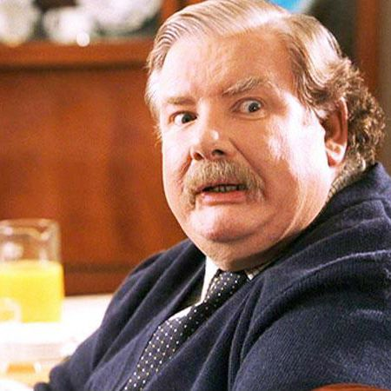
取胜第一招：外貌描写要据情节发展的需要去写
素材摘录1：Mr. Dursley was a big, beefy man with hardly any neck, although he did have a very large mustache.
beefy
德斯利先生身材魁梧，几乎没有脖子，尽管他确实留着很大的胡子。
hardly any neck
mustache

Slide 5
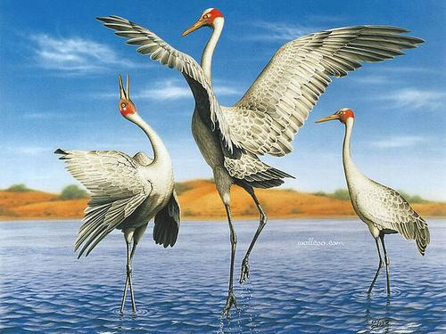
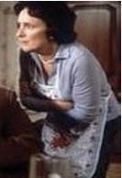
素材摘录2：Mrs. Dursley was thin and blonde and had nearly twice the usual amount of neck, which came in very useful as she spent so much of her time craning over garden fences, spying on the neighbors.
neck(twice)
crane
德思礼身材瘦削，金发碧眼，脖子几乎是平时的两倍，这对她来说非常有用，因为她花了很多时间在花园围栏上窥探邻居。
spy
Nosy(爱八卦的)

Slide 6
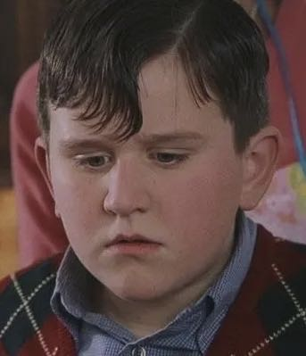
素材摘录3： He (Dudley) had a large pink face, not much neck, small, watery blue eyes, and thick blond hair that lay smoothly on his thick, fat head.﻿
Why thick???
thick also means foolish
他(Dudley)有一张粉红色的大脸，脖子不大，水蓝色的小眼睛，浓密的金发平稳地披在他又厚又胖的头上。
large pink face
not much neck
small, watery blue eyes
thick blond hair
thick fat head

Slide 7
素材解读：The Dursleys are the first three characters to appear in the entire Harry Potter series. The main function of describing their appearance is to introduce the protagonist Harry Potter and explain how he grew up in the first 11 years of his life.
Being minor figures, the three were not much attention paid, except the beginning of the story. The writer grabbed a common point - the neck - to write. Dudley has not much neck. Mr. Dursley has a short neck. While Mrs. Dursley’s neck is long.
From the appearance of Mr. Dursley (tall and chubby, a big beard on his face), the reader can imagine in their minds a man, who is bulky, rough, and even a bit wild. While the personality of Mrs. Dursley is nosy, isn't it? Clearly, the "function" of her long neck was emphasized. She used it to spy on her neighbors. Dudley is “thick”.

Slide 8
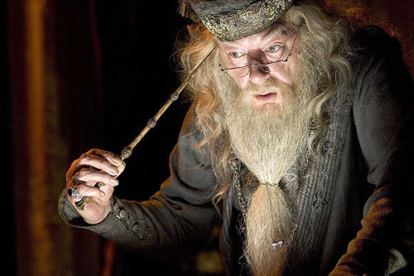
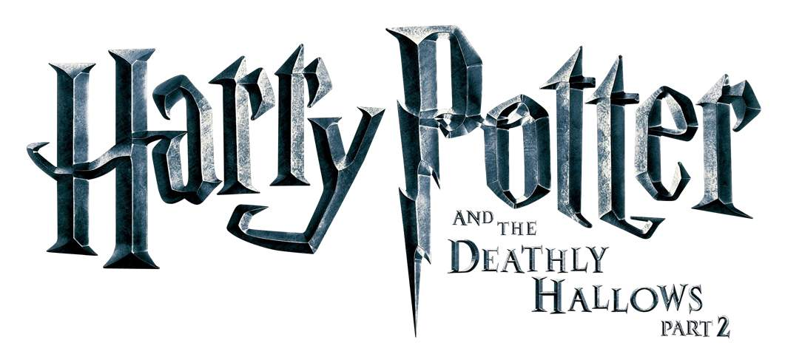
取胜第二招：外貌描写要展现人物的性格
smart,wise
smart,wise
素材摘录：His blue eyes were light, bright, and sparkling behind half-moon spectacles and his nose was very long and crooked, as though it had been broken at least twice.
sparkle(v.)闪烁
spectacles(n.)眼镜
Why???
crooked(adj.)弯曲的
他那双半月形眼镜后边的蓝眼睛炯炯有神。鼻子又长又弯，看来至少断过两次。
It is a sorcerer with many stories.
and the
Sorcerer’s Stone

Slide 9
素材解读：Dumbledore is a very important person to Harry Potter. He is a teacher, a benefactor, who bestowed many blessings on Harry. He has changed Potter’s entire life, thus his presence indicates a turning point that Harry’s fate is about to turn.

Slide 10
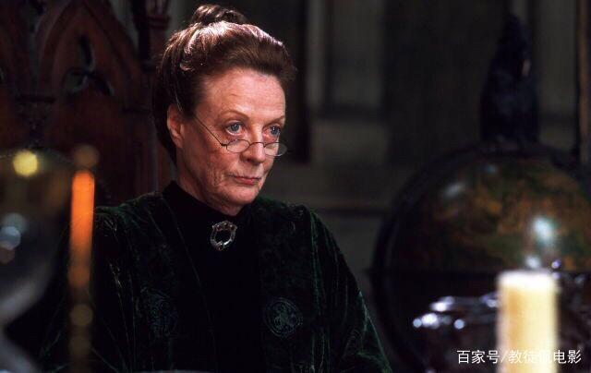
素材摘录：He was smiling at a rather severe looking woman who was wearing square glasses exactly the shape of the markings the cat had had around its eyes. She, too, was wearing a cloak, an emerald one. Her black hair was drawn into a tight bun. She looked distinctly ruffled﻿.
smart, wise
Why square?
rigorous ; strict ; well-knit
distinctly adv.明显地
ruffle v. 激怒
他朝一个神情严肃的女人微笑着。她戴一副方形眼镜，正是猫眼睛周围为纹路。她也披了一件祖母绿的斗篷。乌黑的头发挽成一个很紧的发髻。她看上去很生气﻿。

Slide 11
素材解读：Before Harry’s eleventh birthday, Professor McGonagall waited outside the Dursley’s house in the form of a cat. Albus Dumbledore recognized her. And she shapeshifted again.
Professor McGonagall's description goes from details to the whole, highlighting expressions, glasses, then clothing, and hair.
Square glasses is used to show that Professor McGonagall's personality has a slight bit of "dogmatism", adhering to rules and regulations, particularly respecting discipline and law.

Slide 12
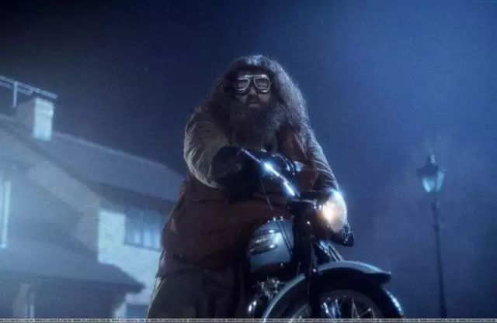
取胜第三招：外貌描写要展现人物的显著特征
素材摘录： He was almost twice as tall as a normal man and at least five times as wide. He looked simply too big to be allowed, and so wild — long tangles of bushy black hair and beard hid most of his face. He had hands the size of trash can lids, and his feet in their leather boots were like baby dolphins.
wild and tough/ careless about his appearance
tall and big
他几乎比普通人高一倍，宽度至少五倍，显得出奇地高大，而且粗野——纠结在一起的乱蓬蓬的黑色长发和胡须几乎遮住了大部分脸庞。那双手有垃圾桶那么大。一双穿着皮靴的脚像两只小海豚。

Slide 13
素材解读：Hagrid first appeared when he was riding a motorcycle to the front door of the Dursleys, holding a bundle of blankets --- the baby Harry. Hagrid is a character who is both a teacher and a friend to Harry.
From the author’s vivid description, we clearly know his major appearance and personality characteristics.

Slide 14
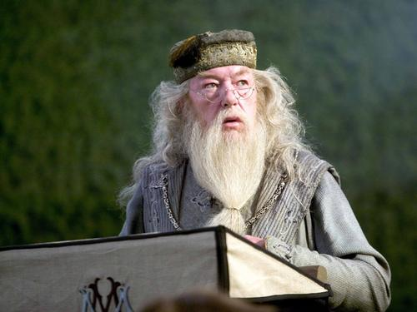
素材摘录：He was tall, thin and very old, judging by the silver of his hair and beard, which were both long enough to tuck into his belt.
他个子瘦高，银发和银须长到能够塞到腰带里了，凭这一点就可以断定他年纪已经很大了。
素材解读：The most distinguish appearance characteristics of Albus Dumbledore is his long silver hair and beard, which indicates he is old and he knows a lot about past and about Harry’s parents.

Slide 15
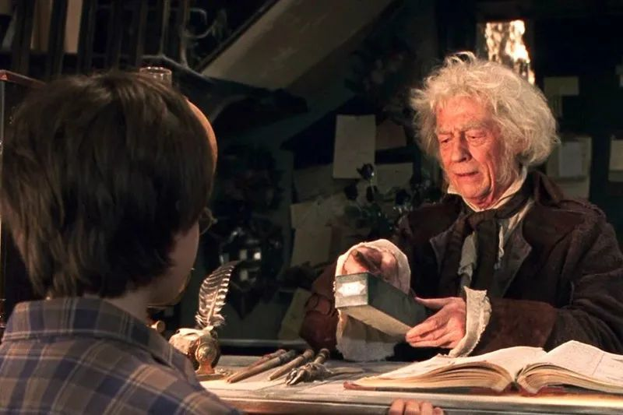
素材摘录1：An old man was standing before them, his wide, pale eyes shining like moons through the gloom of the shop.
一位老人站到他们面前。他浅色的大眼睛在暗淡的店铺里像两轮闪亮的月亮。
素材摘录2：“Hmmm,” said Mr. Ollivander, giving Hagrid a piercing look.
“嗯，”奥利万德先生说，敏锐地看了海格一眼。
素材解读：Thought his shop is narrow and shabby, yet from the description of his eyes, the readers will believe Mr. Ollivander is undoubtedly the best wand maker in the world. Even Hagrid is nervous of him. So, it is enough that only his eyes are described in the story.

Slide 16
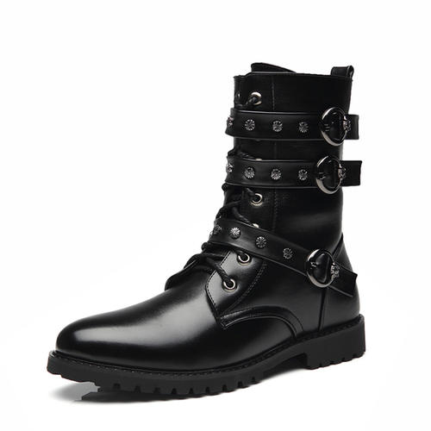
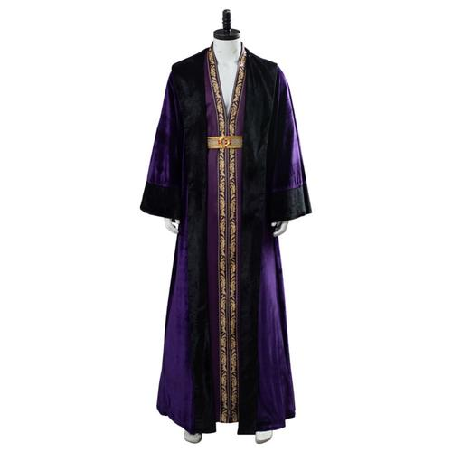
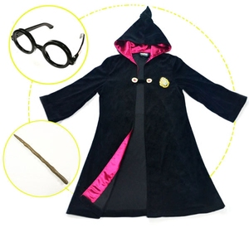
服饰描写
取胜第四招：外貌描写要展现人物的身份
素材摘录：He was wearing long robes, a purple cloak which swept the ground, and high-heeled, buckled boots.
他穿一件长袍，披一件拖到地的紫色斗篷，蹬一双带搭扣的高跟靴子。
robe袍服
cloak斗篷
buckled boots
系扣的靴子
and the
Sorcerer’s Stone

Slide 17
素材解读：A robe that explains Dumbledore’s identity as a magician; The purple robe, which is different from the green robe used by Professor McGonagall in the text, indicates the different colors of the robe, representing the level difference of the magician.

Slide 18
取胜第五招：外貌描写要反映人物所处的环境
﻿素材摘录：Harry had always been small and skinny for his age. He looked even smaller and skinnier than he really was because all he had to wear were old clothes of Dudley’s, and Dudley was about four times bigger than he was.
哈利显得比他的同龄人瘦小。他看上去甚至比他实际的身材还要瘦小，因为他只能穿达力的旧衣服，而达力要比他宽大三四倍。
素材解读：From the description of Harry’s appearance, the readers can see Harry wasn’t treated well by the Dursleys. Harry’s thin and weak body was contrasted with Dudley‘s plump clothes, highlighting Harry’s small and thin figure.

Slide 19
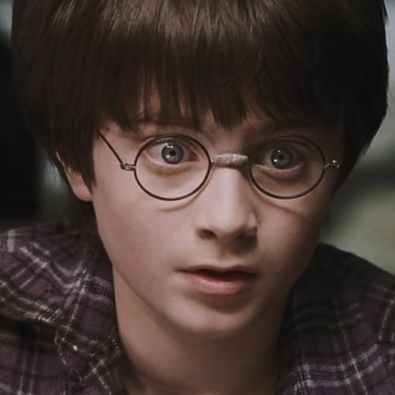
取胜第六招：外貌描写要紧扣细节
素材摘录： He wore round glasses held together with a lot of Scotch tape because of all the times Dudley had punched him on the nose. 他戴着一副用许多透明胶粘在一起的圆框眼镜，因为达力总用拳头揍他的鼻子。
Scotch tape:思高透明胶带
and the
Sorcerer’s Stone

Slide 20
素材解读：This is only one sentence and one detail, but it reveals much information. First, it indicates that Harry’s life at the Dursley family is not good at all. His cousin Dudley often bullies him. And the Dursley couple are not good to him, for he hasn’t been given a new pair of glasses.
Why Harry wears round glasses, not square glasses like Professor McGonagall’s? Round usually means a hint of roundness and flexibility. It indicates that Harry is not as rigid and dogmatic as McGonagall. He is intelligent and flexible, and even in the 11 years of life of the Dursley family, he survived the fittest with a touch of “smoothness”.

Slide 21
取胜第七招：外貌描写要结合动词
素材摘录：The giant squeezed his way into the hut, stooping so that his head just brushed the ceiling.
巨人好不容易才挤进屋来。他弓着腰，这样他的头刚刚擦着天花板。
素材解读：From the verbs “squeeze”, “stoop” and “brush”, a vivid image of a giant (Hagrid) is formed in the readers’ mind.

Slide 22
素材摘录：Hagrid was so huge that he parted the crowd easily, all Harry had to do was keep behind him.
海格身材魁梧，很容易就把人群拨拉开了。哈利只要跟在他身后就行。
素材解读：From the sentence, especially the verb “part”, the readers can easily get an image of a giant walking through the crow, who all make way for him, while the thin and small Harry tried his best to keep up with him with quick short steps.

Slide 23
取胜第八招：外貌描写要结合修辞手法
素材摘录：His face was almost completely hidden by a long, shaggy mane of hair and a wild, tangled beard, but you could make out his eyes, glinting like black beetles under all the hair.
他的脸几乎完全被他蓬乱斗地长发和结成一团的胡子遮住了，但你仍能清楚地看到他那对眼睛在头发下像黑甲壳虫似的闪闪发光。
素材解读：It is the second time Hagrid has appeared in the story. His strong and big figure hasn’t changed much over the time. This time, the writer uses simile to describe his eyes to indicate that though his action of tearing down the door is reckless, he is actually a kind, warm-hearted and helpful person, especially to Harry.

Slide 24
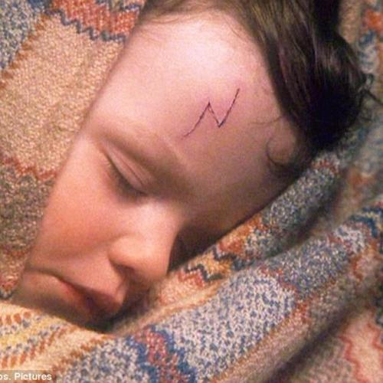
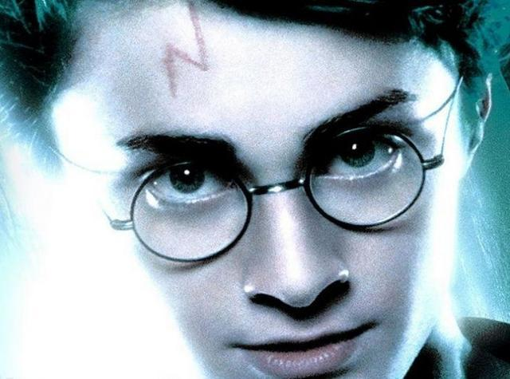
tuft n.:一绺毛发，一丛草
Jet-black: adj. 乌黑发亮的
素材摘录：Under tuft of jet-black hair over his forehead they could see a curiously shaped cut, like a bolt of lightning.
素材解读：The writer uses simile to describe the most distinguish feature on Harry’s face: a scar shaped like a bolt of lightning, which is mentioned multiple times in the following stories.
在他额头上一簇乌黑发亮的头发下面，他们可以看到一道形状奇特的伤口，就像一道闪电。

Slide 25
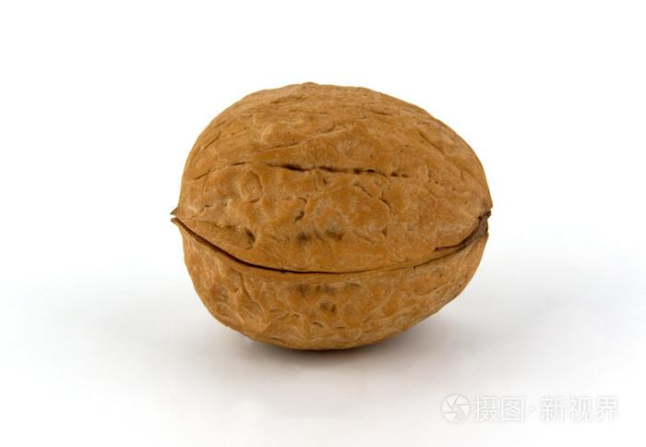
取胜第九招：外貌描写要体现对角色感情
素材摘录：A little man in a top hat was talking to the old bartender, who was quite bald and looked like a toothless walnut.一个戴大礼帽的小男人正在跟一个头发几乎脱光、长得像瘪胡桃似的酒保聊天。
bartender n.酒保
bald adj.秃顶的
素材解读：Here the bartender is only mentioned to develop the story. But clearly, the writer, or rather Harry, doesn’t like him or the environment, so the negative words like “bald”, “toothless” and “look like walnut” are used.
walnut n.胡桃

Slide 26
素材摘录1：The goblin was about a head shorter than Harry. He had a swarthy, clever face, a pointed beard and, Harry noticed, very long fingers and feet.这个妖精大约比哈利矮一头。生着一张透着聪明的黝黑面孔，尖尖的胡子，哈利发现他的手和脚都特别长。
goblin n. 小妖精
swarthy adj. 黝黑的
素材摘录2：A toothless old man came ambling up to them, pointing, with a rather wicked grin, at an old rowboat bobbing in the iron-gray water below them. 一个没有牙齿的老人慢慢地向他们走来，带着相当邪恶的笑容，指着他们下面铁灰色水中漂浮的一艘旧划艇。
amble v. 慢行
bob v. (在水中)上下快速移动
素材解读：Compare these two passages, isn’t it clear which one is liked by the writer, the goblin or the old man?! Why?

Slide 27
Practice 1
Fill in the blanks, using the proper words to describe the appearance of the characters, according to the Chinese meaning and the plot.
According to the large clock over the arrivals board, Harry had ten minutes left to get on the train to Hogwarts and he had no idea how to do it; he was stranded in the middle of a station with a heavy trunk, and a large owl.
Suddenly, Harry heard someone say Hogwarts and swung round. The speaker was a _______ (丰满的)woman who was talking to four boys, all with _______________(火红的头发). Each of them was pushing a trunk like Harry’s -- and they had an owl.
Heart hammering, Harry said to the plump woman, “Excuse me.”
“Hello, dear,” she said. “First time at Hogwarts? Ron’s new, too.”
She pointed at the last and youngest of her sons. ______________________________________________________________________ (他又高又瘦，略显笨拙，脸上长着雀斑，大大的手和脚，还有一个长长的鼻子。)
“Please, come with us.” she said kindly, and Harry nodded.
plump
flaming red hair
He was tall, thin, and gangling, with freckles, big hands and feet, and a long nose.

Slide 28
Practice 2
Fill in the blanks, using the proper words to describe the appearance of the characters, according to the Chinese meaning and the plot.
Harry and other first year students clambered up a passageway in the rock after Hagrid’s lamp, came out at last onto smooth, damp grass right in the shadow of the castle, and walked up a flight of stone steps and crowded around the huge, Oak front door.
Hagrid raised a ___________ (大拳头) and knocked three times on the castle door.
The door swung open at once. ______________________________________________________ (一个身穿翠绿色长袍的高个子黑头发女巫站在那里。) She had a very _____ (严厉的) face and Harry’s first thought was that this was not someone to cross.
“The first years, Professor McGonagall,” said Hagrid.
“Thank you, Hagrid. I will take them from here.”
gigantic fist
A tall, black-haired witch in emerald-green robes stood there.
stern

Slide 29
Have a practice 3
Fill in the blanks, using the proper words to describe the appearance of the characters, according to the Chinese meaning and the plot.
“Ron! Ron! Where are you? The game’s over! Harry’s won! We’ve won! Gryffindor is in the lead!” shrieked Hermione, dancing up and down on her seat and hugging Parvati Patil in the row in front.
Harry jumped off his broom, a foot from the ground. He couldn‘t believe it. He’d done it -- the game was over; it had barely lasted five minutes. As Gryffindors came spilling onto the field, he saw Snape land nearby, _________________________ (脸色煞白，嘴唇抿得紧紧的) —— then Harry felt a hand on his shoulder and looked up into Dumbledore’s _________________ (笑脸).
white-faced and tight-lipped
smiling face

Slide 30
抓住最主要的特点
运用最贴切的词汇
Thank you

