Slide 1

感恩遇见，相互成就，本课件资料仅供您个人参考、教学使用，严禁自行在网络传播，违者依知识产权法追究法律责任。
更多教学资源请关注
公众号：溯恩高中英语
知识产权声明

Slide 2
浙江省高考英语试卷应用文写作解析
2021年6月
桐乡市高级中学 俞莺婕

Slide 3
Contents
精准审题，搭建框架
1.
各个击破，组织语料
2.
调整补充，注意衔接
3.
由此及彼，举一反三
4.

Slide 4
PART 01
精准审题，搭建框架

Slide 5

试题回顾（考生回忆版）
昨天你去学校参观了一个中国画的展览，请你为学校英语报写一篇宣传稿。
要点：1.时间、地点；2. 你的参观感受；3.帮助推荐。
昨天你去学校参观了一个中国画的展览，请你为学校英语报写一篇宣传稿。
要点：1.时间、地点；2. 你的参观感受；3.帮助推荐。
昨天你去学校参观了一个中国画的展览，请你为学校英语报写一篇宣传稿。
要点：1.时间、地点；2. 你的参观感受；3.帮助推荐。
昨天你去学校参观了一个中国画的展览，请你为学校英语报写一篇宣传稿。
要点：1.时间、地点；2. 你的参观感受；3.帮助推荐。
文体 | 新闻报道+推荐
主题语境 | 人与社会（文学、艺术与体育）
框架结构 | 标题+首段（导语）+中段（要点1+要点2）+尾段（要点3）
内容要点 | 中国画展览的时间、地点+感受(意义)+推荐
语言风格 | 客观简练（描述画展）、生动形象（描述感受）、有一定煽动性（帮助推荐）

Slide 6

An inverted pyramid writing structure
The headline (must-know information)
The lead (the most significant information)
The body (the details)
The ending

Slide 7
PART 02
各个击破，拓展细节

Slide 8
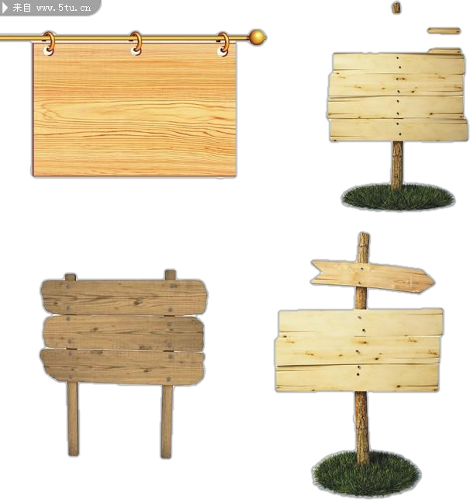

标题
Headline
The headline should be easy to understand (clear), straightforward (concise) and eye-catching (attractive).
Clear
Concise
Attractive
Exquisite/Marvelous Chinese Paintings Are Exhibited On Campus

Slide 9
首段（导语）
summary lead
summary lead
descriptive lead
lead
quotation lead
suspense lead
elements of a summary lead
Who
When
Where
What
How
Why

Slide 10
首段（导语）
elements of a summary lead
Who
When
Where
What
How
Why
Eg1:
Yesterday, I paid a visit to the Art Hall to appreciate the marvelous Chinese paintings exhibited, which gave an aesthetic pleasure to all those present.
To make it vivid, you can add some rhetorical devices(修辞手法).
Eg2:
personification
Yesterday witnessed an extraordinary Chinese painting exhibition organized by the Students’ Union, which gave an aesthetic pleasure to all those present.

Slide 11
中段（要点1）
时间（此处表示画展的起讫时间）、地点的描述:
in the Art Hall
in the school library
in the Student (Activity/Recreational)Center
in the stadium
from June 8th to June 20th
from Monday to Sunday
Started on Monday, the week-long exhibition
To combine the time and place, you can use the sentence pattern:
Arranged/Organized in +place+ time, the exhibition...
e.g.:
Arranged in the Art Hall from June 8th to June 20th, the exhibition...

Slide 12
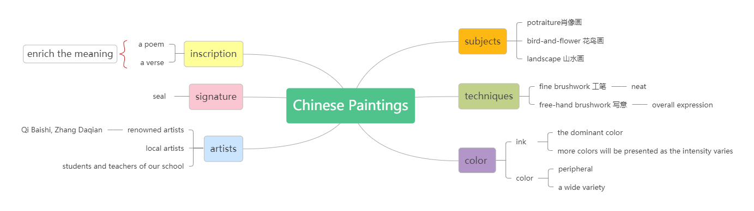
中段（要点1拓展细节）
画展细节的描述:
e.g.: Arranged in the Art Hall from June 8th to June 20th, the exhibition displays a wide variety of marvelous artworks, the subject of which varies from portraiture to landscape.

Slide 13
中段（要点2）
参观感受:
e.g.:
Amazed by the neat brushstrokes (笔法，笔锋) which perfectly present the exquisite details and the varied intensity(浓度) of the ink and colors, I felt an irresistible pull into the stunning art world.
amazed
e.g.:
Impressed by the integration(融合) of Zen (禅) and freehand brushwork style, which emphasizes the overall expression of the individual painter, I was totally immersed in the charm of the stunning Chinese paintings.
impressed

Slide 14
中段（要点2拓展细节）
画展的意义:
The exhibition is of great significance as it thoroughly exposed me to the exquisite art world and elevated my artistic/aesthetic sense.
Considered as the beginning of the Art Festival, the exhibition offers not only visual delight but also a deep insight into the fabulous art world.
With cultural and artistic identity recognizable in every single piece of artwork, the exhibition is truly a living fossil (化石) and a museum of the traditional Chinese culture.

Slide 15
中段（要点2拓展细节）
画展的意义:
Undeniably, the show not only promotes my aesthetic taste, but also fuels my passion for art exploration.
Undeniably, the show not only allows me to experience the beauty of the marvelous Chinese paintings first hand, but also fuels my passion for exploring the profound art world.

Slide 16
尾段（要点3）
推荐参观:
I strongly recommend you pay a visit and check out the exquisite artworks by yourself. Don’t miss it!
I have to admit that it is a fabulous opportunity to get close to art. You can’t afford to miss it !
It is highly recommended that you come and relish the exquisite artworks by yourself. Don’t miss it!

Slide 17
PART 03
调整补充，注意衔接

Slide 18


Exquisite Chinese Paintings Are Exhibited On Campus
Yesterday witnessed an extraordinary Chinese painting exhibition organized by the Students’ Union, which gave an aesthetic pleasure to all those present.
Arranged in the Art Hall from June 8th to June 20th, the exhibition displays a wide variety of marvelous artworks, the subject of which varies from portraiture to landscape. Amazed by the neat brushstrokes and the varying intensity of ink and colors, I felt an irresistible pull into the stunning art world. Undeniably, the show not only elevates my aesthetic taste, but also fuels my passion for art exploration.
Therefore, it is highly recommended that you come and relish the exquisite artworks by yourself. Don’t miss it!

Slide 19
PART 04
由此及彼，举一反三

Slide 20

广东省“百越名校联盟”普通高中学业质量检测
假定你是李华，上周日你校举办了第15届校园艺术节。请你为校英文报写一篇报道，内容包括：
1.艺术节主题：和谐校园，艺术校园；
2.艺术节活动：班歌比赛，美术作品展；
3.活动反响。

Slide 21
The 15th Campus Art Festival of Our School
Last sunday witnessed the 15th campus art festival organized by the Students’ Union, which enjoyed great popularity among students and teachers.
Themed at “Harmonious campus and Artistic campus”, the festival turned out to be a feast for ears and eyes as well as minds. Students and teachers showed great enthusiasm and took an active part in the singing competition and artwork exhibition, which undoubtedly added color to our campus life. To our great delight, many students were awarded with prizes for their wonderful presentations which gave an aesthetic pleasure to all those present.
The meaningful and marvelous activities not only exposed us to the exquisite art world but also elevated our artistic sense. We do hope for a similar festival next year.

Slide 22
应用文写作5C原则
conciseness
courtesy
语言简洁，词决意畅
coherence
语言得体，
读者意识
clarity
completeness
行文连贯，
衔接得当
表述清楚，结构清晰
格式完整，要点齐全

Slide 23
THANKS!

