Slide 1
感恩遇见，相互成就，本课件资料仅供您个人参考、教学使用，严禁自行在网络传播，违者依知识产权法追究法律责任。
更多教学资源请关注
公众号：溯恩高中英语
知识产权声明

Slide 3
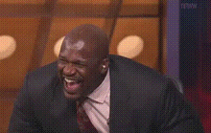
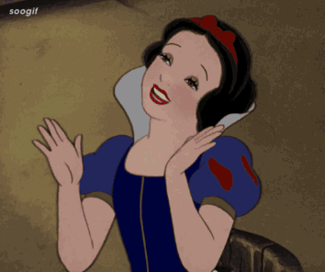
Lead-in
When you are happy, what will you do to show your happiness?
What means of communication are used to show your happiness?
Which means of communication do you think is more powerful?
“I feel so happy!”
“I’m thrilled!”
“I’m in heaven!”
“I’m walking on air!”
<
Spoken Language
(Verbal Communication)
Body Language
(Non-verbal Communication)
Some psychologists believe that we communicate 65% of our ideas and feelings without words!

Slide 4
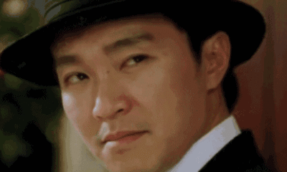
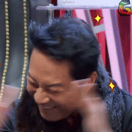
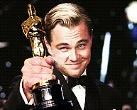
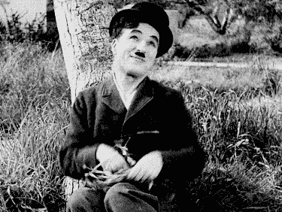
Lead-in
Act and Guess
Act and Guess
One student will be invited to come to the front; act the words out by using body language, and the other students try to guess what he/she means.

Slide 5
Lead-in
curious
frightened
confused
delighted
anxious
moved
satisfied
astonished
embarrassed
furious
indifferent
frustrated
impatient
regretful
crazy
relaxed
exhausted
jealous

Slide 6
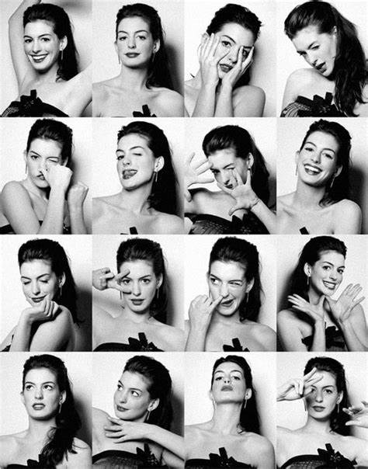
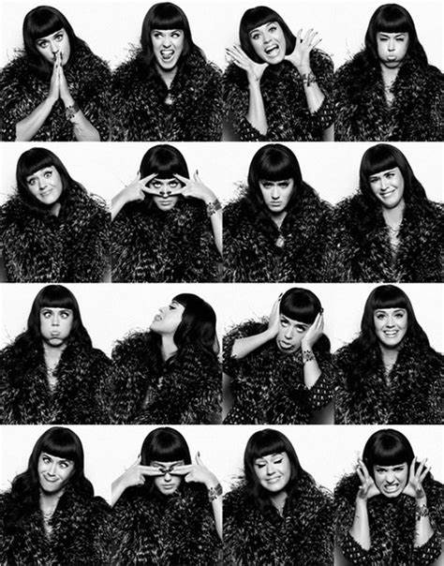
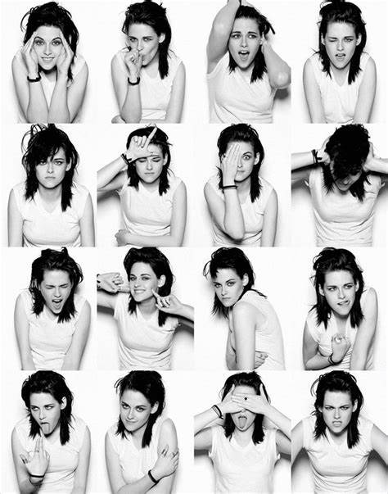
SHOWING OUR FEELINGS

Slide 7
Reading for Structure
Before writing, authors usually make a writing outline. Complete this outline in your own words, using these steps:
Use the topic sentences of the first and the last paragraphs to help you write the main idea.
Use the topic sentences of the middle paragraphs for the supporting points.
Main idea: _______________________
Points: 1. Showing happiness
2. Showing unhappiness or anger
3. ________________________
4. ________________________
5. ________________________

Slide 8
Reading for Structure:
Topic sentences
Para. 1
Para. 7
Of course, body language can be misread, but many gestures and actions are universal.
With so many cultural differences between people, it is great to have some similarities in body language.
Tip for Summary: the first or the last sentence of a paragraph in an informative or argumentative writing is often the topic sentence.

Slide 9
Reading for Structure:
Topic sentences
Para. 2
Para. 3
Para. 4
Para. 5
Para. 6
The most universal facial expression is, of course, the smile – its function is to show happiness and put people at ease.
From the time we are babies, we show unhappiness or anger by frowning.
*There are many ways around the world to show agreement, but nodding the head up and down is used for agreement almost worldwide.
How about showing that I am bored? Look away from people or yawning will, in no case, make me appear to be uninterested.
Being respectful to people is subjective, based on each culture, but in general it is probably not a good idea to give a hug to a boss or teacher.

Slide 10
Reading for Structure:
Outline
Main idea: _______________________
Points: 1. Showing happiness
2. Showing unhappiness or anger
3. ________________________
4. ________________________
5. ________________________
Body language has many universal gestures.
Showing agreement or disagreement.
Showing boredom.
Showing respect.

Slide 11
Reading for Details:
Universal Body Language
Fill in the form and act them out.
feelings | body language
happiness
smile
anger or unhappiness
frown; turn against sb; make a fist & shake it
agreement
nod the head up and down
disagreement or refusal
shake the head from side to side
boredom
look away from people or yawn
interest
turn toward & look at someone or something
disbelief or dislike
roll my eyes and turn my head away
respect
don’t give a hug to a boss or teacher
don’t stand too close to someone of a higher rank
stand at a little distance with open hands

Slide 12
Post-reading:
Discussion
Why did people give false smile sometimes?
They want to hide their feelings and don’t want to lose face.
2. What are some jobs in which using body language is extremely important?
Teachers; medical care people; interviewers & interviewees; People in diplomatic jobs & in some government jobs, etc.
3.Does the same body language always have the same meaning in different cultures?
Not exactly. For example, “thumbs up” means “good job” in most countries but is a rude gesture in Niagara; and “shaking the head from side to side” mostly means disagreement but in India it becomes “yes”!

Slide 13
Writing:
Letter of concern
One of your classmates came in this morning looking sorrowful. When you tried to communicate with him, he used his body language to show his refusal. Then, you decide to write him a short letter to ask about what is wrong and whether you can help. Use the structure below to help you.
Dear (friend’s name),
(1st paragraph: describe the body language that you noticed)
(2nd paragraph: ask if something is wrong; perhaps make some guesses)
(3rd paragraph: offer to help; remind him/her that you are a good friend)
(closing),
(your name)

Slide 14
Writing:
Letter of concern
1. 开头常用语:
(1) It broke my heart to notice that...
(2) I just can’t tell you how sad I was when I notice that...
(3) I’m writing to express my deep sympathy and care for you.
2. 结尾常用语：
(1) If I can be of any help, please don’t hesitate to let me know.
(2) I hope our caring will help to comfort you.
(3) I hope that time will take away the sorrow of your recent loss.
(4) Remember that my heart and my thoughts are always with you.

Slide 15
Writing:
Letter of concern
Dear Lin Pei,
I noticed this morning that you seemed in great sorrow because your eyes are red, swollen and watery. So I approached you, hoping to figure out what had happened and ease your sadness. Though you put your head down and left immediately, I still want to write this letter to express my deep sympathy and care for you.
Is there anything bothering you or even afflicting you? I heard that your mum had been ill for long and that you were really exhausted by doing all the housework at home. Is that true?
Anyway, I just want to let you know that I will be always available for having a little heart-to-heart or sharing your housework. Please don’t hesitate to pour your sorrow to me. Your sorrow will definitely be reduced by half.
Yours,
Oscar

Slide 16
Assignment
1. Summarize the passage by using your own words.
2. Surf the internet to find more information about the same body language’s different meanings in different customs.
Notes:
prediction

Slide 17
Thank you for
your participation!

