Slide 1
感恩遇见，相互成就，本课件资料仅供您个人参考、教学使用，严禁自行在网络传播，违者依知识产权法追究法律责任。
更多教学资源请关注
公众号：溯恩英语
知识产权声明

Slide 2
2024年浙江省金华十校高三模拟考试
英语试卷客观题讲评课件
傅嘉

Slide 3
题型概况
01

Slide 4
题型 | 话题 | 体裁 | 词数（文本+题目）
阅读A | 人与自我: Offer guidance on how to become a successful writer | 应用文 | 295
阅读B | 人与自我: AQ vs EQ | 记叙文 | 495
阅读C | 人与自然：the history and development and the protection of Everglades | 说明文 | 463
阅读D | 人与社会： Explore the reasons why the saving rate in USA is falling down | 议论文 | 472
七选五 | 人与自我： how to spark fading motivation into a flame | 说明文 | 348
完型填空 | 人与社会 Our new life in Arizona | 记叙文 | 406
语法填空 | 人与社会 a hanfu parade in Valletta | 说明文 | 223

Slide 5
PART 1
阅读理解

Slide 6
A 篇
杂志的新年特刊
读者寄语
---
指引尚未成功的作家们

Slide 7
Dear readers,
"Persist."-Viet Thanh Nguyen
"Success is no accident." -Chris Bohjalian
"Keep writing and it'll get easier." -Lisa Jewell
"Be patient with yourself." -Min Jin Lee
These are words of advice taken from our interviews with award-winning and bestselling authors. Notice, though, not a single mention of their status, prizes, or advances in other words, their success. And while status, literary awards, and money can be indicators of a successful writer, one must actually sit down and write for any of those things to happen. That's what all of these pieces of advice have in common: putting words on the page.
In this issue, you'll find articles to help you succeed, no matter your goals. If it's to figure out whether that mess of a novel you've got sitting in a drawer can be rescued or if you need to move on, Andromeda Romano's article will offer questions to ask yourself. Michael La Ron's essay will give you an example of how an unexpected opportunity might be just the push you need. Or, if you've had trouble finding an agent, Ryan Van Cleave's collection of tips and advice from 22 literary agents on every aspect of the business might change your luck. Matty Dalrymple shares ways to reach more readers and build a community with them.
Wish you success and happy new year!
P1: advice for successful writing
P2: essence of the advice above
P3: writing problems and solutions to them
P4: ending: anticipation and wishes

Slide 8
主题语境--人与社会、自我
A 篇：应用文
Dear readers,
"Persist."-Viet Thanh Nguyen
"Success is no accident." -Chris Bohjalian
"Keep writing and it'll get easier." -Lisa Jewell
"Be patient with yourself." -Min Jin Lee
点击添加标题
细节理解题
21. The advice mentioned at the beginning highlights the importance of
A . a big dream B. constant practice
C. earning money D. achieving success
应用文解题：题文同序，关注题目中的“原词复现”or “核心词汇”。

Slide 9
(Para3) In this issue, you'll find articles to help you succeed, no matter your goals. If it's to figure out whether that mess of a novel you've got sitting in a drawer can be rescued or if you need to move on, Andromeda Romano's article will offer questions to ask yourself.
点击添加标题
应用文解题：关注原题与原文的近义词、同义词
细节理解题
22. Whose article may help those who are unsure whether to save an unsuccessful novel?
Matty Dalrympl. B. Michael La Ronn.
C. Ryan Van Cleave. D. Andromeda Romano.

Slide 10
In this issue, you'll find articles to help you succeed, no matter your goals. If it's to figure out whether that mess of a novel you've got sitting in a drawer can be rescued or if you need to move on, Andromeda Romano's article will offer questions to ask yourself. Michael La Ron's essay will give you an example of how an unexpected opportunity might be just the push you need. Or, if you've had trouble finding an agent, Ryan Van Cleave's collection of tips and advice from 22 literary agents on every aspect of the business might change your luck. Matty Dalrymple shares ways to reach more readers and build a community with them.
点击添加标题
23. Who might be the target readers of this issue?
Writers. B. Businessmen.
C. Booksellers. D. Literary agents.
推理判断题

Slide 11
A 篇：语料库
1.indicators of a successful writer 成功作家的标志
2. In this issue 在这一期（ 杂志）
构词法：动词+er/ or ： 表示“从事某种职业的人, 某地区，地方的人“ 或者“某种机/器或者某种工具”；
注意本卷第27题的四个选项：都要猜测一下指什么人。
（注意对比：本卷七选五选项C： What ‘s at the heart of this issue?
issue n. 问题；争端 ） 另：
issue vt. 发行；发布；发出
issue a new set of stamps; 发行一套新邮票
issue a warning 发出警告

Slide 12
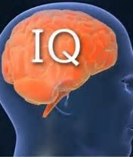
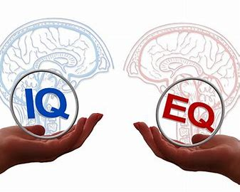
B 篇
我要成为一个有AQ的人

Slide 13
I'm in a coffee shop in Manhattan and I'm about to become the most disliked person in the room. First, I'm going to interrupt the man reading quietly near the window and ask for a drink of his latte. Next, I'm going to ask the line of people waiting to pay if I can cut to the front of the queue. This is how I chose to spend my last vacation. Here's why.
Growing up, all I ever heard about was "EQ." It was the mid-1990s, and psychologist Daniel Goleman had just popularized the concept of emotional intelligence. Unlike IQ, which tracked conventional measures of intelligence like reasoning and recall, EQ measured the ability to understand other people ---to listen, to empathize , and to appreciate.
My mother, an elementary school principal, prized brains and hard work, but she placed a special emphasis on Goleman's new idea. To her, EQ was the elixir (万能药) that separated the good students from the great after they left school. She was determined to send me into the adult world with as much of this elixir as possible.
But when I finally began my first job, I noticed a second elixir in the pockets of some of my colleagues. It gave their opinions extra weight and their decisions added impact. Strangest of all, it seemed like the anti-EQ: Instead of knowing how to make others feel good, this elixir gave people the courage to do the opposite ---to say things others didn't want to hear.
This was assertiveness (魄力). It boiled down to the command of a single skill: the ability to have uncomfortable conversations. Assertive people--- those with high "AQ" --- ask for things they want, decline things they don't, provide constructive feedback, and engage in direct confrontation (对峙) and debate.
A lifetime improving my EQ helped me empathize with others, but it also left me overly sensitive to situations where I had to say or do things that might make others unhappy. While I didn't avoid conflict, I was always frustrated by my powerlessness when I had to say or do something that could upset someone. This is my problem and I'm working on it.
P1:the way I spent my last vacation and raise a question
P2-3 : my growing background with EQ
P6: answer the question in Par
P4: the discovery of AQ
P5: behaviors of people with high AQ
P6: Explain why I work on AQ

Slide 14
主题语境--人与自我
B 篇：记叙文
(Para. 1) I‘m in a coffee shop in Manhattan and I’m about to become the most disliked person in the room. First, I‘m going to interrupt the man reading quietly near the window and ask for a drink of his latte. Next, I’m going to ask the line of people waiting to pay if I can cut to the front of the queue. This is how I chose to spend my last vacation. Here‘s why.这就是我过上一个假期选择的方式。原因如下
点击添加标题
Para1 描述了我在度假期间做的各种奇葩行为。
Para2-3叙述了EQ以及我从小被教育EQ是万能药。
Para4讲述了工作后的我发现还有一种万能药。与EQ 截然相反。
Para5 引出AQ的概念。

Slide 15
(Para. 6) A lifetime improving my EQ helped me empathize with others, but it also left me overly sensitive to situations where I had to say or do things that might make others unhappy. While I didn't avoid conflict, I was always frustrated by my powerlessness when I had to say or do something that could upset someone. This is my problem and I'm working on it.
点击添加标题
最后一段的尾句与首段尾句呼应。本段讲述了EQ较高的我不敢做让别人不开心的事情。 所以我要努力提升AQ。 work on it = work on AQ. 呼应Para5 a simple skill: the ability to have uncomfortable conversations.
24. Why did the author act that way in the coffee shop?
To improve a skill. B. To test a concept.
C. To advocate a new idea. D. To have a unique vacation.
推理判断题

Slide 16
(Para. 3) My mother, an elementary school principal, prized brains and hard work, but she placed a special emphasis on Goleman's new idea. To her, EQ was the elixir (万能药) that separated the good students from the great after they left school. She was determined to send me into the adult world with as much of this elixir as possible.
点击添加标题
Tip: 通过关键词定位是细节题的主要方法
细节理解题
25. What do we know about the author's mother?
She thought little of IQ.
B. She popularized Goleman's idea.
C. She was a strict mother and principal.
D. She valued EQ as the key to greatness.

Slide 17
But when I finally began my first job, I noticed a second elixir in the pockets of some of my colleagues. It gave their opinions extra weight and their decisions added impact. Strangest of all, it seemed like the anti-EQ: Instead of knowing how to make others feel good, this elixir gave people the courage to do the opposite ---to say things others didn't want to hear.
This was assertiveness (魄力). It boiled down to the command of a single skill: the ability to have uncomfortable conversations. Assertive people--- those with high "AQ" --- ask for things they want, decline things they don't, provide constructive feedback, and engage in direct confrontation (对峙) and debate.
文化知识3：除了智商、情商外，近年来又流行一个新概念:挫折商(逆商)。IQ、EQ、AQ并称3Q，成为人们获取成功必备的不二法宝。有专家甚至断言，100%的成功=20%的IQ+80%的EQ和AQ。逆商AQ来自英文AdversityQuotient全称逆境商数，一般被译为挫折商或逆境商。是美国职业培训师保罗·斯托茨提出的概念。它是指人们面对逆境时的反应方式，即面对挫折、摆脱困境和超越困难的能力。
点击添加标题
代词指代题
26. What does the word "it" underlined in the fourth paragraph refer to?
A. EO B. AQ. C. Empathy. D. Courage.

Slide 18
(Para. 6) A lifetime improving my EQ helped me empathize with others, but it also left me overly sensitive to situations where I had to say or do things that might make others unhappy. While I didn't avoid conflict, I was always frustrated by my powerlessness when I had to say or do something that could upset someone. This is my problem and I'm working on it.
点击添加标题
please vt. 取悦 pleaser n. 取悦别人的人；讨好别人的人
Complainer 抱怨不断的人； Pleasure seeker 追求享乐的人；
27. According to the passage, those with high EQ but low AQ are likely to be
A. successful leaders B. people pleasers
C. terrible complainers D. pleasure seekers
推理判断题

Slide 19
长难句分析1；
并列句1
A lifetime improving my EQ helped me empathize with others, but it also left me overly sensitive to situations where I had to say or do things that might make others unhappy.
主语
谓语
宾语
非谓语作宾补
谓语
宾语
形容词短语作宾补
Where 定语从句修饰situations
that 定语从句修饰things
并列句2

Slide 20
B 篇：语料库
1. popularize the concept of emotional intelligence 普及情商概念
2. empathize with others与别人共情
3. place a special emphasis on …特别重视…
4. give their opinions extra weight 让他们的观点有特别的分量
5. anti-EQ与情商相反
6. boil down to the command of a single skill归结为对一项技能的掌握
7. decline things 拒绝东西
8. engage in direct confrontation (对峙) and debate参与直接的对峙以及争论

Slide 21
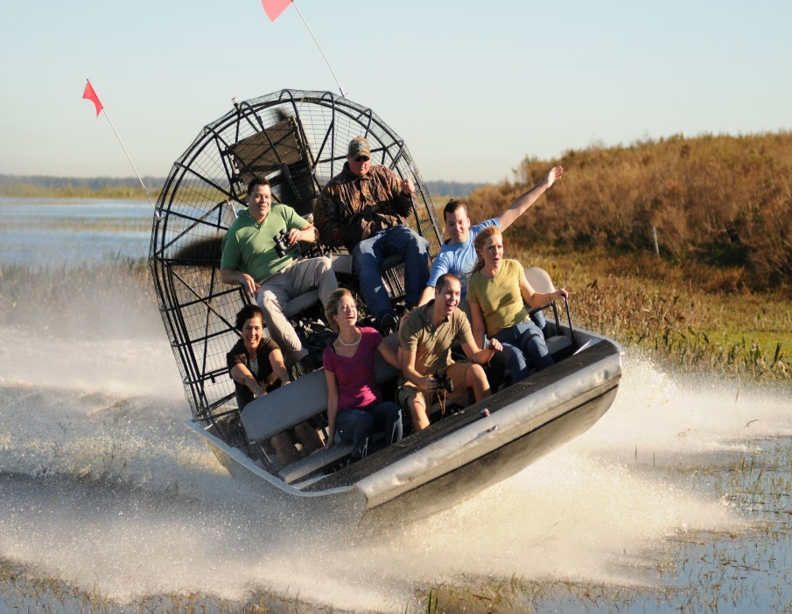
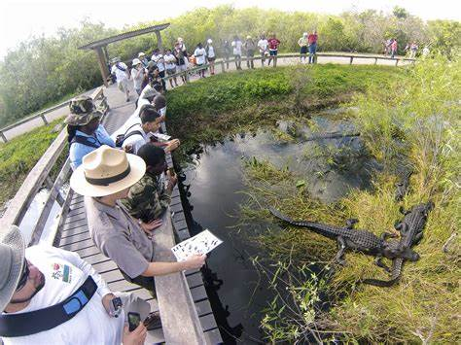
C 篇
Everglades National Park
in Florida

Slide 22
Sometimes we only appreciate something when we realize we may lose it. That is the story of the Everglades. A shallow slow-moving river, the Everglades once covered about 18,000 square miles of southern Florida. Until the 1900s, few people lived in the grassy wetlands. Not much was understood about the unique balance of nature that existed there. Plants, creatures, and water had formed a remarkable ecosystem.
By the early 1900s, Florida's pleasant winters attracted more people. Visitors became new permanent residents They built homes and roads. The conditions looked good for farming, so the newcomers planted large agricultural crops. But South Florida's cycle of flooding was a problem. To address that, developers attempted to drain (排水) the land. They also built structures to control water levels and flow.
Those changes made it easier for more people to live year-round in South Florida. However, they also disturbed life in the Everglades, which depends on freshwater regularly refilling the land. The area's growing human population needed freshwater. And large farms consumed large quantities of freshwater. By the mid-1900s, water levels in southern Florida began to go down. Lack of freshwater wasn't the only problem. As more and more land was developed for people and farms, the Everglades' historic boundaries contracted. Loss of habitat and hunting threatened the survival of native species in the Everglades.
Some people hoped that the government's recognition might save the Everglades. They fought for it Everglades National Park was established in 1947. It became the first park in the United States created for its biodiversity.
Now, Everglades National Park protects 1.5 million acres along the southern tip of Florida. An amazing variety of creatures live there. About 360 different species of birds have been sighted in the park. Nearly 300 different species of fish have been identified. About 40 species of mammals and 50 species of reptiles inhabit the park. Nature still rules in the Everglades, a place worth understanding, appreciating, and protecting.
P1:the original condition of Everglades before 1900
P2: new residents inhabit for warm winter
P3:problems caused by residents
P4: solution---national park was established in 1947
P5: the result of the conservation

Slide 23
主题语境--人与自然
C 篇：说明文
(Para. 1) Sometimes we only appreciate something when we realize we may lose it. That is the story of the Everglades. A shallow slow-moving river, the Everglades once covered about 18,000 square miles of southern Florida. Until the 1900s, few people lived in the grassy wetlands. Not much was understood about the unique balance of nature that existed there. Plants, creatures, and water had formed a remarkable ecosystem.
点击添加标题
Tip: 通过关键词定位是细节题的主要方法
28. What was the Everglades like before the 1990s?
Naturally wild. B. Partly explored
C. Completely lifeless. D. Thickly populated
细节理解题

Slide 24
(Para.3) Those changes made it easier for more people to live year-round in South Florida. However, they also disturbed life in the Everglades, which depends on freshwater regularly refilling the land. The area's growing human population needed freshwater. And large farms consumed large quantities of freshwater. By the mid-1900s, water levels in southern Florida began to go down. Lack of freshwater wasn't the only problem. As more and more land was developed for people and farms, the Everglades' historic boundaries contracted. Loss of habitat and hunting threatened the survival of native species in the Everglades.
点击添加标题
Tip: 找到与原文内容贴合的paraphrase
29. What problem did new residents cause for the Everglades?
A. A cycle of flooding. B. Pollution of freshwater.
C. Possible extinction of native species. D. The extension of historic boundaries.
细节理解题

Slide 25
(Para.5) Now, Everglades National Park protects 1.5 million acres along the southern tip of Florida. An amazing variety of creatures live there. About 360 different species of birds have been sighted in the park. Nearly 300 different species of fish have been identified. About 40 species of mammals and 50 species of reptiles inhabit the park. Nature still rules in the Everglades, a place worth understanding, appreciating, and protecting.
点击添加标题
Tip: 通过适度归纳+结尾的小结句来解题
Tip: protect 同义词conserve
30. Why are the figures mentioned in the last paragraph?
To attract visitors to the park.
B. To stress the great power of nature.
C. To call for more efforts to protect nature.
D. To show the successful conservation of the park.
归纳概括题

Slide 26
Para1. Everglades 1900前是完全未开垦的荒野之地；
Para2. 冬天温暖的气候吸引很多人来此地过冬，开始开垦定居；
Para3. 居民的增加带来了很多问题。栖息地的丧失威胁到野生物种的生存；
Para4.政府在1947建立Everglades National Park 以保护生物多样性；
Para5. 建国家公园后的成效，保护了当地动物。
点击添加标题
Tip: 通过首段+尾段来确定主旨归纳或标题类题目
31. What is the text mainly about?
A. How people adapted to life in the Everglades.
B. How Everglades National Park was established.
C. How humans harmed and saved the Everglades.
D. How the ecosystem of the Everglades was formed.
归纳概括题

Slide 27
C 篇：语料库
1. permanent residents 永久居民
2. address that problem 处理问题
3. consume large quantities of freshwater 消耗大量的淡水
4. the Everglades' historic boundaries contracted 大沼泽地的历史边界缩小了
5. biodiversity n. 生物多样性
6. About 360 different species of birds have been sighted in the park. （ sight= see）
7. inhabit the park 栖息在国家公园
8. Nature still rules in the Everglades. (rule vt. 统治；主宰)
“处理” 同义词小结： deal with, cope with ; handle ; tackle ; approach ; 解决：solve; settle ; resolve
Contract n. 合同 vi 收缩；近义词shrink

Slide 28
D
Spending money
vs
Saving money

Slide 29
American families don't save money like they used to. In 2018 the personal saving rate was somewhere around 7%, which is well below the rate of a few decades ago.
There are a lot of potential explanations for this. Wage growth has slowed while necessities such as housing and medical care have grown more expensive. The rise of easy credit and loans has made overspending easier than ever. And the number of people who make a budget is decreasing.
Now, a team of U.S. and Canadian economists have proposed a new explanation for the declining savings rate, one rooted in individual psychology. At its heart lies a simple observation: Spending is a lot more visible to others than not spending. Humans are social creatures, and we have a tendency to evaluate our own standing in life relative to how our friends and neighbors are doing. We want to keep up with the Joneses, and stay ahead of the Smiths. Because of this, when we see other people spending money we have a tendency to believe that we can--- or should --- be spending too. Nowadays, changes in the media landscape have made other people’s spending more visible than ever. That, in turn, is making all of us spend even more--- and save even less.
David Hirshleifer, one of the economists, said that "it's easy to think that you're saving enough because you are not throwing luxury parties or taking expensive journeys the way some people you know are.“ But, he warned. "those journeys and parties may not really be typical of your acquaintances - they just stand out in memory."
The economists imply that finding ways to make non-spending more visible might help individuals develop more realistic views of overall spending and saving behavior. "Make a special effort to notice when your friends are careful with money, such as holding on to their 15-year-old car," Hirshleifer said.
P1: present the phenomenon in America
P2: potential explanations for the phenomenon( social aspect)
P3:a new explanation ( psychological aspect)
P4: warning from David ( an economist)
P5: a reasonable and realistic view of spending and saving

Slide 30
主题语境--人与社会
D 篇：说明文
(Para. 1) American families don't save money like they used to. In 2018 the personal saving rate was somewhere around 7%, which is well below the rate of a few decades ago.
There are a lot of potential explanations for this. Wage growth has slowed while necessities such as housing and medical care have grown more expensive. The rise of easy credit has made overspending easier than ever. And the number of people who make a budget is decreasing.
the easy access to money 同义替换The rise of easy credit
点击添加标题
32. Which of the following is a potential explanation for the low saving rate in America?
A. The reduction in the income. B. The easy access to money.
C. The growing desire for housing. D. The difficulty in sticking to a budget.
细节理解题
Tip: 通过关键词定位是细节题的主要方法

Slide 31
(para3)Now, a team of U.S. and Canadian economists have proposed a new explanation for the declining savings rate, one rooted in individual psychology. At its heart lies a simple observation: Spending is a lot more visible to others than not spending. Humans are social creatures, and we have a tendency to evaluate our own standing in life relative to how our friends and neighbors are doing. We want to keep up with the Joneses, and stay ahead of the Smiths. Because of this, when we see other people spending money we have a tendency to believe that we can--- or should --- be spending too. Nowadays, changes in the media landscape have made other people’s spending more visible than ever. That, in turn, is making all of us spend even more--- and save even less.
点击添加标题
文化知识：keep up with the Joneses (字面意思：赶上琼斯家)
跟别人比阔;赶时髦;与他人攀比
细节理解题
33. The "individual psychology" mentioned in paragraph 3 refers to a tendency to
A. show off wealth B. connect with others
C. compare oneself to others D. adapt oneself to social change
Tip: 通过关键词定位是细节题的主要方法

Slide 32
(Para5）David Hirshleifer, one of the economists, said that “it‘s easy to think that you’re saving enough because you are not throwing luxury parties or taking expensive journeys the way some people you know are.” But， he warned， "those journeys and parties may not really be typical of your acquaintances - they just stand out in memory."
点击添加标题
细节理解题
Tip: 通过关键词定位是细节题的主要方法
34. What is the warning of David Hirshleifer?
A. It is improper to copy others' spending habits.
B. It is unwise to spend more than one can afford.
C. One may spend too much on journeys and parties.
D. One may have misunderstanding of others' spending habits.

Slide 33
(Para6) The economists imply that finding ways to make non-spending more visible might help individuals develop more realistic views of overall spending and saving behavior. "Make a special effort to notice when your friends are careful with money, such as holding on to their 15-year-old car," Hirshleifer said.
点击添加标题
细节理解题
Tip: 通过关键词定位是细节题的主要方法
35. What do the economists suggest people do?
A. Make good use of money.
B. Save as much money as possible.
C. Pay attention to non-spending behavior.
D. Change overall spending and saving behavior.

Slide 34
D 篇：语料库
1. The rise of easy credit 宽松信贷的增加
2. be rooted in individual psychology 根植于个人心理
3. in the media landscape 在媒体领域
4. in turn 相应地
5. throw luxury parties 举办豪华宴会
6. sth be typical of your acquaintances sth 是你认识的熟人的一贯做派

Slide 35
PART 2
七选五

Slide 36
主题语境：人与自我
探讨动机以及如何找到动机

Slide 37
首先观察选项设置的特点：
A， C 句式相似，可能有冗余选项。 E, F 都有thankfulness 可能有冗余选项。
A. What's the possible solution?
B. Identify when motivation slips.
C. What's at the heart of this issue?
D. Decide what works best for you and give it a try.
E. A thankfulness journal is a perfect way to show your gratitude to others.
F. Some people Find that thankfulness and motivation are directly connected.
G. Make it a point to go outdoors and try new things even when you don't want to.
关注：主语；宾语；关键名词，动词等。

Slide 38
Have you ever wondered why you want to do something, or what causes people to go through extraordinary pain or personal investment just to achieve a particular outcome? 36 Motivation.
段中题：提出问题，回答问题。前句意思：你有没有想过为什么你想做某事，或者是什么让人们经历了巨大的痛苦或个人投资，只是为了达到一个特定结果?这个问题的核心是什么？故选C。A 冗余选项。
A. What's the possible solution?
B. Identify when motivation slips.
C. What's at the heart of this issue?
D. Decide what works best for you and give it a try.
E. A thankfulness journal is a perfect way to show your gratitude to others.
F. Some people Find that thankfulness and motivation are directly connected.
G. Make it a point to go outdoors and try new things even when you don't want to.

Slide 39
Motivation is the reason for people's actions, goals, and willingness to pursue the goals. Sometimes it seems difficult to find, but we all have that spark at our core. Here are some ways you can turn that spark back into a flame.
37 If your motivation is fading, notice when this starts to happen and what events could have driven it. You'll find that you're more likely to feel bored when you're in certain environments. As you become more aware of this, you can put yourself in situations where you're more likely to thrive.
Motivation slips 与原文motivation is fading 同义。
段首题：37空后的句意与选项B吻合。
A. What's the possible solution?
B. Identify when motivation slips.
C. What's at the heart of this issue?
。

Slide 40
Keep a thankfulness journal. 38 When they're aware of what they're thankful for, it drives them in specific areas of their lives. Considering this, you may find value in keeping a thankfulness journal where you regularly list blessings.
段中题：注意38 空后的代词they ,注意辨别两个选项的意思，没有突出向他人感恩。故E为冗余选项，F则为正确答案。
A. What's the possible solution?
B. Identify when motivation slips.
C. What's at the heart of this issue?
D. Decide what works best for you and give it a try.
E. A thankfulness journal is a perfect way to show your gratitude to others.
F. Some people Find that thankfulness and motivation are directly connected.
G. Make it a point to go outdoors and try new things even when you don't want to.

Slide 41
Design an accomplishment book. Creative people may do well to design an accomplishment book with images of past work and accomplishments as a form of encouragement. It can be as informal or formal as you'd like. It might be a simple scrapbook you keep at your desk, or a professionally printed booklet that you keep by your bed. 39
段末题：注意39 空前的代词it 以及提到的名词 , 结合段首句，说明要明确那种记录本最适合你，然后尝试一下你明确的记录本。
A. What's the possible solution?
B. Identify when motivation slips.
C. What's at the heart of this issue?
D. Decide what works best for you and give it a try.
E. A thankfulness journal is a perfect way to show your gratitude to others.
F. Some people Find that thankfulness and motivation are directly connected.
G. Make it a point to go outdoors and try new things even when you don't want to.

Slide 42
Get out of the house. If your life consists of going to work, coming home, watching Netflix, and going to sleep, you shouldn't be surprised that you're unmotivated. 40 Stretching yourself will expose you to new ideas, activities, and people, which will either strike up new motivation or rekindle things you have forgotten about.
段中题：注意40 空前后的内容以及段首句，都表明要去户外。
A. What's the possible solution?
B. Identify when motivation slips.
C. What's at the heart of this issue?
D. Decide what works best for you and give it a try.
E. A thankfulness journal is a perfect way to show your gratitude to others.
F. Some people Find that thankfulness and motivation are directly connected.
G. Make it a point to go outdoors and try new things even when you don't want to.
注意： make it a point to do sth 下决心去做sth

Slide 43
七选五语料库
1. list blessings 列出幸运的事情
2. consists of …由…组成
expose you to new ideas, activities, and people
让你接触到新的观点，新的活动和陌生的人
4. strike up new motivation = 激发新的动力
5. at the core of this issue 问题的核心
6. make it a point to do sth坚持做某事；重视做某事

Slide 44
PART 3
完形填空

Slide 45
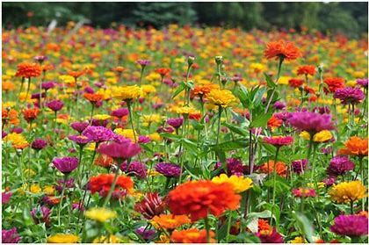
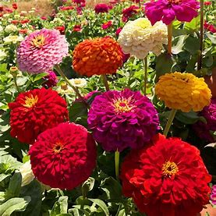
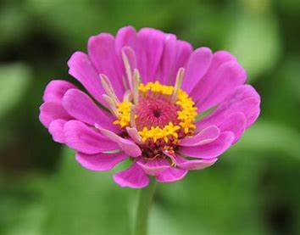
Thrive in Arizona
主题语境：人与社会、自我
我们一家人搬到亚利桑那州像院子里栽种的百日菊一样繁盛生息。
PART 3

Slide 46
I found a brown bag outside after our move. "Grass Seed." it said in big letters. My husband and I 41 the seeds all over the dirty yard in front of our new house. "I have no idea if they will 42 ," I told him, "but it's worth a shot." Just like our 43 to move to the rural Arizona.
41. A. sought B. spread C. collected D. removed
42. A. remain B. last C. dry D. root
43. A. need B. intention C. decision D. agreement
41. 结合首句和41 空后的地点all over the dirty yard ，可知是播散种子。 sought 动词原形为seek，意思：寻找，寻求。remove vt.除掉；除去；故B。
代词they 指seeds, 所以是生根发芽才合理；root n. 树根； vi 生根；扎根；
故D 正确；
43. 结合move to the rural Arizona 搬家到新的地方，自然需要“决定”； C正确。

Slide 47
Near our new house sat a charming cottage, which was 44 to tourists. I got a job offer to 45 the cottage. I'd worked in hotels for years, so when offered the 46 , I jumped at it. Still, it was a big change. I 47 that it would be a right move.
44. A. rented B. given C. sold D. introduced
45. A. green B. advertise C. fill up D. look after
46. A. help B. chance C. service D. accommodation
47. A. pretendedB. decided C. understood D. prayed
44. 定语从句which 关系代词指代 a charming cottage , 根据43 空后tourists, 可知是出租给游客；45.我得到一份工作---照看乡间别墅;46.我之前在宾馆工作了很多年，所以当被提供这个工作的机会，我开心极了。Jump at sth (因听到、看到…而高兴地跳起来) 47. 可是，宾馆工作和乡间别墅的工作是巨大的改变，我祈祷这个工作机会将是一个正确的行动。

Slide 48
While we waited for our grass to grow--- or not---we 48 settled into our new house through our efforts. We made it a cozy home, despite the 49 in the front yard, which was still bare now. Meanwhile, many of the cottage guests became 50 , and I got to know them well. I felt 51 to make their stays memorable. Perhaps I was better at that than 52 .
48. A. naturally B. hardly C. gradually D. temporarily
49. A. uncertainty B. potential C. danger D. untidiness
50. A. locals B. employers C. regulars D. gardeners
48. 在等待草长出来或者压根不会长出来的过程中，我们通过努力渐渐地在新家安居乐业；49. 我们把家变成一个舒适的家，尽管前院有不确定性；50‘
结合I got to know them well, 说明许多别墅的客人成了别墅的常客。 regulars n. = regular customers.

Slide 49
While we waited for our grass to grow--- or not---we 48 settled into our new house through our efforts. We made it a cozy home, despite the 49 in the front yard, which was still bare now. Meanwhile, many of the cottage guests became 50 , and I got to know them well. I felt 51 to make their stays memorable. Perhaps I was better at that than 52 .
51. A. proud B. grateful C. curious D. stressed
52. A. house renting B. yard cleaning
C. keeping house D. growing grass

Slide 50
But after a monsoon (季风) swept through, I woke up to a beautiful morning and looked out the window. There was no grass growing in the sunlight. 53 , our yard was covered in a rainbow of zinnias (百日菊)! The front yard turned out even better than I could have 54 , just like our new life. And it remains a powerful 55 of the beauty that awaits us in our new chapter.
53. A. Otherwise B. instead C. Besides D. Therefore
54. A. imagined B. designed C. remembered D. appreciated
55. A. test B. memory C. reminder D. choice
53. Instead 一般前一个句子为否定句。前后为相反或对比关系。前院并没有草长出来，相反，彩虹般的百日菊绽放在阳光下；54. 该句意思为：结果前院比我原本想象的还要美。55. It 指的是盛开着缤纷百日菊的前院，依然提醒着我们记得那种美好，那种美好在我们人生的新篇章里等待我们去发现去探索。

Slide 51
完形填空语料库
1. Sth be worth a shot 值得尝试
2. jump at sth 因听到或看到sth 狂喜
3. turn out 结果是
4. a powerful reminder 强有力的提醒物
…await us in our new chapter
…在我们新的人生篇章等待我们

Slide 52
PART 4
语法填空

Slide 53
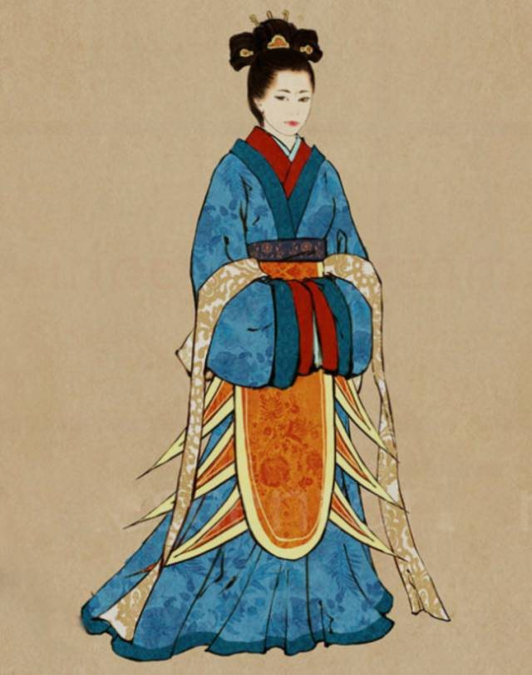
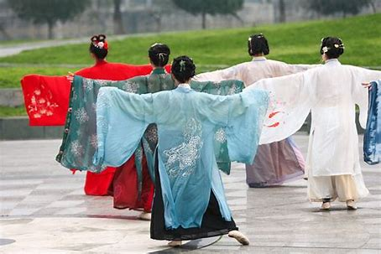
主题语境：人与社会—汉服
主旨大意：汉服与中国传统文化
设空类型：有提示词7
无提示词3

Slide 54
In celebration of Chinese New Year, a hanfu parade 56 (hold) by China Cultural Centre in Valletta, the capital of Malta, on February 17, 2024.
was held
考查谓语动词一般过去时+被动语态

Slide 55
考查非谓语动词作定语
received
The parade, well 57 ( receive) among the locals and tourists, featured 23 volunteer models from
diverse cultural backgrounds coming together to show 58 beauty of traditional Chinese costumes.
the
考查定冠词，特指传统中国服饰的美

Slide 56
考查reflecting 的并列宾语。
The parade attracted local residents and visiting tourists with its display of ancient Chinese elegance and grace. Each model wore delicate hanfu in different styles, reflecting the 59 ( rich) and diversity of China’s cultural heritage. From silk garments to elaborate accessories (配饰), the hanfu parade represented the essence of centuries-old traditions passed down through 60 (generation).
richness
generations
考查名词复数：一代一代传承的有着数百年历史的传统。

Slide 57
考查定语从句关系代词
The event drew enthusiastic participation from both local residents and tourists, 61 wondered at the exquisite craftsmanship and cultural significance of hanfu. Many 62
(engage) with the models, eager to learn more about the history and 63 (symbol) meaning behind each garment, further fostering cross-cultural exchange and understanding.
who
engaged
symbolic
考查名词变形容词
考查谓语动词的时态；many = many residents and tourists 充当主语
engage with sb 与某人互动

Slide 58
考查非谓语动名词：介词to 的并列宾语
By including the hanfu parade into its Chinese New Year celebrations, the China Cultural Centre in Malta showed its commitment to promoting cultural exchange and
64 (strengthen) the bonds of friendship between Malta and China. The event showed the lasting appeal 65 Chinese traditions and their ability to go beyond borders, uniting people from diverse backgrounds in celebration and appreciation.
strengthening
of
考查介词of ，of Chinese traditions 充当后置定语。

Slide 59
常见形容词后缀：
1.+y 结尾的形容词
anger →angry 生气的
2.名词+ ed (具有某种特点的)
balance→balanced 平衡的
3．名词+ ful/less
meaning→meaningful
4．名词+ able、 ible
knowledge→knowledgeable 博学的
5.名词- ous
space--- spacious
6. ence/ance变成t结尾的形容词
confidence→confident 自信的
significance- significant 有意义的
7. +al 结尾的形容词
addition→additional 附加的额外的
8．+ly结尾的形容词
friend→friendly
9.+ en结尾的形容词
wood→wooden 木制的
10. 学科名词以及其它一些名词
加cal变成形容词。
chemistry →chemical 化学的
11.ce 结尾的名词-- cial结尾的形容词。
race→ racial 种族的
face→ facial 面部的
12.—ic
energy→energetic 精力充沛的
13. -- ish
self→selfish 自私的
14—tive act- active

Slide 60
长难句分析1；
The parade, well received among the locals and tourists, featured 23 volunteer models from diverse cultural backgrounds coming together to show the
beauty of traditional Chinese costumes.
主语
非谓语作后置定语，修饰the parade
谓语
宾语
from介词短语后置修饰23 volunteer models
非谓语现在分词短语Coming together …costume 充当后置定语修饰 models

Slide 61
长难句分析2；
Many engaged with the models, eager to learn more about the history and symbolic meaning behind each garment, further fostering cross-cultural exchange and understanding.
主语
谓语
宾语
形容词短语作伴随状语
介词about 有两个并列介宾
介词短语作后置定语
非谓语doing sth 表主语的伴随动作

Slide 62
长难句分析3；
The event showed the lasting appeal of Chinese traditions and their ability to go beyond borders, uniting people from diverse backgrounds in celebration and appreciation.
主语
谓语
宾语1
介词短语作后置定语
宾语2
动词不定式作后置定语
非谓语doing sth 表伴随结果

Slide 63
语法填空语料库
1. a hanfu parade 汉服游行活动
2. be well received 受到好评
3. engage with the models 与模特们互动，交流
4.foster cross-cultural exchange and understanding 培养跨文化交流和理解
5.show its commitment to promoting cultural exchange 展现促进文化交流的决心
6. strengthen the bonds of friendship 加强友谊的纽带
7. the lasting appeal of Chinese traditions 中国传统的经久不衰的吸引力
8. go beyond borders 跨越国界

Slide 64
Nothing is impossible to a willing heart！

