Slide 1


感恩遇见，相互成就，本课件资料仅供您个人参考、教学使用，严禁自行在网络传播，违者依知识产权法追究法律责任。
更多教学资源请关注
公众号：溯恩英语
知识产权声明

Slide 2
话题驱动型发言稿的结构化写作
24届浙江台州二模应用文
Designed by郭烨辉

Slide 3
目录
01
Analysis:
Based on Topic-driven Method
4“A” Model
02
Arrangement:
Key Points Writing
03
Appreciation:
Sample Writing
04
Association:
Similar Application Letters

Slide 4
Based on Topic-driven method
01
Analysis

Slide 5
What does “Topic-driven” mean?
The term "topic-driven" refers to an approach or method that is guided and structured around a specific topic or theme.
In the context of speeches, presentations, being topic-driven means that the content is organized and developed with a clear focus on a particular subject, ensuring that all parts of the speech or document are directly related to and support the central theme.
It helps in maintaining clarity and coherence throughout the discourse, making it easier for the audience or readers to follow and understand the main message.
When writing a structured speech based on the concept of "topic-driven speaking," the aim is to focus on a central theme and elaborate on it through a well-organized and coherent structure.

Slide 6
原题呈现
假定你是李华，你负责的小组项目“Surveying Students’ English Novel Reading” 在学校项目评比中获奖, 现受校英语俱乐部邀请作该项目的介绍。请用英语写一篇发言稿，
内容包括:
1.实施过程:
2.组员感受
注意:
1.写作词数应为80个左右; 2.请按如下格式在答题纸的相应位置作答。
Dear English Club Members,
________________________________________________________________________________________________________________________________________________________________________________________________________ Thank you !

Slide 7
建构理论关联
这个题目典型地契合了话题驱动型应用文的要求，因为它要求内容围绕一个明确的中心主题——"Surveying Students’ English Novel Reading"项目的介绍和分析。整个发言稿都是按照这一主题展开的，从项目的实施过程到组员的感受，每一部分都直接支撑和阐述了这个中心主题。具体来说，话题驱动型应用文的特点在于：
主题清晰：全文聚焦于“学生英文小说阅读情况调查”项目，所有内容都与这一主题紧密相关，没有偏离主题的内容，保证了演讲的条理性和连贯性。
结构有序：从介绍、实施过程、组员感受到总结，每一部分都围绕主题进行扩展，每一个段落都服务于对主题的深入解释和展示。
目的明确：通过这样的结构和内容安排，旨在向听众清晰展示项目的价值和团队成员的学习成果，同时增强听众对英文小说阅读的兴趣和了解。
增强参与感和影响力：话题驱动的表达方式能够更好地吸引听众的注意力，使他们能够清晰地理解信息，从而产生共鸣，提高信息的接受度和影响力。

Slide 8
基于话题的命题分析
to ask people questions in order to find out about their opinions or behaviour
话题 | Surveying Students’ English Novel Reading
话题理解
话题表现形式 | 发言稿/分享式汇报（Similar to presentation）
话题背景 | 你负责的小组项目脱颖而出，受邀介绍项目实施过程与组员感受
目标听众 | 考虑受众的身份、年龄、知识水平、价值观等 注意：本文尽量使用正式、客观的语气进行介绍，关切听众最想知道的内容。
人称时态 | 第一人称 | / | 一般现在时 | 一般过去时
Investigate How Students Engage with English Literature
Examine English Novel Reading Trends in the Student Population ……

Slide 9

各段要点组织
Para 1 | 自我身份介绍+项目简要导入（概括性进入主题/话题）
Para 2 Part 1 | 要点1：实施过程 （Different Stages: Preparation-Conduction-Conclusion etc.)
Para 2 Part 2 | 要点2：组员感受
Para 2 尾句 | 前面内容的回顾总结+*未来展望
The identity of the speaker
The topic
lead-in
The conduction
A campus Project:
Surveying Students’ English Novel Reading
Feelings of the teammates
Future Expectations

Slide 10
Key Points Writing
02
Arrangement

Slide 11
【体裁穿插】
应用文写作发言稿或演讲稿是较为灵活的文本写作，赋予更广阔的写作空间，实质上更为贴合社会生活实践，选材多为校园发言稿，班级演讲稿，社会倡议号召等。
【核心表达】I feel privileged/honored to stand here,delivering this presentation.

Slide 12
首段
自我身份介绍+项目简要导入
Version 1 : （无个人介绍）
It's my great honor to share with you our group project “Surveying Students’ English Novel Reading."
Version 2 : （含个人介绍）
I'm Li Hua, leading the team behind the project "Surveying Students' English Novel Reading," which was recently honored in our school's project competition. I feel quite privileged to share this project with you.

Slide 13
Other good examples of writing a beginning
1. It’s my great honor to have the opportunity to share with you my opinion on how to take online courses more effectively. 2. Ladies and gentlemen, today I’d like to deliver a lecture on stressing the importance of having a positive attitude to study. 3. It’s my great honor to stand here on behalf of all the students, and I’d like to offer you my warmest welcome.
4. Ladies and gentlemen/Boys and girls, I’m greatly honored to speak here to talk about... on behalf of...

Slide 14
次段
要点1：实施过程
方法1：以目标实现带出实施过程
我们的目标是探索本校学生群体对英语小说的不同阅读偏好和习惯。为此，我们精心设计了一份全面的调查问卷，询问学生最喜欢的类型、阅读频率以及影响小说选择的因素。
Our goal was to explore the diverse reading ____________ and habits related to English novels among our student ____________. To achieve this, we meticulously developed a comprehensive survey that asked about favorite genres, reading ____________, and factors influencing novel ____________.
preferences
community
frequency
selection

Slide 15
次段
要点1：实施过程
方法2：依据时序完整展现过程
我们的项目从制作一份全面的调查问卷开始，内容包括学生最喜欢的类型阅读频率、偏好的形式等。在向 500 名同学发放问卷并进行访谈之后，我们收集到了大量宝贵的数据，经过仔细分析，我们最终得出了有关学生英语小说阅读的重要结论。
well-rounded
Our project began with the creation of a ____________ questionnaire covering students’s favorite genres reading frequency, preferred formats, etc. After ______________ questionnaires and conducting interviews among 500 schoolmates, we collected a wealth of valuable data, Following a careful ___________(analyse), we finally drew important conclusions regarding students' English novel reading.
distributing
analysis

Slide 16
次段
要点1：实施过程
*方法3：增加相关细节
为确保获得广泛而多样的回复，我们通过各种平台，包括在线论坛、社交媒体和英语课堂，有策略地分发了调查问卷。收集到调查问卷后，我们的团队利用统计工具对数据进行了认真分析，以解读学生回答的趋势。
To ensure a broad and diverse set of responses, we strategically distributed the survey across various platforms, including online forums, social media, and during English classes.
Once the surveys were collected, our team diligently worked on the data analysis, utilizing statistical tools to interpret the trends among the student responses.

Slide 17
次段
要点2：组员感受
感受1：值得+鼓舞
This project has been incredibly rewarding, raising our awareness of teamwork and fostering our research abilities, More importantly, learning about our peers' reading habits has sparked our self-reflection and encouraged us to dive into English literature.
感受2：丰厚+团结
The experience was incredibly enriching for our team. We not only developed our research skills but also felt a strong sense of achievement and camaraderie. This project not only deepened our appreciation for literature but also brought us closer as a team.

Slide 18
次段
要点2：组员感受
感受3：深刻+提信心
Participating in this project was a profound journey for us all as it challenged us to step outside our comfort zones, fostering a deeper appreciation for literary analysis and data interpretation."
Each team member felt a significant boost in confidence as we collaborated on solutions and formed stronger bonds between eath other"
感受4：理论运用于实践+未来可能性
Reflecting on the project, we all agreed that the most rewarding aspect was seeing our theoretical knowledge applied in a practical context, which not only proved our capabilities but also sparked a curiosity to explore further academic research opportunities.

Slide 19
尾句
总结上述发言+*展望
在我们结束这个项目的时候，我们不仅要将获得的知识传承下去，还要将合作与探索的记忆传承下去。我们感谢对我们的认可，并很高兴能在此成功的基础上探索新的项目。
As we close this chapter on our project, we carry forward not just the knowledge gained but also the memories of collaboration and discovery. We appreciate the recognition and are excited to explore new projects that build on this success.
That’s all for our project!

Slide 20
Sample Writing
03
Appreciation

Slide 21
One possible Version
Dear English Club members,
It's my great honor to share with you our group project “Surveying Students’ English Novel Reading."
Our project began with the creation of a well-rounded questionnaire covering students’s favorite genres reading frequency, preferred formats, etc. After distributing questionnaires and conducting interviews among 500 schoolmates, we collected a wealth of valuable data. Following a careful analysis, we finally drew important conclusions regarding students' English novel reading.
This project has been incredibly rewarding, raising our awareness of teamwork and fostering our research abilities, More importantly, learning about our peers' reading habits has sparked our self-reflection and encouraged us to dive into English literature. That's all about our project.
Thank you.

Slide 22
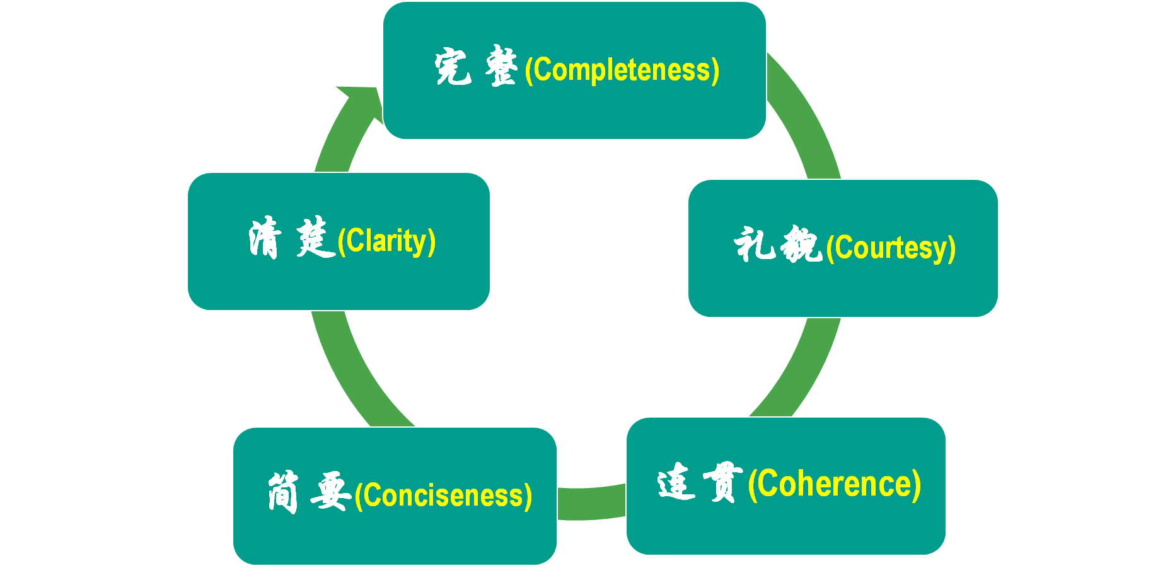
Self-evaluation 自评
Directions:
After reading these excellent compositions, please note down the materials that will be useful to your writing. Then revise and polish your own articles according to the following 5 aspects of reference.
应用文写作的5C原则

Slide 23
Checklist based on 5 dimensions
Dimension | Criterion | Rank
Completeness | Have you clearly defined the purpose? | ☆☆☆☆☆
 | Does your composition include all the points? | ☆☆☆☆☆
Clarity | Are your sentences structured clearly? | ☆☆☆☆☆
 | Have you used understandable language? | ☆☆☆☆☆
Courtesy | Is your tone polite and respectful ? | ☆☆☆☆☆
 | Have you considered any sensitivities that might affect how your message is perceived? | ☆☆☆☆☆
Conciseness | Have you eliminated any redundant words or phrases? Do you avoidunnecessary details? | ☆☆☆☆☆
Coherence | Does your compositionmaintain a logical flow from beginning to end? | ☆☆☆☆☆
 | Have you used transitional phrases to help the reader understand the progression of your ideas? | ☆☆☆☆☆
 | Does your content stay focused on the main topic, avoiding irrelevant digressions? | ☆☆☆☆☆

Slide 24
Similar Application letters
04
Association

Slide 25
话题驱动型：GPT
（2023年诸暨市5月统测）
假定你是李华, 最近一直在使用ChatGPT辅助自己的学习, 颇有收获和感受, 现请你在班级发言, 内容要点包括：
1. 使用体验和评价；
2. 使用建议和希望。

Slide 26
范文欣赏
Dear fellow students, The presence of ChatGPT won the favor of the world, becoming the hottest topic nowadays. I also use this chatbot to aid my study and the powerful function of this artificial intelligence have really amazed me. ChatGPT definitely brings people an excellent user experience, though, we can't immerse ourselves in it. With the fast updates of information in the Internet era, we would give way to AI in the near future if we put aside or spontaneously neglect our independent learning and improvement. More than anything is to become competitive since it is inevitable to work with AI. That's all. Thank you!

Slide 27
Thanks!
郭烨辉

