Slide 1

感恩遇见，相互成就，本课件资料仅供您个人参考、教学使用，严禁自行在网络传播，违者依知识产权法追究法律责任。
更多教学资源请关注
公众号：溯恩高中英语
知识产权声明

Slide 2

2023年1月8号浙江首考听力精听课件
瑞安新纪元高中
焦海滨老师制作

Slide 3


影响听力的因素
心理因素学生在进行听力练习或考试时往往表现为听音时感到紧张、焦虑因而导致无法正常听音。
壹
缺乏背景知识由于没有语言环境，学生很少了解听力材料中的背景知识，无法做出正确的判断、推理、猜测。
贰
叁
学生缺乏听力解题技巧研究发现，很多情况下由于听者未能掌握相关的听力技巧，因而不能很好地理解听力材料。
肆
词汇储备不足一个学生的听、说、读、写要达到一定的水平，必须拥有相应数量的必备词汇。

Slide 4

语音知识对听力的影响
在听力理解的过程中，语音是第一位的，听者首先接受的是语音信息，大脑接受了因素，音节，中音等因素构成的单词，短语和句子后使他们在自己的语言图式中“对号入座”，根据已有的知识结构( 图式 ),开始对该信息进行建构，以理解其意义。

Slide 5
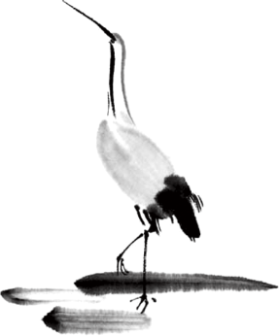
语速的加快主要有一下三种原因
壹
贰
叁
连读
（ 以下用红色标记 )
省音
（ 以下用蓝色标记 ）
音变
（以下用黄色标记 ）

Slide 6



一，连读 （ 以下用红色标记 )
1，“辅音+元音”型连读（异性相吸）
如：I’d like another bowl of rice.
2、“辅音+半元音”型连读英语语音中的/j/和/w/是半元音，如果前一个词是以辅音结尾，后一个词是以半元音，特别是/j/开头，此时也要连读。Thank you .

Slide 7

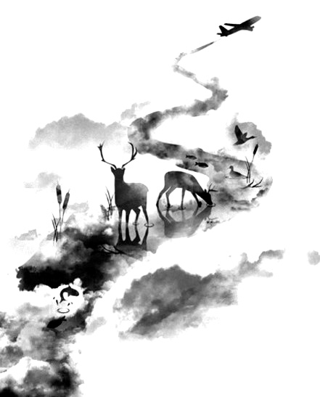

二，省音 （以下用蓝色标记）
01
壹
一、爆破音/b/ /p/ /d/ /t/ /g/ /k/
1.以上任何一个爆破音后面如果紧接着是一个辅音或者半元音，那么这个爆破音将不再发音，仅空半拍就行。如：Good morning!可以发为/gu_'mɔ:niŋ/。
2.以上任何一个爆破音在句尾时，这个爆破音不再发音。如：Good night!最后的/t/音便不再发，整句话可读作/gu_nai_/。

Slide 8
省音 （以下用蓝色标记）
01
二、不完全爆破
① 爆破音中的任何两个爆破音相邻时，前一爆破音失去爆破。如：a big car等。
② 爆破音中的任何一个后接摩擦音f,h,x,sh,s,r时，前面的爆破音失去爆破。
如：I didn't say so.
③ 爆破音后接/t/， /d/， /tr/， /dr /时，前面的爆破音失去爆破。如：a great change等。
④ 爆破音后接/m/, /n/, /l/, /s/时，前面的爆破音失去爆破。如：a bit more expensive等。

Slide 9
省音 （以下用蓝色标记）
01
三、/s/-/z/ /ts/-/dz/ /∫/-/ ʒ / /t∫/-/ dʒ / /θ/-/ ð / ds发/dz以上任何两个音相遇，只读后面的那个音，而前面的音则省略不发。
如：Who is Stone?可把前面一个/z/省掉，只读作/hu i stəun /。

Slide 10
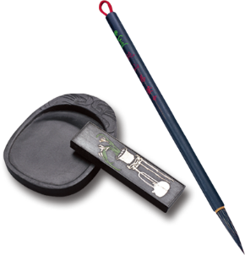
音的变化也是一种连读现象，两个词之间非常平滑的
过渡，导致一个音受临音影响而变化。
主要是以下两种方式：
1、 辅音[d]与[j]相邻时，被同化为[dʒ]：
Would you....?
2、 辅音[t]与[j]相邻时，被同化为[t∫]：
Can’t you？
三，音变
（以下用黄色标记 ）

Slide 11
听力试音材料
M:Hello ! International Friends Club , can I help you ?
W: Oh , hello ! I read about your club in the paper today . And I thought I’d phone to find out a bit more .
M:Yes , certainly . well , we’re a sort of social club for people from different countries . It’s quite a new club .we have about 50 members at the moment but we’re growing all the time .

Slide 12
听力试音材料
W: That sounds interesting .I’m British actually ,and I came to Washington about three months ago ,I’m looking for ways to meet people . . Er ,what kinds of events do you organize ?
M: well , we have social get-togethers ,and sports events ,and we also have language evenings
W: Could you tell me something about the language evenings ?

Slide 13
听力试音材料
M: Yes , every day except Thursday , we have a language evening. People can come and practice their languages .you know , over a drink or something .we have different languages on different evenings . Monday -Spanish; Tuesday- Italian ;Wednesday- German and Friday- French .On Thursday we usually have a meal in a restaurant for everyone who wants to come .

Slide 14
听力试音材料
W:well,that sounds Great , I really need to practice my French .
M: Ok , well if you can just give me your name and address I’ll send you the form and some more information .If you join now ,you can have first month free .

Slide 15


例题
M:Excuse me ,can you tell me how much the shirt is ?
W：Yes, it’s nine-fifteen.
例：How much is the shirt?
A. ￡19.15. B. ￡9.18. C. ￡9.15.

Slide 16


Text 1 购买实验用品 词数：31 时长：13秒
M: Billy ____________ for his science project at school. Maybe we can __________ on our way home.
W: Let’s go to Greens . It’s just around the corner.
M: Okay.
1. What will the speakers do next?
A. Visit a friend.
B. Pick up Billy.
C. Buy some beans.

Slide 17

Text 1
M: Billy needs some beans for his science project at school. Maybe we can stop by a store on our way home.
W: Let’s go to Greens. It’s just around the corner. (Greens 商店名）
M: Okay.
1. What will the speakers do next? （ 细节题 ）
A. Visit a friend. B. Pick up Billy. C. Buy some beans.
science project 科学项目
stop by 顺便访问
around the corner 在不远处
pick up 接某人

Slide 18

Text 2 偶遇明星 词数：39 时长：20 秒
——————————
Text 2
W: Hi, Stephen, guess who I saw at the city library? Andy Clarkes
— the __________ in The Good Lawyer — the famous_________.
M: What was he doing there? His popularity has slipped since the
final season of the show.
2. What does Andy Clarkes do?
A. A public librarian.
B. A TV actor.
C. A famous lawyer.

Slide 19

——————————
Text 2
W: Hi, Stephen, guess who I saw at the city library? Andy Clarkes — the leading actor in The
Good Lawyer — the famous TV series. ( 同位语）
M: What was he doing there? His popularity has slipped since the final season of the show.
2. What does Andy Clarkes do? （ 细节题）
A. A public librarian.
B. A TV actor.
C. A famous lawyer.
slip vi 下降；变差
season 赛季、演播季
leading actor 主角
TV series 电视剧
popularity 受欢迎

Slide 20

Text 3 同事退休 词数：30 时长：19秒
W: It seems as if everybody is talking about Jason’s retirement.
M: Yes, his office is filled with ___. I gave him a _____ with a baseball pattern on it.
W: That’s nice. I’ll get him _____ this afternoon. Hope it’s not late.
3. What are the speakers mainly talking about?
A. Gifts for Jason.
B. A baseball game.
C. The woman’s retirement.
天人合一
天 下 皆 知 美 之 为 美 ， 斯 恶 已
皆 知 善 之 为 善 ， 斯 不 善 已
有 无 相 生 ， 难 易 相 成 ， 长 短 相 形
高 下 相 盈 ， 音 声 相 和 ， 前 后 相 随
恒 也

Slide 21
W: It seems as if everybody is talking about Jason’s retirement.
M: Yes, his office is filled with gifts. I gave him a T-shirt with a baseball pattern on it.
W: That’s nice. I’ll get him something this afternoon. Hope it’s not late.
3. What are the speakers mainly talking about? （主旨大意题）
A. Gifts for Jason.
B. A baseball game.
C. The woman’s retirement.
天人合一
天 下 皆 知 美 之 为 美 ， 斯 恶 已
皆 知 善 之 为 善 ， 斯 不 善 已
有 无 相 生 ， 难 易 相 成 ， 长 短 相 形
高 下 相 盈 ， 音 声 相 和 ， 前 后 相 随
恒 也
retirement. n 退休
pattern .n. 图案；式样

Slide 22

T Text 4 打折卡 词数：30 时长：15秒
W: Did you go to Cooper’s last night?
M: No, was there anything special?
W: Yes, the employees dressed up as movie characters, and every customer received ___________.
M: That was interesting.
4. What went on at Cooper’s last night?
A. A movie show.
B. A birthday party.
C. A sales promotion.

Slide 23
W: Did you go to Cooper’s last night?
M: No, was there anything special?
W: Yes, the employees dressed up as movie characters, and every customer
received a discount card.
M: That was interesting.
4. What went on at Cooper’s last night? ( 推理题）
A. A movie show.
B. A birthday party.
C. A sales promotion.
dress up as 装扮成
discount card 打折卡
sales promotion 促销

Slide 24
Text 5e交通堵塞 词数：28 时长：13秒t
W: Oh, the road____________ traffic again. We are going to be late for work.
M: Let’s ___________ at the next crossroads and ___________.
5. What problem do the speakers have?
A. They are late for work.
B. They are stuck in a traffic jam.
C. They are lost on the way.

Slide 25
W: Oh, the road is jammed with traffic again. We are going to be late for work.
M: Let’s make a U-turn at the next crossroads and try another way.
5. What problem do the speakers have? （推理题）
A. They are late for work.
B. They are stuck in a traffic jam.
C. They are lost on the way.
jammed adj.挤满的；拥挤不堪的
crossroads 十字路口
make a U-turn 掉头
be stuck in 被陷在，被卡在

Slide 26
Text 6 赶飞机 词数：69 时长：33秒
W: Do you think Janet could make it?
M: I’m sure she can. Have you tried calling her?
W: Yes, of course. But I can’t get through. _____ has already been called twice. What are we going to do? _____ without her? I _________ her at the office yesterday. She may have totally forgotten it.
M: ________, Sarah. Let me call her home number. Oh, there she is.

Slide 27

W: Do you think Janet could make it?
M: I’m sure she can. Have you tried calling her?
W: Yes, of course. But I can’t get through. The flight has already been called twice. What are we going to do? Board without her? I should have reminded her at the office yesterday. She may have totally forgotten it.
M: Take it easy, Sarah. Let me call her home number. Oh, there she is.
6. Where does the conversation take place? （推理题）
A. At home. B. At the office. C. At the airport.
7. How does the woman sound? （推理题）
A. Anxious. B. Surprised. C. Grateful.
make it 成功做某事
board 登机
There she is . 她来了
should have done
本应做某事而没做

Slide 28
Text 7 采访获奖教师 词数：130 时长：58秒
Text 7
M: Welcome to our program, Miss Johnson. Congratulations on winning the Teacher of the Year
award.
W: Thank you, Peter. I’m more than happy to be here.
M: What ________you to be a teacher, Miss Johnson?
W: Well, I’ve always _________, but I’ve _____________ even more. It’s in the
family.
M: Could you tell us what the best part about your job is?
W: Getting to _____ all of the different______ and ____________ with ____. I have always ______ kids. _____, I will always ______ that part of my job.
M: Then, what do you hope to _______ by being a teacher?
W: My_____is to help my students develop awareness of their strengths, weaknesses, and
learning needs, and to _______them to ___________________.
M: That sounds great.

Slide 29
M: Welcome to our program, Miss Johnson. Congratulations on winning the Teacher of the Year
award.
W: Thank you, Peter. I’m more than happy to be here.
M: What inspired you to be a teacher, Miss Johnson?
W: Well, I’ve always loved to learn, but I’ve enjoyed teaching others even more. It’s in the
family.
M: Could you tell us what the best part about your job is?
W: Getting to know all of the different kids and communicating with them. I have always loved
kids. So, I will always enjoy that part of my job.
M: Then, what do you hope to achieve by being a teacher?
W: My goal is to help my students develop awareness of their strengths, weaknesses, and
learning needs, and to enable them to learn throughout their lives.
M: That sounds great.
Teacher of the Year 年度最优秀教师
it’s in the family 家族遗传
develop awareness of 逐渐懂得

Slide 30
8. Why did the woman choose to be a teacher as a profession?（ 推理题）
A. Because of the pressure from her family.
B. Because of the passion for the work.
C. Because of a teacher’s encouragement.
9. What does the woman think is the best part of her job? （推理题）
A. Being with children.
B. Winning others’ respect.
C. Learning different things.
10. What does the woman want her students to be? （ 细节题）
A. Lifelong learners.
B. Creative thinkers.
C. Good communicators.
天人合一
天 下 皆 知 美 之 为 美 ， 斯 恶 已
皆 知 善 之 为 善 ， 斯 不 善 已
有 无 相 生 ， 难 易 相 成 ， 长 短 相 形
高 下 相 盈 ， 音 声 相 和 ， 前 后 相 随
恒 也
passion for the work 工作热情
win others’ respect 得到他人的尊重
good communicators 善于沟通的人

Slide 31
Text 8 和父母生活在一起 词数：157 时长：70秒
Text 8
W: Ethan, have you thought about getting your own house?
M: Yeah. But I’m convinced my parents love having me back. What about you?
W: Um… Not sure yet. Right now, I __________________________ for me every day.
M: Do you pay a contribution to the house?
W: Of course I do. But it’s still much less than I would pay to live in my own flat. Right?
M: Obviously.
W: The only thing I don’t like is that my mom wants to know every part of my life. Becky, what
are you doing tomorrow? Where? With whom? The same questions every day.
M: Moms are like that. They ask because they care. You’ve got to_____________ them. My
parents ask those questions too, but I may not move out soon. The thought of leaving them
fills me with _____. What if one of them ________? What if they both _________together?
W: That would be terrible.

Slide 32
Text 8
W: Ethan, have you thought about getting your own house?
M: Yeah. But I’m convinced my parents love having me back. What about you?
W: Um… Not sure yet. Right now, I enjoy getting my meals cooked for me every day.
M: Do you pay a contribution to the house?
W: Of course I do. But it’s still much less than I would pay to live in my own flat. Right?
M: Obviously.
W: The only thing I don’t like is that my mom wants to know every part of my life. Becky, what
are you doing tomorrow? Where? With whom? The same questions every day.
M: Moms are like that. They ask because they care. You’ve got to be patient with them. My
parents ask those questions too, but I may not move out soon. The thought of leaving them
fills me with fear. What if one of them falls over? What if they both have a fall together?
W: That would be terrible.
be convinced ( that ) 确信 pay a contribution to 为。。。捐款
the thought of doing sth 想到做某事 fill sb with ... 让人充满
fall over 跌倒 what if ... 如果。。。将会怎么样？

Slide 33

11. Why does the woman like living with her parents? ( 细节题）
A. They have a big house.
B. They can cook meals for her.
C. They pay all the expenses.
12. What does Ethan suggest the woman do? （ 细节题之词性转换）
A. Have patience.
B. Provide company.
C. Move out.
13. Why is Ethan concerned about his parents living on their own?
A. They may feel lonely. （ 推理题 ）
B. They may fail to get along.
C. They may have emergencies.
provide company 提供陪伴
be concerned about 为。。。担心
on one’s own 独自
feel lonely 感觉孤单
fail to get along 不好相处
have emergencies 遇到紧急事故

Slide 34
Text 9 会议后寒暄 词数：157 时长：70秒
W: It’s a pretty good conference, huh?
M: Yeah. All speakers are well-known and knowledgeable in the subject matter. Did you listen to John Miller’s speech on how to avoid business risks this morning?
W: No, I _______ that one. I ____________ at Alan Brown Hall. _________ was David
Thompson.
M: Oh, that should be a good one, too. I attended his lecture last year. By the way, there will be a __________ this afternoon on how to _________________. Are you interested?
W: Sure. I was promoted to the________ of manager a few months ago. And I have to manage
a staff of 12 people. It can be quite a ________ situation sometimes. That’s ____ I am here today.
M: ______. I only have seven people reporting to me. Yet, sometimes I feel like _____________. I need to __________ to create _________ within my ________.

Slide 35
W: It’s a pretty good conference, huh?
M: Yeah. All speakers are well-known and knowledgeable in the subject matter. Did you listen to
John Miller’s speech on how to avoid business risks this morning?
W: No, I missed that one. I went to a speech at Alan Brown Hall. The speaker was David
Thompson.
M: Oh, that should be a good one, too. I attended his lecture last year. By the way, there will be a
workshop this afternoon on how to motivate employees. Are you interested?
W: Sure. I was promoted to the position of manager a few months ago. And I have to manage
a staff of 12 people. It can be quite a difficult situation sometimes. That’s why I am here today.
M: Same here. I only have seven people reporting to me. Yet, sometimes I feel like pulling
my hair out. I need to find a way to create harmony within my department.
workshop n C] 研讨会；讲习班 subject matter 主题/题材/主要内容
a staff of 职工（有…人） Same here... 我也一样
report to sb 向某人汇报 pull one's hair out 焦虑；发怒
knowledgeable 知识渊博的 attend one’s letter 听某人的讲座
avoid business risks避免商业风险

Slide 36
14. Whose speech did the woman listen to this morning?( 细节题）
A. John Miller’s. B. David Thompson’s. C. Alan Brown’s.
15. What is the workshop about? （细节题之词性转换）
A. Economy knowledge.
B. Risk assessment.
C. Employee motivation.
16. What does the woman think of her job? （ 同义转述）
A. Challenging. B. Interesting. C. Rewarding.
17. What do the speakers both want to do? （ 推理判断题）
A. Find a new position.
B. Raise employees’ salaries.
C. Improve management skills.
Economy knowledge 经济知识 Risk assessment风险评估
Employee motivation员工的动力 Challenging具有挑战性的
Rewarding值得的，有意义的 Find a new position找新工作
Raise employees’ salaries提高员工工资 Improve management skills提高管理技能

Slide 37
Text 10 如何正确健身 词数：152 时长：72
W: Welcome to _________. I’m Tina Harrison. Before you start, I’d like to offer you _________. We all know that regular exercise is important, but few of us know how to exercise properly. I’ve seen many people make the same workout mistakes in this place. One mistake people often make is ___________________. It is not good for building up your muscles. I’d like to suggest that you change your routine every other month. What’s more, you can try different kinds of workouts, such as jogging, biking, or swimming. This can help keep your whole body in shape. Another mistake most people make is to work out intensely almost every day. You need to give your body a break, and allow time for the muscles to grow. It is not “the harder the better”. _____________ every week is enough. If you really hate to skip a day, you can plan easy exercises on other days. However, experts’ suggestion is that you take one day off completely each week.

Slide 38
W: Welcome to Star Fitness Club. I’m Tina Harrison. Before you start, I’d like to offer you some tips. We all know that regular exercise is important, but few of us know how to exercise properly. I’ve seen many people make the same workout mistakes in this place. One mistake people often make is sticking to the same routine. It is not good for building up your muscles. I’d like to suggest that you change your routine every other month. What’s more, you can try different kinds of workouts, such as jogging, biking, or swimming. This can help keep your whole body in shape. Another mistake most people make is to work out intensely almost every day. You need to give your body a break, and allow time for the muscles to grow. It is not “the harder the better”. Two hard workout days every week is enough. If you really hate to skip a day, you can plan easy exercises on other days. However, experts’ suggestion is that you take one day off completely each week.
workout 锻炼 routine 惯例；常规 intensely 激烈地；剧烈地 skip 不做
stick to sth 坚持 build up muscles 增肌 every other month 每隔一个月
in shape 健康良好 allow sth for 为。。。留出（时间 ）take one day off 休息一天

Slide 39
18. What does the speaker do? （ 推理题）
A. A medical doctor.
B. A fitness instructor.
C. A swimming coach.
19. What is one common mistake people make in workouts?
A. Focusing on only muscle training. ( 同义转述）
B. Doing too many types of workouts.
C. Keeping the same routine all the time.
20. How often does the speaker suggest people do hard workouts? ( 细节题 ）
A. Once a week. B. Twice a week. C. Three times a week.
fitness instructor 健身教练
Focus on 专注于
Keep the same routine保持相同的日程

Slide 40
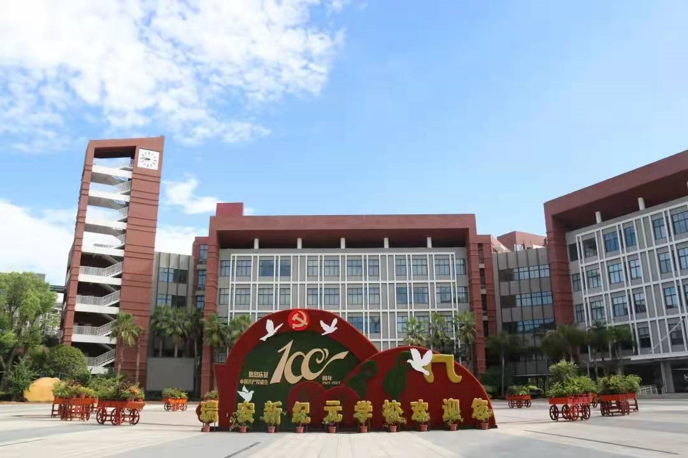
祝各位考生金榜题名！
欢迎指导

