Slide 1


感恩遇见，相互成就，本课件资料仅供您个人参考、教学使用，严禁自行在网络传播，违者依知识产权法追究法律责任。
更多教学资源请关注
公众号：溯恩高中英语
知识产权声明

Slide 2
Looking into the Future
选择性必修1Unit2
Using Language
Should We fight New Technology?
----made by Lily

Slide 3

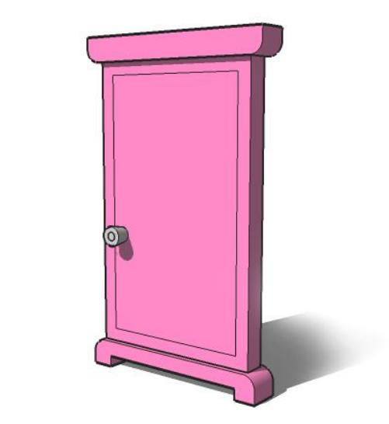
My Dream Robot
the beginning of dream of AI

Slide 4
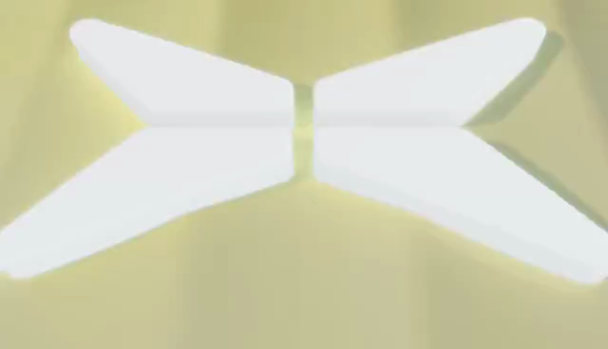
Latest News: Automatic Horse
the innovation of transport tools

Slide 5

self-driving car & self-driving mode
What does this innovation bring to us?

Slide 6
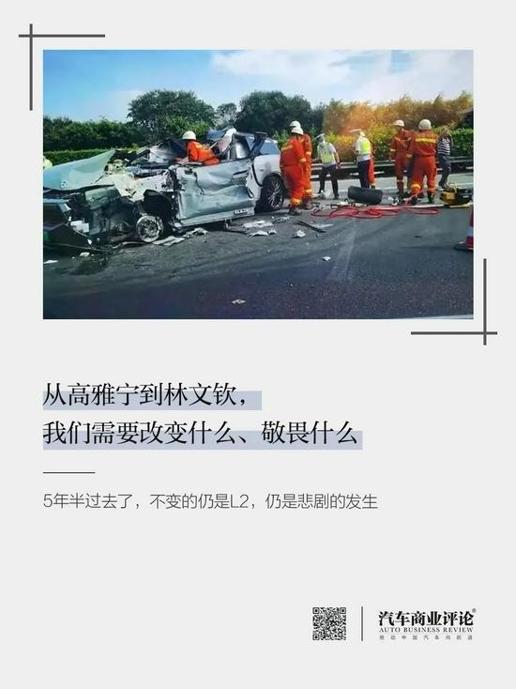

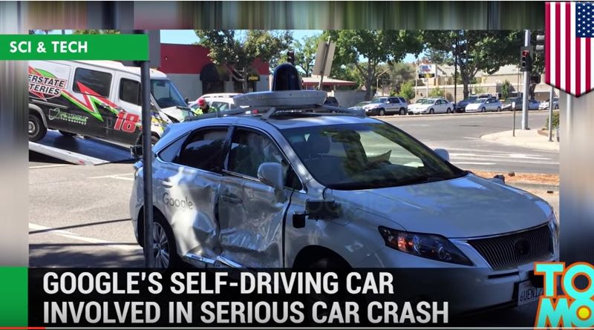
the problems
The self-driving mode car involved in car accidents.

Slide 7
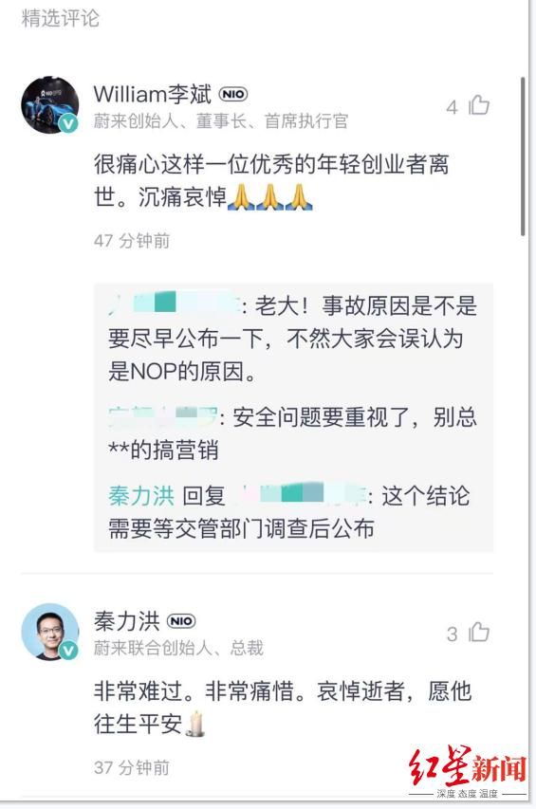
The innovation causes controversy.
This morning, I saw the shocking headline: "Passenger Dies When Car Crashes in Driverless Mode". In the article, various people said that the public should oppose the idea of developing driverless cars. They said that some advances in technology were unnecessary and could even be dangerous. Hence, we should cease accepting technology just because it is new. The newspaper reported that the car company had already apologised for the accident, but the families of the deceased said it was not enough. Nevertheless, the company still claimed that most people would be travelling in driverless cars one day soon.
Q1: Who are arguing and what are the opinions?
Q2: What’s the function of para1?
a specific event
We should oppose the driverless cars.
Hence,
The apology was not enough.
,but
Nevertheless,
an argument on a general topic
The prospect for driverless
cars is still good.
Should we fight the new technology?

Slide 8
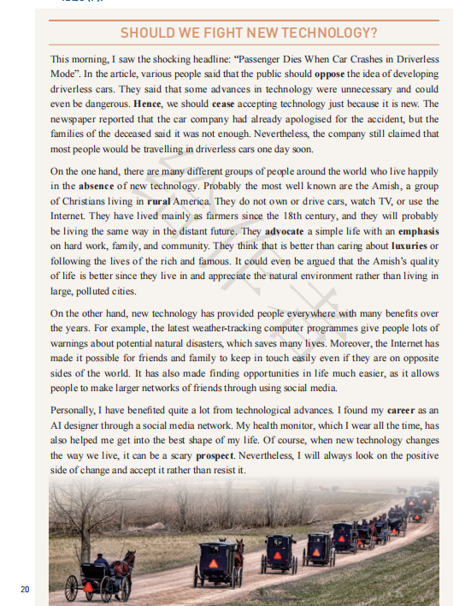
Should We Fight the New Technology?
Q: What are the major opinions on this topic?
The side who opposes new technology.
On the one hand, there are many different groups of people around the world who live happily in the absence of new technology.
The side who advocates new technology.
On the other hand, new technology has provided people everywhere with many benefits over the years...
The writer’s opinion
Personally, 1 have benefited quite a lot from technological advances. ...

Slide 9
read for details (para 2-4)
opinion (topic sentence) | supporting details | How
We should fight new technology. (On the one hand, there are many different groups of people around the world who live happily in the absence of new technology.)
We should not fight new technology. (On the other hand, new technology has provided people everywhere with many benefits over the years.)
the writer’s opinion: Personally, I have benefited quite a lot from technological advances.

Slide 10
read for details (para 2-4)
opinion (topic sentence) | supporting details | How
We should fight new technology. (On the one hand, there are many different groups of people around the world who live happily in the absence of new technology.)
the Amish:
...the most well known...
...do not own or drive cars...
...have lived mainly as farmers... and ...will ... be living the same...
...advocate a simple life
...that is better than caring...
...the Amish's quality of life is better since...
list an example

Slide 11
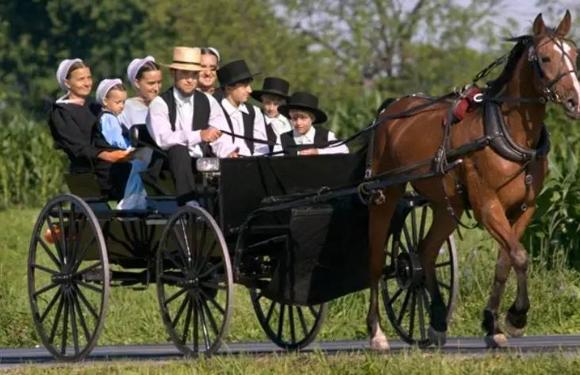
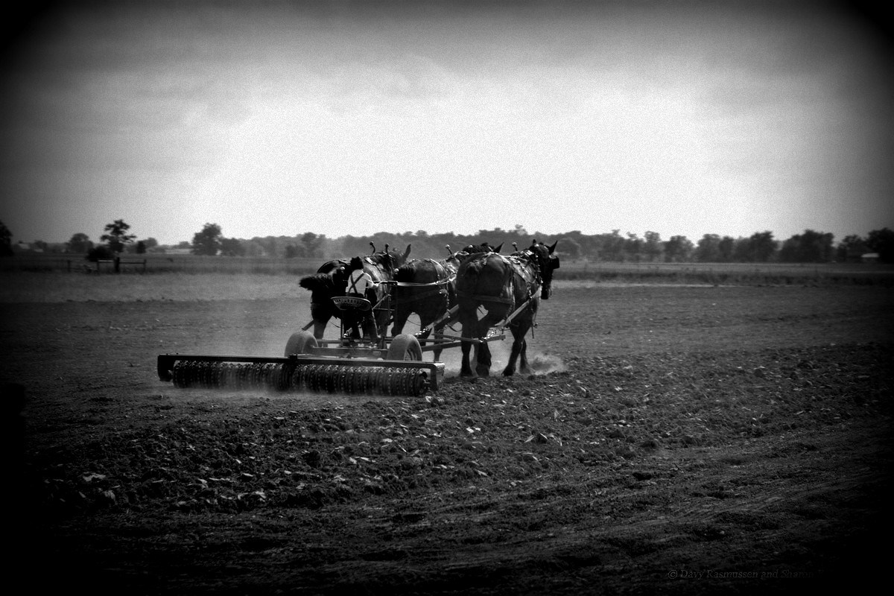
the Amish
The Amish originated in Switzerland in the late 17th century and later immigrated to the USA.
The largest Amish community is in Lancaster, Pennsylvania.
The majority of Amish are farmers.
belief:
1) completely reject violence
2) believe in the concept of humility
3) do not completely reject the technology but will discuss the pros and cons of new technology before using it.

Slide 12
read for details (para 2-4)
opinion (topic sentence) | supporting details | How
We should not fight new technology. (On the other hand, new technology has provided people everywhere with many benefits over the years.)
The latest weather...give people lots of warnings...
The Internet has made it possible for ...to keep in touch easily...
It has also made finding opportunities in life much easier...
list the benefits/
positive effects
of new technology

Slide 13
read for details (para 2-4)
opinion (topic sentence) | supporting details | How
the writer’s opinion: Personally, I have benefited quite a lot from technological advances.
I found my career through a social media network.
My health monitor...has also helped me get into the best shape of my life.
I will always look on the positive side of change and accept it rather than resist it.
List the benefits of advanced technology through my own experience.
the writers’ attitude to the new technology:
supportive and positive

Slide 14
Thinking:
Q1: Why didn’t the writer express his opinion directly at the beginning?
The writer express his opinion in a more gentle tone through explaining the two sides’opinions on the topic to show the pros and cons of the new technology, which also makes his argument more persuasive and reasonable so that readers can accept his argument easily.

Slide 15
Q2: What’s your attitude to the new technology?
A different thinking mode
accept the diversity
embrace the innovation
create the future

Slide 16
Should we fight social medias like Wechat?
Topics for Discussion
Should we fight ___________?
Should we fight online courses?
Should we fight online shopping ?

Slide 17
Writing
How to support an opinion?
to give reasons
e.g1 We should fight social medias like Wechat because it takes up too much people’s attention and time.
to explain positive or negative effects
e.g2 Personally, I will look on the positive side of online shopping rather than resist. With it, our life has become more convenient. And the big data can analyse our data so that online shopping can help us find the bargain efficiently.
to list specific examples
e.g3 Online courses are a good way for everyone to take part in to show their presence. For example, students who are too shy can have the chance to take part in an online discussion.

Slide 18
A Possible Sample
More and more people are beginning to use Wechat and checking it regularly has been a part of our daily routine, which also leads to controversy. As far as I am concerned, WeChat is convenient but we should use it properly.
On the one hand, WeChat really benefits us a lot. It shortens the distance between people. No matter where we are we can easily get in touch with our friends. On the other hand, it also has disadvantages. First, some information offered on WeChat is false and it may result in people being cheated. Second, some people spend too much time on WeChat, greatly influencing their normal life.
Hence, personally, there is nothing wrong with Wechat but what matters is how we use it.

Slide 19
Thank You!
-Lily

