Slide 1
感恩遇见，相互成就，本课件资料仅供您个人参考、教学使用，严禁自行在网络传播，违者依知识产权法追究法律责任。
更多教学资源请关注
公众号：溯恩高中英语
知识产权声明

Slide 2
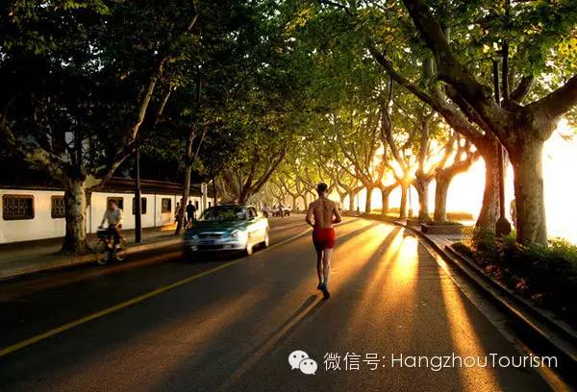
High school English descriptive language series — Lesson 5
Outdoor Activities
户外活动
Hiking / Cycling / Driving / Fishing / Camping / Outdoor survival
Use similes and metaphors and other rhetorical devices（使用修辞手法）
Sublimate the theme of the article（升华文章主题）
浙江省常山一中 吴俊峰

Slide 3
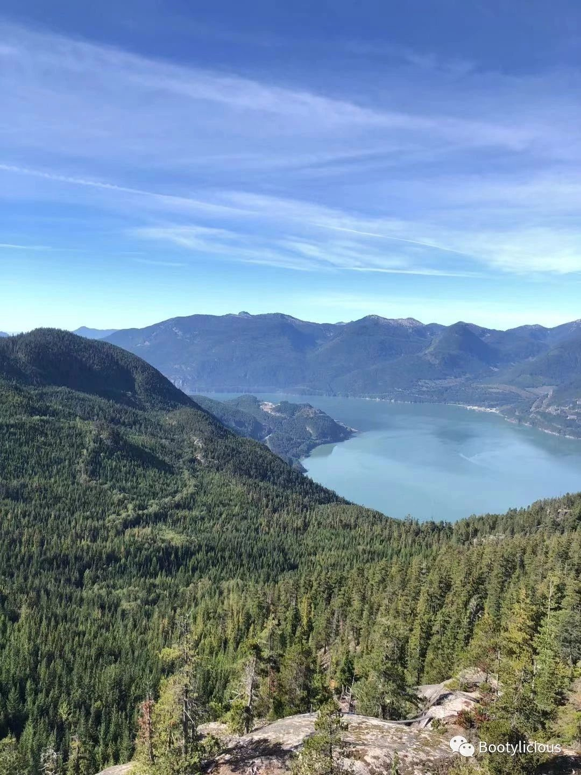
01 Introduction
02 Vocabulary 03 Skills 04 Writing 05 Self-Assessment
The meaning of life is adventure.
-- Stephen William Hawking
人生的精彩在于探险。——霍金
The color and sound of nature are really therapeutic. /ˌθerəˈpjuːtɪk/ adj. 治疗的；有益于健康的
大自然的色彩和声音真的很有治疗效果。

Slide 4
01 Introduction
02 Vocabulary 03 Skills 04 Writing 05 Self-Assessment
Do you like outdoor activities or indoor activities?
Do you spend time outdoors?
Where would you like to do outdoor sports?
How does nature make you feel?
What is your relationship with nature?
The outdoors can bring us so much joy, excitement, but it also brings danger. When we are in nature, our spirits can be healed by the fresh air and the beautiful views. The outdoors also offers us a variety of fun and exciting activities. But the outdoors can also make us scared and worried since it is so powerful.

Slide 5
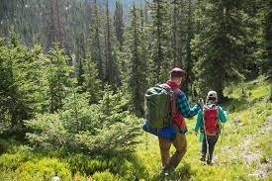
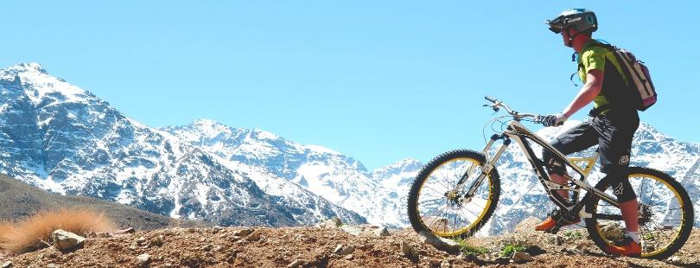
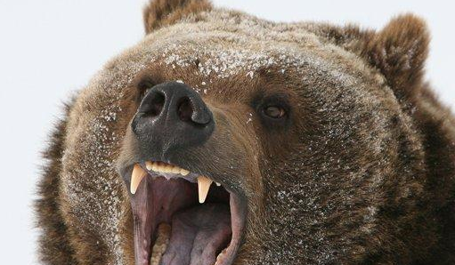
01 Introduction
.
02 Vocabulary 03 Skills 04 Writing 05 Self-Assessment
Picture 1
Picture 2
Picture 3
Picture 4
Look at the four pictures above and try to describe the pictures.

Slide 6
02 Vocabulary
.
01 Introduction 02 Vocabulary 03 Skills 04 Writing 05 Self-Assessment
2-1 Related Vocabulary
Nouns
Water: ocean, river, stream, sea, rapids, waterfalls, rain, boat, ship, canoe
Land: forest, mountainside, trail, road, tree, bike, car, bike, helmet, boots, tire
Animal: bear, snake, cougar, wolf, fox, tiger, lion, birds
Other: survival, backpack, direction, scenery, fire, knife, rope, injury, blister, heatstroke
rapid /ˈræpɪd/ n. 急流
canoe /kəˈnuː/ n. 独木舟；轻舟
mountainside /ˈmaʊntənsaɪd/ n. 山腰；山坡
trail /treɪl/n. 足迹；踪迹；（荒野）小路
helmet /ˈhelmɪt/ n. 钢盔，头盔
boot /buːt/ n. 靴子
tire /ˈtaɪə(r)/ n. 轮胎 v. 疲劳；厌倦
cougar/ˈkuːɡə(r)/ n. 美洲狮
blister /ˈblɪstə(r)/ n. 水泡；水疱
heatstroke /ˈhiːtstrəʊk/ n. 中暑
Related
Vocabulary

Slide 7
02 Vocabulary
.
01 Introduction 02 Vocabulary 03 Skills 04 Writing 05 Self-Assessment
2-1 Related Vocabulary
Adjectives
tranquil /ˈtræŋkwɪl/adj. 平静的；宁静；波澜不惊
lush /lʌʃ/ adj. 丰富的；苍翠繁茂的
sparkling /ˈspɑːklɪŋ/ adj. 闪耀的；闪烁的
steep /stiːp/ adj. 陡峭的
uneven /ʌnˈiːvn/ adj. 不均匀的；不平坦的
unstable/ʌnˈsteɪbl/ adj. 不稳定的；动荡的
crumbling /ˈkrʌmblɪŋ/ adj. 破碎的；摇摇欲坠的；岩块剥落的
slippery /ˈslɪpəri/ adj. 滑的；光滑的；滑得抓不住的
ferocious /fəˈrəʊʃəs/ adj. 凶猛的；残暴的；猛烈的
flat /flæt/ adj. 平的；平坦的；扁平的；
Beautiful: breathtaking, fresh, lovely, tranquil, lush, sparkling, waving
Dangerous: steep, rocky, uneven, unstable, dark, crumbling, slippery, wet, ferocious
Other: heavy, broken-down, over-heated, injured, flat
Related
Vocabulary

Slide 8
.
02 Vocabulary
.
01 Introduction 02 Vocabulary 03 Skills 04 Writing 05 Self-Assessment
2-1 Related Vocabulary
descend /dɪˈsend/vi. 下降；下去；下倾；下落
crash /kræʃ/ v. 碰撞；（使）坠毁；
steer /stɪə(r)/vt. 控制，操纵；驾驶；驶向
squeal /skwiːl/ v. 发出长而尖的声音
The car squealed to a halt.
汽车嘎的一声停了下来。
bandage /ˈbændɪdʒ/ n. 绷带 vt. 用绷带包扎
chop /tʃɒp/v. 剁碎，砍
He was chopping logs for firewood.
他在把原木劈成柴火。
shiver /ˈʃɪvə(r)/ v. 颤抖；打碎
shiver with cold/excitement/pleasure
冷得发抖/激动得发抖/高兴得发抖
growl /ɡraʊl/ v. （动物，尤指狗）发出低吠声；（机器或引擎发出的）发隆隆声
tumble /ˈtʌmbl/ v. 摔倒；滚落，翻滚下来
Verbs
Walked: hike, climb, descended, fall, turn, fall, trip
Drove: crashed, steered, braked, squealed, rode
Other: mended, bandaged, chopped, changed, struggled, shivered, growled, damaged, exploded, tumbled
Related
Vocabulary

Slide 9
.
02 Vocabulary
.
01 Introduction 02 Vocabulary 03 Skills 04 Writing 05 Self-Assessment
2-2-1 Related Expressions —— rescue
抓住绳子
grip /ɡrɪp/ vt. 紧握；夹紧
clutch /klʌtʃ/ v. 紧握；（因害怕或痛苦）突然抓住
搭起帐篷/搭起避难所
发动机轰鸣着发动起来
roar /rɔː(r)/ v. 咆哮；呼喊；轰鸣
猛踩刹车
slam /slæm/ v. 砰地关上; 用力一放（或摔、推）
抛锚或爆胎/换胎
生火
投下救生圈
buoy /bɔɪ/ n. 浮标，航标；救生圈
摇下窗户
wound---wind(v. 缠绕；蜿蜒而行)的过去式和过去分词
（用力地）拉开门
tug /tʌɡ/; haul /hɔːl/ v. （用力地）拉，拖
（用力地）推开门
shove /ʃʌv/; thrust /θrʌst/ v猛然或用力推
使劲把门撞开
might/maɪt/n. 强大力量，威力，势力
宁可事先谨慎有余，不要事后追悔莫及
held on to/seized/grabbed /gripped / captured / clutched the rope
set up the tent /built a shelter
Engine roared to life
slammed on the brakes
a breakdown or flat tire/changed a tire
started a fire
threw / cast a life buoy
wound down the window
tugged /hauled the door
shoved / thrust the door
burst the door open with all might
Better safe than sorry
Expressions

Slide 10
.
02 Vocabulary
.
01 Introduction 02 Vocabulary 03 Skills 04 Writing 05 Self-Assessment
2-2-2 Related Expressions —— in the wild
互相扶着，蹒跚地走向卡车
waddle /ˈwɒdl/v. 蹒跚而行
沿着泥泞的小路艰难地行进
plod /plɒd/ v. 沉重缓慢地走
涉水进入洪水
wade /weɪd/ vi. 跋涉 vt. 涉水；费力行走
被树根绊倒了 trip /trɪp/ n. 旅行v. 绊倒，跌倒
穿过陡峭岩壁的小道
潺潺的小溪 chuckle /ˈtʃʌkl/ v. 咯咯的笑
trickle /ˈtrɪkl/ v. 滴；细细地流
刻在陡峭山坡上的粗糙台阶 slope /sləʊp/ n. 斜坡
鞋子在岩石小道上沙沙地响 scrape /skreɪp/v.刮
食品包装袋被打开时的噼啪声
wrapper /ˈræpə(r)/ n. 包装材料；包装纸
燃烧发出噼啪声的篝火 crackle /ˈkrækl/ v. 发噼啪声
正在弹奏的吉他
strum /strʌm/ v. 弹奏（吉他等乐器）；漫不经心地弹拨
绑在肩上的笨重的背包
bulky /ˈbʌlki/ adj. 体积庞大的；笨重的
strap /stræp/ v. 用带捆绑；包扎
蒙在脚或鞋上的灰尘
waddled to the truck by holding each other up
plodded down the muddy track
waded into the flood
tripped over a tree root
a trail passing between sheer rock faces
chuckling streams and trickling creeks
rough steps carved into steep slopes
shoes scraping over rocky paths
the crackle of a food wrapper being opened
a crackling campfire
a guitar being strummed
a bulky pack strapped to shoulders
dust coating one's feet or shoes
Expressions

Slide 11
.
02 Vocabulary
.
01 Introduction 02 Vocabulary 03 Skills 04 Writing 05 Self-Assessment
2-2-3 Related Expressions —— wildlife
Expressions
squirrels chattering and scrabbling around tree trunks
a horse nuzzling one's palm
wolf snarling savagely at us
dogs barking and panting
emit a blood-curdling growl
the itch of poison mosquitoes
prickly brambles and thorns
birds chirping
insects buzzing and humming
encountering a dangerous animal (a grizly bear, a cougar)
startling the spotted fawn into running across the road
松鼠叽叽喳喳，在树干上乱蹦乱跳
scrabble /ˈskræbl/ v. （忙乱地）摸索；（动物）用爪子乱抓
马用鼻子蹭手掌 nuzzle/ˈnʌzl/ v.用鼻爱抚
狼凶猛地向我们咆哮 snarl/snɑːl/v.（动物）呲牙低吼
savagely /ˈsævɪdʒli/ adv. 野蛮地；残忍地; 狂怒地
狗喘着粗气大声吠叫 pant /pænt/ v. （因用力或激动）气喘
发出令人毛骨悚然的咆哮
emit /iˈmɪt/ vt. 发出(声音或噪音)，放射；
blood-curdling /ˈblʌd kɜːrdlɪŋ/ 令人毛骨悚然的
毒蚊的瘙痒 itch /ɪtʃ/ n. 痒；渴望
多刺的荆棘 prickly/ˈprɪkli/ adj. 多刺的；刺痛的
bramble /ˈbræmbl/ n. 荆棘
thorn /θɔːn/ n. 刺；[植] 荆棘
鸟儿鸣叫 chirpv. （虫、鸟）吱喳而鸣 n. 唧喳声
昆虫嗡嗡叫 buzz /bʌz/ v. 发出嗡嗡声；发出蜂鸣声
hum /hʌm/ v. 哼（曲子）；发低哼声，发嗡嗡声
遇到危险动物(灰熊、美洲狮)
encounter /ɪnˈkaʊntə(r)/ v. 遭遇；邂逅
吓得斑点小鹿跑过马路
startle /ˈstɑːtl/ vt. 使吓一跳；使惊奇 vi. 惊吓

Slide 12
02 Vocabulary
.
01 Introduction 02 Vocabulary 03 Skills 04 Writing 05 Self-Assessment
Picture 1
Picture 2
Picture One: Luke and Anna hiked (v) into the tranquil (adj) forest (n).
Picture Two: Before darkness descended (expression), the cyclist (n) rode (v) down the steep (adj) mountainside (n).

Slide 13
02 Vocabulary
.
01 Introduction 02 Vocabulary 03 Skills 04 Writing 05 Self-Assessment
Picture 3
Picture 4
Picture Three: I screamed when I heard the ferocious (adj) growl (n) of a massive bear (n) behind me.
Picture Four: I heard a pop. The uneven (adj) road (adj) had damaged (v) the tire (n) on my truck.

Slide 14
.
03 Skills
.
01 Introduction 02 Vocabulary 03 Skills 04 Writing 05 Self-Assessment
3-1 Adding Vocabulary to Foundation Skill
The foundation skill of this unit is using similes and metaphors and other rhetorical devices . Go back to Lesson1 of this unit if you need to review.
Quick Reminder: Similes compare two things using “like/ seem / as /resemble/ comparable to”. Metaphors make a direct comparison between two things.
“The lake was as still as a mirror,” is an example of a simile since it compares a lake to a mirror using “as.”
“My injury screamed when I touched it,” is a metaphor since it compares the injury to a person that is screaming.
“The mountain was a monster that destroyed our bodies,” is a metaphor since it compares a mountain to a monster.

Slide 15
.
03 Skills
.
01 Introduction 02 Vocabulary 03 Skills 04 Writing 05 Self-Assessment
3-1-2 Concepts about Metaphor
1
《牛津词典》“a word or phrase used to describe sb/sth else, in a way that is different from its normal use, in order to show that the two things have the same qualities and to make the description more powerful.”
2
《不列颠英语用法大全》“Metaphor, perhaps the most important figure of speech, points out resemblance but with no acknowledging word.”
Metaphor
隐喻
3
《柯林斯字典》“If one thing is a metaphor for another, it is intended or regarded as a symbol of it.” metaphor还有“象征”的含义。我们使用象征的时候，也多是在用具象来象征抽象、用特殊来象征一般、用部分来象征全体。当我们有了传输想法和感情的“触角”，想把自己的情感分毫不差地传输给别人，便使用各种方法让对方联想其经历过的相同或相似的体验，唤醒其相近的情感。
4
关于隐喻，亚里士多德是这样定义的——“以他物之名名此物。”
隐喻能给予文字更强的力量。原因可能在于我们感知理解他人的情感时，更倾向于将其与某种实体存在相联系；而在传达和表述自己的感受时同理。

Slide 16
.
03 Skills
.
01 Introduction 02 Vocabulary 03 Skills 04 Writing 05 Self-Assessment
3-1-3 Classification of Metaphor
1
结构隐喻
Classification of Metaphor
用一种概念结构构建另一种概念结构，如“time as money”，金钱可以量化，时间也就可以被量化。
空间隐喻
2
与方位有关，用来指用整个空间方位描述整个概念体系，可以用于表达情感、社会地位等抽象概念，如“the upperclass”“to feel down”“I won't let you down”。
3
实体隐喻
使用具象的事物来表示难定义的抽象概念。最典型的实体隐喻就是“容器”隐喻，这里的“容器”不仅仅指盆子、杯子等，也可以指人体，如“open your mind”“in a bad mood”“He is a success”“The chairman handed his power to his sons”。

Slide 17
.
03 Skills
.
01 Introduction 02 Vocabulary 03 Skills 04 Writing 05 Self-Assessment
3-1-4 Metaphors for Emotion
从大量的写作实践来看，由于学生缺乏隐喻意识和知识，输出的语言非常平淡、苍白，不够形象，缺乏美感。在英语教学中，我们要变换不同的方式表达，突出隐喻的优势和魅力。我们来探讨一下表达情感的隐喻：
01
情感是对手
情感的发生往往比较强烈，人们要与它斗争，犹如敌人或对手，但往往被它击败。这在语言使用中常表现为情感词汇与 fight(斗争)、get the better of(挫败)、get the best of(胜过)、prey(折磨)、struggle(搏斗)等词汇搭配使用。例如：
I am struggling with anger. 我怒火中烧。
He fought back his anger. 他克制住了愤怒。
Enthusiasm gets the better of me.我太激动了。
Boredom often gets the best of them.
他们常感到非常无聊。
His curiosity got the better of him. 他异常好奇。
Anger and bitterness had preyed upon me continually.我感到愤怒和痛苦。
情感是统治者
由于人们不能战胜情感，有时反而被其控制，所以情感被比作统治者，可以 oppress(压迫)人们，甚至deprive(剥夺)人们的某种能力。例如：
Worrying deprived him of sleep.
他焦虑万分，难以入睡。
Excitement deprived me of all power of speech.
我激动得什么话都说不出来。
Astonishment, apprehension and even horror oppressed her.
她感到心情抑郁，甚至惊恐不安。
02
——节选自“英语情感隐喻的几种情形”，《中小学英语教学与研究》

Slide 18
.
03 Skills
.
01 Introduction 02 Vocabulary 03 Skills 04 Writing 05 Self-Assessment
3-1-4 Metaphors for Emotion
情感隐喻式表达就是将各种情感心理直接隐喻成某种事物，然后用描述喻体的各种词语直接对情感心理进行描述。这种隐喻式表达与直陈式表达在语法、修辞上迥异，让读者有耳目一新的感觉。值得我们学习应用。
03
情感是人手
人们常被情感掌控，受其制约，因此情感常被比作一双无形巨手，人们被其grip/seize(牢牢抓握)，无处遁形，或处于其cover(覆盖)下，无能为力，有时甚至被其tear... into pieces(撕成碎片)。例如：
Fear gripped her heart. 她心中充满恐惧。
She was seized with jealousy. 她妒火中烧。
A feeling of panic seized her. 她突然惊慌失措。
Anxiety tore her into pieces. 她焦虑不安，身心憔悴。
Anger and bitterness covered upon me for weeks.
我好几周都沉浸在愤怒和痛苦中。
情感是液体
人体常被视为容器，情感因此被比作容器中的液体，如同wave/ flood的 surge/ sweep，有时 fill/brim（注满/盛满)容器，有时 overflow/ well(漫出/溢出）容器，在高温下甚至会boil(沸腾)。例如：
Panic surged up within him.他惶恐不安。
His heart is overlowing with joy.他满怀喜悦。
I could feel anger boiling up inside me.
我感到怒火中烧。
A wave of panic swept over her.
一阵惊恐袭上她的心头。
They have been immersed in the deep sorrow since then. 从那以后他们一直沉浸在悲伤中。
04
——节选自“英语情感隐喻的几种情形”，《中小学英语教学与研究》

Slide 19
.
03 Skills
.
01 Introduction 02 Vocabulary 03 Skills 04 Writing 05 Self-Assessment
3-1-4 Metaphors for Emotion
我们要学会表达出隐喻的外在形式特征，而且要突现出隐喻“由此及彼”的认知功能，遵循可接受性原则、语言形象性原则、认知性原则。
05
情感是光线
情感和光线变化密切相关。在sunny(晴朗)、radiant(阳光灿烂)的天气，人们会感到开朗高兴，cloudy(阴云密布)或者 dark(光线晦暗)则让人心情阻塞、郁闷不快。例如：
Joy shone from his brow. 他喜上眉梢。
She was radiant with joy. 她喜气洋洋，容光焕发。
The boss is in a sunny mood today. 老板今天心情很好。
She has been in a dark mood this week.
她这周心情一直不好。
His face clouded over when he heard the news.
听了这个消息，他满脸愁云。
情感是动物
由于情感具有换然而至、悄无声息的特点，因此会像动物那样crawl/creep(爬动)。例如：
Happiness crawls up to the tips of his brows.
他喜上眉梢。
A slight feeling of fear slowly crept on him.
他慢慢感到一丝恐惧。
06
——节选自“英语情感隐喻的几种情形”，《中小学英语教学与研究》

Slide 20
.
03 Skills
.
01 Introduction 02 Vocabulary 03 Skills 04 Writing 05 Self-Assessment
3-2-1 Rhetorical devices(修辞手法) suitable for this Lesson -- Sunlight
Metaphors隐喻
✍The sun was verging/ dipping/ sinking towards the horizon, but a faint pastel haze lingered in the mid-summer sky. verge /vɜːdʒ/ v. 濒临，接近；趋向；处在边缘 pastel /ˈpæstl/ adj. 淡的，柔和的；彩色粉笔的，蜡笔的 haze /heɪz/ n. 阴霾；薄雾；疑惑 v. 变朦胧；变糊涂 linger /ˈlɪŋɡə(r)/ vi. 徘徊；苟延残喘；磨蹭；逗留；流连 ✍They lay on the grass/beach, basking/ saturating/ luxuriating in the genial/mild/warm sunshine. bask /bɑːsk/ v. 晒太阳；享受；陶醉于 saturate /ˈsætʃəreɪt/ vt. 浸透，使湿透；使饱和，使充满 luxuriate /lʌɡˈʒʊərieɪt/ v. 沉溺；繁茂； (尤指因舒适豪华而)尽情享受; 陶醉于 genial /ˈdʒiːniəl/ adj. 亲切的，友好的；和蔼的；适宜的 ✍After an oppressive day in the hot sun my skin began to peel. oppressive /əˈpresɪv/ adj. 压迫的；沉重的；压制性的；难以忍受的 peel /piːl/ v. 剥，剥落；削 | ☞太阳快要下山了，但是在仲夏的天空中，有一层淡淡的柔和的薄雾。 ☞他们躺在草地/海滩上，沐浴在和煦的阳光中。 ☞在烈日下暴晒了一天后，我的皮肤开始脱皮。

Slide 21
.
03 Skills
.
01 Introduction 02 Vocabulary 03 Skills 04 Writing 05 Self-Assessment
3-2-1 Rhetorical devices(修辞手法) suitable for this Lesson -- Sunlight
Similes 明喻
✍ A cluster of sunshine cast over the road as if extending its encouragement and blessing to them. cluster /ˈklʌstə(r)/ n. 群；簇；丛；串 ✍The crystal and cerulean water was gentle as I waded through it, the sunset like orange paint on a blue canvas. crystal/ˈkrɪstl/ n. 结晶；水晶；水晶饰品adj. 水晶的；透明的，清澈的 cerulean /sɪˈruːliən/ adj. 蔚蓝的，天蓝色的 wade /weɪd/ vi. 跋涉 vt. 涉水；费力行走 canvas /ˈkænvəs/ n. 帆布；油画布 ✍The lingering sunlight was obliterated by the rapidly falling night，resembling a pitch-black curtain draped over the sky. obliterate /əˈblɪtəreɪt/ vt. 消灭；涂去；冲刷；忘掉；清除 pitch-black/ˌpɪtʃ ˈblæk/ adj. 漆黑的 drape /dreɪp/ vt. 用布帘覆盖；使呈褶裥状 vi. 成褶皱状垂下 | ☞一缕阳光落到路上，好像在表达对他们的鼓励与祝福。 ☞当我涉过水晶般天蓝色的轻柔的水时，日落就像蓝色画布上的橙色颜料。 ☞逗留在天际的最后一缕阳光被迅速落下的夜幕擦除，就像是天空被一层漆黑的幕布覆盖。

Slide 22
.
03 Skills
.
01 Introduction 02 Vocabulary 03 Skills 04 Writing 05 Self-Assessment
3-2-1 Rhetorical devices(修辞手法) suitable for this Lesson -- Sunlight
Similes 明喻
✍The brilliant sun hung on the trees like a golden jewel. ✍The burning/flaming sunlight bored into my skin like a knife, sweat pouring down my brow. bore /bɔː(r)/ v. 钻孔；使烦扰 bore into钻穿；盯着看 flaming /ˈfleɪmɪŋ/adj. 燃烧的；火红的；激昂的 | ☞灿烂的太阳像一颗金色的宝石挂在树上。 ☞炽热的阳光像一把刀刺进我的皮肤，汗水流淌在我的额头上。
Personification 拟人
✍The sun looks down through the yellow leaves; the rocks give them mossy seats; the birds and squirrels wonder what these strange people are doing in their woods. mossy /ˈmɒsi/adj. 苔藓覆盖的，长满苔藓的，苔藓状的；老派的，极端保守的 squirrel /ˈskwɪrəl/ n. 松鼠 | ☞太阳透过金黄的叶子俯视着他们；岩石为他们准备好了铺满青苔的座位；小鸟和松鼠好奇地看着他们，嘀咕着这些奇怪的人到底在它们的树林里做什么。

Slide 23
.
03 Skills
.
01 Introduction 02 Vocabulary 03 Skills 04 Writing 05 Self-Assessment
3-2-2 Rhetorical devices(修辞手法) suitable for this Lesson -- Wind/Clouds/Rain
Metaphors隐喻
✍The breeze stroke my cheek tenderly. （stroke /strəʊk/ vt. 轻抚；轻挪） ✍The soft breeze stirred the leaves, and the leaves were dancing in the wind. （stir /stɜː(r)/ v. 搅拌；激起） ✍A flag stirred loudly in the strong wind. ✍There were ominous dark clouds gathering/ massing overhead. ominous/ˈɒmɪnəs/ adj. 不祥的；恶兆的；不吉利的 ✍The sweet scent of the flowers was wafted to us by the breeze. waft /wɒft/ v. （随风）飘荡，吹拂；飘浮；飘过 ✍Large, black clouds threatened/announced a coming storm. ✍The heavy rain was driving in our faces/splattered on the windshield/spattered against the windows. splatter /ˈsplætə(r)/ v. 啪嗒啪嗒地落下（或击打）；溅洒 spatter /ˈspætə(r)/ v. 溅；洒；洒落；溅出水滴n. （雨等的）滴滴答答声 | ☞微风轻拂着我的脸颊。 ☞柔和的微风摇动着树叶，树叶随风起舞。 ☞一面旗子在狂风中哗哗啦啦地抖个不停。 ☞不祥的阴霾在头顶上汇聚。 ☞微风给我们送来花的芳香。 ☞巨大的乌云预示着暴风雨即将来临。 ☞雨疾落在我们脸上。/雨点啪啦啪啦打在窗户上。/大雨噼里啪啦地打在挡风玻璃上。

Slide 24
.
03 Skills
.
01 Introduction 02 Vocabulary 03 Skills 04 Writing 05 Self-Assessment
3-2-2 Rhetorical devices(修辞手法) suitable for this Lesson -- Wind/Clouds/Rain
Metaphors隐喻
✍The wind howled, whipping the rain against the window. whip /wɪp/ v. 抽打 n. 鞭子；鞭策者；纪律委员 ✍The rain was pouring and the winds roared. ✍Hearing the trees creaking in the howling winds and the rain beating against the car window, my palms got sweaty. creak /kriːk/ v. （门、木地板等）嘎吱作响；（过劳或紧张）显得虚弱 ✍The rain drummed on the window, bidding farewell to the last beam of sunlight. drum /drʌm/ v. 击鼓；不停敲击 n. 鼓；鼓声 bid farewell to告别 beam /biːm/ n. 横梁；光线；电波 vt. 发送；以梁支撑；用…照射 vi. 照射；堆满笑容 ✍With rain frantically spattering down on his body, what I could see was a hero-like figure… frantically /ˈfræntɪkli/ adv. 疯狂似地；狂暴地 | ☞风怒吼着，把雨打在窗户上。 ☞大雨倾盆，狂风怒吼。 ☞听到树在呼啸的寒风中吱吱作响，雨水打在车窗上，我的手心都冒汗了。 ☞雨水不停敲击着窗户，向最后一缕阳光告别。 （大雨即将来临） ☞雨水疯狂地溅在他身上，我看到的是一个英雄般的身影……

Slide 25
.
03 Skills
.
01 Introduction 02 Vocabulary 03 Skills 04 Writing 05 Self-Assessment
3-2-2 Rhetorical devices(修辞手法) suitable for this Lesson -- Wind/Clouds/Rain
Similes 明喻
✍The bullying wind was howling dreadfully like a homeless dog hungry for a delicious bone. bully /ˈbʊli/ v. 欺负；威吓 dreadfully /ˈdredfəli/ adv. 可怕地；极其 ✍The fragrant breeze gently touched my face, as if comforting all the tiredness and terror along the trip. ✍As splashing raindrops hit the windshield frantically and the skies were overhung with a blanket of grey, I could barely make out the figure in the truck. splash /splæʃ/ v. 泼洒；把（水、泥等）泼在……上 windshield /ˈwɪndʃiːld/ n. 挡风玻璃 ✍A rough wind raked my scalp and tossed leaves along the trail, turning it into an orange-red mess. rake /reɪk/ v. 用耙子耙；扫射 ；搜寻；（树枝或手指甲）刮擦 scalp /skælp/ n. 头皮 toss /tɒs/ v. 抛，投 | ☞咄咄逼人的冷风像一只无家可归的狗渴望着美味的骨头一样呼啸。 ☞芬芳的微风轻轻抚摸着我的脸庞，仿佛抚慰着我所有的的疲惫和恐惧。 ☞雨滴疯狂地打在挡风玻璃上，天空笼罩在一片灰色之中，我几乎看不清卡车里的人影。 ☞一阵狂风刮过我的头皮，树叶在小径上胡乱飞舞，把我的头皮变成了一片橘红色的狼藉。

Slide 26
.
03 Skills
.
01 Introduction 02 Vocabulary 03 Skills 04 Writing 05 Self-Assessment
3-2-3 Rhetorical devices(修辞手法) suitable for this Lesson -- Darkness/ Night
Metaphors隐喻
✍Darkness gently hummed a lullaby. hum /hʌm/ v. 哼（曲子）；发低哼声 lullaby /ˈlʌləbaɪ/ n. 摇篮曲；催眠曲 ✍Darkness wrapped around me. (wrap /ræp/ vt. 包；缠绕；隐藏；掩护) ✍Twilight merged into darkness. (merge /mɜːdʒ/ vt. 合并；吞没) twilight /ˈtwaɪlaɪt/ n. 黄昏，暮色；衰退期 adj. 虚幻的；模糊的，朦胧的 ✍But no more helicopters came and it was getting dark again. Immediately, an impenetrable/ utter darkness ruled the forest. impenetrable /ɪmˈpenɪtrəbl/ adj. 不能通过的；顽固的；费解的；无法透视的 utter /ˈʌtə(r)/ adj. 完全的；彻底的；无条件的 ✍A huge shape loomed up through the mist. loom /luːm/ v. 赫然耸现，可怕地出现；显得突出，逼近；（不祥之事）似将发生 ✍Two flickering shapes could be discerned through the darkness. flicker /ˈflɪkə(r)/ v. 闪烁，摇曳；颤动；（情绪等）闪现 discern /dɪˈsɜːn/ v. 觉察出；识别；辨别；隐约看见 | ☞黑暗轻轻地哼着摇篮曲。 ☞黑暗笼罩着我。 ☞暮色消失在黑暗中。 ☞但是再也没有直升机飞来，天又黑了。立刻，一片漆黑笼罩着森林。 ☞一个模糊的庞然大物在雾中隐约出现。 ☞在黑暗中可以看见两个闪烁的人影。

Slide 27
.
03 Skills
.
01 Introduction 02 Vocabulary 03 Skills 04 Writing 05 Self-Assessment
3-2-3 Rhetorical devices(修辞手法) suitable for this Lesson -- Darkness/ Night
Metaphors隐喻
✍Dotted with glittering stars, the midnight blue sky gave the scene a fairytale quality. dot /dɒt/n. 点，圆点 v. 打上点; 遍布于 glitter /ˈɡlɪtə(r)/ v. 闪光；闪烁 ✍The dark, rainy evening, the wind, the thundering clouds held me entirely in ther power. ✍The never ending blackness consumed everything. consume /kənˈsjuːm/v. 消耗，消费；使…着迷；挥霍; 耗尽，毁灭 | ☞午夜湛蓝的天空点缀着闪烁的星星，给周边场景一种童话般的质感。 ☞漆黑的雨夜，风雨交加，电闪雷鸣，我全然被这种力量镇住了。 ☞无尽的黑暗吞噬了一切。
Similes 明喻
✍Darkness as black as ink flowed over the land. ✍Darkness crept into the forest like a snake. creep /kriːp/ -crept- crept /krept/vi. 爬行；蔓延；慢慢地移动 ✍The night sky was as dark as the deepest ocean. | ☞黑暗如漆黑的墨汁流淌在大地上。 ☞黑暗象一条蛇似的潜入森林。 ☞夜空像最深的海洋一样漆黑。

Slide 28
.
03 Skills
.
01 Introduction 02 Vocabulary 03 Skills 04 Writing 05 Self-Assessment
3-2-4 Rhetorical devices(修辞手法) suitable for this Lesson -- The fire
Metaphors隐喻
✍The smoke spiralled up. (spiral /ˈspaɪrəl/ v. 盘旋；成螺旋形；螺旋形上升) ✍The fumes almost suffocated me, making my eyes smart. fume /fjuːm/ n. 刺鼻的烟；刺激性气味；水汽，薄雾 suffocate/ˈsʌfəkeɪt/v. 受阻，受扼制；窒息 ✍The spark kindling the dry wood, we could see the blaze of a cheerful fire that sheded warmth. kindle /ˈkɪndl/ v. 点燃；着火；激起；照亮；激动起来 blaze /bleɪz/ v. 燃烧；发光 shed /ʃed/ v. 流出；摆脱；散发；倾吐 | ☞烟盘旋上升。 ☞熏烟几乎使我窒息,使我的眼睛感到剧痛。 ☞火星点燃了干木柴，我们可以看到融融的火焰，散出温暖。
Similes 明喻
✍Red flames stretch into the sky like tree branches. ✍The fire devoured the forest like a demon. devour /dɪˈvaʊə(r)/ v. 吞食，吞噬；毁灭；狼吞虎咽地吃； 津津有味地看；如饥似渴地读 demon /ˈdiːmən/ n. 恶魔；魔鬼 | ☞红色的火焰像树枝一样伸展到天空。 ☞大火像恶魔一样吞噬了森林。

Slide 29
.
03 Skills
.
01 Introduction 02 Vocabulary 03 Skills 04 Writing 05 Self-Assessment
3-2-5 Rhetorical devices(修辞手法) suitable for this Lesson -- The water
Metaphors隐喻
✍The boat was at the mercy of the boiling waves, and was soon swallowed up. at the mercy of 受…支配；任凭；听命于 ✍As our ship steamed out to the sea, the coast slowly receded. steam/stiːm/ n. 蒸汽；蒸汽动力 vi. 冒水汽；用蒸汽动力推动；疾行 recede /rɪˈsiːd/ vi. 后退；减弱 vt. 撤回 ✍We waded and splashed our way across the murmuring stream. splash /splæʃ/ v. 泼洒；把（水、泥等）泼在……上 murmur /ˈmɜːmə(r)/ vi. 低声说；私下抱怨；发出轻柔持续的声音 ✍Unfortunately, the water poured in and crept upon my waist. ✍The lake was a year-round paradise for the fishermen. paradise/ˈpærədaɪs/n. 天堂；乐园 | ☞小船任由汹涌的波涛摆布，很快就被吞没了。 ☞当我们的船驶往大海时，海岸离我们越来越远。 ☞我们费力地溅着水花趟过潺潺的溪流。 ☞不幸的是，水灌了进来，漫过了我的腰。 ☞那个湖对于钓鱼者来说,一年四季都是天堂。

Slide 30
.
03 Skills
.
01 Introduction 02 Vocabulary 03 Skills 04 Writing 05 Self-Assessment
3-2-5 Rhetorical devices(修辞手法) suitable for this Lesson -- The water
Similes 明喻
✍The lakes was deep blue and sunlight glittered on its looking glass-clear surface. glitter /ˈɡlɪtə(r)/ v. 闪光；闪烁 ✍The water in the valley dashed down to the plain like hundreds of galloping wild horses. gallop /ˈɡæləp/ v. 飞驰；驰骋；急速进行；腾跃；急急忙忙地说 ✍The water kept rising, as if it would engulf me alive. engulf /ɪnˈɡʌlf/ vt. 吞没；吞食，狼吞虎咽 | ☞湖水呈深蓝色，阳光照在清澈如镜的湖面上闪闪发光。 ☞山谷的水直冲平原，像无数奔腾的野马发出雷鸣般的咆哮声。（夸张） ☞水不停地涨，仿佛要把我活吞下去。

Slide 31
.
03 Skills
.
01 Introduction 02 Vocabulary 03 Skills 04 Writing 05 Self-Assessment
3-2-6 Rhetorical devices(修辞手法) suitable for this Lesson -- The car/bike
Metaphors隐喻
✍The brakes failed to grip and the bicycle collided into a wall. grip/ɡrɪp / vt. 紧握；夹紧 vi. 抓住 collide /kəˈlaɪd/ v. 碰撞；相撞；抵触，冲突 ✍The tractor/truck/van sailed /rattled /lurched over the stony, rough, uneven track. van/væn/ n. 厢式货车 vt. 用车搬运 rattle /ˈrætl/ v. 喋喋不休地讲话；发出卡嗒卡嗒声；使慌乱，使惊慌 lurch /lɜːtʃ/ v. 突然倾斜；（因震惊或惊恐等）心猛地一跳，胃猛地翻腾；蹒跚 uneven /ʌnˈiːvn/ adj. 不均匀的；不平坦的 ✍The brakes screeched as the car stopped. screech /skriːtʃ/v. 尖叫；发出尖锐刺耳的声音 ✍At one point we were so high that we found ourselves cycling through clouds_{（宾补）}. | ☞ 刹车失灵，自行车撞到了墙上。 ☞ 拖拉机/卡车/货车在崎岖起伏的小道上颠簸。 ☞ 汽车停下时刹车发出尖利的声音。 ☞ 在某个时刻，我们发现自己置身高处，彷佛骑车穿越云层。

Slide 32
.
03 Skills
.
01 Introduction 02 Vocabulary 03 Skills 04 Writing 05 Self-Assessment
3-2-6 Rhetorical devices(修辞手法) suitable for this Lesson -- The car/bike
Metaphors隐喻
✍Taking a load off my mind, I drove back home — a lovely drive along winding roads rich in the picturesque scenes that delighted beauty-loving eyes. winding /ˈwaɪndɪŋ/adj. 蜿蜒曲折的 picturesque [,pɪktʃə'resk] adj. 独特的；生动的；图画般的 ✍Gravel crackled under the tires as we coasted along the road. Our headlights bathed the narrow road in light—and hit on two flashes in the ditch. gravel /ˈɡrævl/ n. 碎石；砂砾 crackle /ˈkrækl/ v. 发噼啪声；给人紧张（或活泼）感 ditch /dɪtʃ/ n. 沟渠，壕沟 v. 开沟，掘沟 | ☞ 如释重负，我开车回到家——沿着蜿蜒曲折的道路行驶，沿途风景如画，令人赏心悦目。 ☞我们沿路行驶时，轮胎下的碎石发出劈啪声。我们的前灯照亮了狭窄的道路，在沟渠中闪了两道亮光。

Slide 33
.
03 Skills
.
01 Introduction 02 Vocabulary 03 Skills 04 Writing 05 Self-Assessment
3-2-6 Rhetorical devices(修辞手法) suitable for this Lesson -- The car/ bike/ step
Similes 明喻
✍The car/bike sped across the road as quickly as a bee/ as quickly as lightning. ✍The car dashed away like the wind, throwing up a plume of dust in its wake. ▪plume /pluːm/ n. 羽毛；飘升之物；（尤指污染物）一团物质 wake /weɪk/ v. 醒来；唤醒；警觉 n. 尾迹；守夜 ✍The rider spurred on to his destination at a furious pace/ at a tremendous speed. ▪spur /spɜː(r)/ v. 用踢马刺驱马前进；激励；鞭策；加速 furious /ˈfjʊəriəs/ adj. 激烈的；狂怒的；热烈兴奋的；速度与激情 tremendous /trəˈmendəs/ adj. 极大的，巨大的；惊人的；极好的 ✍The car/bike slowed to a stop like a sick man. ✍Trembling like a leaf, the car was ready to be flooded away at any time, which refrained me from moving a single inch. refrain /rɪˈfreɪn/ vi. 节制，克制；避免；制止；限制 | ☞ 汽车/自行车飞快地穿过马路。 ☞ 汽车像一阵风似地疾驰而去，后面扬起一阵尘土。 ☞ 骑手以极快的速度奔向目的地。 ☞ 汽车/自行车像病人一样慢了下来。 ☞ 车子像一片树叶一样颤抖着，随时都有可能被洪水冲走，这使我寸步不动。

Slide 34
.
03 Skills
.
01 Introduction 02 Vocabulary 03 Skills 04 Writing 05 Self-Assessment
3-2-6 Rhetorical devices(修辞手法) suitable for this Lesson -- The car/bike
Similes 明喻
✍Although it was autumn, the snow was already beginning to fall in Tibet. Our legs were so heavy and cold that they felt like blocks of ice. Have you ever seen snowmen ride bicycles? ✍The wolf was chasing the car like playing a game. Paul accelerated the car immediately, with Mac's heart still popping wildly like a deer. ✍While the passing drivers zoomed past us without a stop, we never lost hope for another try — summoning up/plucking up/mustering up our courage and yelled at the top of our lungs for the fear that we would miss a van. zoom /zuːm/ v. （尤指汽车、飞机等）疾行 summon /ˈsʌmən/ vt. 召唤；召集；鼓起；振作 pluck /plʌk/ v. 采摘；鼓起勇气 muster /ˈmʌstə(r)/ vi. 召集；聚集，激起（支持、勇气等） | ☞ 虽是秋天，但是西藏已开始下雪了。我们的腿又沉又冷，感觉就像大冰块。 你看到过雪人骑自行车吗？ ☞ 这匹狼就像玩游戏一样追逐着汽车。Paul立即加快车速，Mac的心依旧像小鹿一 样跳个不停(紧张、心有余悸)。 ☞ 当那些过路的司机不停车就从我们身边疾驰而过时，我们从未失去再试一次的希望——鼓起我们的勇气大声叫喊，因为我们害怕会错过一辆面包车。

Slide 35
.
03 Skills
.
01 Introduction 02 Vocabulary 03 Skills 04 Writing 05 Self-Assessment
3-2-7 Rhetorical devices(修辞手法) suitable for this Lesson -- Hurt
Metaphors隐喻
✍A twinge of sharp/ severe/violent pain crawled down my body. twinge/twɪndʒ/ n. （一阵）剧痛，刺痛；（一阵）不快，难过，痛苦 crawl /krɔːl/ vi. 爬行；匍匐行进；缓慢地行进 ✍The acute pain washed over me, making me dance up and down. acute /əˈkjuːt/ adj. 严重的，[医] 急性的；敏锐的；激烈的；尖声的 ✍Blood ran in torrents. torrent /ˈtɒrənt/ n. 奔流；倾注；迸发；连续不断；急流，激流；（话语、感情的）迸发 ✍Blood gushed from a wound. gush /ɡʌʃ/ v. 涌出；迸出 n. 涌出；迸发 | ☞一阵剧痛爬满全身。 ☞剧烈的疼痛遍布全身,使我蹦跳起来。 ☞血流如注。 ☞血从伤口涌出。

Slide 36
.
03 Skills
.
01 Introduction 02 Vocabulary 03 Skills 04 Writing 05 Self-Assessment
3-2-7 Rhetorical devices(修辞手法) suitable for this Lesson -- Hurt
Personification/pə,sɒnɪfɪ'keɪʃ(ə)n/ 拟人
✍There was a wide gash which seemed to have been waiting for him to look at it because once all the attention was focused on it, it started to bleed rather badly. gash /gæʃ/ n. 砍得很深的伤口 vt. 砍入很深；（使）负深伤 bleed /bliːd/ （-- bled-- bled）v. 流血；失血 | ☞有一个很大的伤口，这个伤口好像就等着被发现呢，因为布鲁诺一看见它，它就开始流血。（拟人的修辞格，符合心理特征。）
Similes 明喻
✍The stabbing pain shot up my back like an earthquake. stabbing /ˈstæbɪŋ/ adj. （疼痛）突然而剧烈的 stab /stæb/ v. 刺；刺伤；戳；刺穿；直入 ✍The blood spread as slowly as honey. | ☞我的背部突然一阵刺痛，像地震一样。 ☞血液像蜂蜜一样缓慢地扩散。

Slide 37
.
03 Skills
.
01 Introduction 02 Vocabulary 03 Skills 04 Writing 05 Self-Assessment
3-2-8 Rhetorical devices(修辞手法) suitable for this Lesson -- Camp/ in the wild
Metaphors隐喻
✍At midnight the sky became clear and quiet. There was almost no wind -- only the sound of nature and the flames of our fire for company. ✍It was so quiet that you might hear a pin drop. pin /pɪn/n. 大头针，别针，针vt. 钉住；压住；将……用针别住 ✍The hooting of an owl came over the hill--ominous sound! hooting /ˈhuːtɪŋ/ v. 发出大声；喊叫；鸣响 hoot n. 鸣响；嘲骂声；汽笛响声vi. 鸣响 ✍The valley echoed as he sang. echo /ˈekəʊ/ vt. 反射；重复vi. 随声附和；发出回声 ✍His voice reverberated from the walls of the cave. reverberate /rɪˈvɜːbəreɪt/ v. 回响；反响；弹回 adj. 回响的；反射的 ✍The path climbed steeply to the summit. steeply /ˈstiːpli/ adv. 陡峭地；险峻地 summit /ˈsʌmɪt/ n. 顶点；最高级会议；最高阶层 | ☞半夜里，天空变得晴朗了。夜晚很安静，几乎没有风，只有大自然的声音和篝火的火焰与我们作伴。 ☞静得连针掉在地上都能听见。 ☞山那边传来猫头鹰的叫声——不吉利的声音！ ☞他唱歌时山谷发出回声。 ☞他的声音在岩壁中回响。 ☞这条小路陡峭地通向山顶。

Slide 38
.
03 Skills
.
01 Introduction 02 Vocabulary 03 Skills 04 Writing 05 Self-Assessment
3-2-8 Rhetorical devices(修辞手法) suitable for this Lesson -- Camp/ in the wild
Metaphors隐喻
✍The fantastic/ magnificent landscape unfolded before us/ greeted us after scrambling up the side of a cliff. We rigged up a shelter for the night on a narrow ledge. magnificent /mæɡˈnɪfɪsnt/ adj. 高尚的；壮丽的；华丽的；宏伟的 scramble /ˈskræmbl/ v. （迅速而吃力地）爬 n. （尤指需要手脚并用的）艰难行走，攀登 cliff /klɪf/ n. 悬崖；绝壁 rig /rɪɡ/ v. 操纵；装配；装扮 ✍The clearing in the woods held a circle of ten cabins. Rose bushes stood by each door, their silky blossoms attended by bumblebees. A soft breeze blew in from the surrounding woods, fluttering the curtains at each window and raising the hair on my arms. clearing /ˈklɪərɪŋ/n. 结算；空地；清扫 flutter /ˈflʌtə(r)/v. 飘动；（鸟或昆虫）鼓翼；飞来飞去；（心脏等）怦怦乱跳 | ☞爬上悬崖后，壮丽的景色展现在我们面前。我们在一个突出的狭窄岩石上匆匆架起一个帐篷过夜。 ☞树林里的空地上有一圈十间小屋。每扇门旁都有玫瑰花丛，柔滑的花朵上点缀着大黄蜂。微风从周围的树林吹进来，吹动着每扇窗户的窗帘，撩起了我手臂上的毛发。

Slide 39
.
03 Skills
.
01 Introduction 02 Vocabulary 03 Skills 04 Writing 05 Self-Assessment
3-2-8 Rhetorical devices(修辞手法) suitable for this Lesson -- Camp/ in the wild
Similes 明喻
✍The stars sparkled like diamonds. sparkle ['spɑːkəl] n. 闪耀；火花；活力 v.闪耀；发光 ✍With the fierce wind howling like a hungry wolf, they huddled together in their camp for warmth. The sound of the whining lions made their hair stand on end. huddle /ˈhʌdl/ v. 挤在一起；缩成一团 whine /waɪn/ v. 发牢骚；哭诉；发呜呜声n. 抱怨；牢骚；哀鸣 ✍Like a dim lamp, the moon shone above and the stars twinkled their eyes with curiosity. dim /dɪm/adj. 暗淡的，昏暗的；模糊的，看不清的；悲观的 v. 使暗淡；变模糊 ✍The air smelled like dry leaves and cold tree bark and impending winter. impending /ɪmˈpendɪŋ/ adj. 即将发生的；迫切的；悬挂的 | ☞星星像钻石一样闪闪发光。 ☞狂风像饿狼一样咆哮着，他们在帐篷里挤作一团取暖。狮子哀鸣的声音使他们毛骨悚然。 ☞月亮像一盏昏暗的灯，从上面照下来，星星也好奇的眨着眼。 ☞空气中散发着枯叶、冰冷的树皮和即将到来的冬天的味道。

Slide 40
.
03 Skills
.
01 Introduction 02 Vocabulary 03 Skills 04 Writing 05 Self-Assessment
3-2-9 Rhetorical devices(修辞手法) suitable for this Lesson -- Nature/ Sight
Metaphors隐喻
✍Hunter ①was immediately captured by the sight in front of him/②was totally immersed / drowned in the charm of nature, and could not wait to explore it. immerse /ɪˈmɜːs/ vt. 沉浸；使陷入 ✍If you have enough free time, you’ll find it surprising with a feast of colors created by nature. feast [fiːst]/n./vi宴会 ✍Fear winged his steps./ Fear lent him wings. wing /wɪŋ/ n. 翼；翅膀 vt. 使飞；飞过；空运；增加…速度 ✍Curiosity drove Wang Peng inside. | ☞亨特①马上被眼前的风景虏获/②完全沉浸在大自然的美丽中，迫不及待的要去探索。 ☞如果你有足够空闲时间，你会惊奇发现大自然创造了一场视觉盛宴。 ☞ 恐惧使他加快了脚步。 ☞ 王鹏受到好奇心的驱使，走了进去。

Slide 41
.
03 Skills
01 Introduction 02 Vocabulary 03 Skills 04 Writing 05 Self-Assessment
3-2-9 Rhetorical devices(修辞手法) suitable for this Lesson -- Nature/ Sight
Personification 拟人
✍The next morning the bushes and maple trees outside their windows were red, gold and orange, and there was frost on the ground, confirming that fall had arrived in Canada. ✍The leaves crunched beneath my feet as I strolled down the tree-lined trail. Occasionally, one would fall past me, lightly swaying as the air gently carried it to the ground. crunch /krʌntʃ/ n. 咬碎，咬碎声vt. 压碎；嘎扎嘎扎的咬嚼；嘎吱嘎吱地踏过 stroll /strəʊl/ v./ n.散步，闲逛；（体育比赛）轻而易举地获胜 trail /treɪl/ n. 足迹；（跟踪某人的）踪迹;（荒野）小路; （乡间的）小路，小径 sway /sweɪ/ v./ n. 影响；统治；摇摆 ✍The world was burdened with a sea of darkness. I was seized with the roaring power of nature, a sense of horror creeping up on me. I immediately turned around to slide into the bed and curled up. | ☞第二天早上，在她们的车窗外到处是灌木丛和枫树，挂满朱红、赤金和橘黄色的叶子，地面覆盖上一层薄霜，表明秋天已经来到了加拿大。 ☞漫步在林荫小道，树叶在我脚下嘎吱作响。偶尔，有叶子会从我身边掉下来，轻轻地摇晃，缓缓落到到地面。 ☞周围被一片漆黑所笼罩。我被大自然咆哮的力量攫住了，一种恐惧感向我袭来。我立刻转过身，溜进被窝，蜷成一团。

Slide 42
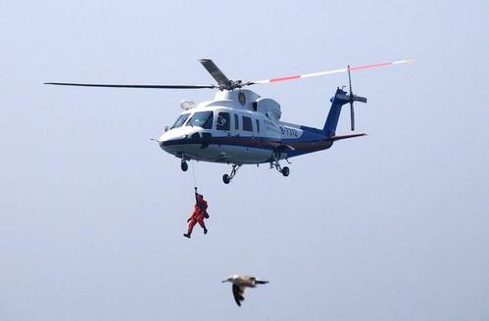
.
03 Skills
01 Introduction 02 Vocabulary 03 Skills 04 Writing 05 Self-Assessment
3-3-1 户外运动--- “helicopter rescue”的描述高分赏析
At that very moment, the helicopter arrived. (2020年7月浙江高考读后续写第二段开头)
1.巨大的嗡嗡声吓得那头熊往后退了几步。直升机上放下了绳梯，埃利迅速抓住绳梯，然后爬了上去，轮到我了。 2.嗡嗡声在我们头顶盘旋，一架软梯掉了下来。言语无法表达我们的狂喜，我们紧紧抱着相机爬上了直升机。 3.螺旋桨的轰鸣声把熊吓跑了，直升飞机急速下降，救援人员很快就赶到了我们这里。
1....The loud drone scared the bear to step back a few inches. A rope ladder was put off from the helicopter, Elli gripped it swiftly and climbed up and it was my turn.
drone/drəʊn/ n. 雄蜂；嗡嗡的声音v. 嗡嗡作声； 低沉地说
2....The buzz hovering over our head, a soft ladder dropped
off. Words failed to express our utter merriment and we
climbed up into the helicopter with the camera embracing
tightly in my arms.
buzz /bʌz/ n. 嗡嗡声v. 发出嗡嗡声；发出蜂鸣声
hover /ˈhɒvə(r)/ vi. 盘旋，翱翔；徘徊
3....The whir of the 's propellers scaring the bear away, the
helicopter zoomed down and the rescuers rushed to us soon.
whir /wɜː(r)/ v. 作呼呼声，呼呼作声地飞; 急速旋转
propeller /prəˈpelə(r)/ n. [航][船] 螺旋桨；推进器

Slide 43
.
03 Skills
01 Introduction 02 Vocabulary 03 Skills 04 Writing 05 Self-Assessment
3-3-1 户外运动--- “helicopterrescue”的描述高分赏析
At that very moment, the helicopter arrived. (2020年7月浙江高考读后续写第二段开头)
4. 直升机在营地上空盘旋，震耳欲聋的噪音打扰了熊。大风吹得熊站不稳。这只熊咆哮着扑向我和埃利之际，直升机上的救援人员发射了一颗麻醉子弹，熊倒在了地上。 5.从盘旋的飞机上吹来的狂风立刻把我们令人窒息的恐惧一扫而空。直升飞机垂下一条绳子把我们拉上来。我们激动不已，但也松了一口气，紧紧抓住绳索，最终安全降落在直升机上。
4....The helicopter hovered over the camp, the deafening noise disturbing the bear. The huge wind blew the bear unsteady on his feet. The bear pounced at Elli and me with a snarl when rescuers in the helicopter fired a drugged bullet at the bear, the bear fell to the ground.
pounce /paʊns/ vi. 突袭，猛扑vt. 扑过去抓住
drugged /drʌgd/ adj. 掺有麻醉药的；镇静剂作用下的；（睡觉）安眠药起作用的
5....The gusting wind from the hovering vehicle swept away our choking fear immediately. Out of the helicopter descended a rope to haul us up. Thrilled yet relieved, we clutched the rope and eventually landed on the helicopter safe and sound.
gust /ɡʌst/ v. 一阵阵地劲吹;（感情的）迸发
descende /dɪˈsend/ v. 下降;降落
haul /hɔːl/ vt. （用力）拖，拉；费力前进

Slide 44
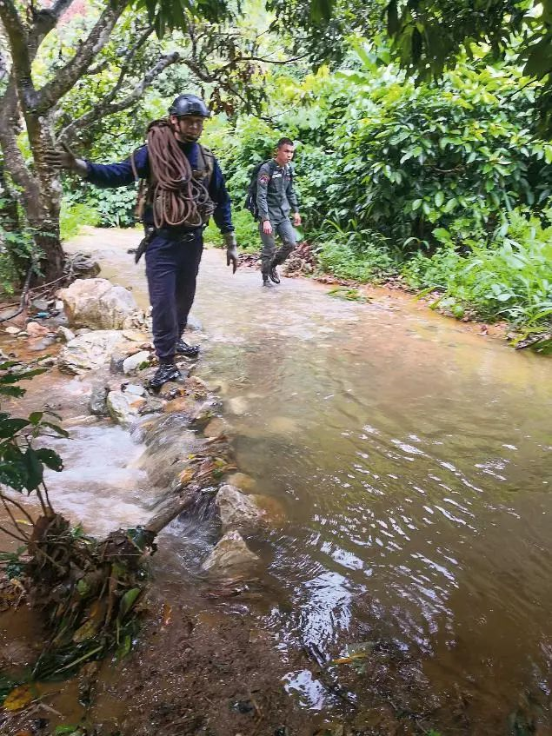
.
03 Skills
.
01 Introduction 02 Vocabulary 03 Skills 04 Writing 05 Self-Assessment
3-3-2 户外运动--- “Outdoor survival”的描述高分句型
☞我咬紧牙关，决心一寸一寸地靠近它。 ☞使我们沮丧的是，所有这些努力都白费了。 ☞“对不起，我应该接受你的建议。”我喃喃地说，低着头。乔如释重负地轻笑着说:“你安全了。这就够了。” ☞然后他扔给我一根粗绳子，好让我抓住它，然后径直朝他走去。我打开门，一把抓过门，慢慢地走了出去。 ☞一阵如释重负的感觉席卷了全身，我对埃利喊道:“我们现在安全了!”
✍With jaws clenched, I resolved to keep edging closer, inch by inch.
resolve/rɪˈzɒlv/ v. 决定；溶解；决心要做……
clench /klentʃ/ v. （表愤怒、决心或不安时）攥紧（拳头等），咬紧（牙齿等）
✍To our dismay, all these efforts were in vain.
dismay /dɪsˈmeɪ/ n. 沮丧，灰心；惊慌
✍“I’m sorry, and I should have taken your advice,” I murmured,
head drooping. Joe chuckled in relief, “You are safe. That’s enough.”
droop /druːp/ v. 下垂；萎靡；凋萎
chuckle /ˈtʃʌkl/ v. 咯咯的笑，轻声地笑；（动物）咯咯叫 n. 轻笑，窃笑
✍Then he threw a thick rope so that I could hang on to it and walk
straight toward him. I opened the door, grabbed it and inched out.
✍A sudden surge of relief sweeping over me, I exclaimed at Elli, “We're safe now!”
exclaim /ɪkˈskleɪm/ v. （由于强烈的情感或痛苦而）惊叫，呼喊

Slide 45
.
03 Skills
.
01 Introduction 02 Vocabulary 03 Skills 04 Writing 05 Self-Assessment
3-3-2 户外运动--- “Outdoor survival”的描述高分句型
☞想象着路面开裂，汽车被水淹没，我感到更加害怕，感觉到死亡在等着我。“从车里跳出来，向我跑过来!”乔大叫着下了卡车，等着我的行动。 ☞我们一浮出水面，汽车就被冲走了。这是多么惊险而难忘的一次逃生啊! ☞得免于难，真是侥幸。 ☞我们侥幸逃过一场大难。 ☞我能安然无恙地逃脱，真是奇迹。
✍Picturing the road cracked and the car was flooded away, I felt more frightened and sensed death was waiting for me. “Jump out of the car and ran to me!” Joe yelled and got off the truck, waiting for my action.
✍The moment we pulled ourselves out of the water, the car was washed away. What a narrow and an unforgettable escape!
✍That was a lucky miss.
✍We only just missed/ escaped having a nasty accident.
nasty /ˈnɑːsti/ 极差的；令人厌恶的；令人不悦的
✍It's a marvel that I escaped unhurt.
marvel /ˈmɑːvl/ n. 令人惊异的人（或事）；不平凡的成果，成就；奇迹

Slide 46
.
03 Skills
.
01 Introduction 02 Vocabulary 03 Skills 04 Writing 05 Self-Assessment
3-3-3 户外运动--- “fishing” 的片段描述赏析
这是初夏一个宁静而甜蜜的日子。午后长长的树影凉凉地横在我们的小路上。一路之上,树叶苍翠欲滴,十分悦目；花儿鲜妍可爱,芬芳醉人；鸟儿们叽叽喳喳,欢叫不已。 多年的垂钓经历使叔叔深谙何处小狗鱼最多,他特意将我安排在最有利的位置上。我模仿别人钓鱼的样子,甩出钓鱼线,宛若青蛙跳动似的在水面疾速地抖动鱼钩上的诱饵,眼巴巴地等候鱼儿前来叮食。
It was a still, sweet day of early summer; the long afternoon shadows of the trees lay cool across our path; the leaves seemed greener, the flowers brighter, the birds merrier, than ever before.
My uncle, who knew by long experience where were the best haunts of pickerel, considerately placed me at the most favorable point. I threw out my line as I had so often seen others, and waited anxiously for a bite, moving the bait in rapid jerks on the surface of the water in imitation of the leap of a frog.
haunt /hɔːnt/ n. 栖息地；常去的地方v. 常出没于…；萦绕于…；经常去…
pickerel /'pɪk(ə)r(ə)l/ n. 梭鱼子；小梭鱼
bait /beɪt/ n. 饵；诱饵；诱惑物 v. 上饵；故意激怒，招惹
jerk /dʒɜːk/ n. 急拉；猛的一动；肌肉抽搐 vi. 痉挛; 猛拉
imitation /ˌɪmɪˈteɪʃn/ n. 模仿，仿造；仿制品 adj. 人造的，仿制的

Slide 47
.
03 Skills
.
01 Introduction 02 Vocabulary 03 Skills 04 Writing 05 Self-Assessment
3-3-3 户外运动--- fishing 的片段描述赏析
突然间,好像有什么东西在拽我的钓线,旋即一下子将它拖入了深水之中。我连忙往上 一拉鱼竿,立刻看到一条逗人爱的小狗鱼在璀璨的阳光下活蹦乱跳。“叔叔!”我掉转头,欣喜若狂地喊道,“我钓住了一条!”还没有哩。“叔叔慢条斯理地说。他的话音未落,只见那条惊恐万状的小狗鱼鳞光一闪,便箭一般地射向了河心。钓线上的鱼钩不见了。我功亏一匮,眼看快到手的捕获物又失去了。
Suddenly something pulled at my line. Off with it swept the line into deep water_{倒装}. Pulling it up as quickly as I could, I saw a fine pickerel wriggling in the sun. “Uncle!” I cried, looking back in uncontrollable excitement, “I've got a fish!” “Not yet,” said my uncle. As he spoke, I saw the fish shooting into the middle of the stream and there was a splash. My hook hung empty from the line. I had lost my prize.
倒装句还原：the line swept into deep water off with it.
swept（sweep的过去式和过去分词）v. 扫去；（迅猛地）推送
wriggle ['rɪgəl] v. 蠕动；蜿蜒而行 n. 蠕动；扭动
splash /splæʃ/ n. 飞溅的水
hook /hʊk/ n. 挂钩，吊钩 v. 钩住；引上钩

Slide 48
.
03 Skills
.
01 Introduction 02 Vocabulary 03 Skills 04 Writing 05 Self-Assessment
3-3-4 户外运动--- driving 的片段描述赏析
突然，在一个偏僻的地方，我妈妈把车停了下来，跳下车来，从后座上抓起鲜花。“只要一分钟，”她隔着开着的窗户喊道。我不耐烦地瞥了一眼路的边缘，然后看到一个小牌子，上面写着这是一家养老院。我回头，有点生气，因为我妈妈再次出现的时候两手空空。 在她发动汽车之前，好奇心驱使我问:“你认识那里的人吗?”她摇了摇头。“那你是怎么处理这些花的?”她微微一笑，“我把它们给了接待员。”“什么?”她笑看我的困惑。“我让接待员把花送给任何需要的人，尤其是那些很久没有收到花的人。”
Suddenly, in the middle of nowhere my mom pulled over, hopping out of the car and grabbing the flowers from the back seat. “It’ll just be a minute,” she called back through the open windows. My eyes impatiently skimmed the edge of the road before settling on a little sign showing that it was a nursing home. I looked back to the building, somewhat annoyed, as my mom reappeared— empty-handed．
Before she started the car, curiosity drove me to ask, “Do you know someone there?” She shook her head. “Then what did you do with the flowers?” She smiled slightly, “I gave them to the receptionist. “What?” She laughed at my confusion. “I told the receptionist to give the flowers to whoever needed them, especially who hasn’t gotten any in a while.”
pull over 把…开到路边；开到路边；靠边停车；靠岸
grab [græb] v. 攫取；夺取; 迅速伸手抓住
hop [hɒp] v. 蹦跳, 跳跃 a little girl hopping and skipping 一个蹦蹦跳跳的小女孩
receptionist [rɪ'sepʃənɪst] n. 接待员；传达员

Slide 49
.
03 Skills
.
01 Introduction 02 Vocabulary 03 Skills 04 Writing 05 Self-Assessment
3-4-1 Sublimate the theme of the article （升华文章的主题）
—— 2017版《普通高中英语课程标准》 the 2017 Edition of English Curriculum Criteria for Regular High School
文化意识：文化意识的培育有助于学生增强国家认同和家国情怀，坚定文化自信，树立人类命运共同体意识，学会做人做事，成长为有文明素养和社会责任感的人。Cultural consciousness: The cultivation of cultural awareness will help students to enhance their national identity and family-country feelings and heighten their cultural self-confidence as well as the community consciousness of human destiny so that they will learn to do and grow up to be persons with sense of social responsibility and civilization accomplishment.
1.
2.
思维品质：思维品质的发展有助于提升学生分析和解决问题的能力，使他们能够从跨文化视角观察和认识世界，对事物作出正确的价值判断。Thinking quality:The development of thinking quality helps to improve students' ability to analyze and solve problems, so that they can observe and understand the world from a cross-cultural perspective and make correct value judgments about things.
3.
学业质量水平三：能以口头或书面形式陈述事件、传递信息、创造性地再现经历、阐释观点和态度等 Academic quality level 3: They're also demanded to state the event, transmit the information, creatively form a clear picture of an authentic or imaginary occurring and interpret their point of views and attitudes.

Slide 50
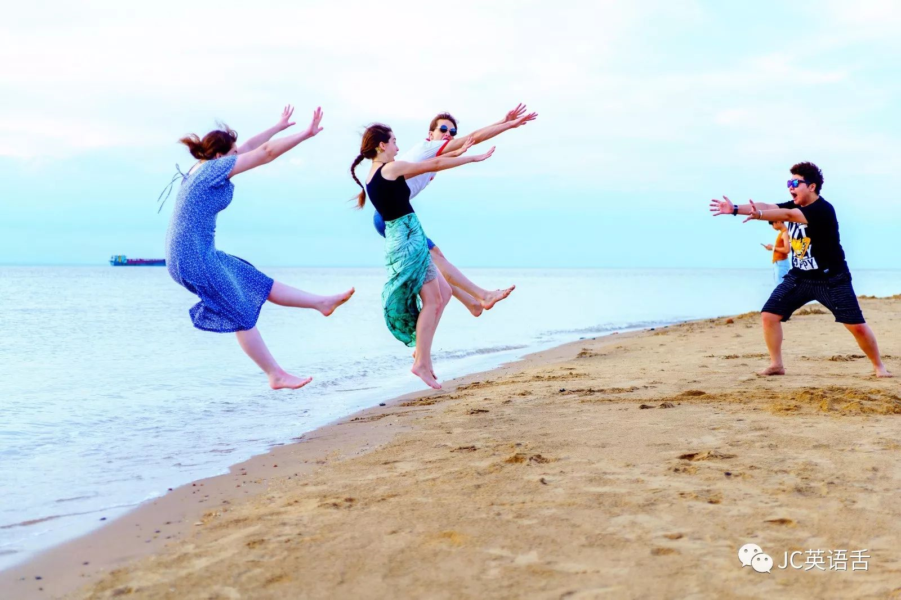
.
03 Skills
.
01 Introduction 02 Vocabulary 03 Skills 04 Writing 05 Self-Assessment
3-4-2 The Meaning of Traveling/Outdoor Activities —— Improve Your Social Skills
✈Meeting new people is one of the great upsides of traveling.
upside /ˈʌpsaɪd/ n. （不利局面中）积极面; 光明的一面，正面
结识新朋友是旅行的好处之一。
✈Whether it's chatting up your hostel roommate, making small talk with your seat-mate on a train or having a lively discussion at a local bar, you will be forced to improve your social skills (especially if you're traveling alone).
与旅馆室友交谈，和火车临座聊天，在一家当地酒吧加入热烈讨论，都能提高你的社交能力。
✈If life is a long journey, honesty/ love will be the backpack that should be taken along all the way.
如果生活是一段长长的旅程，诚实/爱的背包应该一直陪伴它。
Be someone's sunshine when their skies are grey. 当别人的天空灰暗时，做他们的阳光。

Slide 51
.
03 Skills
.
01 Introduction 02 Vocabulary 03 Skills 04 Writing 05 Self-Assessment
3-4-2 The Meaning of Traveling/Outdoor Activities —— Reduce Stress and Stay Fit
✈Traveling removes you from your everyday life and lets you truly escape.
旅行能将你从日常生活中解放出来，真正逃离。
✈Traveling lets you put aside your daily responsibilities and focus on yourself for a moment.
旅行让你撇开日常责任，暂时只专注自己。
✈When you return home you'll feel refreshed and have the motivation you felt drained of before you left.
返回家中，你会精神抖擞，重新找回逝去的生活激情。
drain /dreɪn/ v. 排水；流干；喝光；（感情）变淡；使精疲力竭
Paradise isn't a place, it's a feeling.
天堂不是时间和地点，而是一种美好的感觉、一种近似完美的状态，一种执着的境界。

Slide 52
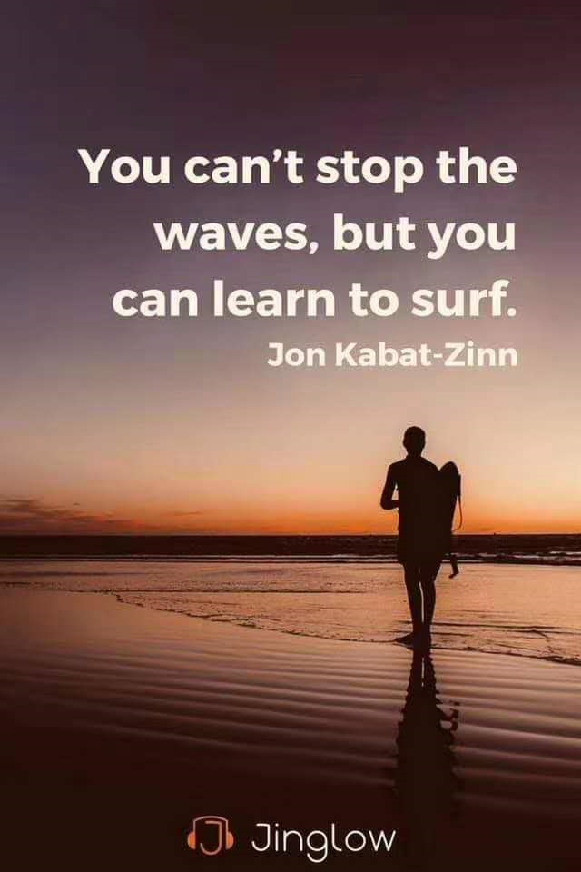
.
03 Skills
.
01 Introduction 02 Vocabulary 03 Skills 04 Writing 05 Self-Assessment
3-4-2 The Meaning of Traveling/Outdoor Activities —— Accomplish Goals and Keep Positive
✈Having a travel "to-do" list and slowly crossing things off that list keeps you motivated and positive.
列出旅行清单，做完一项划掉一项，保持你有目标有动力。
✈Achieving those goals also increases confidence and gives a sense of success.
目标的实现还能增强你的信心，给你成就感。
✈You're healthier and fitter than ever and you get to look forward to accomplishing new goals.
待身体更强健，你开始企盼征服新目标。
You can't stop the waves, but you can learn to surf. 你不能阻止海浪，但你可以学会冲浪。

Slide 53
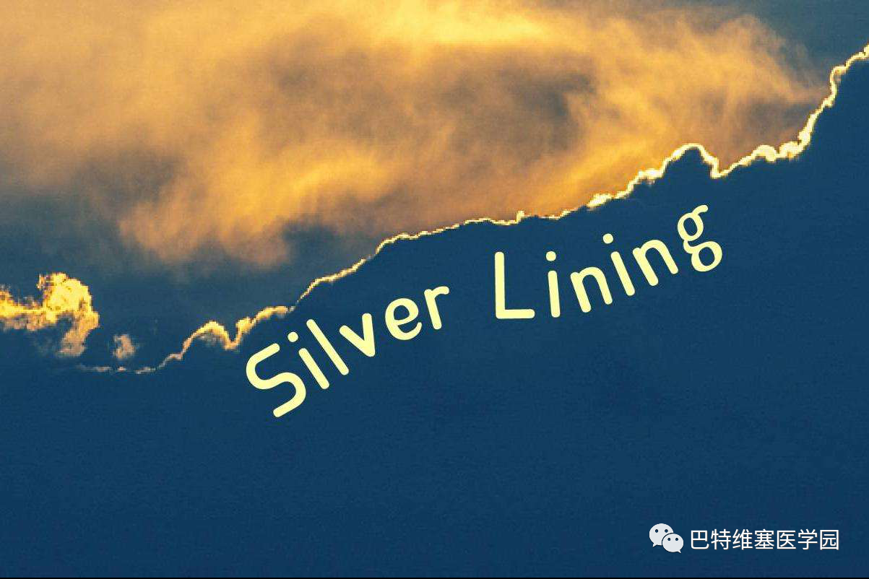
.
03 Skills
.
01 Introduction 02 Vocabulary 03 Skills 04 Writing 05 Self-Assessment
3-4-2 The Meaning of Traveling/Outdoor Activities —— Accomplish Goals and Keep Positive
✈Every cloud has a silver lining.
每朵乌云背后都有阳光/天无绝人之路/山重水复疑无路，柳暗花明又一村
✈If you have a positive attitude, you're more fun in the trip. Your friends will definitely appreciate you more if you see the silver lining rather than just the dark clouds!
如果你有一个积极的态度，你在旅行中会更有趣。如果你看到的是一线希望而不是乌云，你的朋友一定会更欣赏你!
✈You do everything you can,work your hardest. And if you do, if you stay positive, you have a shot at a silver lining.
你必须用尽任何方法，必须尽己所能。如果你能做到，而且保持乐观，就有机会见到一线光明。
silver lining（不幸或失望中的）一线希望；乌云周围的白光 。银色的边, 在云中出现银色的光芒, 如同在黑暗中出现曙光。Every sad or unpleasant situation has a positive side to it.

Slide 54
.
03 Skills
.
01 Introduction 02 Vocabulary 03 Skills 04 Writing 05 Self-Assessment
3-4-2 The Meaning of Traveling/Outdoor Activities —— Learn More about Life and Yourself
✈Maybe it rains the day you're scheduled to go on an epic outdoor adventure. Just on that rainy day you'll discover a hidden bookstore to explore or an adorable cafe to experience.
epic /ˈepɪk/adj. 史诗般的；漫长而艰难的；宏大的；英雄的
或许你准备好做一次史诗级的户外探险时，雨却不期而至。就在
那个下雨天，你却意外发现一家值得光顾的隐蔽书店或一家惬意的
咖啡馆。
✈Traveling helps you be more flexible and open-minded.
旅行让你豁达、随机应变。
✈It is incredible if one can transform the perseverance and seeking-for-individuality spirit into one's life.
这种坚持不懈、探寻自我的精神延续到生活当中，也是一件难能可贵的事情。
Life is a matter of choice. You can be a doctor who saves life, a lawyer who defends life, a soldier who protects life.
Or just be yourself. 生活是选择的问题。 你可以是拯救生命的医生，保护生命的律师，保护生命的士兵。或者做你自己。

Slide 55
.
03 Skills
.
01 Introduction 02 Vocabulary 03 Skills 04 Writing 05 Self-Assessment
3-4-2 The Meaning of Traveling/Outdoor Activities —— Learn More about Life and Yourself
✈The world is a book, and those who do not travel read only a page. --Saint Augustine
世界是一本书，不旅行的人只看到其中的一页。——圣奥古斯丁（隐喻）
✈Life is ultimately a journey of life-long learning , “It is better to travel ten thousand miles than to read ten thousand books.” Hope this journey leave a deep impression in their lives.
人生终究是一次终身学习的旅程。“行万里路读万卷书”，希望这次旅行能给他们的生活留下深刻的印象。
✈Life is an unexplored river, full of twists, great beauty, and dangerous surprises.
生活是一条未被探索的河流，充满曲折，伟大的美丽和危险的惊喜。（隐喻）
Grow through what you go through.所谓成长，就是经历。

Slide 56
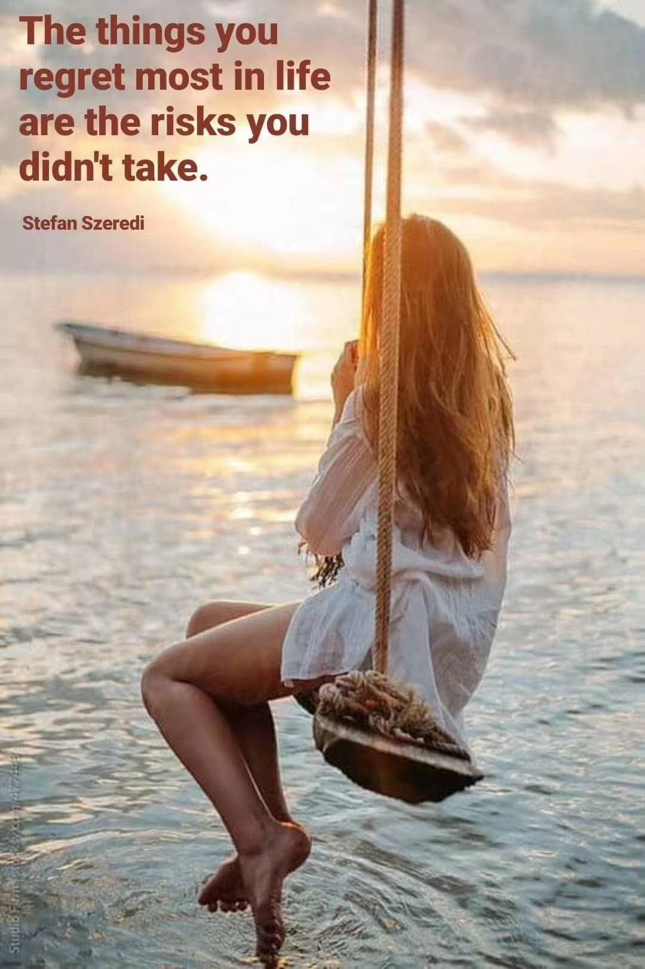
.
03 Skills
.
01 Introduction 02 Vocabulary 03 Skills 04 Writing 05 Self-Assessment
3-4-2 The Meaning of Traveling/Outdoor Activities —— Learn More about Life and Yourself
✈Actually the trip is a life of self-actualization by achieving peace and balance of real life and mentality.
actualization /,æktʃʊəlaɪ'zeɪʃən/ n. 实现；现实化
mentality /menˈtæləti/ n. 心态；[心理] 智力
这次旅程是一段追求自我实现的人生，而真正达到的是生活和
心理上的平衡和宁静。
✈Life is a journey. It should be savored each step of the way. What we should care about is not destination but what we see and how we feel.
人生是一场旅行, 应该欣赏的每一步的方式。我们应该关心的不只是它将走向何方，而是我们看到了什么，我们感觉到了什么。
savor['seɪvə] vt. 尽情享受；品尝，欣赏
✈It is but a hard and tortuous journey.
tortuous['tɔːtʃʊəs] adj.弯曲的
人生无坦途。
The things you regret most in life are the risks you didn't take.生活中你最后悔的事是你没有冒的险。

Slide 57
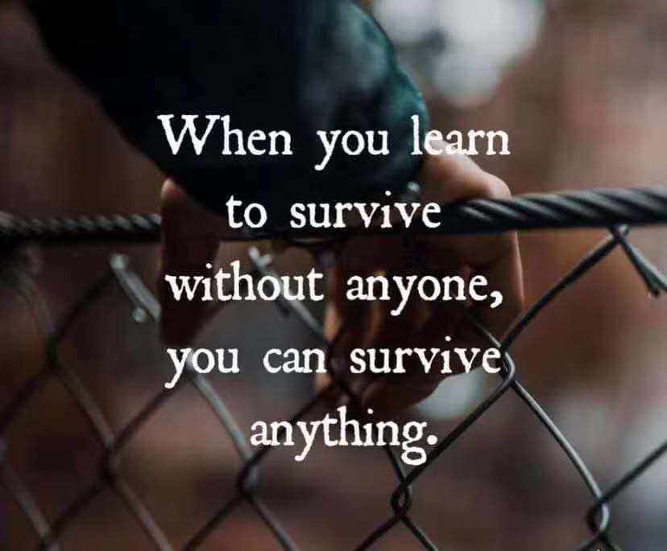
.
03 Skills
.
01 Introduction 02 Vocabulary 03 Skills 04 Writing 05 Self-Assessment
3-4-2 The Meaning of Traveling/Outdoor Activities —— Close to Nature /Meet the Challenges
✈Once you catch the adventure travel bug, you'll never be the same.
bug /bʌɡ/n. 臭虫；故障 --- catch the bug着了迷 / the... bug热衷；着迷
一旦旅行成瘾，你将不再墨守成规。
✈While traveling, you get lured into taking a hike with beautiful panoramic views. It's not too strenuous and the experience takes your breath away. Now you want more -- harder hikes with even better pay off.
lure /lʊə(r)/n. 诱惑；饵 vt. 诱惑；引诱 --- get lured into吸引进入
panoramic /ˌpænəˈræmɪk/ adj. 全景的; 远景的
strenuous /ˈstrenjuəs/ adj. 紧张的；费力的；奋发的；艰苦的；热烈的
旅行时，沿途的美景使你不忍驻足。你没有感觉到特别辛苦，
这种体验反而美妙得让你吃惊。现在你渴望更多——通向更好风
景但更高难度的远足。
When you learn to survive without anyone, you can survive anything.
当你学会在没有任何人的情况下生存，你就可以在任何事情上生存。

Slide 58
.
03 Skills
.
01 Introduction 02 Vocabulary 03 Skills 04 Writing 05 Self-Assessment
3-4-2 The Meaning of Traveling/Outdoor Activities —— Close to Nature/ Meet the Challenges
✈After completing the challenges when she tried a new rock climbing way, Angie had a new insight of past and future.
通过挑战全新攀岩方式，安吉对过去和未来有了新的领悟。
✈As a rock climbing enthusiast, the challenges brought by nature requires greater courage, and the journey filled with the adventures and challenges is how you release yourself.
作为一个攀岩爱好者，大自然带来的挑战需要更大的勇气，挑战和冒险的过程也是释放自我。
✈The mountain-trekking experience inspired pioneering and adventurous spirits.
trek /trek/ n/v. 艰苦跋涉；徒步旅行
艰苦跋涉的登山经历激发了开拓探险精神精神。
Those who find beauty in all of nature will find themselves at one with the secrets of life itself. 那些在大自然中发现美的人将发现生命的秘密。

Slide 59
.
03 Skills
.
01 Introduction 02 Vocabulary 03 Skills 04 Writing 05 Self-Assessment
3-4-2 The Meaning of Traveling/ Outdoor Activities—— Close to Nature /Meet the Challenges
✈But in the steep mountains of the Faroe Islands, he, while surviving the snowstorms and gusting winds, explored nature with his own way and a steadfast determination to find freedom and his actual self.
steadfast /ˈstedfɑːst/ adj. 坚定的；不变的
在法罗群岛陡峭的山、冰冷的雪和狂暴的风中，他用自己的方式
探索和坚定内心，寻找自由纯粹的真我。
✈I felt how small life is in nature when the whale met the canoes. We must revere nature so as to feel the fresh lives in our planet.
revere /rɪˈvɪə(r)/ vt. 敬畏；尊敬；崇敬
当鲸鱼和皮划艇交汇的一刹那，我体会到生命在大自然中也是
渺小的一瞬间，我们真的需要非常敬畏自然，才能从中感受到热烈
的生命触动。
You must go on adventures to find out where you truly belong. 你必须冒险, 去寻找你真正的归属。

Slide 60
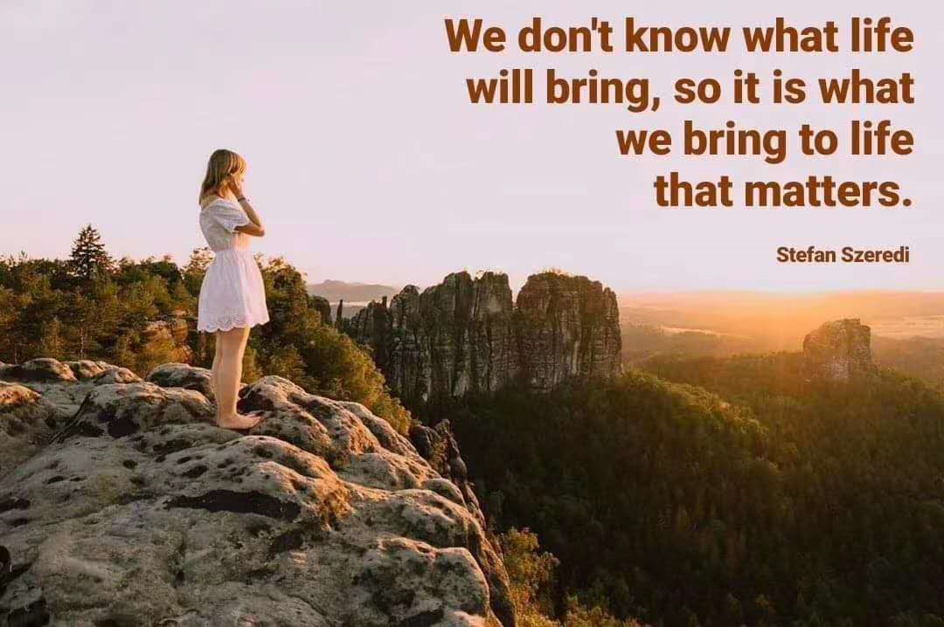
.
03 Skills
.
01 Introduction 02 Vocabulary 03 Skills 04 Writing 05 Self-Assessment
3-4-2 The Meaning of Traveling/Outdoor Activities ——Close to Nature /Meet the Challenges
✈Fourteen days, a tent, two canoes, numerous penguins and seals, countless glaciers and rivers and gusting winds and blizzards, those were what accompanied us during our adventurous Antarctica journey, which pushed us to our physical limits and showed the amazing and majestic polar region.
majestic /məˈdʒestɪk/ adj. 庄严的；宏伟的
十四天，一顶帐篷，两艘皮划艇，数不尽的企鹅和海豹，划
不完的冰川和河流，狂风暴雪与体力挑战的探险旅途，让我们看
到了极地星球的奇妙与壮丽。
✈The stories about out-door activities composed by courage show the splendor of the ultimate bloom of life.
compose/kəmˈpəʊz/v. 组成；作曲；写作
splendor /ˈsplendər/ n. 光彩；壮丽；显赫
用勇气谱写的户外活动故事展示了生命极致绽放的精彩。
We don't know what life will bring, so it is what we bring to life that matters.我们不知道生活会带来什么，所以重要的是我们给生活带来什么。

Slide 61
.
03 Skills
.
01 Introduction 02 Vocabulary 03 Skills 04 Writing 05 Self-Assessment
3-4-3 Six ways to sublimate the theme of the article 升华文章主题的六种方法
由此及彼
通过触类旁通升华文章主题。
（由这个到那个，从物到人）
由事及理
由具体的人事
向为人处世的一般道理升华。
（偶然到必然)
由点到面
通过揭示普遍性升华主题。
（由一个到多个）
由一及众
由个人联系国家
从个人命运向国家民族命运升华。
（由个体到命运共同体）
由表及里
通过揭示本质升华主题。（由浅到深，从小到大）
由反求正
以逆向思维，
反证事物的另一面。
（反弹琵琶）

Slide 62
.
03 Skills
01 Introduction 02 Vocabulary 03 Skills 04 Writing 05 Self-Assessment
3-4-3 浙江高考续写 —— 有关户外活动的主题意义探究
1.201610 丛林逃生 （场景特点：丛林、溪流、直升机、外套）
✍Seeing Tom, she excitedly told him how much she missed him and only when she was in such helpless situation was she aware that her beloved Tom meant so much to her. Tom gave her the warmest and longest hug she had ever received.
☝由事及理，由“劫后余生”悟得“失而复得，倍感珍惜”的哲理。
✍Tom got off the helicopter and dashed to his beloved wife at once. “Oh, my dear Tom! I will never leave you again!” The couple hugged tightly. After this life-risking journey, they realized the precious love between them could conquer every difficulty in life.
☝由事及理，由“户外遇险”向“爱可以战胜生活中的一切困难”的主题升华。
✍It was the narrow escape that made Jane perceive that love was priceless. Over the next years, a change came over the couple. Reasoned discussion replaced fierce arguments and politeness replaced contradiction. They treasured the life and love more.
☝由点到面，由“丛林逃生”一件事过渡到“夫妻从此懂得相处之道——理智尊重，相爱一生”，升华了事件的内核。

Slide 63
.
03 Skills
01 Introduction 02 Vocabulary 03 Skills 04 Writing 05 Self-Assessment
3-4-3 浙江高考续写 —— 有关户外活动的主题意义探究
2.201706 狼口脱险 （场景特点：夏日下午、公路、自行车、汽车）
✍On the way home, night breeze made him at ease and he couldn’t wait to share his experience with his wife and daughters and show the kindness of the world.
☝由点到面，呼应首段，并使主题的境界得到提升“分享经历传播正能和互帮互助人间大爱”。
✍The story of this narrow escape had vividly and dramatically demonstrated that nothing could be intimidating if you are calm and brave enough.
☝由事及理，由“狼口脱险”向“如果你足够冷静和勇敢，没有什么是可怕的”的主题升华，起到画龙点睛的效果。

Slide 64
.
03 Skills
01 Introduction 02 Vocabulary 03 Skills 04 Writing 05 Self-Assessment
3-4-3 浙江高考续写 —— 有关户外活动的主题意义探究
3.201710 健忘妈妈旅行记 （场景特点：开车旅行探亲、宿营、沿途风光）
✍Through this trip, I discovered that，despite my occasional anger towards her, I actually felt proud of Mom. This was the trip of my life.
✍Though she did love going camping, she presented that poor boy with this tent out of sympathy. It was Mom that made my childhood colorful. And it was also she that showed me the true meaning of giving.
✍Seemingly absent-minded and forgetful as she was, she never failed to demonstrate the beauty of life to her children, and endowed us with a fun-filled childhood and a never-drained passion to embrace life.
☝☝☝由表及里，通过“健忘妈妈旅行”回归文本标题，深入探讨“母爱”本质，升华到“关爱与陪伴”的主题。

Slide 65
.
03 Skills
01 Introduction 02 Vocabulary 03 Skills 04 Writing 05 Self-Assessment
3-4-3 浙江高考续写 —— 有关户外活动的主题意义探究
3.201710 健忘妈妈旅行记 （场景特点：开车旅行探亲、宿营、沿途风光）
✍This thrilling, memorable trip reminded every now and then that Mom was not all about an absent-minded, forgetful person, but was someone who was fully aware of how to add color to daily life. It dawned on me that once we explored, life would embrace you.
☝由反求正，反弹琵琶，既回扣全文，又通过与健忘妈妈旅行，人物形象反转：妈妈是一位给我们带来多彩的生活，教会我们人生道理。
✍I gradually realized that I was not reluctant to set out for trips any more. Anyway, it was such a wonderful way to broaden our horizons and explore the outside world. Finally,when we reached our destination, I was even eager to set out once again. Undoubtedly, it was all my mom's magic to shape me into a travel lover!
☝由此及彼，由“担心旅行到乐意旅行”的认知改变转化为“成为旅行爱好者”行动诉求，耐人寻味，凸显母爱的力量。

Slide 66
.
03 Skills
01 Introduction 02 Vocabulary 03 Skills 04 Writing 05 Self-Assessment
3-4-3 浙江高考续写 —— 有关户外活动的主题意义探究
4.201806 父子寻路 （场景特点：农场、河流、兔子、骑马）
✍Never had I experienced such a thrilling yet dangerous vacation before. The special trip to the Wild West was deeply engraved in my mind forever.
✍ Reflecting on this memory, I regarded this experience as my special adventure with my dad.
✍ Back in the farm house, we reflected on the exciting yet dangerous experience, which was carved in our mind permanently.
☝☝☝由点到面，呼应首段，并使主题的境界得到提升“成长经历人生轨迹和父爱陪伴终生受益”。
✍ Finally, we arrived home safely just in time for supper, but what an experience! It turns out there’s always a way out of any plight as long as we stay calm.
☝由事及理，由“荒野寻路”讲述“只要我们保持冷静，就总有办法摆脱任何困境”的道理，起到画龙点睛的效果。

Slide 67
.
03 Skills
01 Introduction 02 Vocabulary 03 Skills 04 Writing 05 Self-Assessment
3-4-3 浙江高考续写 —— 有关户外活动的主题意义探究
5.202007 北极熊营地拍照遇险 （场景特点：营地、北极熊、拍照、直升机）
✍After we calmed down, the locals told us that the bears were losing their homes and food because of human activities and climate changes. On the way back home, I checked the precious pictures in the camera, lost in thought.
☝由一及众，由个人经历联系“人类活动对动物生存环境的负面影响”，紧扣主题适当呼吁，升华到“环境保护”主题。
✍It was a tremendously nail-biting experience, from which I realized that we should keep harmony with wild animals and maintain a safe distance to protect ourselves as well as to avoid hurting them.
☝由一及众，由个人经历联系“人应该与自然和谐相处，与动物保持安全距离”，升华到“人与自然”主题。（由个体到命运共同体）

Slide 68
.
03 Skills
01 Introduction 02 Vocabulary 03 Skills 04 Writing 05 Self-Assessment
3-4-3 浙江高考续写 —— 有关户外活动的主题意义探究
5.202007 北极熊营地拍照遇险 （场景特点：营地、北极熊、拍照、直升机）
✍Once safe, I took out my camera and admired the pictures. Only then did we figure out that the bear was not out of malevolence but so starving as to be murderous. Seeing this, I sank into silence. Maybe it was human's invasion that drove bear to search food desperately.
☝由表及里，通过遇熊脱险揭示“动物本无意伤害人，是因为人的冒犯才导致动物饥饿觅食而伤人”的本质，升华到“人与自然”主题。
✍To our surprise, so perfect was the last picture that we thought it did deserve our life-risking effort. Initially what seemed like a nightmare ultimately turned out to be a rich reward. “Surprise hides everywhere.” Elli blurted. “Maybe it's just the most secret and attracting part of life.” I replied. Smile blossomed on both of our faces.
☝由事及理，由“冒险拍照”悟得“惊喜在惊险处”的生活秘密和魅力，起到尾首呼应，虎头豹尾的效果。

Slide 69
.
04 Writing
.
01 Introduction 02 Vocabulary 03 Skills 04 Writing 05 Self-Assessment
4-1 Show What You Have Learned
Use at least 3 similes or metaphors and the outdoor living vocabulary you have learned to continue the piece of writing below. Add between 50 - 75 words in the space below to continue the story. Your writing should use at least five items from the vocabulary chart. Aim to use compare objects, feelings and descriptions to something else to paint a picture. Complete this task in no more than 20 minutes.
The weekend had finally arrived, and Glenn and Macy decided to go for a bike ride in the mountains. They strapped on their helmets and cycled onto the open road. The scenery was like a painting by a famous artist. The waves on the lake danced with the wind. All of a sudden, Macy’s front tire popped, and she tumbled onto the rocky ground.
Glenn’s eyes widened when he saw the blood running down Macy’s leg. __________ ________________________________________________________________________

Slide 70
.
04 Writing
.
01 Introduction 02 Vocabulary 03 Skills 04 Writing 05 Self-Assessment
4-1 Show What You Have Learned
Pre-Writing Task:
 1.Where and when did Glenn and Macy’s story take place?
 2.How did Glenn and Macy react and feel when discovered the injury?
 3.How did Glenn and Macy’s problem get resolved?
The weekend had finally arrived, and Glenn and Macy decided to go for a bike ride in the mountains. They strapped on their helmets and cycled onto the open road. The scenery was like a painting by a famous artist. The waves on the lake danced with the wind. All of a sudden, Macy’s front tire popped, and she tumbled onto the rocky ground.
Glenn’s eyes widened when he saw the blood running down Macy’s leg. __________ ________________________________________________________________________

Slide 71
.
04 Writing
.
01 Introduction 02 Vocabulary 03 Skills 04 Writing 05 Self-Assessment
4-2 Sample Answers
Basic: Macy's leg hurt so much. She could no longer ride her bike. It was getting dark. The forest was full of dangerous animals. They needed to build a fire to keep the animals away and then try to get help in the morning.
Version 1: The pain crawled (metaphor) from Macy’s knees down to her toes. She took off her helmet and laid down on the uneven trail as darkness descended. Sensing the desperate gleam in Macy’s eyes, Glenn bent over to give him a tight embrace, comforting that they would be safe. They would need a fire in order to survive.
crawl /krɔːl/ v. 爬行；匍匐行进

Slide 72
.
04 Writing
.
01 Introduction 02 Vocabulary 03 Skills 04 Writing 05 Self-Assessment
4-2 Sample Answers
Version 2: The acute pain washed over (metaphor) Macy’s body and she closed her eyes for a moment. Darkness descending, as black as ink (simile), Glenn struggled to help his injured girlfriend get more comfortable. When she moved her leg, the blood spread slowly like honey (simile) down her leg and made a puddle on the surface of her shoe. Somewhat hopeless, Macy sank on the stoney ground. Even worse, they heard a long snarl and realized encountering a wolf — the wolf pricked up his ears, baring his teeth and lashing his tail wrathfully. Just at that life-or-death moment, a police car came. Hearing the sirens, the wolf slunk into the thick woods in a flash. Macy was taken to a local hospital. What a narrow escape!

Slide 73
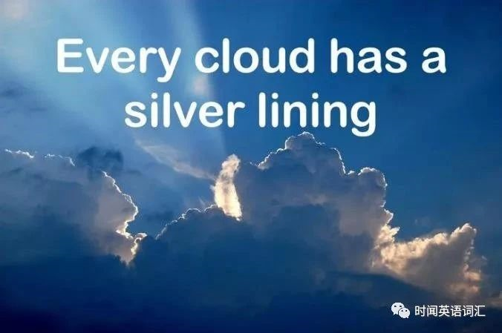
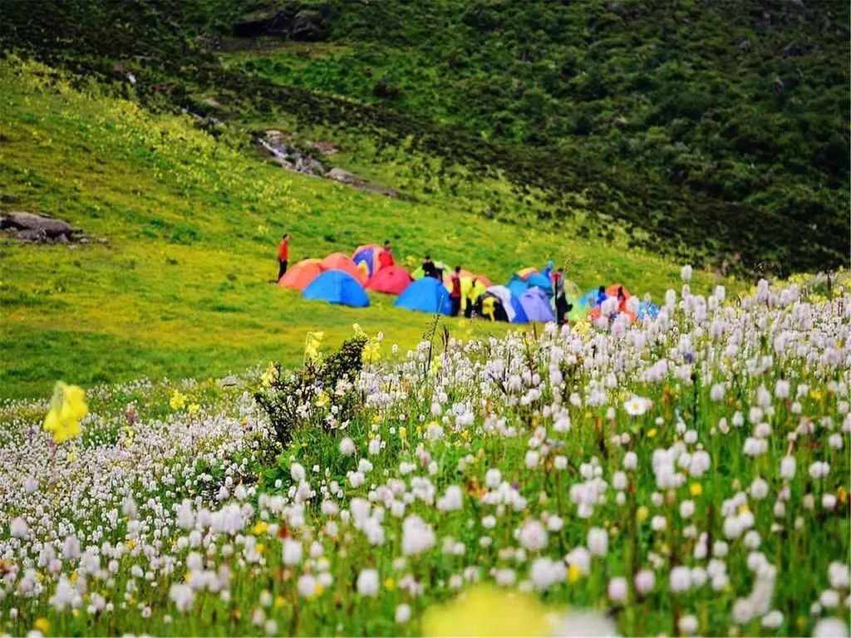
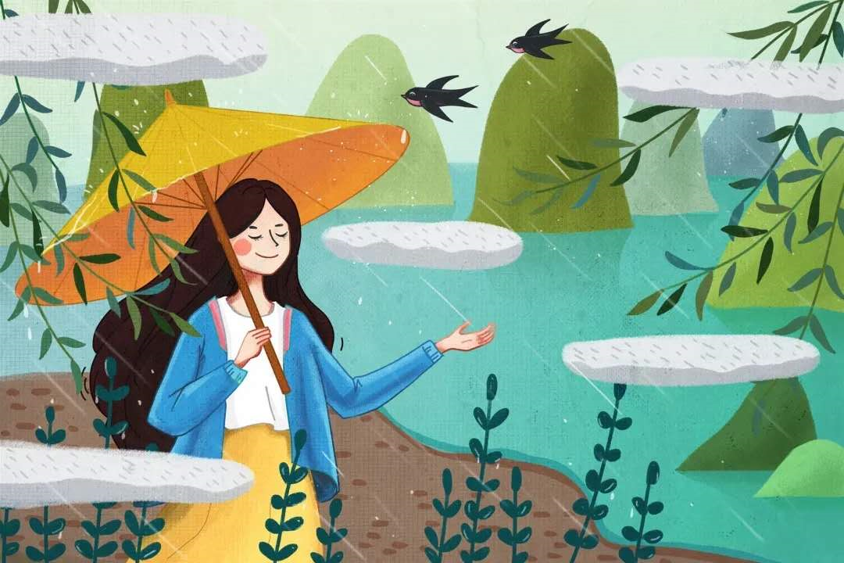
.
05 Self-assesment
.
01 Introduction 02 Vocabulary 03 Skills 04 Writing 05 Self-Assessment
5-1 Which new items have you learned from the above lesson?
new words
new expressions
new sentence
new writing skills

Slide 74
.
05 Self-assesment
.
01 Introduction 02 Vocabulary 03 Skills 04 Writing 05 Self-Assessment
5-2 阅读下面短文，根据所给情节进行续写，使之构成一个完整的故事。(2018年6月浙江高考试题)
It was summer, and my dad wanted to treat me to a vacation like never before. He decided to take me on a trip to the Wild West.
We took a plane to Albuquerque, a big city in the state of New Mexico. We reached Albuquerque in the late afternoon. Uncle Paul, my dad’s friend, picked us up from the airport and drove us up to his farm in Pecos.
His wife Tina cooked us a delicious dinner and we got to know his sons Ryan and Kyle. My dad and I spent the night in the guestroom of the farm house listening to the frogs and water rolling down the river nearby. Very early in the morning, Uncle Paul woke us up to have breakfast. "The day starts at dawn on my farm," he said. After breakfast, I went to help Aunt Tina feed the chickens, while my dad went with Uncle Paul to take the sheep out to graze(吃草). I was impressed to see my dad and Uncle Paul riding horses. They looked really cool.
In the afternoon, I asked Uncle Paul if I could take a horse ride, and he said yes, as long as my dad went with me. I wasn’t going to take a horse ride by myself anyway. So, my dad and I put on our new cowboy hats, got on our horses, and headed slowly towards the mountains. "Don’t be late for supper," Uncle Paul cried, "and keep to the track so that you don’t get lost!" "OK! " my dad cried back. After a while Uncle Paul and his farm house were out of sight. It was so peaceful and quiet and the colors of the brown rocks, the deep green pine trees, and the late afternoon sun mixed to create a magic scene. It looked like a beautiful woven(编织的) blanket spread out upon the ground just for us.
Paragraph 1： Suddenly a little rabbit jumped out in front of my horse. ____________________________
Paragraph 2：We had no idea where we were and it was getting dark. ____________________ ________

Slide 75
.
05 Self-assesment
.
01 Introduction 02 Vocabulary 03 Skills 04 Writing 05 Self-Assessment
5-2-1 Writing Scaffold：Classify the underlined words and first sentences to help plotting
①时空线 | ②情节线 | ③情感线
farm house， river， late， track | dad，Uncle Paul， feed ，the sheep， get lost，sight
Suddenly a little rabbit jumped out in front of my horse…
We had no idea where we were and it was getting dark…
farm house
明线
dad
Uncle Paul
明线
暗线
river
late
track
get lost
sight
?
?
How did we get lost?
?
Did we find our way back? And how?
特别关注两个段首句！
形成问题链推动情节发展。

Slide 76
.
05 Self-assesment
.
01 Introduction 02 Vocabulary 03 Skills 04 Writing 05 Self-Assessment
5-2-2 高分习作赏析 1
Suddenly a little rabbit jumped out in front of my horse. “What a lovely rabbit!” I shouted with eyes glittering _{(隐喻)}with terrific excitement_{神态描写}. It was quite different from those I saw in our city, thus immediately stimulating my interest. Dad was also stunned by this special rabbit/creature, gawking at it motionlessly_{动作描写}. “Daddy, let’s catch it as our pet!” I suggested, unexpectedly receiving his prompt agreement_{语言描写}. Entirely forgetting what Uncle Paul had told us, we chased after that pretty rabbit, frantic with rapture_{心理描写}. Unfortunately, so clever and swift was it that it disappeared in the forest before long. Not until then did we realize that the last ray of twilight was quickly disappearing among the numerous trees_{环境描写} and we couldn’t find our track at all! We did get lost!
glitter ['glɪtə] vi. 闪光；闪烁n. 闪光；灿烂
stimulate ['stɪmjʊleɪt] v. 刺激；鼓舞，激励
stun [stʌn] vt. 使震惊；打昏；给以深刻的印象
gawk [gɔːk] n. 呆子；腼腆的人vi. 呆呆地看
motionlessly 不动地;静止地 motion n. 动作；手势； v. 运动；打手势
prompt [prɒmpt] adj. 敏捷的，迅速的；立刻的
frantic with rapture 喜出望外；欣喜若狂 frantic ['fræntɪk] adj. 狂乱的，疯狂的
rapture ['ræptʃə] n. 兴高采烈 vt. 使…狂喜
the last ray of twilight最后一缕曙光/霞光 ray [reɪ] n. 射线；光线； v. 放射
twilight ['twaɪlaɪt] n. 黄昏；朦胧状态
numerous ['njuːmərəs] adj. 许多的

Slide 77
.
05 Self-assesment
.
01 Introduction 02 Vocabulary 03 Skills 04 Writing 05 Self-Assessment
5-2-2 高分习作赏析 1
bone-chilling 刺骨的
chill [tʃɪl] n. 寒冷 adj. 寒冷的 v. 冷冻
howl [haʊl] v. 咆哮；狂吠 n. 嗥叫；怒号
suffocating ['sʌfəketɪŋ] adj. 令人窒息的；使人呼吸困难的；憋气的
suffocate扼制；窒息的ing形式
quivering ['kwivəriŋ] adj. 颤抖的
quiver ['kwɪvə] n./ v.颤抖；震动
stark [stɑːk] adj. 完全的；荒凉的；刻板的；光秃秃的
adv. 完全；明显地；突出地；质朴地
horror ['hɒrə] n. 惊骇；惨状；极端厌恶；令人恐怖的事物- horrible adj. 可怕的；极讨厌的
mollify ['mɒlɪfaɪ] vt. 平息，缓和；使…平静；使…变软( mollified - mollifying)
scary ['skeərɪ] adj. （事物）可怕的；恐怖的；（人）提心吊胆的；引起惊慌的；胆小的
over the moon 兴高采烈；欣喜若狂
radiant ['reɪdɪənt] adj. 辐射的；容光焕发的；光芒四射的n. 光点；发光的物体
light up 照亮；点亮；呈现高兴的情绪（过去式过去分词lighted 或 lit）
We had no idea where we were and it was getting dark. The bone-chilling wind howled fiercely like a wolf_{（明喻）}, making the darkness even more suffocating_{（隐喻）环境描写}. “Dad, what can we do?” I threw my arms around him tightly, quivering and seized by stark horror. “All is going well!” Dad answered in a gentle voice, calm and mollified_{语言描写}. We wandered in the scary forest and didn’t know what horrible thing would happen to us, hoping to find the way back. Suddenly, we heard the sound of water rolling down the river. We were over the moon_{（隐喻和夸张）心理描写} and decided to follow the river. After a while, we heard the familiar sound of sheep and then caught sight of the farm house. The family were waiting for us in the distance. Seeing this, a radiant smile_{(隐喻)} lit up both of our faces_{神态描写}.

Slide 78
.
05 Self-assesment
.
01 Introduction 02 Vocabulary 03 Skills 04 Writing 05 Self-Assessment
5-2-2 高分习作赏析 1
这篇文章内容丰富、主题明确、故事情节设计自然流畅、合乎逻辑。考生在第一段中以“这只兔子与我在城里见过的兔子不同，从而激起了我的兴趣”为由引出“和父亲一起追逐兔子”的情节，与原文的写作思路契合、融洽度高，突出了作者对兔子的好奇和新鲜感。之后的情节“失去兔子踪影”和“发现迷路”也在情理之中，并与第二段首句自然衔接。第二段中围绕“父亲鼓励我想办法自救”、“沿河寻找出路”、“成功脱险”展开情节，将故事推向高潮，并巧妙地体现了“人与自我”主题语境下的家庭亲情主题——父爱。
有效地使用了连接成分，如：thus, unfortunately, not until then, suddenly, after a while, seeing this使全文结构紧凑。
习作者具有较强的语言功底，具体表现在：丰富的词汇，如stimulate my interest, stunned, gawk at, bone-chilling, quiver等。
更值得一提的是， 文中用了不同的短语来表达“喜悦”之意：frantic with rapture, be over the moon, a radiant smile。
语法结构丰富，包括倒装结构、非谓语结构、形容词和副词作状语等等。
Suddenly a little rabbit jumped out in front of my horse. “What a lovely rabbit!” I shouted with eyes glittering with terrific excitement. It was quite different from those I saw in our city, thus immediately stimulating my interest. Dad was also stunned by this special rabbit/creature, gawking at it motionlessly. “Daddy, let’s catch it as our pet!” I suggested, unexpectedly receiving his prompt agreement. Entirely forgetting what Uncle Paul had told us, we chased after that pretty rabbit, frantic with rapture. Unfortunately, so clever and swift was it that_{倒装} it disappeared in the forest before long. Not until then did we realize_{倒装} that the last ray of twilight was quickly disappearing among the numerous trees and we couldn’t find our track at all! We did get lost!
We had no idea where we were and it was getting dark. The bone-chilling wind howled fiercely like a wolf, making the darkness even more suffocating. “Dad, what can we do?” I threw my arms around him tightly, quivering and seized by stark horror. “All is going well!” Dad answered in a gentle voice, calm and mollified. We wandered in the scary forest and didn’t know what horrible thing would happen to us, hoping to find the way back. Suddenly, we heard the sound of water rolling down the river. We were over the moon and decided to follow the river. After a while, we heard the familiar sound of sheep and then caught sight of the farm house. The family were waiting for us in the distance. Seeing this, a radiant smile lit up both of our faces.

Slide 79
.
05 Self-assesment
.
01 Introduction 02 Vocabulary 03 Skills 04 Writing 05 Self-Assessment
5-2-2 高分习作赏析 2
Suddenly a little rabbit jumped out in front of my horse. My horse was so afraid that it began running ferociously. I could feel the air hitting my face heavily and hear my dad’s hysterical cry from a distance_{环境描写}. My heart was pumping wildly and my blood was pulsing through my veins_{心理描写}. I pulled back the reins, distracted the horse and tried every means to stop the horse but in vain_{动作描写}. After what seemed an eternity_{（夸张）}, my dad caught up with me breathlessly and managed to stop my horse. But we found that we were in distress, with no track beside us.
We had no idea where we were and it was getting dark. The river beside us was still and serene under the last ray of sunshine_{环境描写} but we didn’t have the mood to enjoy it_{心理描写}. Suddenly, it occurred to us that there was also a river nearby the farm house. Realizing the river may be a guide back, our spirits soared_{（隐喻）心理描写} and we began to trot briskly along the river_{动作描写}. Just a few minutes later, catching sight of the silhouette of the house, I felt a feeling of relief and relaxation surging through me_{心理描写}. I could picture Uncle Paul’s smiling face and our delicious supper and I thought to myself _{心理描写}that our being lost added a special taste to my adventurous vacation which I would remember all my life._{（由此及彼，思想升华融于叙事描写）}
ferociously /fə'rəuʃəsli/ adv. 残忍地；野蛮地；凶猛地
hysterical /hɪ'sterɪk(ə)l/ adj. 歇斯底里的；异常兴奋的
pulse [pʌls] n. [电子] 脉冲；脉搏vt. 使跳动vi. 跳动，脉跳
vein [veɪn] n. 血管；叶脉；[地质] 岩脉；纹理；翅脉；性情 vt. 使成脉络；象脉络般分布
distract /dɪ'strækt/ vt. 转移；分心
eternity /ɪ'tɜːnɪtɪ/ n. 来世，来生；不朽；永世；永恒
distress /dɪ'stres/ n. 危难，不幸；贫困；悲痛
in distress在困境中
serene /sɪ'riːn/ adj. 平静的；安详的；清澈的；晴朗的
soar /sɔː/vi. 高飞；高耸；往上飞舞; 高涨
trot [trɒt] n. （人）慢跑；马小跑的步态；小跑的马蹄声；刚学步的小孩；老太婆；腹泻；（学生作弊用的）译文对照本 vi. （马）小跑；（人）慢跑；快步走vt. 使小跑；使快步走。
过去式 trotted过去分词 trotted现在分词 trotting
briskly /'briskli/ adv. 迅速地；活泼地; 轻快的; 步履轻快地
silhouette /,sɪlʊ'et/ n. 轮廓，剪影
surge/sɜːdʒ/n. 汹涌；波涛；汹涌澎湃 v. 汹涌；起大浪，蜂拥而来

Slide 80
.
05 Self-assesment
.
01 Introduction 02 Vocabulary 03 Skills 04 Writing 05 Self-Assessment
5-2-2 高分习作赏析 2
这篇文章讲述了这样一个故事：因为兔子的突然出现，马受惊一路狂奔，我与父亲竭尽全力终于控制住马，但是发现我们迷路了。夜幕降临，我们无心欣赏风景。这时，身旁的河流给了我们启示，于是我们沿河前行寻找出路，终于回到了农场。整个故事情节完整，合乎逻辑。文章的结尾，习作者并没有选择宏观的主题，而是用“our being lost added a special taste to my adventurous vacation” 对这次遇险经历作一总结，与文章开头的“a vacation like never before”首尾呼应，使整个故事浑然一体。
After what seemed an eternity, but, suddenly, a few minutes later等连接成分的使用也恰当好处。
本文体现了习作者较为深厚的语言功底：
（1）丰富的词汇，如：ferociously, hysterical, serene, briskly, silhouette等（
2）大量使用非谓语动词，如 “Realizing the river may be a guide back, our spirits soared and we began to trot briskly along the river.”等
（3）句式结构多元，如so…that…、it occurred to sb. that …、定语从句等。
Suddenly a little rabbit jumped out in front of my horse. My horse was so afraid that it began running ferociously. I could feel the air hitting my face heavily and hear my dad’s hysterical cry from a distance. My heart was pumping wildly and my blood was pulsing through my veins. I pulled back the reins, distracted the horse and tried every means to stop the horse but in vain. After what seemed an eternity, my dad caught up with me breathlessly and managed to stop my horse. But we found that we were in distress, with no track beside us.
We had no idea where we were and it was getting dark. The river beside us was still and serene under the last ray of sunshine but we didn’t have the mood to enjoy it. Suddenly, it occurred to us that there was also a river nearby the farm house. Realizing the river may be a guide back, our spirits soared and we began to trot briskly along the river. Just a few minutes later, catching sight of the silhouette of the house, I felt a feeling of relief and relaxation surging through me. I could picture Uncle Paul’s smiling face and our delicious supper and I thought to myself that our being lost added a special taste to my adventurous vacation which I would remember all my life.

Slide 81
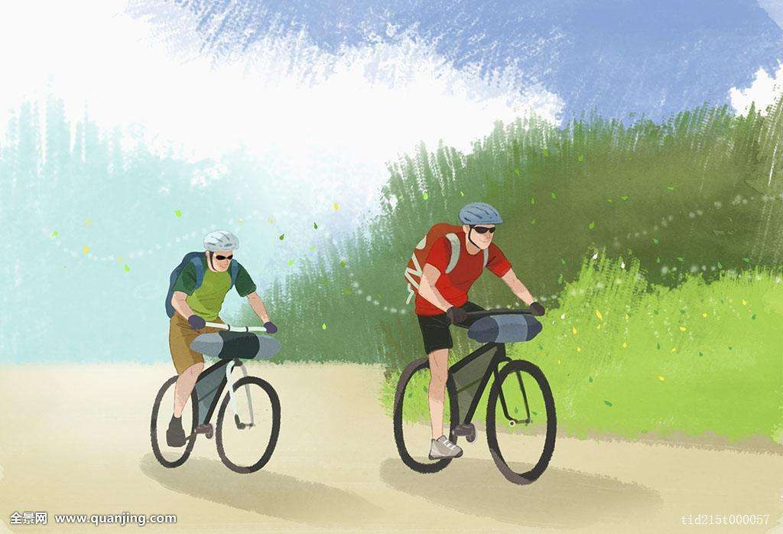
Sun
Edu
High school English descriptive language series — Lesson 5
Thank you

