Slide 1
感恩遇见，相互成就，本课件资料仅供您个人参考、教学使用，严禁自行在网络传播，违者依知识产权法追究法律责任。
更多教学资源请关注
公众号：溯恩高中英语
知识产权声明

Slide 2
绍兴一模应用文讲评
——基于教材和读者意识
陈莹
暨阳分校

Slide 3
2023.11 绍模应用文
假定你是李华，你的英国笔友David刚升入高中，但因一时无法适应新的校园生活而焦虑，写信向你倾诉他的烦恼。请你给他回复一封邮件，内容包括：
1.分析可能的原因；
2.给出合理的建议。
注意：
1. 词数80左右；
2. 请按如下格式在答题卡的相应位置作答。
1.邮件类型：建议信
2.对象：笔友
3.话题： 校园生活
Dear David,
Yours sincerely,
Li Hua

Slide 4
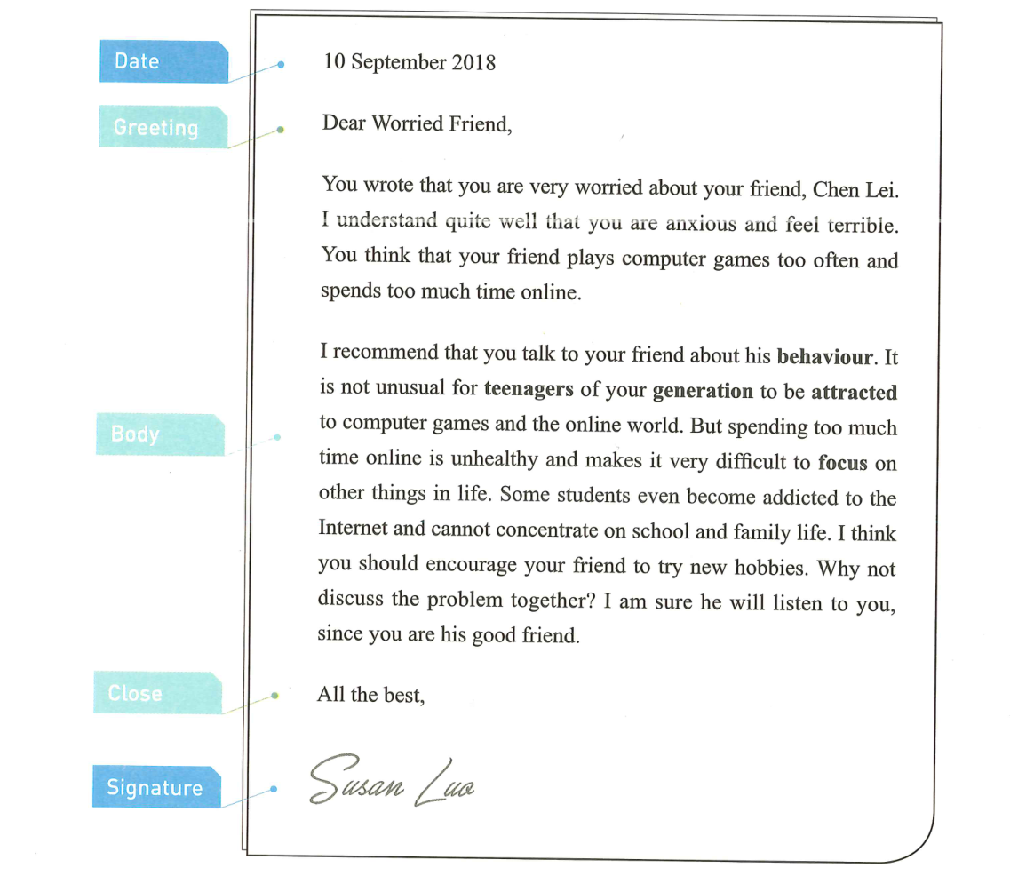
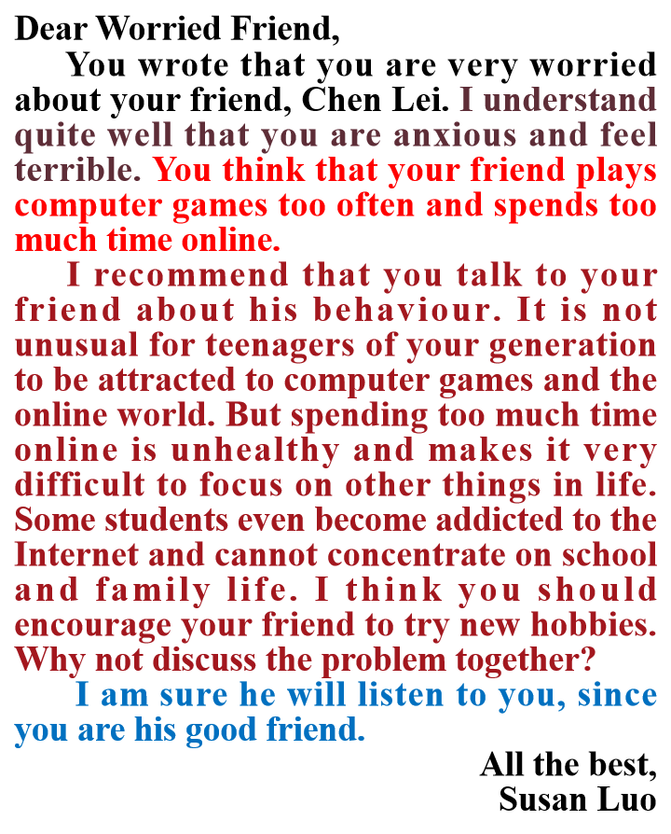
Textbook : 必修一 Unit 1
1) Structure
2) Content
part 1
problems
suggestions
&reasons
part 2
part 3
wish
3) Language
4) Tone: concerned, understanding

Slide 5
审题
Structure
假定你是李华，你的英国笔友David刚升入高中，但因一时无法适应新的校园生活而焦虑，写信向你倾诉他的烦恼。请你给他回复一封邮件，内容包括：
1.分析可能的原因；
2.给出合理的建议。
Para1: purpose
Para2: reasons + suggestions
Para3: wish

Slide 6
Content
假定你是李华，你的英国笔友David刚升入高中，但因一时无法适应新的校园生活而焦虑，写信向你倾诉他的烦恼。请你给他回复一封邮件，内容包括：
1.分析可能的原因；
2.给出合理的建议。
?
P1:purpose
problem
purpose

Slide 7
假定你是李华，你的英国笔友David刚升入高中，但因一时无法适应新的校园生活而焦虑，写信向你倾诉他的烦恼。
Language
P1:problem+purpose
●have trouble/problem doing;
●find it hard/difficult to do;
●It is quite a challenge for sb to do;
●adapt to;
●adjust to;
●fit in well;
●anxiety/anxious/confused/at a loss
Tone
concerned&understanding
●I understand quite well that…;
●I feel terribly sorry to learn that…;

Slide 8
Content
P2:reasons+suggestions
What makes it hard for a high school freshman to adapt to new school life?
higher academic pressure
new interpersonal relationship
1) a tight study schedule
2) more subjects and homework to handle
3) higher academic requirements
4) Fail to keep up with others
5) get insufficient sleep
6)no familiar friends around/ feel lonely
...
reasons

Slide 9
Content
P2:reasons+suggestions
Can you put forward some practical suggestions accordingly?
higher academic pressure
1) adjust learning strategies
2) learn to manage time properly
3) turn to school advisors for guidance
4) take exercise
...
suggestions
(solutions)
new interpersonal relationship
join a club to make friends with like-minded guys
participate in extra-curricular activities
3) stay positive/outgoing

Slide 10
Language
P2:reasons+suggestions
●Were I you, I would...;
●It would be a wise choice if you…;
●Why not…;
●…is highly recommended/a good option;
●It is advisable that…
Tone
concerned&understanding
●It is not unusual for a freshman like you to…;
●It is a common phenomenon that…

Slide 11
Content&Language
P3:wish
●Hopefully, you will find my suggestions helpful and practical. All the best!
●I would be more than delighted to see that these suggestions are of help to you.
Tone
concerned&encouraging
●I will always be there for you.

Slide 12
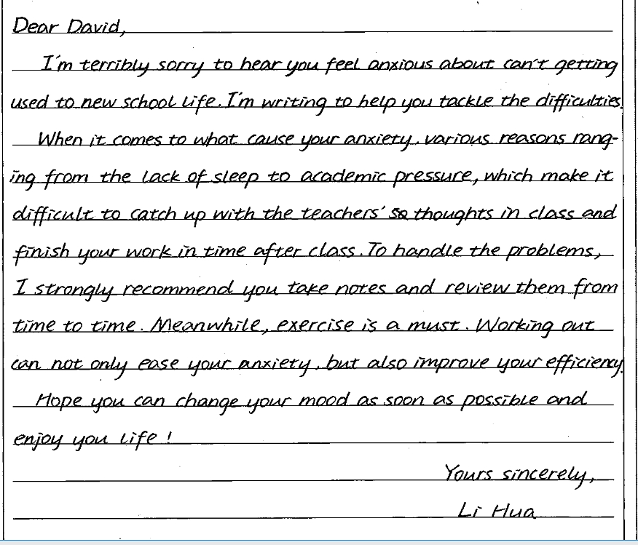
佳作赏析

Slide 13
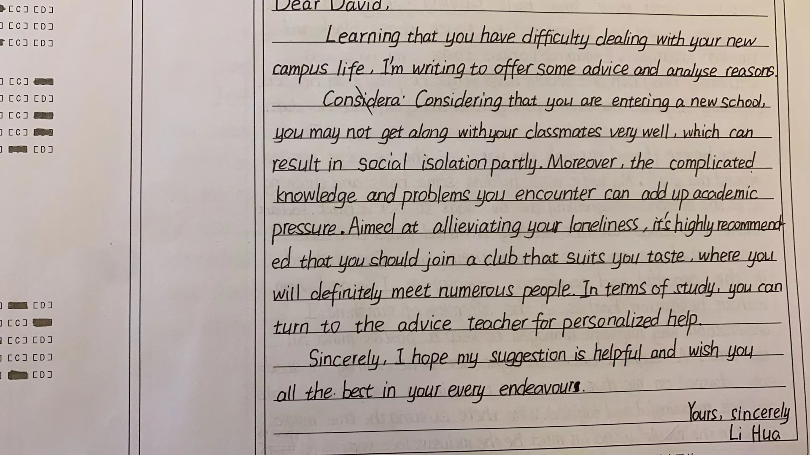
佳作赏析

Slide 14
范文赏析
Dear David,
I'm sorry to hear that you feel confused and anxious as a freshman at senior high school. I truly understand your situation since I've been there.
Going to senior high school is really a big challenge, especially when you face the higher academic pressure and new interpersonal relationship. However, you can make it easier by good time management following some golden rules. First, work out an appropriate schedule helps reduce your stress. If necessary, turn to the school adviser for help, who is experienced in tackling tricky problems for students like you. Finally, stay positive all the time, because a positive attitude sparks extraordinary results.
I really hope the suggestions will be of benefit to you. All the best!
Yours,
Li Hua

Slide 15
Letter of Advice
Tone
Content
Structure
LOREM
Language

Slide 16
THANK YOU！

