Slide 1
感恩遇见，相互成就，本课件资料仅供您个人参考、教学使用，严禁自行在网络传播，违者依知识产权法追究法律责任。
更多教学资源请关注
公众号：溯恩高中英语
知识产权声明

Slide 2
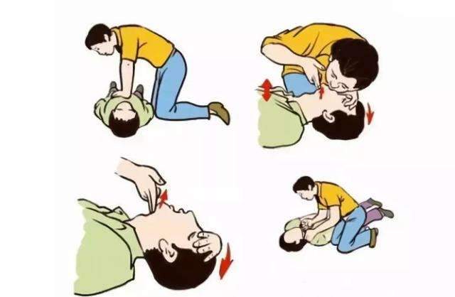
Unit 5 First Aid
Using Language(2) Reading for Writing：
share your story about providing first aid
杭州二中许丽君

Slide 3
In this class, students will
read for the gist of a story;
analyse the structure of the story;
study the structure and language features of a narrative essay;
write a narrative essay that shares a story about providing first aid.

Slide 4
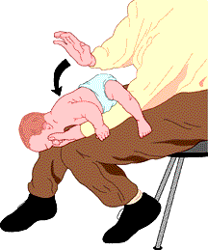
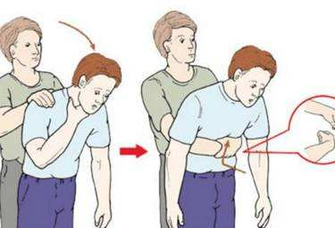
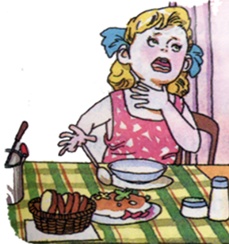
Leading in
Work in groups. Discuss the questions.
What happened in the pictures? And do you know how to deal with it urgently?
To treat a choke, you should make him /her spit by patting him/her on the back.

Slide 5
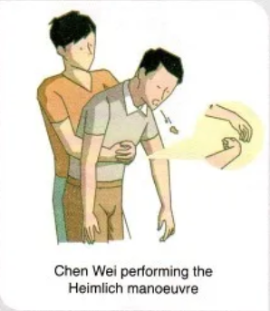
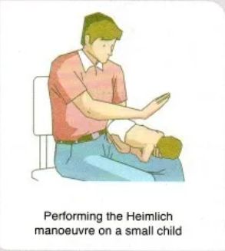
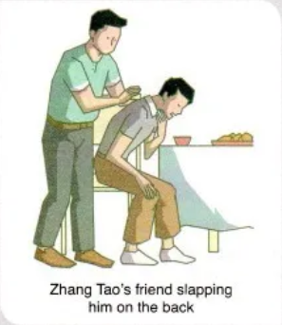
Leading in
Look at the pictures. What do you think the boy and the man are suffering from?
choking
What do you think the Heimlich manoeuvre is?
a way to help the choking victim

Slide 6
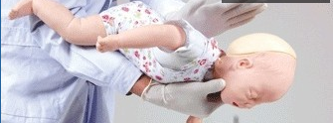
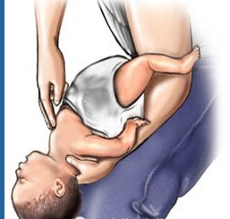
Pre-Reading
海姆立克式急救法
也可以采取另外一个姿势，把孩子翻过来，躺在坚硬的地面或床板上，抢救者跪下或立于其足侧，或取坐位，并使患儿骑在抢救者的大腿上，面朝前。抢救者以两手的中指或食指，放在患儿胸廓下和脐上的腹部，快速向上重击压迫，但要很轻柔。重复，直至异物排出。
3岁以内小孩 应该把孩子抱起来，一只手捏住孩子颧骨两侧，手臂贴着孩子的前胸，另一只手托住孩子后颈部，让其脸朝下，趴在救护人膝盖上。在孩子背上拍1-5次，并观察孩子是否将异物吐出。

Slide 7
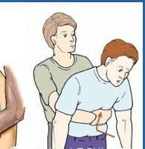
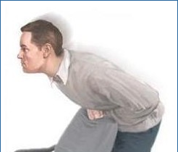
Pre-Reading
海姆立克式急救法
如果是成人站在病人背后，用两手臂环绕病人的腰部，然后一手握拳，将拳头的拇指一侧放在病人胸廓下和脐上的腹部。再用另一手抓住拳头、快速向上重击压迫病人的腹部。重复以上手法直到异物排出。
自救是应该稍稍弯下腰去，靠在一固定的水平物体上，以物体边缘压迫上腹部，快速向上冲击。重复之，直到异物排出。

Slide 8
While-Reading: Read for the main idea
Ⅰ. Read the passage quickly and get the general idea of the passage.
1.What’s the main idea of the passage?
A. How an American doctor，Henry Heimlich，created the Heimlich
manoeuvre.
B. How to do the Heimlich manoeuvre.
C. We should help each other.
D. Chen Wei，a high school student in Beijing，did the Heimlich
manoeuvre to Zhang Tao and saved his life.
√

Slide 9
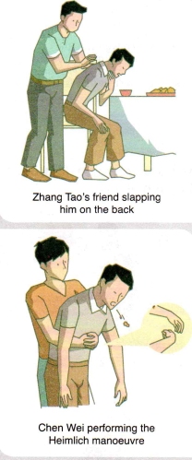
While-Reading
A FIRST-AID STORY
Chen Wei, a high school student in Beijing, had his dinner interrupted when he heard someone screaming from another table. A fellow diner at the restaurant, Zhang Tao, was choking on some steak. He was now holding his throat with his face turning red, while his desperate friends were slapping him on the back.
_____________He got up and ran to Zhang’s table at once. With the help of Zhang’s friends, he was able to help Zhang to his feet. Then, standing behind Zhang, Chen did the Heimlich manoeuvre. The food was instantly forced out, and Zhang began to breathe again. Ten minutes later, an ambulance arrived. The doctors checked Zhang and made sure that he was fine. They suggested he eat more slowly and take smaller bites before they left.
_______________, leaving no time for an ambulance to arrive. To solve this problem, in 1974, an American doctor, Henry Heimlich, created the Heimlich manoeuvre, saving thousands of lives around the world. Doing the Heimlich manoeuvre is quick, practical, and easy. It is so easy, in fact, that almost anyone can learn how.

Slide 10
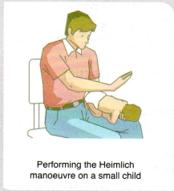
While-Reading
______________________Then, make sure that the victim is really choking: A choking person cannot speak. Slapping the victim’s back will often force out the obstruction. If this does not work, you can perform the Heimlich manoeuvre by standing behind him and wrapping your arms around his waist. Make a fist with one hand and place it in the upper part of his stomach. Grabbing your fist with your other hand tightly, push up and into his stomach in one motion. Continue doing this until the obstruction is forced out.
______________________ as you may hurt him. Instead, lay the child face down on your lap with the head lower than the rest of his body, and then give firm slaps to his upper back until he can breathe again.
______________________ You cannot just stand by and do nothing. Luckily, Chen had learnt how to give first aid in school. Seeing Zhang choking, he remained calm and reacted immediately. Chen later said about the incident, “How could I justify sitting there and doing nothing? We are all humans and we all have a responsibility to look after one another’s welfare.”

Slide 11
While-Reading
1 Read the article and put A-E in the correct place in the text.
A Choking victims usually have only about four minutes before they collapse and sometimes die
B If you see someone choking, first call the emergency services
C Chen wasted no time
D With choking victims, every minute counts
E Doing the Heimlich manoeuvre on a small child is not recommended
5
3
1
2
4

Slide 12
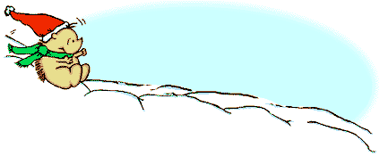
While-Reading
Skimming
Reading Comprehension
Ⅱ. Read the passage carefully and choose the best answer.
1.What did Chen do to Zhang?
A. With the help of Zhang’s friends，he was able to help Zhang lying on
the ground.
B. Chen did the Heimlich manoeuvre without hesitation.
C. Standing in front of Zhang，Chen did the Heimlich manoeuvre.
D. With the help of the doctor，Chen rushed Zhang to the hospital at once
in the ambulance.
√

Slide 13
Skimming
While-Reading
Reading Comprehension
2.Why did an American doctor，Henry Heimlich，create the Heimlich manoeuvre？Because .
A. victims will always die because of choking
B. choking is an urgent case without time to wait for the ambulance
C. ambulance will not come in time
D.it is quick，practical，and easy to do the Heimlich manoeuvre
√
3.What can we infer from Paragraphs 4－5?
A. If someone is choking，first slap the victim’s back.
B. When doing the Heimlich manoeuvre，wrap your arms around his neck.
C. If slapping does not work，do the Heimlich manoeuvre right away.
D. Make a fist with one hand and place it in the lower part of his stomach.
√

Slide 14
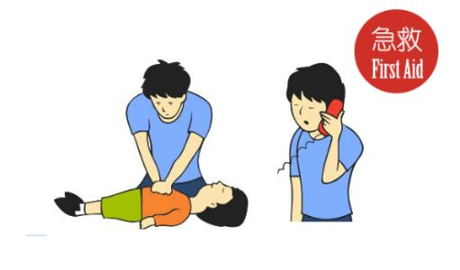
Skimming
While-Reading
Reading Comprehension
4.Which of the following is NOT true?
A. We should not do the Heimlich manoeuvre on a small child in order not to hurt him.
B. Let the child lying on your lap face down，with the head lower than the rest of his body.
C. Don’t stop performing firm slaps to his upper back unless he can breathe again.
D. If a child choke，call 120 at once and wait patiently.
√
5.From which is the text probably taken?
A.A health magazine.
B.A biology textbook.
C.A research paper.
D.A travel brochure.
√

Slide 15
While-Reading
2 Read the article again and choose the correct words to complete the sentences.
1 Chen Wei was a friend/complete stranger to Zhang Tao.
2 When Chen Wei reached Zhang Tao, Zhang Tao was sitting an the chair/standing.
3 The Heimlich manoeuvre is quite easy/difficult to do.
4 You will know that the victim is choking if he cannot speak/stops breathing.
5 To help a small child who is choking, you need to lay the child face up/down on your lap and slap his upper back.
6 Chen Wei was able to save Zhang Tao because he learnt the Heimlich manoeuvre at school/from a first-aid manual.

Slide 16
While-Reading：Read for the structure
Structure
Reading Activity: Read for the structure of a narrative essay.
Organize the structure of the article.
Part 1 (Para. 1-2): | the story of a choking incident
Part 2 (Para. 3-5): | the introduction of the Heimlich manoeuvre
Part 3 (Para. 6): | comments on the choking incident

Slide 17
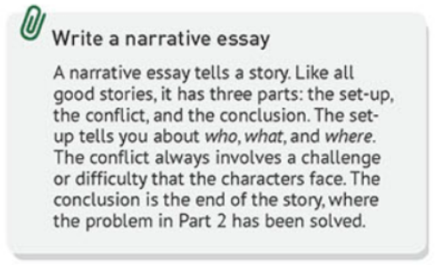
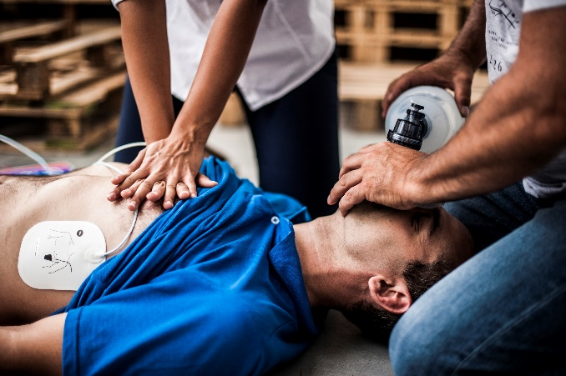
While-Reading:
the set-up
who
what
where
the conflict
a challenge or difficulty
the conclusion
the end of the story

Slide 18
While-Reading: Read for the details
3 Reread the article, and then answer the questions below.
1 Part1: Who were the people involved? What happened? Where did it happen?
2 Part 2: What did Chen Wei do?
3 Part 3: How does the story end?
4 What purpose does the quote at the end of the essay serve?
ChenWei, a high school student in Beijing, had his dinner interrupted by a person who was chocked.
He called the ambulance and do the Heimlich manoeuvre.
The chocked person was saved in time
A conclusion for the whole story.

Slide 19
While-Reading：Read for the language
Reading Activity: Read for the language.
Read again and underline the language for describing actions.
to introduce the emergency
to perform Heimlich manoeuvre
to perform first aid on children

Slide 20
While-Reading：Read for the language
Reading Activity: Read for the language.
Read again and underline the language for describing actions.
to introduce the emergency
choke on some steak;
hold his throat with his face turning red;
help his desperate friend to his feet.
to perform Heimlich manoeuvre
make sure that the victim is really choking
stand behind him; wrap your arms around his waist;
make a fist; place it in the upper part of his stomach;

Slide 21
While-Reading：Read for the language
Reading Activity: Read for the language.
Read again and underline the language for describing actions.
to perform Heimlich manoeuvre
grab your fist with your other hand tightly;
push up and into his stomach in one motion;
continue doing this until the obstruction is forced out.
to perform first aid on children
lay the child face down on your lap with the head lower than the rest of his body;
give firm slaps to his upper back until he can breathe again.

Slide 22
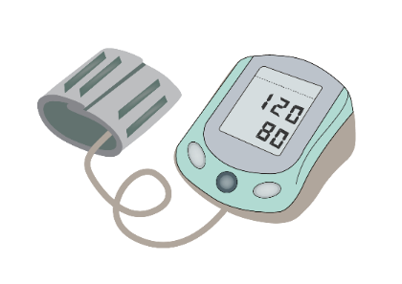
While-Reading：summarize the structure and language features
The structure of narrative essays:
the set-up: who, what, and where.
the conflict: a challenge or difficulty.
the conclusion: the end of the story.
Language features of narrative essays:
clear and concise;
written in the first person or third person;
written in active voice;
informal words and phrases.

Slide 23
Post-Reading: Writing Activity:
Writing Activity:
Use what you have learnt to write a narrative essay that shares a story about providing first aid.
Recall your experiences of giving first aid in an emergency. If you have never had any experiences, share stories you have read or heard about, or think up a situation.
Write an outline of the three parts in your story. Then think of a good quote to sum things up.
Write your narrative essay.

Slide 24
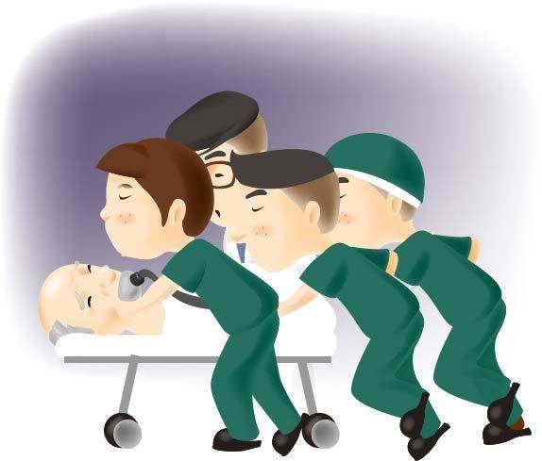
Writing: write a narrative essay
Pre-writing Activity: Brainstorm and decide the content.
 | Questions | Key words
Part 1 | Who? What? Where?
Part 2 | The process?
Part 3 | The end？
Part 4 | Any comments?

Slide 25
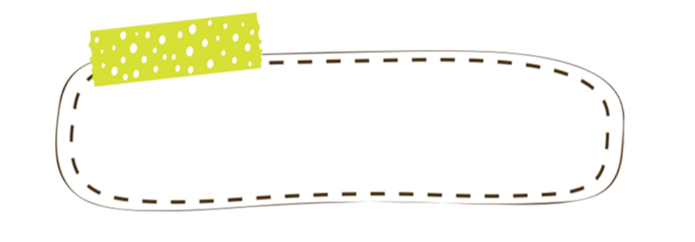
Writing:
审题定调
写一篇关于急救的记叙文，应注意：
1.按时间发生的顺序来写；
2.需要一些必要的连接词把实施急救的步骤连贯起来
3. 时态以过去时为主。
谋篇布局
Part 1：简述事件发生的背景（who，what and where）
Part 2：细致描述实施急救的具体步骤
Part 3：总结经验教训

Slide 26
Writing:
精彩开篇
Part 1：简述事件发生的背景（who，what and where）
1. One day Mike was studying in his room when he heard a scream from the kitchen.
2. Chen Wei, a high school student in Beijing, had his dinner interrupted when he heard someone screaming from another table.
主体部分
Part 2：细致描述实施急救的具体步骤
1. First，he took off the clothes that his mother was wearing near the burns.
2. Then, he put clean cloth in the cold water, squeezed water out and placed it on the burned area.
3. At last, he put his hands on a dry and clean bandage, held the bandage in place to the burned area.
Ending
Part 3：总结经验教训
1. Mike’s experience shows a knowledge of first aid does make a difference.
2. In short, only if we master the knowledge of first aid, can we help others in an emergency.

Slide 27
Writing:
假如你是红星中学学生李华，你校正在开展急救知识学习周活动，因为急救会涉及自身安全和被救助者的安全问题，请你以“How to offer first aid safely?”为题向校报英文版投稿，介绍紧急情况下的安全处理方式。主要内容包括：
①如何安全急救；
②注意的问题。
注意：词数80左右。

Slide 28
Writing:
One possible version:
How to offer first aid safely?
When in urgent situations, first check the scene to make sure of your own safety. Don't move the victim unless you must do so. Then manage to call for the ambulance. Before help comes, cover the victim with a carpet and ease his or her fear and anxiety.
In many cases, we can use a piece of cloth to cover minor cuts or burns. However, if the person is bleeding, stop bleeding by pressing a piece of clean cloth on the cut tightly. But remember, it is always vital to protect yourself from danger when providing first aid. Avoid direct contact with blood, and wash your hands with soap and water immediately after providing first aid care.

Slide 29
Assignment:
Write a narrative essay about your experiences of giving first aid in an emergency
Share your story about providing first aid

Slide 30
Thank you for your attention!

