Slide 1
感恩遇见，相互成就，本课件资料仅供您个人参考、教学使用，严禁自行在网络传播，违者依知识产权法追究法律责任。
更多教学资源请关注
公众号：溯恩高中英语
知识产权声明

Slide 2
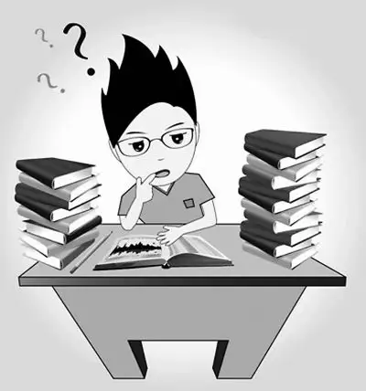
聚焦续文内容 探究协同效应
—2022年1月浙江高考英语读后续写分析

Slide 3
Contents
1
Understand the story
2
Design the plot with synergy（协同）
3
Analyze students’ compositions
4
Appreciate the possible version

Slide 4
2022.1 浙江高考读后续写
第二节(满分25分) 阅读下面材料，根据其内容和所给段落开头语续写两段，使之构成一篇完整的短文。
When Dr. Henderson was assigning(指定) project mates for his psychology class, I secretly hoped that he would pair me with my best friend or at least a classmate I could have some fun with. Above all, I hoped he wouldn’t assign me to work with the fiercely competitive and extremely serious fellow who always wore dark clothes and apparently had a personality to match. As fate(命运) would have it, Dr. Henderson very deliberately matched everyone in class and announced that I would be working with the one person in class I wanted to avoid.
I went up to my new teammate and introduced myself. He looked at me as though I weren’t there. I felt he treated me as though I would hold him back and probably make him fail to get an A in the course. He wasn’t mean or abusive; he just gave me the impression he could do whatever project we dreamed up better if he did it alone.
Needless to say, I didn’t look forward to an entire team of being brushed off, but I tried to make the best of it and didn’t say anything for fear that I would make things worse.
The project required each team to develop a hypothesis(假设), set up an experiment to test the hypothesis, do the statistical analysis and present the findings. Whatever grade the team received would be shared by both students.
When my teammate and I met to discuss our project, I was uneasy. Here was this challenging student who had a reputation for single-mindedness and good grades—the exact opposite of me. I actually wanted to drop the class at one point, but stopped short because I didn’t want to give him the satisfaction of my chickening out. I decided to stick to it no matter what.
After long discussions we somehow agreed to do a study on the psychological well-being of teenagers. I wasn’t sure what it meant exactly, but at least we had a topic.
Para.1 We started to meet regularly to draw up our plans.
Para.2 Then one day I got word that he was admitted to the hospital for a serious disease.

Slide 5
Contents
1
Understand the story
2
Design the plot with synergy
3
Analyze students’ compositions
4
Appreciate the possible version

Slide 6
Read for basic information（5W1H)
Who
How
Dr. Henderson, I, my teammate
develop a hypothesis(假设),test the hypothesis, do the statistical analysis and present the findings.
When
narration
(记叙文)
Where
in the school
Why
What
I was paired with my classmate
to do a project.

Slide 7
Read for charaters
competitive & careful
When Dr. Henderson was assigning(指定) project mates for his psychology class, I secretly hoped that he would pair me with my best friend or at least a classmate I could have some fun with. Above all, I hoped he wouldn’t assign me to work with the fiercely competitive and extremely serious fellow who always wore dark clothes and apparently had a personality to match. As fate(命运) would have it, Dr. Henderson very deliberately matched everyone in class and announced that I would be working with the one person in class I wanted to avoid.
I went up to my new teammate and introduced myself. He looked at me as though I weren’t there. I felt he treated me as though I would hold him back and probably make him fail to get an A in the course. He wasn’t mean or abusive; he just gave me the impression he could do whatever project we dreamed up better if he did it alone.
Needless to say, I didn’t look forward to an entire team of being brushed off, but I tried to make the best of it and didn’t say anything for fear that I would make things worse.
The project required each team to develop a hypothesis(假设), set up an experiment to test the hypothesis, do the statistical analysis and present the findings. Whatever grade the team received would be shared by both students.
When my teammate and I met to discuss our project, I was uneasy. Here was this challenging student who had a reputation for single-mindedness and good grades—the exact opposite of me. I actually wanted to drop the class at one point, but stopped short because I didn’t want to give him the satisfaction of my chickening out. I decided to stick to it no matter what.
After long discussions we somehow agreed to do a study on the psychological well-being of teenagers. I wasn’t sure what it meant exactly, but at least we had a topic.
（maybe)a little arrogant（骄傲自大）
（maybe）uncooperative
dedicated专注的& academically outstanding
average
determined

Slide 8
Read for charaters
conflict/problem
unwilling to cooperate
not ready to be friends
academically outstanding;
serious; determined
（maybe）a little arrogant;
（maybe）uncooperative
average;
determined

Slide 9
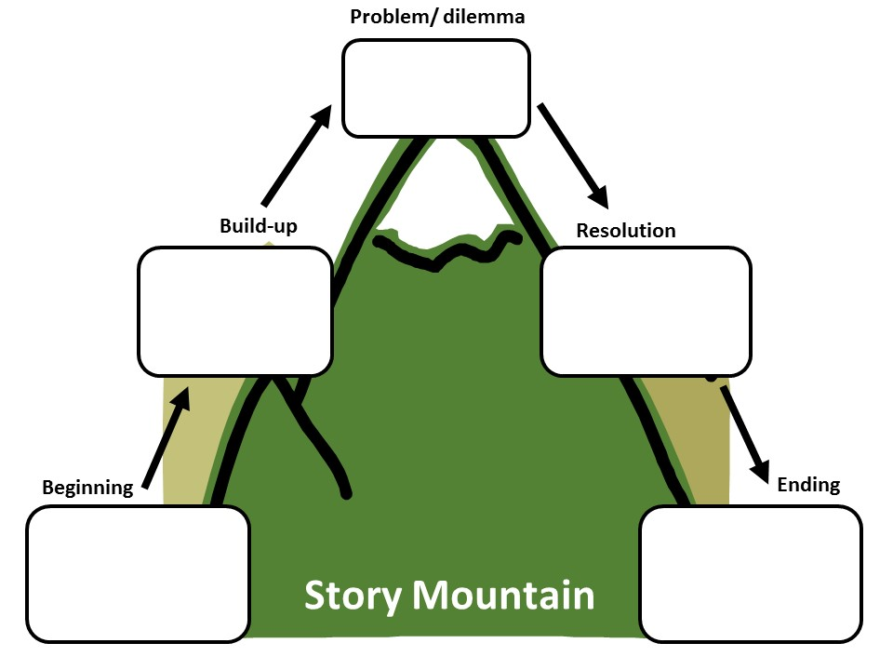
Read for plots & emotion
unwilling to cooperatebut I still decided to stick to the project.
I:uneasy but determined
I introduced myself to my teammate but was neglected .
We started to meet regularly to draw up our plans...
I introduced myself to my teammate but was made light of.
?
I:feel slighted被轻视的
I introduced myself to my teammate but was neglected .
Then one day I got words that he was admitted to the hospital for a serious disease.
I:unwilling &
disappointed
Dr. H paired me with my classmate I want to avoid.
?

Slide 10
Read for plots & emotion
正能量原则
he was willing to do the project alone, but I still decided to stick to the project.
I:uneasy but determined
I introduced myself to my teammate but was neglected .
We started to meet regularly to draw up our plans...
明线：项目的进展（project）
暗线：两方关系的推进（friendship）
I introduced myself to my teammate but was made light of.
?
I:feel slighted
冷落的
I introduced myself to my teammate but was neglected .
Then one day I got words that he was admitted to the hospital for a serious disease.
I: satisfied
teammate:
grateful
I :unwilling &
Idisappointed
We succeeded in finishing the project&became friend
Dr. H paired me with my classmate I want to avoid.
What contributed to the success?
Cooperation

Slide 11
Contents
1
Understand the story
2
Design the plot with synergy
3
Analyze studnts’ compositions
4
Appreciate the possible version

Slide 12
Predict the ending of para.1
(Para.1)We started to meet regularly to draw up our plans.
(Para.2)Then one day I got words that he was admitted to the hospital for a serious disease.
Tip : The ending of the story can help you determine the ending of Para.1 . (逆推法）
Possible plot:
We gradually learnt to cooperate.
We succeeded in finishing the project.
I won his respect and we developed friendship.

Slide 13
Design the plot
(Para.1)We started to meet regularly to draw up our plans.
project：
relationship：
work together & go smoothly
情节协同
plot
soften（缓和）
I:
teammate：
slighted(受冷落的)--determined--delighted
情感协同
emotion
unwilling--touched触动的--willing
We gradually learnt to cooperate.

Slide 14
Design the plot
(Para.2)Then one day I got words that he was admitted to the hospital for a serious disease.
project：
relationship：
completed perfectly
情节协同
plot
deepen
I:
teammate：
worried--determined--satisfied
情感协同
emotion
grateful
We succeeded in finishing the project.
we developed friendship.

Slide 15
Synergy （协同）
Plot synergy 情节协同
LOREM
Emotional synergy 情感协同
LOREM
LOREM
Thematic synergy 主题协同

Slide 16
Contents
1
Understand the story
2
Design the plot with synergy
3
Analyze students' compositions
4
Appreciate the possible version

Slide 17
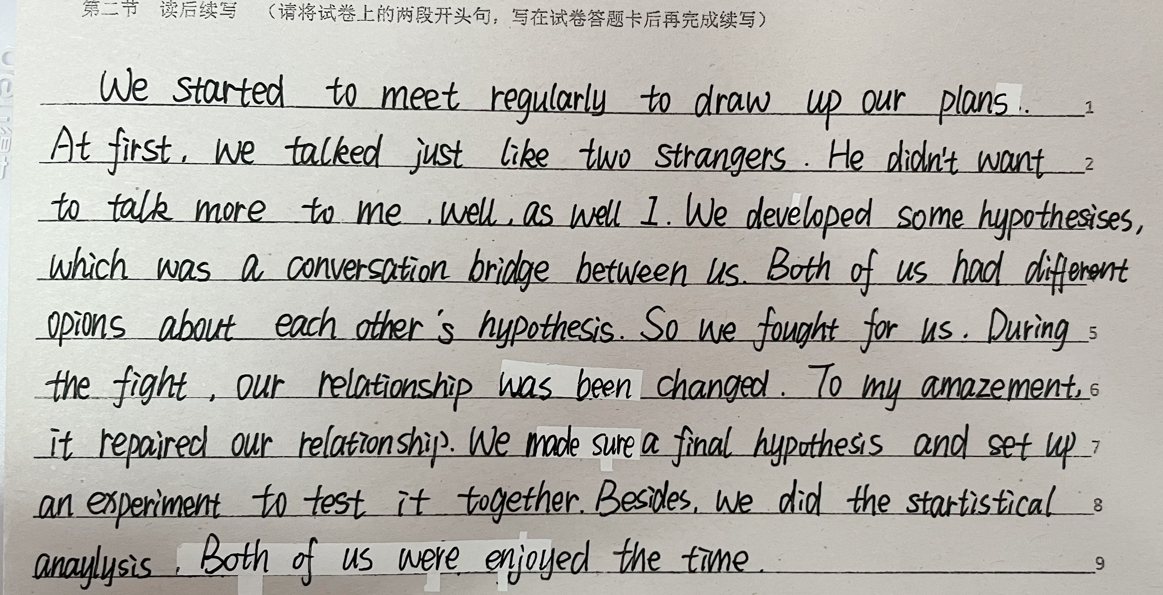
Students’ composition analysis
与首句衔接自然且情感协同
情节协同
情绪协同
主题协同
情节协同
主线2：关系的推进（情节协同）
情感转变过于牵强
结尾没有提到主线project的进程如何

Slide 18
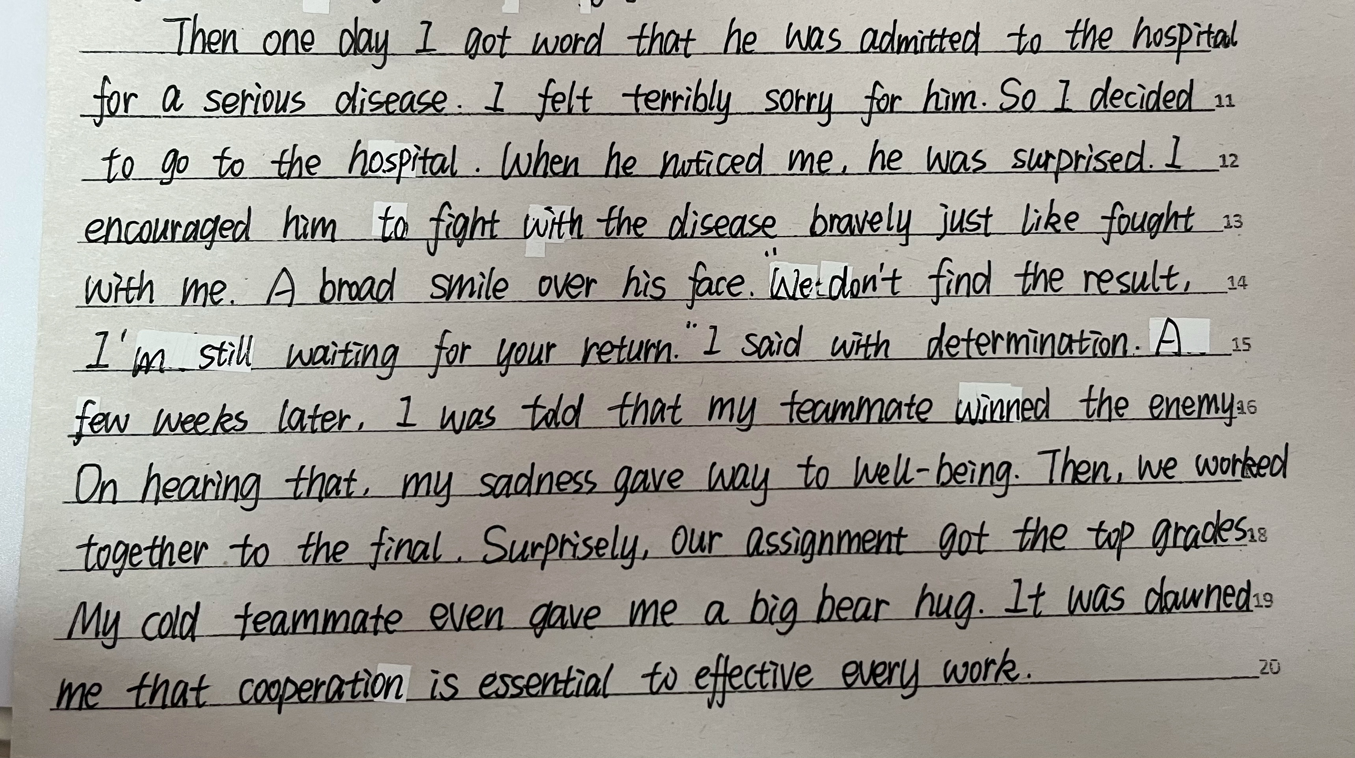
Students’ composition analysis
与首句衔接合理，且与para1 情感协同
情节协同
情绪协同
主题协同
点出主线1：project的结果
结尾建议点出主线2：收获友谊

Slide 19
Contents
1
Understand the story
2
Design the plot
3
Analyze the students’ compositions
4
Appreciate the possible version

Slide 20
Possible version
I 人设协同（stick to it）
衔接自然
teammate人设协同（competitive）
Para.1
We started to meet regularly to draw up our plans. As expected, my ideas were completely ignored by him during our first few meeting. As he was a fiercely competitive fellow, he put the project totally in his charge. However, my self-esteem wouldn’t allow me to yield to the challenge and I took a more active part in the test of the hypothesis. My dedication gradually melted my teammate’s heart and his attitudes towards me began to change. He was no more unwilling to discuss, and instead he listened attentively to my ideas and we ran the tests and did the statistical analysis together. It was the first time that I had thought that we could be called a team. Everything seemed to go on so smoothly.
矛盾的解决，同时主题协同（cooperation)

Slide 21
Possible version
承上衔接
Para.2
One day I got word that he was admitted to hospital for a serious disease. Immediately, I hurried to the hospital, where I learned that he had to be hospitalized for quite a while. It meant that we had no alternative but to discontinue our project. Seeing the worry and weakness written on his face, I assured him that I would not let him down and carry on. With all my heart put into the challenging task, I did the analysis accurately and presented our findings amazingly, which won thunderous applause. Our project did end with an “A”. Learning this, he smiled, grateful for my devotion.My seemingly single-minded and cold teammate and I achieved something satisfying and had fun but more than fun.
teammate人设协同（serious/careful）
结尾句包含两条主线：项目的完成以及收获友谊（情节协同&主题协同）
情节协同：事件拆分法

Slide 22
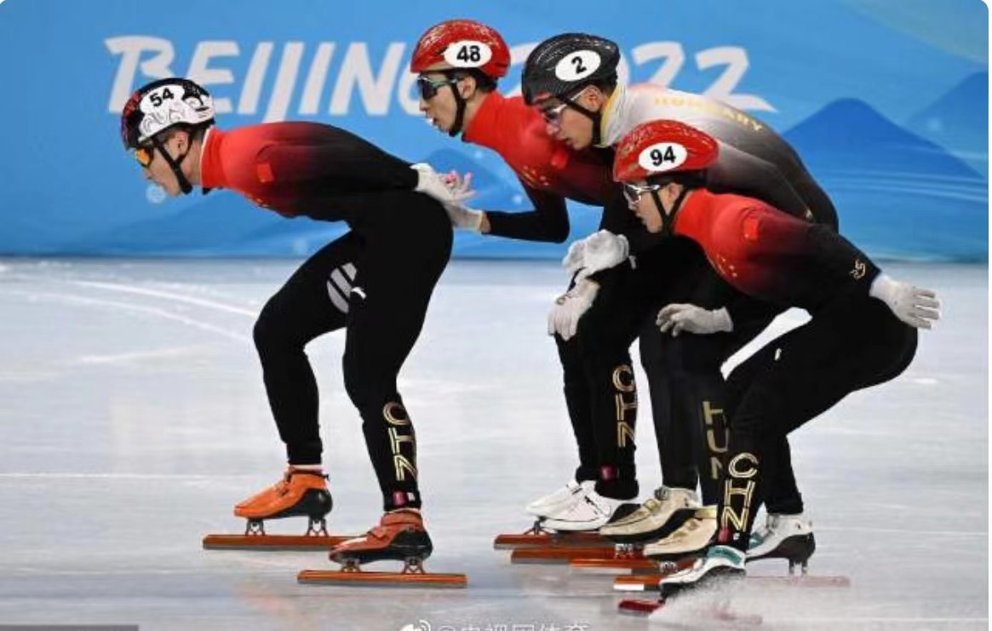
Cooperation & Win-Win
It is cooperation that contributes to friendship.

Slide 23
Homework
Please self-evaluate your writing and polish it based on the synergy.

Slide 24
Thank You!

