Slide 1
感恩遇见，相互成就，本课件资料仅供您个人参考、教学使用，严禁自行在网络传播，违者依知识产权法追究法律责任。
更多教学资源请关注
公众号：溯恩高中英语
知识产权声明

Slide 2
高考加油，勇敢追梦
How to write a SPEECH ?
台州一中 陈泓静
台州一中 周 媚

Slide 3
Structure
Good evening, everyone!
Dear xxx,
Ladies and gentlemen,
It’s my great honor to speak here…
It’s the dreams behind the technology that change the world…
I have a strong dream that we want to help small business…
We try to…
So ladies and gentlemen, let’s work hard…
Thank you very much for listening!
Salutation
Beginning
Ma’s opinion of dreams
Body
Ma’s dream
how to realize his dream
Ending
a call to action

Slide 4
假设你是某国际学校学生李华，你校计划于下周日上午主办题为“My Dream”的英语演讲比赛，你准备参加。请你根据以下要点写一篇演讲稿，内容包括:
1. 你对梦想的看法；
2. 你的梦想；
3. 你打算如何实现你的梦想。
Tip 1: Pay attention to “person” and “tense”.
Beginning
1. I’m very glad/pleased/delighted to stand here to give you a speech about my dream.
2. I'm more than honored to have the chance to make a speech with the topic of my dream.
3. It’s my privilege/honor/pleasure to have such an opportunity to deliver my speech, whose topic is my dream.

Slide 5
Tip 2: Use advanced sentences.
Body: my opinion about dreams
1. We all need a dream inspiring us to be strong, without ______ we are like tramps roaming everywhere.
which
2. No matter big or small, dreams play a fundamental role in our life, __________ (enable) us to spare no efforts to overcome difficulties.
enabling
that
3. It’s dreams _____always cheer us up, awake our enthusiasm and lead us to success.
what
4. Dreams are ______ pushes you to achieve something that you are desperate for.
It
5. ____ is well-known to all that dreams sparkle our confidence and give us power to go ahead.
6. Only by having a dream can we keep on going despite the fact ______ we are trapped in a dilemma sometimes.
that

Slide 6
Tip 3: Make your dreams concrete and positive.
Body: my dream (and why)
My dream
is to be
I have dreamed of/about
entering an ideal university
being happy every day
travelling around the world
studying in foreign countries
protecting wild animals
making more and more money?

Slide 7
Body: how to realize dreams
As for me, I am determined to be a teacher, devoting myself to education.
For the purpose of achieving my dream, firstly, reading a variety of books is an effective way for me, which could enable me to broaden my horizons. Secondly, I will spare no effort to participate in more social activities, since rarely does a person succeed without experience, even if gifted.
reach one's dream
fulfill one's dream
accomplish one's dream
make one’s dream come true

Slide 8
Tip 4: Use linking words、 good sentences and
contain at least 2 points.
Body: how to realize dreams
I will spare no effort to do…
I should attach great importance to doing…
It is of great significance to do…
It’s a brilliant idea for me to do…
It’s necessary to have a good command of…
…is an effective way.
…is a must.
…
Plan
Effort
Passion
Confidence
Persistence
Strong will
……

Slide 9
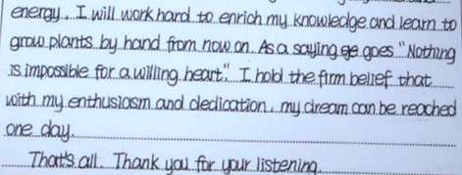
Tip 5: End the article with an impressive sentence.
Ending
proverb
a call to action/hope
I believe your efforts will pay off.
I do hope that all of us can make our dreams come true.
I hereby appeal to all of you to achieve your dreams by working hard.
Where there is a will, there is a way.
Practice makes perfect.
No pains , no gains.

Slide 10
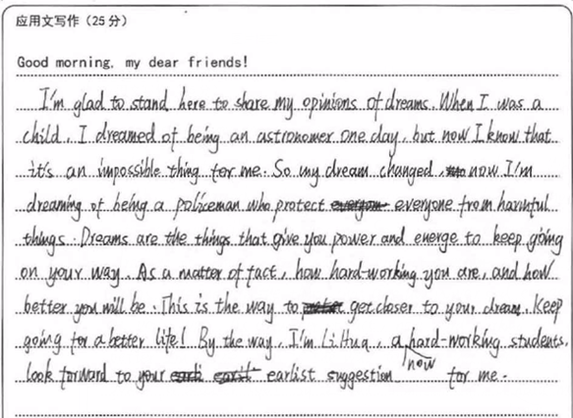
Group work: Find the problems and polish the article!
miss a point
（
unnecessary
）
grammatical mistake
illogical
wrong “person”
wrong place
?
wrong ending
spelling mistake

Slide 11
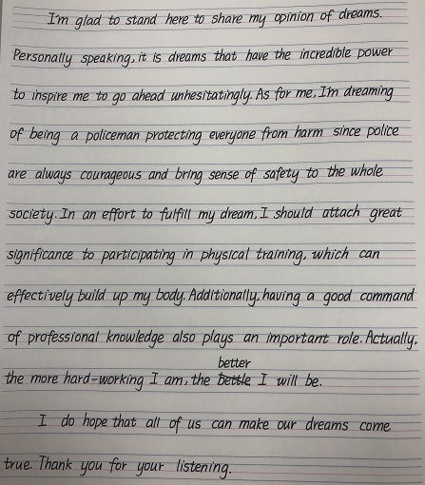
Tip 6: Guarantee high marks by good handwriting！

Slide 12
Fill in the blanks
Good morning, my dear friends!
I feel deeply honored to be here sharing my ______________ (understand)
of dreams. From the personal point of view, dreams are the targets we are chasing, _______ provide encouragement and inspiration. As Hemingway once _______(write), “Man can be destroyed but never_________(defeat)”. It’s dreams ______ make us determined to go forward.
As ____ my own dream, I have a strong desire to be a doctor since health is always the priority_________( especial)in the epidemic. It’s quite important for me to take action to make my dream come true. Success can be achieved with anything ______ laziness. It’s ___ must for me to accumulate related knowledge and get well prepared.
Hopefully, all of us will stick to our dreams and have a __________(promise)
future.
That’s all, thank you!
understanding
which
wrote
defeated
that
for
especially
but
a
promising

Slide 13
Writing sample
Good morning, my dear friends!
I’m very glad to stand here to give you a speech about dreams. A dream is like a light tower, showing the way when one is sailing on the sea, without which one may not know where he goes or even gets lost in life. Therefore, have a dream and that really matters!
As for my dream, I’ve decided to become a doctor to help relieve patients’ pain or even save their lives, which, I believe, is helpful and well worth doing. However, realizing it is really a big challenge for me. Anyhow, I will work hard and go all out for it, exposing myself to books especially on medicine so that I can go to my ideal university. I’m quite sure I can achieve my dream. As a saying goes: If you can dream it, you can do it.
Thank you!

Slide 14
Remember
It’s not only what you dream but also how you realize it that matters!!!

Slide 15
Thanks
Designed by sliva

