Slide 1



感恩遇见，相互成就，本课件资料仅供您个人参考、教学使用，严禁自行在网络传播，违者依知识产权法追究法律责任。
更多教学资源请关注
公众号：溯恩英语
知识产权声明

Slide 2

Z20 2026届第一次联考
2025. 8.25 Shirley
ibaotu.com

Slide 3
语法
56．grows
57．exceptional
58．a
59. prized
60．historian
61．using
62．and
63．has partised /has been practising
64．which
65．in
阅读：A: ACC
B: DCCB
C: CCAA
D: CBDC
七选五：GCBDE
完型： ABADA
DCDBA
BCABD

Slide 4
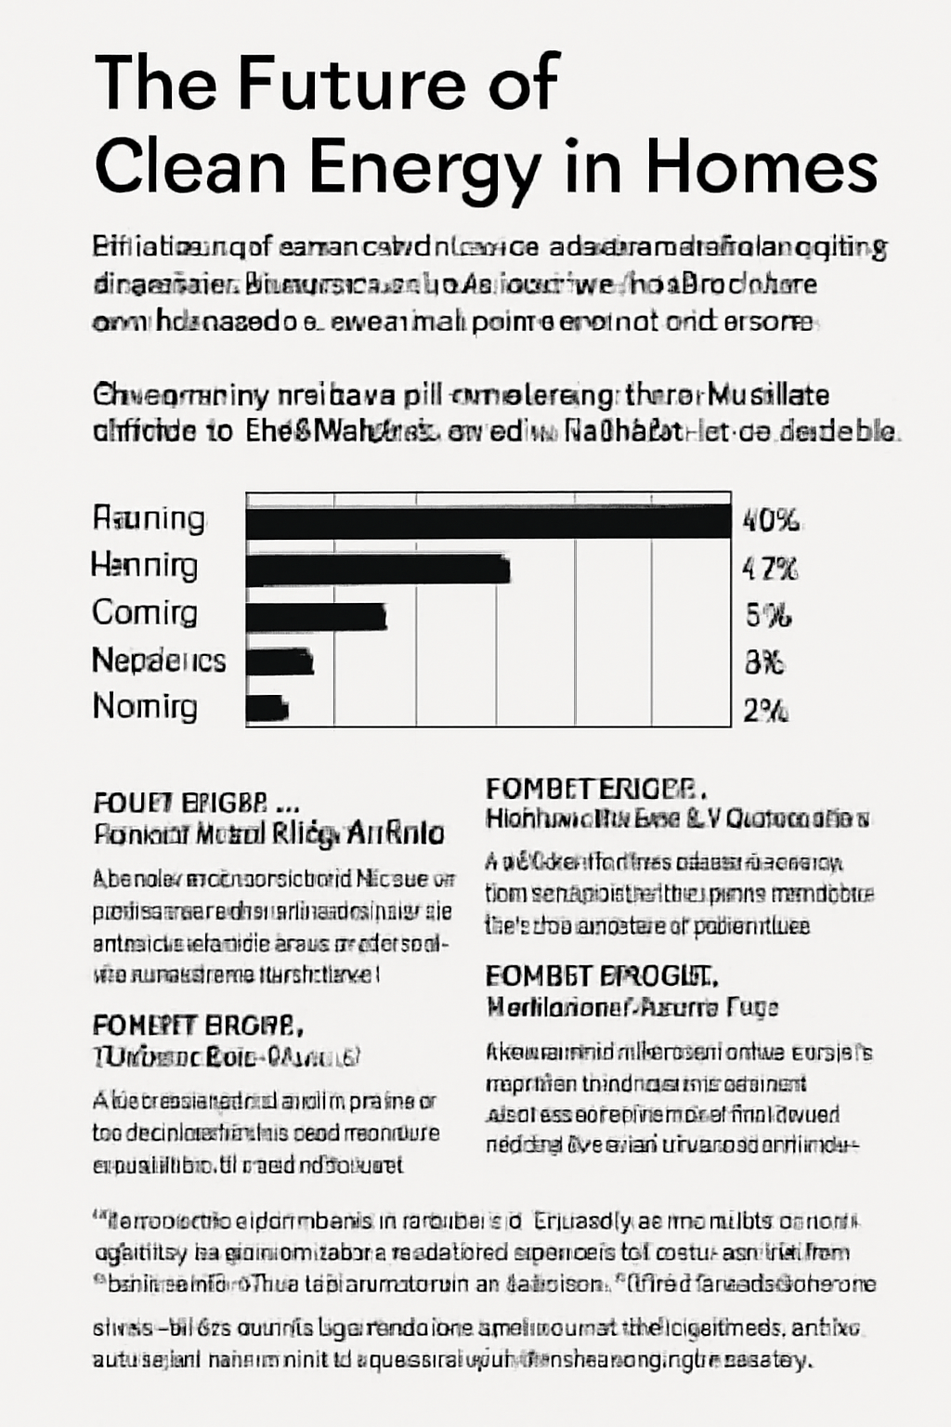
A
Z202026届第一次联考
这篇文章的主旨大意是探讨了家庭能源使用对全球CO₂排放的影响，以及清洁能源技术如何帮助减少家庭能源消耗和支持可持续发展。

Slide 5
contribute significantly to... 对…有显著贡献
be responsible for... 是……的原因；对……负责
pose challenges/ threats to.. 对…构成挑战/威胁
drive the shift towards sustainability 推动可持续发展
hybrid model 混合模型
transfer warmth from air 将热量从空气中转移出去
cut emissions by 减少…的排放
rooftop revolution 屋顶革命
optimize energy use 优化能源使用
peak hour 高峰负荷时间
reduce reliance on fossil-fuel backups 减少对化石燃料备用能源的依赖
dynamic electricity management 动态电力管理
land use debates 土地使用辩论
economically inevitable/ɪnˈevɪtəb(ə)l/ 经济上不可避免的
It was inevitable（unavoidable） that there would be job losses.
heat pumps 热泵
solar panels 太阳能电池板
higher investment 更高的投资
energy transition 能源转型

Slide 6
The Future of Clean Energy in Homes
Heating, cooling, and powering homes contribute significantly to global CO₂ emissions. As nations strive to reduce their carbon footprints, residential energy use — responsible for nearly 20% of energy-related emissions — poses unique challenges. Below is the 2022 breakdown of household emissions by source.
ELECTRICITY 52%
HEATING 28%
COOLING 12%
APPLIANCES 6%
LIGHTING 2%
Clean energy solutions for homes must be affordable, efficient, and adaptable to diverse climates. While technologies vary, here are key innovations driving the shift toward sustainability.
21. Which two categories combined account for over three-quarters of total household emissions?
A. Electricity and Heating. B. Heating and Cooling.
C. Appliances and Lighting. D. Cooling and Appliances.
80%
四分之三=75%
a quarter
two-thirds
zero point two five
seventy-five percent
A fraction of the population
四分之一
三分之二
0.25
75%
人口中的少数部分
account for
解释，说明；占比；对…负责；导致，造成

Slide 7
Discount 用于表达商品原价的减免。（假如物品100）
The store offers a 30% discount on all items this weekend. 100*（100-30）%=70元=打7折
2. Off 折扣，减免
This jacket is 20% off. =打8折
3. Buy One, Get One Free (BOGO) 买一送一
4. Price Reduction 降价
There has been a price reduction of 40% on electronics. =打6折
5. Clearance Sale 清仓大甩卖
There’s a clearance sale with up to 70% off on selected items. =打3折
6. Coupon Code 优惠码
Use the coupon code SAVE10 to get $10 off your next purchase. （下次买$ 90）
7. Half Price 半价
8. Take X% Off 减去X%的折扣
Take 15% off your next purchase when you sign up for our newsletter. （下次付85元）
9. Bonus 赠品，附加优惠
Receive a free gift as a bonus with your purchase of $50 or more.
10. Bundle Deal 捆绑销售
Buy a phone and get a case for half price with this bundle deal.

Slide 8
HEAT PUMPS — Efficient Heating/Cooling
Replacing gas boilers, electric heat pumps transfer warmth from air or ground, cutting heating emissions by 50%. Hybrid models, hopefully, might be able to work in sub-zero temperatures in the near future.
SMART GRIDS(电网) — Dynamic Electricity Management
AI-powered grids optimize energy use, storing surplus solar power during peak hours and reducing reliance on fossil-fuel backups.
SOLAR PANELS — Rooftop Revolution
Solar energy is the most accessible renewable source for households. Advances in photovoltaic cells have cut costs by 80% since 2010, making them viable in numerous regions.
WIND TURBINES — Community Microgrids
Small-scale turbines(涡轮机) in windy areas can power neighborhoods, though land use debates persist.
“The scale of this transition is staggering,” says Dr. Elena Torres, a climate scientist at MIT. “Residential renewables like solar and heat pumps could meet 90% of global household demand by 2050 — but only if investments triple within this decade.” Recent studies show that every $1 invested in green homes today saves $5 in future climate adaptation costs. This isn’t just an environmental imperative; it’s economically inevitable.
光伏电池
光伏电池技术的进步使成本降低了 80%，从而使它们在众多地区都变得可行。
22. Which technology is highlighted as cost-effective for diverse climates?
Heat pumps. B. Smart grids.
C. Solar panels. D. Wind turbines.
在不同气候下具有成本效益（是划算的）
cell （熟词生义） 电池；电芯
viable /ˈvaɪəbl 可实施的；切实可行的= feasible.
viable organisms
可存活的生物 (能独立发展的；可生长发育的)

Slide 9
“The scale of this transition is staggering,” says Dr. Elena Torres, a climate scientist at MIT. “Residential renewables like solar and heat pumps could meet 90% of global household demand by 2050 — but only if investments triple within this decade.” Recent studies show that every $1 invested in green homes today saves $5 in future climate adaptation costs. This isn’t just an environmental imperative; it’s economically inevitable.
但前提是在此十年内投资要增加三倍才行。
注意阅读理解的答案提示词——转折
but；however；while（然而）nevertheless（尽管如此；然而）；yet（但是；然而）
23. What does Dr. Torres emphasize about the energy transition?
The dominance of gas boilers. B. The increase in solar efficiency.
C. The need for higher investment. D. The breakthrough in heat pump technology.
燃气锅炉
staggering adj.令人难以相信的 = astounding
staggeringly beautiful/expensive 漂亮╱昂贵得令人难以置信
The injured woman staggered to her feet. =totter
受伤的女人摇摇晃晃地站起身来。(蹒跚；踉跄)
The company is staggering under the weight of a ￡10m debt.
公司在1 000万英镑债务的重压下步履艰难。
Her remarks staggered me. (=amaze )
There were so many runners that they had to stagger the start.
参加赛跑的选手很多，他们不得不把起跑的时间错开。(v 使交错；使错开)

Slide 10

B
Z202026届第一次联考
这篇文章的主旨是讲述Clara如何通过坚持自己的理念，经营她祖父的布鲁克林书店，抵抗数字化时代和商业压力的挑战。

Slide 11
take over... 接管
outdated stocks 过时的库存
deserve undivided attention 值得全神贯注
polish the brass counter installed in1967 对 1967 年安装的铜质柜台进行擦拭保养
stubbornness 倔强；顽强；棘手
self-destructive 自毁的
an unofficial sanctuary 非官方的避难所
sprawl on 舒展身体躺在某物上 （sprawl 伸开四肢坐（或躺）；蔓延
recite verse 背诵诗句
brain tattooing 脑部纹身（指记忆）
pour in 涌入
physical books 实体书
be starving/ hungry/ thirsty/ aching/ desperate for... 渴望得到
yearn for/ long for/ crave sth/ desire to do /set sb’s heart on/be keen on
represent sb for free 为某人免费代理
resist digital disruption 抵抗数字化破坏
cater to the needs of... 满足…的需要
Survival Bundles 生存包 bundle （一）捆，包，扎
handpicked 精心挑选的

Slide 12
1. When Clara took over her grandfather’s Brooklyn bookshop in 2018, the first thing she removed wasn’t the outdated stocks, but the WiFi router. Regulars protested. A lawyer threatened to transfer his $500 monthly coffee budget elsewhere. “Books deserve the same undivided attention we demand from lovers,” she told me, polishing the brass counter her grandfather installed in 1967.
2. Her stubbornness seemed self-destructive as stores around them closed down. Yet something unusual happened. By 2020, the shop had become an unofficial sanctuary(庇护所). Teenagers sprawled on Persian carpets with Dostoevsky, their phones forgotten in backpacks. A retired judge started hosting Saturday poetry circles where participants recited verses from memory — a practice Clara called “brain tattooing”.
3. The pandemic should have been their death knell. Instead, when Clara launched “Survival Bundles” (handpicked books with handwritten notes), orders poured in from tech executives exhausted by Zoom. A SiliconValley CEO admitted these were the first physical books he'd touched since graduate school. “We’re starving for texture,” Clara noted, wrapping parcels in recycled paper.
4. Last winter, I found her battling a new threat. A property developer had purchased their building, tripling the rent overnight. What unfolded next could fill a novel: customers organized protests on the sidewalk; the judge represented them for free; even the lawyer who once threatened to leave funded their legal defense.
5. In the court, Clara quoted Melville: “We cannot live only for ourselves. A thousand fibers connect us.” The judge — her poetry circle regular — pronounced the rent increase unreasonable. Now their shop displays this judgment alongside signed first editions, proof that some bonds still resist digital disruption.
1. 介绍Clara的经营理念和顾客反应。
2. 描述书店的转变，成为一个文化聚集地。
3. 说明书店如何通过创新应对疫情挑战，获得成功。
4. 描述书店如何通过社区支持和法律手段抗议租金上涨。
5. Clara引用Melville名言，强调集体支持，最终法院判决租金上涨不合理，书店得以保留。
背景
过
程
结局/评价

Slide 13
1. When Clara took over her grandfather’s Brooklyn bookshop in 2018, the first thing she removed wasn’t the outdated stocks, but the WiFi router. Regulars protested. A lawyer threatened to transfer his $500 monthly coffee budget elsewhere. “Books deserve the same undivided attention we demand from lovers,” she told me, polishing the brass counter her grandfather installed in 1967. （关注答案标记词汇-转折（not…but…不是…而是…）
2. Her stubbornness seemed self-destructive as stores around them closed down. Yet something unusual happened. By 2020, the shop had become an unofficial sanctuary(庇护所). Teenagers sprawled on Persian carpets with Dostoevsky, their phones forgotten in backpacks. A retired judge started hosting Saturday poetry circles where participants recited verses from memory — a practice Clara called “brain tattooing”.
24. What made Clara’s approach to running the bookshop special?
A. Catering to the needs of customers. B. Introducing modern technology.
C. Focusing on rare book collections. D. Prioritizing full concentration.
无中生有，她移除WiFi路由器并不是为了满足顾客对网络的需求，反而是为了让顾客专心阅读。
过度推断，她移除WiFi路由器，而不是引入任何技术来提升顾客体验。
无中生有，文章并没有提到Clara专注于稀有书籍的收藏。她的书店注重的是提供一个没有干扰的阅读环境，而不是仅仅收藏稀有书籍。文章的重点在于Clara如何让顾客专注于书籍本身，而不是书籍的稀有性。

Slide 14
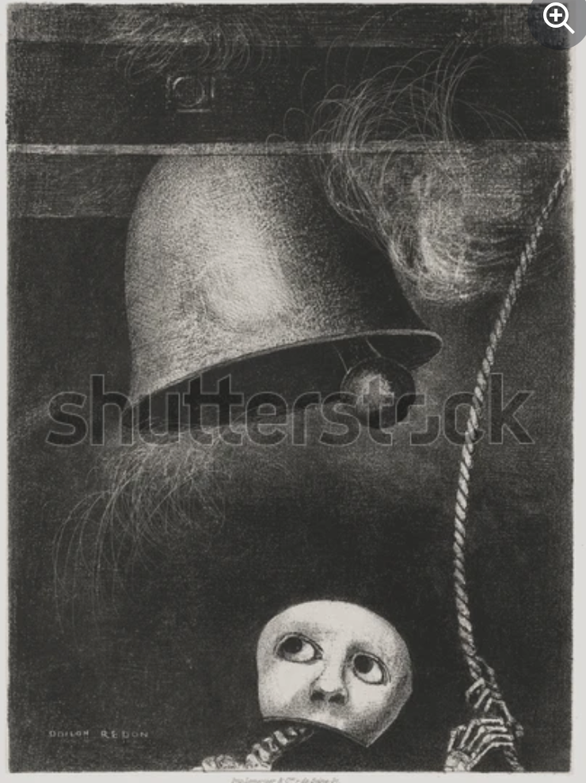
3. The pandemic should have been their death knell. Instead, when Clara launched “Survival Bundles” (handpicked books with handwritten notes), orders poured in from tech executives exhausted by Zoom. A SiliconValley CEO admitted these were the first physical books he'd touched since graduate school. “We’re starving for texture,” Clara noted, wrapping parcels in recycled paper.
丧钟
25. What does the underlined phrase “death knell” in paragraph 3 mean?
A. A moment of celebration. B. A desperate cry for survival.
C. An event marking the end. D. A sudden opportunity for growth.
重于生存的渴望
文章中提到“pandemic should have been their death knell”，但实际上书店并没有关闭，反而通过创新和适应度过了困难。
情态动词+ have done 表示对过去事实的猜测
should（ought to） have done 本该做某事，但实际上没有做。
must have done 对过去的确定推测，认为某事肯定发生。
might have done 过去某事的可能性推测，但不确定。
need have done 本该做某事，实际没做
needn’t have done 本不该做某事，但做了（带有轻微的遗憾或批评）
could have done 过去本可以做某事，但没有做，通常带有后悔或遗憾的情感
would rather have done 宁愿做了某事

Slide 15
Losing that job was a blessing in disguise. It pushed me to find a much better opportunity.
She had to burn the midnight oil to prepare for the final exam.
I've done all I can to help you. Now the ball is in your court.
There's no use crying over spilt milk. What’s done is done.
He would leave his office at the drop of a hat if his children needed him.
You really hit the nail on the head when you said we need more staff to handle the workload.
I have an important interview tomorrow, so keep your fingers crossed for me!
The argument was just a storm in a teacup. They quickly made up and became friends again.
I’m feeling a bit under the weather today, so I’m going to stay home and rest.
We only get together for a family reunion once in a blue moon.
He accidentally spilled the beans about the surprise party.
After trying several times to fix the car, he finally threw in the towel.
If you want to pass the exam, you need to do everything by the book.
塞翁失马，焉知非福；坏事可能会变成好事。
开夜车；熬夜工作或学习。
轮到你行动了，责任在你
为已经发生的事情后悔，无法挽回。
立刻；毫不犹豫
一针见血，准确地说出问题的核心
祈祷好运，祝好运
小题大做，过分反应
生病，不舒服
千载难逢，非常罕见
泄露秘密，揭露真相。
放弃，认输。
按照规则，按常规操作。

Slide 16
Losing that job was a blessing in disguise. It pushed me to find a much better opportunity.
She had to burn the midnight oil to prepare for the final exam.
I've done all I can to help you. Now the ball is in your court.
There's no use crying over spilt milk. What’s done is done.
He would leave his office at the drop of a hat if his children needed him.
You really hit the nail on the head when you said we need more staff to handle the workload.
I have an important interview tomorrow, so keep your fingers crossed for me!
The argument was just a storm in a teacup. They quickly made up and became friends again.
I’m feeling a bit under the weather today, so I’m going to stay home and rest.
We only get together for a family reunion once in a blue moon.
He accidentally spilled the beans about the surprise party.
After trying several times to fix the car, he finally threw in the towel.
If you want to pass the exam, you need to do everything by the book.
塞翁失马，焉知非福；坏事可能会变成好事。
开夜车；熬夜工作或学习。
轮到你行动了，责任在你
为已经发生的事情后悔，无法挽回。
立刻；毫不犹豫
一针见血，准确地说出问题的核心
祈祷好运，祝好运
小题大做，过分反应
生病，不舒服
千载难逢，非常罕见
泄露秘密，揭露真相。
放弃，认输。
按照规则，按常规操作。

Slide 17
1. When Clara took over her grandfather’s Brooklyn bookshop in 2018, the first thing she removed wasn’t the outdated stocks, but the WiFi router. Regulars protested. A lawyer threatened to transfer his $500 monthly coffee budget elsewhere. ..
4. Last winter, I found her battling a new threat. A property developer had purchased their building, tripling the rent overnight. What unfolded next could fill a novel: customers organized protests on the sidewalk; the judge represented them for free; even the lawyer who once threatened to leave funded their legal defense. (找主干)
unfolded
could fill a novel
unfold v打开，展开；呈现，逐渐明朗；发生，发展
"Could fill a novel" is an exaggerated expression used to emphasize that something is so interesting, dramatic, or complex that it could be written as a novel.
我们需要仔细分析第四段中律师的作用，尤其是他与其他人物的互动。
26. Why is the lawyer mentioned again in paragraph 4?
A. To show his contradictory behavior. B. To illustrate the content of a novel.
C. To stress the mass support Clara received. D. To explain the difficulty Clara came across.
接下来发生的事情情节丰富，足以写成一本小说：顾客在街道上组织抗议；法官为他们免费提供法律援助；甚至曾威胁要离开的律师也为他们的法律辩护提供了资金。律师的角色展现了行为的转变，并且他通过资助法律辩护表达了对Clara的支持。

Slide 18
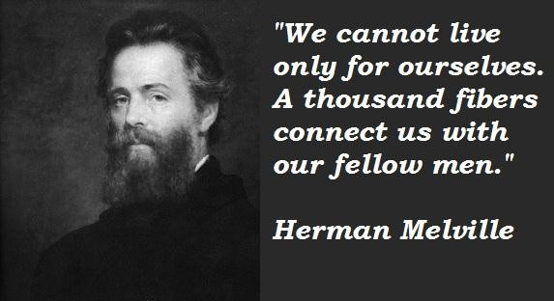
4. Last winter, I found her battling a new threat. A property developer had purchased their building, tripling the rent overnight. What unfolded next could fill a novel: customers organized protests on the sidewalk; the judge represented them for free; even the lawyer who once threatened to leave funded their legal defense. (社区的集体支持在克服挑战中的重要性。)
5. In the court, Clara quoted Melville: “We cannot live only for ourselves. A thousand fibers connect us.” The judge — her poetry circle regular — pronounced the rent increase unreasonable. Now their shop displays this judgment alongside signed first editions, proof that some bonds still resist digital disruption. （记叙文最后一段：结局/评价，往往体现主旨）
主旨类问题：关注首尾段落
主旨类题目：关注首尾段落
27. What can we learn from the story?
A. Profit-driven decisions may lead to unexpected outcomes.
B. Community and human connection can navigate modern challenges.
C. Technology is harmful to traditional businesses and should be avoided.
D. Small bookshops are bound to encounter many threats in the digital age.
以利润为驱动的决策可能导致意想不到的结果。
技术对传统企业有害，应该避免。
小书店注定会在数字时代面临许多威胁。
我们不能仅为自己而活，千丝万缕的联系把我们联结在一起。

Slide 19
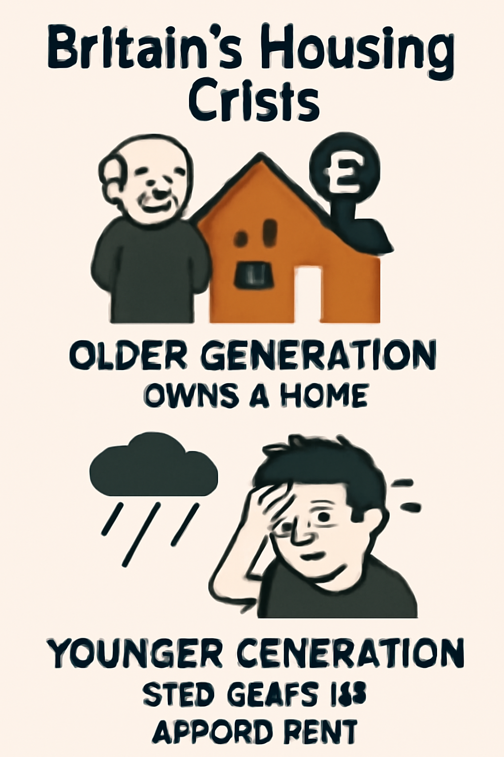
C
Z202026届第一次联考
这篇文章讨论了英国住房危机导致的代际分化，特别是年轻人面临的高租金和难以拥有住房的问题。

Slide 20
housing crisis 住房危机
create a distinct generational divide 造成明显的代际差异
unachievable homeownership 无法实现的购房梦想
chronic shortages of affordable homes 长期存在的经济适用房短缺问题
skyrocket dramatically 急剧上升
widen the gap 扩大差距
narrow/ bridge the gap 缩小/弥合差距
inflate prices 抬高物价（使充气；膨胀；（使）涨价）
in line with inflation 与通货膨胀率一致 （deflation通货紧缩；放气）
carry heavy debts 负重债
exceed v 超过，超出；超越（限制）；优于，胜过
weakening their savings potential 削弱他们的储蓄潜力
little relief 几乎没有缓解
face instability and exploitation 面对不稳定和被剥削的情况
no-fault driving 无过错驱逐
controversial /ˌkɒntrəˈvɜːʃl/ 引起争论的；有争议的(controversy n争论，争议)
propose a landlord registry /ˈredʒɪstri/ and rent control commission.
提议设立房东登记制度和租金管制委员会(registry. n 注册；登记处 commission n 委员会）
C 篇
c

Slide 21
regulate the private sector 规范私营部门
secure right of habitation 稳定的居住权
be essential for dignity 对于尊严而言是至关重要的
intergenerational fairness 代际公平
thrive=flourish v兴旺发达；繁荣；蓬勃发展；旺盛；茁壮成长
a thriving industry 兴盛的行业
bear/shoulder unreasonable burdens 承担不合理的负担
deny them housing security 剥夺他们的住房保障 (deny sb. sth.不给予)
sustain our future 维持我们的未来
consistent policy responses 一贯的政策应对措施
consistent pattern 一致的模式
consistent effort 持续的努力
price out... 阻止某人因价格太高而购买

Slide 22

1.Britain’s housing crisis has created a distinct generational divide. While older generations often own property, millions of young adults face increasing rents and unachievable homeownership. A recent official report warns that 630,000 people under 35 may face homelessness in old age due to chronic shortages of affordable homes.
2.This crisis originates from decades of policy failure. Since the mid-1990s, house prices have skyrocketed dramatically, widening the gap between property owners and others. Government projects like “Help-to-Buy” intended to assist first-time buyers instead inflated prices further, making housing less accessible. University graduates carry heavy debts from tuition fees exceeding £9,000 annually since 2010, weakening their savings potential.
3.The rental market offers little relief. Private renters have jumped from 2.8 million to 4.5 million households since 2007, with those aged 25-34 consisting of over a third. Yet renters face instability and exploitation. “No-fault drivings” allow landlords(房东) to end rentings without cause, while rents exceed wage growth. Even social housing renters experience widening inequality compared to homeowners.
4.Policy responses are emerging but controversial. London Mayor Sadiq Khan proposed a landlord registry and rent control commission to regulate the private sector. Scotland has established “rent pressure zones” to stop increases. The Labour Party advocates abolishing no-fault drivings, arguing that secure right of habitation are essential for dignity.
5.Ultimately, this is about intergenerational fairness. A functional society cannot thrive when younger citizens bear unreasonable burdens. As one analyst notes: “We depend on the young to sustain our future — denying them housing security damages everyone.” （关注主旨句）
描述了英国住房危机导致的代际分化，老一辈人拥有房产，而年轻人面临高租金和无法实现的住房所有权。（a phenomenon）
分析住房危机的根源，归因于长期的政策失误、房价飙升以及“Help-to-Buy”等政策的反效果。（reason）
介绍租赁市场的困境，私有租房的增加导致年轻人面临不稳定和剥削，甚至社会住房的差距也在扩大。（situation）
提出一些政策回应，如伦敦市长提出的房东登记制度和租金控制，但这些方案存在争议。（solution）
强调住房危机是关于代际公平，年轻人承受过重负担会影响社会整体发展。（significance of young adults’ housing security )

Slide 23
31.What can be a suitable title for the text?
A.Housing:Pricing out the Young?
B.Policy:Regulating the Private Owners?
C.Landlords:Forced.to Accept Rent Hikes?
D.Rental Control:Solving the Renter-landlord Conflicts?
将年轻人排除在住房市场之外
1.Britain’s housing crisis has created a distinct generational divide. While older generations often own property, millions of young adults face increasing rents and unachievable homeownership. A recent official report warns that 630,000 people under 35 may face homelessness in old age due to chronic shortages of affordable homes.
英国的住房危机造成了明显的代际分化。老一辈人通常拥有房产，而数百万年轻人面临不断上涨的租金和无法实现的住房所有权。
B. Policy: Regulating the Private Owners? 政策：规范私人业主的行为
文章确实提到了政府政策（如“Help-to-Buy”），并讨论了如何管理房东和租赁市场，但这并不是文章的主要关注点。
C. Landlords: Forced to Accept Rent Hikes? 房东们：被迫接受租金上涨
虽然提到房东的行为和租金上涨，但文章关注的是年轻人的住房问题，因此这个标题不适合。
D. Rental Control: Solving the Renter-landlord Conflicts? 租金管制：解决租客与房东之间的纠纷
这只是文章的一个部分内容。文章主要关注的是年轻人面临的住房困境，而不是专注于租赁市场的冲突。因此，这个标题并不完全符合文章的主旨。

Slide 24

28. What does the official report predict about young adults?
A. Universal elderly poverty. B. Persistent renting difficulties.
C. Long-term housing insecurity. D. Unachievable huge property.
1.Britain’s housing crisis has created a distinct generational divide. While older generations often own property, millions of young adults face increasing rents and unachievable homeownership. A recent official report warns that 630,000 people under 35 may face homelessness in old age due to chronic shortages of affordable homes.
A Universal elderly poverty 普遍的老年贫困
B. Persistent renting difficulties 持续的租房困难；虽然年轻人面临租房问题，报告并没有强调“持续的租房困难”作为重点。它更专注于住房的可得性和可负担性，以及未来可能面临的无家可归问题。
D. Unachievable huge property 无法实现的巨额财产
由于可负担住房的长期短缺，35岁以下的年轻人可能会面临老年时无家可归的风险。

Slide 25
29. What brings about the housing crisis?
A. Stable rental market. B. Students’ reduced debt burden.
C. Decades-long policy failure. D. Consistent policy responses.
2.This crisis originates from decades of policy failure. Since the mid-1990s, house prices have skyrocketed dramatically, widening the gap between property owners and others. Government projects like “Help-to-Buy” intended to assist first-time buyers instead inflated prices further, making housing less accessible. University graduates carry heavy debts from tuition fees exceeding £9,000 annually since 2010, weakening their savings potential.
（翻译以上句子） 找主干
Government projects like “Help-to-Buy” intended to assist first-time buyers instead inflated prices further, making housing less accessible. University graduates carry heavy debts from tuition fees exceeding £9,000 annually since 2010, weakening their savings potential.
像“Help-to-Buy”这样的政府项目本意是帮助首次购房者，但却进一步推高了价格，使住房变得更加难以负担。自2010年以来，大学毕业生背负着超过9,000英镑的学费债务，削弱了他们的储蓄潜力。

Slide 26
30. What can be inferred from the last paragraph?
A. Young adults’ housing security should be guaranteed.
B. Efforts should be made to create a sustainable society.
C. The property of older generations should be passed on.
D. The young should be responsible for intergenerational fairness.
推断理解性题目基本原则
（1）原文原句不可选（有别于细节理解题）
（2）过度推断不可选（通常为通过原文信息可进一步得到）
注意：不能以自己的观点或文章中引用他人的观点代替作者的观点：推理的依据来源于上下文。
如何快速推断 1. 抓住关键词 2. 明确主题 3. 排除法
5.Ultimately, this is about intergenerational fairness. A functional society cannot thrive when younger citizens bear unreasonable burdens. As one analyst notes: “We depend on the young to sustain our future — denying them housing security damages everyone.”
我们依赖年轻人来维持我们的未来——剥夺他们的住房保障损害了所有人。
指出了年轻人住房保障的重要性，强调如果不保障年轻人的住房，将会损害整个社会的未来。
2. 明确主题：最后一段讨论的是代际公平，即年轻人应该得到应有的住房保障，这样才能确保社会的稳定和持续发展。
3. 排除法
B. Efforts should be made to create a sustainable society：应当努力构建一个可持续发展的社会；
虽然文章提到可持续性，但重点在于年轻人面临的住房问题，而不是泛指社会的可持续性。
C. The property of older generations should be passed on：文章并未提及老一辈人财产继承的问题。
D. The young should be responsible for intergenerational fairness：文章强调的是社会应该保障年轻人，而不是让年轻人承担公平责任。

Slide 27
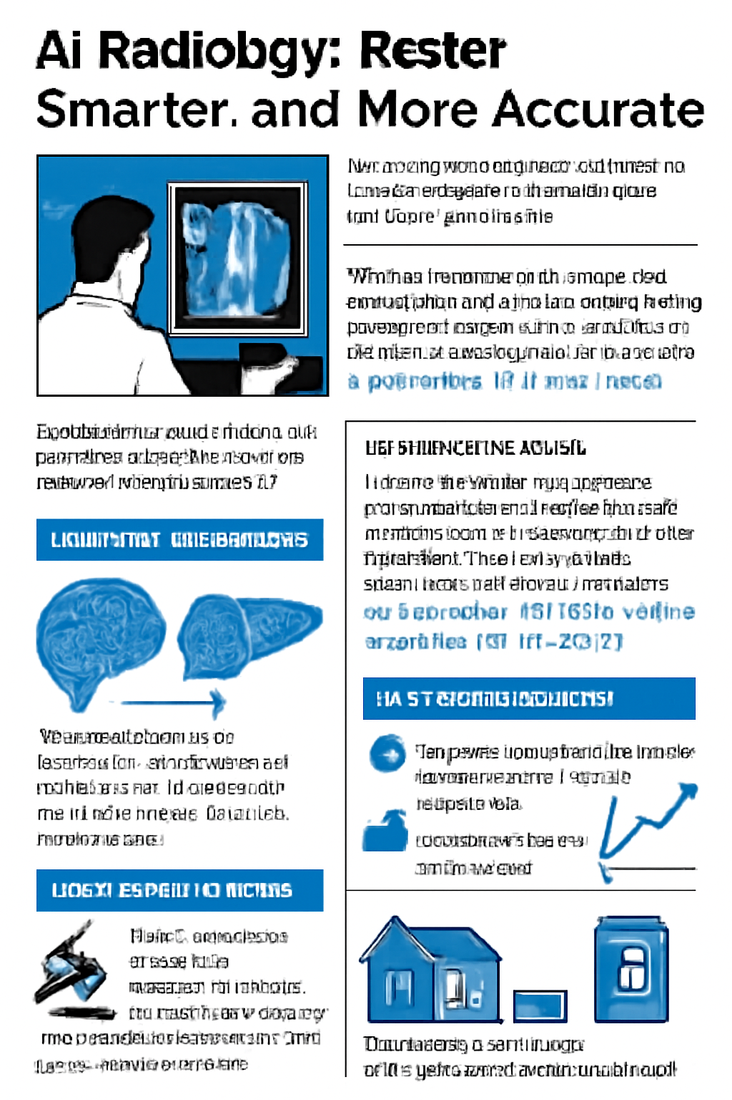
D
Z202026届第一次联考
这篇文章的主旨是AI放射学技术在医疗诊断中的突破，尤其是DeepMedScan系统通过3D神经映射和全球数据库分析，显著提高了肿瘤检测速度和准确性，减少诊断延迟，并为疾病预测提供了更早期的干预机会。

Slide 28
detect tumors 检测肿瘤
match top experts' accuracy 与顶级专家的准确度相匹配
reduce diagnosis delays by up to 80% 将诊断延误时间缩短多达 80%
lie in -- consist in neural mapping 在于，存在于神经映射
dynamic 3D models of organs 器官的动态三维模型
cross-references scans with global databases 将扫描与全球数据库交叉参考
process historical cases 处理历史案例
critical advantages 关键优势，
critical cases 严重病例，
critical eye 批评的眼光
micro-lesions under 2mm 2毫米以下的微小病变
predict disease progression 预测疾病的发展进程
life-saving interventions 救命性干预
legal frameworks struggle with 法律框架难以应对
human-AI co-diagnosis 人类与AI联合诊断
widely accessible 广泛可及
doctor confirmation 医生确认
smartphone-compatible calculation procedure 支持智能手机的计算程序
compatible adj 兼容的；可共存的；可和睦相处的；与……一致的

Slide 29
32. How does the article present the issue in the first paragraph?
A. By quoting an expert. B. By defining a concept.
C. By providing statistics. D. By presenting classifications.
引用专家的意见或语录
对一个概念进行定义
提供统计数据
进行分类
Hospital waiting time for scan results could soon be reduced from days to minutes. A 2025 Stanford study reveals that DeepMedScan, an AI system analyzing CT/MRI images, detects tumors 30% faster than human radiologists(放射科医生) while matching top experts’ 98% accuracy. The system is now used in 40⁺ EU hospitals, reducing diagnosis delays by up to 80%.
医院等待扫描结果的时间可能很快从几天缩短到几分钟。一项2025年斯坦福大学的研究显示，DeepMedScan这款人工智能系统能够分析CT/MRI（磁共振成像）图像，肿瘤检测速度比放射科医生快30%，同时其准确率与顶尖专家相当，达到98%。该系统目前已经在40多家欧盟医院使用，诊断延迟已减少最多80%。
这些数字数据有效地展示了AI技术在诊断中的优势

Slide 30
33. What does the author highlight with “super-powered second brain”?
Replacing radiologists with automated systems.
B. Emphasizing its ultra-fast data processing capacity.
C. Demonstrating its superiority over human intelligence.
D. Promoting commercial sales of medical equipment.
用自动化系统取代放射科医生
ultra-fast 超快的
彰显了其在智能方面优于人类的优势。
促进医疗设备的商业销售
The breakthrough lies in 3D neural mapping. Unlike traditional AI recognizing 2D patterns, DeepMedScan constructs dynamic 3D models of organs. It cross-references scans with global databases — processing 200,000⁺ historical cases in 0.2 seconds. “It’s like giving each radiologist（放射科医生）a super-powered second brain,” explains lead researcher Dr. Aris Thorne.
lies in 3D neural mapping
dynamic 3D models of organs
It cross-references scans with global databases
—— 联网的、全球性的协同分析
breakthrough
processing 200,000⁺ historical cases in 0.2 seconds
惊人效果是速度和规模
比喻说明了AI系统快速、准确地分析大量数据
It’s like giving each radiologist a super-powered second brain
该突破在实际应用层面的巨大意义

Slide 31
34. What does the author intend to convey in paragraph 4?
A. The potential of AI diagnosis.
B. The inaccuracy of AI diagnosis.
C. The dominance of authorities in AI diagnosis.
D. The necessity of human participation in AI diagnosis.
人工智能诊断中的权威主导地位。
Challenges persist, however. Legal frameworks struggle with responsibility for AI misdiagnosis (occurring in 0.7% of cases vs. human 1.2%). Inaccuracy risks also exist; early versions performed poorly on pediatric (小儿科的) scans due to limited child data. Regulatory authorities now enforce “human-AI co-diagnosis” — requiring doctor confirmation for critical cases.
1.Legal frameworks… 法律体系（Legal frameworks） 无法明确界定当AI出现误诊时，责任谁来承担。是AI算法的开发者？医院？使用AI的医生？还是所有人共同承担？
2. Inaccuracy risks also exist… AI的准确性（Accuracy） 严重依赖于其训练数据的数量和质量。
3. Regulatory authorities… 如何安全地应用AI. 人机协同诊断（human-AI co-diagnosis）AI的诊断结果必须由医生进行最终确认（requiring doctor confirmation）。这实际上是将最终的诊断决定权和责任明确地交给了人类医生，AI充当的是“超级助手”的角色。
challenges

Slide 32
35. What can be inferred about AI radiology’s future development?
It will replace doctors.
B. It can work with smart phones.
C. It can reach people in far-off areas.
D. It can avoid late-stage cancer deaths completely.
Future upgrades focus on accessibility. Lightweight versions for rural clinics are being tested in India, using smartphone-compatible calculation procedure. As WHO advisor Dr. Priya Sharma notes, “Making this tech widely accessible could prevent 500,000⁺ annual late-stage cancer deaths globally by 2030.”
在印度测试了轻量版的AI放射学系统，该系统适用于农村诊所，并且与智能手机兼容。这表明，AI放射学系统可以帮助偏远地区的人群，提供快速、准确的诊断服务，改善这些地区的医疗可及性。
far-off =distant faraway remote
memories of those far-off days
久远往昔的回忆（a long time ago很久以前的；久远的）

Slide 33
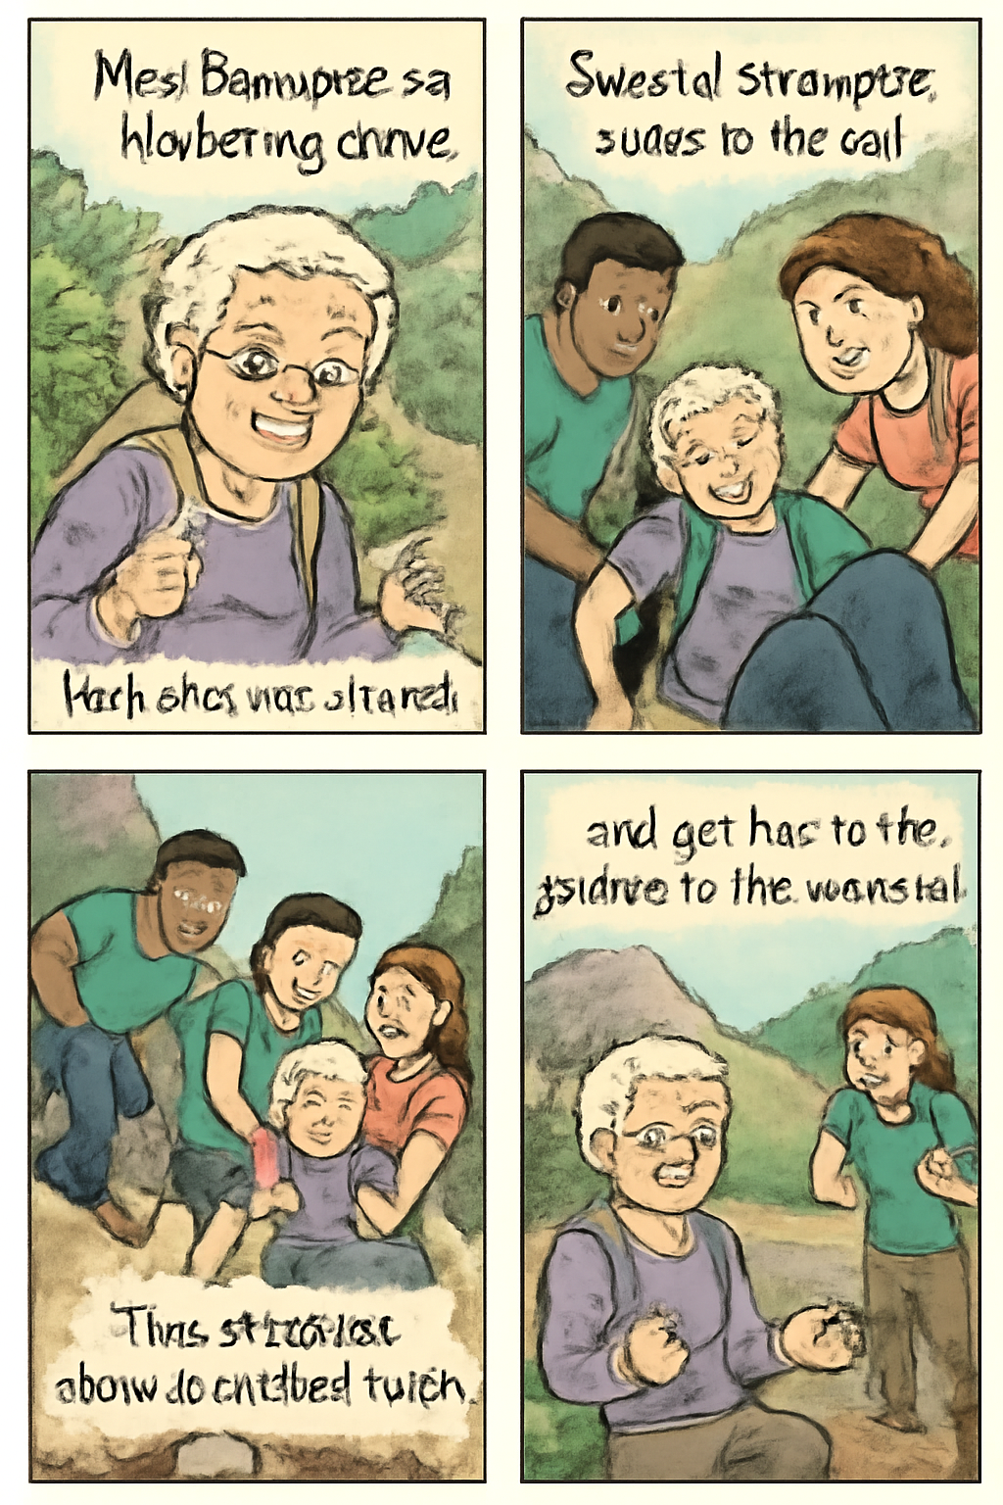
七选五
Z202026届第一次联考
本文讲述了一位79岁的老人Bannister在独自徒步旅行时意外受伤，几位陌生人无私地伸出援手，克服困难将她救下山的故事。文章歌颂了人性中的善良、同情心以及陌生人之间建立的深厚情谊。

Slide 34
piggyback ride 背驮
scatter sb’s ashes 撒骨灰
---be scattered with... 到处散落着…
shatter （使）破碎，碎裂；破坏
shatter into piece 破碎成碎片
made her way to the lookout 前往瞭望台
get/ be caught in... 被困在…
pain was pretty substantial 疼痛非常剧烈
ease onto his back 把她小心地放到背上
make a makeshift splint 做了一个简易夹板
cry out for... 迫切需要
distract her from the mounting pain 使她无法专注; 迫于愈加严重的疼痛
rush... to the nearest hospital 赶紧送往就近的医院
against all expectations 出乎所有人的预料

Slide 35
A Piggyback Ride from a Stranger
Once a year, Bannister climbs to High Rock Lookout where she scattered her mother’s ashes 23 years ago. ___36___ Last August, Bannister, then 79, went on her own, figuring she’d be fine because she’s an experienced hiker.
She arrived at the trail early and made her way to the lookout. As she headed back down, her foot got caught in a hole in the ground. ___37___ When sitting up, she knew immediately she had broken her leg. She cried out for help, and before long, a stranger approached and called 911. They were told a search and rescue team would arrive in five hours.
“It wasn’t very encouraging,” Bannister says. “I asked if anyone had painkillers, because the pain was pretty substantial then.” ___38___ But two young men, Troy May, an Air Force airmail and his friend Layton Allen, came over to see what was going on. When seeing Bannister in extreme pain, they offered to carry her to the bottom of the trail.
May eased Bannister onto his back and started hiking downward. He carried her for most of the nearly three-hour journey, and Allen carried her for the rest. “That was just one kindness,” says Bannister. ___39___ One, a physical therapist, bandaged Bannister's foot and built a makeshift splint(夹板) for her leg. The other did breathing exercises with her to help calm her. During the long hike down, her rescuers shared stories to distract her from the mounting pain. Once reaching the parking lot, they rushed Bannister to the nearest hospital.
___40___ “I think we’ll be lifelong friends,” Bannister says.
文章结构
背景 (Background): 年迈的Bannister独自去登山纪念母亲。（铺垫）
冲突 (Conflict): 摔倒骨折，救援需5小时，疼痛无助。（描述事故）
转折 (Turning Point): 两位年轻人出现，主动背她下山。（转机）
发展 (Development): 另一对夫妇提供专业帮助。（帮助升级）
结局 (Resolution): 成功送医，陌生人成为一生朋友。（圆满结局）

Slide 36
圈出每个选项的关键词（Key Words）和指代词（Reference Words）
A. She was almost in despair.
B. No one in the surrounding area did.
C. She fell forward against all expectations.
D. A couple hiking that day also lent a hand.
E. They have visited her several times afterwards.
F. Therefore, she visited there regularly in honor of her.
G. She usually hikes with someone along the 3.2-mile trail.
A Piggyback Ride from a Stranger
Once a year, Bannister climbs to High Rock Lookout where she scattered her mother’s ashes 23 years ago. ___36___ Last August, Bannister, then 79, went on her own, figuring she’d be fine because she’s an experienced hiker.
She arrived at the trail early and made her way to the lookout. As she headed back down, her foot got caught in a hole in the ground. ___37___ When sitting up, she knew immediately she had broken her leg. She cried out for help, and before long, a stranger approached and called 911. They were told a search and rescue team would arrive in five hours.
“It wasn’t very encouraging,” Bannister says. “I asked if anyone had painkillers, because the pain was pretty substantial then.” ___38___ But two young men, Troy May, an Air Force airmail and his friend Layton Allen, came over to see what was going on. When seeing Bannister in extreme pain, they offered to carry her to the bottom of the trail.
May eased Bannister onto his back and started hiking downward. He carried her for most of the nearly three-hour journey, and Allen carried her for the rest. “That was just one kindness,” says Bannister. ___39___ One, a physical therapist, bandaged Bannister's foot and built a makeshift splint(夹板) for her leg. The other did breathing exercises with her to help calm her. During the long hike down, her rescuers shared stories to distract her from the mounting pain. Once reaching the parking lot, they rushed Bannister to the nearest hospital.
___40___ “I think we’ll be lifelong friends,” Bannister says.

Slide 37
A. She was almost in despair.
B. No one in the surrounding area did.
C. She fell forward against all expectations.
D. A couple hiking that day also lent a hand.
E. They have visited her several times afterwards.
F. Therefore, she visited there regularly in honor of her.
G. She usually hikes with someone along the 3.2-mile trail.
A Piggyback Ride from a Stranger
Once a year, Bannister climbs to High Rock Lookout where she scattered her mother’s ashes 23 years ago. ___36___ Last August, Bannister, then 79, went on her own, figuring she’d be fine because she’s an experienced hiker.
She arrived at the trail early and made her way to the lookout. As she headed back down, her foot got caught in a hole in the ground. ___37___ When sitting up, she knew immediately she had broken her leg. She cried out for help, and before long, a stranger approached and called 911. They were told a search and rescue team would arrive in five hours.（描述事故）
“It wasn’t very encouraging,” Bannister says. “I asked if anyone had painkillers, because the pain was pretty substantial then.” ___38___ But two young men, Troy May, an Air Force airmail and his friend Layton Allen, came over to see what was going on. When seeing Bannister in extreme pain, they offered to carry her to the bottom of the trail.（求助）
May eased Bannister onto his back and started hiking downward. He carried her for most of the nearly three-hour journey, and Allen carried her for the rest. “That was just one kindness,” says Bannister. ___39___ One, a physical therapist, bandaged Bannister‘s foot and built a makeshift splint(夹板) for her leg. The other did breathing exercises with her to help calm her. During the long hike down, her rescuers shared stories to distract her from the mounting pain. Once reaching the parking lot, they rushed Bannister to the nearest hospital. （帮助升级）
___40___ “I think we’ll be lifelong friends,” Bannister says.（圆满结局）
理清故事线 - 定位逻辑关系 -匹配关键词。
But前的句子必须是消极内容
动作顺序（填补因和果）
also ——继年轻人之后的帮助
故事主线时间点完美衔接
（usually vs on her own）

Slide 38
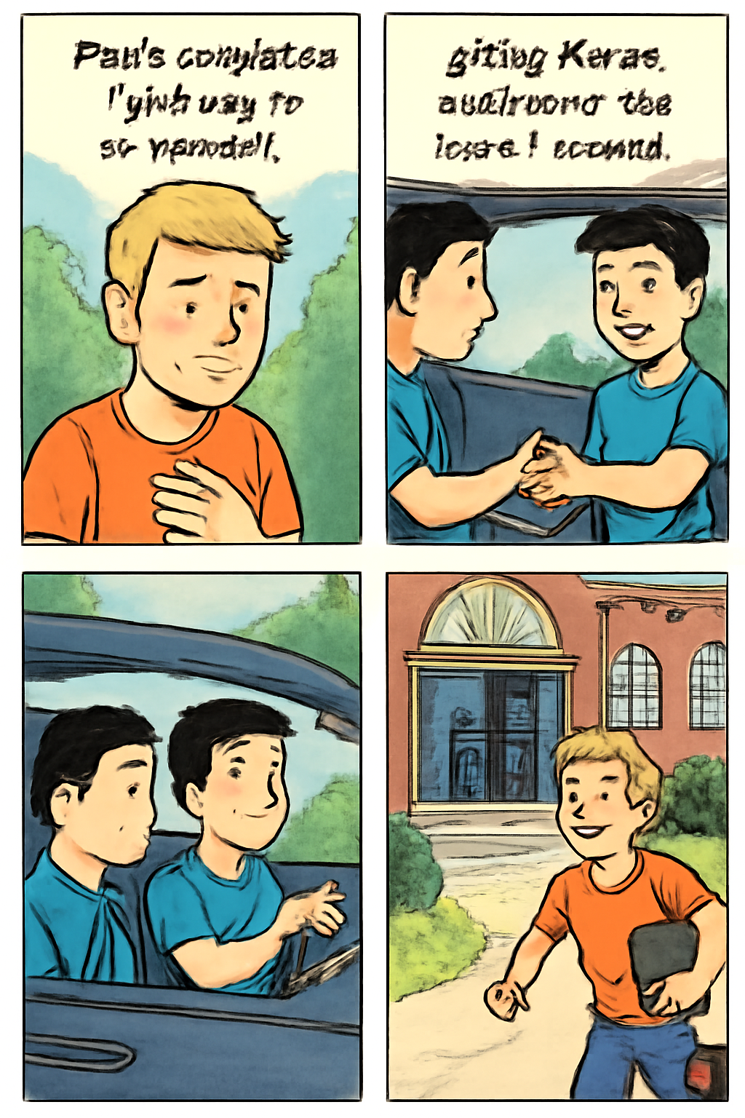
完形填空
Z202026届第一次联考
本篇主要讲述了Karen因自私与邻居Pam关系紧张，却在紧急关头受其帮助，从此学会宽容与感恩，一生受益。

Slide 39
paced helplessly 无助地来回踱步
The last person someone expected to see.
最后那个人竟然是自己一直以为不会见到的人
Their relationship had been tense.
他们的关系一直很紧张
disregard someone's requests 无视某人的请求
catch one’s breath 喘口气
extend kindness to... -- express/ convey 表达善意
Pam’s complaints gave way to forgiveness. 帕姆的抱怨逐渐变成了宽恕。
reflect on the gesture 反思这个举动 (gesture/ act of kindness)
ripple effects 连锁反应
earn (sb.) a place/spot (为某人)赢得一席之地
a miraculous save 奇迹般的挽救
merely a ride 仅仅是一次搭乘
bridges divides 架起隔阂
grace 优美；文雅，高雅；风度，体面；恩宠，恩典；
It was only by the grace of God that they survived.
承蒙天恩，他们才幸免于难。

Slide 40
以德报怨 (repaying evil with good)：完形填空——关注首尾段，把握文章主旨
1. Karen, 16, was a college freshman in a local university. She was thrilled to earn a ___41___ in the renowned choir for their international tour. However, ___42___ overcame her when she overslept before a key performance at a distant church. Missing the bus, she ___43___ helplessly in her dorm hallway. She had no cars nor friends nearby to help. Ironically, her neighbor Pam emerged, the ___44___ person Karen expected to see.
2. Their relationship had been ___45___. Karen’s group frequently disturbed the floor with late-night noise, ___46___ Pam’s requests for quiet. They ___47___ temporarily just long enough to catch their breath — before the disruptions came crashing back in. Now facing ___48___ of her own mistake, Karen awkwardly confessed her dilemma to Pam.
3. To her astonishment, Pam offered a ride immediately, which stunned Karen — Why did he extend kindness to someone who had shown ___49___ ? They raced to Pam’s car and arrived just as the choir entered the church — a miraculous ___50___.
4. Decades later, Karen still ___51___ that gesture. It was never ___52___ a ride, but a profound lesson in grace.Pam's complaints gave way to forgiveness, ___53___ Karen redemption(救赎) she hadn’t earned. If she could speak to Pam today, Karen would offer an apology for her youthful selfishness, and ___54___ for that transformative compassion. Its ripple effects ___55___ her next thirty years, proving that true mercy bridges divides and heals hearts.
Karen的困境（迟到、无助）
与Pam的紧张关系 vs. Pam意外出现。
Pam提供帮助，解决危机。
件事对Karen产生的深远影响和人生教益。
grace 熟词生义 the kindness that God shows towards the human race 恩宠；恩典
41. A. spot B. chance C. bonus D. prize
earn a spot（a position in a group）=place/position 赢得一席之地：通过表现或努力赢得某个位置或机会。
chance：尽管有一定关联，但“chance”一般指机会，而“spot”更能准确表达她获得合唱团的位置。
bonus：这个词通常指额外的奖励，不适合描述她获得的位置。
prize：通常指奖品，而不是获得一个位置。

Slide 41
1. Karen, 16, was a college freshman in a local university. She was thrilled to earn a ___41___ in the renowned choir for their international tour. However, ___42___ overcame her when she overslept before a key performance at a distant church. Missing the bus, she ___43___ helplessly in her dorm hallway. She had no cars nor friends nearby to help. Ironically, her neighbor Pam emerged, the ___44___ person Karen expected to see.
2. Their relationship had been ___45___. Karen’s group frequently disturbed the floor with late-night noise, ___46___ Pam’s requests for quiet. They ___47___ temporarily just long enough to catch their breath — before the disruptions came crashing back in. Now facing ___48___ of her own mistake, Karen awkwardly confessed her dilemma to Pam.
3. To her astonishment, Pam offered a ride immediately, which stunned Karen — Why did he extend kindness to someone who had shown ___49___ ? They raced to Pam’s car and arrived just as the choir entered the church — a miraculous ___50___.
4. Decades later, Karen still ___51___ that gesture. It was never ___52___ a ride, but a profound lesson in grace. Pam's complaints gave way to forgiveness, ___53___ Karen redemption(救赎) she hadn’t earned. If she could speak to Pam today, Karen would offer an apology for her youthful selfishness, and ___54___ for that transformative compassion. Its ripple effects ___55___ her next thirty years, proving that true mercy bridges divides and heals hearts.
Karen的困境（迟到、无助）
因为他们的关系很差，所以Pam是Karen“最不想”或“最不期望”见到的人。
与Pam的紧张关系 vs. Pam意外出现。
Pam提供帮助，解决危机。
件事对Karen产生的深远影响和人生教益。
42. A. calmness平静 B. panic恐慌 C. thrill兴奋；激动 D. relief宽慰
43. A. paced来回踱步 B. stormed气冲冲地走 C. bounced弹跳 D. tripped绊倒
44. A. best B. worst C. first D. last
last -- used to emphasize that sb/sth is the least likely or suitable（强调）最不可能的，最不适当的
the last person 最不期望或不想要的人或事物
她在焦虑中不断走动

Slide 42
1. Karen, 16, was a college freshman in a local university. She was thrilled to earn a ___41___ in the renowned choir for their international tour. However, ___42___ overcame her when she overslept before a key performance at a distant church. Missing the bus, she ___43___ helplessly in her dorm hallway. She had no cars nor friends nearby to help. Ironically, her neighbor Pam emerged, the ___44___ person Karen expected to see.
2. Their relationship had been ___45___. Karen’s group frequently disturbed the floor with late-night noise, ___46___ Pam’s requests for quiet. They ___47___ temporarily just long enough to catch their breath — before the disruptions came crashing back in. Now facing ___48___ of her own mistake, Karen awkwardly confessed her dilemma to Pam.
3. To her astonishment, Pam offered a ride immediately, which stunned Karen — Why did he extend kindness to someone who had shown ___49___ ? They raced to Pam’s car and arrived just as the choir entered the church — a miraculous ___50___.
4. Decades later, Karen still ___51___ that gesture. It was never ___52___ a ride, but a profound lesson in grace. Pam's complaints gave way to forgiveness, ___53___ Karen redemption(救赎) she hadn’t earned. If she could speak to Pam today, Karen would offer an apology for her youthful selfishness, and ___54___ for that transformative compassion. Its ripple effects ___55___ her next thirty years, proving that true mercy bridges divides and heals hearts.
Karen的困境（迟到、无助）
与Pam的紧张关系 vs. Pam意外出现。
Dismissing her fears, she climbed higher.
她排除了恐惧，爬得更高了。
~ sth (from sth) to put thoughts or feelings out of your mind 去除，消除，摒除（思想、感情等）
She claims she was unfairly dismissed from her post.
她声称自己被无理免职。 （解雇；免职；开除 fire；sack）
The case was dismissed. 此案已被驳回。（dismiss驳回；不受理）
dismissive adj表示轻视的；解雇的
dismissal n.开除，解雇；不予考虑，摒弃；驳回，不予受理；打发走，遣散；出局
Pam提供帮助，解决危机。
件事对Karen产生的深远影响和人生教益。
45. A. tense B. close亲近的 C. familiar熟悉的 D. distant疏远的
Karen等人制造噪音，无视Pam的请求。 tense (令人紧张的 (形势、时期等)；紧张的).
46. A. disapproving不赞同 B. doubting怀疑 C. supporting支持 D. dismissing
前后动作是相反的，一方制造噪音，一方请求安静。因此，Karen她们是“无视”或“拒绝”了请求。
dismiss ~ sb/sth (as sth) to decide that sb/sth is not important and not worth thinking or talking about 不予考虑；摒弃；对…不屑一提（wave aside）

Slide 43
1. Karen, 16, was a college freshman in a local university. She was thrilled to earn a ___41___ in the renowned choir for their international tour. However, ___42___ overcame her when she overslept before a key performance at a distant church. Missing the bus, she ___43___ helplessly in her dorm hallway. She had no cars nor friends nearby to help. Ironically, her neighbor Pam emerged, the ___44___ person Karen expected to see.
2. Their relationship had been ___45___. Karen’s group frequently disturbed the floor with late-night noise, ___46___ Pam’s requests for quiet. They ___47___ temporarily just long enough to catch their breath — before the disruptions came crashing back in. Now facing ___48___ of her own mistake, Karen awkwardly confessed her dilemma to Pam.
3. To her astonishment, Pam offered a ride immediately, which stunned Karen — Why did he extend kindness to someone who had shown ___49___ ? They raced to Pam’s car and arrived just as the choir entered the church — a miraculous ___50___.
4. Decades later, Karen still ___51___ that gesture. It was never ___52___ a ride, but a profound lesson in grace. Pam's complaints gave way to forgiveness, ___53___ Karen redemption(救赎) she hadn’t earned. If she could speak to Pam today, Karen would offer an apology for her youthful selfishness, and ___54___ for that transformative compassion. Its ripple effects ___55___ her next thirty years, proving that true mercy bridges divides and heals hearts.
Karen的困境（迟到、无助）
与Pam的紧张关系 vs. Pam意外出现。
Pam提供帮助，解决危机。
件事对Karen产生的深远影响和人生教益。
47. A. stayed B. waited C. paused D. hesitated
噪音会暂时停止，但很快又会继续。 pause 暂停
48. A. processes（过程） B. conclusions（结论） C. causes（原因） D. consequences
她此刻正直接承受着错误行为带来的结果（即将毁掉演出机会）
as a consequence of … 的结果
49. A. some一些 B. none C. any一些 D. much很多
“None”就是“一点都没有”，最直接最绝对，强烈地对比出Pam的以德报怨。

Slide 44
1. Karen, 16, was a college freshman in a local university. She was thrilled to earn a ___41___ in the renowned choir for their international tour. However, ___42___ overcame her when she overslept before a key performance at a distant church. Missing the bus, she ___43___ helplessly in her dorm hallway. She had no cars nor friends nearby to help. Ironically, her neighbor Pam emerged, the ___44___ person Karen expected to see.
2. Their relationship had been ___45___. Karen’s group frequently disturbed the floor with late-night noise, ___46___ Pam’s requests for quiet. They ___47___ temporarily just long enough to catch their breath — before the disruptions came crashing back in. Now facing ___48___ of her own mistake, Karen awkwardly confessed her dilemma to Pam.
3. To her astonishment, Pam offered a ride immediately, which stunned Karen — Why did he extend kindness to someone who had shown ___49___ ? They raced to Pam’s car and arrived just as the choir entered the church — a miraculous ___50___.
4. Decades later, Karen still ___51___ that gesture. It was never ___52___ a ride, but a profound lesson in grace. Pam's complaints gave way to forgiveness, ___53___ Karen redemption(救赎) she hadn’t earned. If she could speak to Pam today, Karen would offer an apology for her youthful selfishness, and ___54___ for that transformative compassion. Its ripple effects ___55___ her next thirty years, proving that true mercy bridges divides and heals hearts.
Karen的困境（迟到、无助）
与Pam的紧张关系 vs. Pam意外出现。
Pam提供帮助，解决危机。
件事对Karen产生的深远影响和人生教益。
50. A. save B. contribution贡献 C. performance表演 D. movement移动
如果没有赶上，后果很严重：作为新人，在国际巡演中缺席关键演出，可能会让她失去在合唱团的席位（spot），甚至影响她的声誉和职业生涯。因此，Pam的援助不仅仅是“帮助”，更是一次“挽救”，拯救了她珍视的机会。
51. A. calls on 号召；拜访（某人） B. reflects on C. holds back抑制，阻止；退缩 D. looks back
后文“It was never merely a ride, but a profound lesson in grace” (这从来不仅仅是一次接送，而是一堂关于宽容的深刻一课) 是Karen对这件事的深刻理解和感悟。look back 简单地回忆或“想起”过去发生的事情本身；reflect on 更侧重于深刻地反思，不仅记得这件事，更在于思考这件事的意义、影响，并从中汲取教训或产生感悟。

Slide 45
1. Karen, 16, was a college freshman in a local university. She was thrilled to earn a ___41___ in the renowned choir for their international tour. However, ___42___ overcame her when she overslept before a key performance at a distant church. Missing the bus, she ___43___ helplessly in her dorm hallway. She had no cars nor friends nearby to help. Ironically, her neighbor Pam emerged, the ___44___ person Karen expected to see.
2. Their relationship had been ___45___. Karen’s group frequently disturbed the floor with late-night noise, ___46___ Pam’s requests for quiet. They ___47___ temporarily just long enough to catch their breath — before the disruptions came crashing back in. Now facing ___48___ of her own mistake, Karen awkwardly confessed her dilemma to Pam.
3. To her astonishment, Pam offered a ride immediately, which stunned Karen — Why did he extend kindness to someone who had shown ___49___ ? They raced to Pam’s car and arrived just as the choir entered the church — a miraculous ___50___.
4. Decades later, Karen still ___51___ that gesture. It was never ___52___ a ride, but a profound lesson in grace. Pam's complaints gave way to forgiveness, ___53___ Karen redemption(救赎) she hadn’t earned. If she could speak to Pam today, Karen would offer an apology for her youthful selfishness, and ___54___ for that transformative compassion. Its ripple effects ___55___ her next thirty years, proving that true mercy bridges divides and heals hearts.
Karen的困境（迟到、无助）
与Pam的紧张关系 vs. Pam意外出现。
Pam提供帮助，解决危机。
件事对Karen产生的深远影响和人生教益。
52. A. totally完全 B. rarely罕见地 C. merely仅仅、只不过 D. fairly公平地/相当地
53. A. gifting B. rewarding C. supplying D. sparing
Pam的抱怨让位于原谅，这___了Karen她所不应得的救赎。gifting: 意为“赠与”，强调无偿地、慷慨地给予某人某物，尤其是礼物或美好的东西。rewarding: 意为“奖励，回报”，是给应得之人。 supplying: 意为“供应，提供”，通常指提供物资、货物等具体物品以满足需求。 sparing: 意为“节省，饶恕”，如spare one‘s life（饶某人一命）文章的中心grace （恩典；恩宠）—— 即给予他人他们并不配得 (hadn’t earned) 的善意和宽恕。 Karen之前的行为是自私的，她“不配”得到这份救赎。因此，Pam的原谅是一份无偿的、赠礼般的 (gifting) 恩典。gifting 最精准地捕捉了这种“不因值得，只因慷慨”的深层含义。

Slide 46
consistently （一贯地，一致地）
deliberately （故意地）
momentarily （暂时地，一会儿地）
occasionally （偶尔地）
prosperously （繁荣地）
suspectedly 怀疑地(四川卷)
roughly （粗略地）
slightly （轻微地）
somehow （不知怎么地）
somewhat （稍微，有点）
thoroughly （彻底地）
hardly 几乎不
merely 仅仅，只 =only
rarely 罕见的
barely 勉强才能;几乎不，仅仅
simply 简单地，仅仅
nearly 几乎，差不多
sourly 闷闷不乐地;没好气地(四川卷)
not nearly = far from= nowhere near 远非，远不及，一点也不

Slide 47
1. Karen, 16, was a college freshman in a local university. She was thrilled to earn a ___41___ in the renowned choir for their international tour. However, ___42___ overcame her when she overslept before a key performance at a distant church. Missing the bus, she ___43___ helplessly in her dorm hallway. She had no cars nor friends nearby to help. Ironically, her neighbor Pam emerged, the ___44___ person Karen expected to see.
2. Their relationship had been ___45___. Karen’s group frequently disturbed the floor with late-night noise, ___46___ Pam’s requests for quiet. They ___47___ temporarily just long enough to catch their breath — before the disruptions came crashing back in. Now facing ___48___ of her own mistake, Karen awkwardly confessed her dilemma to Pam.
3. To her astonishment, Pam offered a ride immediately, which stunned Karen — Why did he extend kindness to someone who had shown ___49___ ? They raced to Pam’s car and arrived just as the choir entered the church — a miraculous ___50___.
4. Decades later, Karen still ___51___ that gesture. It was never ___52___ a ride, but a profound lesson in grace. Pam's complaints gave way to forgiveness, ___53___ Karen redemption(救赎) she hadn’t earned. If she could speak to Pam today, Karen would offer an apology for her youthful selfishness, and ___54___ for that transformative compassion. Its ripple effects ___55___ her next thirty years, proving that true mercy bridges divides and heals hearts.
Karen的困境（迟到、无助）
与Pam的紧张关系 vs. Pam意外出现。
Pam提供帮助，解决危机。
件事对Karen产生的深远影响和人生教益。
54.A. complaint抱怨 B. gratitude C. welcome欢迎 D. regret后悔
空格处需要填入一个与“apology”词性相同（名词）、情感色彩相近（都是正向、积极的情感表达）的词语；transformative compassion”（改变人生的同情心）值得她最真挚的感激。
55. A. restricted限制，束缚 B. formed形成 C. constructed建造，构建 D. shaped
它的涟漪效应，即那次事件产生的持续影响，需要填入一个动词，描述这种“持续影响”是如何作用于她的人生的。 shaped (塑造)： 这是最地道的搭配。Shape one's life/future/year 意为“塑造了某人的人生/未来/岁月”，指产生了深刻的、决定性的影响。它完美地表达了“涟漪效应”持续不断地改变和定义了她后来的人生轨迹。

Slide 48

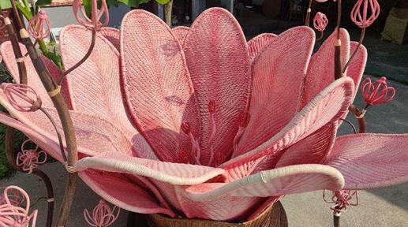
语法填空
Z202026届第一次联考
本篇介绍了陕西汉中原始森林中一种特殊藤蔓的特性、作为优质编织材料的历史（如《三国志》记载的军事用途），以及手艺人陈良书传承相关手工艺、其公司产品热销的情况。

Slide 49
grow in 生长在
exceptional length 非凡的长度
prize sth (for sth) 珍视；高度重视
high-quality natural weaving material 高质量的天然编织材料
create functional household items 制作实用的家居用品
use as 作为…使用
reach orders 达到订单量
unmatched flexibility 无与伦比的灵活性
incomparable/ unparalleled adaptability
peerless agility 无与伦比的敏捷性（unsurpassed 出色的）
smooth surface 光滑表面
remarkable durability 显著的耐用性
resist water 耐水 -- water-proof
stand against arrows 抵抗箭矢 -- 经受住
in one’s 50s/ fifties 在某人50多岁时
weave a tapestry of belonging 编织归属感的挂毯/织锦
fan（熟词生义） n. 扇子；风扇；（影，球）迷
v 扇；吹；煽起，激起

Slide 50

In the primeval forests of Hanzhong, Shaanxi province, ___56___ (grow) a remarkable vine(藤蔓).
56.完全倒装句：地点状语（“In the primeval（远古的；原始的）forests of Hanzhong, Shaanxi province”）开头，并且句子强调的是地点而非主语。
A remarkable vine _______(grow) in the primeval forests of Hanzhong, Shaanxi province. 句子描述的是一个事实性的、普遍性的情况，属于现在时。所以，应该使用 grows”
全部倒装
1. 方位副词开头 (Here, There, Now, Then, Out, In, Up, Down, Away...)
方位副词 + Vi. (不及物动词) + 主语 (名词!)
Out rushed the children.—— The children rushed out. (孩子们冲了出去。)
注意： 当主语是人称代词（I, you, he, she, it, they, we）时，不能用倒装！
2. 表地点/范围的介词短语开头
地点介词短语 + Vi. (如 be, stand, lie, live, sit, come...) + 主语
On the bed lay a sick old man. (床上躺着一位生病的老人。）
3. Such + be + 主语 （Such 在此意为“这样的人/事物”）
Such was Albert Einstein — a man of great achievement but simple habits.

Slide 51
Since ancient times（时间状语）, locals（主语） have recognized（谓语） its potential（宾语） as ___58___ high-quality natural weaving material（表语）（主句）, ___59___ (prize) for the vine’s lightness, breathability and remarkable durability（非谓语做定语，来修饰 material）.
Since ancient times, locals have recognized its potential as ___58___ high-quality natural weaving material, ___59___ (prize) for the vine’s lightness, breathability and remarkable durability.（分析句子成分）
prize=treasure [ usually passive ] ~ sth (for sth) to value sth highly 珍视；高度重视
…material is prized for the vine’s lightness… 因此，非谓语—— prized for…
Oil of cedarwood /ˈsiːdəˌwʊd/ is highly prized for its use in perfumery /pəˈfjuːməri/.（香水；香水商店；香水的制造 ）
雪松油可用于制香水，因此十分珍贵。
perfume n 香水；芳香，香味 v 使香气弥漫；在……上撒香水，抹香水
The fragrance of the flowers filled the room.
The scent of fresh rain was in the air.
The aroma /əˈrəʊmə/ of freshly brewed coffee greeted me in the morning.
The wine had a bouquet/buˈkeɪ/ of fruity and floral notes.
There was an unpleasant odor in the room.
He wore a cologne /kəˈləʊn/ that had hints of citrus/ˈsɪtrəs/（柑橘类的）.
aroma（用于食物、饮料或者花草的香气，通常是愉悦的气味）
描述复杂的香气，尤其是香水或酒的香气
（独特气味）
（古龙水）

Slide 52

The Records of the Three Kingdoms by Western Jin Dynasty ___60___ (history) Chen Shou documented its military applications, describing “vine armor” so effective that it could float across rivers, resist water, and stand against arrows.
以 -ian 结尾的单词通常表示某种职业、学科、地区或兴趣爱好的人
-ian 用来表示从事某一职业或学科的人。
Musician（音乐家）：从事音乐的人。
Physician（医生）：从事医学的人。
Librarian（图书管理员）：负责管理图书馆的人。
Magician（魔术师）：表演魔术的人。
Electrician（电工）：负责电力安装与维修的人。
-ian 用来表示某个国家或地区的人。
Canadian（加拿大人）：来自加拿大的人。
Romanian（罗马尼亚人）：来自罗马尼亚的人。
American（美国人）：来自美国的人。
Indian（印度人）：来自印度的人。
-ian 也用来表示对某种活动、兴趣或思想的倾向。
Vegetarian（素食者）：倾向于只吃植物性食物的人。
Humanitarian /hjuːˌmænɪˈtɛərɪən/ （人道主义者）：关心他人福祉的人，通常从事慈善工作。
Historian（历史学家）：研究历史的人。
Politician（政治家）：从事政治的人。
Comedian（喜剧演员）：从事喜剧演出的演员。

Slide 53
“It is an ancient handicraft that creates functional household items ___61___ (use) wooden or bamboo frames as structures ___62___ green vines as weaving substance, and employing traditional handweaving techniques,” explains Chen Liangshun, who ___63___ (practise) the craft for more than three decades. （分析句子结构）
“It is an ancient handicraft（主句） that creates functional household items（定语从句） ___61___ (use)（现在分词形式表达伴随动作，表示手工艺使用木材或竹子作为结构）wooden or bamboo frames as structures ___62___ green vines as weaving substance（使用使用木材或竹子作为结构，使用绿色藤蔓作为编织材料，并列结构）, and employing traditional handweaving techniques（与use 并列，使用传统的手工编织技术）,” explains Chen Liangshun, who ___63___ (practise) the craft for more than three decades（定语从句）需要填入 “has practiced/has been practising”，因为句子指明了“for more than three decades”（超过三十年），说明动作持续到现在，应该用现在完成时. 定语从句主语是Chen Liangshu，所以用has。
At his company in Huangguan town, Nanzheng district of Hanzhong, villagers have been busy preparing summer products, among ___64___ fans have been particularly popular recently. “The online sales have easily reached 1,000 to 2,000 orders daily,” says Chen ___65___ his 50s.
64. “介词 + 关系代词” 引导的非限制性定语从句，先行词是 “summer products”，指物，故用 which，“among which” 表示 “在这些夏季产品中，扇子最近大受欢迎”

Slide 54
Thank you
ibaotu.com

