Slide 1


感恩遇见，相互成就，本课件资料仅供您个人参考、教学使用，严禁自行在网络传播，违者依知识产权法追究法律责任。
更多教学资源请关注
公众号：溯恩英语
知识产权声明

Slide 2

Exploring New Rural China
A Letter Of Sharing A Study Tour
  —分享探索中国新农村研学经历
    2025.5浙江省六校联盟考应用文

Slide 3
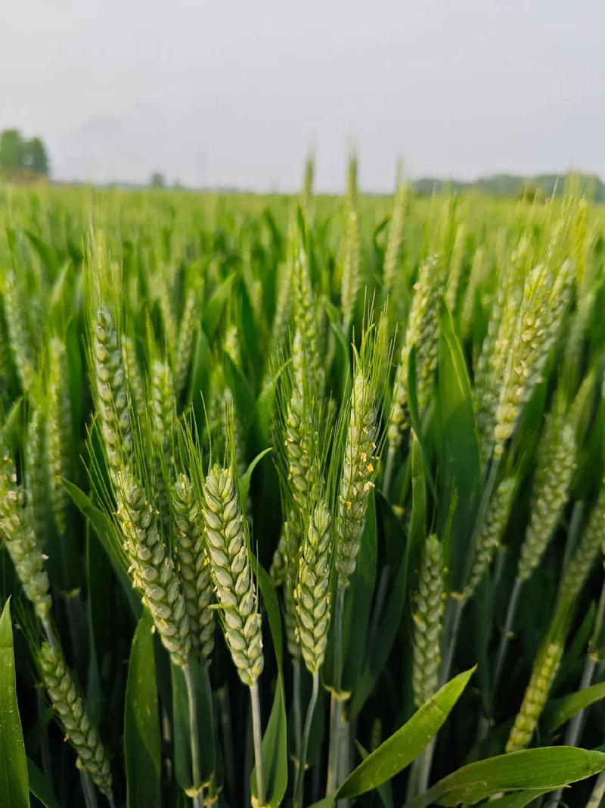
Warm-up
01
Have you ever participated in a study tour ?
02
What do you might see in a rural study tour?

Slide 4
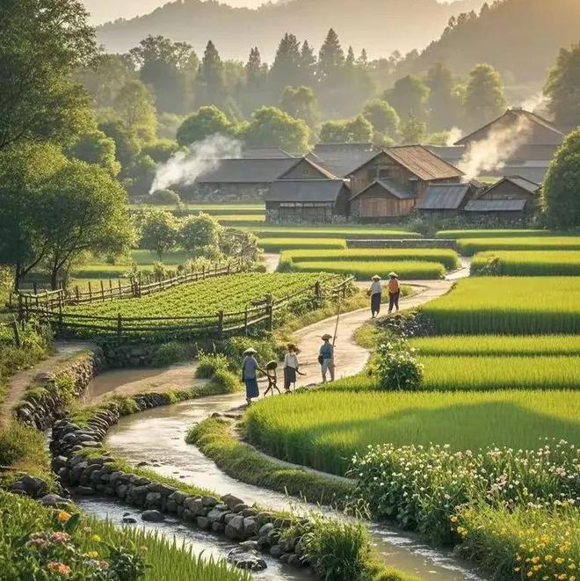
Lead in
What’s most challenging for you in this writing assignment?
Possible difficulties:
1.How to describe what I saw during the rural study tour？
2.How to describe my feelings during the rural study tour？
3.How to describe my feelings after the rural study tour？
4.How to present the body part logically？
...

Slide 5
Analyze
假定你是李华，上周你参加了学校组织的“走进新农村(Exploring New Rural China)”研学活动。请你给新西兰朋友Oliver写一封邮件分享这次经历，内容包括：
(1)你的见闻；
(2)你的感想。
Genre
Receiver
Background
Writing Puporse
Content
Tense
Person
an E-mail of sharing a tour
Oliver(a New Zealand friend)
Last week, I participated in a study tour organized by our school.
share the study tour
offer an invitation(Para.3)
what I saw in the tour
What’s my feeling during or after the tour
simple past tense, present tense
first and second person

Slide 6
Construct
greetings
background information
writing purpose
Beginning
Letter of Sharing the study tour
what I saw in the tour
general
specific
physical
mental
logic
↓
↓
Body
what’s my feeling during or after the tour
Conclusion
invitation/anticipation

Slide 7
Practice and Accumulate
greetings
background information
writing purpose
P1 Beginning
How have you been? I’m excited to share details about the study tour "Exploring New Rural China" organized by our school last week.
I hope this email finds you well. Last week, I participated in a fascinating study trip titled"Exploring New Rural China" organized by my school.Thus, I can’t wait to share the amazing rural development with you.
Hope this email finds you well!‌ Last week witnessed my study tour themed"Exploring New Rural China",which turned out to be a hit. So I can’t wait but share the details with you.

Slide 8






Brainstorm
What might I see during the study tour in the rural area?
4.Rural E-Commerce Hubs (农村电商中心)
1.Modern Agricultural Technology(现代农业技术)
visit livestreaming studios where farmers sell local products online, or village co-ops packing fresh produce for nationwide delivery
greenhouses, drone-assisted farming, or automated irrigation systems, showcasing how technology is transforming traditional agriculture.
rural
study tour
5.Educational & Healthcare Upgrades (教育和医疗升级)
2.Eco-Tourism Projects(生态旅游项目)
homestays, fruit-picking farms, or cultural workshops
smart classrooms, or community health centers
3.Traditional Culture Preservation (传统文化保护)
6.Rural Cultural Revitalization (乡村文化振兴)
restored ancestral halls, watch folk performances like paper-cutting or dragon dances, and learn about centuries-old customs
modern libraries built in traditional architectural styles, or art galleries showcasing local farmers' paintings and handicrafts.

Slide 9
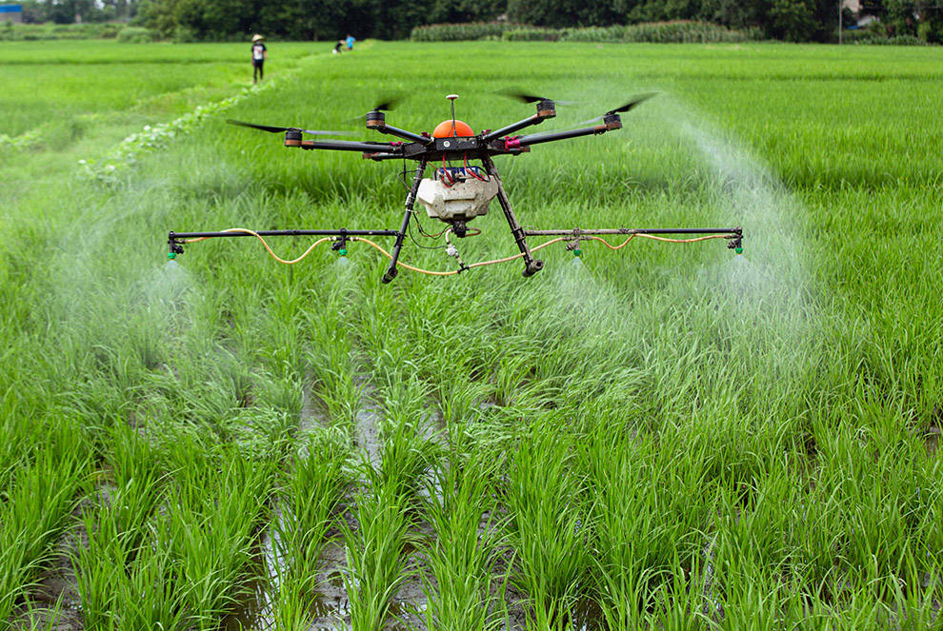
Accumulation
What was my feeling during the tour?
1.Agricultural Technology
Seeing farmers skillfully operating drones to tend their fields brought unexpected tears to my eyes - technology has truly changed/revolutionized people’s lives.
农民们熟练操作无人机耕作的场景让我感动—科技正在实实在在地改变人们的生活。

Slide 10


Accumulation
2.Tourism
Staying in the eco-friendly homestay made me realize rural tourism isn't just about scenery, but a sustainable lifestyle.
生态民宿的体验让我明白，乡村旅游不仅是看风景，更是一种可持续的生活方式。
3.Traditional culture
Local artisans showcased their centuries-old bamboo weaving techniques, creating exquisite artworks that are sold globally through e-commerce platforms, enabling this cultural heritage to take root in the new generation.
当地手艺人展示了传承数百年的竹编技艺，他们制作的精美艺术品并通过电商平台销往全球
,这使得文化传承在新一代心中生根发芽。

Slide 11
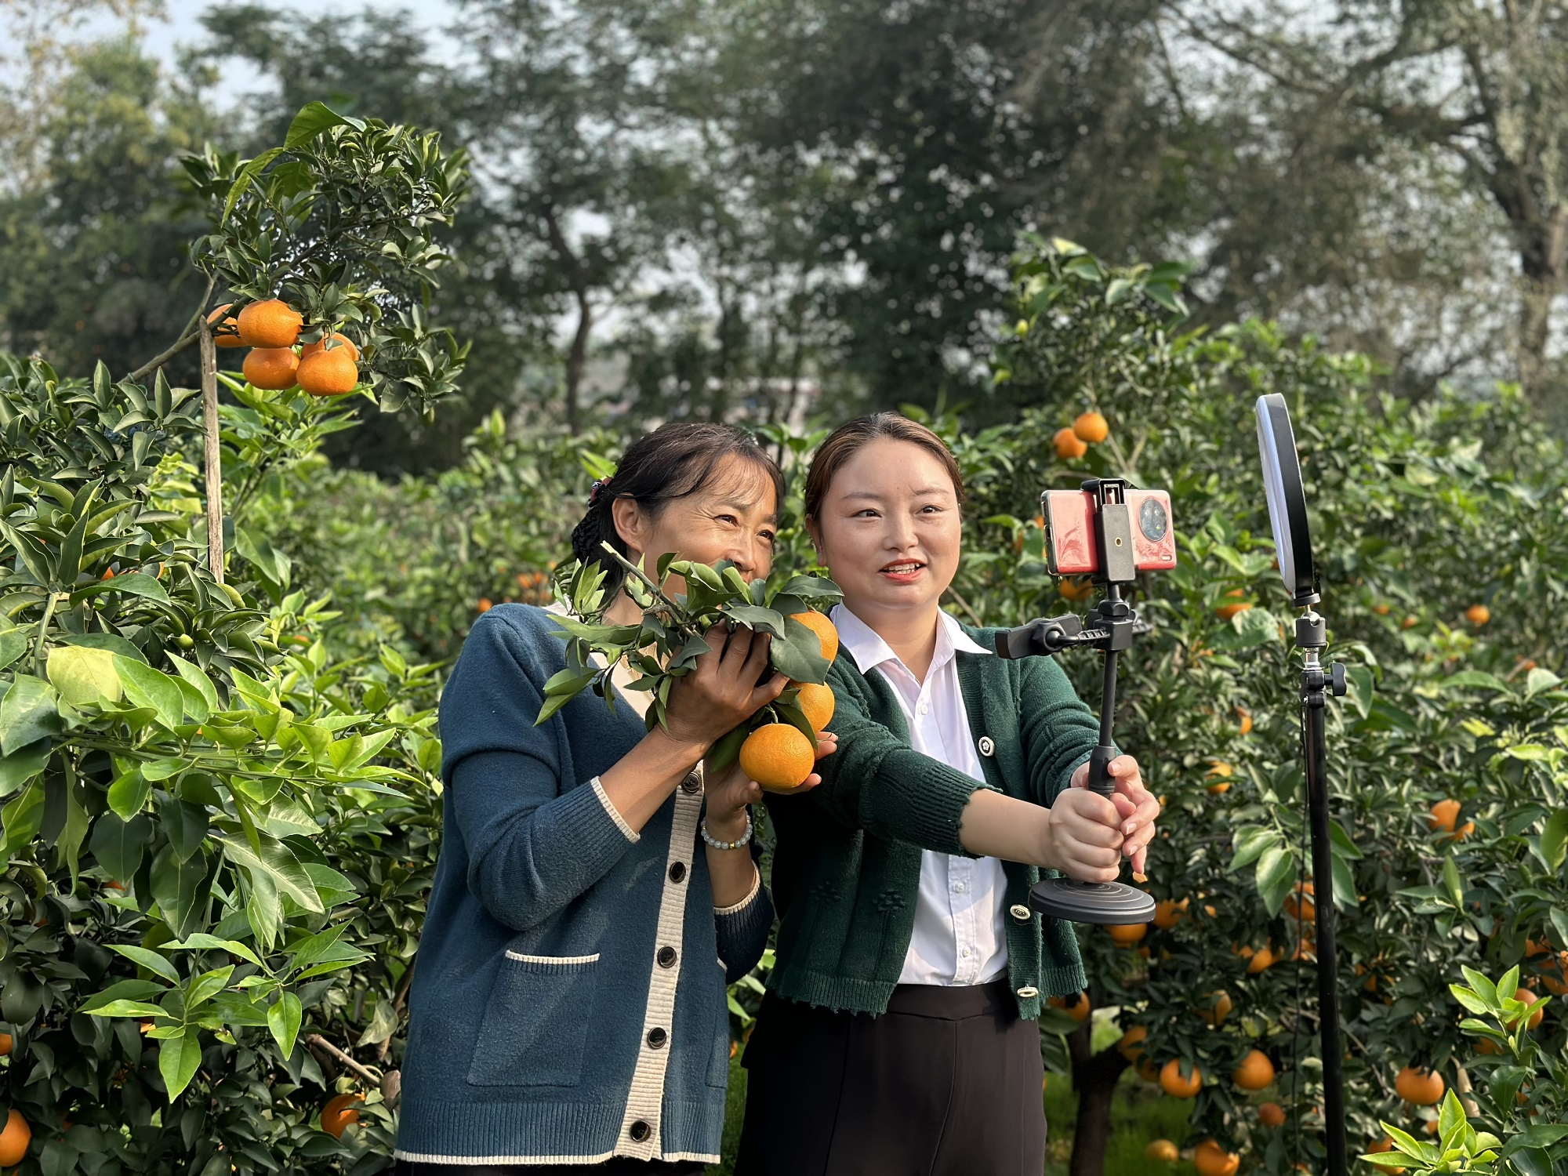
4.E-Commerce Hubs
The livestreaming farmers taught me more about innovation than any textbook ever could.
农民主播的直播课堂，比任何教科书都生动地教会了我什么是创新。
5.Educational & Healthcare
The telemedicine system in the village clinic showed me equality isn't just a concept, but a practice.
村卫生室的远程医疗系统让我明白，平等不仅是理念，更是实践。

Slide 12



What was my feeling during or after the tour?
Brainstorm
China’s development
Rural life
Individual

Slide 13
What was my feeling during the tour?
Accumulation
Individual
Walking through those vibrant villages, I felt an irresistible urge to contribute my part to rural revitalization in the future.(强烈的参与感与责任感)
穿行在生机勃勃的村落间，我内心涌起一股强烈的冲动——未来也要为乡村振兴贡献自己的一份力量。
When I saw a Peking University graduate running an organic farm in the village, I realized rural areas are becoming new frontiers for young talents.(加入具体案例强化说服力)
当我看到北大毕业生在村里经营有机农场时，才明白乡村正在成为年轻人的新舞台。

Slide 14
What is my feeling after the tour?
Accumulation
Rural life
The real 'new rural China' isn't just about better infrastructure - it's about the rekindling of hope in people's eyes.真正的"新农村"不仅是硬件改善，更是人们眼中重新点燃的希望之光。
This journey completely reshaped my understanding of rural China - what was once "backward" in my mind has now become a model of sustainable living.这次旅程彻底改变了我对中国农村的认知——曾经心中的"落后"形象，如今已成为可持续生活的典范。
China’s development
"This tour didn't just show me a new rural China - it showed me a new way to understand my country's development."这次研学不仅让我看见新农村，更让我读懂了中国发展的新维度。I’m genuinely proud of the rural development in my country.

Slide 15

Practice and Accumulate
Conclusion
Summary/invitation/anticipation
Hope you can visit China’s countryside someday to experience its unique charm firsthand!
Overall, this rural study tour is literally an educational, inspiring and memorable experience for me. Have you ever engaged in some study tour in New Zealand? Looking forward to your sharing.

Slide 16
Official Sample Writing
Translation
Dear Oliver,
How have you been? I’m excited to share details about the study tour "Exploring New Rural China" organized by our school last week.
The village we visited was a shining example of rural revitalization. What left the deepest impression on me was the high-tech farm, where advanced technologies such as drip irrigation and drones were being utilized. Additionally, local artisans showcased their centuries-old bamboo weaving techniques, creating exquisite artworks that are sold globally through e-commerce platforms.
This eye-opening experience reshaped my understanding of rural China. I realized that technological advancements are not only breathing new life into villages but also maintaining cultural continuity. I’m genuinely proud of the rural development in our country.
Hope you can visit China’s countryside someday to experience its unique charm firsthand!
Yours,
Li Hua
亲爱的Oliver：
你最近好吗？我想和你分享一下上周学校组织的“探索新农村中国”研学旅行。
我们参观的村庄是乡村振兴的典范。最让我印象深刻的是高科技农场，那里应用了滴灌和无人机等先进技术。此外，当地手艺人展示了传承数百年的竹编技艺，他们制作的精美艺术品并通过电商平台销往全球。
这次大开眼界的经历彻底改变了我对中国农村的认知。我意识到，科技进步不仅为乡村注入新活力，还维系着文化传承。我由衷地为祖国乡村的发展感到自豪！
希望有一天你也能来中国乡村，亲身感受它的独特魅力！
李华

Slide 17
Sample Writing
Translation
Dear Oliver,
Hope this email finds you well!‌ Last week witnessed my study tour themed"Exploring New Rural China",which turned out to be a hit. So I can’t wait but share the details with you.‌
Upon arriving the villages,what came to my sight was the high-tech greenhouses, drone-assisted farming, and automated irrigation systems, showcasing how technology is transforming traditional agriculture.One of the highlights was appreciating folk performances like dragon dances,Batik,Clay Figurine Making, enabling us to learn about centuries-old culture heritage and customs.Walking through those vibrant village, I felt an irresistible urge to contribute my part to rural revitalization in the future.
Overall, this rural study tour is literally an educational, inspiring and memorable experience for me. Have you ever engaged in some study tour in New Zealand? Looking forward to your sharing.
Yours,
Li Hua
亲爱的Oliver：
见信好！上周我参加了"走进新农村"研学活动，很成功的活动，我迫不及待想与你分享！
一到农村，首先映入眼帘的就是高科技温室、无人机辅助耕作或自动灌溉系统，展示着科技如何改变传统农业。活动亮点之一就是我们欣赏了舞龙，蜡染，泥塑等民俗表演，了解延续数百年的文化遗产和传统习俗。穿行在生机勃勃的村落间，我内心涌起一股强烈的冲动——未来也要为乡村振兴贡献自己的一份力量。
这次研学之旅可谓寓教于乐，既开阔眼界又振奋人心。不知你是否参加过新西兰的研学活动？期待你的分享！
李华

Slide 18
Accumulation
见闻
greenhouses, drone-assisted farming, or automated irrigation systems
homestays, fruit-picking farms, or cultural workshops
restored ancestral halls, watch folk performances like paper-cutting or dragon dances, and learn about centuries-old customs,蜡染 (Batik),泥塑 (Clay Figurine Making)
visit livestreaming studios where farmers sell local products online, or village co-ops packing fresh produce for nationwide delivery
smart classrooms, or community health
modern libraries built in traditional architectural styles, or art galleries showcasing local farmers' paintings and handicrafts
a shining example of rural revitalization rural revitalization
the high-tech farm
advanced technologies such as drip irrigation and drones were being utilized.
local artisans showcased their centuries-old bamboo weaving techniques, creating exquisite artworks that are sold globally through e-commerce platforms.
温室、无人机辅助耕作或自动灌溉系统
民宿、采摘果园或文化工坊
参观修缮后的祠堂，观看剪纸、舞龙等民俗表演，了解延续数百年的传统习俗
看到农民直播卖货的现场，或是村庄合作社将新鲜农产品打包发往全国的场景
配备智慧教室的乡村新校舍
传统建筑风格的现代化图书馆，或是展示农民画和手工艺品的乡村美术馆
乡村振兴的典范
高科技农场
应用了滴灌和无人机等先进技术
当地手艺人展示了传承数百年的竹编技艺，他们制作的精美艺术品并通过电商平台销往全球。

Slide 19
Accumulation
感想
科技正在实实在在地改变人们的生活
科技正在消融中国传统农业与现代技术的界限
乡村旅游不仅是看风景，更是一种可持续的生活方式
使得文化传承在新一代心中生根发芽
比任何教科书都生动地教会了我什么是创新
内心涌起一股强烈的冲动——未来也要为乡村振兴贡献自己的一份力量
乡村正在成为年轻人的新舞台
重新点燃的希望之光
彻底改变了我对中国农村的认知——曾经心中的"落后"形象，如今已成为可持续生活的典范
让我读懂了中国发展的新维度
这些村庄既能守住文化根基，又能拥抱前沿科技，实在是两全其美！
注入新活力
维系着文化传承
我由衷地为祖国乡村的发展感到自豪！
technology has truly changed/revolutionized people’s lives
technology is erasing the boundary between tradition and modernity in Chinese agriculture
rural tourism isn't just about scenery, but a sustainable lifestyle
enable this cultural heritage to take root in the new generation
teach me more about ...than any textbook ever could
feel an irresistible urge to contribute my part to rural revitalization in the future
rural areas are becoming new frontiers for young talents
rekindle the hope in people's eyes
reshap my understanding of rural China - what was once "backward" in my mind has now become a model of sustainable living
show me a new way to understand my country's development
It's amazing how these villages preserve their cultural roots while embracing cutting-edge technologies - truly the best of both worlds!
breath new life into villages
maintain cultural continuity
I’m genuinely proud of the rural development in our country.

Slide 20
Thank you!

