Slide 1
感恩遇见，相互成就，本课件资料仅供您个人参考、教学使用，严禁自行在网络传播，违者依知识产权法追究法律责任。
更多教学资源请关注
公众号：溯恩高中英语
知识产权声明

Slide 2
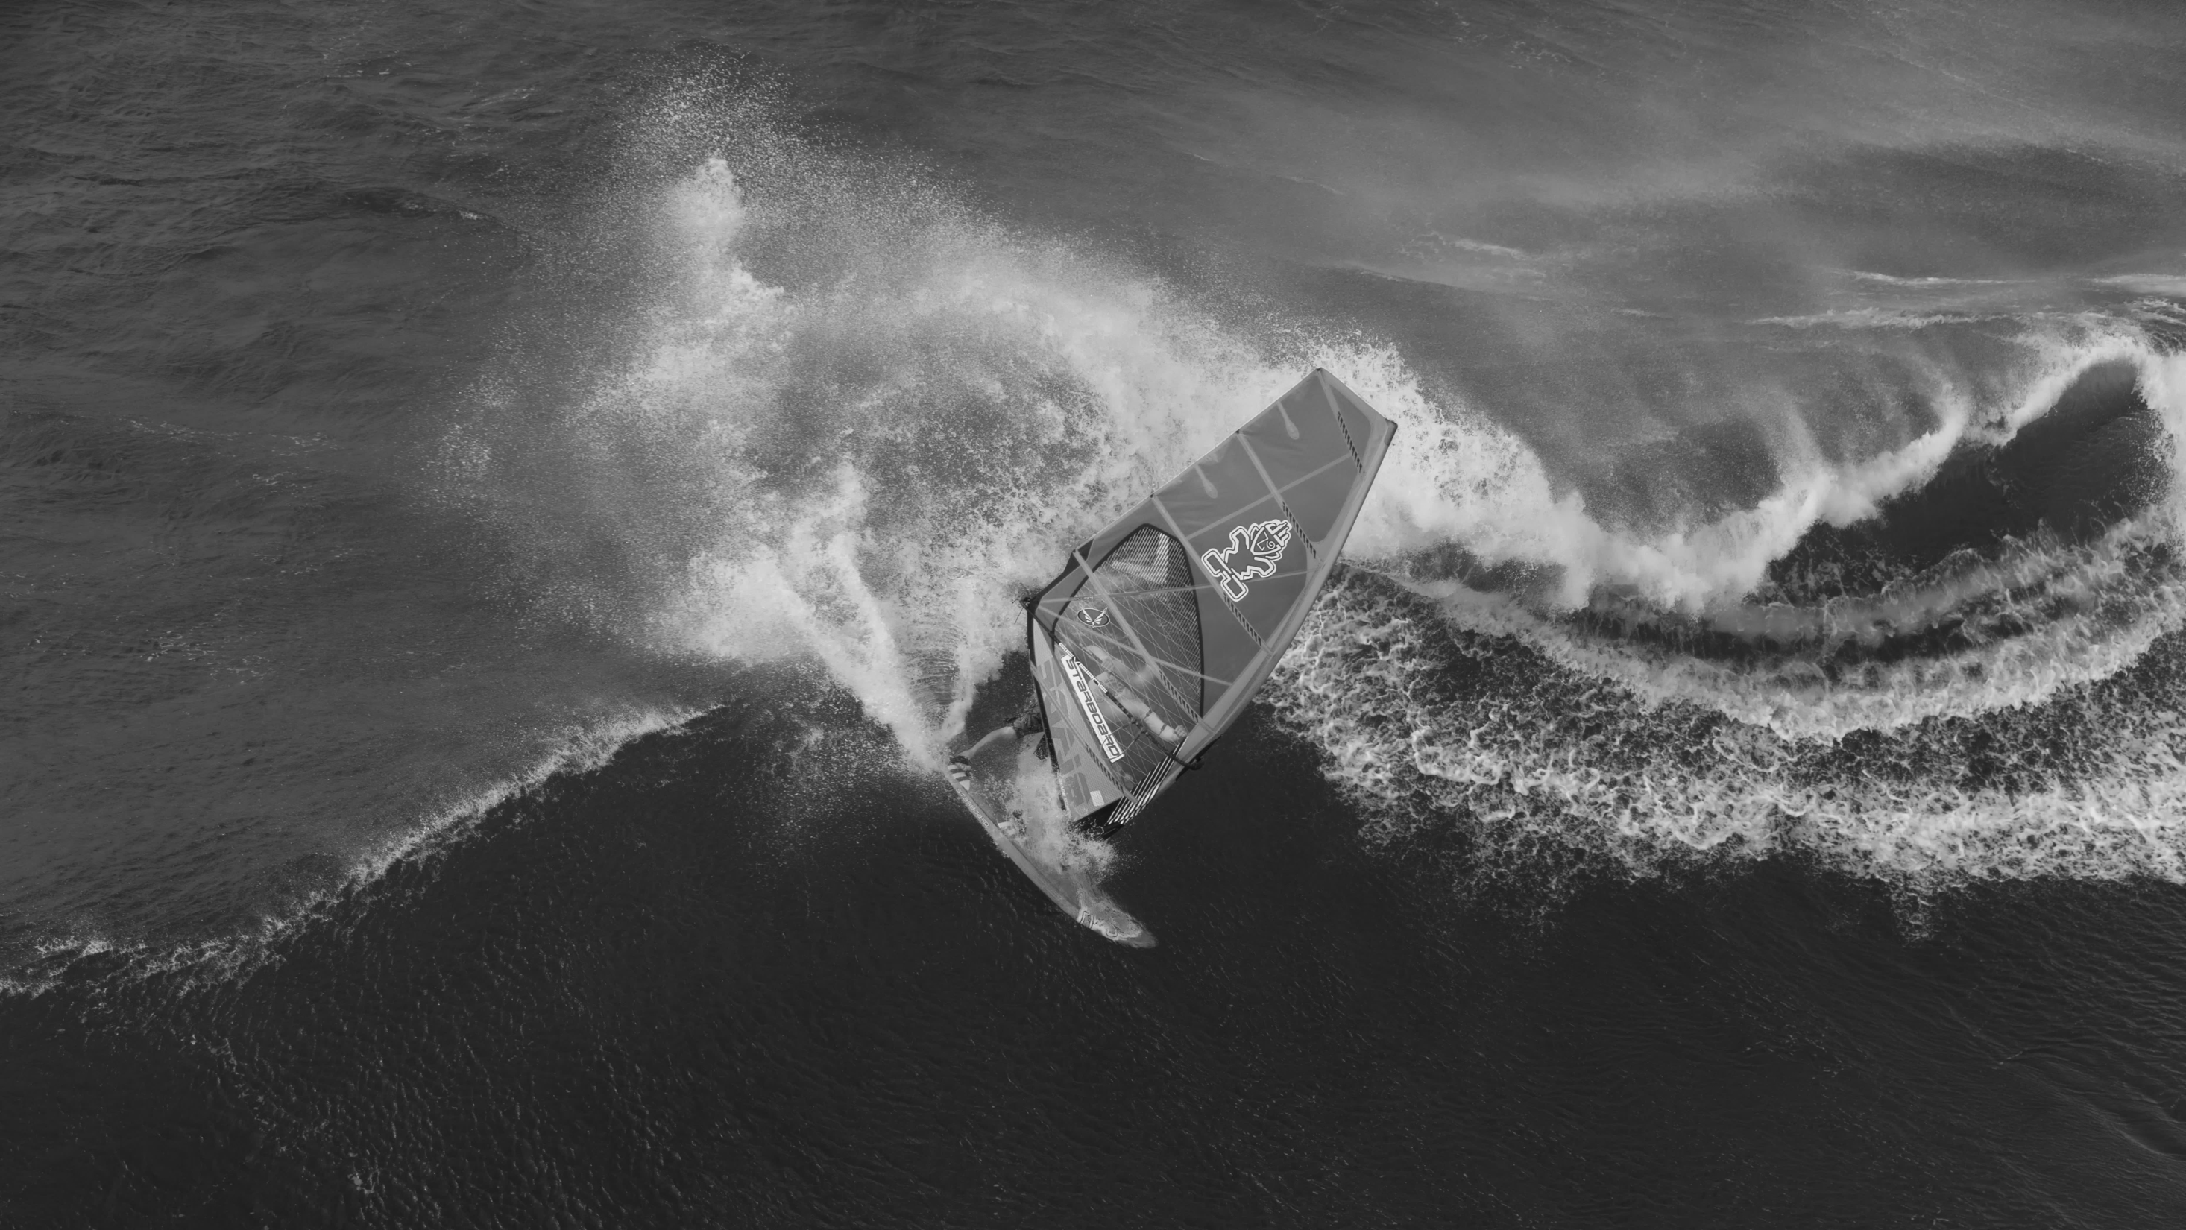
说明文、应用文类语篇what部分确定呈现探究分析
浙江 朱建焕 John

Slide 3
01
思路呈现与问题提出
02
设计理念
CONTENTS
03
教学步骤
04
学习重难点与收获

Slide 4
思路呈现与问题提出
说明文、应用文类语篇在引出主题和展现主题之后，接下去就是深化主题部分，而深化主题部分又可以细分为三个方面，即how(何种问题和解决方法)、why(产生问题的原因)和what (存在问题带来的后果)。在这三部分内容中，what部分主要是讲解主题所产生的影响和结果，因为相比较how和why，what部分内容相对来说难以界定，所以很容易被忽略。
通过探究分析说明文、应用文类语篇why部分，顺利解答相关阅读理解、七选五任务型阅读、语法填空和应用文写作等相关题型。
«

Slide 5
设计理念
通过先讲后练，层层推进的原则，既让学生能够学会在相关阅读理解、七选五任务型阅读、语法填空中确定what部分的内容，又能够在应用文写作中呈现what部分的内容，顺利答题得分。本课设计重在学生参与，做到讲练结合。
教学步骤
01
02
03
04
05
«
«
«
«
宏观讲述what部分内容的相关词汇知识。
2. 确定常规阅读理解的what部分的内容。
确定七选五任务型阅读what部分的内容
确定语法填空what部分的内容
呈现应用文写作中what部分的内容

Slide 6
学习重难点与收获
难点
重点
通过本课件学习，学生应该重点掌握有关what部分内容的相关知识和确定呈现what部分内容，高效准确解答题目。
what部分内容在常规阅读理解、七选五任务型阅读与how部分内容、why部分内容的区分。
what部分内容在语法填空中语言知识的落实。
what部分内容在应用文写作题型中的呈现。
期望收获：
1. 通过本课件学习，学生能够学会在相关阅读理解、七选五任务型阅读、语法填空中确定what部分的内容。
2. 通过本课件学习，学生能够在应用文写作中呈现what部分的内容。
«

Slide 7
简单讲解说明文、应用文类语篇what部分的感情色彩和表达方式。
简单讲解说明文、应用文类语篇what部分的感情色彩和表达方式。
说明文、应用文类语篇中表达what部分的感情色彩主要分为红色褒义结果和评价以及黑色贬义结果和评价。
评价和结果往往围绕着主题展开，评价内容往往是虚写为主，结果则往往是通过数据、现象实写为主。
说明文、应用文类语篇中表达what部分的表达方式主要是正面引用评价和侧面概括评价两种。正面引用评价往往采用直接引语的表达形式，而侧面概括评价则采取总结性语言的表达形式。

Slide 8
常规类阅读理解篇章what部分内容
1). 2020年7月阅读理解A篇
For all of Bellevue’s success, adaptive signals are not a cure-all for jammed roadways. Kevin Balke, a research engineer at the Texas A&M University Transportation Institute, says that while smart lights can be particularly beneficial for some cities, others are so jammed that only a sharp reduction in the number of cars on the road will make a meaningful difference. “It’s not going to fix everything, but adaptive signals have some benefits for smaller cities,” he says.
In Bellevue, the switch to adaptive signals has been a lesson in the value of welcoming new approaches. In the past, there was often an automatic reaction to increased traffic: just widen the roads, says Mark Poch, the Bellevue Transportation Department’s traffic engineering manager. Now he hopes that other cities will consider making their streets run smarter instead of just making them bigger.
使用侧面概括来表达红色what部分内容，即Bellevue的交通管理措施受到欢迎，这部分评价内容通过虚写手法来展开。

Slide 9
常规类阅读理解篇章what部分内容
2). 2022年1月阅读理解B篇
These women were then tested for dementia six times over the following four decades. During that time, 44 of the women developed dementia. Five percent of the highly fit women developed dementia, compared to 25 percent of the women with medium fitness and 32 percent of the women with low fitness.
"However, this study does not show cause and effect between cardiovascular fitness and dementia, it only shows an association.” said Horder. More research is needed to see if improved fitness could have a positive effect on the risk of dementia and also to look at when during a lifetime a high fitness level is most important." She also admitted that a relatively small number of women were studied, all of whom were from Sweden, so the results might not be applicable to other groups.
使用正面引用评价和侧面概括评价两种方式结合来表达黑色what部分内容，即有规律锻炼对于治疗妇女的失智症的效果还是有待检验。在正面引用评价的时候作者采取实写的手法，而在后面侧面概括部分作者则采用了虚写的手法，只是讲到“可能不适用于其他团队”。

Slide 10
七选五任务型阅读what部分的内容
2019年6月浙江七选五任务型阅读
Rock music consists of many different styles. Even though there is a common spirit among all music groups, they make very different music. 31. _______________ At that time the Beatles entered the world of music from Liverpool.
After they were given an invitation to appear live on BBC, the Beatles quickly became famous in Britain with nationwide tours. By mid-1963, the Beatles had been extremely popular in England. 32. ____________________ They held large concerts and performed at clubs. They became the hottest thing on the pop music scene in England. They began as a modestly successful musician group and ended the year as show business legends（传说）. John Lennon and Paul McCartney were named composers of the year.
33.___________________ They were not sure how the Americans would react to the new type of music. Beatlemania hit New York on February 7, 1964. Hundreds of fans jammed the airport to greet them. 34. ____________________ The concert was broadcast live and attracted the largest one night audience in the history of television up to that time. The Beatles were described as a British invasion（入侵）by local and nationwide newspapers at that time. Their victory in America was still remembered as a major turning point in the history of rock and roll. Thanks to the Beatles, a lot of opportunities were opened up to new faces on the market. 35. _____________________
A. They decided on a tour to the United States in 1964. B. Even their hairstyles became major trends at that time.
C. Rock music developed in the 1950s and the early 1960s. D. However, their songs changed the lives of generations to come.
E. Many rock bands were able to follow in the footsteps of the Beatles.
F. They appeared in the films A Hard Day's Night（1964）and Help！（1965）.
G. They performed their first concert in America at CBS television's 53rd street studio.
32题主要描述的是the Beatles乐队在英国受到欢迎的程度，色彩偏红，只有选项B项“在那时即使他们的发型也是很受欢迎”符合描述褒义what的内容，所以是正确答案。命题者在设计本题时采用虚实结合的手法，前面虚写乐队的受欢迎，而后面用具体现象实写来证明乐队的被欢迎，两者相互映照。

Slide 11
语法填空篇章what部分内容
2018年7月浙江省高考英语试卷语法填空题
Few people I know seem to have much desire or time to cook. Making Chinese 56. __________ (dish) is seen as especially troublesome. Many westerners 57. __________come to China cook much less than in their own countries once they realize how cheap 58. ___________ can be to eat out. I still remember 59. ______ (visit) a friend who’d lived here for five years and I was 60. ____ (shock) when I learned she hadn’t cooked once in all that time. While regularly eating out seems to 61. ______ (become) common for many young people in recent years, it’s not without a cost. The obvious one is money; eating out once or twice a week may be 62._______ (afford) but doing this most days adds up. There could be an even 63. _______ (high) cost on your health. Researchers have found that there is a direct link between the increase in food eaten outside the home and the rise in 64. ______ (weigh) problems.
If you are not going to suffer this problem, then I suggest that the next time you go to your mum’s home 65. _______________ dinner, get a few cooking tips from her. Cooking food can be fun. You might also begin to notice the effects not only on your health but in your pocket.
使用侧面概括的方式来表达what部分贬义内容，即外出吃饭带来的钱方面的弊端。命题者先采用反衬法先扬后抑来虚写外出吃饭的弊端，然后再实写具体的两个问题，一为费用，二为健康。

Slide 12
语法填空篇章what部分内容
2018年7月浙江省高考英语试卷语法填空题
Few people I know seem to have much desire or time to cook. Making Chinese 56. ___dishes_______ (dish) is seen as especially troublesome. Many westerners 57. __who/that________come to China cook much less than in their own countries once they realize how cheap 58. ___it___ can be to eat out. I still remember 59. _visiting_____ (visit) a friend who’d lived here for five years and I was 60. _shocked___ (shock) when I learned she hadn’t cooked once in all that time. While regularly eating out seems to 61. __have become____ (become) common for many young people in recent years, it’s not without a cost. The obvious one is money; eating out once or twice a week may be 62.__affordable_____ (afford) but doing this most days adds up. There could be an even 63. __higher_____ (high) cost on your health. Researchers have found that there is a direct link between the increase in food eaten outside the home and the rise in 64. _weight_____ (weigh) problems.
If you are not going to suffer this problem, then I suggest that the next time you go to your mum’s home 65. _____for___ dinner, get a few cooking tips from her. Cooking food can be fun. You might also begin to notice the effects not only on your health but in your pocket.

Slide 13
应用文写作篇章what部分内容
2021年6月浙江省高考应用文写作
昨天你参观了学校举办的学生国画作品展，请给校英语报写一篇宣传稿，内容包括：
1. 展览时间、地点； 2. 观展感受； 3. 推荐观展。
注意：
1.词数80左右； 2. 可以适当增加细节，以使行文连贯。
A Traditional Painting Exhibition
In a praiseworthy attempt to cultivate students’ love for traditional culture, a traditional cultural painting exhibition is held at our school hall from Monday to Friday.
Yesterday I was deeply impressed by those wonderful works at the sight of their graceful colors. Those paintings which illuminate the true essence of Chinese traditional culture made me feel proud and mentally touched. The exhibition is actually a feast for eyes and minds.
Save your hesitation and go to enjoy the exhibition. Immersing you in charm of traditional painting. The exhibition won’t make you disappointed.
使用侧面概括的方式来表达what部分褒义内容，即画展给我带来的正面的影响和我对这个画展的正面评价。前面先虚写说明我被画展深深吸引，然后接下去实写画展具体对我的吸引之处，虚实结合展现作者对画展的评价。

Slide 14
配套训练（一）
Children as young as 5 years old are less likely to help a person in need when other children are present, according to a new study. “Children at this age take responsibility into consideration when deciding whether to help,” explains psychological scientist and lead researcher Maria Plötner.
Previous research has shown that children are generally very helpful, but few studies specifically looked at whether the presence（在场）of others affects this helping behavior.
To find out, Plötner and colleagues invited 60 5-year-olds to participate（参加）in the study. The children were told that they would be choosing a picture and coloring it in. Some children colored with only the researcher present in the room, while others colored at the same time with two other children. The participants didn’t know that the other two children were actually part of the experiment and they behaved according to a script（剧本）.
Before the coloring started, the researcher noticed a water puddle and she cleaned it with paper towels. She left the remaining paper towels on the floor, just “in case（以防）something needs to be cleaned later.” After about half a minute of coloring time, the researcher “accidentally” knocked over her cup of colored water. She tried to hold the water back with her arms. After about 15 seconds, she looked at the water, and said “Oops” to call the children’s attention.
Of all the children who did get paper towels for the researcher, those who were alone with the researcher in the room were faster to help than those who were in the room with the other two children who offered help according to the script. The study result shows that the bystander effect — a social phenomenon shown in adults — is evident in children as young as 5 years old.
28.What is the new study mainly about?
A. Whether children are helpful.
B. Whether children are responsible.
C. Whether the 5-year-olds will help other children.
D. Whether the presence of others affects children’s helping behavior.

Slide 15
配套训练（二）
How would you feel if you were sharing a personal story and noticed that your friend wasn't really listening? You probably wouldn’t be too excited. Without active listening, people often feel unheard and unacknowledged. 31. ___________________________
Listen without making judgments. Most people tend to judge others during conversations. 32. _______________________ If you let your opinions come into play, they may ruin the conversation. However, if you enter a discussion with the goal of understanding someone else' opinion, they will want to have deeper discussions with you.
33.__________________ Physically showing that you’re listening doesn’t come naturally for everybody. But if someone is ready to open up to you，and you sit back with your arms crossed without saying a word, they’re not going to say much. To encourage someone to keep talking, focus on the speaker by turning your head and body to face them and by making eye contact.
Ask questions. Asking questions is one of the best ways to show you're interested. If someone is telling you about their ski trip，don’t respond with “That’s nice.” 34. _________ Instead，you can ask, “How long have you been skiing?” or “What was your favorite part of the trip?” The person will think highly of you because you have asked a few questions.
Think before responding. After the speaker has finished talking, a good listener may take some time before responding. Simply take a few seconds to think or say, “Give me a second to think about that.” Doing so either makes the speaker first feel you’re listening to what they’re saying. 35. ________________ In this way, it will make the speaker feel comfortable as they see you processing what they've said.
A. Use positive body language.
B. Pay attention to the speaker’s judgement
C. That would show a lack of interest and disrespect.
D. Give the speaker a chance to correct your understanding.
E. But judging isn’t helpful when you’re having a conversation.
F. Then they will know you want to be thoughtful in your response.
G. That’s why it’s important for everyone to learn how to be a better listener.
Answers: 1. G 2. E 3. A 4. C 5. F

Slide 16
配套训练（三）
The home crowd erupted when China’s Eileen Gu won the women’s big air free skiing gold in Beijing.
Gu jumped into the top position with her third run, 1. ____________(score) 94.50. Her total score was 188.25 in the event’s debut at the Winter Olympics.
The 18-year-old, who also 2. ______________(go) by her Chinese name, Gu Ailing , is a freestyle skier, model and grade-A student with 3. _____________ American father and a Chinese mother. She grew up in the United States. It was there 4. _______________she grew to love skiing. By2018,she was representing the US in the world cup for the sport.
Then, she decided to switch from representing the US 5. ____________representing China. It was a decision met with shock and 6. _______________ (confuse) from her growing fan base but Gu was 7. _______________(determine), sharing her reasoning on Instagram at the time.
"This was an 8. ___________(incredible) tough decision for me to make... Through skiing, I hope to unite people, promote common understanding , create communication, and forget friendships between 9. ________(nation). If I can help to inspire one young girl 10. __________(break) a boundary, my wishes will have come true.
Answers: 1. scoring 2. goes 3. an 4. that 5. to
6. confusion 7. determined 8. incredibly 9. nations 10. to break

Slide 17
配套训练（四）
为庆祝中国女足亚洲杯决赛夺冠，你校英语社团拟开展以“Be Proud of Our Steel Roses”为主题的征文活动，请你写一篇短文投稿。内容包括：
1. 表达激动心情； 2. 诠释女足精神； 3. 分享个人感悟。
注意：
1. 写作词数应为80左右； 2. 请按如下格式在答题卡的相应位置作答。
Be Proud of Our Steel Roses
One possible version:
Referred to as Steel Roses, the Chinese woman soccer team players, have won our worship and respect recently.
I am extremely thrilled by the feat that the Chinese women’s soccer team delivered in the Asian Cup. With two goals behind, no one believed the Chinese team could win in the Asian Cup final, except the players themselves. Facing difficulties, they never give up but always make adequate preparations for tough challenges.
They convince me that with persistent efforts everyone deserves the championship. Uplifted by the Steel Rose’s spirits, I will go all out to pursue my dream.

Slide 18
Thanks

