Slide 1
感恩遇见，相互成就，本课件资料仅供您个人参考、教学使用，严禁自行在网络传播，违者依知识产权法追究法律责任。
更多教学资源请关注
公众号：溯恩高中英语
知识产权声明

Slide 2
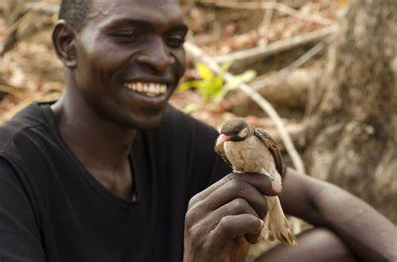
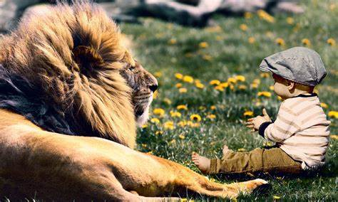
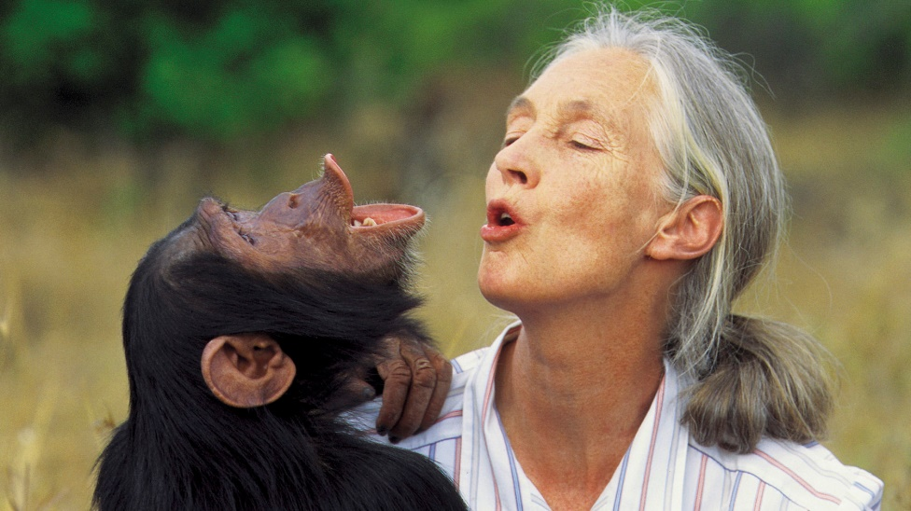
2023年英语首考读后续写
人与动物的“二三事”
What can you see in the pictures?
What’s the relationship between animals and human beings?
How can we maintain the harmony?
Notes:
human and animals - Bing images

Slide 3
What to read
How to write
Characters
Setting
Plot-theme
POV
Language
What to write
all-rounded synergy (协同)
plotting—highlight the theme and personality of characters
two opening paragraphs

Slide 4
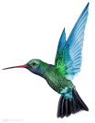
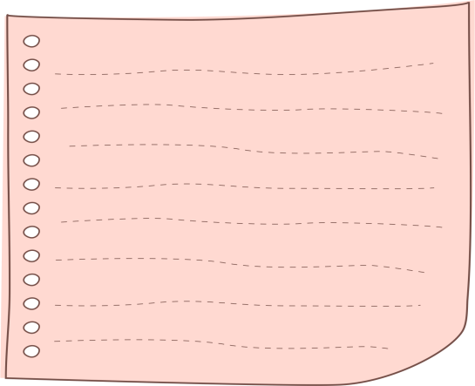
精读原文
Characters
Setting
Plot
—the encounter
❶ I was invited to a cookout on an old friend’s farm in western Washington. I parked my car outside the farm and walked past a milking house which had apparently not been used in many years. A noise at a window caught my attention, so I entered it. It was a hummingbird (蜂鸟), desperately trying to escape. She was covered in spider-webs (蛛网) and was barely able to move her wings. She ceased her struggle the instant I picked her up.
❷ With the bird in my cupped hand, I looked around to see how she had gotten in. The broken window glass was the likely answer. I stuffed a piece of cloth into the hole and took her outside, closing the door securely behind me.
❸ When I opened my hand, the bird did not fly away; she sat looking at me with her bright eyes. I removed the sticky spider-webs that covered her head and wings. Still, she made no attempt to fly. Perhaps she had been struggling against the window too long and was too tired? Or too thirsty?
❹ As I carried her up the blackberry-lined path toward my car where I kept a water bottle, she began to move. I stopped, and she soon took wing but did not immediately fly away. Hovering (悬停), she approached within six inches of my face. For a very long moment, this tiny creature looked into my eyes, turning her head from side to side. Then she flew quickly out of sight.
❺ During the cookout, I told my hosts about the hummingbird incident. They promised to fix the window. As I was departing, my friends walked me to my car. I was standing by the car when a hummingbird flew to the center of our group and began hovering. She turned from person to person until she came to me. She again looked directly into my eyes, then let out a squeaking call and was gone. For a moment, all were speechless. Then someone said, “She must have come to say good-bye.”
I met a hummingbird trapped in webs.
Theme
I rescued the hummingbird
and she showed gratitude before flying away.
Pay attention to the interaction of characters and see how it develops over time
(some cohesive words—still; again…)

Slide 5
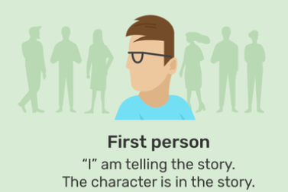
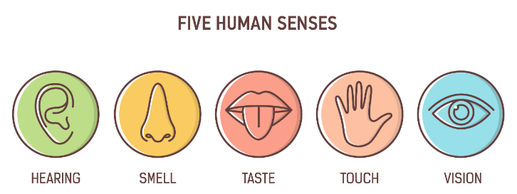
POV (point of view)
Language
Description from the 1st person limited point of view
hearing | A noise at a window caught my attention. …then let out a squeaking call … Then someone said, “She must have come to say good-bye.”
vision | She was covered in spider-webs (蛛网) and was barely able to move her wings. She ceased her struggle… With the bird in my cupped hand, I looked around to see how she had gotten in. When I opened my hand, the bird did not fly away; she sat looking at me with her bright eyes. I stopped, and she soon took wing but did not immediately fly away. Hovering (悬停), she approached within six inches of my face. For a very long moment, this tiny creature looked into my eyes, turning her head from side to side. Then she flew quickly out of sight. I was standing by the car when a hummingbird flew to the center of our group and began hovering. She turned from person to person until she came to me. She again looked directly into my eyes, …
touch | I removed the sticky spider-webs that covered her head and wings.
thinking | Perhaps she had been struggling against the window too long and was too tired? Or too thirsty?
1. “she” — pronoun— to directly narrate what “I” saw, heard, touched and thought
— personification (rhetorical device 修辞手法)
2. “the bird, this tiny creature, a hummingbird” — use different/ varied names to avoid repetition.

Slide 6
Language
1. “she” — pronoun— to directly narrate what “I” saw, heard, touched and thought
— personification (rhetorical device 修辞手法)
2. “the bird, this tiny creature, a hummingbird” — use different/ varied names to avoid repetition.
3. use some cohesive words—still; again… to show how interaction of characters develops over time
4. use simple but descriptive words and expressions
With the bird in my cupped hand…
Hovering (悬停), she approached within six inches of my face.
… this tiny creature looked into my eyes, turning her head from side to side.

Slide 7
首句分析
What for this time?
Para.1 A few weeks later, I went to the farm again.
Para.2 I was just about to leave when the hummingbird appeared.
Change of setting
I was invited by my old friend.
The old friend mentioned the regular visit of the hummingbird.
I waited but she didn’t come.
I felt lost.
I myself wanted to check the condition of the hummingbird.
I searched the forest but didn’t see her.
I felt lost.
The second encounter
What I saw, heard, touched and thought about the appearance of the hummingbird.
What the hummingbird did.
What I did and said; How I felt.
Ending./ What I reflected on this experience. (theme)
interaction of the hummingbird and “I”

Slide 8
协同——主题、情节、情感、语言、人设、视角协同——呼应
Foreshadowing | Echoing
I parked my car outside the farm and walked past a milking house… A noise at a window caught my attention… They promised to fix the window. | My car pulled into the track leading to the milking house and braked in front of the window, which apparently had been fixed. (Para. 1 transitional sentence) This time, my old friend invited me to have a feast of self-made delicacies and joked that the hummingbird was waiting for my return. (Para. 1 transitional sentence)
When I opened my hand, the bird did not fly away; she sat looking at me with her bright eyes. As I carried her up the blackberry-lined path toward my car…she soon took wing but did not immediately fly away. Hovering (悬停), she approached within six inches of my face. For a very long moment, this tiny creature looked into my eyes, turning her head from side to side. Then she flew quickly out of sight. …when a hummingbird flew to the center of our group and began hovering... She again looked directly into my eyes, then let out a squeaking call and was gone. | The second encounter (Para. 2) Suddenly, a squeak caught my attention. Following where the sound was coming, I stepped into the blackberry bushes and spotted a familiar tiny creature hovering in the air./ Driven by a strong instinct,/ Feeling spiritually connected to her, I stepped inside and… With great ecstasy, I moved closer. Upon seeing me approaching, instead of flying away, she hovered a while, then dived down and rested/ landed on my hand. Just like before, this tiny creature looked straight into my eyes and chanted a cheering song as if to celebrate our “reunion”. She was sure to recognize me– she took wing from the branch and flew directly to me, hovering around within only six inches of my face and stared into my eyes for a prolonged period of time.
Perhaps she had been struggling against the window too long and was too tired? Or too thirsty? For a moment, all were speechless. Then someone said, “She must have come to say good-bye.” | Perhaps she had been waiting here for such a long time just to “reunite” with me! (Para. 2) “She must have come to meet you.” exclaimed the host. (Para. 2 Ending)

Slide 9
Possible versions from Nina
Para.1 A few weeks later, I went to the farm again. ❶My car pulled into the track leading to the milking house and braked in front of the window, which apparently had been fixed. ❷When I was enjoying the refreshing scent of grass along the blueberry-lined path, my friend came along and we shared about the busy fleeting days. ❸Then he mentioned that the hummingbird paid regular visits to the farm, which would hover around for a long time before flying away. ❹ “She would come today, I suppose.” added the host in a mocking and expectant voice. ❺ Anticipation instantly triggered, I waited for her appearance as I had dinner, chatted, and took a walk, but she didn’t come. ❻ My heart seemed to be hollowed out, and I thought to myself jokingly, “Am I waiting for a hummingbird?”
Para.2 I was just about to leave when the hummingbird appeared. ❶There she was beside my car! ❷With great ecstasy, I moved closer. ❸Upon seeing me approaching, she took wing, circled around me for a while, then dived down and landed on my hand. ❹Just like before, this tiny creature looked straight into my eyes and chanted a cheering song as if to celebrate our “reunion”. ❺Perhaps she had been waiting here for such a long time just to “reunite” with me! ❻So was I! ❼Immersed in the merry get-together, I couldn’t help tickling her cute little head and cupped her to my heart. ❽ With a tab on the phone, the host froze this cozy moment for me, which would always remind me of this miracle encounter and that we can live in harmony with different species as long as we show some sympathy and respect (主题句——总结+主题).

