Slide 1

感恩遇见，相互成就，本课件资料仅供您个人参考、教学使用，严禁自行在网络传播，违者依知识产权法追究法律责任。
更多教学资源请关注
公众号：溯恩高中英语
知识产权声明

Slide 2
2022年6月全国新高考I卷
应用文分析
Phyllis Shen
Huzhou Binhu High School
June 2022

Slide 3
Revision
假定你是校广播站英语节目“Talk and Talk”的负责人李华，请给外教Caroline写邮件邀请她做一次访谈。内容包括：
1.节目介绍；
2.访谈的时间和话题。
注意：
1.写作词数应为80左右；
2.请按如下格式在答题卡的相应位置作答。
It is an invitation letter.
Dear Caroline, Yours sincerely, Li Hua

Slide 4
What is an invitation letter?
An invitation letter is a type of letter written to an organization or an individual for their participation or presence in an event or an occasion.
The occasion can be official or personal.
Two types of invitation letters:
Formal Invitation Letters (Business Invitation Letters)
Informal Invitation Letters (Friendly Invitation Letters)

Slide 5
How to format a letter of friendly invitation?
Introduce the program briefly
Request a confirmation and express your anticipation of the reader’s acceptance
Start with a friendly but appropriate greeting
1
3
5
2
4
Mention the purpose of your invitation
Clearly state the exact time and explain about the topic

Slide 6
How to arrange the layout?
Beginning (Para. 1) | Start with a friendly but appropriate greeting and mention the purpose of your invitation
Body (Para. 2) | Introduce the program briefly | Clearly state the exact time and explain about the topic
Ending (Para. 3) | Request a confirmation and express your anticipation of the reader’s acceptance
The most important paragraph in this letter.

Slide 7
Start with a friendly but appropriate greeting and mention the purpose of your invitation
假定你是校广播站英语节目“Talk and Talk”的负责人李华，请给外教Caroline写邮件邀请她做一次访谈。
Dear Caroline, Yours sincerely, Li Hua
You can use “Dear” for a friend, but not for a boss.

Slide 8
Start with a friendly but appropriate greeting and mention the purpose of your invitation
假定你是校广播站英语节目“Talk and Talk”的负责人李华，请给外教Caroline写邮件邀请她做一次访谈。
E.g. Responsible for the radio program “Talk and Talk”, I would like to invite you to have an interview with us.

Slide 9
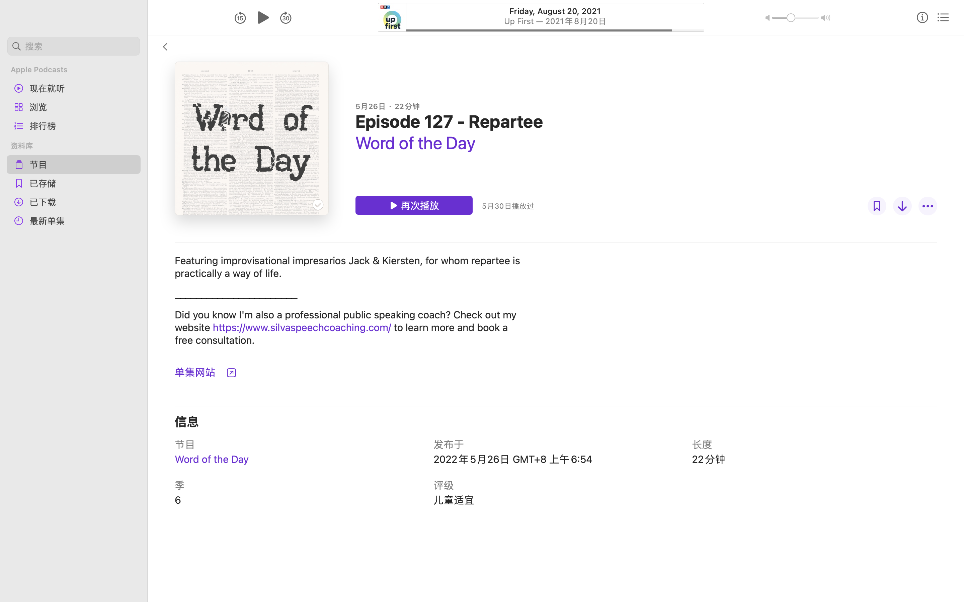
Introduce the program briefly
内容包括：
1.节目介绍；
2.访谈的时间和话题。
Use V-ing
as an adv modifier to illustrate the program’s feature
E.g.
Featuring school life and the hot spots, “Talk and Talk” is an Engslih program which meets you every week via the school radio and aims to give you advice on your study as well as your life.

Slide 10

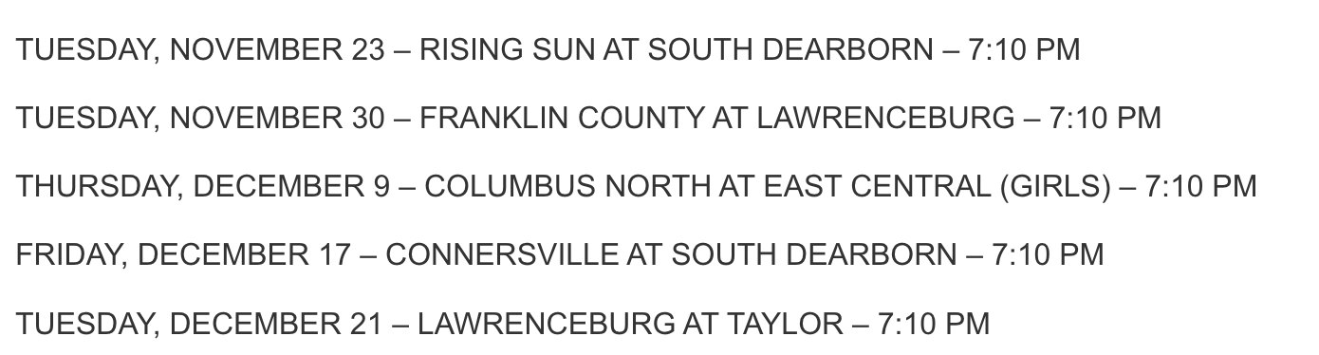
Clearly state the exact time and explain about the topic
内容包括：
1.节目介绍；
2.访谈的时间和话题。
The date and time should both be exact and proper for high school students to listen to and enjoy.

Slide 11


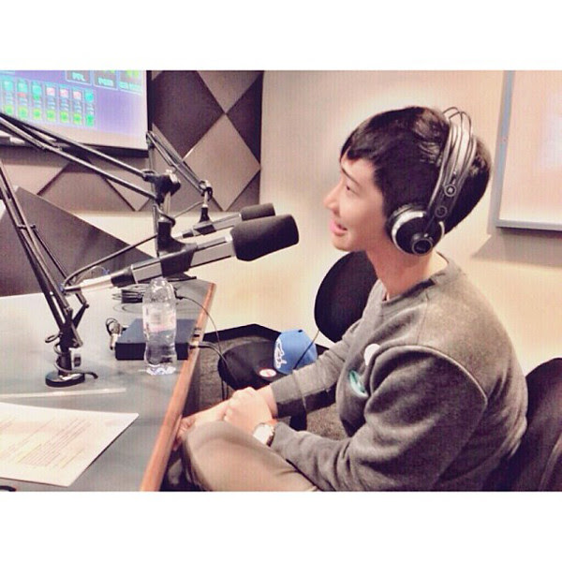

Clearly state the exact date and explain about the topic
内容包括：
1.节目介绍；
2.访谈的时间和话题。
Li Hua, a high school student
Caroline, a foreign English teacher
What will they talk about and what kinds of question will Li Hua raise?

Slide 12
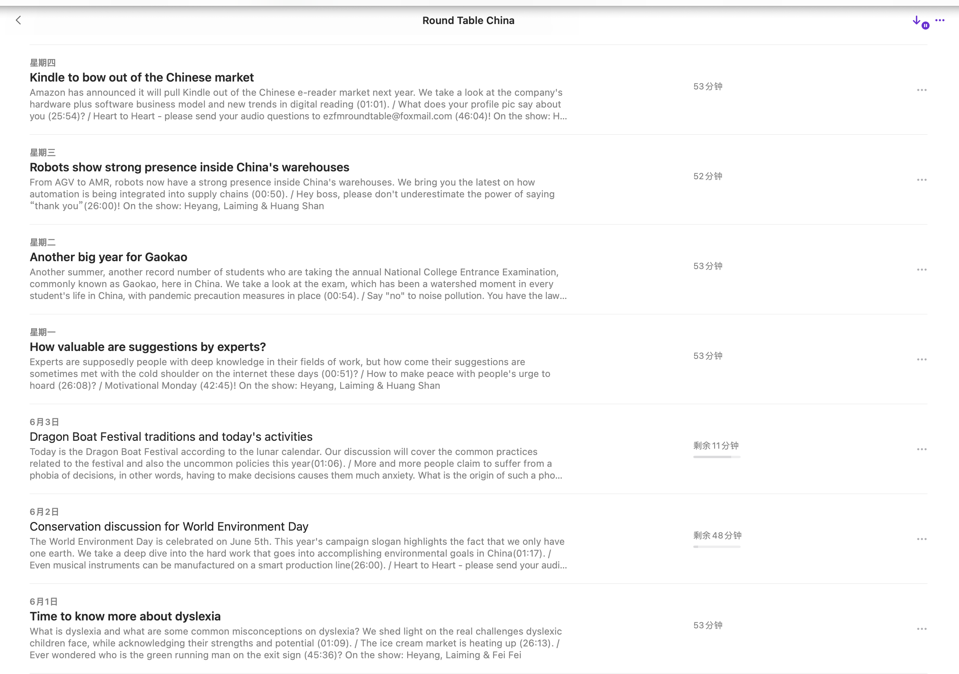
Sample topics

Slide 13
Brainstorm the topics for the interview
social phenomena
personal experience
school life
language and culture

Slide 14

Possible questions for school life
How much sport did you do at school? Is sport important for school kids?
Were art classes important at your school?
Did you learn any practical subjects like woodwork or cooking? What do you think about that kind of practical education?
Were your schools single-sex or co-educational/mixed? Which style is better?
Were you involved in any musical or theatrical performances at school? What memories of these events do you have?
school life

Slide 15
Possible questions for personal experience
personal experience
Why are you interested in teaching at this school?
What is your greatest professional accomplishment?
How do you use technology in the classroom?
What would you do if a student is in danger of failing your class?
What adjectives would you use to describe your presence in the classroom?

Slide 16
Possible questions for social phenomena
To what extent is the individual shaped by society?
To what extent does our social class background affect our life chances?
To what extent does our gender affect our life chances?
To what extent does our ethnicity affect our life chances?
What are the strengths and limitations of a survey in helping us to understand human action?
social phenomena

Slide 17

Possible questions for the language and culture
What is your relationship to your native language and culture?
What is your relationship to other languages and cultures?
How does language shape your identity?
How does culture (or cultures) shape your identity?
In what way have you created your own culture and identity by adopting elements from those you have lived in?
language and culture

Slide 18
Request a confirmation and express your anticipation of the reader’s acceptance
Samples of warm sentences for reference:
I will be waiting expectantly to your reply for joining this interview.
I am looking forward to getting together with you in my the talk show.
It will be a pleasure to have a conversation with you in my radio program.
I would love for you to attend and hope to see you in my program.

Slide 19
Sample writing
Introduce the identity and the program briefly
Dear Caroline, I'm Li Hua, who is in charge of the English program "Talk and Talk "on our school's radio station. I'm writing to invite you to our live interview. I wonder whether you are available next Saturday afternoon. I will embody my questions as follows: Were you involved in any musical or theatrical performances at school? As an English teacher, why are you interested in teaching at our school? The interview will begin at 2:00 p.m. and last for 30 minutes. We are looking forward to getting together with you in our program. Yours sincerely, Li Hua
Clearly state the exact date and time and embody the questions
Request a confirmation and express your anticipation of the reader’s acceptance
92 words

Slide 20
Homework: write an invitation letter
假如你是校英语报记者李华，美国语言学专家Steven受邀将于下周给全体学生做一次线上讲座，你想在讲座前跟他预约一次简短的线上微访谈，内容包括：
1. 表面目的；
2. 预约时间；
3. 告知访谈内容。
注意：词数80左右；可适当增添细节。

Slide 21
Thank you!

