Slide 1
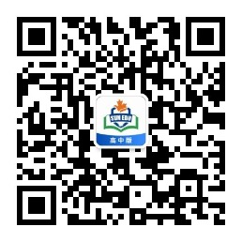
感恩遇见，相互成就，本课件资料仅供您个人参考、教学使用，严禁自行在网络传播，违者依知识产权法追究法律责任。
更多教学资源请关注
公众号：溯恩高中英语
知识产权声明

Slide 2
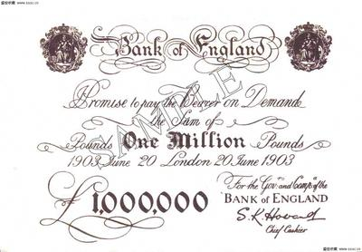
M3U5 The Value Of Money
Reading for writing

Slide 3
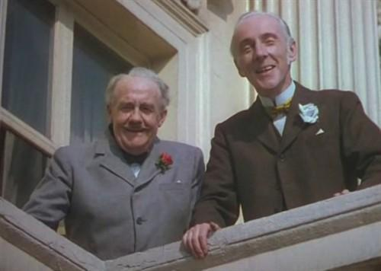
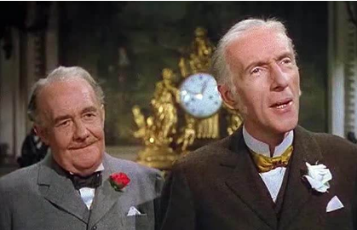
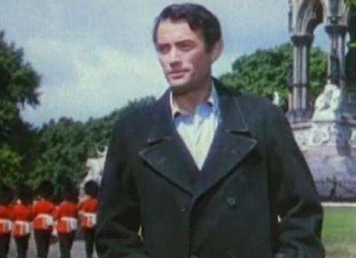
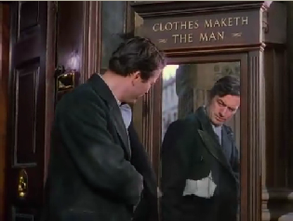
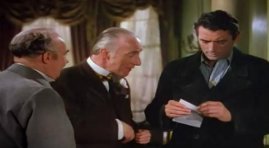
Lead-in
—— Retell the experience
The coat is ______. I need to go to ...
(wear-wore-worn)
worn
worn:_{adj} 破旧的，磨损的
Henry’s journey with the bank note
Where would Henry go?
C: Henry, the weathy brothers, servant
Tailor’s
shop
P: street, the brothers’ house
What would happen in
?
W: make a bet, the million pound bank note

Slide 4
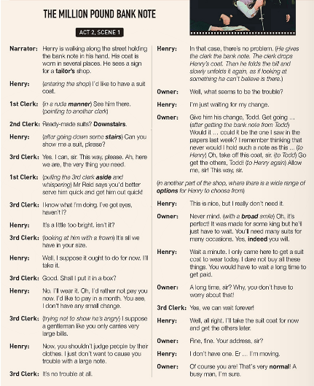

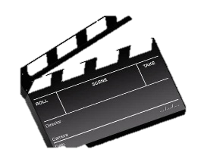




Prediction
—— The elements of a play
title of play
scene
character names
narration
lines of dialogue
stage directions

Slide 5
Read for Structure
While showing
1. Can you divide the scene into three parts, according to the bank note?
The change of the owner’s and clerks’ attitudes
Before showing
Henry was treated badly in the tailors shop
2. What’s the main idea of each part?
After showing
Henry was treated enthusiastically in the tailors shop

Slide 6
Read for Plots
What’s the owner’s/clerks’ attitude?
What happened to Henry detailedly?
1
Henry _______ the shop _______ a suit
———— in a rude manner
entered
to buy
Why?
downstairs
———— in a impatient manner
2
Henry was showed ___________with the _____________ suits.
ready-made
Revision of the Reading Tip
, rejected
take
but
————disbelieving
3
Henry would _____the suit ____ to pay later
4
You can get the hidden message and the emotions of characters from their lines, and the stage directions.
took out the bank note
, unbelievable
Henry___________________________.
———shocked
5
was guided to another part of the shop
Henry __________________________.
———patient, careful
6
Henry was provided with _____________
____________.
a wide range of options
———enthusiastic
, flattering
Never judge a book by its cover
7
Henry just needed one, and told the owner they would _________ after a long time.
get paid
Why?
was permitted to
8
Henry ________________ pay for the bill for a long time.
———happy, determined

Slide 7
Read for Plots
climax
Atmosphere
The development of the plots
1
4
8
Plots

Slide 8
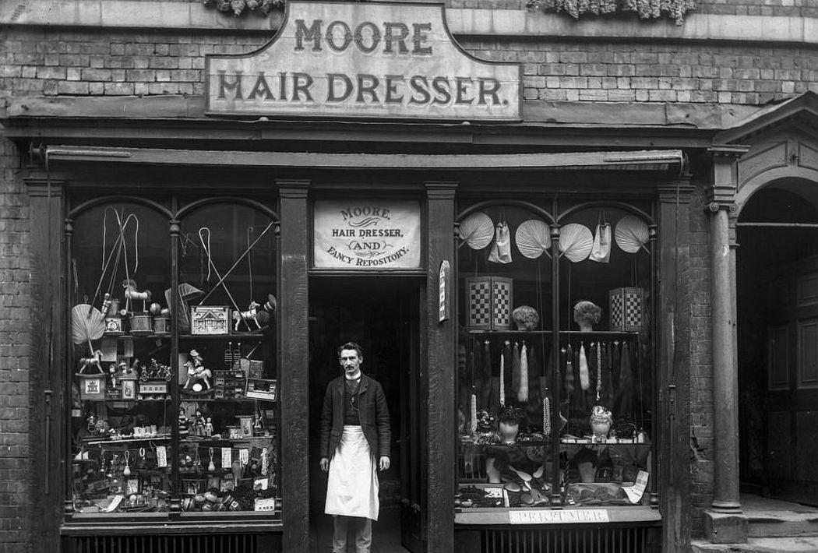
It’s Your Turn
After leaving the tailor shop, Henry wanted to have his hair cut, so what would happen to Henry in the barbershop? Please discuss and then write a short play for this part.
The Million Pound Bank Note
Act1 Scene 5
Narrator:…
Henry: …
Character A: …
Henry:…
Character B: …
(stage direction)
...
Helping clues:
1. Make a list of the characters.
2. Make an outline of the scenes(B--W--A) .
3. The change of the characters’ feeling in different scenes.
4. The dialogue happened among the characters.
5. The stage direction you may give.

Slide 9
Part of my version
The Million Pound Bank Note
Act1 Scene 5
Narrator: After leaving the tailor’s shop, Henry keeps walking along the street with the bank note in hand. When passing a barbershop, he sees his hair like straw. So he walks into it. (putting the note into pocket) 1st Barber: (in a normal manner) What can I do for you? Henry: ( point to a famous start’s photo) I want to make my hair look like that one. 1st Barber: (in an impatient way) Are you sure? Do you know how much will it take? Henry: I’m sure. Please have my hair cut like this. 1st Barber: OK. And Mary, wash his hair, please. Mary: (with a “please” gesture) This way, sir. 1st Barber: (walking to another barber) See this man. I bet that he cannot afford the prize. I’m busy now, and I can’t offer him my service. 2nd Barber: Me too. Never brother me. Mary: (after washing, and without looking at Henry) This way, sir. Please sit and wait here.

Slide 10
Part of my version
Henry: (nearly 15 minutes later). Huh, hello? Who can help to cut my hair? (A few seconds later) 3rd Barber: (hurry to Henry) Sorry, sir? Can I help you? Henry: Yeah, I want to have my hair cut like that one.(point to a famous start’s photo) 3rd Barber: Sorry, sir. But I have to tell you the prize of it first. Because I think that it may be a little expensive for you. Henry: (raise his eyebrow) Yeah? 3rd Barber: It’s a little expensive. You may have to pay at least 50 dollars. Henry: Thanks for telling me this. But I think maybe I can. (Then, he took out the bank note, unfold it on the table) ...

