Slide 1
感恩遇见，相互成就，本课件资料仅供您个人参考、教学使用，严禁自行在网络传播，违者依知识产权法追究法律责任。
更多教学资源请关注
公众号：溯恩高中英语
知识产权声明

Slide 2
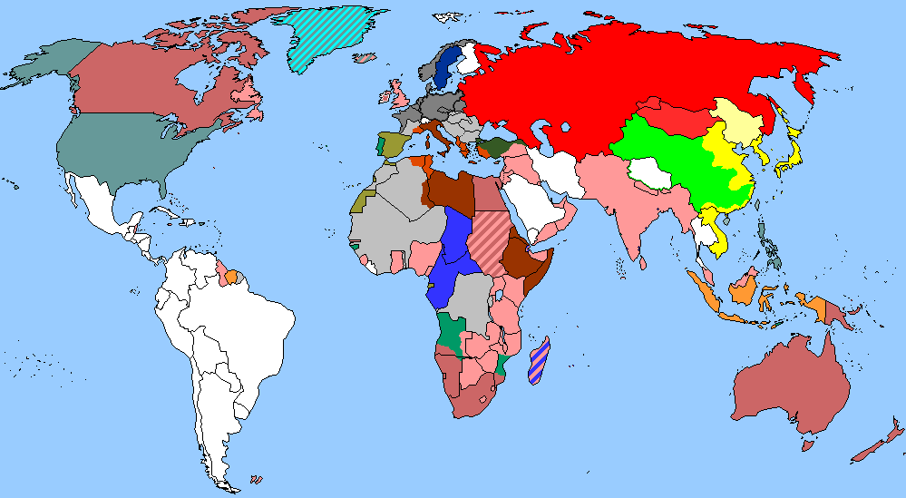
The World
August 16th-31st, 2022

Slide 3
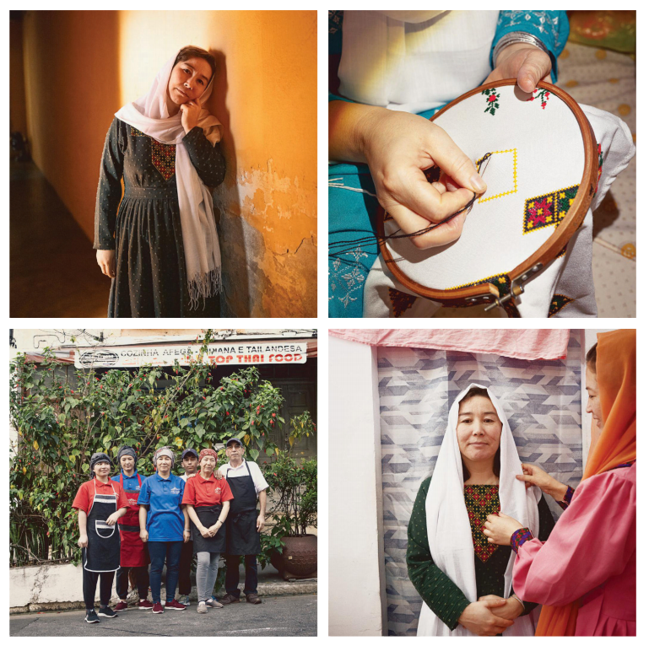
1.FAR FROM HOME
逃离塔利班，阿富汗妇女国外建立新生活
Clockwise from top left: Ebrahimi at the apartment she shares with five relatives; her recent embroidery work; with her cousin, who also fled Afghanistan; the family in front of their restaurant in Brazil

Slide 4
语篇填空
（《时代周刊》 2022年8月22日刊 43页）
NAJIBA EBRAHIMI LIVES in Freedom. It’s the Sao Paulo neighborhood where the 33-year-old has settled and what she feels she’s finally attained after ________ (escape) the Taliban. ___ champion for the rights of women and girls in the minority Hazara escapecommunity, Ebrahimi taught biology at a girls’ school in Afghanistan’s south-eastern Ghazni province and shared her love of sports ____ her students. That turned her into a target when the extremist group made its return.
In late August, she began receiving phone calls from _______ (vary) men using different ________ (number).” They said, “You shouldn’t be alive. If you stay here, you’ll die,” Ebrahimi says. So she ____ (flee). Her parents had left Afghanistan years ______ (early) for Brazil because of ethnic persecution. She crossed the mountains of Pakistan with her teenage daughter, brother, and cousin, the women under the cover of burqas. Her parents got to work on getting them visas.
Now Ebrahimi works in Sao Paulo with her family at their Afghan restaurant, Koh-I-Baba, ______ (name) for the mountains of her ethnic Hazara homeland. It’s a new start and also a return to _____ she loves most: life with her family and the freedom to be ______ (she).
escaping
A
with
various
numbers
fled
earlier
named
what
herself

Slide 5
词汇讲解
1. attain: to succeed in getting sth, usually after a lot of effort （通常经过努力）获得，得到
Most of our students attained five “A” grades in their exams. 我们多数学生的考试成绩是五个优。
2. persecution: cruel or unfair treatment of someone over a period of time, especially because of their religious or political beliefs 迫害
They are refugees who are fleeing religious persecution. 他们是逃离宗教迫害的难民。
翻译句子
越来越多的妇女在生活中获得权位。
More women are attaining positions of power.
翻译句子
他们因害怕遭受迫害而离开了这个国家。
They left the country out of fear of persecution.

Slide 6
句子翻译
A champion for the rights of women and girls in the minority Hazara community, Ebrahimi taught biology at a girls’ school in Afghanistan’s south-eastern Ghazni province and shared her love of sports with her students.
作为少数民族哈扎拉社区妇女和女孩权利的拥护者，Ebrahimi 在阿富汗东南部加兹尼省的一所女子学校教授生物学，并与她的学生分享她对运动的热爱。
翻译
Her parents had left Afghanistan years earlier for Brazil because of ethnic persecution. She crossed the mountains of Pakistan with her teenage daughter, brother, and cousin, the women under the cover of burqas. Her parents got to work on getting them visas.
由于种族迫害，她的父母几年前离开阿富汗前往巴西。她和十几岁的女儿、兄弟和表妹一起穿越了巴基斯坦的山区，她们都是披着罩袍的女人。她的父母必须努力为他们办理签证。
翻译

Slide 7
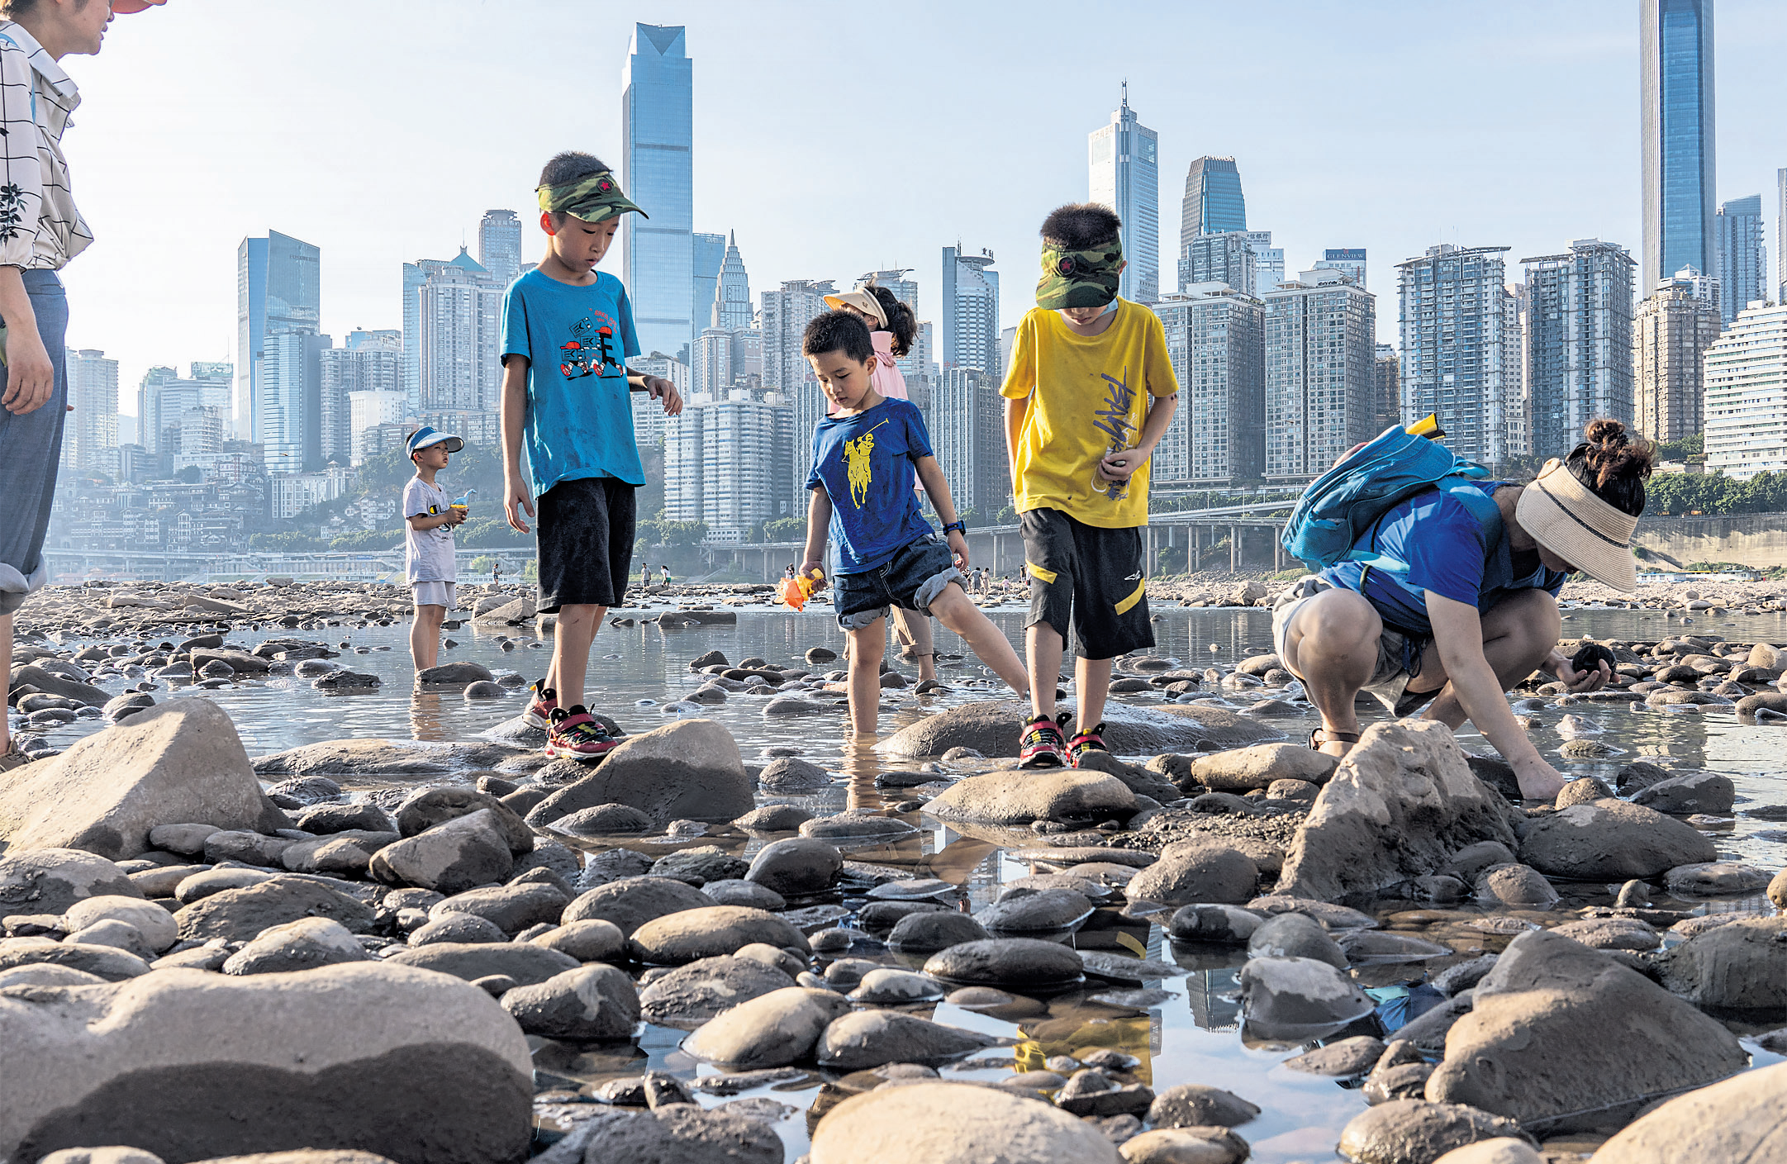
2.China Suffers Power Shortages as Yangtze Dries up in Heatwave
热浪袭人，长江干涸，中国电力短缺
Children catch crabs on the dry riverbed of the Jialing River, a major tributary of the Yangtze, in Chongqing. A nationwide drought alert has been issued.

Slide 8
语篇填空
（《卫报》 2022年8月23日 31页）
A
___ record-breaking drought has caused some rivers in China including parts of the Yangtze to dry up, affecting hydropower, halting shipping and _______ (force) major companies to suspend operations. A nationwide drought alert __________ (issue) on Friday as a long-running and severe heatwave in China’s _______ (heavy) populated south-west was forecast to continue well into September.
The loss of water flow to China’s _________ (extend) hydropower system has sparked a “grave situation” in Sichuan, ______ gets more than 80% of its energy from hydropower. Over the weekend the provincial government declared it was at __________ (high) warning level of “particularly severe”, with water flow to Sichuan’s hydropower reservoirs dropping by half. The demand ____ electricity has increased by 25% this summer and the reduction in hydropower has also reportedly affected downstream populations, including in Chongqing city and Hubei province.
Last week Sichuan suspended or limited power supply to thousands of ________ (factory) and rationed public electricity usage due to the ________ (short). Toyota, Foxconn and Tesla are among companies reported to have temporarily suspended operations at some plants over the last fortnight.
forcing
was issued
heavily
extensive
which
the highest
for
factories
shortage

Slide 9
词汇讲解
1. halt: to stop; to make sb/sth stop （使）停止，停下
The police were halting traffic on the parade route. 警察正阻止车辆在游行路线上行驶。
2. ration: to limit the amount of sth that sb is allowed to have, especially because there is not enough of it available 限定…的量；定量供应
Staples such as bread, rice, and tea are already being rationed. 面包、米、茶等主要食品已经是定量配给。
翻译句子
昨天，汽车厂的罢工工人完全停止了生产。
Striking workers halted production at the auto plant yesterday.
翻译句子
村民每天的用水量限定为两升。
The villagers are rationed to two litres of water a day.

Slide 10
句子翻译
A record-breaking drought has caused some rivers in China including parts of the Yangtze to dry up, affecting hydropower, halting shipping and forcing major companies to suspend operations.
一场破纪录的干旱已经导致包括长江部分地区在内的中国一些河流干涸，影响水电，导致航运中断，并迫使主要公司暂停运营。
翻译
Last week Sichuan suspended or limited power supply to thousands of factories and rationed public electricity usage due to the shortage. Toyota, Foxconn and Tesla are among companies reported to have temporarily suspended operations at some plants over the last fortnight.
上周，由于电力短缺，四川暂停或限制了数千家工厂的电力供应，并对公共用电进行了配给。据报道，丰田(Toyota)、富士康(Foxconn)和特斯拉(Tesla)等公司的一些工厂在过去两周暂停运营。
翻译

Slide 11
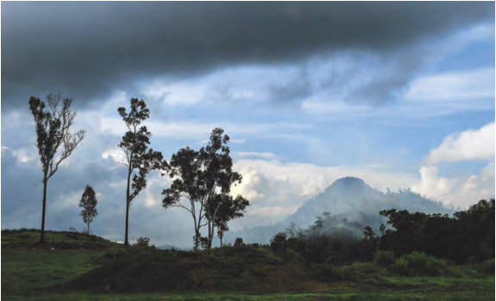
3. Fires in Australia damaged ozone layer, caused major warming, study says
澳洲大火破坏了臭氧层

Slide 12
语篇填空
《华盛顿邮报》2022年8月26日 A22
Australia’s fire season in late 2019 and early 2020 was extreme. It ______ (blow) smoke some 20 miles into the sky, not unlike what a nuclear blast might cause. Smoke from the fires circled the globe and hovered in plumes over the Pacific.
Now, a study _________ (publish) Thursday in the journal Scientific Reports suggests the smoky aerosols caused the highest temperatures in the stratosphere in about three decades and ________ (probable) damaged the ozone layer — _____ has been slowly recovering since the substances that deplete it were largely phased out through the 1987 Montreal Protocol.
But a sudden and __________ (expect) warming of the global stratosphere was detected in the first few months of 2020 — reaching up ___ 3 degrees Celsius (5.4 degrees Fahrenheit) around Australia and about 0.7 degrees Celsius (1.26 degrees Fahrenheit) globally.
Smoke particles are about 50 times ____________ (efficient) at absorbing sunlight than volcanic sulfate particles. Once the particles are in the stratosphere, the researchers said, continued heating can cause changes in ozone through _______ (change) in atmospheric circulation, and chemical reactions on ____ surface of the smoke particles can deplete the ozone layer. _________ (keep) the ozone from recovering or destroying the ozone for a year has a real impact at the surface.
blew
published
probably
which
unexpected
to
more efficient
changes
the
Keeping

Slide 13
词汇讲解
1. deplete: to reduce sth by a large amount so that there is not enough left
大量减少；耗尽；使枯竭
Surely it is an economic nonsense to deplete the world of natural resources.
耗尽世界的自然资源无疑是一件经济上的愚蠢行为。
2. detect: to discover or notice sth, especially sth that is not easy to see, hear, etc. 发现；查明；侦察出
Arnold could detect a certain sadness in the old man's face..
阿诺德能察觉到老人脸上的某种悲伤。
翻译句子
食物供应已严重不足。
Food supplies were severely depleted.
翻译句子
这些检查旨在早期查出疾病。
The tests are designed to detect the disease early.

Slide 14
句子翻译
Now, a study published Thursday in the journal Scientific Reports suggests the smoky aerosols caused the highest temperatures in the stratosphere in about three decades and probably damaged the ozone layer — which has been slowly recovering since the substances that deplete it were largely phased out through the 1987 Montreal Protocol.
现在，周四发表在《科学报告》杂志上的一项研究表明，烟雾气溶胶造成了平流层近30年来的最高温度，并可能破坏了臭氧层——自从1987年《蒙特利尔议定书》逐步淘汰了消耗臭氧层的物质以来，臭氧层一直在缓慢恢复。
翻译
Keeping the ozone from recovering or destroying the ozone for a year has a real impact at the surface.
翻译
让臭氧层在一年内不恢复或破坏臭氧层对地表有真正的影响。

Slide 15
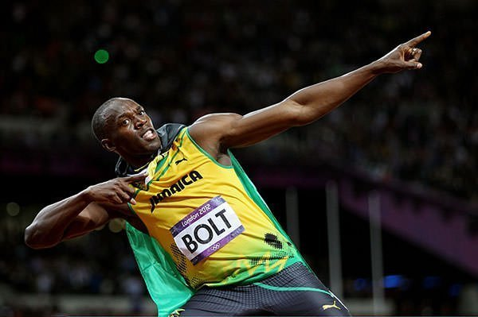
4. Bolt applies for lightning trademark
博尔特为其标志性胜利姿势申请商标
Usain Bolt made the pose famous in his celebrations at three Olympic Games.

Slide 16
语篇填空
《泰晤士报》2022年8月24日 27页
It is the calling card of the fastest man in the world, copied by countless fans. So Usain Bolt is trying to trademark a logo based on the “lightning bolt” __________ (celebrate) he made famous when setting world records more than a decade ago.
The retired athletics star, _____ had his 36th birthday on Sunday, filed an application last week, according to the US Patent and Trademark Office. The logo depicts “the silhouette of a man in a distinctive pose, with one arm _____ (bend) and pointing to the head, and the other arm raised and pointing upward”.
Bolt routinely ______ (strike) the pose after races, including when he set his records for the 100 and 200 metres, which remain ________ (break), and after winning his eight Olympic gold medals in Beijing, London and Rio de Janeiro ______ his retirement in 2017. He also won 11 world titles.
Bolt intends to use the image on items such as sunglasses, jewellery, clothing and restaurants, the filing shows. He applied to register a similar trademark 12 years ago, ____ this has expired under US law. Analysts said he might hope for the brand _________ (achieve) the success of Michael Jordan’s “Jumpman” logo, owned by Nike.
During his career, Bolt had ________ (contract) with several brands. Puma paid him ___ estimated $10 million a year. In March Bolt entered online gaming as co-owner of an Irish esports group. He acquired a stake in Wylde, set up two years ago by an ex-JP Morgan banker and the former boss of the American Ireland Fund.
celebration
who
bent
struck
unbroken
before
but
to achieve
contracts
an

Slide 17
词汇讲解
1. silhouette: the shape of a person’s body or of an object
（人的 ）体形；（事物的）形状
The shirt’s ideal worn loose over leggings or tuck it in for a streamlined silhouette.
这件衬衫最好是松松垮垮地穿在紧身裤外面或者是塞进裤子里显出苗条的身材。
2. expire: (of a document, an agreement, etc.) to be no longer valid because the period of time for which it could be used has ended （因到期而）失效；到期
He had lived illegally in the US for five years after his visitor’s visa expired.
在访问签证到期后，他又在美国非法居住了5年。
翻译句子
穿这件连衣裙，你显得更有身段了。
The dress is fitted to give you a flattering silhouette.
翻译句子
你的驾照什么时候到期？
When does your driving licence expire?

Slide 18
句子翻译
Usain Bolt is trying to trademark a logo based on the “lightning bolt” celebration he made famous when setting world records more than a decade ago.
博尔特正试图根据他在十多年前创造世界纪录时出名的“闪电”庆祝姿势注册商标。
翻译
Bolt routinely struck the pose after races, including when he set his records for the 100 and 200 metres, which remain unbroken, and after winning his eight Olympic gold medals in Beijing, London and Rio de Janeiro before his retirement in 2017.
博尔特经常在赛后摆此姿势，包括在他创造至今未被人打破的100米和200米纪录，以及在2017年退役前在北京、伦敦和里约热内卢赢得八枚奥运金牌后。
翻译

Slide 19
5. BBC新闻听写填空 08/25/22

Slide 20
听力填空
A special prosecutor in the US state of Georgia has ruled that two white police officers involved in the fatal shooting of a black man two years ago shouldn’t face ______________. Rayshard Brooks was shot in the back as he ran away from officers after taking a taser from them and attempting to fire it. His death was one of the high-profile cases that sparked _____________ against racism.
A former police detective in the US city of Louisville has pleaded guilty to providing ____ information to obtain a search warrant that led to the killing of a black woman Breonna Taylor in 2020. She was killed in her home by plainclothes officers.
The democrat representative Charlie Crist has won the primaries in the US state of Florida. And he’ll now _________ the republican governor Ron DeSantis in November’s midterm ________. And polls have closed in Oklahoma where two candidates _______ Donald Trump are hoping to become the state’s next Republican Senator.
The people of Angola are going to the polls later today to vote in presidential elections. _______, inflation and corruption are the main issues in what is predicted to be some of the most __________ elections in the country’s history.
An EU agency has warned that Europe is on course for its ____________ in at least 500 years. The Global Drought Observatory says two-thirds of the continent is under some form of alert.
A human rights group says Qatar has deported some ______________ after they protested against not being paid. Qatar is preparing to host the men’s football World Cup in November.
criminal charges
global protests
false
challenge
elections
loyal to
Poverty
competitive
worst drought
migrant workers

Slide 21
词汇讲解
1. high-profile: receiving or involving a lot of attention and discussion on television, in newspapers, etc. 经常出镜（或见报）的；高姿态的
This is a high-profile case but not unique.
这是一起备受关注的案件，但并非个案。
2. deport: to force sb to leave a country, usually because they have broken the law or because they have no legal right to be there 把（违法者或无合法居留权的人）驱逐出境，递解出境
He was deported from Ecuador when his visa expired.
他的签证到期后被驱逐出厄瓜多尔。
翻译句子
他是备受关注的足球俱乐部主席之一。
He is one of football’s high profile chairmen.
翻译句子
有240多名英格兰球迷被驱逐出意大利。
More than 240 England football fans are being deported from Italy.

Slide 22
句子翻译
A special prosecutor in the US state of Georgia has ruled that two white police officers involved in the fatal shooting of a black man two years ago shouldn’t face criminal charges. Rayshard Brooks was shot in the back as he ran away from officers after taking a taser from them and attempting to fire it.
美国乔治亚州的一名特别检察官裁定，两年前参与枪杀一名黑人的两名白人警察不应受到刑事指控。雷沙德·布鲁克斯在从警察手中夺走泰瑟枪并试图开火后逃离警察时，背部中弹。
翻译
A former police detective in the US city of Louisville has pleaded guilty to providing false information to obtain a search warrant that led to the killing of a black woman Breonna Taylor in 2020.
美国路易斯维尔市的一名前警探承认提供虚假信息以获得搜查令，导致2020年一名黑人妇女布雷娜·泰勒被杀。
翻译

