Slide 1
感恩遇见，相互成就，本课件资料仅供您个人参考、教学使用，严禁自行在网络传播，违者依知识产权法追究法律责任。
更多教学资源请关注
公众号：溯恩高中英语
知识产权声明

Slide 2
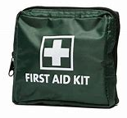
Unit 5
First Aid
Reading and thinking
First Aid For Burns

Slide 3
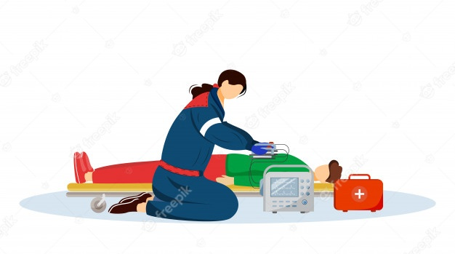
Learning objectives:
By the end of the class, students will
1. sort out the information about first aid for burns (causes, types, characteristics of burns and first aid treatment);
2. describe the characteristics & treatment for different kinds of burns;
3. summarize the stylistic features of hospital leaflet;
4. brainstorm the possible occasions to get burnt and occasions to offer first aid.

Slide 4
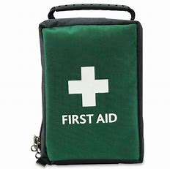
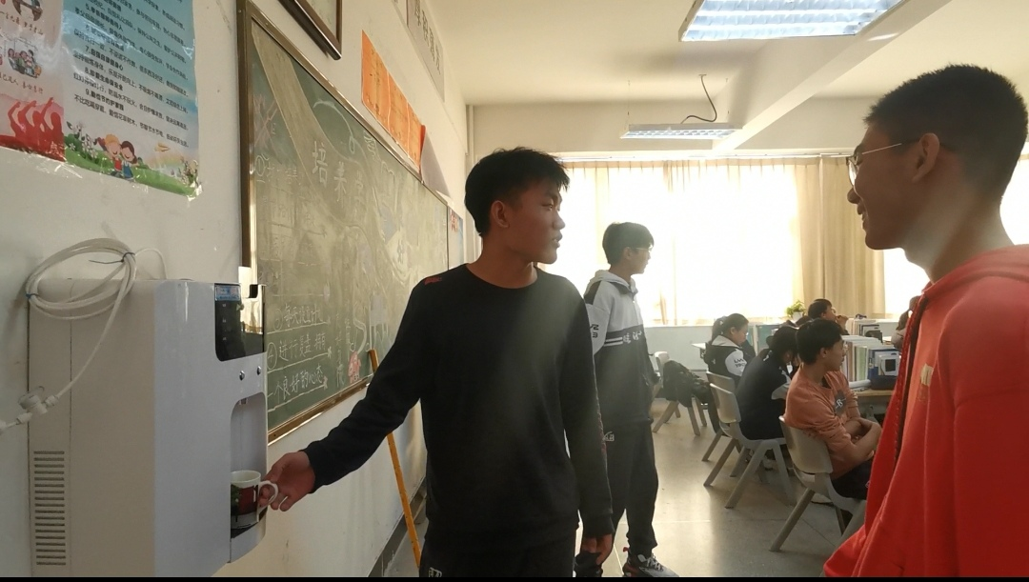
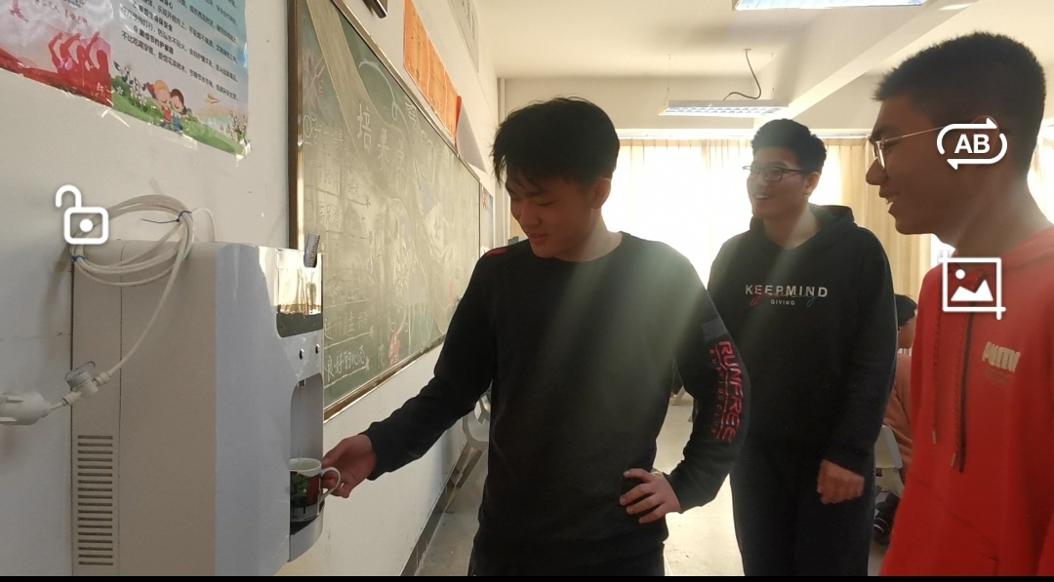
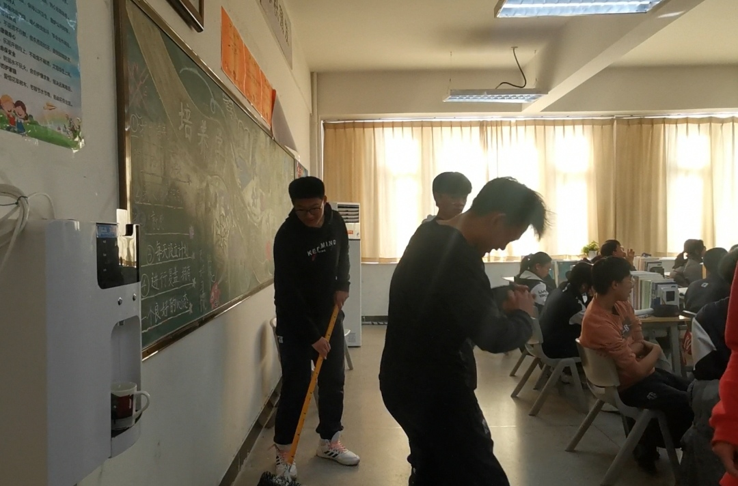
What happened to the boy?
Lead in

Slide 5
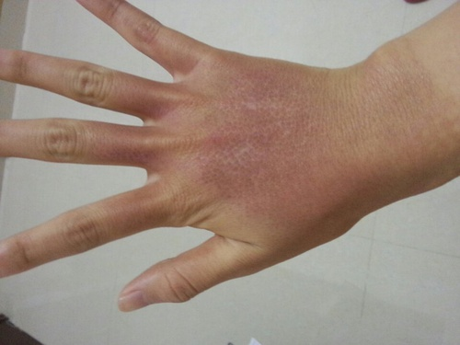
Lead in
dry, red and mildly swollen
no obvious blisters
mildly painful
A part of the body is larger & rounder than normal, usually as a result of injury or illness.
First aid is needed!

Slide 6
Lead in
What is First aid ?
First aid is the kind of help given to someone who suddenly _____________ or __________before a doctor comes.
gets injured
falls ill

Slide 7
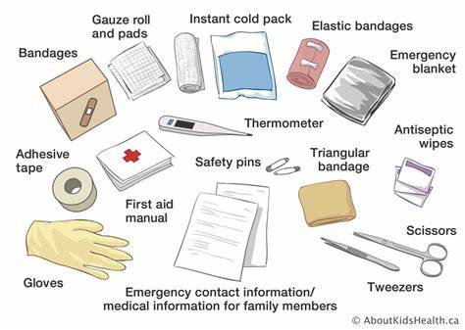
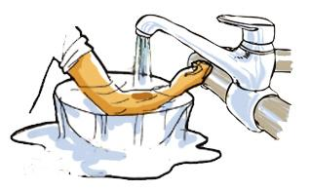
Pre-reading
What should be done when someone suffers a burn?

Slide 8
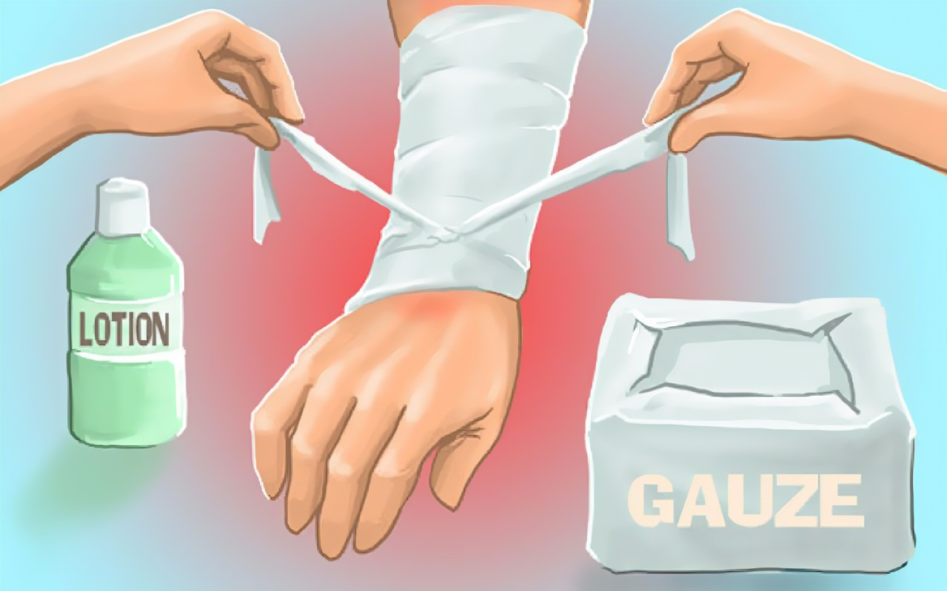
First Aid For Burns
Q1: Where is the text most probably from?
Q2: What is the main idea of the text?

Slide 9
Activity 1: Read to check
Q1: Where is the text most probably from?
____ advertisement ____ blog post
____ hospital leaflet ____ email
____ newspaper article ____ short story
hospital leaflet
factual, informational, objective, gives a description of a medical problem, and tells how to deal with it, uses the imperative to give advice.

Slide 10
Activity 1: Read to check
Q2: What is the main idea of the text?
The text mainly introduces ______ types of burns and their characteristics as well as how to give _________________ when burns happen.
three
first aid treatment
How did you know that?
A. Looking at the title, subtitles or the headings
B. Looking for the details
C. Looking for necessary numbers

Slide 11
Activity 2: Read for information
Scan Part.1 carefully. Q: What are the functions of the skin?
control your__________________
gives you ______________
body temperature
sense of touch
a series of Verbs
functions of the skin
warns you when things are too _____ or _____
hot
cold
prevents your body from ___________________
losing too much water

Slide 12
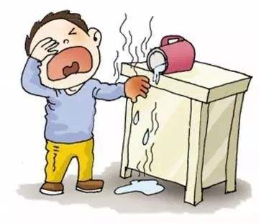
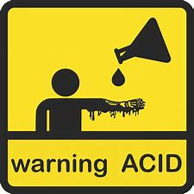
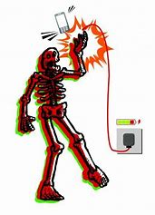
Activity 2: Read for information
Scan Part.2 carefully. Q: What are the causes of burns?
Causes of burns

Slide 13
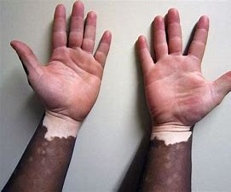
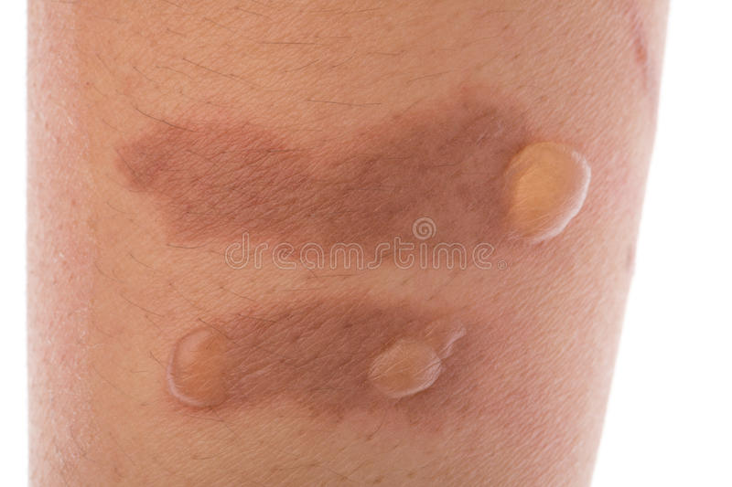
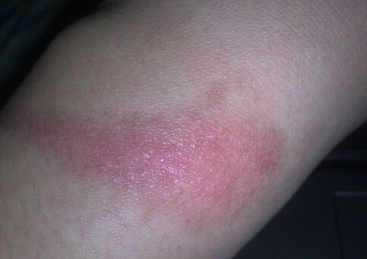
Activity 2: Read for information
Scan Part.3 & 4 carefully.
Q: Which type of burns does the following pictures belong to?
Type
First/ Secnd/ Third degree ?
Evidence
Characteristics ?
Possible causes ?

Slide 14
Activity 2: Read for information
Scan Part.5 carefully. Q: Put the treatment process in correct order.
Dry the burnt area with a clean cloth
Take him/her to the hospital at once
Place burns under cool running water
Make sure the victim can still breathe
Cover the burnt area with a loose cloth
Remove clothes using sassiors

Slide 15
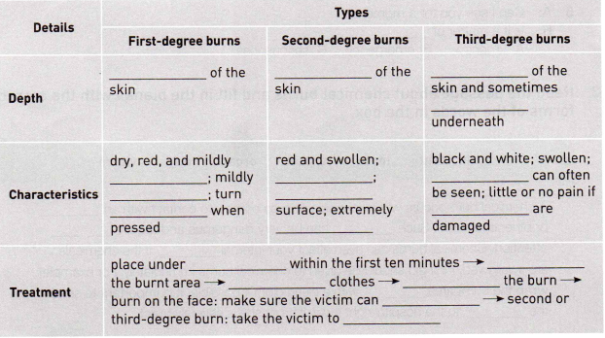
Complete the table to summarise the information.
The top few
millimeters
below the top
layer
every layer
tissues
swollen
blisters
the tissue underneath
painful
watery
white
nerves
painful
cool running water
dry
remove
cover
breathe
hospital

Slide 16
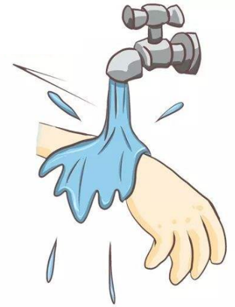
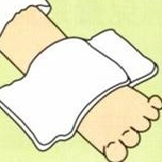
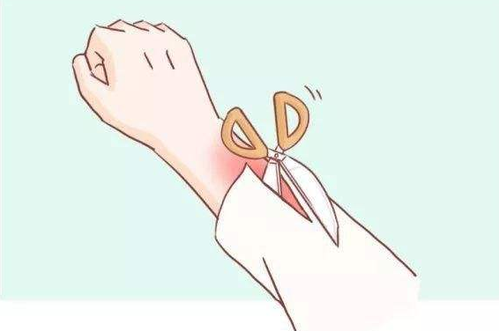
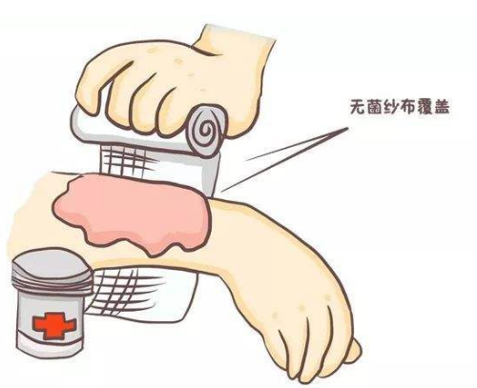
Activity 3: Role play
Perform and desribe the proper first aid by using learned steps.
What should be done to help the boy who suffers a burn ?

Slide 17
Activity 4: Read for textual features
1. What is the genre of the text? Is it a narration, a description, an argumentation, or an expository writing?
2. How does the author make the text objective and factual?

Slide 18
Activity 4: Read for textual features
1. What is the genre of the text? Is it a narration, a description, an argumentation, or an expository writing?
What Is
Expository Writing?
Expository writing also is called informative writing, because its purpose is to explain, inform or clarify.
One essential element of expository writing is that it provides enough details to readers to clearly explain the topic.
Expository writing is intended to be factual and unbiased.
Organization is a characteristic common to expository writing. Information should be presented in a clear and logical manner so readers can follow and easily understand it.

Slide 19
2. How does the author make the text objective and factual?
Expository writing also is called informative writing, because its purpose is to explain, inform or clarify.
One essential element of expository writing is that it provides enough details to readers to clearly explain the topic.
Expository writing is intended to be factual and unbiased.
Organization is a characteristic common to expository writing. Information should be presented in a clear and logical manner so readers can follow and easily understand it.

Slide 20
Expository writing also is called informative writing, because its purpose is to explain, inform or clarify.
One essential element of expository writing is that it provides enough details to readers to clearly explain the topic.
Expository writing is intended to be factual and unbiased.
Organization is a characteristic common to expository writing. Information should be presented in a clear and logical manner so readers can follow and easily understand it.
To describe & explain
a clear and logical manner

Slide 21
Expository writing also is called informative writing, because its purpose is to explain, inform or clarify.
One essential element of expository writing is that it provides enough details to readers to clearly explain the topic.
Expository writing is intended to be factual and unbiased.
Organization is a characteristic common to expository writing. Information should be presented in a clear and logical manner so readers can follow and easily understand it.
Enough details

Slide 22
Expository writing also is called informative writing, because its purpose is to explain, inform or clarify.
One essential element of expository writing is that it provides enough details to readers to clearly explain the topic.
Expository writing is intended to be factual and unbiased.
Organization is a characteristic common to expository writing. Information should be presented in a clear and logical manner so readers can follow and easily understand it.
Written in second & third person voice

Slide 23
Expository writing also is called informative writing, because its purpose is to explain, inform or clarify.
One essential element of expository writing is that it provides enough details to readers to clearly explain the topic.
Expository writing is intended to be factual and unbiased.
Organization is a characteristic common to expository writing. Information should be presented in a clear and logical manner so readers can follow and easily understand it.
passive voice

Slide 24
Expository writing also is called informative writing, because its purpose is to explain, inform or clarify.
One essential element of expository writing is that it provides enough details to readers to clearly explain the topic.
Expository writing is intended to be factual and unbiased.
Organization is a characteristic common to expository writing. Information should be presented in a clear and logical manner so readers can follow and easily understand it.
the -ing form

Slide 25
Expository writing also is called informative writing, because its purpose is to explain, inform or clarify.
One essential element of expository writing is that it provides enough details to readers to clearly explain the topic.
Expository writing is intended to be factual and unbiased.
Organization is a characteristic common to expository writing. Information should be presented in a clear and logical manner so readers can follow and easily understand it.
Written in second & third person voice
passive voice
Objective, factual and unbiased.
the -ing form

Slide 26
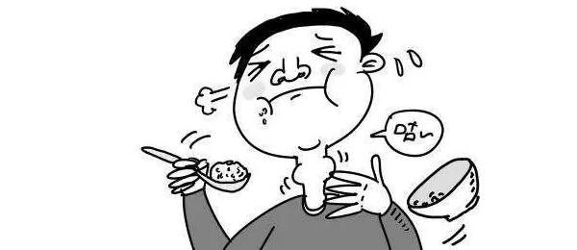
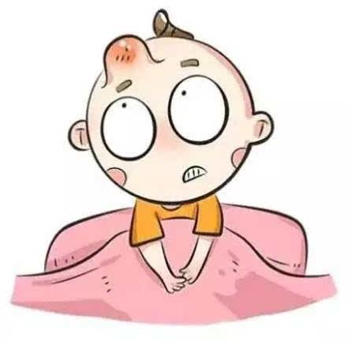
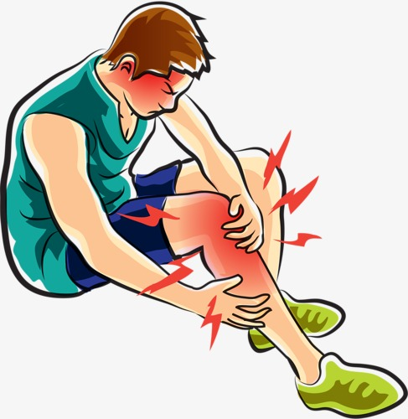
Activity 5: Group Discussion
Brainstorm the following question or refer to the hint.
What are the possible occasions when you are likely to get burnt at school or at home?
What other advice do you know of about first aid for burns? Is it good advice or bad advice? Why?
What are the possible occasions when people need first aid?

Slide 28
Thank you

