Slide 1
感恩遇见，相互成就，本课件资料仅供您个人参考、教学使用，严禁自行在网络传播，违者依知识产权法追究法律责任。
更多教学资源请关注
公众号：溯恩高中英语
知识产权声明

Slide 2
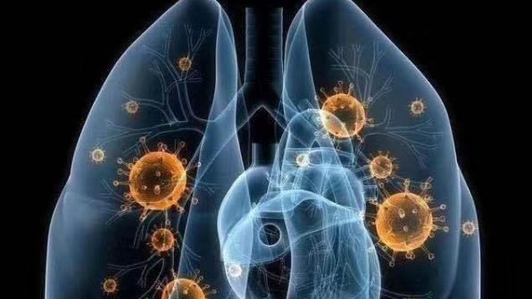
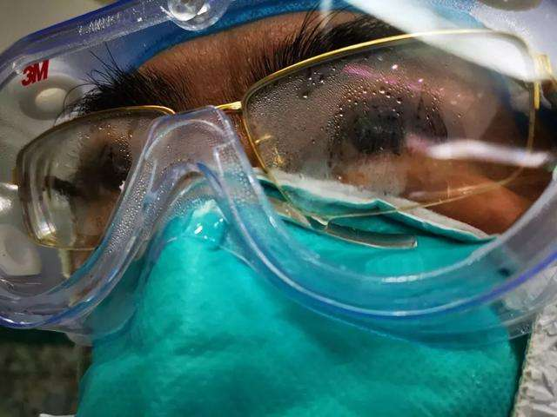
My father’s eyes
衢州高级中学
毛慧霞

Slide 3
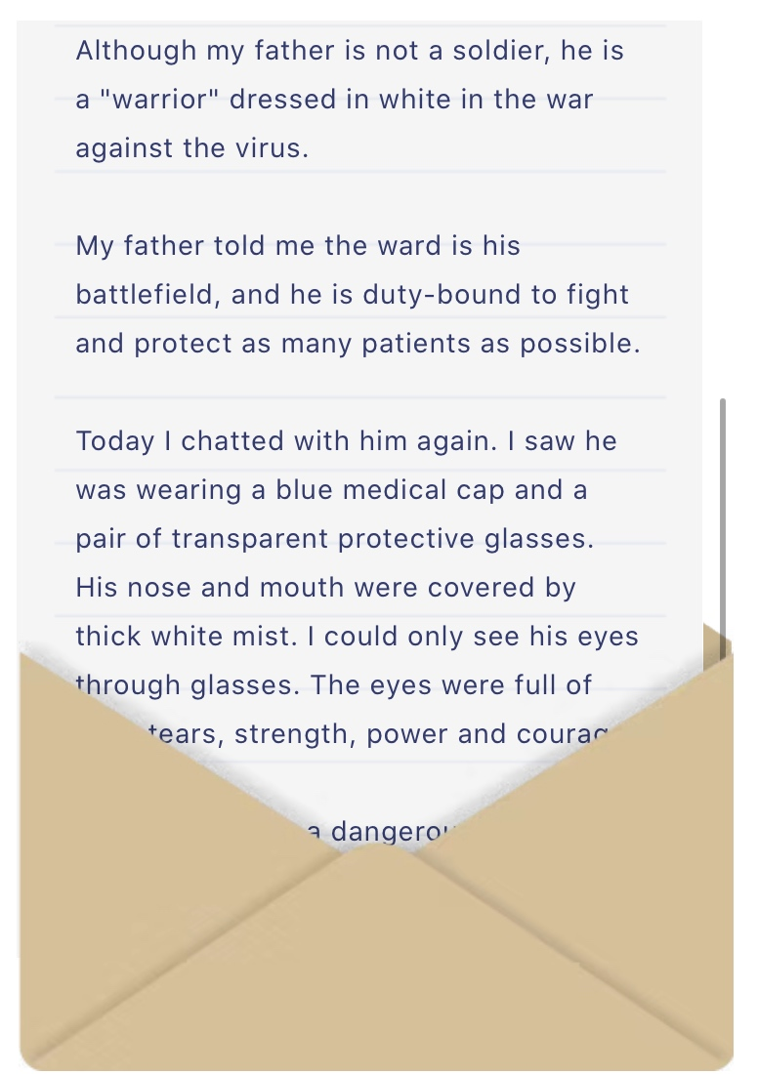
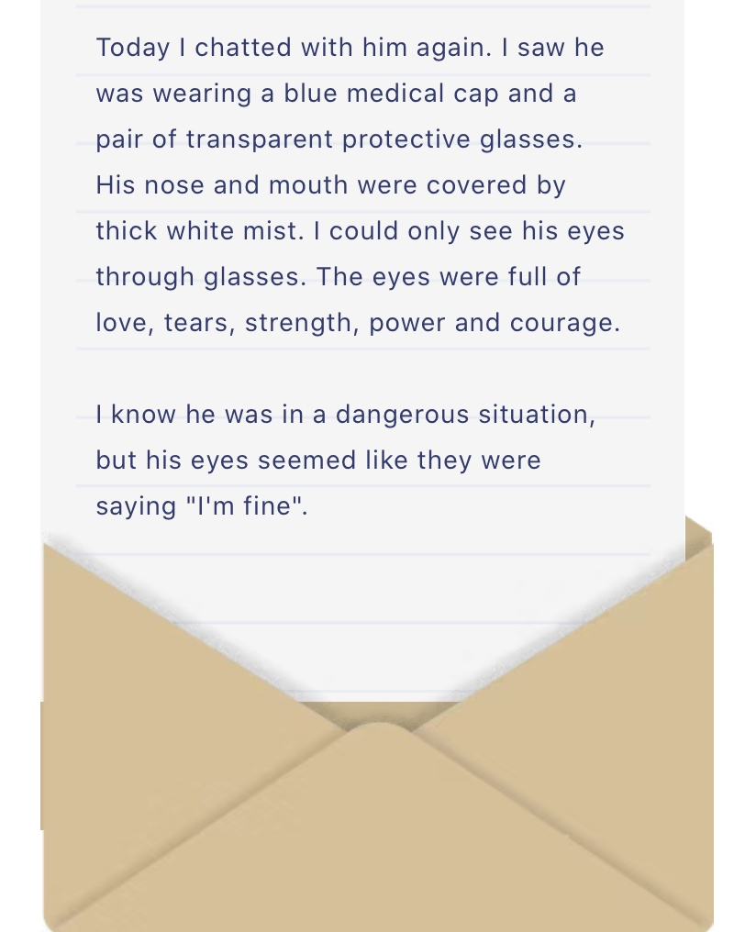

Slide 4
How to describe a pair of tired eyes?
His sunken eyes were grey and bloodshot with huge black bags underneath them.
He held the cigarette in his fingers and the smoke curled up past his bloodshot eyes.
His eyes have sunk in , losing their lustre.
他的眼睛凹陷，失去了光泽。
The eyes are the window of the mind
The old lady was watching me with trembling eagerness, her face flushed and
her eyes bright with expectation.
老太太的身子渴望知道信的内容而颤抖，她的眼睛炯炯有神地凝视着我，
脸庞因急切的期待一片绯红。
There was new color in his face and his eyes were sparkling.
他容光焕发，两眼炯炯有神。
Miss keelder's eyes were lively and Miss helstone's languid.
基达尔小姐的眼睛炯炯有神，赫尔斯通小姐的眼睛则呆滞无神。

Slide 5
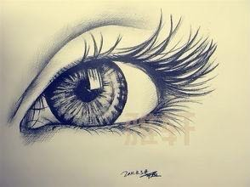
eyes
She is wide-eyed with astonishment.
He ran his tongue around his lips and a wild look came into his eyes.
There was anger in his eyes and revenge(报仇) in his heart.
他两眼闪现怒火，一心只想复仇。
After several attempts at keeping my eyelids from fluttering （颤动，飘扬）closed and the book from collapsing onto my chest, I know it really is time to go to sleep.几次想克服眼皮打架，几次把倒在胸口上的书支起来，我知道的时候的确到了。
The look in his eyes made my heart flutter.
他的眼神让我的心怦怦直跳。

Slide 6
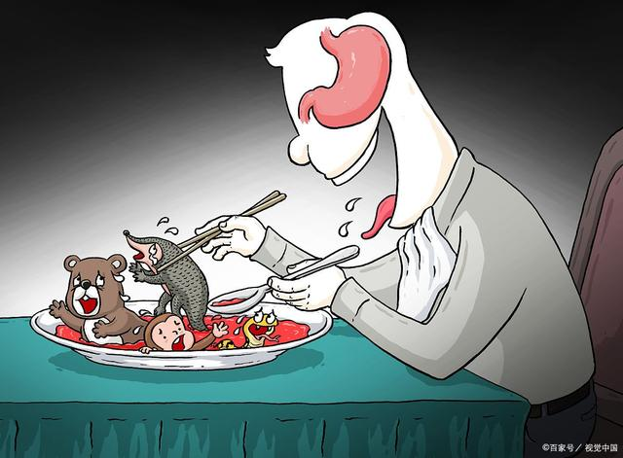
An invisible war is taking place
in the world of human and virus…

Slide 7
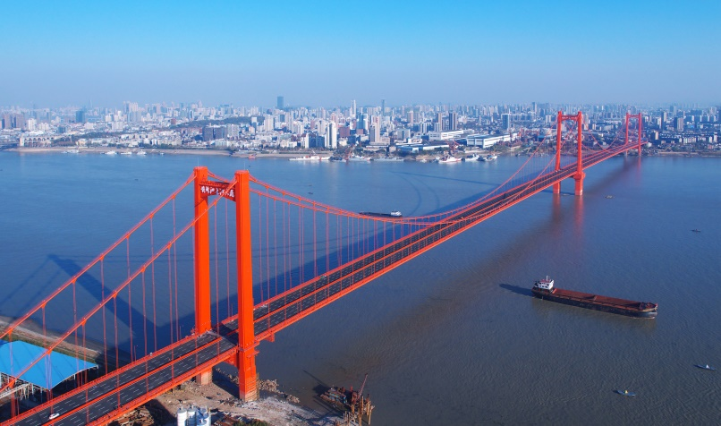
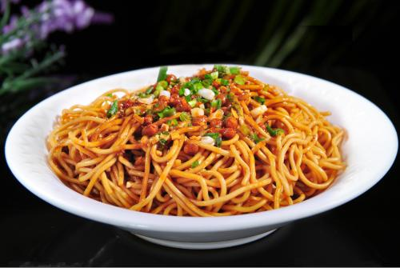
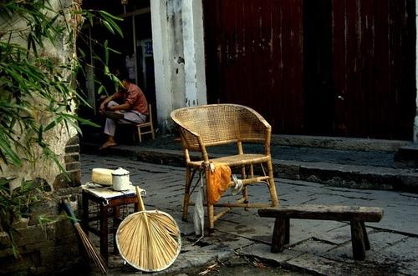
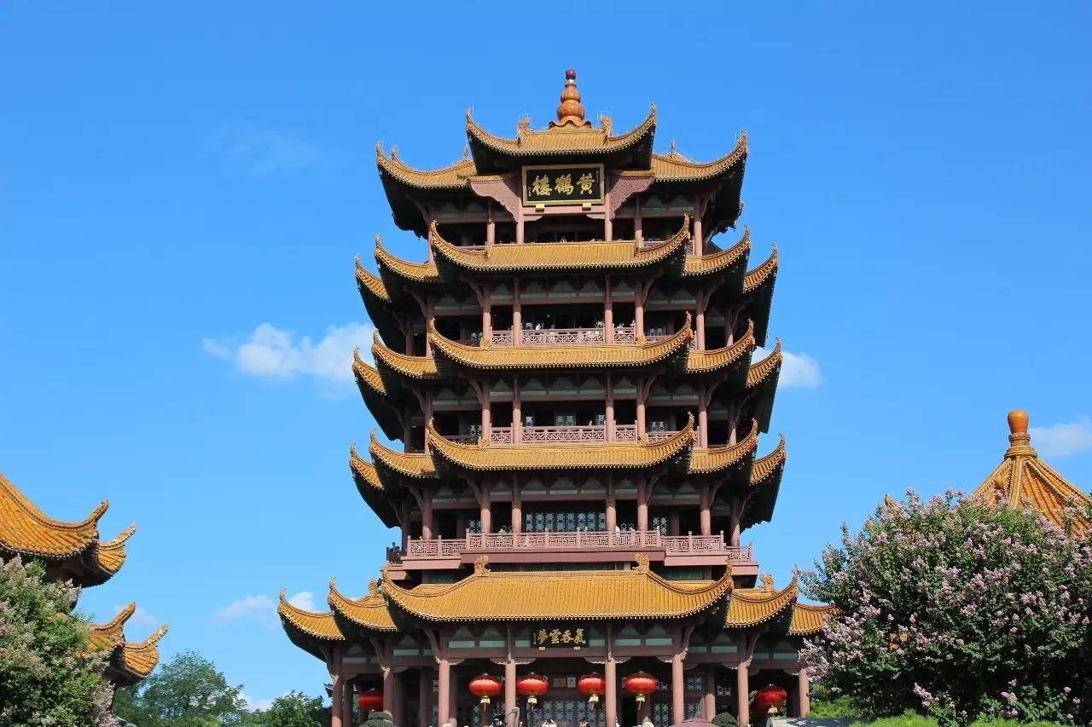
This is a modern city full of vitality
街道口的风，撩醒了夏虫
竹床上的小孩儿做着梦
热干面糊汤，一样的吃相
海角天涯流淌唇齿香
……
这是我的家，我们守护它
黄鹤楼的诗，烂熟在嘴巴
如果有一天，它也需要我
搭把手，就过了……
hot dry noodles

Slide 8
Wuhan

Slide 9
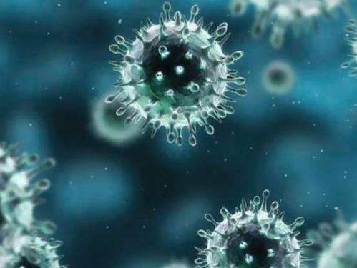
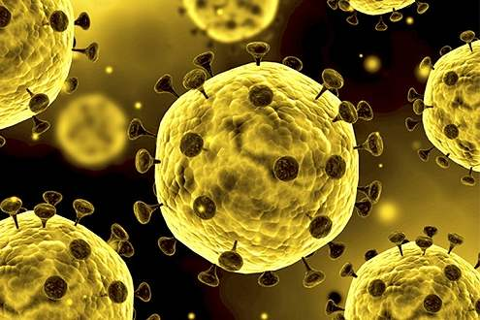
A new virus has caused the pneumonia outbreak in Wuhan, Central China's Hubei
province, The coronavirus can cause respiratory and intestinal (肠道的)diseases.
Coronaviruses were first identified in the 1960s, They get their name from
their crown-like shape. Sometimes, but not often, a coronavirus can infect
both animals and humans.
It was discovered and confirmed by experts that the novel coronavirus is actually
transmitted from one person to another. through infected people coughing and
sneezing, by touching an infected person's hands or face, or by touching
things such as doorknobs that infected people have touched.
So we’ve got people to people transmission.
outbreak of a novel coronavirus
new/ not like anything seen
/ known before
crown(皇冠)
Coronary heart disease

Slide 10
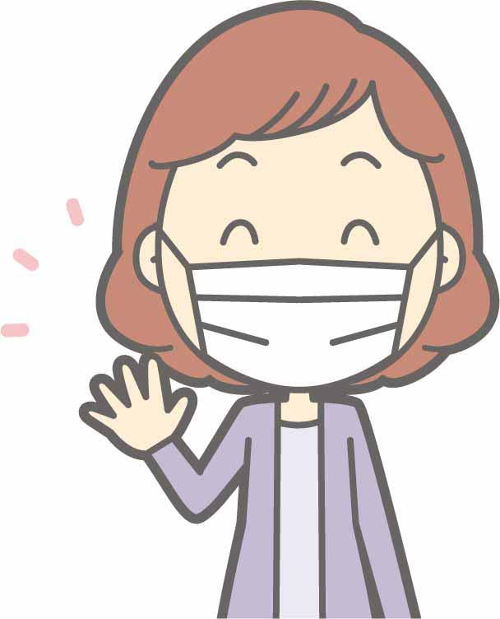
related words and expressions
incubation period 潜伏期
eg. Novel coronavirus incubation period lasts up to 2 weeks.
isolate / isolation 隔离
eg.The man voluntarily self-isolated upon his return home.
He is in isolation at home.
be placed/ held/ put in isolation

Slide 11
related words and expressions
quarantine 隔离，隔离检疫
eg. Two hundred British citizens are being flown out of Wuhan – the centre of the novel coronavirus outbreak-and back to the UK, where they will be quarantined for 14 days.
Since a novel coronavirus outbreak began in December, Chinese officials have placed millions of people under quarantine.
contract 感染
The son has contracted the virus from his father.
transmission 传染
eg. Health authorities say a Bavarian man contracted the virus from a colleague visiting from china. It is believed to be the first case of human-to-human transmission in Europe .
contain 控制，阻止
Can the coronavirus outbreak be contained?
Contain the spread of the virus
infect 传染
More than 130people died in china, and close to 6,000 have been infected.
person-to-person spread

Slide 12
related words and expressions
undetected 未被发现的
We also don’t know how many mild and undetected cases are out there.
suspend 暂停 中止
British Airways has suspended all direct flights to and from mainland china.
lockdown 封锁
China has put 16 cities on lockdown.
vaccine 疫苗
There is no specific cure or vaccine.
confirm 确诊
Tibet reported its first confirmed case.
protective gear防护装备
protective goggles 防护眼镜 surgical face masks 医用口罩 N95 respirators N95 口罩

Slide 13
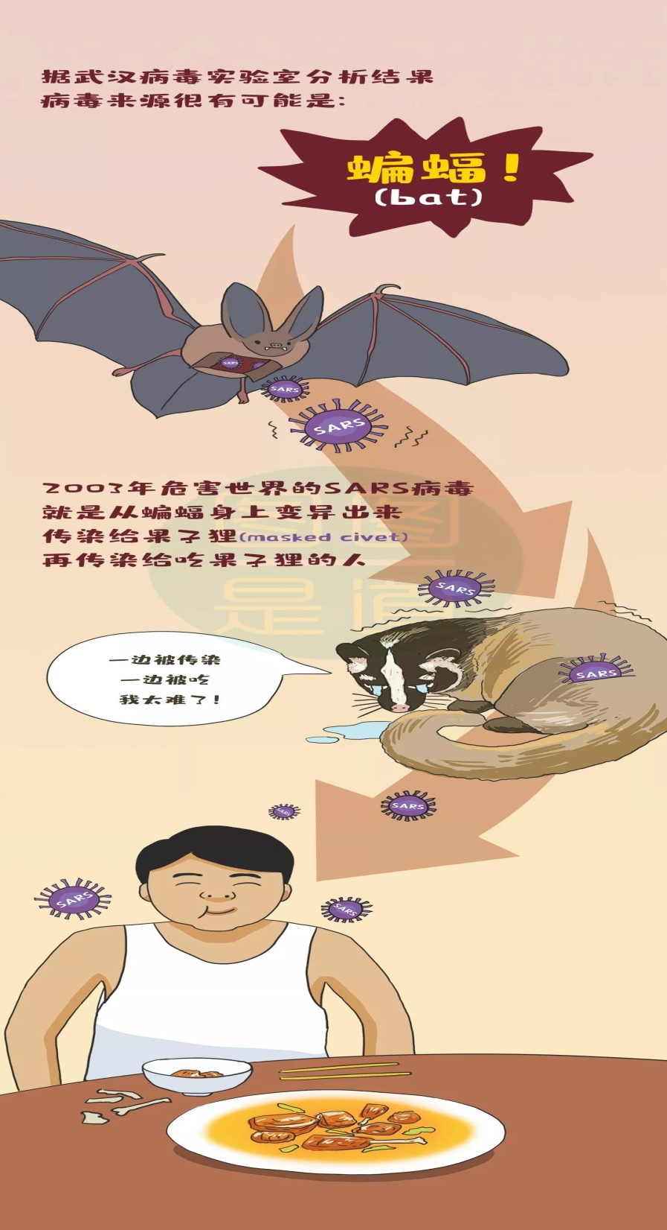
Who
is
to
blame
?

Slide 14
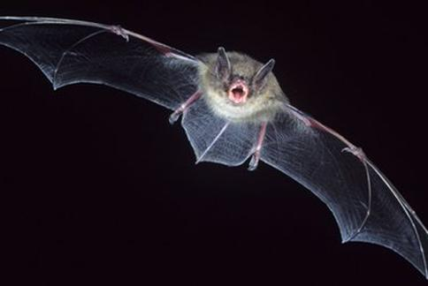
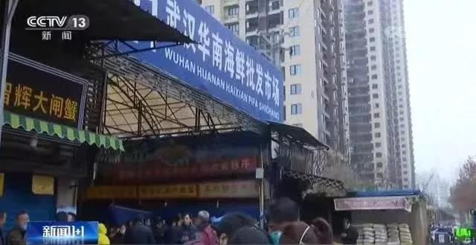
Bat
Is the principal host (宿主)of this deadly new virus.
In Chinese folklore the bat is an emblem of good fortune.
The revenge of animals on humans
All the six coronavirus known to humans, including the one that caused severe acute
respiratory disease, originated from wild mammals
A Central China wet market known for seafood was closed on Wednesday amid（在…中）
a pneumonia outbreak in Wuhan, in addition to the seafood, the market also sold live cats,
dogs, snakes and marmots. There was even a signboard saying that they have live monkeys
and deer for sale.
amid:
They could provide a ray of hope amid the general business and economic gloom.
在普遍的商业和经济低潮中，他们能带来一线希望。
There came the riders amid even louder cheers and whoosh!
在欢呼声中，骑手们冲了过来。

Slide 15
symptoms
headache
pneumonia
[njuːˈməʊniə]
肺炎 n
fever
kidney failure
cough
肾脏
respiratory failure 呼吸衰竭
To the people who has weak immune systems, it can be fatal.
免疫系统 n
fatal:
It is impossible to say who struck the fatal blow. (致命一击)
there was some fatal flaw(致命弱点) in his makeup, and as time went on he lapsed
Into long silences or became off-hand. 他的性格有些缺陷，随着时间的推移，
他陷入了久久的沉默，或者变得漠然。

Slide 16
How do we distinguish between the common cold and novel coronavirus pneumonia?
The early symptoms of the two are similar, including fever, dry cough, respiratory symptoms, and fatigue after fever. Some even showed up in the digestive tract(消化道).
The most important way to distinguish it is by taking samples from throat swabs(拭子，药签) to test for the virus. The report clearly tells whether the tester is infected with H1N1, type B influenza or novel coronavirus. The reagent test kits are supposed to be accessible in designated hospitals.
eg. All this has upset me. I need time to digest it all.

Slide 17
Is there any treatment available now?
There actually isn’t any effective treatment at the moment at all, because it is a virus and it is novel. Antibiotics(抗生素）won’t work. They only work against bacteria rather than viruses. The two main treatment methods are still early detection and early isolation. They are the most primitive(原始的) and effective ways
have a profound/ dispensable effect on
play a dispensable / crucial role in

Slide 18
Great challenge we face
The stark( 赤裸裸的，无法回避的，僵硬的) reality the country is facing is a wider spread of the virus fueled by the Spring Festival travel rush that will see hundreds of millions of people traveling nationwide or overseas during the holidays.
This is a lesson learned during the SARS outbreak at a very high cost in human lives. The country should not have to learn that lesson all over again.
stark：
the windows misted, blurring the stark streetlight.
窗上蒙了水雾，向外望去，原本突兀的街灯变得模糊起来。
fuel:
eg. His indifference was a fuel to her hatred.
His comments are bound to add fuel to the debate.

Slide 19
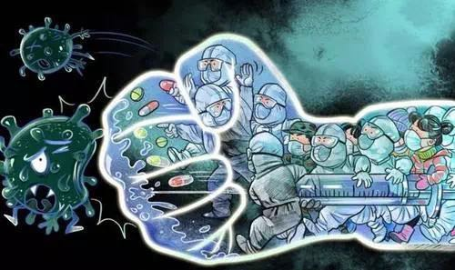
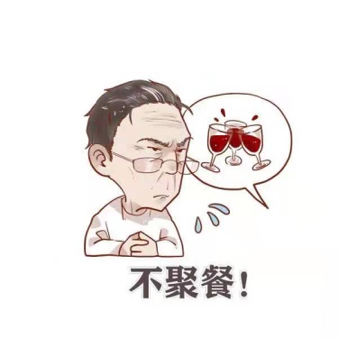
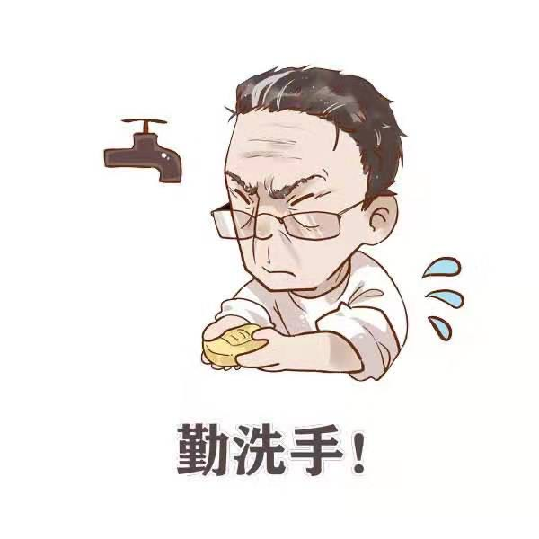
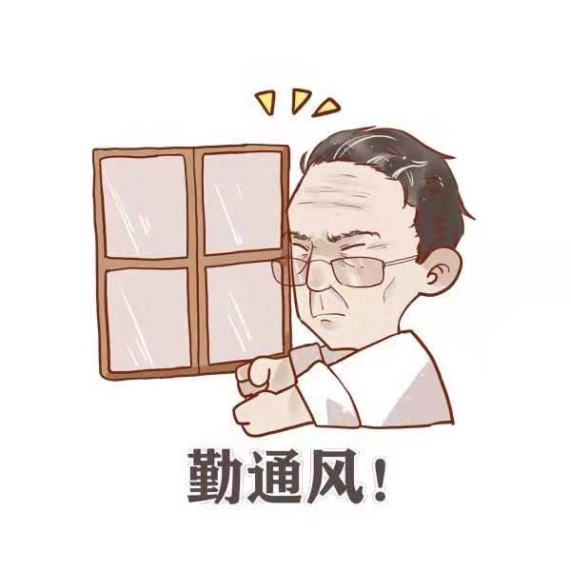
What should we do ?
people should avoid large gatherings, frequently wash their hands, wear masks and make sure their indoor air is circulating during Spring Festival.
isolate yourself at home.

Slide 20
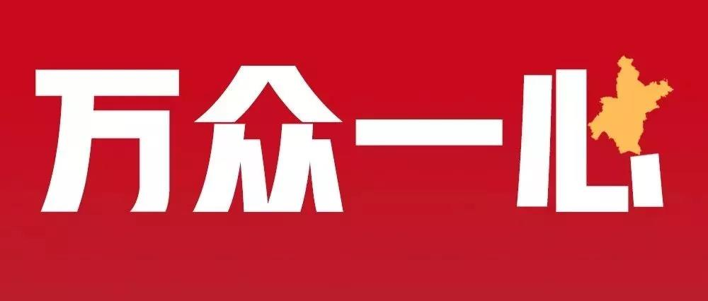
At a time when the whole country is mobilized(调动，动员) to fight the novel coronavirus and the pneumonia it has caused, some unwanted situations have occurred.
On social networks, some unreasonable voices have targeted Wuhan, where the disease was first found, as "evil" and badmouthed people from the city and even Hubei province as a whole, obviously fearing that they might carry the novel coronavirus.
eg.Faced with crisis, people mobilized.
Just the few of us are no use； we must mobilize the masses.

Slide 21
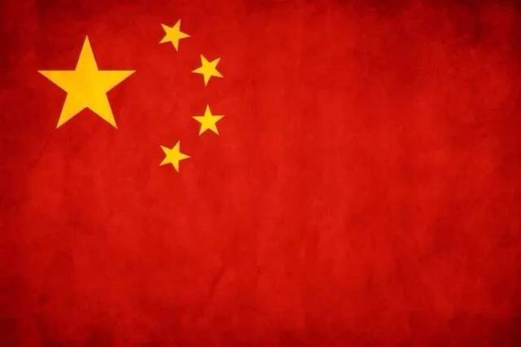
We isolate virus, not love
The coronavirus is still spreading, and it is essential for people to stay united against this common enemy, instead of scolding each other.
people were singing the national anthem on the street, The Chinese nation has entered a critical stage. It shows that people have high morale.

Slide 22
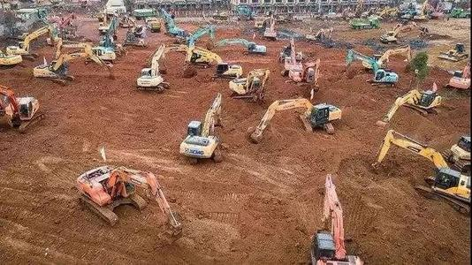
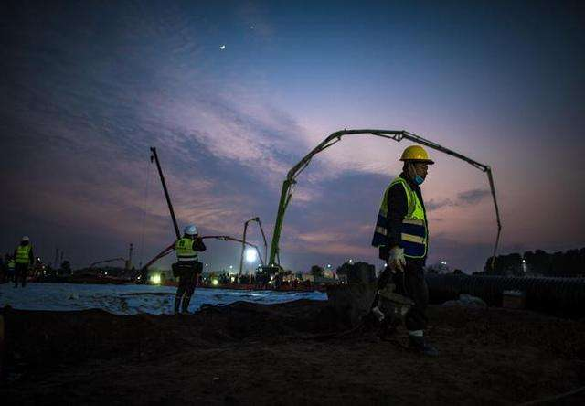
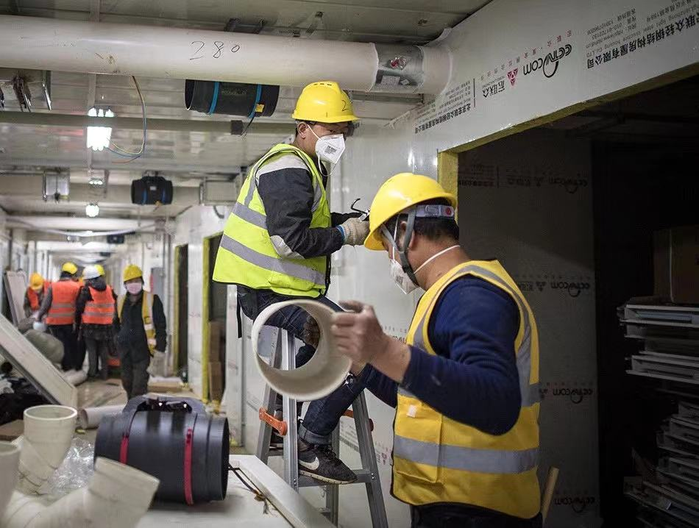
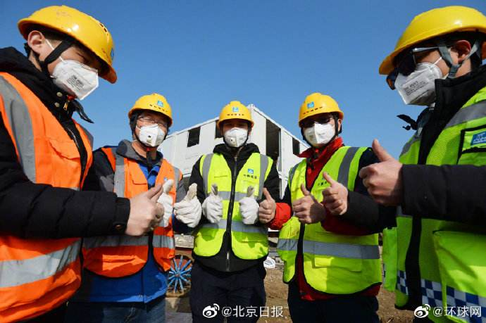

Slide 23
miracle
Construction of Huoshenshan Hospital, inside the Wuhan Workers' Sanatorium in Caidian district, began on Jan 25 and was done by more than 7,000 workers. At the peak of the massive project, more than 4,000 workers and about 1,000 construction machines and trucks worked on the site.

Slide 24
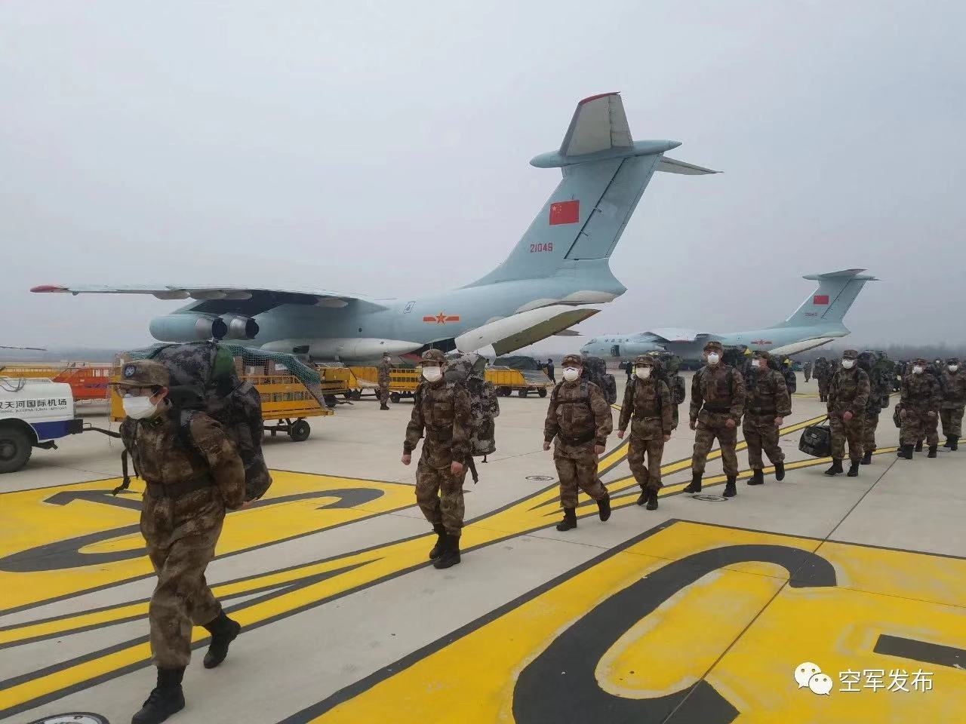
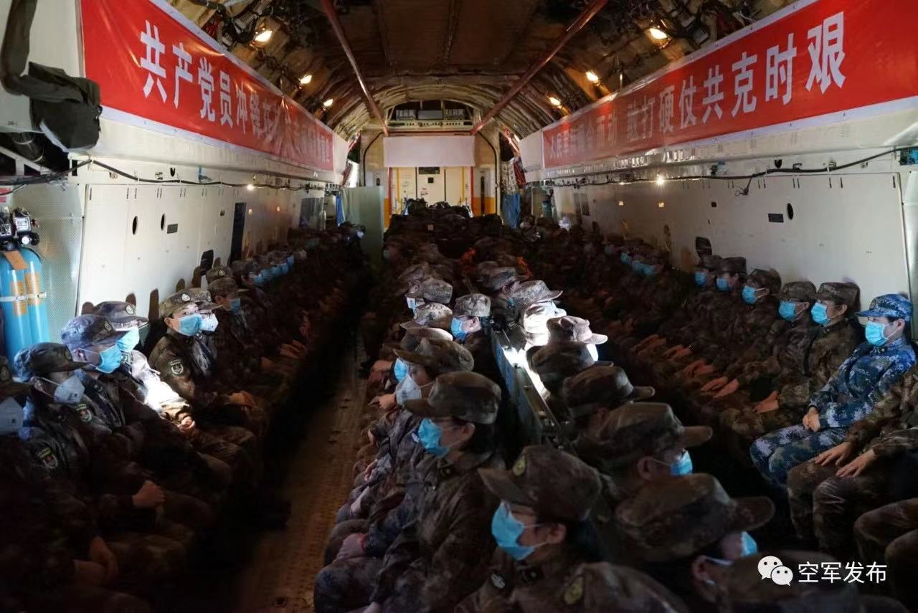
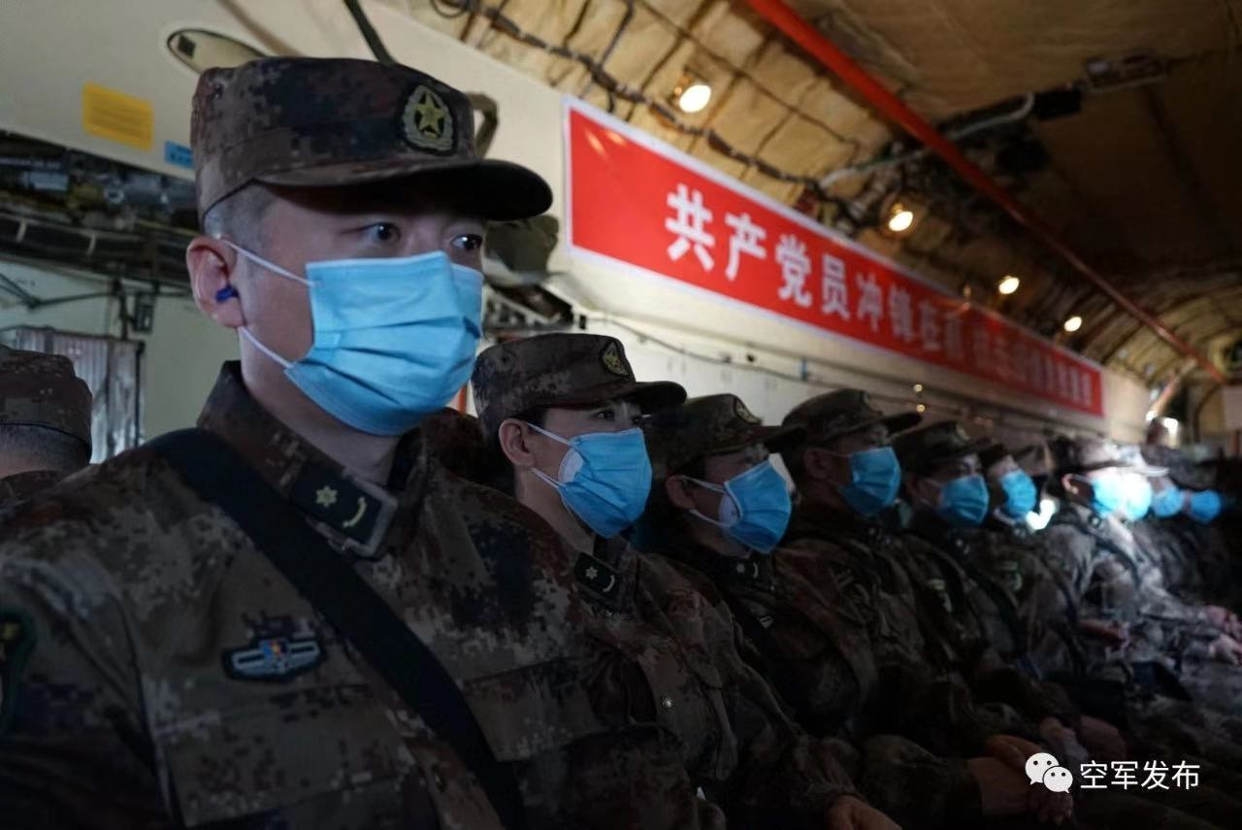
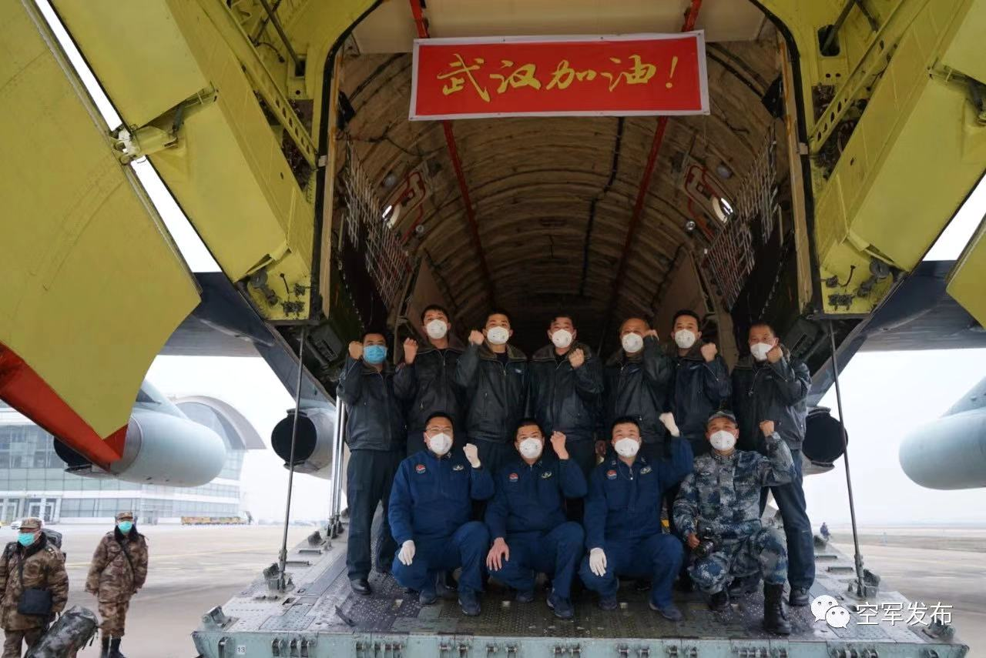

Slide 25
A total of 1,400 medical workers from the military will start on Monday receiving and treating patients infected with the highly contagious pneumonia at Huoshenshan Hospital, which was built in nine days and was formally delivered to the military on Sunday morning.
The facility has 1,000 beds in 419 wards, including 30 intensive care units.

Slide 26
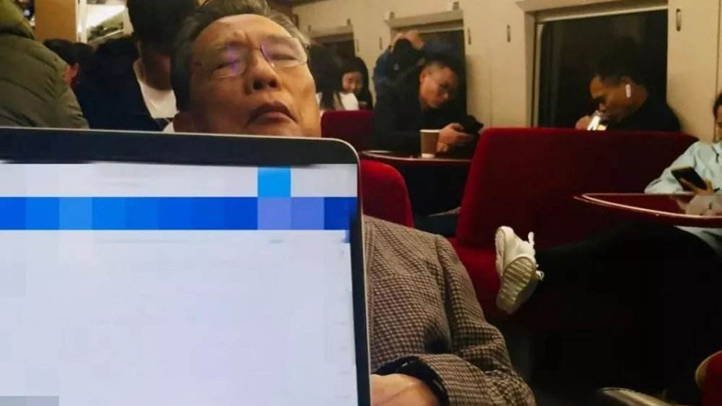
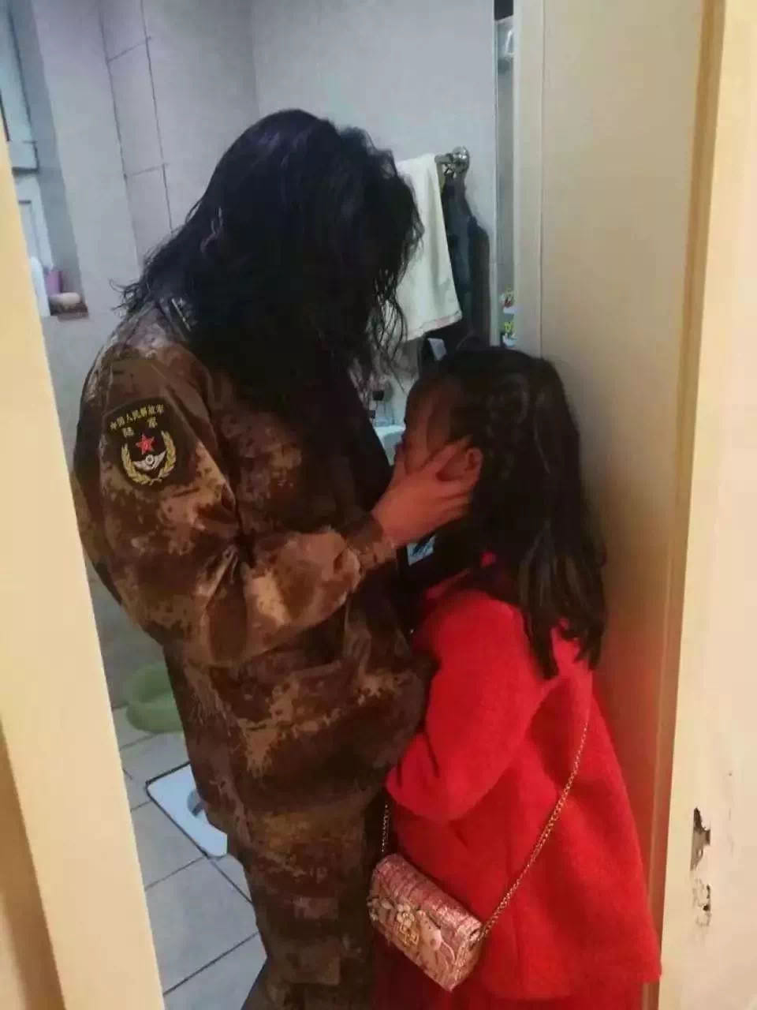
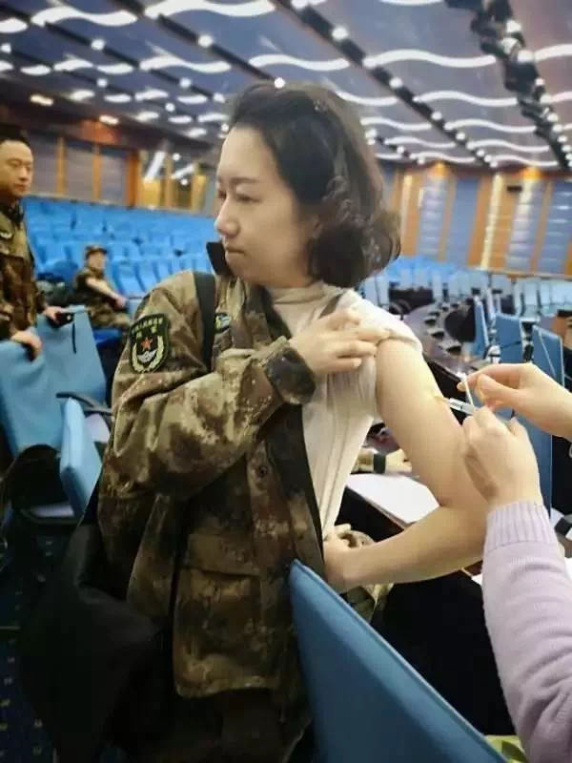

Slide 27
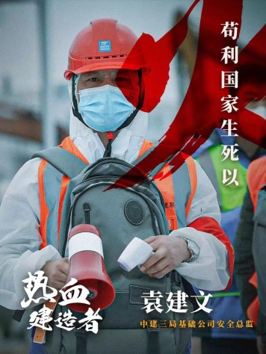
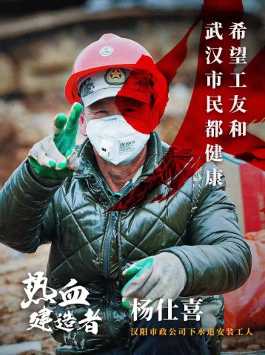
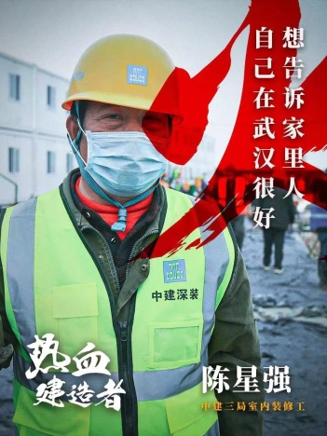
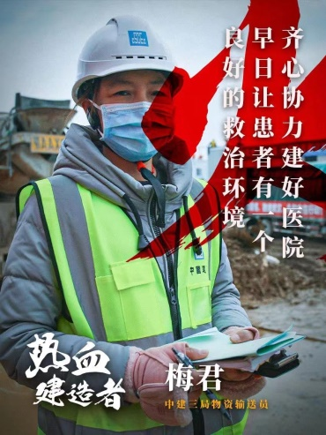
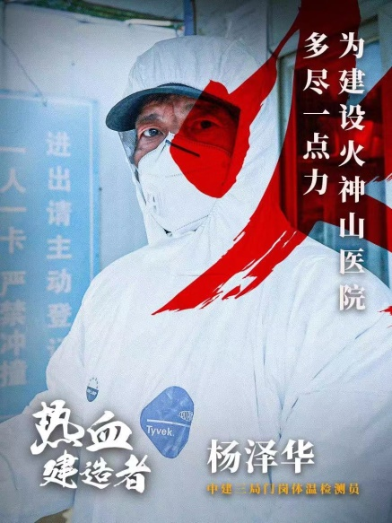
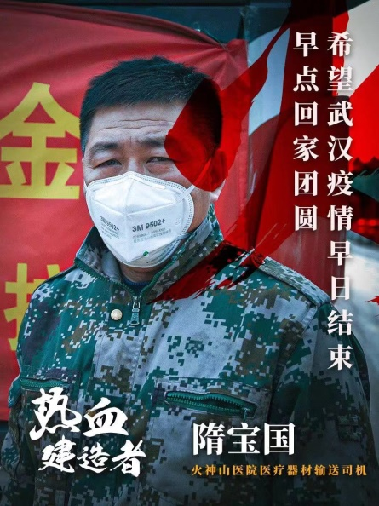
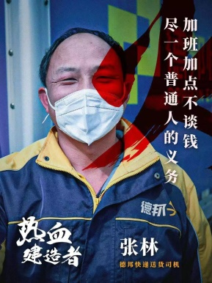
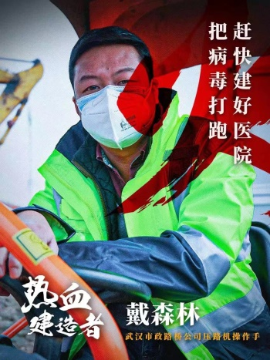
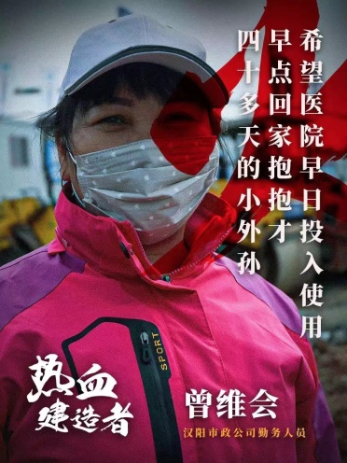
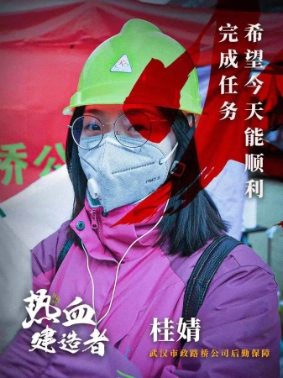
greatness can be seen in commonness

Slide 28
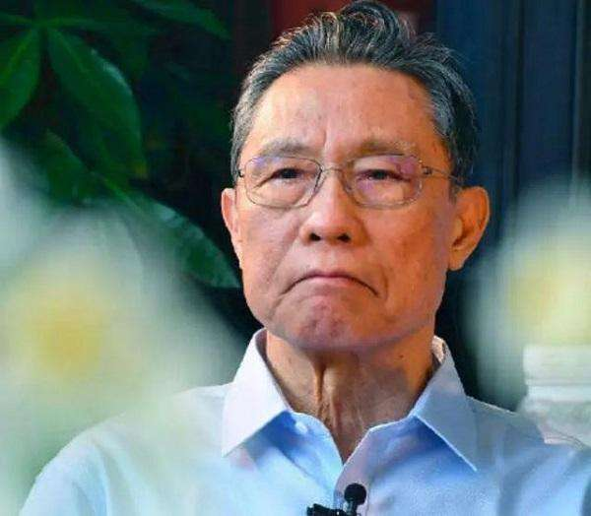
I can see…from their eyes …

Slide 29
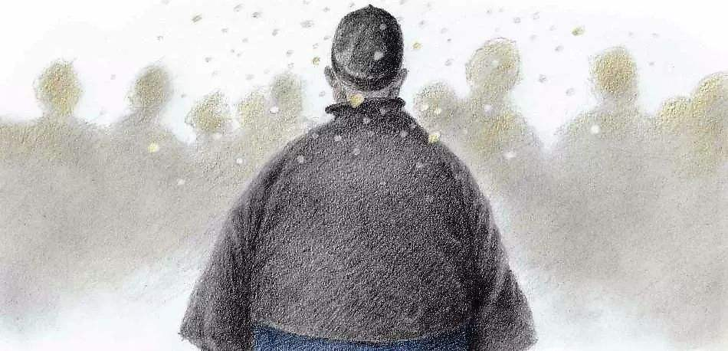
appreciation
The sight of father's back
I caught sight of several vendors waiting for customers outside the railings beyond a platform. But to reach that platform would require crossing the railway track and doing some climbing up and down. That would be a strenuous job for father, who was fat. I wanted to do all that myself, but he stopped me, so I could do nothing but let him go. I watched him hobble towards the railway track in his black skullcap, black cloth mandarin jacket and dark blue cotton-padded cloth long gown. He had little trouble climbing down the railway track, but it was a lot more difficult for him to climb up that platform after crossing the railway track. His hands held onto the upper part of the platform, his legs huddled up and his corpulent body tipped slightly towards the left, obviously making an enormous exertion. While I was watching him from behind, tears gushed from my eyes. I quickly wiped them away lest he or others should catch me crying. The next moment when I looked out of the window again, father was already on the way back, holding bright red tangerines in both hands.

Slide 30
appreciation
The sight of father's back
In crossing the railway track, he first put the tangerines on the ground, climbed down slowly and then picked them up again. When he came near the train, I hurried out to help him by the hand. After boarding the train with me, he laid all the tangerines on my overcoat, and patting the dirt off his clothes, he looked somewhat relieved and said after a while, “I must be going now. Don’t forget to write me from Beijing!” I gazed after his back retreating out of the carriage. After a few steps, he looked back at me and said, “Go back to your seat. Don’t leave your things alone.” I, however, did not go back to my seat until his figure was lost among crowds of people hurrying to and fro and no longer visible. My eyes were again wet with tears.

Slide 31
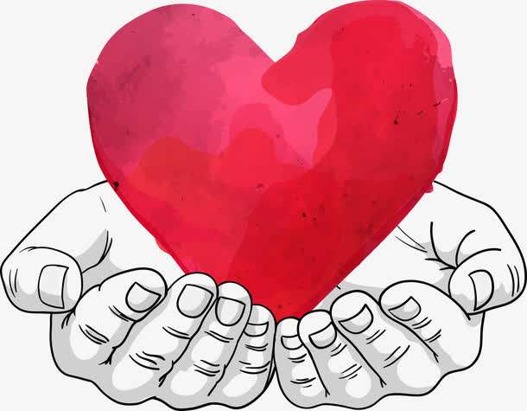
父爱是高山，即使在最困难的时候，也鼓励我挺直脊梁。
love is a mountain, even in the most difficult times, I was encouraged to straighten the backbone.
父爱是一缕阳光，让你的心灵即使在寒冷的冬天也能感到温暖如春。
love is a ray of sunshine, let your mind, even in the cold winter, can feel the warmth of spring.
父爱是一把大伞，总在有雨的天里撑着。父爱是一座大山，挺拔而伟岸。
the father is a big umbrella, in rainy days holding. love is a mountain, tall and stalwart(坚定的).
父爱是一座山峰，让你的身心即使承受风霜雨雪也沉着坚定。
love is a mountain, let your mind calm and firm also even under various difficulties and hardships.
父爱是北斗，即使在伸手不见五指的夜里，也能让我辨明方向。
the father is the big dipper, even in the dark night, also let me identify the direction.

Slide 32
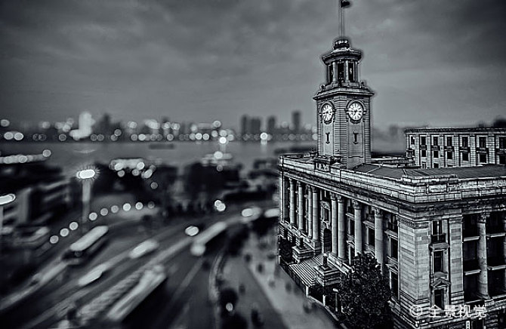
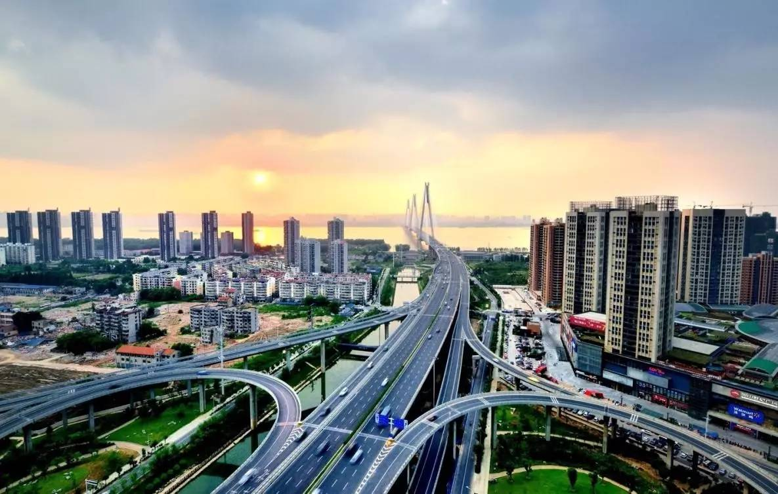
Start of Spring lifts the curtain of spring.
After that everything turns green and
full of vigor.
When spring comes, the whole city
Will begin to breathe again.
No cross , no crown.

Slide 33
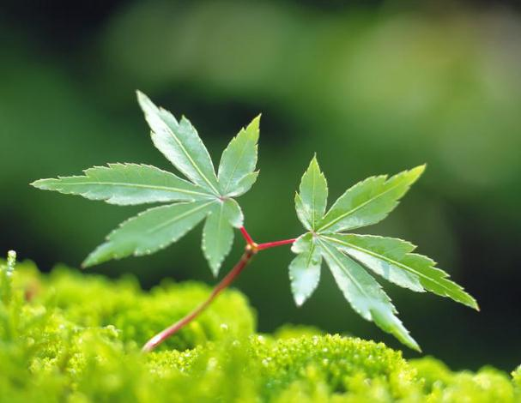
Thank you

