Slide 1

感恩遇见，相互成就，本课件资料仅供您个人参考、教学使用，严禁自行在网络传播，违者依知识产权法追究法律责任。
更多教学资源请关注
公众号：溯恩高中英语
知识产权声明

Slide 2

Letters of Application
2020年6月浙江省五校联考应用文讲评
杭州学军中学 蔡佳珏

Slide 3


2020年浙江省五校联考应用文
假如你是李华，寒假在伦敦学习，得知伦敦市政府在社区招募防疫志愿者。请你用英文写一封电子邮件应聘，
内容包括：1. 写信目的；2.个人优势；3.能做的事情。
注意：1. 词数80左右 2. 可适当增加细节，以使行文连贯。
审题与构思
要能根据体裁很快反应出“应聘信”常用的表达，
如: “Knowing that you are recruiting ..., I am writing to apply for the job.” 以及“Thank you for considering my application.”
体裁：应聘信
写信对象：
Dear Sir/Madam,
时态：一般现在时为主
虽然是伦敦市政府在招募志愿者，但阅读信件应是某位工作人员。不建议使用“Dear London Government,” 或 “To whom it may concern,”

Slide 4
2020年浙江省五校联考应用文
假如你是李华，寒假在伦敦学习，得知伦敦市政府在社区招募防疫志愿者。请你用英文写一封电子邮件应聘，
内容包括：1. 写信目的；2.个人优势；3.能做的事情。
注意：1. 词数80左右 2. 可适当增加细节，以使行文连贯。
审题与构思
对要点一定要进行具体拓展，
且紧密围绕“抗疫志愿者”的主题
分段与要点：
Para.1 自我介绍；背景信息；写信目的
李华，中国人，寒假在伦敦学习；政府招募防疫志愿者；写信应聘
Para.2 个人优势；能做的事情
时间，经验，语言，性格等；发口罩，量体温，做好登记，做好宣传等
Para.3 套句
希望能考虑我；感谢
“感谢”不是要点，
但出于交际原则，以示礼貌，最好出现

Slide 5
常见问题
要点3缺失，或将要点2和要点3融合
Having precious working experience as a volunteer during the outbreak in China, I am able to deal with any situation. Besides, I can speak fluent English and always willing to help people in need. I am ready for anything you want me to do.
I am warm-hearted and I am willing to help others, such as delivering medicines, performing first aid and so on.
TIP：建议按顺序将要点清晰独立地表达出来，
更有利于阅卷老师踩点给分
要点1背景信息不到位
Hearing that you are looking for volunteers, I am writing to apply for it.
TIP：题目中提到的背景信息也是要点，此处缺少了“写信人身份”及“抗疫志愿者”的信息，导致写信目的不够清晰

Slide 6
常见问题
内容不合理
1. Having previous experience as a volunteer during the peak of outbreak in China, I am able to deal with any situation.
2. I major in nursery, so I can perform first aid on patients who are in danger.
3. If I can be the volunteer, I will donate some masks and supplies.
中国疫情正是在寒假爆发，根据题目信息，李华寒假已在英国。
根据题目信息，李华应聘的是社区志愿者，
“能做的事情”不应该涉及到照顾危重病患。
因为使用了条件状语从句，这句话给人感觉
“若不让我当志愿者，我就不捐赠口罩”的意味。

Slide 7
常见问题
语气不合适
Were I chosen, I’d spread out masks and other necessities.
I’d appreciate it if you could grant me this opportunity to join you.
I believe this will make me stand out among other applicants.
“抗疫志愿者”本身有一定风险，
所以在组织语言时不用显得过于客气，
或是流露出过强的竞争意识。

Slide 8
常见问题
套句不熟练
Learning that you are eager for community volunteers to fight against COVID-19, I am writing to ask for permission to join in it.
I hope I can meet with your needs.
Hope I can do you a favor.
应聘信必然涉及到“招聘”与“应聘”的表达，建议同学们将这些表达固定下来，此处可用“recruit/in need of”“apply for”
应聘信结尾通常要表示“谢谢您考虑我的申请”，此处可用“Thank you for considering my application.”

Slide 9
好句欣赏
Para.1 自我介绍；背景信息；写信目的
Knowing that you are looking for volunteers to help contain the spread of the virus, I am writing to apply for the job/position.
Knowing that the government is recruiting volunteers to prevent the spread of the epidemic, I am writing to recommend myself for the following reasons.
Knowing that the government is in need of volunteers to shield/defend communities against the virus, I would like to sign up for this.
Para.3 套句
Thank you for your time.
Thank you for taking my application into consideration.
I hope my application will meet with your approval.
Looking forward to your favorable reply.

Slide 10
好句欣赏
Para.2 个人优势
【总起】
  I believe I am the very person you are looking for.
  I think I am qualified for the job/am equal to the job for the following reasons.
【语言优势】
  Equipped with a good command of English, I can communicate with natives easily.

Slide 11
好句欣赏
Para.2 个人优势
【经验优势】
  I am an experienced volunteer.
  I have previous experience in volunteering.
【时间优势】
  a flexible schedule, to work long hours
【性格优势】
  being cooperative and hard-working

Slide 12
好句欣赏
Para.2 能做的事情
【句型】There are various things I can do, ranging from ... to ...
【发口罩】to give out/hand out/distribute masks
【测体温】to take/measure one's temperature
【做登记】to register those with abnormal temperatures
【做宣传】to help educate people and let them know the danger of COVID-19

Slide 13
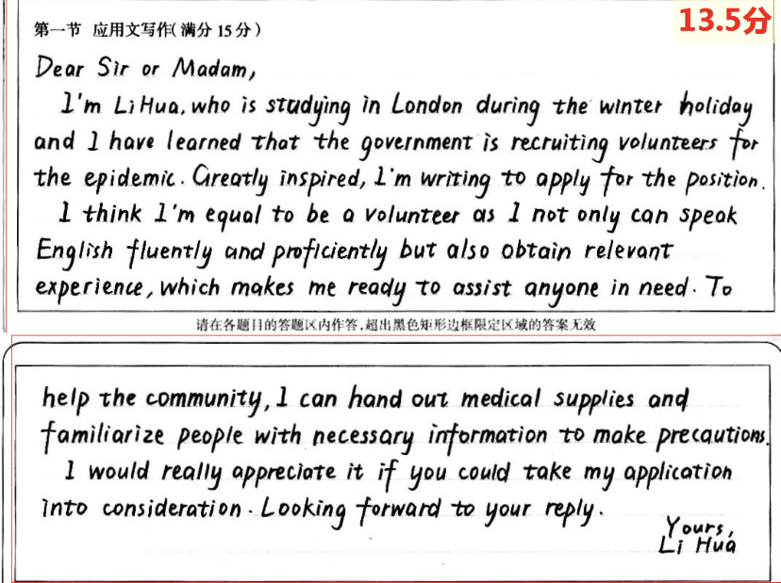
考场佳作
Para.1
①要点全面(身份，背景，目的)；②熟练掌握相关表达；
③使用了复杂的语法结构的词汇
Para.2
①要点全面(优势, 能做的事情)；②结构紧凑(总分; 连接成分)
③使用了复杂的语法结构的词汇
Para.3
①要点全面(感谢；套句)；
②套句熟练

Slide 14
参考范文
Dear Sir or Madam,
I am Li Hua, a Chinese student currently studying in London. Knowing that volunteers are wanted to fight against the virus, I am writing to apply to be one of them.
As a warm-hearted boy, I am always willing to help people in need. Besides, my good command of English and abundant relevant experience make me well suited to the job. If chosen as a volunteer, I will use my medical knowledge to appeal to local people to raise awareness of self-protection, such as washing hands regularly and wearing masks when going out.
Thank you for taking my application into consideration.
Yours,
Li Hua

Slide 15
同类作文巩固练习1
假设你的名字叫李华，今年18岁，想利用暑假打工，你在报纸上看到了某咖啡厅的招聘懂英语的服务员的广告。请根据广告要求（Part-time waiter/ Waitress；Age range 16-20；Previous experience necessary等）写一封求职信。
注意：1. 词数80左右；2.可以适当增加细节，以使行文连贯。

Slide 16
审题与构思
体裁--求职信
时态--一般现在时，一般将来时
写信对象--咖啡厅老板
Para.1 写信目的（求职）
信息来源：报纸广告
所求职位：兼职的，咖啡厅的，服务员
Para.2 满足要求/陈述优势
年龄18岁；擅长英语；有相关经验；工作态度端正；性格好
Para.3 套句
希望求职能够成功

Slide 17
同类作文巩固练习1范文
Dear Sir/Madam,
Learning from the advertisement in the newspaper that your cafe is in need of part-time waiters, I am writing to apply for the position.
I believe I am qualified for the position. I am 18 years old and I have a good command of English, which will surely live up to your expectation. What is equally important is that I have sufficient previous experience working in our school cafe.
I would appreciate it if you could give me the chance to fill in the job vacancy. Looking forward to your reply.
Yours, Li Hua

Slide 18
同类作文巩固练习2
（2018年6月浙江高考真题 应聘信）
假如你是李华，你校英语协会招聘志愿者，接待来访的国外大学生，请你写信应聘，
内容包括：1. 口语能力；2.相关经验；3.应聘目的。
注意：1. 词数80左右；2.可以适当增加细节，以使行文连贯。

Slide 19
同类作文巩固练习2范文
Dear Sir/Madam,
I am writing to apply for the post of a volunteer which is advertised in the school newspaper. I found this position quite appealing to me and I’m well qualified for the job.
First, I have a good command of spoken English, contributing to my interaction with foreign friends. Second, I have previous experience about treating exchange students. Besides, I think it an excellent opportunity to broaden my horizons and improve my social skills.
I’d appreciate it if you could give my a chance. Looking forward to your reply.
Sincerely yours,
Li Hua

Slide 20
THANK YOU

