Slide 1
感恩遇见，相互成就，本课件资料仅供您个人参考、教学使用，严禁自行在网络传播，违者依知识产权法追究法律责任。
更多教学资源请关注
公众号：溯恩英语
知识产权声明

Slide 2
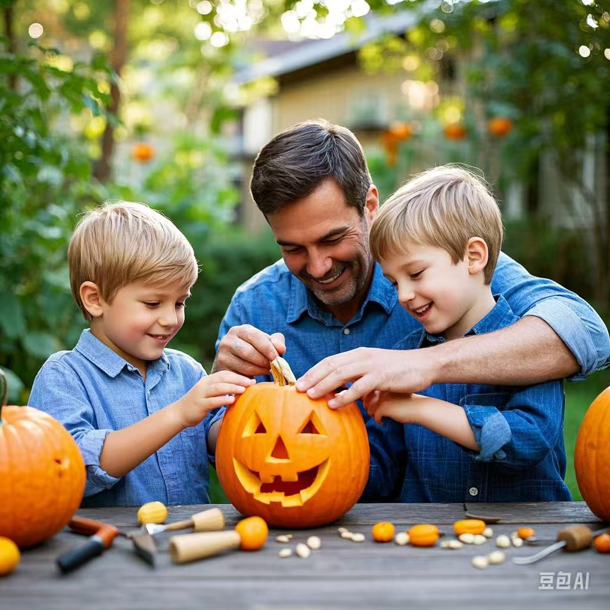
A Jack-O'-Lantern Design Party
---2025届-12 Z20
人与社会之亲情篇
郑素红

Slide 3
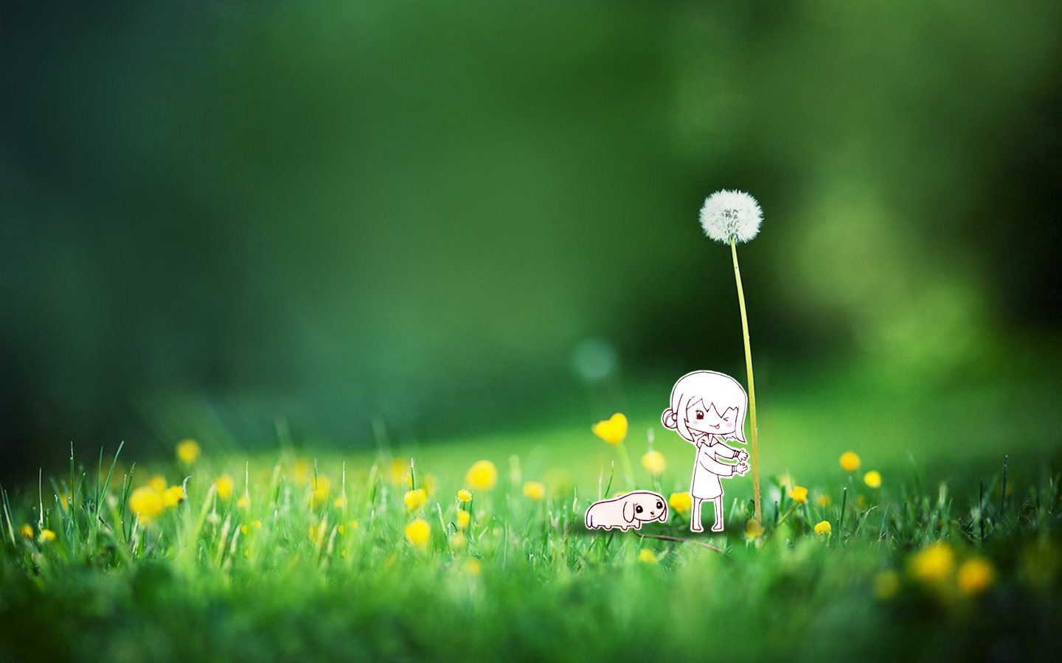
Every October, I beg my parents to take us to a pumpkin patch (园地)and every October it doesn't work out. That's why I couldn't believe my ears when my dad came home with the world's best news.
"Guess what!” he said. “I just saw a poster for the jack-o'-lantern (南瓜灯）design party in the Pumpkin Patch, and it's not too far from here."
"No way!" I said. "Can we go?"
"Pumpkin! Pumpkin! Party! Party!" chanted my little brother, Tex.
"Let's go! But I've heard a rumor that something terrible happened there." said my dad, worried.
Within minutes, Tex and I already jumped into the car and buckled up, ready to go. "I'm going to pick the giantest pumpkin," said Tex.
"Giantest isn't an actual word," I said.
"I'm going to pick the bestest pumpkin!" shouted Tex.
"I'm pretty sure bestest isn't an actual word either." I giggled.
"I'm going to pick whichever pumpkin will make the scariest jack-o'-lantern."

Slide 4
"All right, boys! Too much excitement! What if something really goes wrong?" my dad cut in.
No response. My dad continued, "If plan A fails, we can get creative and come up with Plan B!"
Still no response.
Tex and I continued our excitement, giggling and chatting.
The drive was extra cool because we saw all kinds of Halloween decorations along the way.
"Look!" Tex said, pointing to twinkling orange lights and a flashing Pumpkin Patch sign.
"Yeah! Yes! It wasn't too far a drive," I said. "Watch out, pumpkins! Here we come!"
Coming into our sight were pumpkins of various sizes that lay in the patch.
"I pick that giant one!" Tex said, running over to pick it up. But just before he did, he said, "Ew! There's a hole in it!" Tex quickly raced to another perfectly perfect pumpkin. But when he got closer, he said, "No fair! Someone took a bite."

Slide 5
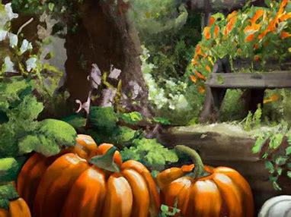
Background information about the Pumpkin Patch
the tradition of the pumpkin patch is to pick pumpkins.
Families with kids can have fun riding ponies, trains and other vehicles.
Design Jack-O’s –Lanterns .
Provide activities intended for kids

Slide 6
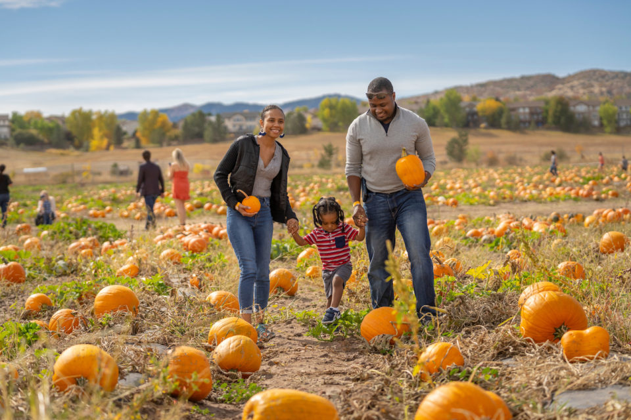
Read for elements
characters： Tex and I ( leading )
Dad ( supporting)
2. narrative perspective: first -person
3. time：October
place： A pumpkin patch & at home
Event : Tex and I were taken to a pumpkin patch to
attend a jack-o’- lantern design party but the
Pumpkin Patch closed.

Slide 7
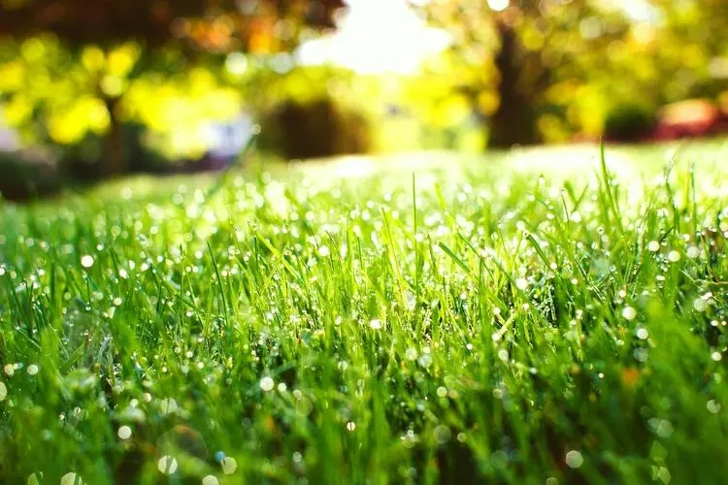
5.
story
line
Climax
Upon arrival at the patch, Tex found ruined pumpkins and I noticed the sign!
Para1: That's when I noticed the Pumpkin Patch Closed sign.
My dad continued, "If plan A fails, we can get creative and come up with Plan B!"
Tex and I were so excited that we giggled and chatted merrily all the way.
Para2:Finally came our own jack-o‘-lantern design party the next day.
.
Every October, I beg my parents to take us to a pumpkin patch (园地)and every October it doesn't work out. That's why I couldn't believe my ears when my dad came home with the world's best news.
background
Ending
Beginning

Slide 8
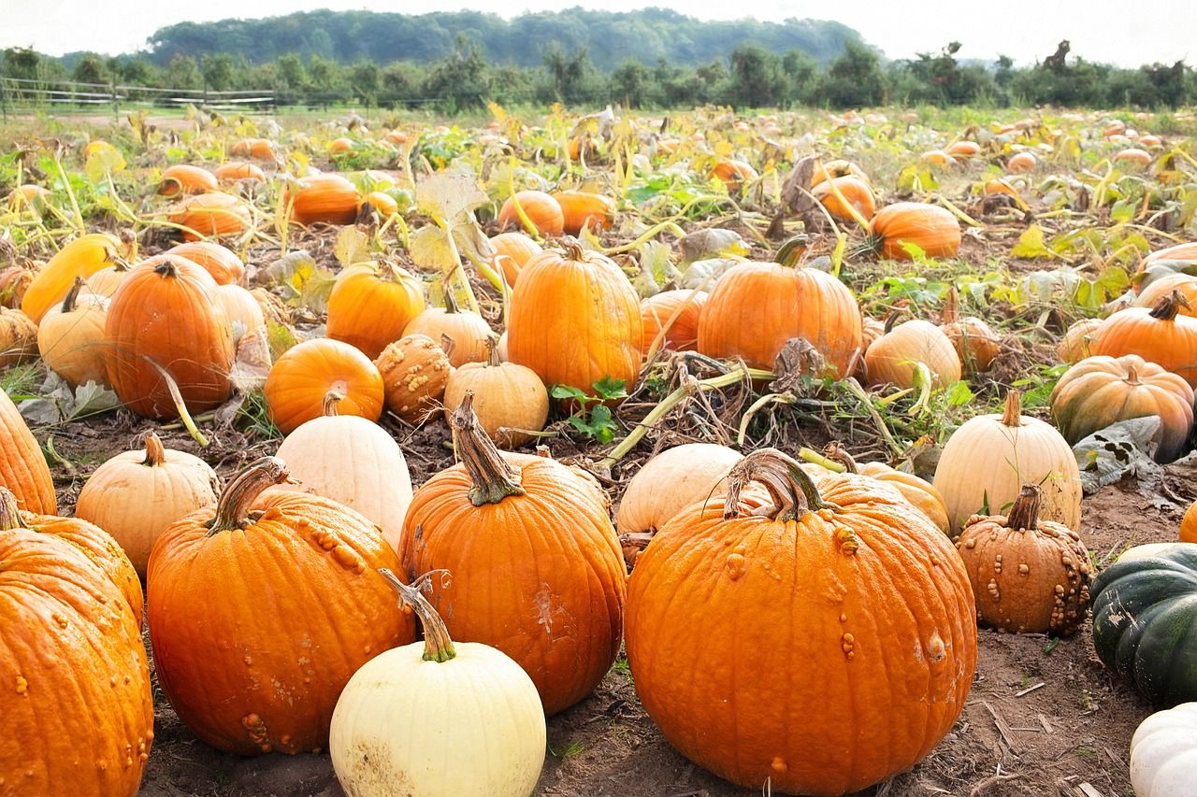
Read for clues and echoes
hidden clues | echoes
Every October, I beg my parents to take us to a pumpkin patch (园地)and every October it doesn't work out. That's why I couldn't believe my ears when my dad came home with the world's best news. "Guess what!” he said. “I just saw a poster for the jack-o'-lantern (南瓜灯）design party in the Pumpkin Patch, and it's not too far from here." | It was the world’s worst news! Not only did the merciless sign evidence the rumor Dad told us but also it deprived us of the opportunity to have fun on the Pumpkin Patch. failure!

Slide 9
Read for clues and echoes
hidden clues | echoes
"No way!" I said. "Can we go?" "Pumpkin! Pumpkin! Party! Party!" chanted my little brother, Tex. "Let's go! But I've heard a rumor that something terrible happened there." said my dad, worried. | 2. Not only did the merciless sign evidence the rumor Dad told us but also it deprived us of the opportunity to have fun on the Pumpkin Patch.

Slide 10
Read for clues and echoes
hidden clues | echoes
"All right, boys! Too much excitement! What if something really goes wrong?" my dad cut in. No response. My dad continued, "If plan A fails, we can get creative and come up with Plan B!" Still no response. | 3. Trying to lift our spirits, Dad announced enthusiastically,” Apparently, Plan A failed. But don’t lose heart, boys! Be creative and come up with Plan B!”

Slide 11
Read for clues and echoes
hidden clues | echoes
Within minutes, Tex and I already jumped into the car and buckled up, ready to go. "I'm going to pick the giantest pumpkin," said Tex. | 4. The moment Dad said yes to Plan B, we jumped into the car, buckled up, hit the road again and headed for a nearby grocery store to grab several giantest and bestest pumpkins for our own jack-o’-lantern design party at home. Excitement bubbling again,/ A ray of hope reignited in our heart, Tex and I were convinced Plan B would not let us down any more !

Slide 12
hidden clues | echoes
Within minutes, Tex and I already jumped into the car and buckled up, ready to go. "I'm going to pick the giantest pumpkin," said Tex. "Giantest isn't an actual word," I said. "I'm going to pick the bestest pumpkin!" shouted Tex. "I'm pretty sure bestest isn't an actual word either." I giggled. "I'm going to pick whichever pumpkin will make the scariest jack-o'-lantern." | 4. Time ticking away, Tex and I used the bestest and giantest pumpkins to carve out the most spooky lanterns with various -shape eyes, noses and mouths, laughing and chatting merrily.
Read for clues and echoes

Slide 13
心理描写
神态描写
动作描写
外貌描写
环境描写
对话描写
语言
无灵主语
动作链
分词作状语
With 复合结构
独立主格
从句
倒装句
虚拟语气
强调句
长短句结合
考生构思情节的同时，要考虑合适的语言句式以及修辞

Slide 14
Plot the continuation story
Para1: That's when I noticed the Pumpkin Patch Closed sign.
Para2:Finally came our own jack-o‘-lantern design party the next day.
Link1: How did Tex and I feel? What did we do?
Body: What did Dad do? What was our plan B?
Link2: After carrying out Plan B, where did we go? How did Tex and I feel?
Link3: How did Tex and I feel?
Body: How did Tex and I make Jack-o'-lanterns?
Ending: ①What were the lanterns like?
② What lesson did I learn from the experience?

Slide 15
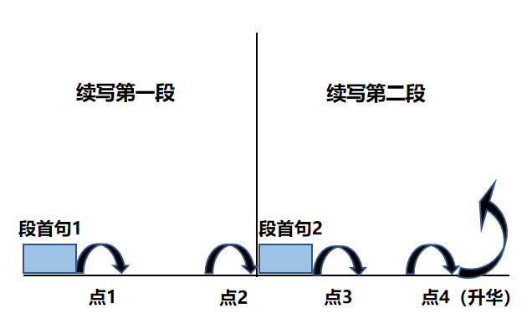
Plot Continuation
点1：位于续写第一段段首，流畅衔接前面的故事（常与原文最后一段呼应）和第一段段首语；
点2：位于续写第一段段尾，流畅衔接第二段段首句；
点3：位于续写第二段段首，续写衔接第二段段首语；
点4：文章结尾升华，给予读者正能量，揭示和强调主题。

Slide 16
Design link1
Para1: That's when I noticed the Pumpkin Patch Closed sign.
Link1A: (回扣原文 the best news 以及所给首句 the Pumpkin Patch Closed ) It was the world’s worst news! Not only did the merciless sign evidence the rumor Dad told us but also it deprived us of the opportunity to have fun on the Pumpkin Patch.
Link1B: : (以首句I 为叙事对象以及描写Tex：） My heart froze/ sank and I could see disappointment etched on Tex’s face. “Closed? But why?” I asked with tearful eyes, a wave of frustration surging up.
Link1 C: (反向回扣原文Tex 的激动）At the terrible news, Tex looked on the verge of tears, pulling a long face with his lips pursed. This was supposed to be our special day, and now it was ruined.

Slide 17
Design link2
Para1: That's when I noticed the Pumpkin Patch Closed sign.
Para2:Finally came our own jack-o‘-lantern design party the next day.
Link2 A: (我们要动脑筋想Plan B ) Mind racing, Tex dried his tears, exclaiming in a choked voice, “ we can still pick some imperfect pumpkins with flaws.” “ And we can throw jack-o'-lantern design party tomorrow!” I added, eyes sparkling with thrill.
Link2B: ( 呼应原文开车去南瓜园地，要回家呀）The moment Dad said yes to Plan B, we jumped into the car, buckled up, hit the road again and sped for a nearby market to grab several giantest and bestest pumpkins for our own jack-o’-lantern design party at home. Excitement bubbling again/ A ray of hope reignited in our heart, Tex and I were convinced Plan B would not let us down any more !

Slide 18
Design link3
Para2:Finally came our own jack-o‘-lantern design party the next day.
Link3A: ( 我们兄弟俩非常期待） Despite the unpleasant incident the day before, Tex and I were in high spirits, readily setting out to throw our design party.
Link3B: ( 呼应Party 这个词，人越多越有feel） Wearing an expectant look, Tex urged our Dad to kick off the design party, saying that we had invited some friends and neighbors to join us.

Slide 19
Design ending
Para2:Finally came our own jack-o‘-lantern design party the next day.
Ending A: (主题式结尾) The episode on that day would be engraved in my mind, reminding me if Plan A failed, be smart and Plan B would never fail you.
Ending B: (情景+感悟式结尾) As the sun set, we lit up our jack-o’-lanterns, which cast a warm, spooky glow over our backyard.
We might not have had the Pumpkin Patch experience, but in that split moment, surrounded by our own handiwork and the love of my family, I realized that sometimes, the best memories could also be created at home, a place overflowing with love.

Slide 20
Design ending
Para2:Finally came our own jack-o‘-lantern design party the next day.
Ending C: (情景式结尾) Candles flickering in darkness, our family continued to enjoy a rich dinner, savoring the festive atmosphere our own jack-o’-lantern design party brought us.
Ending D: (幽默式结尾) I could proudly say that the hellish festive air in our neighborhood on Halloween Eve could be mainly credited to our elaborately-crafted jack-o’-lanterns.

Slide 21
Para1: That's when I noticed the Pumpkin Patch Closed sign.
It was the world’s worst news! Not only did the merciless sign evidence the rumor Dad told us but also it deprived us of the opportunity to pick ideal pumpkins on the Pumpkin Patch. Disappointed and frustrated, Tex was literally devastated, tears streaming down his cheeks. Trying to lift our spirits, Dad announced enthusiastically,” Apparently, Plan A failed. But don’t lose heart, boys! Be creative and come up with Plan B!” Mind racing, I exclaimed, “ We can grab pumpkins in a grocery and throw jack-o'-lantern design party at home tomorrow.” The moment Dad said yes to Plan B, we jumped into the car, buckled up, hit the road again and sped for a nearby grocery stores . Excitement bubbling again, Tex and I were convinced Plan B would never let us down!

Slide 22
Para2:Finally came our own jack-o‘-lantern design party the next day. The sun shining brightly over the courtyard, Tex and I couldn’t wait to embark on the journey of creating our masterpieces. No sooner had we had breakfast than we sprang into action. Bathed in the warm sunlight, we designed weird pictures on bright orange pumpkins, cut their tops off, hollowed the inside out and initiated the carving job. Time ticking away, Tex and I carved out spooky lanterns with various -shape eyes, noses and mouths, laughing and chatting merrily. All the jack-o’-lanterns flickering in darkness, our parents gave us a thumbs-up, radiant smiles blooming across our faces. The episode on that day would be engraved in my mind, reminding me if Plan A failed, be smart and Plan B would never fail you. 结尾2 Candles flickering in darkness, our family continued to enjoy a rich dinner, savoring the festive atmosphere that our own jack-o’-lantern design party brought us .

Slide 23
Para1: That's when I noticed the Pumpkin Patch Closed sign.
It was the world’s worst news! Not only did the merciless sign evidence the rumor Dad told us but also it deprived us of the opportunity to have fun on the Pumpkin Patch. Tex had intended to enjoy a pony ride while I had wished to take a train through the ocean of pumpkins. Disappointed and frustrated, Tex was literally devastated, tears streaming down his cheeks. Trying to lift our spirits, Dad announced enthusiastically,” Apparently, Plan A failed. But don’t lose heart, boys! Be creative and come up with Plan B!” Mind racing, Tex dried his tears, exclaiming in a choked voice, “ we can still pick some imperfect pumpkins with flaws.” “ And we can throw jack-o‘-lantern design party tomorrow!” I added, eyes sparkling with thrill. (首段版本2）

Slide 24
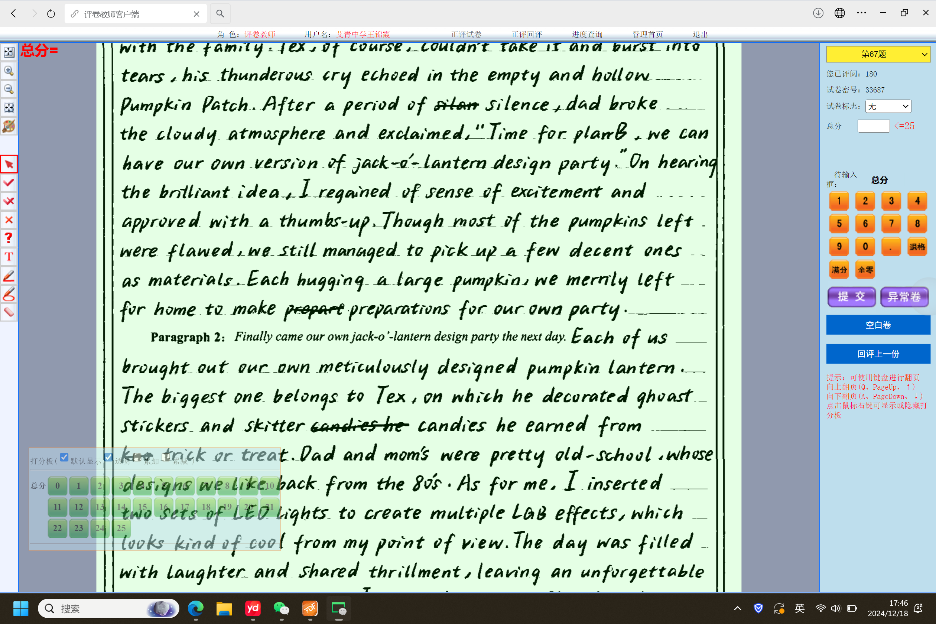
考生习作点评：
考生对于故事的承转启合把控非常老道，语言清新但又回扣巧妙；
叙事非常有逻辑，对于作品的描写细腻有趣，而且还很有现代风；
书写虽有涂改，但是却仍然给人以卷面整洁清爽之感；平行与横线划线的涂改的方法可以借鉴。
（说明： 涉及到阅卷的信息，把首句剪切掉了）

Slide 25
