Slide 1

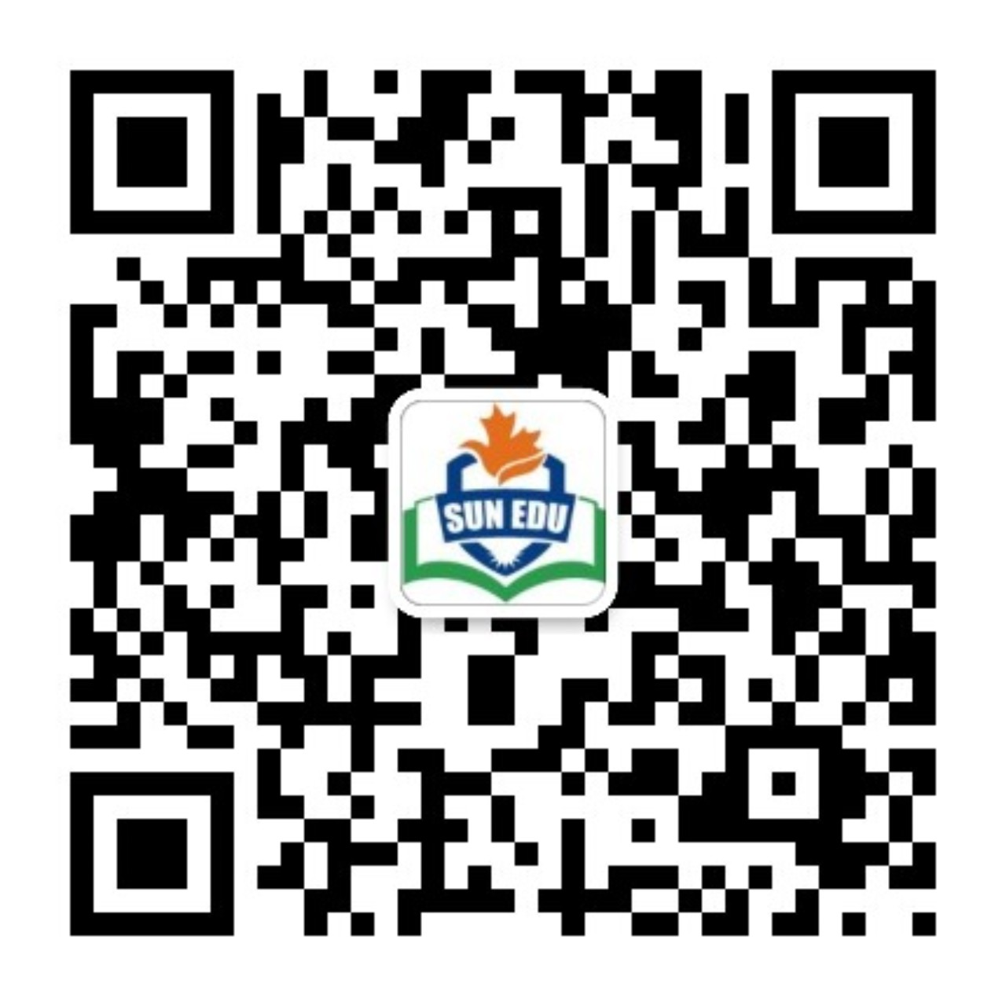
感恩遇见，相互成就，本课件资料仅供您个人参考、教学使用，严禁自行在网络传播，违者依知识产权法追究法律责任。
更多教学资源请关注
公众号：溯恩英语
知识产权声明

Slide 2

Effective Beginning
& Ending
Fay

Slide 3
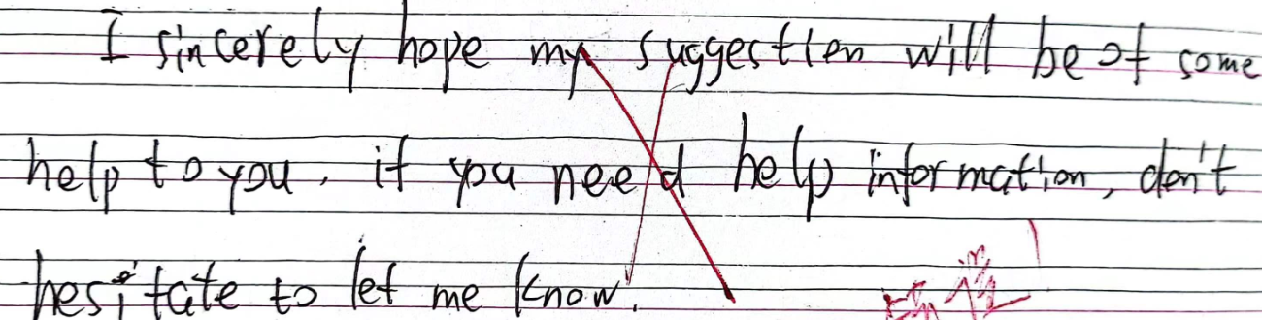
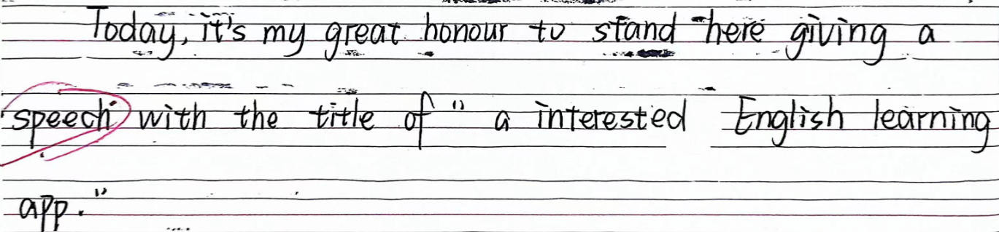
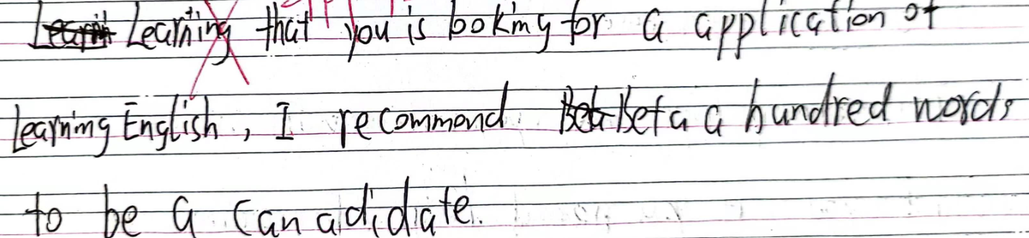
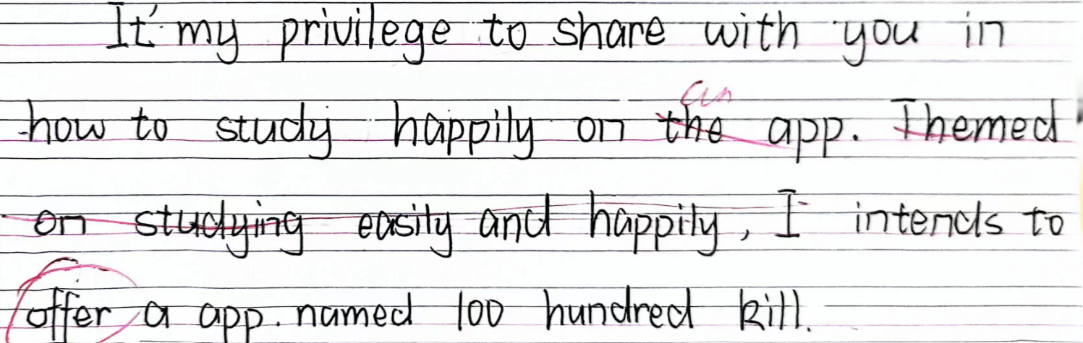
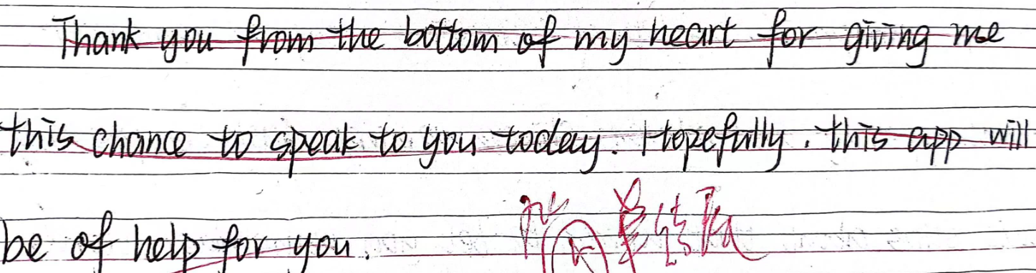
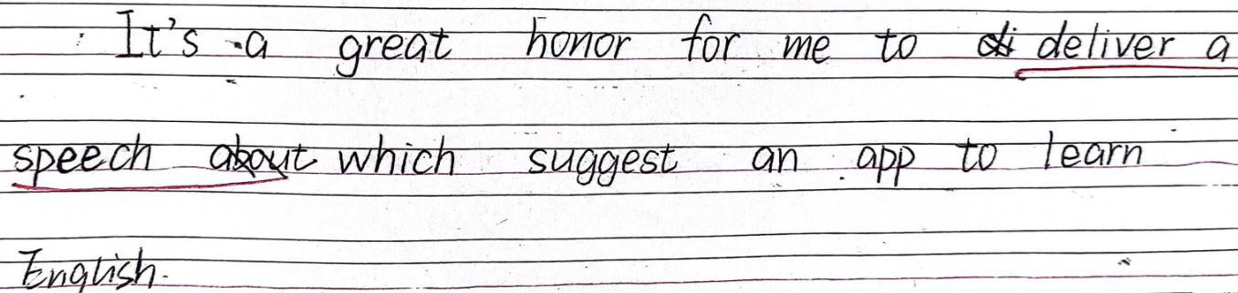
【五校联考】假定你是李华，外教Brian要求同学们在课上推荐一款兼顾趣味与英语学习的app, 请你写一篇发言稿。内容包括：1.介绍这款app; 2.分享使用体验。
审题：非正式/较随意
审题：体裁、语境
审题：
交际：人称、语气等
应用：体裁、语言等
开头/结尾：
交际：互动与否（人称、语气）应用：写作内容（体裁、语境）
易错点：
体裁不适配
语境不适配

Slide 4

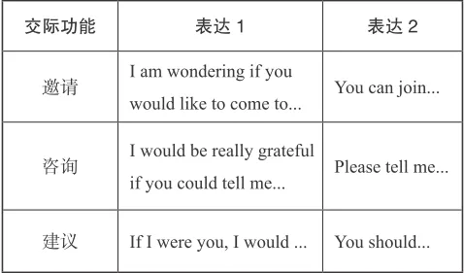
高中英语应用文中的“交际”
《普通高中英语课程标准（2017 年版 2020 年修订）》要求学生掌握一定的语用知识，这有助于学生根据交际目的、交际场合的正式程度、参与人的身份和角色，选择正式或非正式、直接或委婉、口头或书面语等语言形式，得体且恰当地与他人沟通和交流，达到一定的交际目的。
交际类型 | 概述 | 内容举例 | 易错点
形式上的交际 | 格式上体现书信写作的交际意识 | 称呼、寒暄、问候、自我介绍、结束语、落款 | ＊除了称呼以外，没有任何形式的交际，省略寒暄、写作目的。 ＊没有礼貌性的结束语 ＊格式化开头与结尾
语气上的交际 | 不同体裁使用不同语气：陈述语气、祈使语气和虚拟语气 | 内容上开门见山，语气上委婉得体。得体地使用恰当语气进行书面写作 | ＊开头不够直截了当 ＊语言表达不分对象
内容上的交际 | 在写作中完成要点，适当添加细节，正确得体地表达思想、情感和意图。 | 如：假设请你邀请外教参加班级活动，活动时间由考生自己设定。有的考生将班级活动安排在周日或者是周一上午就是缺乏内容上的交际 | ＊内容细节安排不合理 ＊要点比例重点和非重点分配不合理 ＊内容设计缺乏操作性或不贴合实际生活 。。。。。。

Slide 5



高中英语应用文中开头结尾的“交际”
《普通高中英语课程标准（2017 年版 2020 年修订）》要求学生掌握一定的语用知识，这有助于学生根据交际目的、交际场合的正式程度、参与人的身份和角色，选择正式或非正式、直接或委婉、口头或书面语等语言形式，得体且恰当地与他人沟通和交流，达到一定的交际目的。
交际类型 | 形式上的交际 | 语气上的交际 | 内容上的交际
开头 | 体裁、格式、时态等 称呼、寒暄、问候、自我介绍、 | 人称、语气、语言 正式/非正式/委婉 得体 | 写作目的/话题 开门见山
结尾 | 结束语、落款 | 人称、语气、语言 正式/非正式/委婉 得体 | 总结全文 得恰当体
注意事项举例：开头：自我介绍与否、寒暄与否、写作意图是否直接表述精确、细节补充是否合理恰当 结尾：总结与否、互动与否、细节补充是否合理恰当；
具
体
内
容
语言组织：学生需要合理组织文章的结构，包括开头、正文和结尾，确保信息传递的逻辑性和连贯性。
语法词汇：学生需要使用正确的语法结构和词汇来表达思想，避免语法错误和用词不当。
信息传递：学生需要清晰地传达信息，确保读者能够理解文章的主旨和细节。
情感表达：学生需要通过语言表达自己的情感，使文章具有感染力。
交际策略：运用适当的交际策略，如请求、道歉、感谢等

Slide 6
1【温州二模】假定你是李华，暑期想在家乡(杭州)寻找外国友人结伴“城市漫步”. 请通过社交媒体发布一篇帖子，内容包括:
1. 相关介绍;
2. 旅伴要求。
Join Me for a CityWalk
 | 体裁 | 语境
开头 | 非正式 | 交际互动+目的
结尾 | 非正式 | 总结+交际互动
开头
交际互动：Hey everyone! This is Li Hua, a travel enthusiast from Hangzhou.
写作目的：I'm on the lookout for some foreign friends to join me in exploring the fascinating city of Hangzhou this summer.
结尾
内容总结：I can assure you that exploring a city with a local will be the last decision you’ll come to regret.
交际互动：If interested, send me a message and let's together hit the road!

Slide 7
2【2023年12月强基联盟】假定你是李华，你的外国朋友Daniel正在你的城市旅游。请写封邮件邀请他与你一起进行一次城市漫步(CityWalk),内容包括:
1.发出邀请;
2.介绍行程。
 | 体裁 | 语境
开头 | 非正式 | 交际互动+目的
结尾 | 非正式 | 总结+交际互动
开头
①I hope you're having a wonderful time touring our city. You told me earlier that you are free this Sunday, so maybe we can do a city walk to explore some lesser-known sites and experience the authentic lifestyle here.
②I hope this email finds you well and enjoy your visit to our beautiful city! I've been thinking about the best way for you to experience the local culture and sights, and I strongly desire to invite you to join me a CityWalk tour.
③简版：I hope this email finds you well! Knowing that you are now enjoying your visit in my city, I strongly desire to invite you to join me a CityWalk tour.

Slide 8
2【2023年12月强基联盟】假定你是李华，你的外国朋友Daniel正在你的城市旅游。请写封邮件邀请他与你一起进行一次城市漫步(CityWalk),内容包括:
1.发出邀请;
2.介绍行程。
 | 体裁 | 语境
开头 | 非正式 | 交际互动+目的
结尾 | 非正式 | 总结+交际互动
结尾
①This city walk will make your trip truly complete. I really want to spend this Sunday with you and discover these hidden gems together. So, are you in?
②I believe this CityWalk will not only be enjoyable but also a unique way to dive deep into the heart of our city. Looking forward to your response and the chance to share my city with you!
③简版：The CityWalk is bound to be enjoyable and meaningful and I am looking forward to your early reply.

Slide 9
3【2021.6浙江卷】你校正在举办国画作品展，请给校英文报写一篇宣传稿，内容包括：
1.展览时间地点；
2.观展感受
3.推荐展览
 | 体裁 | 语境
开头 | 正式 | 目的
结尾 | 正式 | 总结+交际互动
开头
①In order to better experience traditional Chinese culture, our school is organizing a meaningful activity to visit an Chinese painting exhibition in the school hall this week.
②I am excited to introduce a remarkable exhibition of traditional Chinese paintings, which is organized by the student art club.
结尾
① Through the exhibition, not only can you admire wonderful works, but also understand the art of traditional Chinese painting better. Come and seize this opportunity to appreciate the essence of Chinese art.
② The exhibition is truly a feast of eyes. Come and visit! You can’t miss it!

Slide 10
4【2020全国卷I】你校正在组织英语作文比赛。请以身边值得尊敬和爱戴的人为题，写一篇短文参赛，内容包括:
人物简介；
2. 尊敬和爱戴的原因。
 | 体裁 | 语境
开头 | 正式 | 要点
结尾 | 正式 | 总结
开头
①We have a lot of respectable people around us. They may be our teachers, parents or one of our elders. As for me, my father is the person I respect most.
②For me, the most respectable person round me is my best friend, Li Hua, a 17-year-old teenager currently studying in my class, who is crazy about reading, learning and helping other people.
结尾
① He achieved a lot in his work, respected by his students. So, in my mind my father is the person I respect most and I love him deeply.
② Hopefully, I could become an outstanding person like Li Hua. I have the confidence that, with such an excellent friend around me, I will become better and better.

Slide 11
5【杭州二模】本学期你校开设了每周一节的英语文学阅读课，请你就此写一篇短文向学校英文报“Student Voice” 栏目投稿，内容包括：
1.课程介绍(目的、内容、上课方式等);
2.你的收获。
English Literature Reading Class Opens a New World
 | 体裁 | 语境
开头
结尾
I’m excited to share my experience with the weekly English Literature Reading class.
Moreover, the class has sparked a newfound passion for literature within me, igniting my desire to explore further in the vast world of English letters. It has undoubtedly been a highlight of this academic semester.
6【五校联考】假定你是李华，外教Brian要求同学们在课上推荐一款兼顾趣味与英语学习的app, 请你写一篇发言稿。内容包括：1.介绍这款app; 2.分享使用体验。
Hi, everyone. Today I’d like to recommend an app called “Duolingo” to all of you. It is an excellent app that combines fun and effective English learning methods.
The variety of exercises and the app’s user-friendly interface have made my learning experience pleasurable and productive. I highly recommend giving Duolingo a try.

Slide 12
7【嘉兴二模】假定你是李华，你校外教David正在策划一场英语辩论赛，现向同学们征集辩题。请你给他写一封邮件，内容包括：
1. 提供辩论题目；
2. 说明选题理由。
 | 体裁 | 语境
开头
结尾
Knowing that you are planning an English debate competition and collecting debate topics, I’m writing to propose the topic “Is technology making us more connected or more isolated?”
I believe this topic will engage the participants and the audience, sparking meaningful discussions. I’ll appreciate it if you take my recommendation into consideration.
8【绍兴二模】假定你是某国际学校学生会主席李华，本学期你校将为外籍学生开设一系列以中国传统文化为主题的研讨活动（workshop）, 请你写一则通知，内容包括：
1.介绍活动；2.阐明理由；3.邀请参加。
To help international students adapt to the life here, our school is organizing a series of workshops on Chinese traditional culture.
The workshops are supposed to expand your perspective of Chinese culture and meanwhile, make your campus life here easier and more fruitful. We sincerely hope to see you there!

Slide 13
9 【台州二模】假定你是李华，你负责的小组项目“Surveying Students’ English Novel Reading” 在学校项目评比中获奖，现受校英语俱乐部邀请作该项目的介绍。请用英语写一篇发言稿，内容包括：
1. 实施过程；
2. 组员感受。
 | 体裁 | 语境
开头
结尾
审题/体裁语境----代入写作者角色----构思/交际语言、内容要点
PRACTICE ON YOUR OWN
10【2023上海模拟】假如你是明启中学的李华，你们学校正在开展“花香进校园”活动，一方面开设园艺选修课，让学生了解花的习性；另一方面人人动手实践，用花装扮校园，创建优美的生活学习环境。请你写一封邮件给你的英国笔友Jim，介绍此次活动，你的邮件须包括：
1.对该活动的简要描述；
2.举例说明该活动对你的影响

Slide 14
 | 体裁 | 语境
开头 | 正式 | 交际互动+目的
结尾 | 正式 | 总结+交际互动
参考答案
9 【台州二模】假定你是李华，你负责的小组项目“Surveying Students’ English Novel Reading” 在学校项目评比中获奖，现受校英语俱乐部邀请作该项目的介绍。请用英语写一篇发言稿，内容包括：
1. 实施过程；
2. 组员感受。
B: Good morning, everyone.! I'm Li Hua. It‘s my great honor to share with you our group project “Surveying Students’ English Novel Reading.”
E:①This project has been incredibly rewarding, raising our awareness of teamwork and fostering our research abilities. More importantly, learning about our peers‘ reading habits has sparked our self-reflection and encouraged us to dive into English literature. That’s all about our project.
②In conclusion, our project has not only increased our understanding of students’ English novel reading habits but also inspired us to promote reading for pleasure in our school. Thank you for inviting me to share our project with you today.

Slide 15
 | 体裁 | 语境
开头 | 非正式 | 交际互动+目的
结尾 | 非正式 | 总结
参考答案
10【2023上海模拟】假如你是明启中学的李华，你们学校正在开展“花香进校园”活动，一方面开设园艺选修课，让学生了解花的习性；另一方面人人动手实践，用花装扮校园，创建优美的生活学习环境。请你写一封邮件给你的英国笔友Jim，介绍此次活动，你的邮件须包括：
1.对该活动的简要描述；
2.举例说明该活动对你的影响
B:Hope this mail finds you well! I’m excited to share with you a fantastic initiative taking place at Mingqi High School called “Flowers in Bloom” where our school is being transformed a vibrant and colorful space.
E:I believe that this campaign has been a wonderful opportunity for us to learn and grow, and I am grateful to be a part of it.

Slide 16
Write your beginning and ending in limited time
PRACTICE ON YOUR OWN
11【2022新高考I卷】假定你是校广播站英语节目“Talk and Talk”的负责人李华，请给外教Caroline写邮件邀请她做一次访谈。内容包括：
1. 节目介绍；
2. 访谈的时间和话题。
12【2021.1浙江卷】假定你是李华，下周有新西兰学生访问你校，你将作为学生代表致欢迎辞。请为此写一篇发言稿，内容包括：
1. 表示欢迎； 2. 介绍活动安排； 3. 表达祝愿。
13【2024.1浙江卷】请你写一篇短文向校英文报“Sports and Health”栏目投稿，向同学们推荐一项适合课间开展的运动，内容包括：
介绍这项运动；
说明推荐理由。
Beginning &Ending---Correct, Complete

Slide 17
 | 体裁 | 语境
开头 | 正式 | 交际互动+目的
结尾 | 正式 | 细节+交际互动
参考答案
11【2022新高考I卷】假定你是校广播站英语节目“Talk and Talk”的负责人李华，请给外教Caroline写邮件邀请她做一次访谈。内容包括：
1. 节目介绍；
2. 访谈的时间和话题。
B:I am Li Hua, in charge of the English program “Talk and Talk” in the school radio station. I am writing this email to invite you for an interview.
E:If you can spare your time, please reply to me soon. I'd appreciate it if you accepted my invitation

Slide 18
 | 体裁 | 语境
开头 | 正式 | 交际互动+目的
结尾 | 正式 | 总结+交际互动
参考答案
12【2021.1浙江卷】假定你是李华，下周有新西兰学生访问你校，你将作为学生代表致欢迎辞。请为此写一篇发言稿，内容包括：
1. 表示欢迎； 2. 介绍活动安排； 3. 表达祝愿。
B:I’m Li Hua. On behalf of our school, I would like to convey my sincere welcome for your visiting.
E:As mentioned above, I extremely expect your coming. May you have an unforgettable experience.

Slide 19
 | 体裁 | 语境
开头 | 正式 | 目的
结尾 | 正式 | 总结+推荐
参考答案
13【2024.1浙江卷】请你写一篇短文向校英文报“Sports and Health”栏目投稿，向同学们推荐一项适合课间开展的运动，内容包括：
介绍这项运动；
说明推荐理由。
B: Jumping rope is a type of exercise suitable for students to do at break time in school. To conduct the exercise, all you need is …
E:I strongly recommend this exercise to all of you. Spending 3 to 5 minutes of the break time between classes jumping rope is easy to achieve. If you can do it every day, it will certainly help keep you healthy.

Slide 20

Writing is the painting of your voice, so it allows your thoughts and emotions to resonate with others in a profound and lasting way.

