Slide 1

感恩遇见，相互成就，本课件资料仅供您个人参考、教学使用，严禁自行在网络传播，违者依知识产权法追究法律责任。
更多教学资源请关注
公众号：溯恩高中英语
知识产权声明

Slide 2
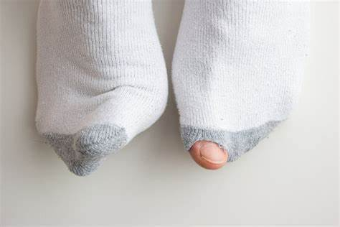
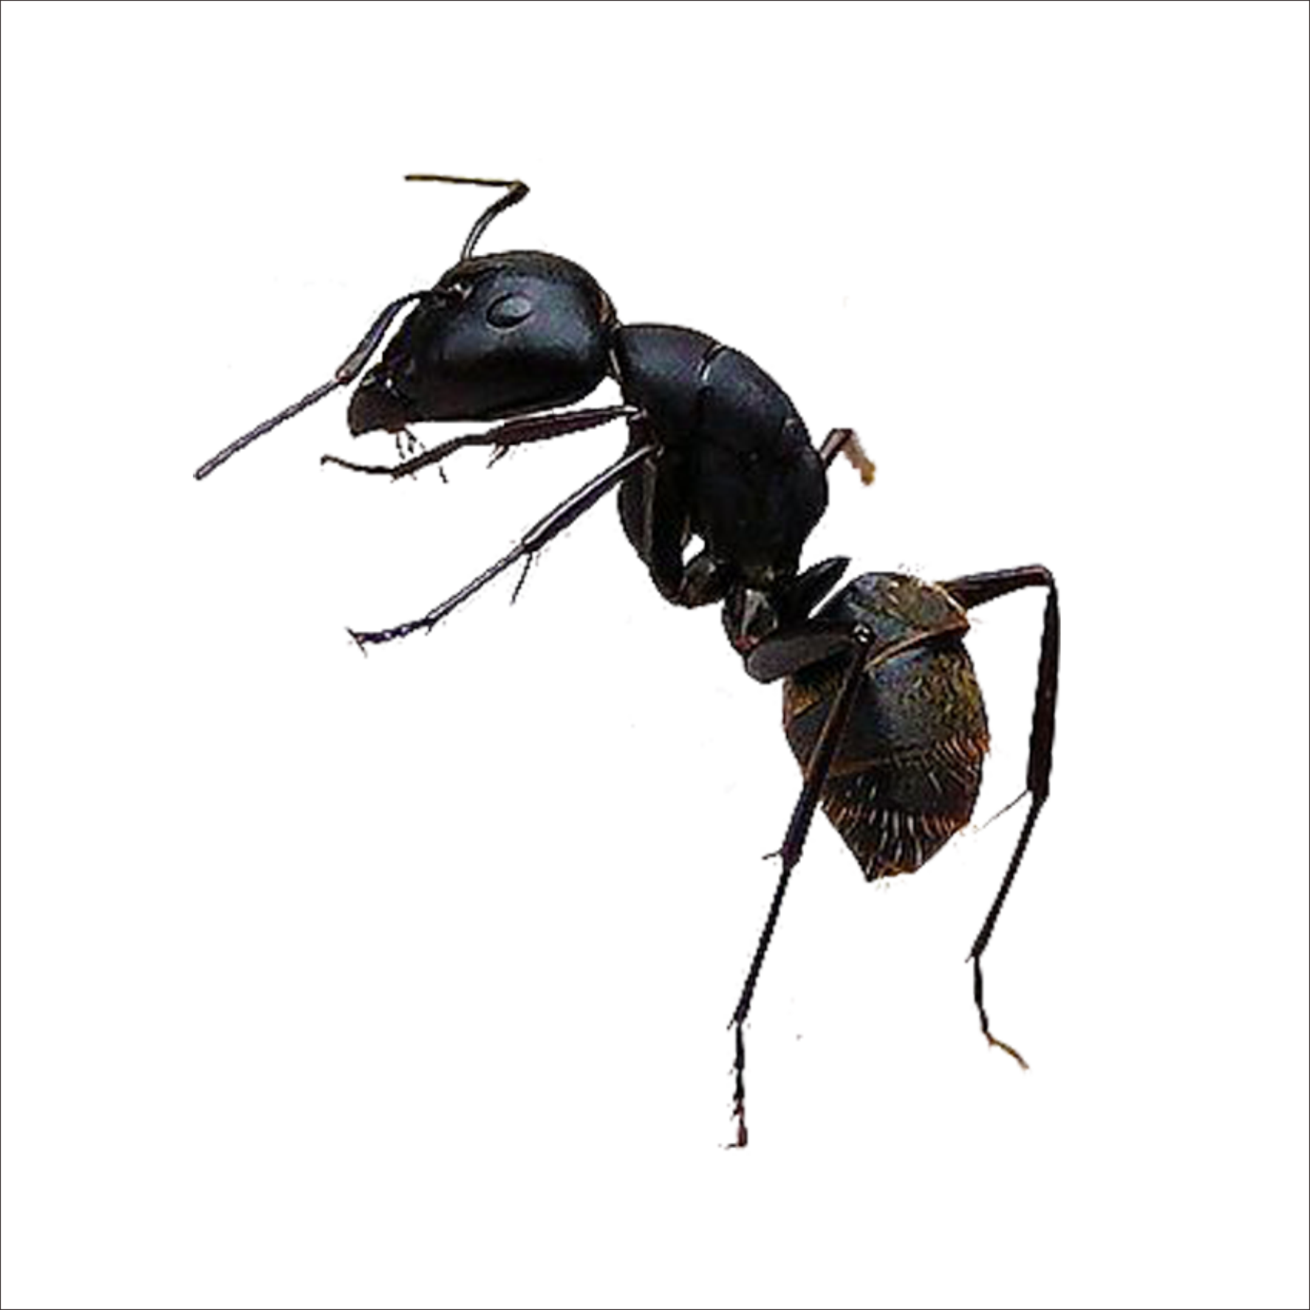
What's in the picture?
Why is there a hole in the sock?
To whom might this pair of socks belong?
How would you feel if you have holes in your socks?
Is it possible for an ant to make a hole like this? Why?
2023年高三下强基续写
sock-eater ants

Slide 3

why
what
topic sentence
①Sock-eater ants are made-up animals with the best intention ever.
②“Ow!Ow!” I shouted as I broke my jump rope rhythm and trapped my feet in the loose rope. “Something in my shoe is biting me,” I screamed. My teacher, Miss Bell, heard me and hurried over. “Which foot is it?” she asked. I stuck up my right foot as she bent over to in-spect it. Just then, feeling a new sting, I yelped in pain. “Here. Let's take off your shoe.” Instructed Miss Bell, squatting down to get the shoe.
③Then, I remembered the holes in my socks. Welfare socks didn‘t last long. Holes in socks were common for our family in the years following the Great Depression. Socks with holes in the heels often got pulled down so the hole wouldn’t show. Where there was a hole, there would soon be a blister. Every week as she washed our clothes, Mama would say, “Even if we’re poor and our clothes are worn out, we can still be clean.”
④I refused to let Miss Bell take off my shoe. I could not bear for her and the others on the playground to see the hole in my faded red sock. “Come on,then. Let's go inside to the office.” I did my best to hold back my tears. Yet, each time the thing in my shoe stung me, I would let out aloud, “Oh, oh, oh!” Tears raced down my twisted face.
⑤Miss Bell lifted me onto the desk and tried again. “Let me take a look.” She just about had the shoe off when I saw the hole. I grabbed the shoe and pulled on and held it. The stinging worsened the tighter I grabbed the shoe. Miss Womble, the fifth-grade teacher, came into the office. “Can I help? I know her. She lives next door to me.” “I guess ants are stinging her right foot, but she won't let me take off her shoe,” said Miss Bell.
key words
Characters
Setting
Plot-theme
POV
Language

Slide 4


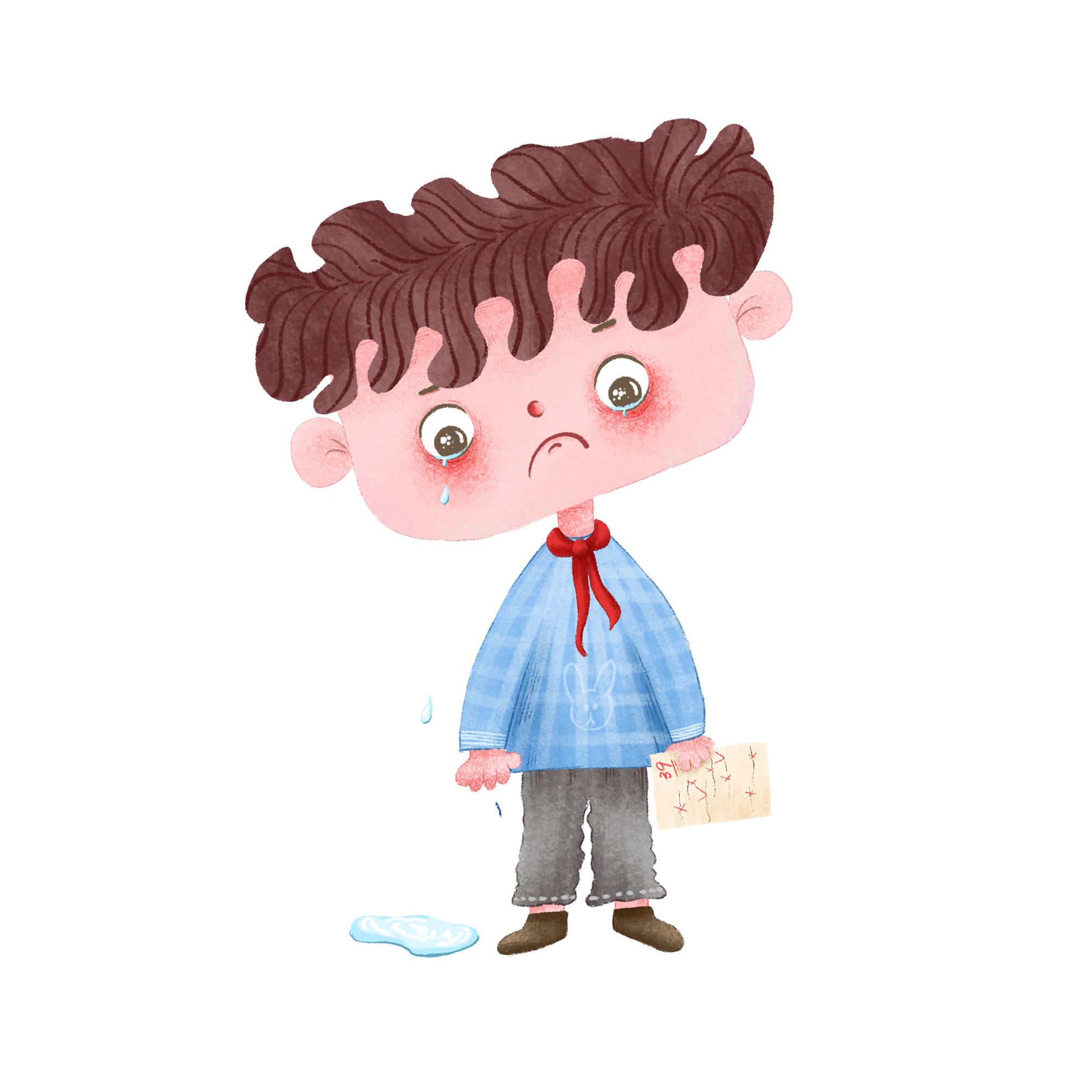

“I” | “Ow!Ow!” I shouted as... “Something in my shoe is biting me,” I screamed. I yelped in pain. ... each time the thing in my shoe stung me, I would let out aloud, “Oh, oh, oh!”
 | I did my best to hold back my tears. Tears raced down my twisted face. ... when I saw the hole. I grabbed the shoe and pulled on and held it.
 | I refused to let Miss Bell take off my shoe. I could not bear for her and the others on the playground to see the hole in my faded red sock. I remembered the holes in my socks. Welfare socks didn't last long. Holes in socks were common for our family in the years following the Great Depression.
personality
Discourse
Actions
a little girl of high self-esteem from a poor family
Thoughts
What problem is facing her?
How to persuade a girl like her?
If you were her teacher, what would you do and say?
Underline discourse and actions related to other characters in the passage.
Conclude the personality of each one.
1st-person limited POV

Slide 5

Miss Bell | My teacher, Miss Bell, heard me and hurried over. “Which foot is it?” she asked. … as she bent over to inspect it. “Here. Let's take off your shoe.” Instructed Miss Bell, squatting down to get the shoe. “Come on, then. Let's go inside to the office.” Miss Bell lifted me onto the desk and tried again. “Let me take a look.” “I guess ants are stinging her right foot, but she won't let me take off her shoe,” said Miss Bell.
Mama | Every week as she washed our clothes, Mama would say, “Even if we're poor and our clothes are worn out, we can still be clean.”
the others on the playground
Miss Womble | Miss Womble, the fifth-grade teacher, came into the office. “Can I help? I know her. She lives next door to me.”
Caring but inflexible
Decent and positive
Where are they now?
Who is the main character? Miss Bell or Miss Womble?
Function?
one of the reasons why “I” refuse to take off “my” shoes

Slide 6

Miss Womble | Miss Womble, the fifth-grade teacher, came into the office. “Can I help? I know her. She lives next door to me.”
Para.1 Sock-eater ants are made-up animals with the best intention ever.
is familiar with “my” family condition
wants to protect “my” delicate dignity
① Miss Womble put both hands on my shaking shoulders and looked into my upset, red eyes.
② Dealing with the angry bites gently, Miss Womble lifted her head and smiled at me.
What will she do and say to “me”?
What she did and said successfully persuaded me to take off the shoe.
interaction
deeper
What she did and said successfully protected my self-esteem and changed my value (价值观).
Will she mention the hole in my sock?
theme
Ending: gratitude + reflection + influence on today & future

Slide 7
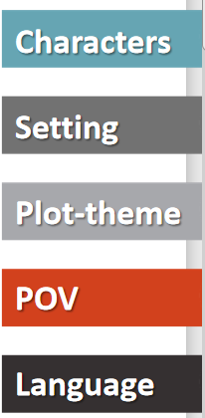
main characters vs. minor characters
personality
interaction
(change of) time & place
problem-solution-theme
determine what we can write
--action & discourse (1st limited POV)
--action & discourse & thoughts (omniscient POV)
linguistic style

Slide 8
Transitional sentences
Para.1 Miss Womble put both hands on my shaking shoulders and looked into my upset, red eyes.
❶动作的影响
Toned down (情绪缓和) by her firm grip and caring look, I loosened my hold on the shoe.
❷ 动作的延续
“Don’t panic, dear! I’ve experienced it before.” She said in a relaxed voice.
Gingerly, she managed a friendly smile and automatically blurted out, “That’s not a big deal!”
❸ look 动作的延续或影响
Seemingly seeing through me, she soothed, “It must be a sock-eating ant.”
So bright were her eyes that I could feel my tension eased a little bit.

Slide 9
Transitional sentences
前提+动作的延续
❶ After examining the blister on my foot, she went to fetch the first-aid kit on the shelf and bent down again.
❷ Looking at the red spots on my foot, Miss Womble joked “It’s like a fierce battle!” and proceeded to get first-aid appliance from the medicine cabinet.
Para.2 Dealing with the angry bites gently, Miss Womble lifted her head and smiled at me.

Slide 10
Transitional sentences
Para.2 Dealing with the angry bites gently, Miss Womble lifted her head and smiled at me.
❶动作的延续+ 伤势情况
鼓励：“You are such a brave girl to take so many bites!”
安抚：“You will be fine/ OK soon.”
❷动作的影响
Feeling ashamed, I dropped my head to avoid any eye contact with her.
The smile, as if a gentle breeze in spring, blew me away and sent my shame hiding away.

Slide 11
Closing sentences
Influence
Despite the hole in my faded sock, I could feel my heart surrounded by the warmth showered by Miss Womble, which not only eased the pain on my foot, but also reminded me of what really matters in life.
Gratitude+ Influence
Had it not been for/ But for Miss Womble, I couldn’t have escaped from the unnecessary shame for my poor family background and gained so much bravery to confront/ brave any difficult/ tough/ tricky situations in life.

Slide 12
下水作文：
Miss Womble put both hands on my shaking shoulders and looked into my upset, red yes. As if reading my mind (有效衔接，“看look”出了我的小心思), she comforted, "I've experienced this before, you know, it's killing me!" Curiosity about her similar miserable experience partly eased my pain, and I asked, "What was it then?" "It's the sock-eating ant!" She continued, “The rice-sized ant even left a hole on my sock after its feast!” (延续原文话语使用以及角色互动，点出文章首段what is the best intention) Then she squatted down and began to pull my foot out. This time, I didn’t refuse.(人物变化) Out came my sock with a big hole on it and a fresh red blister on my toe. Before I knew it, Miss Womble quickly slipped off my sock and tossed it. “What a big ant!” exclaimed Miss Belt, exchanging an assuring smile with Miss Womble (丰富人物形象), who proceeded to grab the medicine box on the table and took out a cotton bud, alcohol and a woundplast.(动作推进情节发展，衔接下文开头句)

Slide 13
Dealing with the angry bites gently, Miss Womble lifted her head and smiled at me. “You are such a brave girl! I was crying for a long time then.”(合理衔接smile) Miss Belt nodded approvingly and retreated out of the office for her duty. In the room were just the two of us. (人物退出场景) After helping me on the sock and the shoe, she rose to her feet, lifted me off the desk, and said gently as she always did, “There won’t be any sock-eaters!” (仍然未提家境或贫穷，延续best intention) That afternoon, she accompanied me home, sharing about her story of becoming a teacher despite her poor family condition.(协同“邻居”) Till today, her witty words, her bright smile, and her careful treatment can still vividly be played in my mind. As a grown-up, I have already known it was a just made-up story, but this experience was imprinted in me and will always remind me to pass on the best intention to protect the self-esteem of others in need. (呼应首段，表明分享此经历的原因和此事的当下及长远影响)

Slide 14
范文：
Miss Womble put both hands on my shaking shoulders and looked into my upset, red yes. “Oh, yes,” she said, as if remembering a fact. “I had a bite from one of those sock eaters. By the time I got my shoe off, that ant had eaten almost the entire bottom off my sock.” She nodded her head up and down as she looked at Miss Bell. She returned the nod, as if she, too, had been bitten by sock-eating ants. “Let me see here.” She freed my heel from the shoe. “Just what I thought. Those sock ants have eaten part of her sock.” Miss Bell opened the medicine cabinet, got a cotton ball, and saturated it with alcohol. Miss Womble slipped off my shoe and sock and shook both of them over the grey trash bucket. Two red ants fell into the waiting container. My swollen foot throbbed.
Dealing with the angry bites gently, Miss Womble lifted her head and smiled at me. “You're going to be okay now,” she said softly. The alcohol ball stroking my savage bruises, it felt cool. By now, there were just Miss Womble and me in the office as Miss Belt had gone to her duty. “You were a pretty brave girl to take that many bites. I think you should leave this shoe and sock off a while.” She helped me off the desk. “Wait for me after school, and we'll walk home together.” Pride can be a wonderful, terrible thing. I knew that Miss Womble had saved my pride with her sock-eating ant story. She had seen that I would rather be stung to death than to let others see my poverty. This kind, insightful teacher had taught me a lesson of compassion that I have applied all my life.

