Slide 1



感恩遇见，相互成就，本课件资料仅供您个人参考、教学使用，严禁自行在网络传播，违者依知识产权法追究法律责任。
更多教学资源请关注
公众号：溯恩英语
知识产权声明

Slide 2
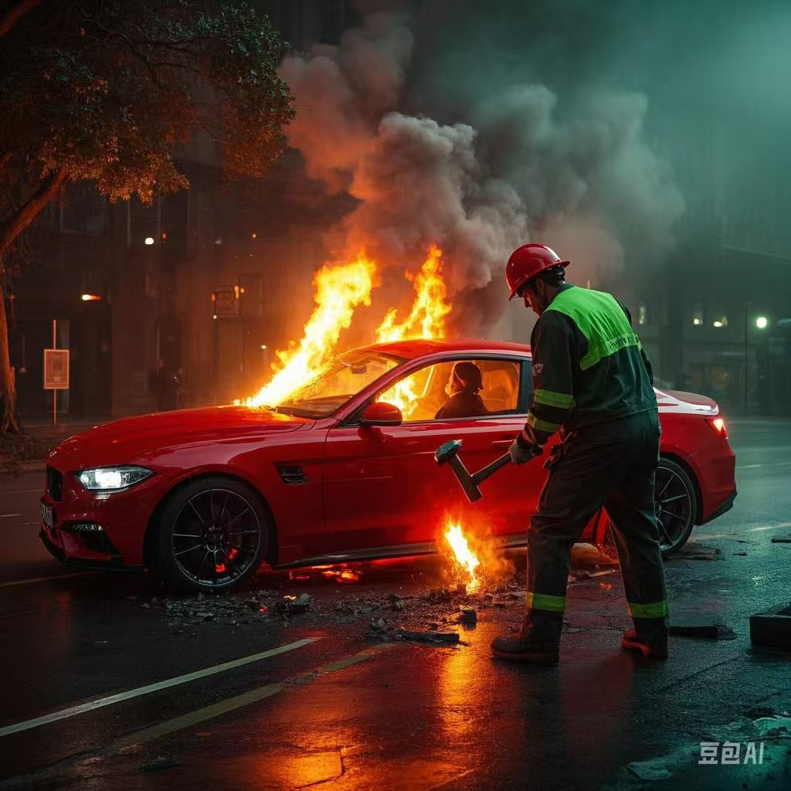
一场意外 两份善举
---2025届-12 强基联盟
人与社会之互助篇
郑素红

Slide 3

Tom Young was on his way home from a hard day’s work at a construction site, carrying his worn-out hammer which had accompanied him through thick and thin. With each step, his mind was filled with worry as he racked his brain to find money for his seriously ill son, Andrew, who was in great need of heart surgery.
Tom had run out of choices and time. Desperation was beginning to set in, but he refused to let his son suffer helplessly. As he walked, the weight of his troubles pressed heavily on his shoulders. So desperate was he that he even heard a hum in his ears. The next moment the hum was entirely covered by a loud sound.
He turned in shock, and what he saw took his breath away. An expensive luxury car was wrapped around a big tree on the other side of the street, with its front twisted and flames starting to spring up from the car.

Slide 4
Without a second thought, he ran to the flaming car. He noticed that although the young lady in the driver's seat did not seem to have been severely injured—apparently because of the open airbag-she was unconscious. Tom saw that the flames began to grow increasingly intense. He realized that he had to get the girl out of the car immediately because there was a high risk of the vehicle exploding at any time.
He grabbed the handle and pulled it, but the door was bent and did not open. He used all his strength and tried again, but in vain. It was a sports car, so it had only two doors, and the other one was blocked by the tree. He decided that he had to break the glass to take her out as quickly as possible. He struck it forcefully with his fist but realized that there was no way he could break the thick glass with bare hands, and the flames were getting bigger.
Para1: Time was running out, and his mind raced madly.
Para2: The girl was sad to know Tom’s trouble from the local news.

Slide 5

Read for elements
1.characters：
Main roles: Tom Young (hard-working , kind-hearted , caring and
loving , selfless and brave )
The girl ( grateful , warm-hearted， generous )
Minor role: Andrew (badly ill with heart disease)
(可增加the girl’s parents ，看情节构思需要）
2. narrative perspective: third -person
3. time： after work
place： in a street
Event : Tom, financially struggling with his son Andrew’s heart
surgery, was on his way home from work when a sports car hit a
tree with the girl driver trapped in it , unconscious but not injured.
And the car in flames, the girl was in critical situation.

Slide 6


6.story line
Climax
He decided that he had to break the glass to take her out as quickly as possible. He struck it forcefully with his fist but realized that there was no way he could break the thick glass with bare hands, and the flames were getting bigger.
Para1: Para1: Time was running out, and his mind raced madly.
He grabbed the handle and pulled it, but the door was bent and did not open. He used all his strength and tried again, but in vain.
An expensive luxury car was wrapped around a big tree on the other side of the street, with its front twisted and flames starting to spring up from the car.
Para2: Para2: The girl was sad to know Tom’s trouble from the local news.
Tom Young was on his way home from a hard day’s work at a construction site with his worn-out hammer, struggling with his son’s critical heart condition.
background
Ending
Beginning

Slide 7
6.story line
Climax
He decided that he had to break the glass to take her out as quickly as possible. He struck it forcefully with his fist but realized that there was no way he could break the thick glass with bare hands, and the flames were getting bigger.
Para1: Para1: Time was running out, and his mind raced madly.
He grabbed the handle and pulled it, but the door was bent and did not open. He used all his strength and tried again, but in vain.
An expensive luxury car was wrapped around a big tree on the other side of the street, with its front twisted and flames starting to spring up from the car.
Para2: Para2: The girl was sad to know Tom’s trouble from the local news.
Tom Young was on his way home from a hard day’s work at a construction site with his worn-out hammer, struggling with his son’s critical heart condition.
background
Ending
Beginning

Slide 8
Read for clues and echoes
hidden clues | echoes
Tom Young was on his way home from a hard day’s work at a construction site, carrying his worn-out hammer which had accompanied him through thick and thin. With each step, his mind was filled with worry as he racked his brain to find money for his seriously ill son, Andrew, who was in great need of heart surgery. | Racking his mind, Tom lowered his head, eyes landing on his tool bag. A brilliant idea struck him like a bolt of lightning.

Slide 9
Read for clues and echoes
hidden clues | echoes
Tom had run out of choices and time. Desperation was beginning to set in, but he refused to let his son suffer helplessly. As he walked, the weight of his troubles pressed heavily on his shoulders. So desperate was he that he even heard a hum in his ears. The next moment the hum was entirely covered by a loud sound. | 2. “ Hammer!” he exclaimed hopefully. Heart pounding violently in his chest, Tom unzipped his bag without hesitation, grabbed the worn-out hammer immediately and swung it like crazy toward the car window with all his might.

Slide 10
Read for clues and echoes
hidden clues | echoes
He turned in shock, and what he saw took his breath away. An expensive luxury car was wrapped around a big tree on the other side of the street, with its front twisted and flames starting to spring up from the car. | 3. Hardly had Tom pulled the girl out of the flaming car to a safe spot when the burning sports car exploded with a deafening bang.

Slide 11
Read for clues and echoes
hidden clues | echoes
Without a second thought, he ran to the flaming car. He noticed that although the young lady in the driver's seat did not seem to have been severely injured—apparently because of the open airbag-she was unconscious. Tom saw that the flames began to grow increasingly intense. He realized that he had to get the girl out of the car immediately because there was a high risk of the vehicle exploding at any time. | 4. Time ticking by, the window cracked and with another hit, it eventually shattered into pieces.

Slide 12
Read for clues and echoes
hidden clues | echoes
He grabbed the handle and pulled it, but the door was bent and did not open. He used all his strength and tried again, but in vain. It was a sports car, so it had only two doors, and the other one was blocked by the tree. He decided that he had to break the glass to take her out as quickly as possible. He struck it forcefully with his fist but realized that there was no way he could break the thick glass with bare hands, and the flames were getting bigger. | 5. Heart pounding violently in his chest, Tom unzipped his bag without hesitation, grabbed the worn-out hammer immediately and swung it like crazy toward the car window with all his might// strength.

Slide 13
心理描写
神态描写
动作描写
外貌描写
环境描写
对话描写
语言
无灵主语
动作链
分词作状语
With 复合结构
独立主格
从句
倒装句
虚拟语气
强调句
长短句结合
考生构思情节的同时，要考虑合适的语言句式以及修辞

Slide 14
Plot the continuation story
Para1: Time was running out, and his mind raced madly.
Para2: The girl was sad to know Tom’s trouble from the local news.
Link1: What idea did Tom come up with? How did he feel?
Body: What did Tyler do?
Link2: How was the girl now? How did she feel?
What was reported as “the local news”?
Link3: What did she do?
Body: What happened to Andrew? How did Tom Young feel?
Ending: ① How was Andrew now?
② What lesson did the girl or Tom Young learn from the
experience?

Slide 15
巧构思
1. 该文本把遇险脱困和助人为乐完美地融合在一起，考生构思发挥余地很大。
2. the local news 可以多角度推测： 当地报纸报道；当地电视台报道；当地社交媒体报道等多种渠道；
3. 女孩帮助Tom儿子做心脏手术也可以多角度进行帮助：从 a luxurious sports car 推知女孩可能家境富裕，可以由女孩一家承担手术费用；也可以通过创设基金会向社会筹钱进行帮助；也可以女孩自己捐了一大笔钱来支付手术费用；
又或者可以是女孩自己碰巧是个心脏手术医生，自身就完全有能力凭借医术来帮助Tom的儿子免费进行手术。

Slide 16
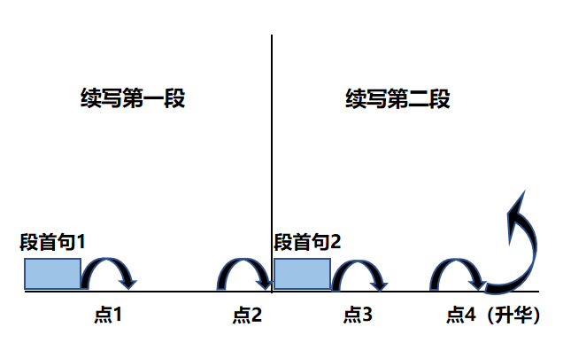
Plot Continuation
点1：位于续写第一段段首，流畅衔接前面的故事（常与原文最后一段呼应）和第一段段首语；
点2：位于续写第一段段尾，流畅衔接第二段段首句；
点3：位于续写第二段段首，续写衔接第二段段首语；
点4：文章结尾升华，给予读者正能量，揭示和强调主题。

Slide 17
Design link1
Para1: Time was running out, and his mind raced madly.
Link1A: (榔头一般会放在工具包里) A brilliant idea struck him like a bolt of lightning. “ Hammer!” he exclaimed hopefully. Heart pounding violently in his chest, Tom unzipped his tool bag without hesitation, grabbed the worn-out hammer immediately and swung it like crazy toward the car window with all his might.
Link1B: (也可能榔头握在另外一只手里) Tom looked around frantically, and his eyes landed on his hammer. Without hesitation, he raised the hammer high and struck the glass with all his might.

Slide 18
Design link2
Para1: Time was running out, and his mind raced madly.
Link2 A: （ 结合第二段所给句the local news 推测英勇行为可能被热心网民报道了）A netizen witnessed Tom’s heroic and fearless act, filmed/ shot the whole process with his mobile phone and posted the video clip on Twitter. Unexpectedly, it attracted much attention from a local newspaper, which ran an article about Tom’s bravery and the critical situation of their family.
Link2B: （ 结合第二段所给句the local news 推测英勇行为可能被记者报道了，体现构思“巧”）What Tom never expected was that the fearless act was witnessed by a reporter and the local newspaper ran a story of Tom’s heroic rescue as well as his son’s critical condition.

Slide 19
Design link3
Para2: The girl was sad to know Tom’s trouble from the local news.
Link3A: （女孩对救命恩人表示感激）Fully recovered from the disastrous accident, she contacted Tom, conveyed her heartfelt gratitude to him and promised to arrange a surgery for Andrew as soon as possible.
Link3B: （女孩要以行动来报答救命之恩 ）Learning that Tom's son was in desperate need of heart surgery and that he was financially struggling, she felt heartbroken. Deeply touched by Tom's selfless act , she made a resolution to do something to help the father and son.

Slide 20
Design ending
Para2: The girl was sad to know Tom’s trouble from the local news.
本文既有人与人之间的温情，又有善有善报的小道理
Ending A: （情景式+影响力结尾）Overwhelmed with an enormous wave of gratitude blended with joy, Tom vowed to pay her kindness forward. The incident became a heartwarming story in the community, inspiring everyone to help those in need.
Ending B: （感悟道理结尾） The heart-touching incident would be engraved in Tom’s mind for ever, which served as a reminder that one good turn deserves another. // what comes around goes around.

Slide 21
Para1: Time was running out, and his mind raced madly.
Racking his mind, Tom lowered his head, eyes landing on his tool bag. A brilliant idea struck him like a bolt of lightning. “ Hammer!” he exclaimed hopefully. Heart pounding violently in his chest, Tom unzipped his bag without hesitation, grabbed the worn-out hammer immediately and swung it like crazy toward the car window with all his might. Time ticking by, the window cracked and with another hit, it eventually shattered into pieces. Hardly had Tom pulled the girl out of the flaming car to a safe spot when the burning car exploded with a deafening bang. Tom heaved a sigh of relief as she had a near brush with death, safe and sound. What Tom never expected was that the fearless act was witnessed by a reporter and the local newspaper ran a story of Tom’s heroic rescue as well as his son’s critical condition.

Slide 22
Para2: The girl was sad to know Tom’s trouble from the local news. Learning that Andrew was in desperate need of heart surgery and that Tom was financially struggling, she felt heartbroken. Deeply touched by Tom's selfless act, the girl made a resolution to help the father and son. Informed of Andrew’s critical condition, her family contacted a hospital, arranged an experienced cardiac surgeon and offered to cover all the expenses for Andrew's surgery. Hearing the incredible news, Tom was literally moved to tears by the kindness of the family. Thanks to the family's generosity, Andrew successfully underwent the surgery and recovered gradually, meaning that Tom’s family could enjoy being together blissfully again. Overwhelmed with an enormous wave of gratitude blended with joy, Tom vowed to pay her kindness forward. The incident became a heartwarming story in the community, inspiring everyone to readily and willingly help those in need. // 结尾2： The heart-touching incident would be engraved in Tom’s mind for ever, which served as a reminder that one good turn deserves another.

Slide 23


