Slide 1


感恩遇见，相互成就，本课件资料仅供您个人参考、教学使用，严禁自行在网络传播，违者依知识产权法追究法律责任。
更多教学资源请关注
公众号：溯恩高中英语
知识产权声明

Slide 2
Unit 5 Using Language
Reading for writing
Chemical farming
VS
Organic farming
Notes:
亮亮图文旗舰店https://liangliangtuwen.tmall.com

Slide 3
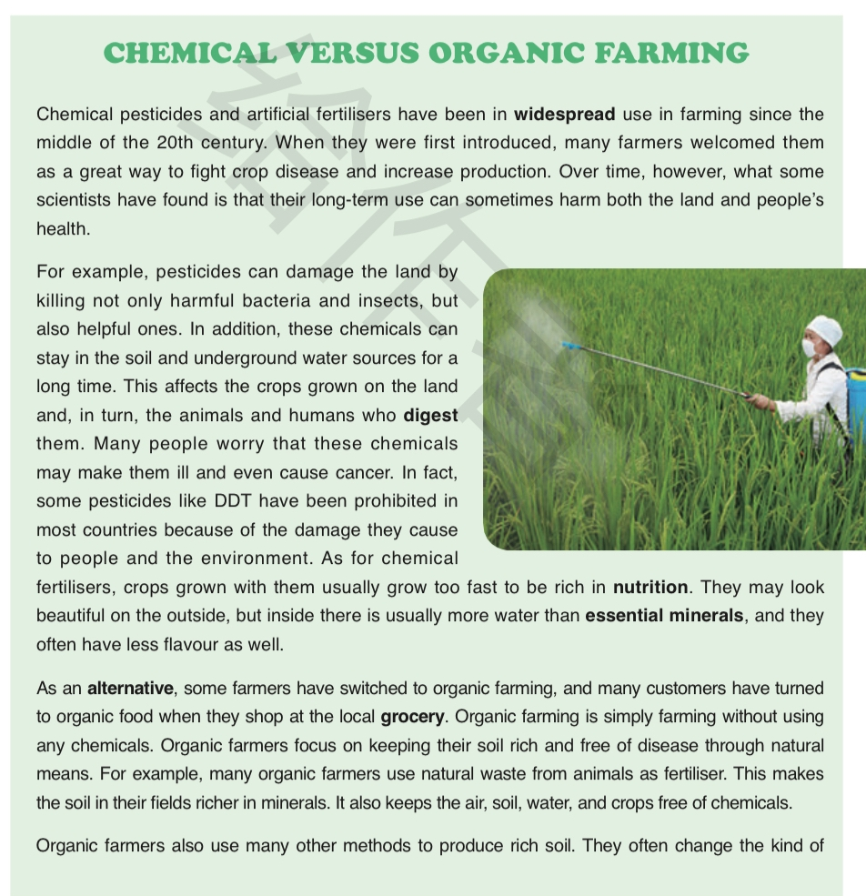
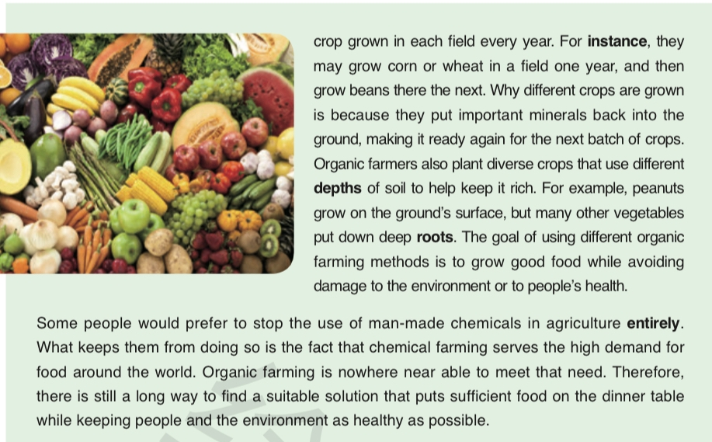



Slide 4

1.Reading
benefits
point：
problems
supporting evidence/details

Slide 5
however
benefits: fight crop disease & increase production
(Para.1)
for example
chemical farming (Paras.1-2)
1.kill harmful and helpful
bacteria and insects
chemical
pesticides
in addition
damage the land
& people’s health
problems
(Para.2)
2.stay in the soil & water crops animals & humans
(chemical pesticides
& fertilisers)
Who
chemical
fertilisers
3.fewer minerals and less flavour
as for
33

Slide 6
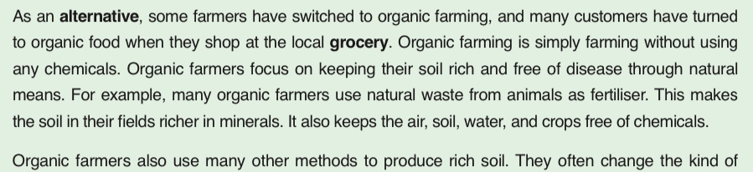
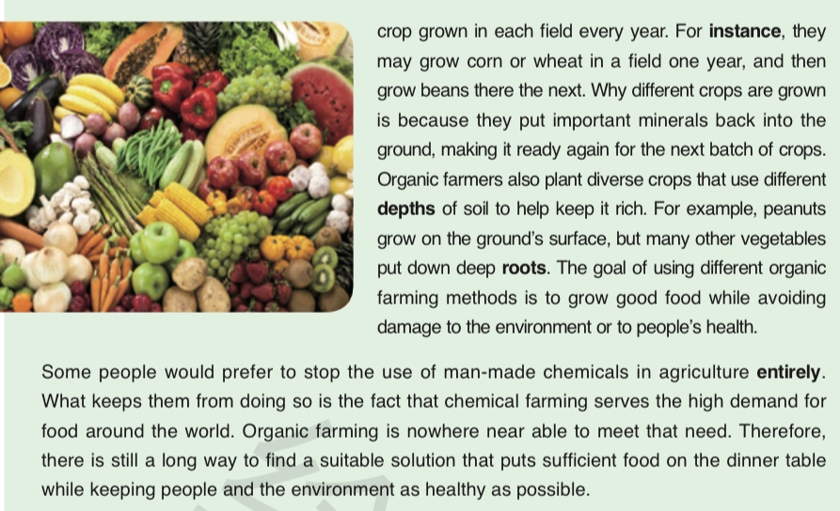



point
benefit
benefit
point
problem

Slide 7
for example/instance
Who
1. use natural waste from
animals as fertiliser;
benefit 1:
keep the soil reach
and free of disease
organic farming (Paras.3-4)
benefits:
(Paras.3-4)
2. change the kinds of crops;
Ho
3. plant diverse crops.
benefit 2: grow good food without harm
(without chemicals)
Why
Conclusion (Para.5): problem: unable to meet the high
demand for food
attitude:
So there is still a long way to go to
keep both sufficient and healthy.
33

Slide 8
(chemical pesticides
& fertilisers)
benefits: fight crop disease & increase production
(Para.1)
1.kill harmful and helpful
bacteria and insects
chemical farming (Paras.1-2)
damage the land
& people’s health
2.stay in the soil & water crops
animals & humans
problems
(Para.2)
3.fewer minerals and less flavour
VS.
Who
1. use natural waste from
animals as fertiliser;
benefit 1:
keep the soil reach
and free of disease
organic farming (Paras.3-4)
benefits:
(Paras.3-4)
2. change the kinds of crops;
Ho
3. plant diverse crops.
benefit 2: grow good food without harm
(without chemicals)
Why
Conclusion (Para.5): problem: unable to meet the high
demand for food
attitude:
So there is still a long way to go to
keep both sufficient and healthy.
33

Slide 9

2. Debate
Chemical farming VS Organic farming

Slide 10
Chemical farming VS Organic farming
2. Debate
1. As far as I'm concerned, chemical farming is preferable to
organic farming. The reasons are that not only can it boost
yields and fight disease, but it is also convenient and economic.
2. For my part, I think it reasonable to promote chemical
farming. As only in this way can you/we increase the outputs.
3. As far as I am concerned, I agree organic farming to some
extent. I think it can reduce pollution and increase
employment as well.
4. Comparing this with that, however, I prefer organic farming
which contributes to sustainable development.
5. On the contrary, I am in favour of organic farming.I want to
say ...

Slide 11
3. Conclusion——Thinking
organic food
Chemical farming VS Organic farming
farming in the future
When facing the future farming, what shall we do?

Slide 12
4.Writing
假如你是李华，你班就化学农业和有机农业进行了讨论，请写一篇文章阐述一下你的观点。内容包括：
1. 明确自己推崇的农业耕种方式；
2. 简述这种农业耕种的优缺点。
注意：1. 词数80左右；
2. 可适当增加细节，以使行文连贯。

Slide 13
4. Writing——language
1. Everything has two sides and farming is not an exception. But I think the..., and
the reasons are as follows.
2. Opinions about farming vary from person to person. As far as I'm concerned,
organic farming is preferable to chemical farming. Here are some reasons.
3. As for me, I would prefer chemical/organic farming...
4. The common assumption was that.../ It was generally assumed that...
5. Given that ...
6. What puts the organic farming at an advantage is that...
7. What attracts consumers most is its tasty flavour.
8....environmentally friendly 环保的
9....far from satisfactory
10....strain every nerve to study in pursuit of dreams...
11....

Slide 14
4. One possible version
Opinions about farming vary from person to person. In my view, organic farming is preferable to chemical farming.
What puts the organic farming at an advantage is its safety. Given that it’s a kind of farming without using any chemicals, customers will turn to organic food when shopping at the grocery, even though they are much more expensive. Besides, organic farming focuses on keeping the soil rich and free of disease, which contributes to keeping sustainable development.
Therefore, I’m strongly convinced that organic farming will become popular and finally tackle the crisis of food shortage all over the world.
99w

Slide 15
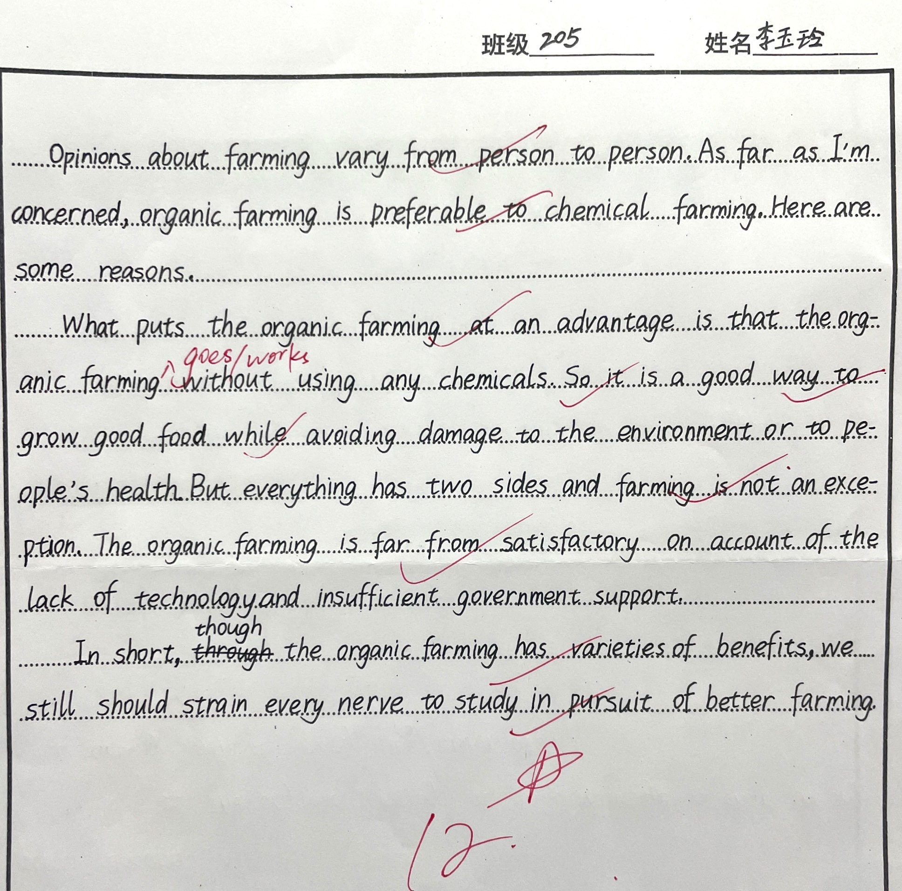
李玉玲

Slide 16
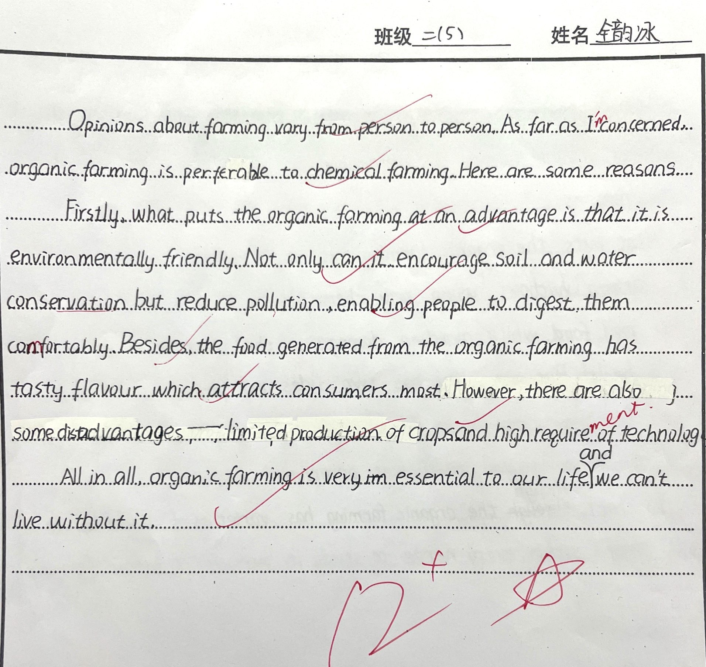
全韵冰

Slide 17
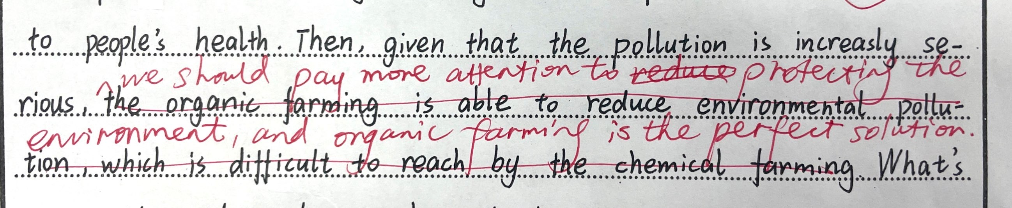
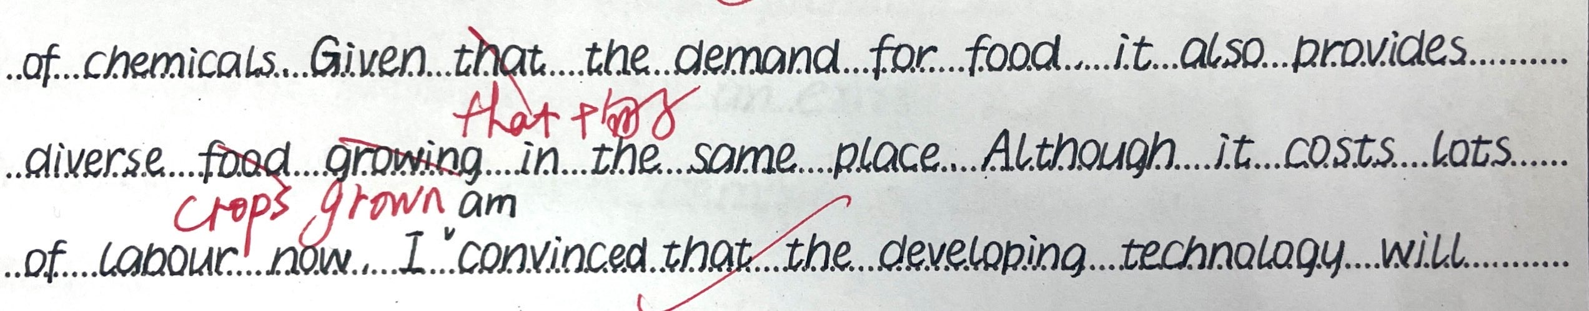
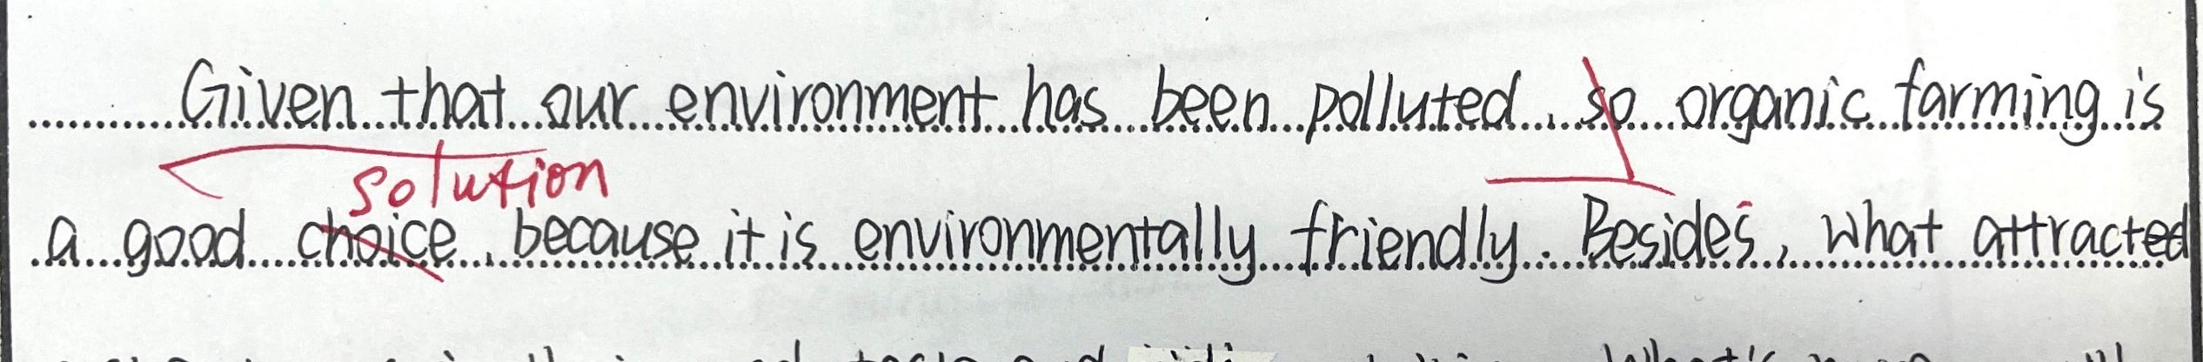
given that 正确使用是？

