Slide 1


感恩遇见，相互成就，本课件资料仅供您个人参考、教学使用，严禁自行在网络传播，违者依知识产权法追究法律责任。
更多教学资源请关注
公众号：溯恩英语
知识产权声明

Slide 2
浙江省名校协作体
2024届2月高三联考
应用文讲评
“倡导低碳生活”专刊寄语
广外英文学院
郭烨辉

Slide 3
目录
C O N T E N T S
01
审题——情境分析的“变与不变”
02
建构——分要点写作语料整合
03
评价——范文与下水文的鉴学
04
迁移——同话题体裁类文的延伸

Slide 4
审题
情境分析的“变与不变”
PART ONE

Slide 5
原题呈现
假定你是校英文报的主编李华，最近准备出一期关于“倡导低碳生活”的专刊。请为专刊写一篇寄语，内容包括:
1.专刊的意义；
2.专刊的内容；
3.寄予的希望。
注意:
1.写作词数应为80个左右; 2.请按如下格式在答题纸的相应位置作答。
Dear Readers,
__________________________________________________________________________________________________________________________________________________________________________________________________________________
Warm regards,
Li Hua
Editor-in-chief

Slide 6
试题简要评析
1. 试题创新度：本应用文试题在情境上具有较高的创新度。以校英文报主编李华的身份，要求学生撰写关于“倡导低碳生活”的专刊寄语，这既考察了学生对社会热点问题的关注，同时也引导学生在实际应用场景中运用英语表达能力，迁移了未来职业的某种发展可能（主编），提前让学生感受新的职业写作要求。
2. 促学效果：通过要求学生以英语撰写专刊寄语，同时，涉及到环保和可持续发展的主题，可以促使学生思考并加深对这些重要议题的理解。这有助于培养学生的社会责任感和环保意识。
3. 情境考察学生能力：通过模拟李华编辑的身份，要求学生在寄语中包括专刊的意义、内容和对未来的期望，试题更全面地考察了学生的写作能力、逻辑思维能力以及对社会议题的综合理解能力。这样的设计使得学生需要在一个真实的情境中进行全面性的表达。
4. 综合评价：从综合角度看，这个应用文试题在涵盖语言表达、社会关注度、逻辑思维等方面均有涵盖，符合培养学生综合素质的要求。通过在实际场景中应用英语，学生更容易将语言技能与实际应用相结合，提高学科整体素养。

Slide 7
独立篇章审题分析
文体体裁 | 英文报专刊稿件（寄语）
写作人 | 主编
写作对象 | 英文报读者— 全体同学
写作背景 | 主编准备出一期“倡导低碳生活”专刊
写作目的 | 以主编的身份，给专刊写一篇寄语，主要介绍意义内容 注意：强化写作人的身份意识，写作的正式语气，恰当运用寄语的句型风格。
人称时态 | 第一人称 | 第二人称 | 一般现在时 | 一般将来时

Slide 8
对比篇章分析情境
6月13-19日是全国节能宣传周，主题为“绿色低碳，节能先行”。请你代表英文校报Youth写一封倡议书，倡导全体同学积极践行低碳节能的生活方式。内容包括：
1.低碳节能的做法;
2.低碳节能的益处;
3.呼吁大家共同参与。
假定你是校英文报的主编李华，最近准备出一期关于“倡导低碳生活”的专刊。请为专刊写一篇寄语，内容包括:
1.专刊的意义；
2.专刊的内容；
3.寄予的希望。
V
S
 | 左边题目 | 右边题目
情境载体 |  | 倡议书——践行低碳节能
作者立场 |  | 代表英文报（本质类似学生投稿）
写作要点 |  | 益处+做法+呼吁
语气态度 |  | 呼吁式（一起践行）
专刊寄语——背景+介绍+希望寄托
变
作为主编来寄语
意义+（专刊）内容+希望/祝愿
客观语气+期盼语气（希望读者能……
不变
1.话题语境素材的运用： 同为低碳生活，益处/意义事实上是类似互通的；
2.文章主题意义升华： 最终希望读者能够践行某一目的；
3.服务交际目的： 传递给读者有价值易理解的信息。

Slide 9
建构
分要点写作语料整合
PART TWO

Slide 10
结构分析
首段自介+意义
01
本文属于创新类话题文章，分析题干后发现，第一段要写明自己的身份——校英文报刊的主编。随后，自然导入提倡低碳生活的意义。
次段陈述主体
02
第二段是整篇应用文写作的核心部分，也就是所说的“主体”（body），即围绕专刊内容的设计，这部分需要学生自主考虑内容的分布和类型。
尾段寄托希望
03
表达笔者代表报刊对读者们的希望，希望大家通过这个专刊走近低碳生活。展望的语气态度需要注意。

Slide 11
首段
Q:对于创新类写作，首段如何开篇切入？
适当参考倡议书的格式写法，即身份介绍部分
主编的表达参考文末署名。
As the chief editor of our school's English newspaper,I'm pleased to introduce our latest issue focused on advocating a low-carbon lifestyle.
As the editor-in-chief of our school's English newspaper, I am excited to share with you our upcoming special edition focusing on "Advocating Low-Carbon Living."

Slide 12
首段
Q:专刊设立意义可以用什么句型？是否需要写很多？
根据文章总体长度，意义一般1-2句话即可。
This edition's significance lies in its aim to inspire a commitment to environmental conservation among us.
This special issue holds great significance as it addresses a critical aspect of our present and future – the need for a sustainable and environmentally conscious lifestyle. We aim to raise awareness about the impact of our daily choices on the environment and promote actions that contribute to a lower carbon footprint.

Slide 13
次段
Q:专刊的内容可以选取什么角度？
角度1：碳减排相关文章和成功案例（分总）
Featuring articles on the benefits of reducing carbon emissions, tips on sustainable living, and success stories of individuals and communities making a real difference,we provide a comprehensive guide to eco-friendly practices.
In this edition, you can expect insightful articles on various facets of low-carbon living. From practical tips on energy conservation and waste reduction to inspiring stories of individuals and communities making a positive impact, our content aims to inform, inspire, and encourage a collective effort towards a greener and more sustainable future.

Slide 14
次段
Q:专刊的内容可以选取什么角度？
角度2：生态保护+环境可持续发展、内在联系
In this edition, you will find a diverse range of content aimed at inspiring and empowering individuals to make eco-conscious choices in their daily lives.
From practical tips on reducing carbon emissions and conserving energy to thought-provoking articles on the interconnectedness of environmental sustainability and social justice, our goal is to provide readers with valuable insights and resources to embark on their journey towards a greener future.

Slide 15
尾段
Q:表达希望应该用什么语气？可以如何升华内涵？
祈使+祝愿 主题升华到未来发展、绿色发展层面
We aspire for this issue to serve as a catalyst for positive change,encouraging everyone to take actionable steps towards a greener future.
My hope is that this special issue will spark meaningful conversations and actions within our school community and beyond. Let us come together to embrace the principles of sustainability, not just for ourselves but for the well-being of our planet and all its inhabitants.

Slide 16
评价
范文与下水文的鉴学
PART THREE

Slide 17
官方范文
Dear Readers,
As the chief editor of our school's English newspaper,I'm pleased to introduce our latest issue focused on advocating a low-carbon lifestyle.This edition's significance lies in its aim to inspire a commitment to environmental conservation among us.
Featuring articles on the benefits of reducing carbon emissions,tips on sustainable living,and success stories of individuals and communities making a real difference,we provide a comprehensive guide to eco-friendly practices.
We aspire for this issue to serve as a catalyst for positive change,encouraging everyone to take actionable steps towards a greener future.
Warm regards
Li Hua，
Editor-in-chief

Slide 18
下水作文
Dear Readers,
As the editor-in-chief of our school's English newspaper, I am pleased to share with you our upcoming special edition focusing on "Advocating Low-Carbon Living."
This special issue holds great significance as it addresses a critical aspect of our present and future——environmental conservation. We aim to raise awareness about the impact of our daily choices on the environment and promote actions that contribute to a lower carbon footprint.
In this edition, you can expect insightful articles ranging from practical tips on energy conservation and waste reduction to inspiring stories of individuals and communities making a positive impact, our content aims to inform, inspire, and encourage a collective effort towards a greener and more sustainable future.
I hope, through the thoughtful exploration of low-carbon living in these pages, each reader will find practical ways to integrate eco-friendly practices into their daily lives. Together, we can create a community that values and actively participates in the preservation of our environment, thus striving forwards a more sustainable and harmonious coexistence with our planet.
Wishing you an enlightening and transformative reading experience.

Slide 19
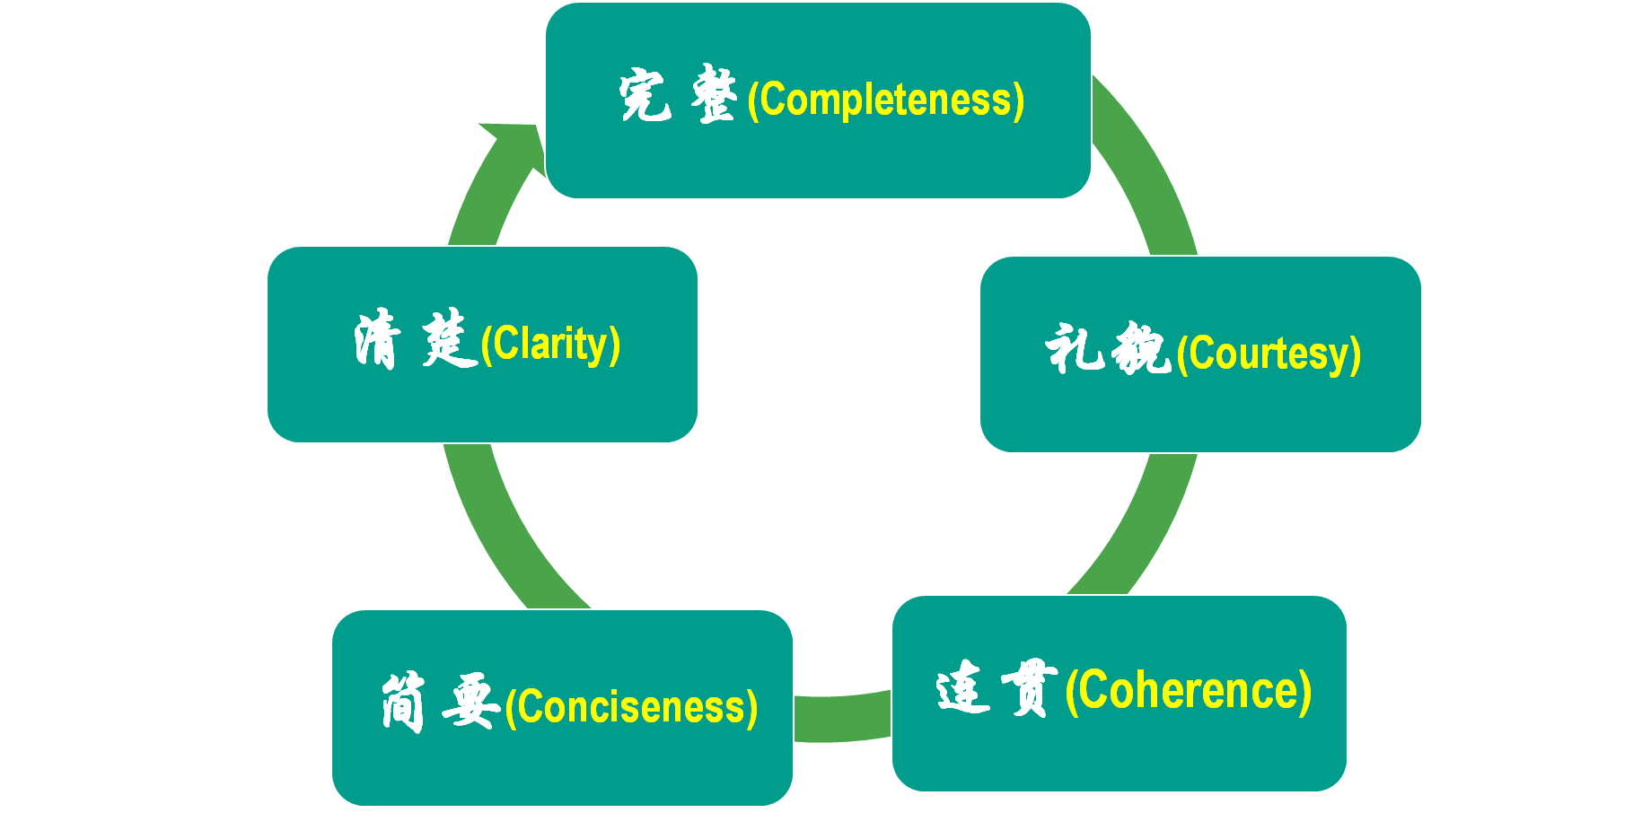
Self-evaluation 自评
Directions:
After reading these excellent compositions, please note down the materials that will be useful to your writing. Then revise and polish your own articles according to the following 5 aspects of reference.
应用文写作的5C原则

Slide 20
迁移
同话题体裁类文的延伸
PART FOUR

Slide 21
类似题材：倡议信
6月13—19日是全国节能宣传周，主题为“绿色低碳，节能先行”。请你代表英文校报Youth写一封倡议书，倡导全体同学积极践行低碳节能的生活方式。内容包括：
1.低碳节能的做法；
2.低碳节能的益处；
3.呼吁大家共同参与。
注意：1.词数80左右；
2.可以适当增加细节，以使行文连贯；
参考词汇：低碳 low carbon 节能energy conservation

Slide 22
范文语篇填空
Dear fellow students,
Do you know the earth is becoming warmer and warmer? It is human activity that has caused this global warming. A low-carbon lifestyle is the key to __________(处理) this big problem facing the earth.
To _________(实现) it, we should do our part in our daily life. First, turn off the taps, the lights and so on when we are not using them. It is a good idea to recycle everything ___________(可循环的) in our daily life. What’s more, motor vehicles use a lot of energy — so walk or ride a bike if we can. It also makes sense to _________(坚持) the habit of setting the temperature of our air conditioners at above 26℃ in summer.
Let’s all take action now! If we can make small changes in our way of life, we can make a big difference to the earth.
The Students’ Union
handling
fulfill
recyclable
persist in

Slide 23
关于“低碳、环保”话题语料素材整理
Low-carbon lifestyle 低碳生活方式
Reduce carbon footprint减少碳排
Sustainable energy usage可持续能源使用
Renewable energy sources可再生能源
Eco-friendly practices 环保实践
Green transportation options 绿色交通选择
Energy-efficient appliances 节能家电
Waste reduction and recycling 减少浪费循环利用
Environmental conservation efforts 环保努力
We should all strive to adopt a low-carbon lifestyle to reduce our impact on the environment. 我们都应该努力采用低碳生活方式，减少对环境的影响。
Riding bicycles or using public transportation are eco-friendly alternatives to driving cars. 骑自行车或使用公共交通是开车的环保替代方案。
Planting trees and participating in beach clean-up activities are important environmental conservation efforts. 种植树木和参加海滩清理活动是重要的环境保护努力。

Slide 24
THANKS

