Slide 1
感恩遇见，相互成就，本课件资料仅供您个人参考、教学使用，严禁自行在网络传播，违者依知识产权法追究法律责任。
更多教学资源请关注
公众号：溯恩高中英语
知识产权声明

Slide 2
台州一模应用文讲评
之栏目介绍
龙泉市第一中学 兰建珍

Slide 3
审题
假定你是校英文报主编李华。你们报纸将开设一个新栏目Voices of Youth。请你用英语在校报上写一篇栏目介绍，内容包括：1. 开设目的；2. 栏目内容；3. 呼吁投稿。
注意：
1. 词数80左右；
2. 可适当增加细节，以使行文连贯。
假定你是校英文报主编李华。你们报纸将开设一个新栏目Voices of Youth。请你用英语在校报上写一篇栏目介绍，内容包括：1. 开设目的；2. 栏目内容；3. 呼吁投稿。
注意：
1. 词数80左右；
2. 可适当增加细节，以使行文连贯。
Why?
What?
How?
Para.1: the purpse of starting a new column
Para.2: the contents of the column
Para.3: appeal for contributions

Slide 4
Para.1 the purpose of starting a new column
开设新栏目
start/establish/launch/set up/roll out a new column
to provide a platform for young people to
express/voice their opinions, share their views
and participate in dialogues, enhancing their skills of
language expression, writing and teamwork.
开设目的
为年轻人提供一个发表意见、分享观点和
参与对话的平台，帮助他们发展语言表达、
写作和团队合作等能力。
1. Aiming to provide a platform for our talented and passionate young
students to voice their opinions on various topics, our newspaper has
launched a new column—Voices of Youth.
主动形式
2. “Voices of Youth”, an upcoming brand new column of our newspaper,
is designed to give us students a platform to express our thoughts, share
our experiences, and highlight our perspectives on various issues.
被动形式

Slide 5
Para.2 the contents of the column
1. 个人故事：青少年可以分享他们的个人故事和经历，启发和帮助其他人的同时，自己也能成长。
1. It offers a platform for the teens to share their personal tales and
experiences, which not only inspire and help others through their
experiences, but also breathe new life into their own hearts/souls.
2. 观点和评论：青少年可以分享自己对社会、文化、政治等
领域的看法和评论，以引起读者的思考和交流,从而加深青少年对社会的深入探究。
2. The teenagers/teens can share their opinions and comments on social,
cultural, political and other fields to provoke readers’ thinking and
communication, which will in turn empower them to have a deeper
insight into the whole society.

Slide 6
Para.2 the contents of the column
3. 学校新闻报道：青少年可以报道学校内的新闻和活动，展示校园文化和学生生活。
3. Our newspaper offers a specific section where the youngsters can
report the news and activities in the school, demonstrating the campus
culture and student life, which will take the readers to a world of
varied, inviting activities and the latest news.
4. From hot environmental issues to lesser-known aspects of campus life,
the column will cover a wide range of topics. Our first topic will be
“Health”, and you are welcome to raise a specific health issue
troubling you, share an anecdote about your healthy lifestyle or anything
related to the topic.

Slide 7
Para.2 the contents of the column
5. As a bridge to connect teens’ hearts, the “Voices of Youth” will consist
of two parts: “Looking World Through My Eyes” and “Heart’s Secret”.
Focusing on a particular event or phenomenon, the “Looking World
Through My Eyes” part will gather opinions from teenage readers, thus
enabling us to have an authentic glimpse of the voices of youth. Then,
the “Heart’s Secret” will receive students’ letters about their worries or
confusion, and then our teen volunteers will give some feedback, in the
hope of soothing the youth’s pain and offering a stage to have a
heartfelt connection.

Slide 8
Para.3 appeal for contributions
1. Submissions can be sent to Voices of Youth@edu.com before l0*each
month. And your voice does matter! Looking forward to your
contributions!
2. Stay tuned for 敬请期待the first edition of “Voices of Youth” in our
upcoming school newspaper. Let us unite as a generation and make
our voices heard — your submissions are welcome in any form.
3. Whether you are an aspiring有抱负的；有志向的 writer, an advocate
for change, or simply someone with a unique perspective, we want to
hear your voice. Let’s come together and make a difference through
our words.

Slide 9
possible version 1:
“Voices of Youth”, an upcoming brand new column of our newspaper, is
designed to give us students a platform to express our thoughts, share our experiences, and highlight our perspectives on various issues.
From hot environmental issues to lesser-known aspects of campus life, the column will cover a wide range of topics. Our first topic will be "Health", and you are welcome to raise a specific health issue troubling you, share an anecdote about your healthy lifestyle or anything related to the topic. Submissions can be sent to Voices of Youth@edu.com before l0*each month.
Your voice does matter! Looking forward to your contributions!
106w
Your evaluation?

Slide 10
possible version 2:
In a praiseworthy attempt to stir up our teenagers’ passion to freely voice themselves, the School English Newspaper is going to open a new column called “Voices of Youth”, hoping for an in-depth and fresh communication.
As a bridge to connect teens’ hearts, the “Voices of Youth” will consist of two parts: “Looking World Through My Eyes” and “Heart’s Secret”. Focusing on a particular event or phenomenon, the “Looking World Through My Eyes” part will gather opinions from teenage readers, thus enabling us to have an authentic glimpse of the voices of youth. Then, the “Heart’s Secret” will receive students’ letters about their worries or confusion, and then our teen volunteer will give some feedback, in the hope of soothing the youth’s pain and offering a stage to have a heartfelt connection.
So, all my dear teenagers, please share your words by emailing englishnewspaper@163.com or writing letters to the newspaper’s office. Never deprive yourself of such an incomparable chance! 183w

Slide 11
possible version 3:
Aiming to provide a platform for our talented and passionate young students to voice their opinions on various topics, our newspaper will lanunch a new
column—Voices of Youth.
Voices of Youth offers the students access to share their opinions and comments on social, cultural, political and other fields to provoke readers’ thinking and communication, which will in turn empower them to have a deeper insight into the whole society. Besides, it’s also a privilege for the youth to
report the news and activities in the school, demonstrating the campus culture and student life, which will take the readers to a world of varied inviting activities and the latest news.
Stay tuned for 敬请期待the first edition of “Voices of Youth” in our upcoming school newspaper. Let us unite as a generation and make our voices heard — your submissions are welcome in any form. 155w
Your evaluation?

Slide 12
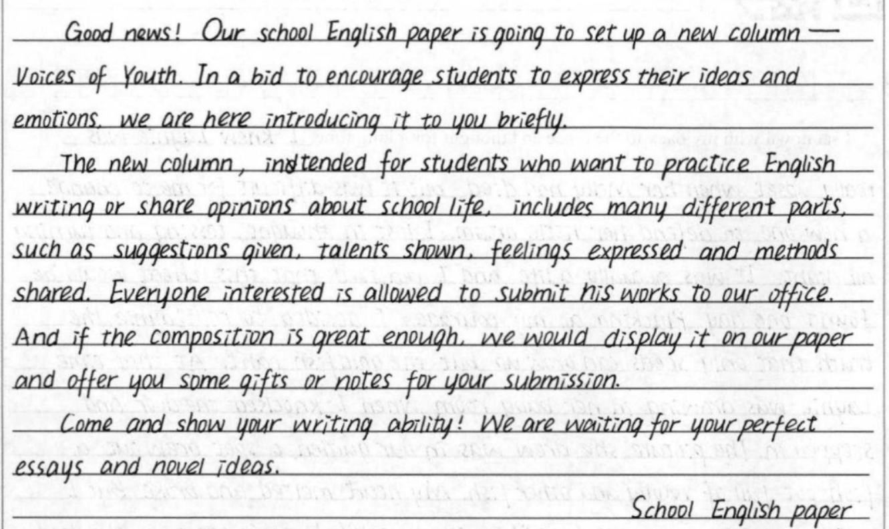
A good version from Ss
12-13分
(1)内容：内容要点齐全，表述清楚、合理；
(2)词汇语法：使用词汇和语法结构基本准确性、恰当，语言表达还算多样；
(3)篇章结构：上下文衔接合理、连贯。

Slide 13
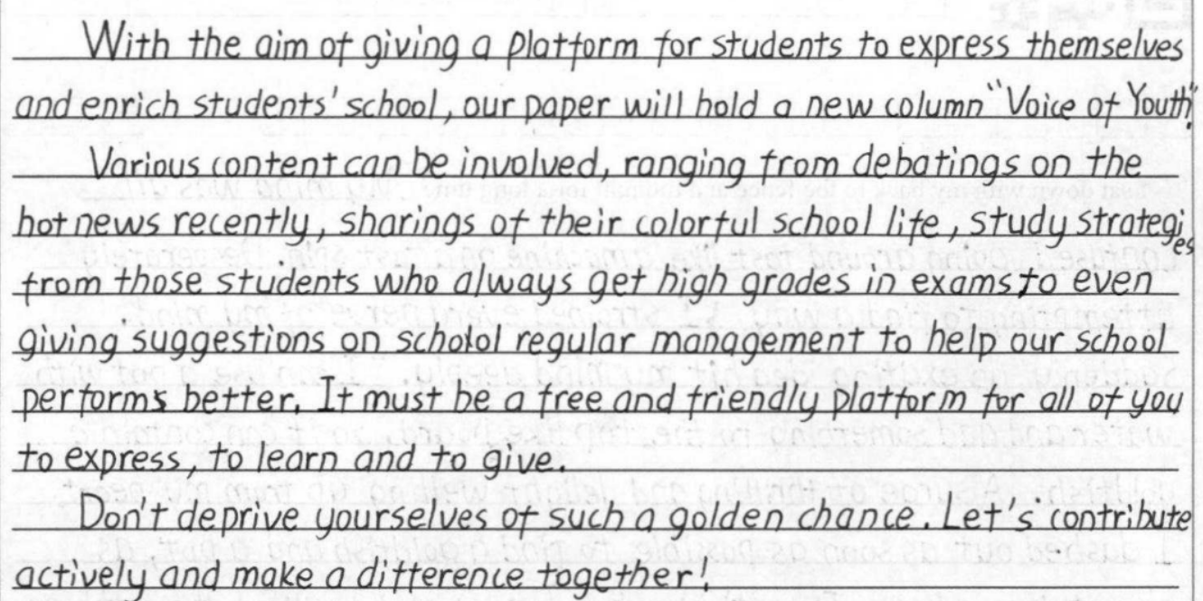
A good version from Ss
11-12分
(1)内容：内容要点齐全，表述清楚、合理；
(2)词汇语法：使用词汇和语法结构基本准确性、恰当，不过多样性还有待加强；
(3)篇章结构：上下文衔接合理、连贯。

Slide 14
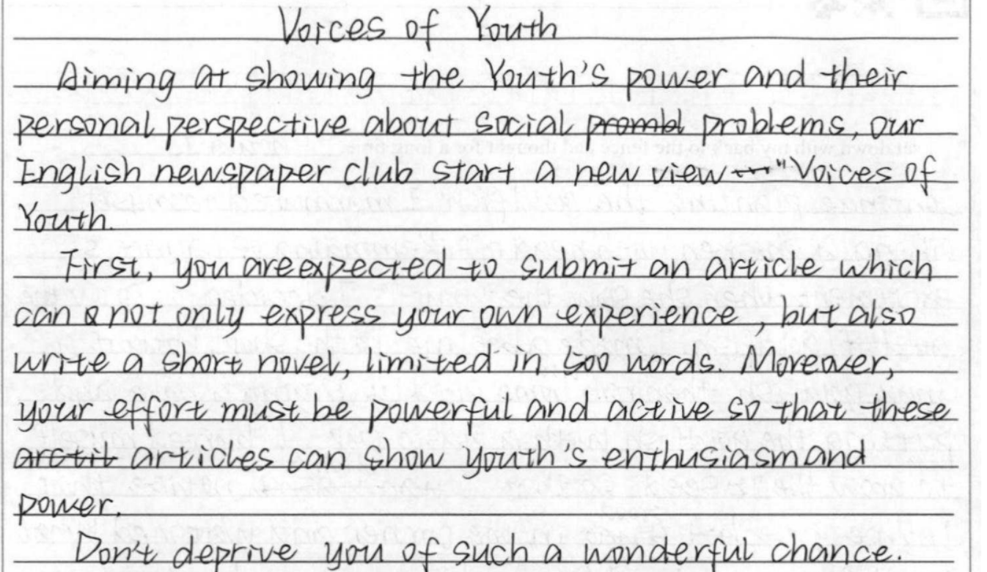
Ss’ common mistakes:
7分
(1)内容：内容要点不齐全，虽然表述清楚，但完全缺失了栏目内容这一核心要点；
(2)词汇语法：使用词汇和语法结构基本准确性、恰当；
(3)篇章结构：上下文衔接不太合理、不够连贯。
方向错了，再努力都是白费！——注意审题!!!
栏目
内容？

