Slide 1

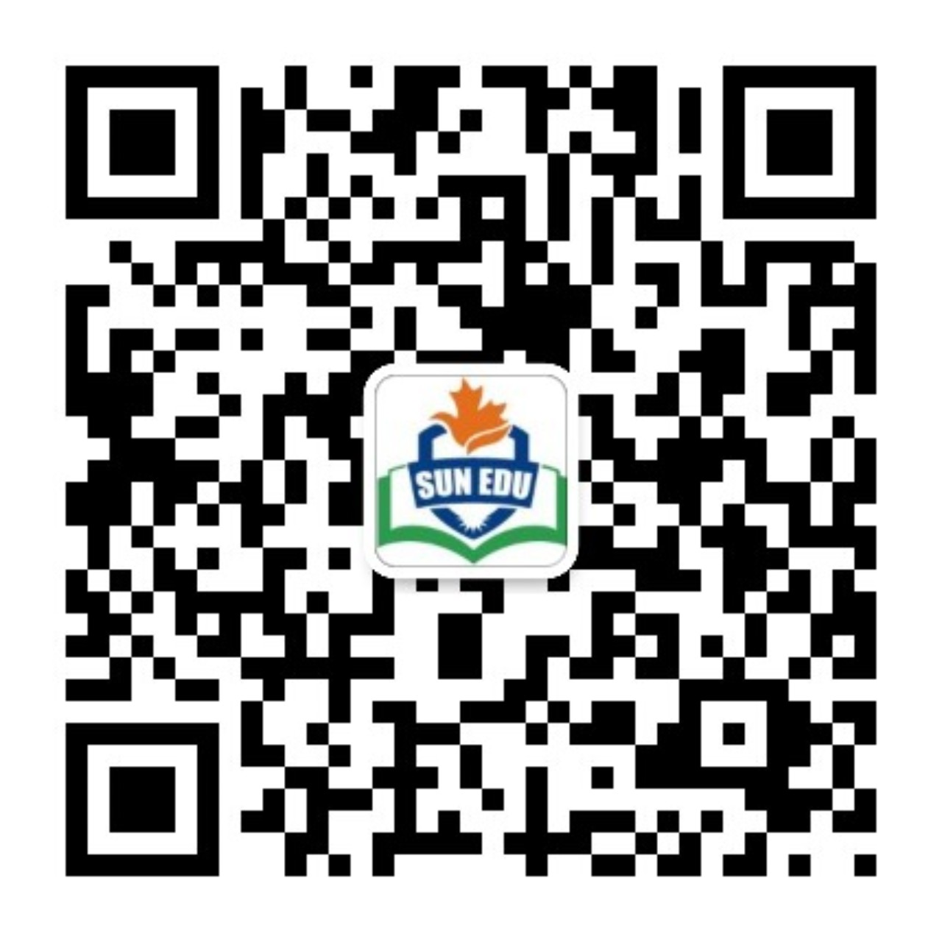
感恩遇见，相互成就，本课件资料仅供您个人参考、教学使用，严禁自行在网络传播，违者依知识产权法追究法律责任。
更多教学资源请关注
公众号：溯恩英语
知识产权声明

Slide 2
2024年8月广东六校第一次联考 应用文
海报设计活动通知

Slide 3
目录
01
审题分析
02
分段语料
03
例文提升
04
拓展比较

Slide 4
审题分析
01

Slide 5
原题呈现
第一节（满分15分）
假如你是学生会负责人李华，学校将组织“Let’s Cherish Wildlife Together”野生动植物保护海报设计大赛，请写一则通知发布在校园英文网上。内容包括：
1. 活动目的;
2. 参赛要求；
3. 号召参与。
注意：
1. 写作词数应为80个左右；
2. 请按如下格式在答题卡的相应位置作答。

Slide 6
对比篇章分析情境
假如你是学生会负责人李华，学校将组织“Let’s Cherish Wildlife Together”野生动植物保护海报设计大赛，请写一则通知发布在校园英文网上。内容包括：
1. 活动目的;
2. 参赛要求；
3. 号召参与。
V
S
假如你是李华，你校将举办十八岁成人仪式，请代表学生会出一则通知，内容包括:
1．活动时间、地点;
2．活动流程;
3．注意事项。
 | 左边题目 | 右边题目
情境载体 |  | 普通通知（更客观）
作者立场 |  | 代表学生会
写作要点 |  | 概况+流程+事项
语气态度 |  | 客观语气
变
与不变
带有倡议性质的通知
代表学生会
目的+要求+号召
客观语气+期盼语气（希望读者能……
问：为什么这篇通知会有呼吁号召色彩？
虽然两则命题体裁均为通知，但本题客观为主，增加主观期盼色彩，更符合比赛类活动通知的语境。成人礼类是客观安排好的活动，大家都需要参与，一般不需要号召。

Slide 7
总结—破解题目信息
文体体裁 | 通知
写作人 | 学生会负责人
目标读者 | 全校学生
写作背景 | 学校为了增强学生对野生动植物保护意识，提高生态环境保护的认知，决定由学生会组织一次“Let’s Cherish Wildlife Together”野生动植物保护海报设计大赛。
写作目的 | 宣传活动的目的，即提高学生对野生动植物保护的意识。 明确参赛的具体要求，以便学生了解如何参与和准备。 发出号召，鼓励更多的学生参与到这次海报设计大赛中来。
人称时态 | 第三人称 | *第二人称 | 一般现在时

Slide 8
分段语料
02

Slide 9

首段：介绍比赛的目的
1.The primary goal of this contest is to raise awareness and foster a love for wildlife among our student body.
2.Through this initiative, we aim to promote the significance of wildlife conservation and its impact on our ecosystem.
3.These posters will serve as a visual reminder of the need to protect and preserve our natural heritage.
4. The contest seeks to encourage students to become advocates for wildlife and environmental protection.

Slide 10
Expansion: combination practices
句型结构
1.The primary goal of …… is to
2.Through this initiative, we aim to……
3.…… will serve as a visual reminder of …….
4. …… seeks to ……
语料模块
1.鼓励可循环材料的使用 __________________________
2.推广可持续的实践 __________________________
3.减少校园内的塑料垃圾 __________________________
4.我们自然世界的美丽与脆弱 __________________________
5.清理当地的公园 __________________________
encourage the use of reusable materials
promote sustainable practices
reduce plastic waste on campus
beauty and fragility of our natural world
clean up local parks
1. 我们环保俱乐部的主要目标是促使学生群体采取可持续的实践。
_________________________________________________________________________________________.
2. 通过这项倡议，我们旨在减少校园内的塑料垃圾，并鼓励使用可重复使用的材料。
_________________________________________________________________________________________.
3. 即将举行的艺术展将作为视觉提醒，提醒人们自然世界的美丽和脆弱。
_________________________________________________________________________________________.
The primary goal of our environmental club is to promote sustainable practices among the student body
Through this initiative, we aim to reduce plastic waste on campus and encourage the use of reusable materials.
The upcoming art exhibit will serve as a visual reminder of the beauty and fragility of our natural world.

Slide 11
次段：说明比赛要求
角度1：比赛海报内容要求
1. Entrants are expected to create a poster that vividly highlights the importance of wildlife conservation.
2. Participants are supposed to think outside the box and come up with unique and creative designs.
3. Poster entries should be visually appealing and capable of capturing the attention of the audience.

Slide 12
次段：说明比赛要求
角度2：比赛海报主题要求
1. Your design should convey a powerful message that resonates with viewers and encourages them to take action.
2. Please include a concise description that outlines your design concept and its connection to the contest theme.
3. Entries that effectively combine artistic skills with a passion for wildlife conservation will stand a better chance of winning.

Slide 13
次段：说明比赛要求
角度3：比赛海报提交要求
最后但同样重要的是，必须在9月20日截止日期前将作品提交至学生会邮箱。
Last but not least, the entry must be submitted to the Students’ Union mailbox by the deadline of September 20th.

Slide 14
Expansion: 参赛要求一般的构成要素
Theme: Your essay should revolve around the theme "……."
Word Count: Keep your essay concise, with approximately XX words.
Submission Deadline: Please submit your entries by [insert deadline].
Eligibility: Open to all students of [your school].
Format: Entries should be typed in English and submitted to [specified location] by the deadline.
Submission Ways: In person& By mail& By email

Slide 15
结尾段写作
进一步深化交际功能，号召参与
1.Your involvement in this contest can inspire others to take action and cherish our wildlife.
2.Together, let's use our artistic talents to shed light on the importance of wildlife conservation.
3.Don't miss this opportunity to express your passion for wildlife and be part of a positive change.
4.Your participation is crucial in creating a campus community that cares about and takes responsibility for our natural world.

Slide 16
例文提升
03

Slide 17
官方范文
Notice
Aiming to promote awareness and action towards wildlife conservation, our school will launch a poster design competition themed “Let’s Cherish Wildlife Together”.
Below are the requirements. First and foremost, participants are expected to design a visually striking and informative poster, expressing their understanding of the theme. Furthermore, there is no limit to the art forms of the poster, which offers diverse choices for students to present their innovation. Last but not least, the entry must be submitted to the Students’ Union mailbox by the deadline of September 20th.
This competition is not only a platform to showcase your creativity, but also an opportunity to contribute to a world where nature and wildlife are valued and protected. Your inspiring designs are eagerly anticipated.

Slide 18
下水范文
Notice
Aimed at encouraging creative expression and to promote the importance of wildlife conservation, our school will launch a wildlife protection poster design contest named "Let’s Cherish Wildlife Together" .
Everyone wanting to participate should submit an original poster design that reflects the theme of wildlife protection. Your work should be visually appealing, informative, and thought-provoking. The entry must be your own creation and should not infringe upon any copyrights. Additionally, it must be submitted to the Students’ Union mailbox by the deadline of September 18th.
Let's come together to make a difference! Show your support for wildlife conservation through your designs and help spread the message of cherishing our precious wildlife. We look forward to seeing your creative contributions to this meaningful cause.

Slide 19
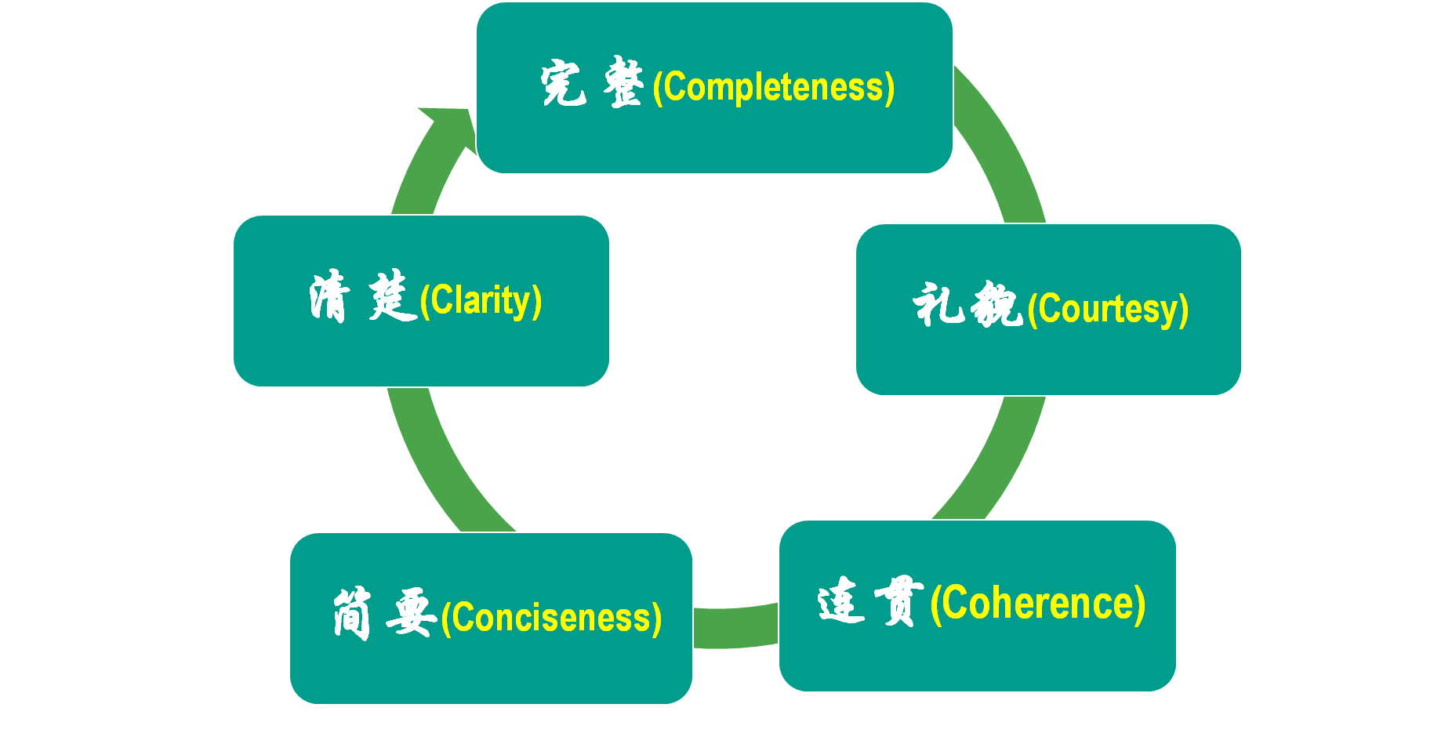
修改
After reading these excellent compositions, please note down the materials that will be useful to your writing. Then revise and polish your own articles according to the following 5 aspects of reference.

Slide 20
拓展比较
04

Slide 21
类似体裁：2024九省联考
第一节 (满分15分)
你校英文报计划举办主题为“携手行动，节约粮食”的作文比赛。请你写一则活动
通知，内容包括：
1.介绍活动目的；
2.说明参赛要求。
注意：
(1)写作词数应为80个左右；
(2)请按如下格式在答题卡的相应位置作答。
Welcome to Join the English Writing Competition
____________________________________________________________________________________

Slide 22
例文
Welcome to Join the English Writing Competition
Launched by our school English newspaper with the theme "Join Hands, Save Food" ,
the upcoming English Writing Competition is awaiting your participation.
This competition aims to raise awareness about the food conservation and show solidarity with the industrious farmers , thus stimulating everyone to adopt sensible eating habits and jointly contribute to a sustainable future. Everyone interested is expected to submit an essay in English with approximately 150 words. Your essay should reflect a positive and proactive approach towards food conservation, which should be submitted to our editorial department by the end of this month.
Let's join hands and use the power of words to advocate for a society that values food conservation! Please stay tuned for further updates and more details in the English newspaper.

