Slide 1

感恩遇见，相互成就，本课件资料仅供您个人参考、教学使用，严禁自行在网络传播，违者依知识产权法追究法律责任。
更多教学资源请关注
公众号：溯恩高中英语
知识产权声明

Slide 2
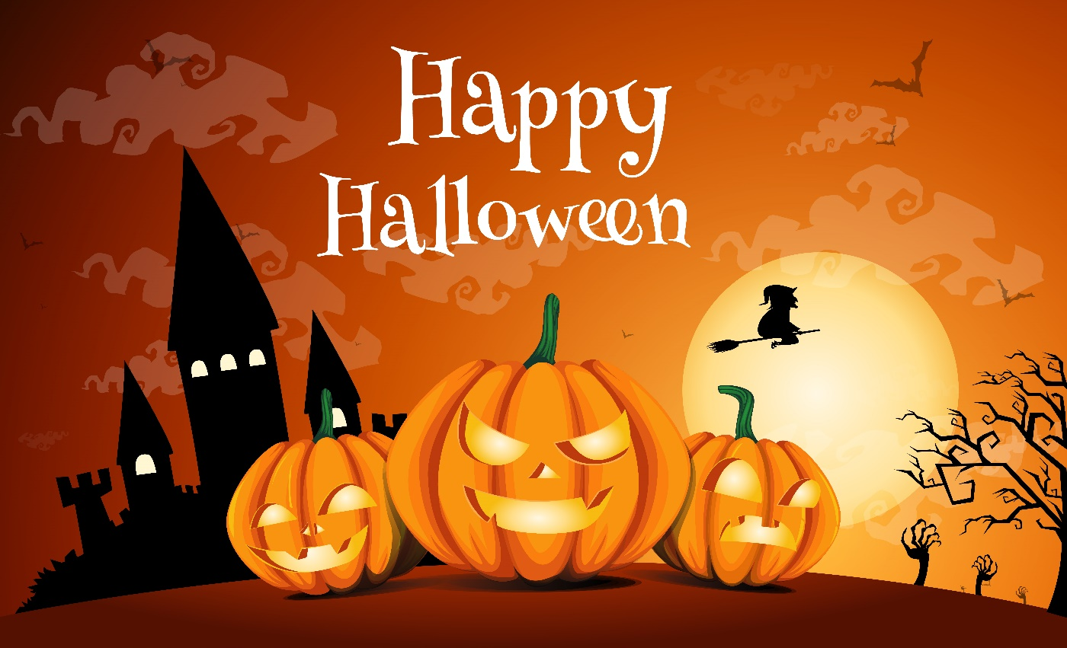
2021年5月温州三模读后续写讲评
The Night of of the Jack- o’-Lantern
Thinker, Tiantai High School

Slide 3
试题呈现
After dinner, Mrs. Quimby told the family that Grandma, who lived on a farm, had sent in a lot of pumpkins for jack-o- lanterns(空心南瓜灯) for the neighborhood children. “There was one in the basement waiting to be carved,” she added. Ramona sprang to her feet and dashed down to bring it up，but it was too heavy for a second-grader. Finally Mr. Quimby gave a hand.
“Let's make it smile like last year,” exclaimed Ramona.
“Hmm. Let’s see.” Mr. Quimby studied the pumpkin, turning it to find the best side for the face.
With a pencil he sketched (素描) a nose-shaped nose, not a triangle. Then the mouth turned up on both sides. “smiling!” Ramona clapped her hands.
Mr. Quimby nodded with a smile, cut a circle around the top of the pumpkin and lifted it off for a lid. Without being asked, Ramona found a big spoon for scooping out the seeds. Picky- picky, the Quimbys' shabby old cat, came into the kitchen to see if something had been put in his dish. When he found that it had not, he paused, sniffed the pumpkin smell and angrily walked out with his tail twitching.

Slide 4
试题呈现
Mr. Quimby began to whistle as he carved with skill and care, first a mouthful of teeth, each one neat and square, then eyes and eyebrows. He was working on two ears shaped like question marks when Mrs. Quimby announced it was bedtime for Ramona. Unwillingly Ramona ran, took a shower and quickly returned. Now, Mr Quimby had just carved a few C-shaped curls(卷发) around the hole in the top of the pumpkin. He reached inside and dug a candle holder in the bottom.
“There,” he said, putting down his knife. “A work of art.” Mrs. Quimby found a candle stub(残根) inserted it in the pumpkin, lit it and set the lid in place. Ramona turned off the light. The jack-o'-lantern was smiling with a flickering flame, “Wow!” Ramona threw her arms around her father before going to bed with great satisfaction.
Paragraph 1. In the middle of the night Ramona awoke to a noise.___________
Paragraph 2. On the table their jack-o-lantern no longer had a whole face._______

Slide 5
About Halloween:
Halloween is a holiday ________________ each year on October 31. The tradition dates back to the ancient Celtic festival of Samhain, ______ people would light bonfires and wear costumes to scare off ghosts. This day marked the end of summer and the harvest and the ____________ of the dark, cold winter. During the celebration, the Celts wore costumes, typically __________ (consist) of animal heads and skins, and attempted to tell other _________ (people) fortunes.
In the eighth century, Pope Gregory III designated November 1 as a time __________ (honor) all saints. Soon, All Saints Day incorporated some of the traditions of Samhain. The evening before was known as All Hallows Eve, and later Halloween. Over time, Halloween evolved into a day of activities like trick-or-treating, carving jack-o-lanterns, festive gatherings, wearing costumes and eating _________.
celebrated
when
beginning
consisting
people’s
to honor
treats

Slide 6
文本语言积累:
1. wait to be carved
2.spring/jump to one’s feet
3.bring... up
4.a second-grader
5.clap one’s hands
6.nod with a smile
7.scoop out the seeds
8.a mouthful of teeth
9.two ears shaped like quesions marks
10.a work of art
11.put/ lay... in place
12.throw one’s arms around her dad
13.with great satisfaction
1. 等着被雕刻
2.跳着站了起来
3.把.......带上来
4.一名二年级的学生
5.拍手，鼓掌
6.微笑着点点头
7.把里面的籽挖出来
8.一口牙齿
9.两只像问号的耳朵
10.一件艺术品
11.把......放就位
12.抱住爸爸
13.心满意足地

Slide 7
Summary of the story
To get prepared for the approaching Halloween, Mr. Quimby set out ________ (carve) a jack-o-lantern out of a pumpkin from his mother. He intended to make a smiling one _____ great skill and care. And excited Romano, his daughter, was with him all the time. Even when it was bedtime, Romano simlpy took a shower and came back. She waited until the work of art ____________ (complete) and everything was set ____ ______. Then she went to sleep with satisfaction ______ (write) on her face. However, the poor shabby cat, Picky-picky seemed to have been _____________.
to carve
with
was completed
in place
written
forgotten

Slide 8
Undertsand the passage-- story mountain
Climax
After a shower, Ramona still waited until the work of art was completed.
unwilling, satisfied
Rising Action
Mr. Quimby carved the lantern with skill and care, with excited Ramona around, ignoring Picky-picky.
Falling Action
Para1: In the middle of the night Ramona awoke to a noise...
smiling, angry
?
Background/Beginning
After dinner, Mr. Quimby set out to carve a jack-o-lantern for the Halloween.
Resolution
Parag2: On the table their jack-o-lantern no longer had a whole face...
?
excited, expectant
Story Mountain

Slide 9
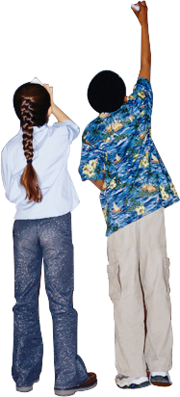
Design the plot-- underlined words
Ramona, Mr. Quimby, Picky-picky
1.Ramona’ s heart was beating wildly and strange ideas popped up into her mind one after another.
2. Woken up by Ramona’s call, Mr. Quimby immediately rushed over, wondering what had happened.
3. Looking around, they found that it was Picky-picky who had made the lantern what it was now. She must be hungry.
kitchen
pumpkin, candle
smile, carve
1. There under the kitchen table, poor Picky-picky was enjoying the pumpkin pieces.
2.When they opened the kitchen door, what greeted them was their cat eating something in the corner.
angrily, satisfaction
Tip1
Underlined words help you design the plot without going off the main story line.

Slide 10
Design the plot-- underlined words
Ramona, Mr. Quimby, Picky-picky
1.It seemed that they would have to get another pumpkin and carve a new jack-o-lantern!
2.Since all the rest pumpkins had gone to the neighbors, how could they carve a new jack-o-lantern?
3. Looking at the ruined jack-o-lantern, Mr. Quimby shrugged his houlders, smiling bitterly.
kitchen
pumpkin, candle
smile, carve
1.Angrily, Romano kicked the poor Picky-picky, who had suffered from hunger so long.
2. At the scene, the satisfaction written on her face transformed into exreme anger.
angrily, satisfaction
Tip1
Underlined words help you design the plot without going off the main story line.

Slide 11
Design the plot-- first sentences
Paragraph1
In the middle of the night Ramona awoke to a noise.
How did Romano react to the noise? (feeling and action）
To whom did she turn for help? Or did she manage it by herself?
What did Mr.Quimby do about Romano’s feeling and the noise?
Paragraph2
On the table their jack-o-lantern no longer had a whole face.
How did Mr. Quimby react to the broken jack-o-lantern? (feeling+action)
Who was the criminal? And how did he deal with the criminal?
What did he do with the broken lantern?

Slide 12
Design the plot-- first sentences
Paragraph1
In the middle of the night Ramona awoke to a noise.
How did Romano react to the noise? (feeling and action）
1.She immediately sat up, instinctively wanting to find out the truth. But fear drove her back and she buried her head under the blanket.
2. She wanted to call for help, but afraid that doing so might invite more danger, she swallowed hard and buried her whole body under the blanket.
To whom did she turn for help? Or did she manage it by herself?
1. She jumped out of the bed and went in the direction of the kitchen, but the fear inside pulled her back and the next moment her whole body was under the blanket.
2. Swallowing hard, she called “Dad, Dad!...”, which was eventually answered by Mr. Quimby, who hurried over, gathered Ramona into his arms, comforting gently.

Slide 13
Design the plot-- first sentences
Paragraph1
In the middle of the night Ramona awoke to a noise.
What did Mr.Quimby do about Romano’s feeling and the noise?
1. Hearing Romano’s call, Mr.Quimby rushed over, gathered her into his arms and comforted her until she calmed down.
2. Curiously and cautiously, he headed for the kitchen, trying to figure out what on earth had happened.
Paragraph2
On the table their jack-o-lantern no longer had a whole face.
How did Mr. Quimby react to the broken jack-o-lantern?
1. He couldn’t believe his eyes. Angrily, he looked around, trying to figure out who the criminal was.
2.Seeing his work of art ending this way, he was so annoyed that he clenched his teeth angrily.

Slide 14
Design the plot-- first sentences
Paragraph2
On the table their jack-o-lantern no longer had a whole face.
Who was the criminal?
1.After several attempts, into his sight came the pet cat under the kitchen table, who seemed to be enjoying the pumpkin.
2. There under the kitchen table, Picky-picky was eating the pumpkin pieces, obviously from the lantern, as if having gone without for for days.
What did he do with the the criminal and the broken lantern?
1.Ramona suddenly remembered that she had forgotten to feed the cat. She immediately scooped the cat up and decided to treat her to something nice.
2. As for the lantern, Mr. Quimby knew he would have to find a new pumpkin to carve a new one. After all, a Halloween without a jack-o-lantern couldn’t be called Halloween!

Slide 15

Language accumulation--害怕
A ripple/wave of fear ran/surged through him/his body.
A flood of fear welled up in him.
Panic overcame her as she thought of the terrible scene.
Devi sat on the side on a bench, paralyzed with fear.
A shiver ran down her spine.
A ripple/rush of fear took hold of her.
I froze with terror, too scared to move an inch.
I felt a wave of fear wrap around me.
I can feel the thumping of my heart against my chest, and my palms sweating.

Slide 16
Language accumulation--害怕
Hearing the astonishing news, she was scared /frightened to death.
Paula was seized by fear and was rooted to the floor.
Frightened by the big sum of money, the thrifty husband turned pale, unable to utter a single word.
She was so frightened that she took the chance to escape from her place, running faster than her legs could carry her.
I said nervously, my voice trembling a bit.
Watching the shore in the distance, I felt powerless as if we were broken tiny boats at the mercy of strong wave.(simile)

Slide 17

参考范文
In the middle of the night Ramona awoke to a noise. Tense, she listened hard. There it was again,a sort of thumping noise. Silence. Then again in the kitchen, Something was moving. All the ghost stories she had ever heard flew through her mind. Ramona sat up in bed, shrieking. “Daddy!” Within seconds, Mr. Quimby rushed in, asking what was the matter, Pointing to the kitchen, Ramona sobbed something was moving there. Mr. Quimby smiled, assured her calmly and they went to have a look. （76）
On the table their jack-o-lantern no longer had a whole face. Part of its forehead and one eye were gone. Picky-picky was crouched in guilt under the kitchen table. “Bad cat! Bad cat!” shrieked Ramona, angrily stamping her bare foot on the floor. The old cat cat flew out of the kitchen. Mr. Quimby laughed a small laugh, “Maybe he’s starving.” He put his arms around Ramona, who now burst into tears. “Don’t worry. We’ll get another pumpkin and make another cool jack-o-lantern.” (84)

Slide 18

下水作文及点评：
In the middle of the night Ramona awoke to a noise. She immediately sat up, instinctively wanting to find out the truth. But fear drove her back and she buried her head under the blanket. Her heart was beating wildly, with strange ideas popping up into her mind one after another: maybe it was the wind blowing through the window; or maybe it was the ghost coming back to life... The more he thought about it, the more frightened she became. Swallowing hard, she called “Dad, Dad!...”, which was eventually answered by Mr. Quimby, who hurried over, gathered Ramona into his arms, comforting her gently. When he learned that the noise seemed to have come from the kitchen, he, doubtfully but curiously, headed for the place for a close look, together with his baby daughter. And what greeted them certainly made him puzzled.(134)
作文点评：
1.immediately, instinctively, curiously等评注性状语的运用，凸显动作神态。
2.wanting, blowing, coming, swallowing, comforting等非谓语动词的运用，使表达方式变得多样化。
3.无灵主语和独立主格的运用，使句子变得紧凑，动作之间的紧密联系得到加强。
4.高级词块drove her back, poppinh up, swallowing hard, answered. headed for, greeted.

Slide 19
下水作文及点评：
On the table their jack-o-lantern no longer had a whole face. Mr.Quimby simply couldn’t believe his eyes. Wondering what had happened to the pumpkin and who had done it. He looked around, hoping that he could get some clues. After several attempts, into his sight came the pet cat under the kitchen table, who seemed to be enjoying the pumpkin. Witnessing the scene, Ramona suddenly remembered that she had forgotten to feed the cat while all her attention was devoted to the jack-o-lantern. Exchanging an understanding smile with Dad, Ramona immediately scooped the cat up and decided to treat her to something nice, relieved that the frightening “ghost” turned out to be her old pet cat, Picky-picky. (109)
作文点评：
1.wondering, exchanging, relieved, witnessing, hoping等非谓语动词的运用，使文章方式变得多样化。
2.倒装结构、定语从句、状语从句的运用，使句子变得紧凑，动作之间的紧密联系得到加强，并且帮助实现了行文的长短句交错。
3.Ghost的出现也体现了对英语文化万灵节的了解，有增分的作用
5.高级词块after several attempts, was devoted to, exchanging a smile, treat her to, turned out to be.

Slide 20
读后续写30天冲刺建议：
思考多于写作：
不要求写太多的读后续写新题，回顾旧题，着重于训练如何快速构思情节、如何从哪几个维度来进行画面感的描述、用什么句式来丰富句子的表达。
分类整理文本类型，快速判断情节发展途径：
归类整理到现在为止所写的所有读后续写材料，确定不同的情节发展类型。如果是问题解决型，就遵循“遇到问题/冲突 --- 想出办法---出现新的问题---关键人/物出场完美收场”的途径。

Slide 21
读后续写30天冲刺建议：
分类整理、巩固素材语料：
要形成丰富扎实的语料库，按照“情绪、心理活动、动作、场景、动态场景、有意境的句子”等几方面的内容进行分类记忆；各类中又按照人、身体部位、情绪名词等三类做主语分别记忆一些有场面感的句子。这一块内容最好能够通过默写或者听写来巩固。
掌握高效的句子升级策略，驾驭长句子：
借助于头脑风暴模式，熟知重要的几种句子升级方法，如倒装结构、虚拟语气、各种从句、无灵主语、修饰性副词、主位推进等等，融合动作、心理活动和情绪等元素，练就长短句的交错运用。

Slide 22
读后续写30天冲刺建议：
构建合理的结尾套路：
多阅读读后续写试题，思考并判断各中类型的文本应该采用什么样的结尾比较合适，并且熟知各种结尾的一般性写法。结尾方式可以分为Message点睛式、环境描写烘托式、展望将来式、回首反思式、自然过程式、首尾呼应式等等。
大浪淘沙始见金，
你就是黄金！

Slide 23

Wish you excellent performance
in the CEE!

