Slide 1
感恩遇见，相互成就，本课件资料仅供您个人参考、教学使用，严禁自行在网络传播，违者依知识产权法追究法律责任。
更多教学资源请关注
公众号：溯恩英语
知识产权声明

Slide 2
 | Language study
M2U2 Wildlife Protection

Slide 3
Listening and speaking

Slide 4
1. Up to 73 million sharks end up ______ shark fin soup.
in
end up 1) in…/adv.
2) doing sth. 最终成为；最后处于
结果所有的活儿都是我一个人干了。
I ended up doing all the work myself.
如果你继续这样，早晚得惹麻烦。
If you go on like this you'll end up in trouble.
up to… as far as a particular number, level, etc. 达到（某数量、程度等）

Slide 5
2. We must make people aware _____ the problem and help protect the endangered wildlife before it was too late.
of
aware adj. knowing or realizing something 知道；意识到；明白
1) be aware of sth. 2) be aware that-clause
1）我们这是在让公众意识到这个问题。
We're just making the public aware of the issue.
2） 我察觉到她在发抖。
I was aware that she was trembling.

Slide 6
3. How many elephants are killed ______ average every day?
on
on average, above average, below average
1) average adj. normal or typical 中等的，适中的
他年近三十， 中等个头。
He was in his late twenties and of average height.
2) average adj. ordinary; not special 普通的；平常的；一般的
我只是一个普通的学生。
I was just an average sort of student.

Slide 7
am concerned
4. I _____________________(concern ) about the African elephants.
concern v. to worry somebody 让（某人）担忧
be concerned about/for …
To whom it may concern… (= used for example, at the beginning of a public notice or of a job reference about somebody’s character and ability)
敬启者…（如用于公告或求职推荐信的开头）
我担心他的安全。
I’m concerned about his safety.
2) as far as …be concerned, 就…而言，关于
am concerned
As far as I _______________ (concern), you can do what you like.
3) to affect somebody/something; to involve somebody/something
影响；涉及；牵涉
be concerned with… 与…有关；涉及

Slide 8
concern n.
1) a feeling of worry, especially one that is shared by many people（尤指许多人共同的）担心，忧虑
There is growing concern about the spread of Omicron.
2) n. something that is important to a person, an organization, etc.
（对人、组织等）重要的事情
Our main concern is to ensure the safety of the children.

Slide 9
5. Elephants need large living spaces, so it’s difficult for them to adapt ______ the change.
to
1) adapt (oneself) to… （使）适应
随着时间的推移，我逐渐适应了学校生活。
As time went by, I gradually adapted (myself) to the life on campus.
from
This new film is said to be adapted ________ a novel by Jane Austin.
2) be adapted from…..改编自…

Slide 10
Reading and thinking

Slide 11
Identify literal and implied meaning
Literal meaning ( 字面意义) L | The usual, basic meaning of the words i.e. exactly what they words say
implied meaning （隐含意义）I | suggested but not directly expressed, i.e. you guess the meaning based on you know.
1. The Tibetan antelope lives high above sea level.
Implied by “The air is thin.”

Slide 12
When they first saw the antelopes, they were very far away.
We should not buy goods made from endangered animals.
Human activities are threatening animals and plants.
The Tibetan antelope is not an endangered species now.
implied
by
We can just make out a herd of graceful animals.
They are being hunted, illegally, for their valuable fur.
Hunters were shooting antelopes to make profits.
implied
by
The reserve is a shelter for the animals and plants.
…since the threats to the Tibetan antelope have not yet disappeared.
implied
by
In June 2015, the Tibetan antelope was removed from the endangered species list.
Literal meaning

Slide 13
空气稀薄。
一次短途远足
白雪覆盖的山脉消失在云端
在平原
分辨出
一群形体优美的动物
看着他们慢慢穿过…, 被它们的美打动
想起
Para 1-2
The air is thin.
a short hike
snow-covered mountains disappear into clouds
on the plain
make out
a herd of graceful animals
Watching them moving slowly across the grass, I’m struck by their beauty.
be reminded of… (remind sb of sth)

Slide 14
自然保护区
动植物的避难所
数目下降了百分之五十
射杀羚羊来盈利
为了保护…而不灭绝
放置/使处于国家保护之下
照看
免受攻击
采取有效的措施
数目得以恢复
从濒危名单上被移除
打算做某事
Para 3-6
Nature Reserve
a shelter for animals and plants
the population dropped by 50%
shoot antelopes to make profits
in order to save/ protect sth from extinction
place it under national protection
watch over
keep ..safe from attacks
take effective measures (to do sth)
The population has recovered
be removed from the endangered list
intend to do sth (be intended for…)

Slide 15
Para 1-2
1. On the plain in front of us, we can just make out a herd of graceful animals.
make out: 1) to manage to see somebody/something or read or hear something 看清；听清；分清；辨认清楚
黑暗中我只看出了一个人的轮廓。
I could just make out a figure in the darkness.
我能听到说话的声音，却听不清他们在说什么。
I could hear voices but I couldn't make out what they were saying.
make out: 2) to understand something; to see the reasons for something
理解；明白（事理）
我搞不清自己做了 什么惹她不高兴。
I couldn’t make out what I had done to annoy her.

Slide 16
2. Watching them move slowly across the green grass, I _____________(strike) by their beauty.
am struck
strike v.
struck, struck/stricken
be struck by…. to be impressed or interested by somebody/something; to like somebody/something very much 被某人（或某物）打动；迷恋某人（或某物）
I was particularly struck by the sound of the birds.
(that)
(which)
of
3. I _________________(remind) _______the danger__________ they are in.
was reminded
remind v. make sb
remember sth.
remind sb of sth.
remind sb to do sth.
remind sb that-clause
The pictures reminded him of his childhood.
We reminded him to close the door.
She reminded that I hadn’t called Mother.

Slide 17
Para 3-6
Only when we learn to exist in harmony with nature can we stop being a threat to wildlife and to our plant.
Only+状语（从句）置于句首，主句用部分倒装
(助动词或情态动词放在主语之前）
did I realize that I was wrong
Only then__________________________.
只是到了那时我才意识到是我错了。
Only by working hard can you succeed
_____________________________________.
只有努力工作你才能成功。
Only after he had the confidence in himself ___________________________________________.
did he make great progress in his study.
只有在他对自己有了信心之后，他才在学习上取得了很大的进步。

Slide 18
Discovering useful structures
Reporting an ongoing event
be doing
be being done

Slide 19
现在进行时（主动，被动）表示正在进行，或者未完成
Para 1
Tibetan antelopes live on the plains of Tibet, Xinjiang, and Qinghai. Watching them move slowly across the green grass, I’m struck by their beauty. I’m also reminded of the danger they are in. They are being hunted, illegally, for their valuable fur.
前一句中的they (Tibetan antelopes), 在后一句中放在句首的位置利用被动再次提及，保证两句的连贯和衔接，保证语段的流畅性。
VS
I’m also reminded of the danger they are in. People are hunting them, illegally, for their valuable fur.
后一句中的主语 people 在前文未被提及，显得突兀，前后句子不连贯，破坏了语段的连贯性。

Slide 20
The last para:
In the evening, I drink a cup of tea and watch the stars, I think about the antelopes and what Zhaxi told me. Much is being done to protect wildlife, but if we really want to save the planet, we must change our way of life.
In the evening, I drink a cup of tea and watch the stars, I think about the antelopes and what Zhaxi told me. People are doing much to protect wildlife, but if we really want to save the planet, we must change our way of life.
VS
本段主要内容是写作者的思考 (reflect), 视角是第一人称，如果加入别的人物，就会破坏语段的连贯性。

Slide 21
Practice
1. Right now, the deer ________________(watch) over by many volunteers.
2. Who ______________(hunt) the kangaroos? Where are they ______________(hunt)?
3. It is reported that living spaces for wildlife __________________(reduce) due to the cutting of trees?
4. A new library ________________(build) in our school. It will open next year.
5. Don’t worry. Measures _______________(take) to stop such a thing from happening again.
6. It is believed that many plant species ___________________(threaten) with extinction.
are being watched
is hunting
being hunted
are being reduced
is being built
are being taken
are being threatened

Slide 22
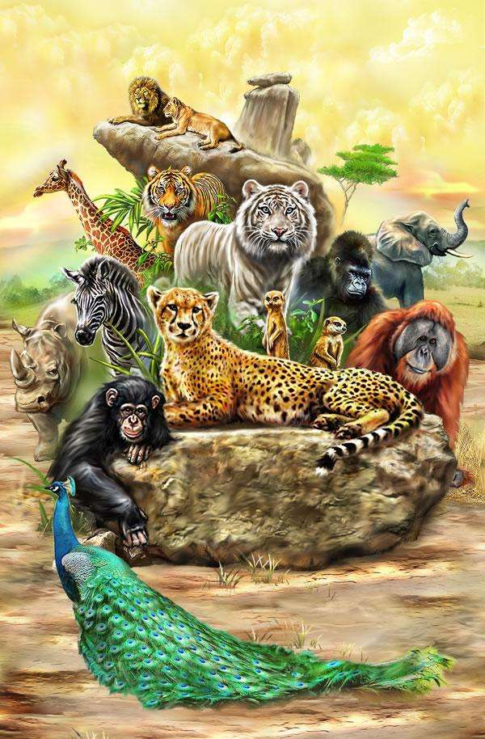
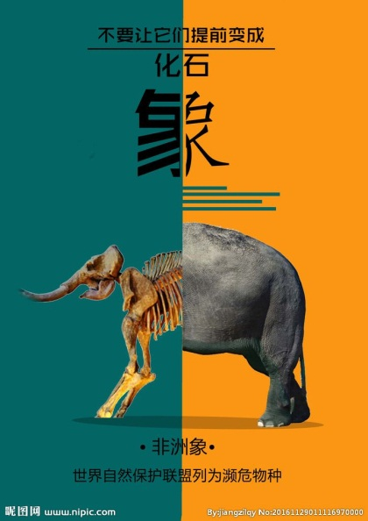
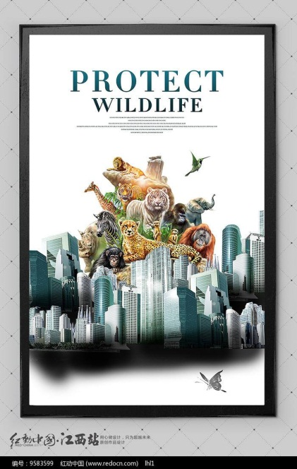
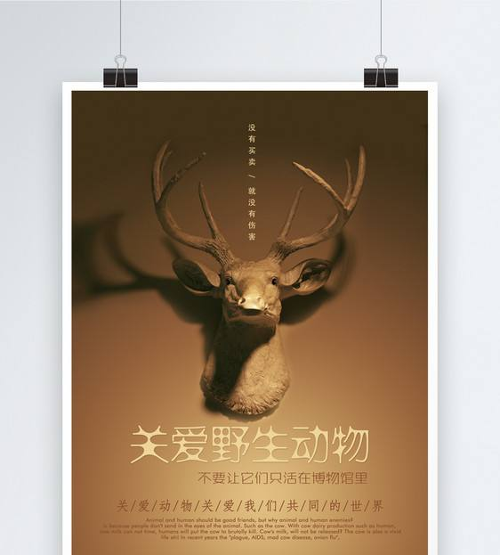
B2U2 Reading for writing

Slide 23
Language study
When it comes to +n 当涉及某事（或做某事）时
When it comes to playing football, Lionel Messi is the best I know.
2. stir – stirred, stirred, stirring
to move a liquid or substance around, using a spoon or something similar, in order to mix it completely 搅动；搅和；搅拌
stir up
to make people feel strong emotions 激起（感情）
2) to try to cause arguments or problems挑起，煽动（争执或事端）
stir up a debate
stir up trouble
stir up things 挑拨是非

Slide 24
3. Who do you think is the ________(intend) audience for each poster?
intended
intended adj. 1） that you are trying to achieve or reach 意欲达到的；打算的；计划的
intended audience 预期的观众/ 读者
2）be intended for…be planned or designed for somebody/something 为…打算（或设计）的
The book is intended for you.
3）intend to do sth. = mean/plan to do sth. 打算做…

Slide 25
B2U2 教材答案和讲评

Slide 26
Activity 4 on P 17
plains, threat, hunters, illegally, reserves, attacks, exists, harmony
herd n. a group of animals of the same type that live and feed together 兽群；牧群
a herd of cows/deer/elephants一群牛／鹿／象
where
2. In order to save them, some countries have created reserves _______ they can live in peace and safety.
on
in
3. However, the attacks ______ them will continue as long as interest ______ buying elephant products exists.
只要

Slide 27
Activity 2 on P 18
working, being painted 2. being written 3. being attacked
4. being watched 5. hunting , being hunted 6. being reduced
due to… because of somebody/something 由于；因为
The team's success was largely due to her efforts.
这个队的成功主要是她努力的结果。

Slide 28
Activity 1 on P 22 Assessing your progress
adapt to, die (out) of be concerned about, search for, put up/out
be aware of
短文：
is concerned about； are dying out, be aware of, search for, adapt to, puts out
II. is being done , are being studied, is being tested,
is being used, are being observed

Slide 29
B2U2 WORKBOOK P67
1. mass extinction adj. affecting or involving a large number of people or things 大批的；数量极多的 huge extinction
2. at an alarming rate (speed) 以惊人的速度
rate n. 1)速度 2）比率 3） 价格
3. measure n. What measures (efforts) are being taken to help them?
4. authorities: government departments
5. observe: watch carefully
6. recovered: returned to its earlier level
7. intend: plan
8. variety: differences 多样性

Slide 30
II. 1. The shepherds watched over their sheep.
2. I couldn’t make out what he was saying
3. We are concerned about endangered animals
4. This poster reminds me of the importance of protecting wildlife.
5. Everyone is aware of the animals’ serious situation.
6. Several bird species are dying out.
7. The zoo provides shelter for a variety of animals.
8. We are looking forward to living in harmony with all wildlife.

Slide 31
III. On P 68
endangered wildlife 2. are being threatened 3. effective measures
Set up/build more native reserves 5. are hunting illegally
6. have designed a poster to make more people aware of the importance of protecting wildlife

