Slide 1
感恩遇见，相互成就，本课件资料仅供您个人参考、教学使用，严禁自行在网络传播，违者依知识产权法追究法律责任。
更多教学资源请关注
公众号：溯恩英语
知识产权声明

Slide 2
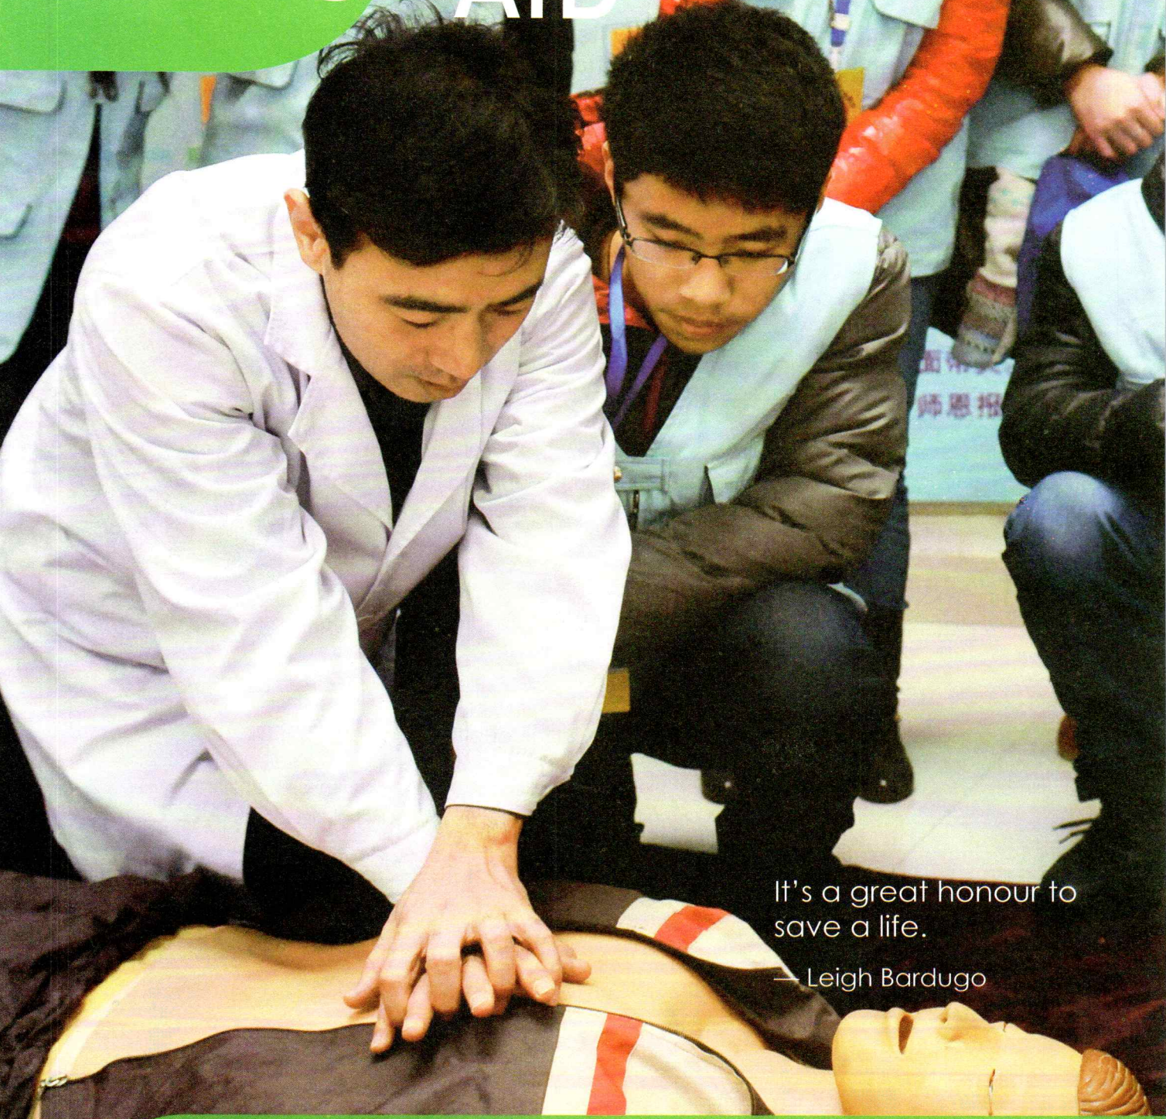
B5U5
First Aid
Language study

Slide 3
Para 1
as
1. Your skin acts ______ a barrier against disease, toxins, and the sun’s rays.
=serve as , work as
to perform a particular role or function充当；起作用
She acted as an adviser to the committee.
你能担任口译员吗？
Can you act as an interpreter?

Slide 4
getting
2. _____you can imagine, _______(get) burnt can lead to very serious injuries.
As
as 引导非限定性定语从句，代表整个主句，可以放在句首、句中、句尾。
“正如”
我们都知道，地球 绕着太阳转。
As we all know, the earth moves around the sun.
The earth moves around the sun, as we all know.
The earth, as we all know, moves around the sun.
动名词短语作主语
2. 正如我们预料，这支足球队再次获胜。
As we had expected, the soccer team won the game again.
3. 他经常缺席，这次也是一样。
He is absent, as if often the case.

Slide 5
get lost
get stuck
get arrested
get caught
get broken
get dressed
get married
get paid
get hurt
get prepared
城市工人通常按小时计酬。
学生在为运动会作准备。
Workers in urban areas usually get paid by the hour.
系表结构，
表示状态的变化，即动作的结果
get done
The students are getting prepared for the sports meet.
become done
grow done
不一会房间里就挤满人 。
Soon the room became crowded.
2. 我的眼睛很快就适应了黑暗。
My eyes soon grew accustomed to the darkness.

Slide 6
As you can imagine, getting burnt can lead to very serious injuries.
表示有能力做或能够发生）能，会
used to say what somebody/something is often like（表示常有的行为和情形）
有时会，时而可能
这里的春天有时还真够冷的。
It can be quite cold here in spring.

Slide 7
3. 1) You can get burnt by various things: hot liquids, steam, fire…
2) You can get burnt by a v_________ of things: hot liquids, steam, fire…
ariety
depending
4. Burns are divided into three types, ____________(depend) on the _______(deep) of skin damage.
depth
depending on: according to 取决于，根据
起薪为 26 000 至 30 500 英镑不等，依个人经验而定。
Starting salary varies from £26 000 to £30 500, depending on experience.

Slide 8
caused
4. Examples include mild sunburnt and burns _________(cause) by other minor household incidents.
adj. not severe or strong
not so serious slight

Slide 9
5. Remove any clothes using scissors if necessary, unless you see the fabric _____________(stick) to the burnt skin.
sticking
stick v. to fix something to something else, usually with a sticky substance; to become fixed to something in this way 粘贴；粘住
湿衣服贴在她身上。
Her wet clothes were sticking to her body.
stick to…to continue doing something despite difficulties
坚持（做某事，不怕困难）
饮食老受限制，她觉得受不了。
She finds it impossible to stick to a diet.

Slide 10
be/get stuck: to become fixed in one position and impossible to move
（在某物中）卡住，陷住，动不了
The car got stuck in the mud.
At age 50, she found herself out of work and ___________(stick) at home with only her computer to keep her company.
stuck
stuck
…twisted up in a hard little knot behind with two hairpins __________(stick) aggressively through it, Marilla’s hair showed some great streaks.
stick vt. to push something, usually a sharp object, into something; to be pushed into something 将…刺入（或插入）；刺；戳；插入

Slide 11
6. Cover the burnt area with a loose clean cloth.
干净透气的布
not tightly packed together; not solid or hard
疏松的；不结实的；不坚固的
编织稀疏的织物
a fabric with a loose weave

Slide 12
Applying
injured
6. ___________(apply) oil _______ the _________(injure) area is a bad idea.
to
动名词短语作主语，表示一件事情
to put or spread something such as paint, cream, etc. onto a surface 涂；敷；施
两面都应该涂上胶水。
The glue should be applied to both surfaces.
apply to sb for sth.
向…提出申请
He applied to the company for the job.
apply
这项新技术已应用于农业。
The new technology was applied to farming.
apply…to….
使用于；应用于
努力学习就会通过考试。
You would pass your exams if you applied yourself.
apply oneself
勤奋工作；努力学习

Slide 13
Practice :
___________the cream ________ exposed areas every three hours and after swimming.
每3小时及游泳后将防晒霜充分涂抹于身体裸露部位。
The paint should ___________________ thinly and evenly.
漆应该薄薄地刷上一层，且要刷得均匀。
Apply
to
be applied

Slide 14
to for
I’ve ________ _________ the local newspaper _________ a new job.
我已经申请了地方报纸的一个职位。
Please apply in writing to the address below.
请将书面申请寄到以下地址。
We’ve ________ _______a charitable organization ________ a grant for the project.
我们已经向一家慈善组织提出申请，请求其对这个项目提供资助。
applied
applied
to for
apply
to
That part of the form is for UK citizens - it doesn’t ________ ________you.
表格的那一项是给英国公民填的——和你无关。
The discount _________ only _______ children under the age of ten.
applies
to

Slide 15
7. If the victim is _________(suffer) from second or third-degree burns, there is _______ urgent need to take him/her to the hospital at once.
suffering
an
adj. that needs to be dealt with or happen immediately 紧急的；紧迫的；迫切的
这项法律亟待修订。
The law is in urgent need of reform.
请在通知上注明 “急件”。
Mark the message ‘urgent’, please.

Slide 16
8. ease discomfort
这些药丸能缓解疼痛。
These pills should ease the pain.
v. alleviate
减轻；缓解
为了缓解监狱里人满为患的情况，将修建新的监狱。
To ease the problem of overcrowding, new prisons will be built.
ease v. n.
stand at ease 稍息
at (one’s) ease 自由自在；无拘无束
put … at ease 宽慰某人
n. 舒适，安逸

