Slide 1
感恩遇见，相互成就，本课件资料仅供您个人参考、教学使用，严禁自行在网络传播，违者依知识产权法追究法律责任。
更多教学资源请关注
公众号：溯恩高中英语
知识产权声明

Slide 2
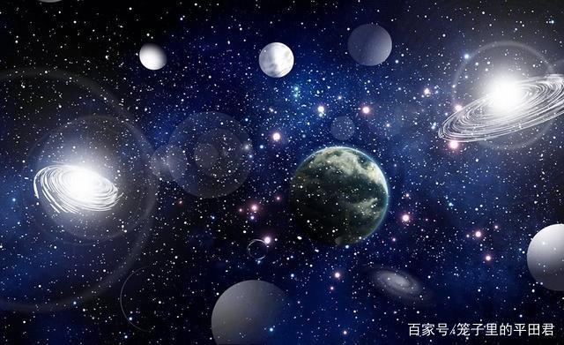
M3U4 SPACE EXPLORATION
Reading for thinking
-- Yu Yue, Shengzhou Senior High School

Slide 3
Mystery created wonder and wonder is the basis of man’s desire to understand.
-- Neil Armstrong

Slide 4
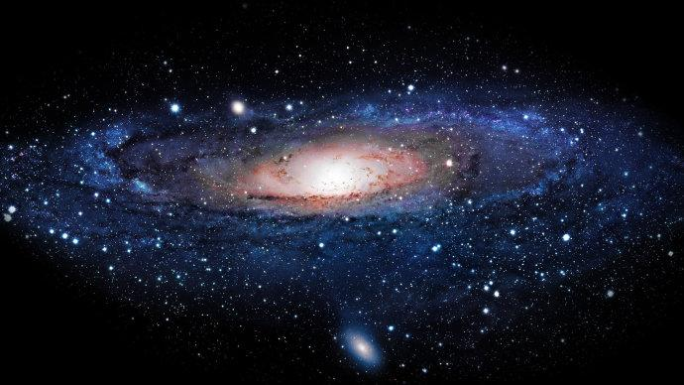
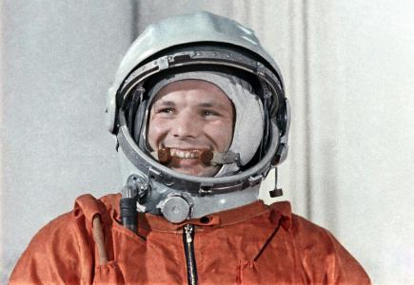
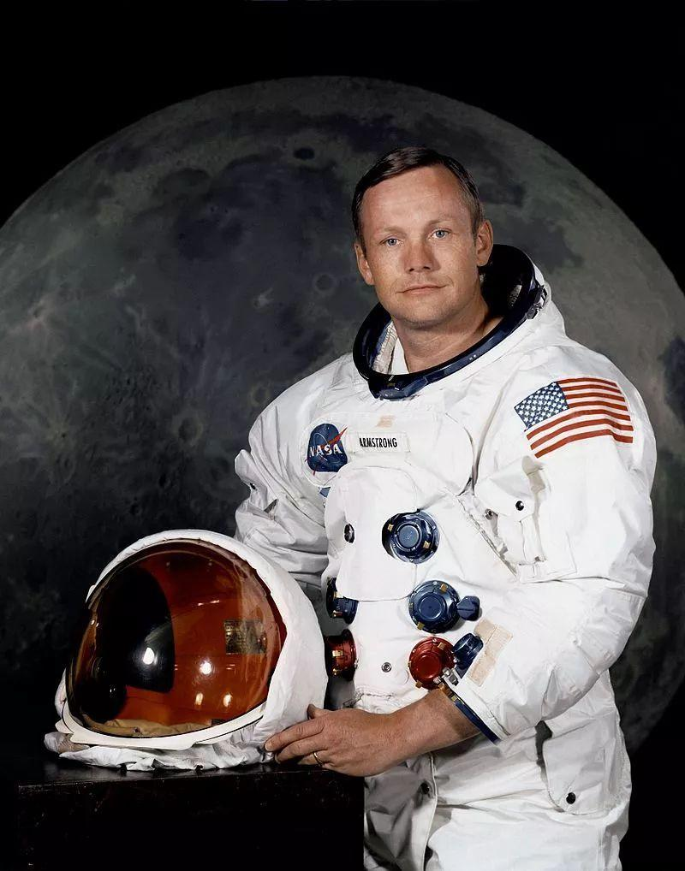
astronaut
Yuri Gagarin,
the Soviet Union
Neil Armstrong,
the US
pioneer
the first man to travel into space in 1961
the first person to walk on the moon in 1969

Slide 5
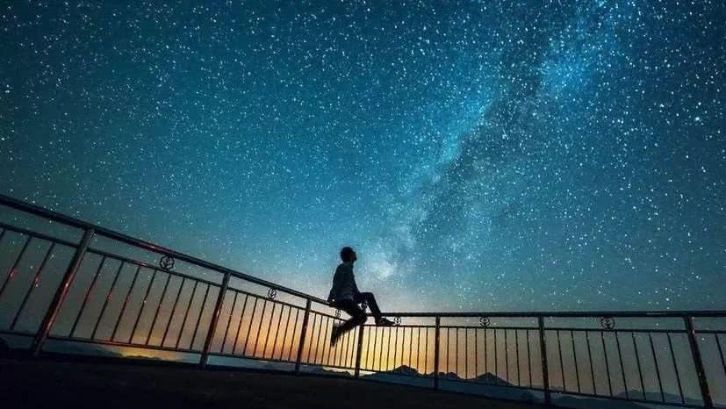
When you are looking up at the stars/universe, are you curious about the unknown universe? Are you feel lonely and down?

Slide 6
Space: the Final Frontier

Slide 7
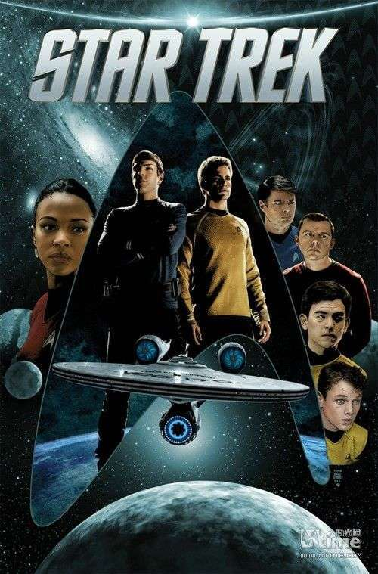
Space: the Final Frontier
Space, the final frontier. These are the voyages of the starship Enterprise. Its continuing mission, to explore strange new worlds, to seek out new life and civilizations, to boldly go where no man had gone before.

Slide 8
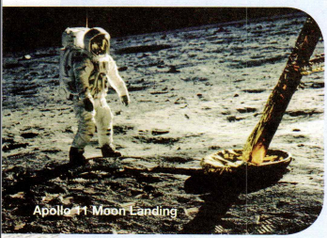
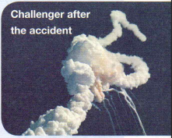
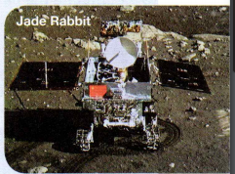
Space: the Final Frontier
achievements
accidents/challenges
China’s progress
man’s first success moon spacewalk
America's challenger exploded
China Jada Rabbit on the moon
According to the title and illustrations, can you infer what the passage include?

Slide 9
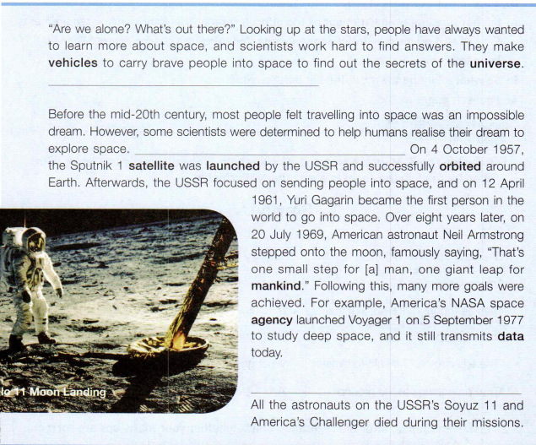
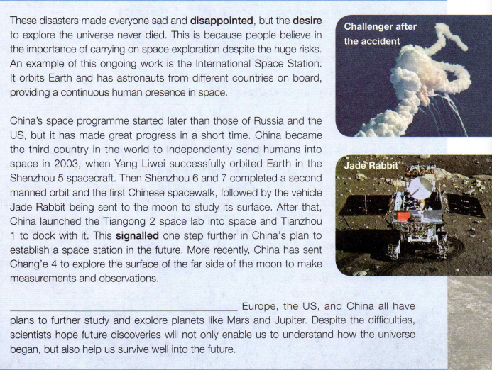
Although scientists try to make sure nothing goes wrong, accidents can still happen.
They also really wish to discover other planets that are suitable enough to support life.
The future of space exploration remains bright.
After many experiments, they succeeded in making rockets that could escape Earth’s gravity.
Can you choose the correct sentence to fill in the gap?
B
D
A
C

Slide 10
Para. 1
“Are we alone? What’s out there?” Looking up at the stars, people have always wanted to learn more about space, and scientists work hard to find answers. They make vehicles to carry brave people into space to find out the secrets of the universe. They also really wish to discover other planets that are suitable enough to support life.
learn more about space
find out the secrets of the universe
discover other planets that are suitable enough to support life.
Why do people want to explore space?
main idea:
Humans have always had _______________
about space.
a natural curiosity
Space exploration carries human’s curiosity.

Slide 11
Para. 1
“Are we alone? What’s out there?” Looking up at the stars, people have always wanted to learn more about space, and scientists work hard to find answers. They make vehicles to carry brave people into space to find out the secrets of the universe. They also really wish to discover other planets that are suitable enough to support life.
Why does the passage begin with two questions?
To impress readers
To attract readers’ attention and curiosity about the content
To raise readers’ reflection
Writing tip 1 : A beginning with questions can impress readers.

Slide 12
Para. 2
What’s the topic sentence in Para. 2?
Before the mid-20th century, most people felt travelling into space was an impossible dream. However, some scientists were determined to help humans realise their dream to explore space. After many experiments, they succeeded in making rockets that could escape Earth’s gravity. On 4 October 1957, the Sputnik 1 satellite was lunched by the USSR and successfully orbited around Earth. Afterwards, the USSR focused on sending people into space, and on 12 April 1961, Yuri Gagarin became the first person in the world to go into space. Over eight years later, on 20 July 1969, American astronaut Neil Armstrong stepped onto the moon, famously saying, “That’s one small step for [a] man, one giant leap for mankind.” Following this, many more goals were achieved. For example, America’s NASA space agency launched Voyager 1 on 5 September 1977 to study deep space, and it still transmits data today.
However, some scientists were determined to help
humans realise their dream to explore space.
How realised their dream?

Slide 13
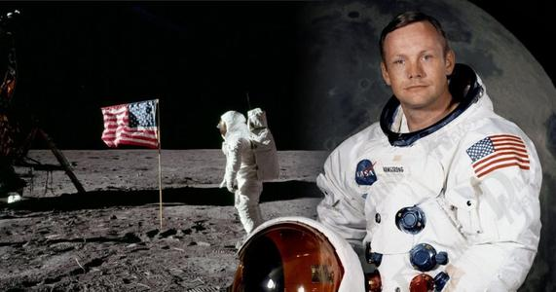
Para. 2
Voyager 1 was sent to study deep space, and transmits data today
The Sputnik 1 satellite was launched bt the USSR
Yuri Gagarin, he first person to go into space
Neil Armstrong stepped onto the moon
impossible dream
before the mid-20th century
12 Apr. 1961
20 Jul. 1969
5 Sep. 1977
4 Oct. 1957
That’s one small step for a man, a giant leap for mankind.
determination
persistence
Space exploration motivates human’s determination, persistence, curiosity, effort and ambition.
an impossible dream
a reality
curiosity
effort
ambition

Slide 14
the Cold War
Further thinking:
Voyager 1 was sent to study deep space, and transmits data today
The Sputnik 1 satellite was launched bt the USSR
Yuri Gagarin, he first person to go into space
Neil Armstrong stepped onto the moon
before the mid-20th century
12 Apr. 1961
20 Jul. 1969
5 Sep. 1977
4 Oct. 1957
VS
The USSR
The USA
Why was space exploration mainly carried out by the USSR and the US in the 20th century?
competition between two superpowers

Slide 15
Para. 2
What’s the topic sentence in Para. 2?
Before the mid-20th century, most people felt travelling into space was an impossible dream. However, some scientists were determined to help humans realise their dream to explore space. After many experiments, they succeeded in making rockets that could escape Earth’s gravity. On 4 October 1957, the Sputnik 1 satellite was lunched by the USSR and successfully orbited around Earth. Afterwards, the USSR focused on sending people into space, and on 12 April 1961, Yuri Gagarin became the first person in the world to go into space. Over eight years later, on 20 July 1969, American astronaut Neil Armstrong stepped onto the moon, famously saying, “That’s one small step for [a] man, one giant leap for mankind.” Following this, many more goals were achieved. For example, America’s NASA space agency launched Voyager 1 on 5 September 1977 to study deep space, and it still transmits data today.
How does the writer show the achievements in space exploration?
using examples C. giving specific number
making comparison D. giving definition
However, some scientists were determined to help
humans realise their dream to explore space.
What are benefits of using examples and specific numbers?
To be more detailed, vivid and persuasive
To impress readers with great progress in space exploration
To make it more easy-understanding
Writing tip 2 : Examples and specific numbers can make a scientific article more pervasive and objective.

Slide 16
However, some scientists were determined to help humans realise their dream to explore space.
Voyager 1 was sent to study deep space, and transmits data today
The Sputnik 1 satellite was launched bt the USSR
Yuri Gagarin, he first person to go into space
Neil Armstrong stepped onto the moon
before the mid-20th century
12 Apr. 1961
20 Jul. 1969
5 Sep. 1977
4 Oct. 1957
main idea:
Space travel became __________ in the 20th century with ________ and ________________ remarkable mission.
a reality
American
the Soviet Union

Slide 17
Space exploration is always successful and satisfying?
Do humans stop exploring space due to problems or failures?
Why don’t humans stop?

Slide 18
Para. 3
Although scientists try to make sure nothing goes wrong, accidents can still happen. All the astronauts on the USSR’s Soyuz 11 and America’s Challenger died during their missions. These disasters made everyone sad and disappointed , but the desire to explore the universe never died. This is because people believe in the importance of carrying on space exploration despite the huge risks. An example of this ongoing work is the International Space Station. It orbits Earth and has astronauts from different countries on board, providing a continuous human presence in space.
Although scientists try to make sure nothing goes wrong, accidents
can still happen
International
Space Station
cooperation
What’s the topic sentence in Para. 3?
What accident is showed?
Why don’t people stop exploring?
What proof?
Space exploration enlightens international cooperation.

Slide 19
Para. 3
Although scientists try to make sure nothing goes wrong, accidents can still happen. All the astronauts on the USSR’s Soyuz 11 and America’s Challenger died during their missions. These disasters made everyone sad and disappointed , but the desire to explore the universe never died. This is because people believe in the importance of carrying on space exploration despite the huge risks. An example of this ongoing work is the International Space Station. It orbits Earth and has astronauts from different countries on board, providing a continuous human presence in space.
Although scientists try to make sure nothing goes wrong, accidents
can still happen
International
Space Station
cooperation
main idea:
Space travel has always involved _________, but despite ______ exploration _________.
great risks
risks
continues

Slide 20
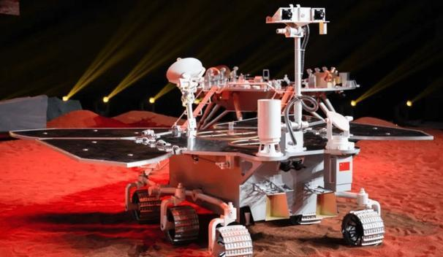
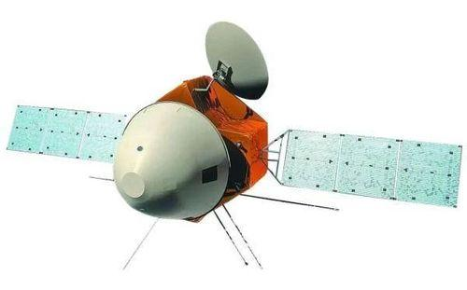
China also made great progress in space exploration!
July 23, 2020, Tianwen 1 – a Mars probe, was sent to the Space.
Zhurong, one of the mission rover of the Tianwen 1, is tasked with detailed mission.

Slide 21
Para. 4
China’s space programme started later than those of Russia and the US, but it has made great progress in a short time. China became the third country in the world to independently send humans into space in 2003, when Yang Liwei successfully orbited Earth in the Shenzhou 5 spacecraft. Then Shenzhou 6 and 7 completed a second manned orbit and the first Chinese spacewalk, followed by the vehicle Jade Rabbit being sent to the moon to study its surface. After that, China launched the Tiangong 2 space lab into space and Tianzhou1 to dock with it. This signalled one step further in China’s plan to establish a space station in the future. More recently, China has sent Chang’e 4 to explore the surface of the far side of the moon to make measurements and observations.
China’s space programme started later than those of Russia and the US,
but it has made great progress in a short time
What’s the topic sentence in Para. 4?
What progress did China make?

Slide 22
Para. 4
In 2003
independently send humans into space
Yang Liwei
Shenzhou 5 spacecraft
Shenzhou 6 and 7
completed a second manned orbit and the first Chinese spacewalk
the vehicle Jade Rabbit studies the moon’s surface.
Tiangong 2 space lab
China launched it into space and Tianzhou1 to dock with it
This signalled one step further in China’s plan to establish a space station in the future.
Chang’e 4
explore the surface of the far side of the moon to make measurements and observations
Space exploration witnesses China’s progress.

Slide 23
Para. 4
China’s space programme started later than those of Russia and the US, but it has made great progress in a short time. China became the third country in the world to independently send humans into space in 2003, when Yang Liwei successfully orbited Earth in the Shenzhou 5 spacecraft. Then Shenzhou 6 and 7 completed a second manned orbit and the first Chinese spacewalk, followed by the vehicle Jade Rabbit being sent to the moon to study its surface. After that, China launched the Tiangong 2 space lab into space and Tianzhou1 to dock with it. This signalled one step further in China’s plan to establish a space station in the future. More recently, China has sent Chang’e 4 to explore the surface of the far side of the moon to make measurements and observations.
China’s space programme started later than those of Russia and the US,
but it has made great progress in a short time
main idea:
made great progress
China has __________________ in space exploration in the early 21st century, becoming only _________ country to send humans into space.
the third

Slide 24
What’s the future of space exploration?
Is it bright or hopeless?

Slide 25
Para. 5
The future of space exploration remains bright. Europe, the US, and China all have plans to further study and explore planets like Mars and Jupiter. Despite the difficulties, scientists hope future discoveries will not only enable us to understand how the universe began, but also help us survive well into the future.
The future of space exploration remains bright
will not only enable us to
understand how the universe began, but also help us survive well into the future.
What’s the topic sentence in Para. 5?
Why is the future bright?
What does space exploration mean to us?
future plan
/international
/human’s determination, curiosity and effort
cooperation
/Chinese growing contributions
/more knowledge and
experience
/developing science and technology
Space exploration links humans and future.

Slide 26
cooperation
will not only enable us to
will not only enable us to
Para. 5
The future of space exploration remains bright. Europe, the US, and China all have plans to further study and explore planets like Mars and Jupiter. Despite the difficulties, scientists hope future discoveries will not only enable us to understand how the universe began, but also help us survive well into the future.
The future of space exploration remains bright
will not only enable us to
understand how the universe began, but also help us survive well into the future.
main idea:
future
The _______ of space exploration looks _______, as many countries are planning _____________.
bright
further missions
future plan

Slide 27
Further thinking:
What’s the significance of space exploration?
Space exploration carries human’s curiosity.
Space exploration motivates human’s determination, persistence, curiosity, effort and ambition.
Space exploration enlightens international cooperation.
Space exploration witnesses China’s progress.
Space exploration links humans and future.
significant
necessary
rewarding

Slide 28
Para. 1
start the topic of space exploration
structure
achievements
Para. 2
accidents/challenges
Para. 3
China’s progress
Para. 4
Para. 5
bright future of space exploration
Para. 1
Para.1
Para. 1
Para. 1

Slide 29
Further thinking:
a popular science article
What’s the writing type of the passage?
brief and attractive
topic
The title is __________________ and shows the _______.
___________________________ are used to make language __________,_________ and easy-understanding.
The beginning offers brief information about ____________.
Examples and specific numbers
persuasive
objective
background
A popular science article is written for the public to popularize scientific conclusions, development or theories.

Slide 30
4K
25FPS
REC
HD
The process of China’s space explorations is hard. Thanks to scientists’ devotion and contributions, we have gained remarkable and surprising achievements.
Nowadays, there is an activity titled “ I say something to CNSA.”
As a teenager, what would you say and why do you say so?
MENU

Slide 31
Thank you!

