Slide 1
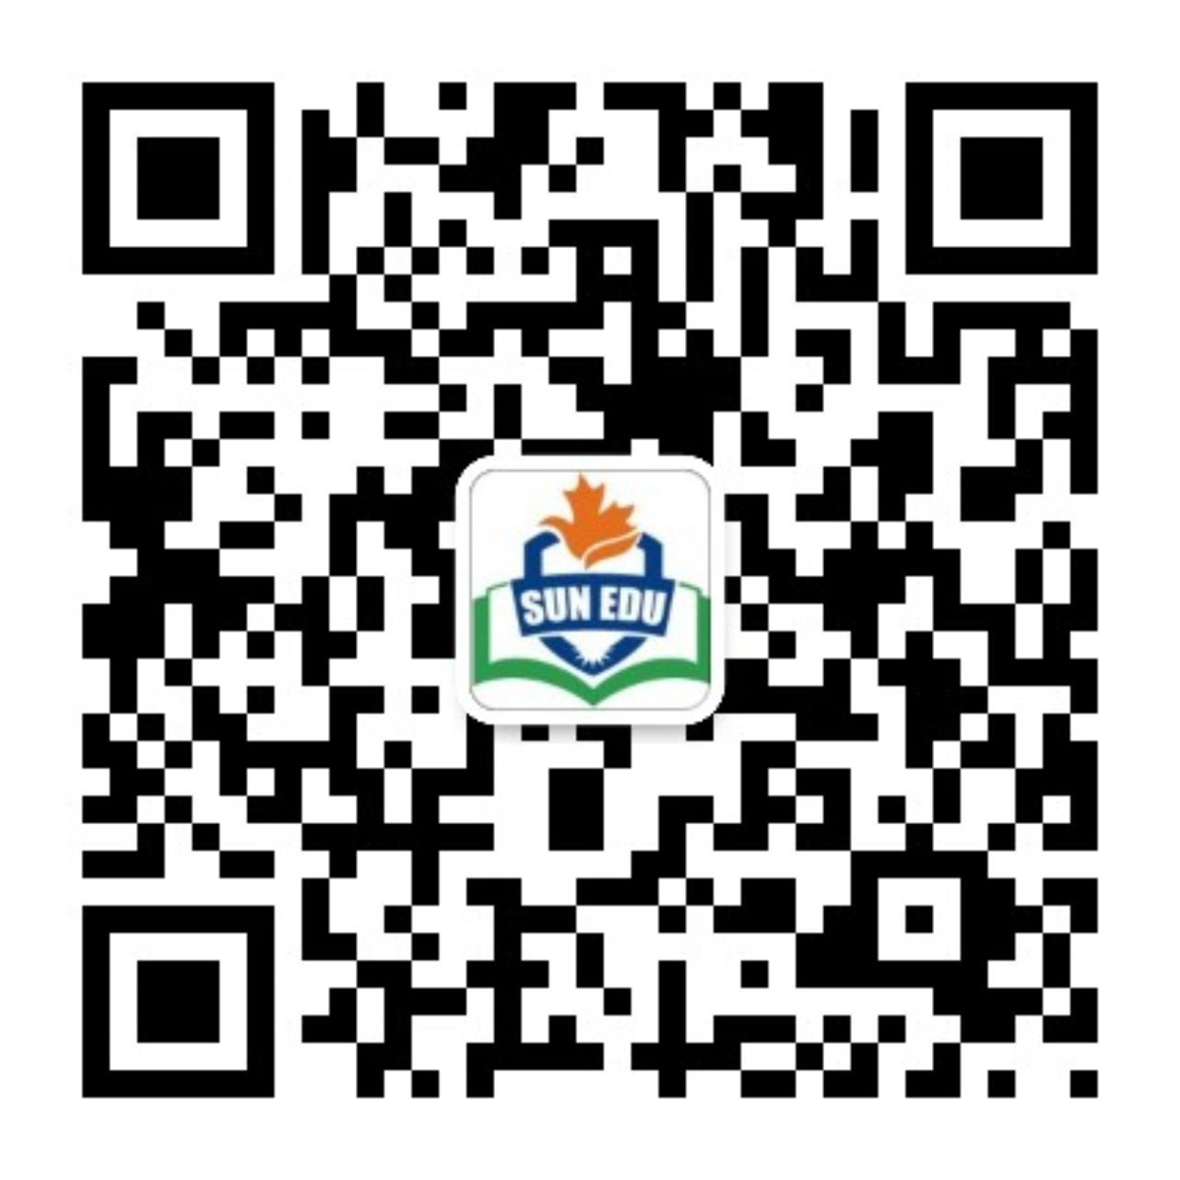
感恩遇见，相互成就，本课件资料仅供您个人参考、教学使用，严禁自行在网络传播，违者依知识产权法追究法律责任。
更多教学资源请关注
公众号：溯恩英语
知识产权声明

Slide 2
Letter of discussing the performance for the Time Machine Music Festival
—关于共同表演的商讨信
2025.5温州三模应用文分析

Slide 3
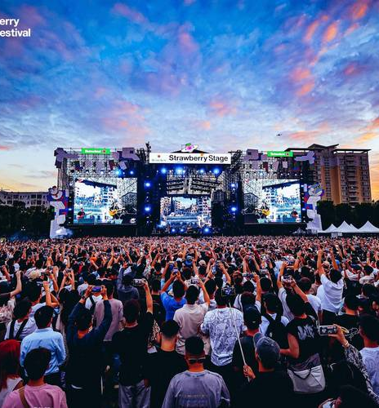
Warm-up
01
Have you ever participated in a Music Festival?
02
What should you expect to hear in a Time Machine Music Festival?

Slide 4
Lead in
What’s most challenging for you in this writing assignment?
Possible difficulties:
1.How to describe the program's conception and its design reason？
2.What can be a good performance on Time Machine Music Festival？
3.How to ask for Tom’s specific opinions sincerely ?
4.How to present the body part logically？
...

Slide 5
Analyze
假定你是李华，你校计划举办 “时光机音乐节（Time Machine Music Festival）”，你将与英国交换生Tom 共演一个节目。请你写一封邮件与他商讨，内容包括：
1.节目设想
2.设计理由
3.征求意见。
Genre
Receiver
Background
Writing Puporse
Content
Tense
Person
Tone
an E-mail of discussion/consultation
Tom(a British exchange student)
collaborate to give a performance on an upcoming music festival
discuss about the related details
elaborate on the program's conception and reasons
seek the other party's opinions.
simple present tense, future tense
first and second person
friendly;cooperative;respectful;sincere

Slide 6
Construct
a greeting
background information
writing purpose
Beginning
elaborate on the program's conception and its design reasons
Basic
Structure
Body
specific & related
Time Machine Music Festival
seek Tom’s opinions
Conclusion
express expectations for the response

Slide 7
Practice and Accumulate
a greeting
background information
writing purpose
P1 Beginning
I hope this email finds you well! I’m thrilled to hear we’ll collaborate on a performance for the upcoming Time Machine Music Festival. Let’s brainstorm some ideas to make our act unforgettable!
How is everything going ? I'm excited to collaborate with you on the Time Machine Music Festival! Here is my initial idea.

Slide 8
Brainstorm
What comes to your mind when seeing the title—Time Machine Music Festival?
Time/tradition/instrument
1
2
Classic/popular
Content
Form
Culture exchange
3
4
Future
5
Technology/AI
6
Band...

Slide 9
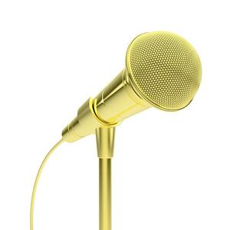
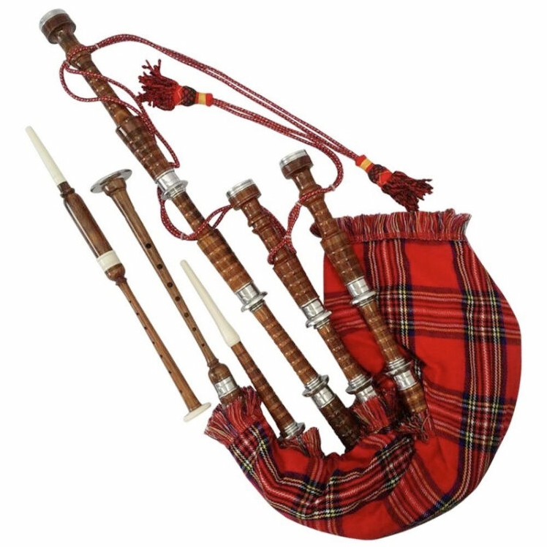
Brainstorm
What is the program's conception and its design reason?
I propose singing the engaging melodies of Yesterday Once More and the traditional Chinese folk masterpiece Jasmine Flower, which can reflect cultural integration and also allows the audience to embark on an immersive journey through the charm of music from different eras.
我建议演唱《昨日重现》和中国传统民间名曲《茉莉花》的动人旋律，既能体现文化融合，又能让观众沉浸在不同时代音乐的魅力中。
Content
Form
Given your mastery of Bagpipe‌ alongside my proficiency in the Erhu‌, perhaps we could collaborate on performing classic songs from different eras using these instruments, which is both nostalgic and innovative.Such a combination is more attractive and likely to evoke resonance.
考虑到你对风笛的精通和我对二胡的精通，也许我们可以合作用这些乐器演奏不同时代的经典歌曲，既怀旧又创新。这样的组合更有吸引力，更容易引起共鸣。

Slide 10
Brainstorm
How to ask for Tom’s specific opinions sincerely?
I would greatly appreciate hearing your thoughts on the current proposal. Your insights would be invaluable.
Given your expertise and creative vision, I’m keen to know if there are any aspects you feel could be refined.
While it’s our first cooperation, please feel free to inform me of your specific preferences.I’m fully prepared to adapt preivous plan ensure our shared success.

Slide 11
Sample Writing One
Dear Tom,
I hope this email finds you well! I’m thrilled to hear we’ll collaborate on a performance for the upcoming Time Machine Music Festival. Let’s brainstorm some ideas to make our act unforgettable!.
Given your mastery of Bagpipe‌ alongside my proficiency in the Erhu‌, perhaps we could collaborate on performing classic songs from different eras using these instruments, which is both nostalgic and innovative.Such a combination is more attractive and likely to evoke resonance. I would greatly appreciate hearing your thoughts on the current proposal. Your insights would be invaluable.
Looking forward to your creative input!
Best regards ,
Li Hua

Slide 12
Sample Writing Two
Dear Tom,
How is everything going ? I'm excited to collaborate with you on the Time Machine Music Festival! Here is my initial idea.
I propose singing the engaging melodies of Yesterday Once More and the traditional Chinese folk masterpiece Jasmine Flower, which can reflect cultural integration and also allows the audience to embark on an immersive journey through the charm of music from different eras. While it’s our first cooperation, please feel free to inform me of your specific preferences.I’m fully prepared to adapt preivous plan ensure our shared success.
I’m so confident that it will literally be an unforgettable and rewarding experience for both of us. I can’t wait but hear your invaluable insights and try our first rehearsal.
Best regards,
Li Hua

Slide 13
Thank you!

