Slide 1
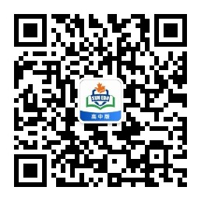
感恩遇见，相互成就，本课件资料仅供您个人参考、教学使用，严禁自行在网络传播，违者依知识产权法追究法律责任。
更多教学资源请关注
公众号：溯恩高中英语
知识产权声明

Slide 2
应用文写作之
——推荐信（推荐物）

Slide 3
第一节:应用文写作（满分15分)
假定你是李华，某国际学校学生。新学期学校开设了文学、科技和摄影三个社团，你校新西兰交换生Biff不知如何选择，写信向你求助。请你给他回信，内容包括：
1.推荐某一社团；
2.简介该社团；
3.告知申请方式。
参考词汇：
文学社 the literature club
科技社 the science club
摄影社 the photography club
注意:1.词数80左右；
2.可适当增加细节，以使行文连贯。
审题!!!

Slide 4
推荐信：
Para.1 background(背景信息) ＋ writing purpose（写作目的）
Background(背景信息): 新学期学校开设了文学、科技和摄影三个社团，你校新西兰交换生Biff不知如何选择，写信向你求助。
1. Knowing that you are stuck in choosing the club, I’m delighted/ willing/honored to do you a favor/lend you a hand/offer my recommendation.
2. Sorry to learn that you have trouble in/have no idea about choosing the club, I’d like to offer my recommendation./I’m dropping you a line to keep you informed of the ...club.
3. I am sorry to learn that you are at a loss about choosing the club, and I highly recommend you choose the ...club.

Slide 5
Para.2 某一社团＋简介＋（申请方式）
1. What tops my recommendation is the literature club.
2. ...I highly recommend you choose the literature club. (第一段)
What puts the literature club at an advantage is its precious
chance to savor/relish the glamour of ...
3. The reason why I recommend the literature club is...
4. What is highly recommended is...
5. The literature club has varieties of activities which are tailored
to meet your requirements./to/for you.

Slide 6
Para.2 某一社团＋简介＋（申请方式）
文学社 the literature club简介:
1. 开展写作、辩论、诗歌朗诵等比赛，陶冶参与者情操，锻炼参与者能力，丰富校园文化生活;
1. carry out various contests such as writing, debate and poetry reading，which will cultivate your mind, practice the abilities and add spice to your campus life;
2. 请校内外专家学者开展系列文学讲座，拓宽视野，增长见识;
2. invite the experts in and out of our school to deliver lectures,
broadening your horizons/views and expanding the knowledge;
3. 举行趣味猜谜活动，使我们对中国文学有更深入的了解;
3. There are funny riddle guessing games as well, which makes it possible for us to gain a deeper glimpse into Chinese literature;

Slide 7
Para.2 某一社团＋简介＋（申请方式）
文学社 the literature club简介:
4. Not only can it boost your integrated skills, but also enables you
to perceive the importance of Chinese literature;

Slide 8
Para.2 某一社团＋简介＋（申请方式）
文学社 the literature club简介:
Interpreted as the most appealing club, the literature club carries out various contests such as writing, debate and poetry reading, which will cultivate your mind, practice the abilities and add spice to your campus life. Besides, some experts are always invited to deliver lectures, broadening your horizons/views and expanding the knowledge. There are funny riddle guessing games as well, which makes it possible for you to gain a deeper glimpse into Chinese literature.

Slide 9
Para.2 某一社团＋简介＋（申请方式）
科技社 the science club:
1. do/conduct researches/experiments, not only can you have a
deeper understanding of the universe, but you can obtain great
knowledge about science.
2. stir up your passion for science and help you to explore the
unknown secrets about the world.
3. visit themuseum and appreciate the technological works, which
will certainly trigger your interest and curiosity, finally sowing
the seed of innovation and creation in your future.

Slide 10
Para.2 某一社团＋简介＋（申请方式）
科技社 the science club:
What is highly recommended is the science club, where you can conduct researches . By joining the club, not only can you have a deeper understanding of the universe, but you can obtain great knowledge about science.Besides, you can visit themuseum and appreciate the technological works, which will certainly trigger your interest and curiosity, finally sowing the seed of innovation and creation in your future.

Slide 11
Para.2 某一社团＋简介＋（申请方式）
摄影社 the photography club:
1. offter a fantastic chance to learn and practice photographing,
which will equip you with rich knowledge about photogaraphy,
get your skills improved and relieve yourself.
2. It’s a perfect place to relish masters’ masterpieces, where you can
enjoy the unique charm of the pictures, totally bathed in the
glamour of photography/ which is a true feast both for your mind
and soul.

Slide 12
Para.2 某一社团＋简介＋（申请方式）
摄影社 the photography club:
The photography club is a perfect place to relish masters’ masterpieces, where you can enjoy the unique charm of the pictures, totally bathed in the glamour of photography/ which is a true feast both for your mind and soul. In addition, it offters a fantastic chance to learn and practice photographing, which will equip you with rich knowledge about photogaraphy, get your skills improved and relieve yourself.

Slide 13
Para.3 （申请方式）＋结尾：
1. If it’s the club you’re looking for, don’t hesitate to sign up at
literatureclub@126.com.
2. Please send your application form to literatureclub@126.com.
And I bet it won’t let you down.
3. It’s such a fabulous club that you can’t afford to miss it, so join it
by contacting Tom at 13346578967.
4. If you are interested, you can fill in an application form on the
school website before Dec.31.

Slide 14
Possible version1: the literature club
Dear Biff,
Learning that you have trouble in choosing the club, I’d like to offer my recommendation.
Interpreted as the most appealing club, the literature club carries out contests such as writing, debate and poetry reading, which will cultivate your mind, practice the abilities and add spice to your campus life. Besides, experts are always invited to deliver lectures, broadening your horizons and expanding the knowledge. There are funny riddle guessing games as well, making it possible for you to gain a deeper glimpse into Chinese literature.
Therefore, don’t hesitate to sign up at literatureclub@126.com.
97w
Yours,
Li Hua

Slide 15
Possible version2: the science club
Dear Biff,
Sorry to learn that you are at a loss about choosing the club, I’m delighted to do you a favor.
What is highly recommended is the science club, where you can conduct researches .By joining the club, not only can you have a deeper understanding of the universe, but you can obtain great knowledge about science. Besides, you can visit the museum and appreciate the technological works, which will trigger your interest and curiosity, finally sowing the seed of innovation and creation in your future.
It’s such a fabulous club that you can’t afford to miss it, so join it by contacting Tom at 13346578967.
Yours,
Li Hua

Slide 16
Possible version3: The photography club
Dear Biff,
I am sorry to learn that you are stuck in choosing the club, and I’m dropping you a line to keep you informed of the photography club.
The photography club is a perfect place to relish masters’ masterpieces, where you can enjoy the unique charm of the pictures, totally bathed in the glamour of photography/ which is a true feast both for your mind and soul. In addition, it offters a fantastic chance to learn and practice photographing, which will equip you with rich knowledge about photogaraphy, get your skills improved and relieve yourself.
Please send your application form to literatureclub@126.com.
And I bet it won’t let you down.
Yours,
Li Hua

Slide 17
参考范文：
Dear Biff,
Knowing that you are at a loss when choosing an appropriate club to attend, I am writing to recommend the literature club and keep you informed of some information about it.
The club gathers its members on Thursday, from 4:00 p.m. to 5:00 p.m. Enjoying a high popularity among students, the club is bound to bring you into a magical world of literature, providing you a platform
where you can communicate with great minds in those masterpieces. If possible, some particular literature salons will be arranged on a regular basis. Please send your application form to literatureclub@126.com.
I’m sure your participation will be highly welcomed.
Yours,
Li Hua

Slide 18
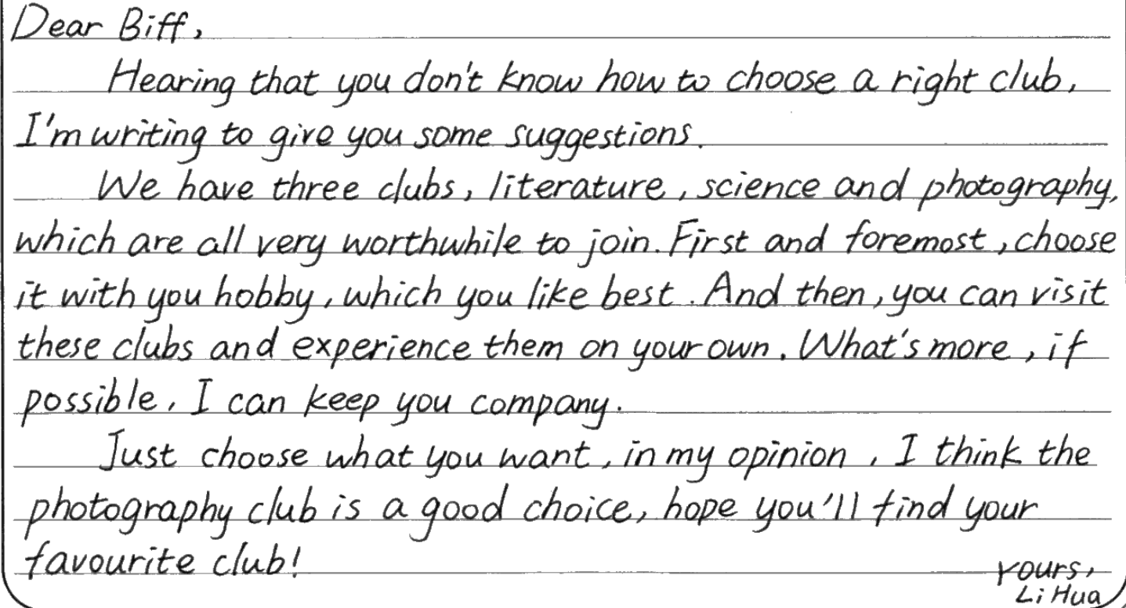
审题有误——介绍了三种club, 没有聚焦某一俱乐部，离题 6-7分

Slide 19
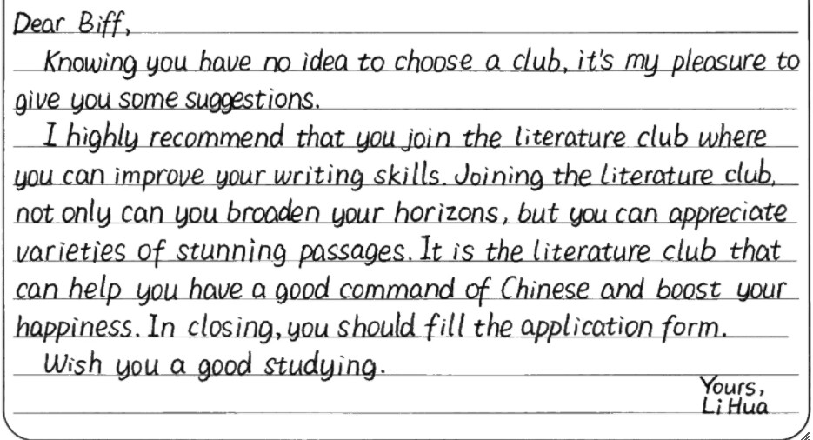
字迹工整，语言准确并优美，句型结构丰富，值得大家学习。12-13分

Slide 20
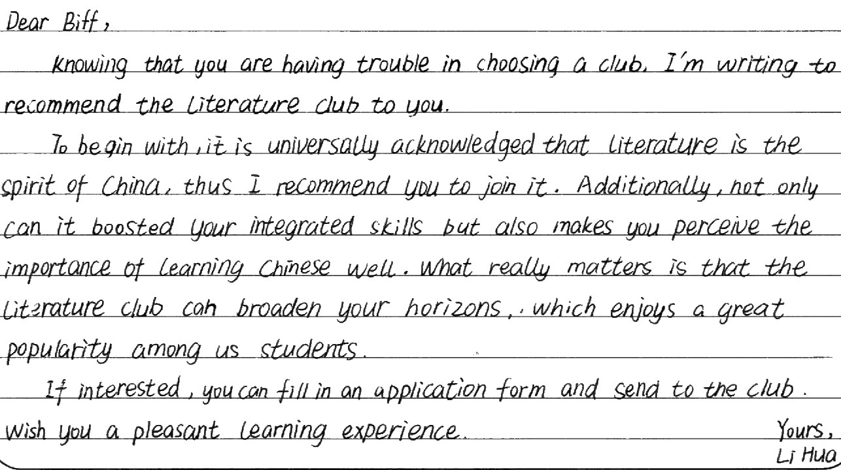
字迹工整，语言准确并优美，句型结构丰富，值得大家学习。 11-12分

Slide 21
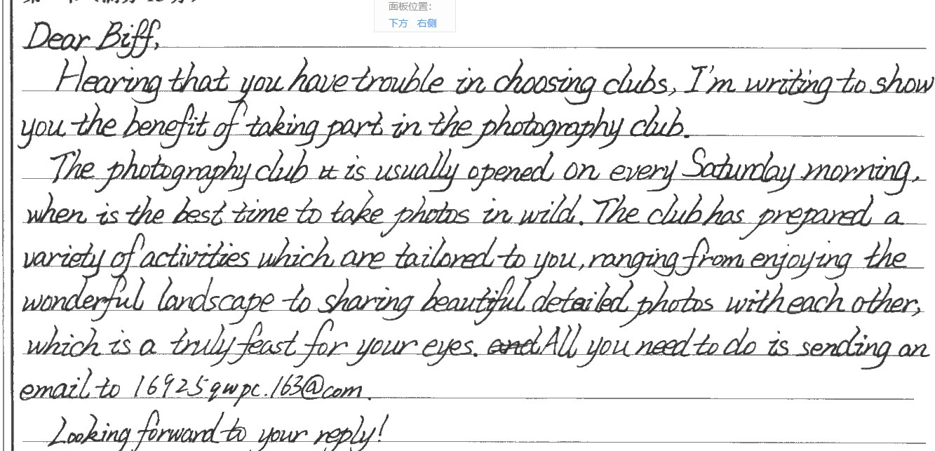
难得的一篇关于the photography club的作文，虽然有些许语言错误，但还是有可圈可点之处。 9-10分
Yours,
Li Hua

Slide 22
Thank you !

