Slide 1

感恩遇见，相互成就，本课件资料仅供您个人参考、教学使用，严禁自行在网络传播，违者依知识产权法追究法律责任。
更多教学资源请关注
公众号：溯恩高中英语
知识产权声明

Slide 2
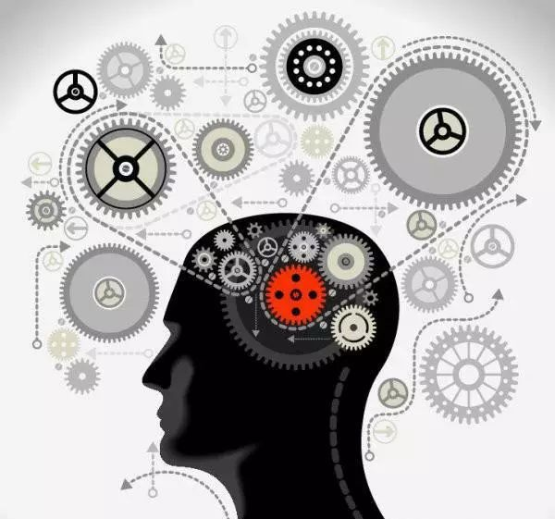
读后续写思维品质的培养
－结合浙江五校读后续写谈思维品质的培养
浙江省衢州第一中学 徐荣仙

Slide 3
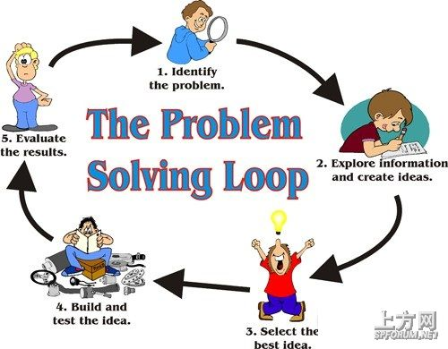
读后续写都是围绕一个事件的冲突，要求构思一个处理问题的办法及处理冲突完毕后的释怀感悟等

Slide 4
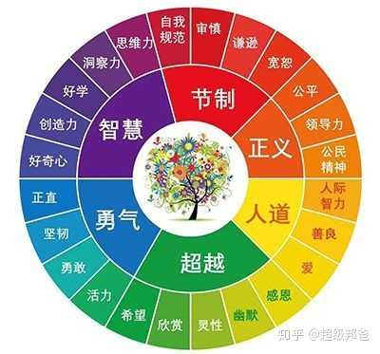

Dimensions of Thinking Quality
What?
How ?

Slide 5
缺乏思维品质导致的问题：
文章缺乏生命力、灵动感
情节构思缺乏思维高度、深度
不能巧取角度、错失有效信息
文章立意肤浅、缺乏思想
文章思维偏离、导致离题
。。。。。。

Slide 6
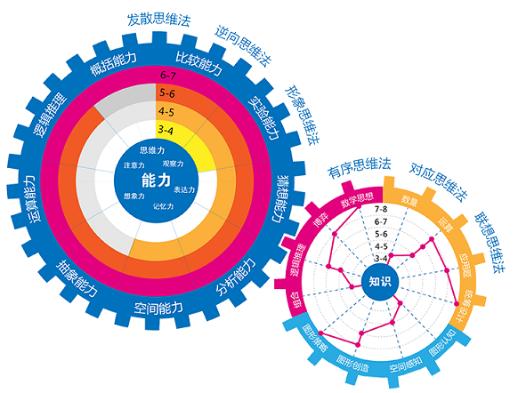
Examples

Slide 7
案例1：
Neil loves to travel and he was so fond of forests. Whenever he plans for a holiday, he would choose a place that is blessed by Mother Nature. To celebrate his son's second birthday, he decided to stay and enjoy the celebration in woods, located at the lap of a mountain. He with his family and friends, reached the village located near the woods and had his stay in the cottage. The cottage was located at the entrance of the dense forest, where the villagers warned them of wolves roaming in the nearby place. Neil's son saw a dog at the door and offered him a biscuit. The dog was happy and very soon the little boy befriended the dog. On second day, the birthday of the boy was celebrated grandly in the woods within beautiful nature. The dog did not leave the boy even for a minute and they both became close pals. The next day, Neil, his wife and others decided to go for hunting in the forest and arranged a babysitter to take care of the little baby for half a day. After 3 hours, all the elders returned to the cottage and they seemed very tired. The dog saw Neil and others, it rushed to them and licked Neil's shoes. The cottage was open and nobody was there. Neil's wife was shocked to see the blood stains in the dog's mouth and she shouted. All of them thought that the dog has killed Neil's little boy.
Paragraph1: Everyone was shocked to see the blood-spattered mouth. ____________________
Paragraph2:
Hearing the dog’s noise, the babysitter rushed to the room. ________________

Slide 8
案例分析1：
情节构思不合理，思维品质差，人物角色不明
狗非但被杀了，还被剥皮了。是不是太没人性了？人文素养呢？
小孩从外面拿着东西进来，质问“为何伤害我好朋友？” 两岁的孩子会用这种语气说话吗？
即使出现上文因为愤怒和误解而杀害了狗，第二段应该出现了解真相后，而懊悔和反思，不能一杀了之。
反思：学生写出这样的文章，构思出这样的故事情节，根本原因不是语言水平的问题，而是缺乏基本的思维品质，才限制了文本的内容和高度。

Slide 9
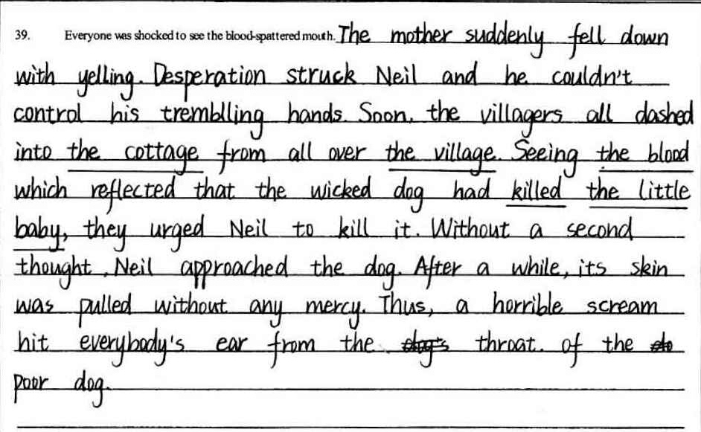

Slide 10
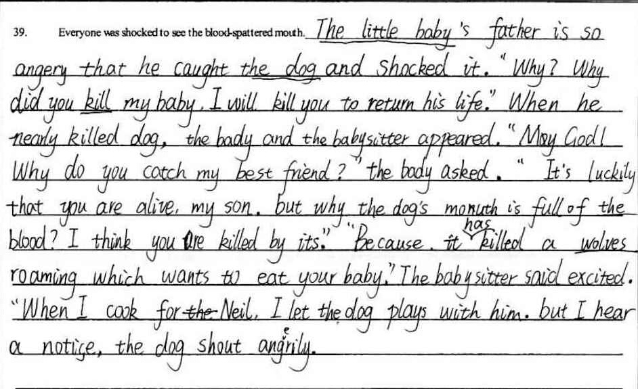

Slide 11
案例2：
Carl and Henry worked in the same company. One day they were both called into the manager’s office. They were informed that they were fired. It was a big hit to both of them.
Carl had a family to support. He knew he must keep earning money, or his family would suffer hunger. However, he also knew he had got fired of working at the company.
“Maybe it’s a good opportunity for me to start my own business,” he said to himself. After talking with his wife, he made a decision to start a career that he had always wanted to do. It was the first time for him to do business. So it was not surprising that things didn’t go well at first. However, Carl didn’t get discouraged. He worked hard and gradually his business got better and better. As a result, his business went so well that it expanded quickly.
So what did Henry do after he lost his work? Well, he reacted quite differently. “Why me?” he asked, “Why did such a bad thing happen to me? It’s so unfair!” Instead of thinking about what to do later, Henry kept complaining.
“You should go to work again, or you’ll become homeless,” his friends said to him. But Henry didn’t listen. He couldn’t stop thinking that life was unfair to him. The more he thought like that, the more he didn’t want to find work. What was worse, he started drinking alcohol. At last, he even couldn’t afford the rent and had to sleep on the street. As his friends had warned him, he became homeless.
One day, while sitting by the street, Henry was given a newspaper by a passer-by. It was cold that day and the passer-by thought that a newspaper might help keep him warm a bit. By chance, Henry saw a picture of a man in the newspaper, and there was a report about the man. He thought the man in the picture was a bit familiar to him. But he couldn’t remember who he was.
Paragraph1
Henry decided to read the report. ______________________________________________
Paragraph2
Henry started looking back upon his life after he lost his work.________________________

Slide 12
案例分析2：
本案例讲述的是两个同事同时被公司裁员的事件。一个被裁员后对生活充满抱怨，觉得生活对他不公平，于是自暴自弃，结果流落街头，成了无家可归的流浪汉。而另外一个在被裁员后，觉得这是生活给他的另外一个机会，为了生活他得奋斗，于是多年后他成功了，成了报纸刊载的成功人士。
Paragraph1
Henry decided to read the report. ___________________
Paragraph2
Henry started looking back upon his life after he lost his work._______

Slide 13
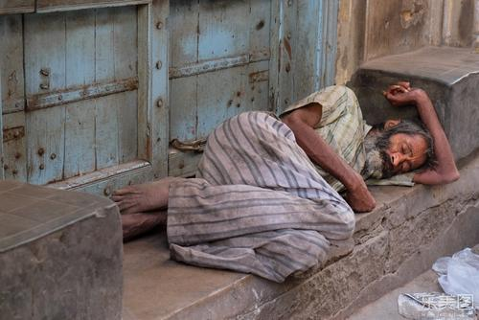
Paragraph1
Henry decided to read the report. ___________
Paragraph2
Henry started looking back upon his life after he lost his work._______
思维品质：
看到报纸后的“好奇心”
从同事身上发现“坚韧、勇敢”
自我反思后对未来的“希望”，摆脱现状的“上进心”“乐观”
遇见这份报纸的“感恩”

Slide 14

意境
抓住意象
描绘画面
表达情感
营造氛围

Slide 15
Henry decided to read the report. The hero of the story is a successful man who started his own business after being fired. losing a job is absoultely a shock to everyone who has a family to support and Carl was no exception. However, he picked himself up quickly and moved on instead of complaining. Eventually, his efforts paid off. Admittedly, he was the very man fired together with him. But why did they write totally different destinies (命运)？

Slide 16
Henry started looking back upon his life after he lost his work. To his surprise, he found his life was of nothing but complaints. Had he taken his friends' advice, he wouldn't be homeless now. It dawned on him that it was not the unfair fate but his negative attitude that ruined his life. Then, with the carefully folded newspaper in his pocket, he stood up and walked to the direction of a brand new life. （Yang Hu Class 14）

Slide 17
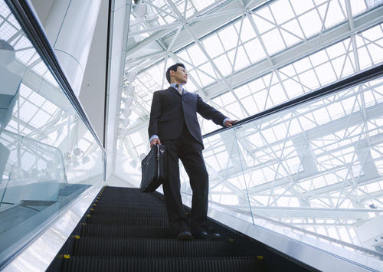
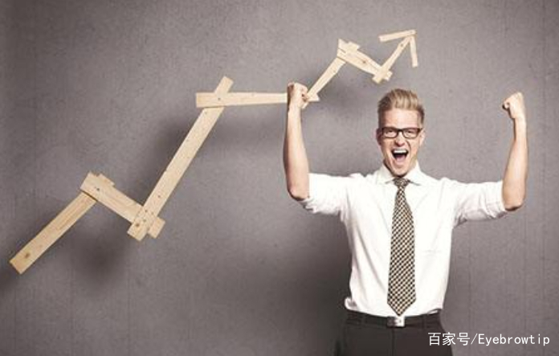
该学生紧抓所给文章的意象，借助留白的结局塑造了一个很唯美的画面，把文章需要的氛围点缀的很到位，没有直抒其意，而是让读者自己去营造一个意境。“Then, with the carefully folded newspaper in his pocket, he stood up and walked to the direction of a brand new life.
”该句中的“carefully folded newspaper”和“walk to the direction of a brand new life
”中的“carefully”“brand new”把Henry对未来的期望，对改变现状的决心以及可期的成功都淋漓尽致的表达了出来。

Slide 18

浙江五校读后续写

Slide 19
Theo stood at the microphone. Silence settled over the hall. “Your word is onomatopoeia,” said Mr. Ramirez, the announcer. I got this! Theo thought. Spelling was sort of his superpower. He wasn’t a math or science guy, but he had a gift for spelling. Theo’s brain fast-forwarded to the spelling bees ahead: first the county championship, then the state championship, and finally the national spelling bee. “Your answer, please, Theo?” He glanced back at Alexa, another fourth-grader, sitting on the edge of her chair. She wanted another chance at winning. If he missed his word, she’d be back in the game. But that wasn’t going to happen. Theo got the right spelling. Theo’s sister, Deandra, who had also competed but missed her word, applauded with the rest of the crowd. Mr. Ramirez presented the trophy (奖杯) to Theo. He lifted both arms into the air. “I’m the alpha-best.” Then he raced toward his sister. “Ha!” Tero said, making the trophy dance in front of Deandra’s nose. She rolled her eyes. “You’re a terrible winner.” “What’s wrong with celebrating my victory?” Deandra crossed her arms and made a sour face. “You know, it wasn’t cool the way you ignored Alexa onstage. She tried to shake your hands.” Theo shrugged. “I didn’t notice. Anyway, county bee, here I come!” “You might want to crack open the dictionary before counties. In two weeks, you’ll be facing the best of the best.” “And they’ll up against me, the alpha-beast.” Deandra shook her head. “Well, good luck. I think you’re going to need it.” Two weeks passed in a blink. As the county bee, students from different schools gathered around onstage, some looking more worried than others. Finally, it was time for the contestants(选手) to take their seats. After six rounds, the group of more than 100 students decreased to just seven. This was no regular spelling bee. Theo barely made it through the last round with a lucky guess on conscience. And if he’d had to spell aerospace or conical, he’d be out already. His sister’s advice suddenly made sense.
Paragraph1: When it was his turn again. Theo stood frozen for the longest moment. __________________________ Paragraph2: The following Monday at school, Theo found Alexa in the lunchroom. ___________________________

Slide 20
分析文本暗含的思维品质 Para1
Theo stood at the microphone. Silence settled over the hall. “Your word is onomatopoeia,” said Mr. Ramirez, the announcer. I got this! Theo thought. Spelling was sort of his superpower. He wasn’t a math or science guy, but he had a gift for spelling.
self-confident
proud

Slide 21
分析文本暗含的思维品质 Para1-Para9
Deandra : generous, considerate
kind; honest
Theo’s sister, Deandra, who had also competed but missed her word, applauded with the rest of the crowd. Mr. Ramirez presented the trophy (奖杯) to Theo. He lifted both arms into the air. “I’m the alpha-best.” Then he raced toward his sister. “Ha!” Tero said, making the trophy dance in front of Deandra’s nose. She rolled her eyes. “You’re a terrible winner.” “What’s wrong with celebrating my victory?” Deandra crossed her arms and made a sour face. “You know, it wasn’t cool the way you ignored Alexa onstage. She tried to shake your hands.” Theo shrugged. “I didn’t notice. Anyway, county bee, here I come!” “You might want to crack open the dictionary before counties. In two weeks, you’ll be facing the best of the best.” “And they’ll up against me, the alpha-beast.” Deandra shook her head. “Well, good luck. I think you’re going to need it.”
Theo :boastful / over-confident; rude

Slide 22
分析文本暗含的思维品质 Para10-Para11
Two weeks passed in a blink. As the county bee, students from different schools gathered around onstage, some looking more worried than others. Finally, it was time for the contestants(选手) to take their seats. After six rounds, the group of more than 100 students decreased to just seven. This was no regular spelling bee. Theo barely made it through the last round with a lucky guess on conscience. And if he’d had to spell aerospace or conical, he’d be out already. His sister’s advice suddenly made sense.
Prediction :
Will he win the final round ?
Did he realize his problem?

Slide 23

Paragraph1: When it was his turn again. Theo stood frozen for the longest moment. _______________________ Paragraph2: The following Monday at school, Theo found Alexa in the lunchroom. _______________________
1. What's the real purpose of the passage?
2. Which is the focus of the ending?
A. Whether Theo won the spelling bee?
B. Theo realized his problem.
3. What quality did Theo lack?
4. What would he do after he came to be aware of his problem?

Slide 24
modest
considerate
kind
polite
forgiving
quality

Slide 25
When it was his turn again. Theo stood frozen for the longest moment. The silence hurt his ears. He wiped his sweaty palms on his pants. It seemed that his superpower disppeared at the moment. Almost every word that followed was the one that Theo couldn't spell. He remembered the school spelling bee and Alexa just missing the win. He hadn't even make it as far in this bee as she had in that one. He had to admit that Deandra was right. He was absolutely a terrible winner, and now, a terrible loser.
本段作者想要通过一个自然的例子告诉读者：骄必败。让作者在经历一次失败后明白这个道理。如果本段作者构思的是一个Theo 再次获胜的结局，那与作者最初所给的思维品质培养的初衷背道而驰了。

Slide 26
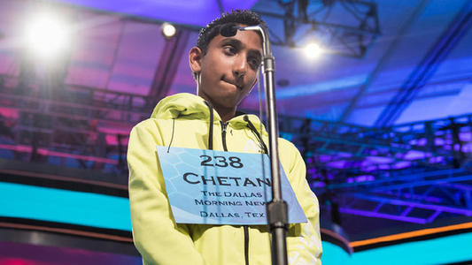
quality
1. Pride goes before a fall.
2.One swallow does not make a summer.
4.It is an ill wind that blows nobody good.
5.A rolling stone gathers no moss
6.Good heart will get good rewards.

Slide 27
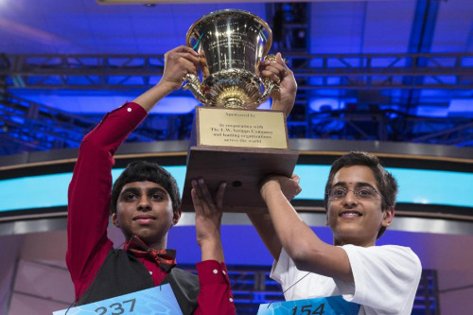
The following Monday at school, Theo found Alexa in the lunchroom. “Do you mind if I sit down?” he asked in a weak voice. Alexa slid her books aside to make room. Theo gathered up his courage and apologized for his rudeness after he won the school bee. “It's ok. How was the county bee?” Alexa asked. “What a disaster.” Theo shrugged his shoulders. “Would you like to be my study partner for next time?” “Why not?” Alexa's beam of smile seemed to wipe off Theo's frustration and he was expecting to be the next Alpha-best.
本段陈述的是Theo意识到问题后积极主动向对方道歉，寻求谅解。而Alexa 不顾前嫌，宽容的原谅了Theo。Theo 还在此事件中学会要与人合作共赢。这才是本文真正想要传达的思维品质：
modest、generous、considerate、a sense of cooperation...

Slide 28

quality
1. Not generous heart, not real hero.
没有宽宏大量的心肠，便算不上真正的英雄。
2. Generous spirit is the greatest of all things.
宽宏精神是一切事物中最伟大的。
3. One tree can't make a forest.
独木不成林。
4. When everybody adds fuel, the flames rise high.
众人拾柴火焰高。

Slide 29
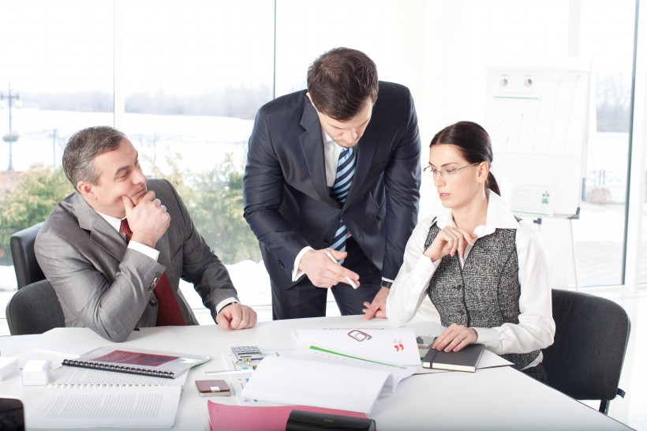
Modest helps one go forward, whereas conceit makes one lag behind.

Slide 30


