Slide 1
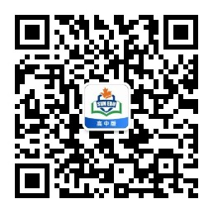
感恩遇见，相互成就，本课件资料仅供您个人参考、教学使用，严禁自行在网络传播，违者依知识产权法追究法律责任。
更多教学资源请关注
公众号：溯恩高中英语
知识产权声明

Slide 2
Apply for a summer job
Unit 5 Using Language
RESUME

Slide 3
Lead in
search for recruitment information
list proper job information
Have you ever applied for a summer job?
What are the steps for applying for a summer job?
write a cover letter
write a CV
send them

Slide 4
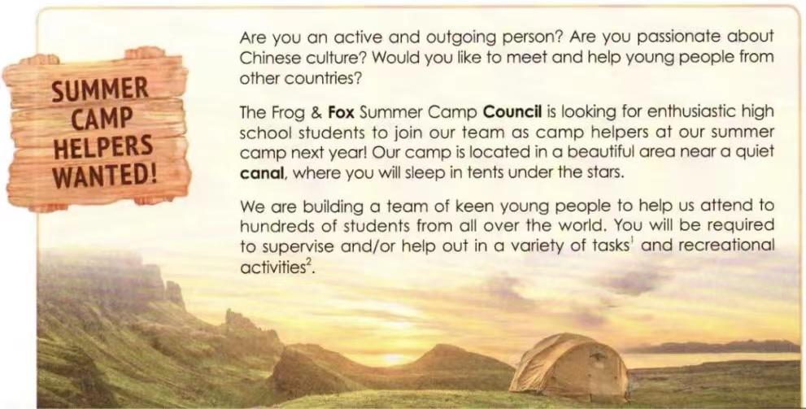
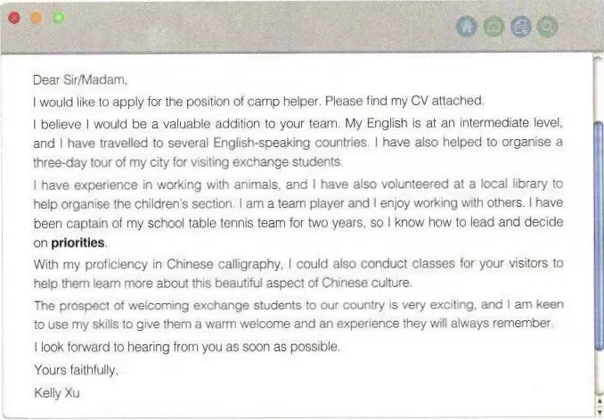
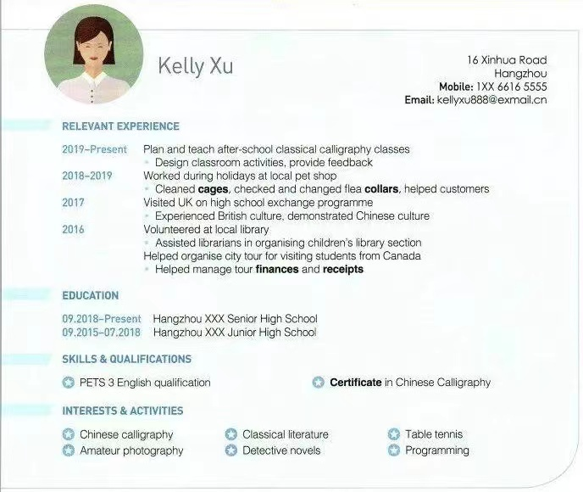
Fast Reading
What are these three different texts about?
What type of texts are they?
a cover letter
an application letter
a job advertisement
a CV（简历）

Slide 5
Detailed Reading
What kind of job is offered in the advertisement?
What are the requirements mentioned in the job advertisement?
active and outgoing, enthusiastic, keen,
friendly, welcoming
Personality and attitude
Language skills
a good level of English
good organisational and teamwork skills
a passion for Chinese and international culture experience with animals
good handwriting
Experience and skills

Slide 6
Detailed Reading
What elements are included in Kelly Xu’s CV?
Do you think Kelly Xu is a good match for the job ? Why?
CV 简历
name, address, phone number, email address
Experience with animals
Personality and attitude
Language skills
Experience and skills
A passion for Chinese and international culture
Good organisational and teamwork skills
good handwriting
A good level of English

Slide 7
Detailed Reading
Do you think Kelly Xu is a good match for the job ? Why?
cover letter 求职信
A good level of English
Experience with animals
Language skills
Experience and skills
Personality and attitude
Good organisational and teamwork skills
Good handwriting &A passion for Chinese and international culture
Personality and attitude

Slide 8
Reading for writing
the structure
the language
Dear Sir/Madam,
I would like to apply for the position of camp helper. Please find my CV attached.
I believe I would be a valuable addition to your team. My English is at an intermediate level, and I have travelleld to several English-speaking countries. I have also helped to organise a three-day tour of my city for visiting exchange students.
I have experienced in working with animals, and I have also volunteered at a local library to help organise the children's section. I am a team player and I enjoy working with others. I have been captain of my school table tennis team for two years, so I know how to lead and decide on priorities.
With my proficiency in Chinese calligraphy, I could also conduct classes for your visitors to help them learn more about this beautiful aspect of Chinese culture.
The prospect of welcoming exchange students to our country is very exciting, and I am keen to use my skills to give them a warm welcome and an experience they will always remember.
I look forward to hearing from you as soon as possible.
Yours faithfully
Kelly Xu
Greeting
Body
Revise the letter to make it more inviting and persuasive
Signature

Slide 9
Revising and Polishing
Dear Sir/Madam,
Knowing you are recruiting summer camp helpers, I am writing to apply for it, my CV attached.
I am confident that I meet your requirements in every way. Equipped with an intermediate level of English, I have travelled to several English-speaking countries and got involved in organising a tour for visiting exchange students.
Working during holidays at a local pet shop and volunteering at a local library to help organise the children's section have added to my experience. Also of primary note is that I have been captain of my school table tennis team for two years, which has enabled me to be a team player as well as a good leader.
Additionally, with my proficiency in Chinese calligraphy, I am also capable of conducting classes to help your visitors learn more about the charm of Chinese culture.
The prospect of welcoming exchange students must be very exciting, and I am keen to give them a warm welcome and an unforgettable experience.
I firmly believe that I am quite qualified for the position. Looking forward to your early reply.
Yours faithfully
Kelly Xu

Slide 10
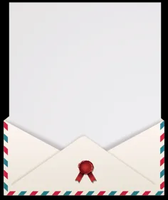
Assignment
（2019 全国I卷）
假定你是李华，暑假在伦敦学习，得知当地美术馆要举办中国画展览。请写一封信申请当志愿者。内容包括：
1. 写信目的；
2. 个人优势；
3. 能做的事情
注意：1.词数100左右；
2.可适当增加细节，以使行文连贯。
Content
Beginning
Application Body
(cover)
letter
Ending
skill
experience
personality and attitude
speciality
what the job means to you

Slide 11
Sample
（2019 全国I卷）
Dear Sir/Madam,
I'm Li Hua, (an outgoing boy,) taking a summer course in London now. Knowing a Chinese Painting Exhibition will be held in the local art museum, I am writing to apply to be a volunteer.
I firmly believe I am competent for this job. First of all, (having lived in China for sixteen years and having learnt English since childhood,) I am fluent in both Chinese and English, which is of great benefit to introduce Chinese paintings. My good knowledge of Chinese painting culture will surely help foreigners and locals to get deep insight into it. Additionally, my perfect introduction of Chinese culture is sure to promote the cultural exchange (and strengthen the friendship) between China and England.
I would appreciate it if you could take my application into consideration.
Yours,
Li Hua

Slide 12
Thank you

