Slide 1
感恩遇见，相互成就，本课件资料仅供您个人参考、教学使用，严禁自行在网络传播，违者依知识产权法追究法律责任。
更多教学资源请关注
公众号：溯恩英语
知识产权声明

Slide 2
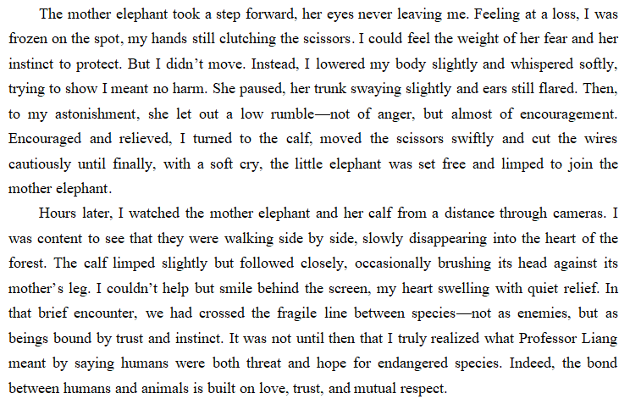
衔接句1
衔接句2
衔接句3

Slide 3
借用 “3C”策略
写好读后续写3个衔接句
Use “3C” Strategies to Write Three Excellent Linking Sentences in Continuation Writing
云南民大附中 方琳

Slide 4
Learning Objectives
In this class, we are expected to
1. observe excellent linking sentences to summarize “3C” strategies;
2. apply “3C” strategies to write linking sentences;
3. comment on partners’ linking sentences with a checklist.

Slide 5
Step 1 Observe the following linking sentences to summarize the common points.
2025年3月昆明市统测
The mother elephant took a step forward, her eyes never leaving me. Feeling at a loss, I was frozen on the spot, with my hands still clutching the scissors. ********** Encouraged and relieved, I turned to the calf, moved the scissors swiftly and cut the wires cautiously until finally, with a soft cry, the calf was set free and limped to join the mother elephant.
Hours later, I watched the mother elephant and her calf from a distance through cameras. I saw them walk side by side and slowly disappear into the heart of the forest, with a sense of satisfaction and wonder welling up in my heart. **********

Slide 6
(1) What do the circled words have in common?
The mother elephant took a step forward, her eyes never leaving me. Feeling at a loss, I was frozen on the spot, with my hands still clutching the scissors. ********** Encouraged and relieved, I turned to the calf, moved the scissors swiftly and cut the wires cautiously until finally, with a soft cry, the calf was set free and limped to join the mother elephant.
Hours later, I watched the mother elephant and her calf from a distance through cameras. I saw them walk side by side and slowly disappear into the heart of the forest, with a sense of satisfaction and wonder welling up in my heart. **********

Slide 7
(2) What do the underlined parts have in common?
The mother elephant took a step forward, her eyes never leaving me. Feeling at a loss, I was frozen on the spot, with my hands still clutching the scissors. ********** Encouraged and relieved, I turned to the calf, moved the scissors swiftly and cut the wires cautiously until finally, with a soft cry, the calf was set free and limped to join the mother elephant.
Hours later, I watched the mother elephant and her calf from a distance through cameras. I saw them walk side by side and slowly disappear into the heart of the forest, with a sense of satisfaction and wonder welling up in my heart. **********

Slide 8
(3) What do the parts in shadow have in common?
The mother elephant took a step forward, her eyes never leaving me. Feeling at a loss, I was frozen on the spot, with my hands still clutching the scissors. ********** Encouraged and relieved, I turned to the calf, moved the scissors swiftly and cut the wires cautiously until finally, with a soft cry, the calf was set free and limped to join the mother elephant.
Hours later, I watched the mother elephant and her calf from a distance through cameras. I saw them walk side by side and slowly disappear into the heart of the forest, with a sense of satisfaction and wonder welling up in my heart. **********

Slide 9
(4) What sentence structures can be used?
The mother elephant took a step forward, her eyes never leaving me. Feeling at a loss, I was frozen on the spot, with my hands still clutching the scissors. ********** Encouraged and relieved, I turned to the calf, moved the scissors swiftly and cut the wires cautiously until finally, with a soft cry, the calf was set free and limped to join the mother elephant.
Hours later, I watched the mother elephant and her calf from a distance through cameras. I saw them walk side by side and slowly disappear into the heart of the forest, with a sense of satisfaction and wonder welling up in my heart. **********

Slide 10
(5) How to determine what movements and emotions to describe?
(2023年2月四省联考读后续写) We nurtured a lost baby red squirrel back to health and released it into the wild.
One day in the trees, Squirt met up with a family of gray squirrels. Hesitant but curious, Squirt took one step forward tentatively, put his nose to them and wagged his tiny red tail back and forth.**********Ever since then, Squirt had been merrily hanging out with his fellows regularly, but still came back to our house every night, which made us filled with a mixed sense of pride and sorrow.
One night, Squirt didn’t come back to our house and it rained hard. Feeling anxious and worried, we swiftly put on our raincoats, took out flashlights, and started to seek for him outdoors.**********

Slide 11
(5) How to determine what movements and emotions to describe?
One day in the trees, Squirt met up with a family of gray squirrels. Hesitant but curious, Squirt took one step forward tentatively, put his nose to them and wagged his tiny red tail back and forth.**********Ever since then, Squirt had been merrily hanging out with his fellows regularly, but still came back to our house every night, which made us filled with a mixed sense of pride and sorrow.
One night, Squirt didn’t come back to our house and it rained hard. Feeling anxious and worried, we swiftly put on our raincoats, took out flashlights, and started to seek for him outdoors.**********

Slide 12
Continue the story with key characters.
“3C”
Combine movements and emotions.
Feeling..., sb did sth, with + n. + doing / done
Adj+ adj, sb did A, B and C.
Sb did sth, with a sense of + n. + welling up in one’s heart.
Sb did sth, which made sb filled with a sense of...
Conclude the action-response chain.

Slide 13
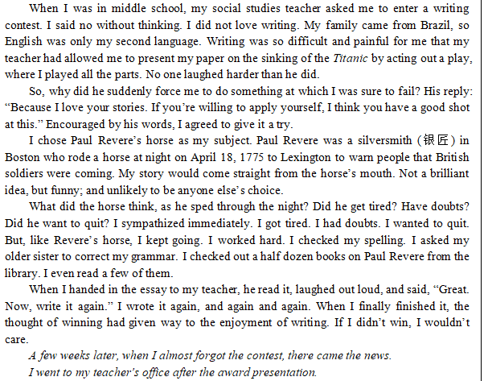
Step 2 Apply “3C” strategies to write the linking sentences. 2023年全国新高考(I、II卷)读后续写
I was good / not good at writing but my teacher asked me to enter a _________ contest.
writing
I was / was not persuaded by my teacher to give it a try.
efforts
I made a lot of ______ to prepare for it.
winning
The thought of ________ gave way to the __________of writing.
enjoyment

Slide 14
A few weeks later, when I almost forgot the contest, there came the news. ①_____________________________________________________________________________________________________________________________ ********************②__________________________________________________________________________________________________________
I went to the teacher’s office after the award presentation. ③__________
________________________________________________________________________________________________________________________________

Slide 15
Step 3 Comment on partners’ linking sentences with the checklist.
Questions | Yes/No
Does he or she continue the story with key characters?
Does he or she combine movements and emotions?
Does he or she use wonderful sentence patterns?
Is the action-response chain he or she concluded reasonable?

Slide 16
A Possible Version
A few weeks later, when I almost forgot the contest, there came the news. ① I won the first place in the competition and I was invited to deliver a speech in the award presentation, which made me filled with a sense of disbelief and excitement. ********************② My teacher’s words of encouragment echoed in my mind, with a strong sense of eagerness to share the good news with him welling up in my heart.
I went to the teacher’s office after the award presentation. ③ Excited and expectant, I knocked on the door gently, went straight to my teacher’s desk, and found him immersed in work.

Slide 17
Step 5 After-class Assignment
1. Compulsory Task (必做)
Read a new story(2021新课标I&II卷) and write the three linking sentences.
2. Optional Task (选做)
Think of more strategies to help us make linking sentences better.
As the twins looked around them in disappointment, their father appeared. ①___________________________________________________________________________________________________________________********************②________________________________________________________________________________________________________
The twins carried the breakfast upstairs and woke their mother up. ③__________________________________________________________
_______________________________________________________________

