Slide 1
感恩遇见，相互成就，本课件资料仅供您个人参考、教学使用，严禁自行在网络传播，违者依知识产权法追究法律责任。
更多教学资源请关注
公众号：溯恩高中英语
知识产权声明

Slide 2
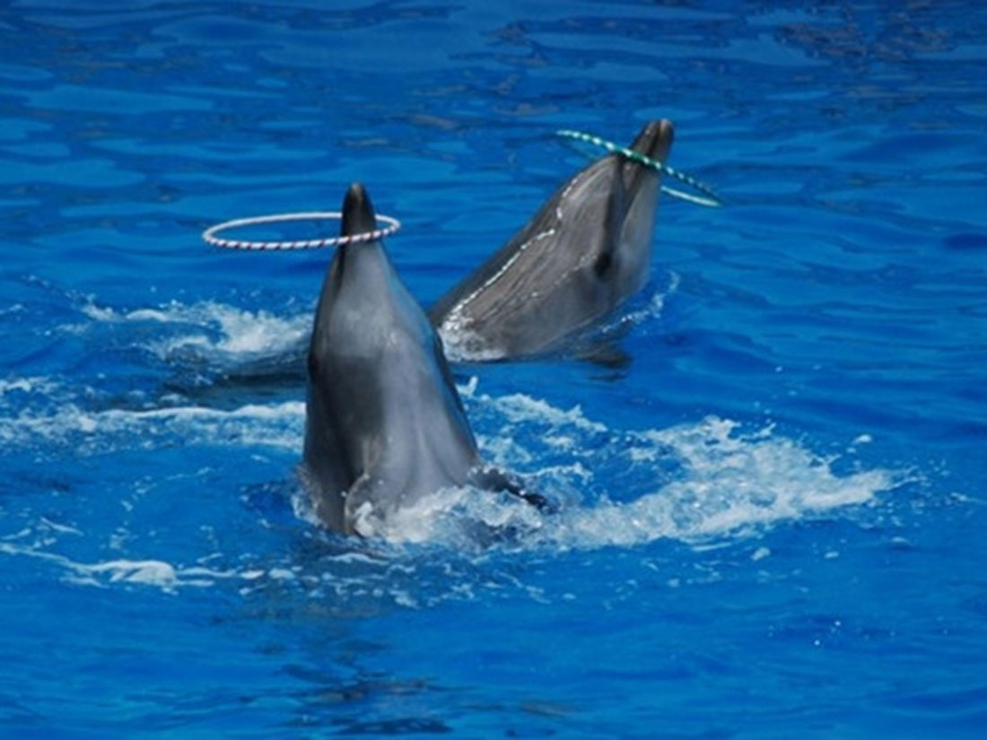
淘气海豚Maya
浙江金华市汤溪高级中学 郑素红

Slide 3
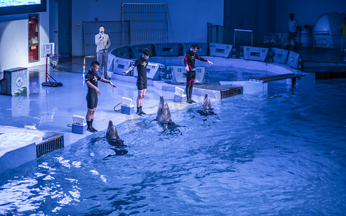
Last summer, Hilda worked as a volunteer with dolphin trainers at a sea life park. Her job was to make sure the tanks were free of any items so that the trainers could train the dolphins to fetch specific items. However, one day after cleaning, one of the dolphins, Maya, presented Hilda with a candy wrapper from the tank. When Katherine, the trainer, saw this, she blamed Hilda for her carelessness. Upset but not discouraged by this event, Hilda decided to do some spying on Maya.
Q1: What did Hilda do at the sea life park? And why?
Q2: What was Katherine? Why did she blame Hilda?
Q3: How did Hilda feel?

Slide 4
Last summer, Hilda worked as a volunteer with dolphin trainers at a sea life park. Her job was to make sure the tanks were free of any items so that the trainers could train the dolphins to fetch specific items. However, one day after cleaning, one of the dolphins, Maya, presented Hilda with a candy wrapper from the tank. When Katherine, the trainer, saw this, she blamed Hilda for her carelessness. Upset but not discouraged by this event, Hilda decided to do some spying on Maya.
Q1: What did Hilda do at the sea life park? And why?
Q2: What was Katherine? Why did she blame Hilda?
Q3: How did Hilda feel?

Slide 5
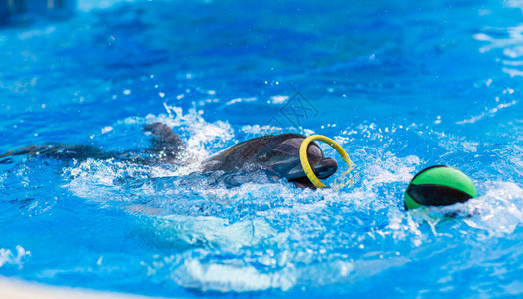
The next morning, Hilda arrived at the park early. She put on her scuba gear（水下呼吸器）and jumped into the tank for her usual, underwater sweep. Finding nothing in the tank, she climbed out of the water just in time to see Katherine jumping in on the other side. After what happened yesterday, Hilda knew what she was doing. She watched as Katherine performed her underwater search, but Hilda wasn't surprised when she surfaced empty-handed.
Q1: Did Hilda find something in the tank?
Q2: Did Katherine find something ?
Q3: How did Hilda feel?

Slide 6
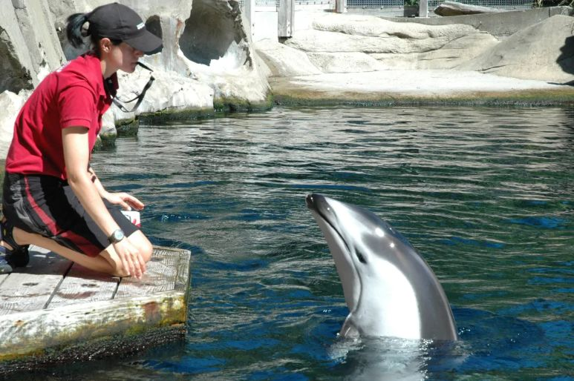
During the tank sweeps, Maya had been swimming playfully, but now the dolphin stopped suddenly and swam to the back part of the tank where the filter （过滤） box was located. She stuck her nose down behind the box and then swam away. What was Maya doing back there? Hilda wondered. She jumped back into the water and swam over to take a look behind the box, and her question was answered. Hilda then swam across the tank following Maya's path and emerged from the water to find Katherine removing her scuba gear. As Katherine turned around, her mouth dropped open. There was Maya at the edge of the tank with a comb（梳子） in her mouth waiting for her treat.
Q1: Why did Maya stop swimming ?
Q2: Why did Katherine’s mouth drop open?
Q3: What did Maya expect from Katherine?

Slide 7
“Maya! Where did you get that?” demanded Katherine, taking the comb and throwing her a fish. “I know where she got it,” declared Hilda climbing out of the tank with a handful of items still wet from their watery, resting place. “What's all this?” Katherine asked, obviously confused.
Q1: What did Hilda get when climbing out of the tank?
Q2: What did Maya get with the comb?

Slide 8
原文伏笔 | 续写回扣
When Katherine, the trainer, saw this, she blamed Hilda for her carelessness. Upset but not discouraged by this event, Hilda decided to do some spying on Maya. | Maya was responsible for the candy wrapper.
After what happened yesterday, Hilda knew what she was doing. She watched as Katherine performed her underwater search, but Hilda wasn't surprised when she surfaced empty-handed. | Hilda and Katherine would take advantage of Maya’s unique talent to invent a new dolphin show.
As Katherine turned around, her mouth dropped open. There was Maya at the edge of the tank with a comb（梳子） in her mouth waiting for her treat. | Maya stored items that she could find in the tank in order to get her extra treats! Maya was smarter than other dolphins!

Slide 9
本文故事情节梳理：
Katherine 是海豚训练师；Hilda 是志愿者，帮忙清洁海豚水池。有一天因 Maya 的一张糖纸而受到训练师Katherine 的责备；
Maya 是水池中接受训练的海豚之一，但她很聪明，会藏东西来获取额外的奖励；
地点是sea life park ( 暗示意义比较足的一个地点）
时间没有线索 （续写具有开放性和创造性，时间线可以延长，方便续写）

Slide 10
续写两段的构思安排：
Para1“This is Maya's secret,” Hilda said with a big smile.
第一段： 结合原文尾段Hilda 已经发现了Maya 的秘密行为，接下来怎么写？继续写Maya 的取宝行为，以拟人的方式进行。尾句可以让Hilda 来提醒Katherine Maya 这种行为极有可能是趁其他海豚训练时发生的。
Para2:Now Katherine realized what had been going on.
Hilda 消除误会，接下来做什么？比较考验学生的思维能力和构思情节能力。

Slide 11
Para1:“This is Maya's secret,” Hilda said with a big smile.
分析：面对误会，Hilda 没有辩解，而是仔细观察Maya这只海豚，发现Maya 聪明机智，善于收藏水里的宝贝并换取Katherine 的奖励。
Para2:Now Katherine realized what had been going on.
分析： Katherine 明白之前糖纸事件的原委，会向Hilda道歉，并对Maya 进行精心训练，使之成为优秀的表演海豚。
思考：海洋生物馆中海豚训练师为啥训练海豚？
该问题可以为第二段续写提供很好的接续内容。
（为游客进行表演，展示海豚们的聪明才智。）

Slide 12
结合原文本最后一段定首段第一句 (句群）
Para1“This is Maya's secret,” Hilda said with a big smile.
手法1. （首句可以以Maya为叙事对象：)
Staring at Katherine, Maya seemed quite proud of herself for her ingenious trick.

Slide 13
结合原文本最后一段定首段第一句
Para1“This is Maya's secret,” Hilda said with a big smile.
手法2. （首句可以以Hilda为叙事对象：) Looking into Maya’s innocent eyes, Hilda was overwhelmed by her exceptional intelligence.

Slide 14
结合第二段首句定首段尾句
Para1:“This is Maya's secret,” Hilda said with a big smile.
Think： What had been going on? 结合海豚Maya 藏东西在滤水箱后，考生需要追问：这些东西哪里来的？会不会训练时 海豚藏起来的？had been going on 是过去完成进行时，说明这个事情进行了一段时间了。
Para2:Now Katherine realized what had been going on.

Slide 15
结合第二段首句定首段尾句
Para1:“This is Maya's secret,” Hilda said with a big smile.
Looking back on all those training sessions, Hilda reminded Katherine that Maya was likely to collect items and stored them when other dolphins were training.
Para2:Now Katherine realized what had been going on.

Slide 16
结合第二段首句定第二段第一句
Para2:Now Katherine realized what had been going on.
手法1：（以Katherine 角度主位叙述推进法+第一段对 Hilda 的误解，推断要向 Hilda 真诚致歉）
As Katherine took over the wet items from Hilda, Katherine sincerely apologized to Hilda for her misunderstanding and carelessness.
手法2. （Katherine 道歉后，对Maya说 你可真淘气 +感叹句）
Having apologized sincerely to Hilda, Katherine exclaimed, “ Maya, how naughty you are!”

Slide 17
定第二 段尾句
Para2:Now Katherine realized what had been going on.
鉴于原文的伏笔内容：可以考虑海豚之所以藏东西是因为担心失去属于她的点心-鱼 （这个结尾和原文本接近）
Every time Hilda took an item off the water while doing sweeping in the tank, Maya lost a treat. So Maya came up with a great way to get her treats--- grab and hide the items that she could find.
由于续写是开放性的一种写作模式，考生可以结合一下水族馆里训练师训练海豚是为啥？最终是给水族馆的观众进行表演，结合Maya 会藏东西， 就自然会找东西，可以设计一个表演节目，应该可以一炮成名。

Slide 18
定第二 段尾句
Para2:Now Katherine realized what had been going on.
结尾1： It didn’t take a long time before Maya turned into a star with her marvelous performance!
结尾2： Maya’s underwater secret not only highlighted her intelligence but also earned a great reputation for herself with her remarkable performance!
结尾3： Hearing the story of Maya, the most talented dolphin, streams of visitors flocked into the sea life park/aquarium to witness Maya’s marvelous trick!

Slide 19
Para1:“This is Maya's secret,” Hilda said with a big smile.
1. (以Maya 的叙事角度推进+拟人手法）Staring at Katherine, Maya seemed quite proud of herself for her ingenious trick.
2.（仍然以Maya 主位推进叙事+Katherine 奖励给她的美味） After feasting on the delicious treat, Maya dived into the water , swimming back to the filter box in the hope of fetching another treasure to get a second treat.
3. （仍然以Maya 主位推进叙事，结合尾段Hilda 手上拿了Maya 藏起来的东西，应该推测可能滤水箱后没有她藏起来的宝贝了。） What she never expected was that no items remained behind the box.
4. （仍然以Maya 主位推进叙事，会继续之前的行为去取收藏的物品，无果） Maya stuck her nose down again, trying to grab something but without luck.

Slide 20
5. （Maya 主位叙述推进：很困惑，游回到水池边）Extremely confused, Maya swam to the edge of the tank.
6. （此刻，Maya 注意到Hilda 手中的东西+拟人手法） Maya fixed her eyes on the wet stuff in Hilda’s hands, looking annoyed as if questioning Hilda why she stole her treasures without permission!
7. （结合第二段首句 what had been going on , 由Hilda 来提醒Katherine一直来发生的事情。）Smiling at the poor Maya, Hilda reminded Katherine that Maya was likely to collect the items and stored them secretly during her practice/ training.

Slide 21
Para2:Now Katherine realized what had been going on.
1：（以Katherine 角度主位叙述推进法+第一段对 Hilda 的误解，推断要向 Hilda 真诚致歉) Having apologized sincerely to Hilda for her misunderstanding and carelessness, Katherine exclaimed, “Maya, how naughty you are!”
2. ( Hilda利用Maya 的聪明才智，提议设计水族馆海豚表演的新项目）
Hilda’s eyes sparkling with thrill mingled delight, she proposed to Katherine that they could design a unique dolphin show to attract visitors--- Seeking Hidden Treasures Underwater.
3. （Katherine 作为训练师，马上践行）Hardly had Katherine taken her advice when she stored/ placed/ put/ hid all the original items behind the filter box.

Slide 22
4. (Katherine 如何训练）The next moment, showing a comb to Maya , Katherine issued a request- Maya，please fetch a comb！
5. （训练策略奏效）Miraculously, the strategy worked !
6. （Maya 浮出水面带着梳子）Katherine and Hilda were both over the moon when Maya surfaced with a comb in her mouth.
7. （不久Maya 就凭借精湛的表演成为明星海豚）It didn’t take a long time before Maya turned into a star with her marvelous performance!

Slide 23
Para1:“This is Maya's secret,” Hilda said with a big smile. Staring at Katherine, Maya seemed quite proud of herself for her ingenious trick. After feasting on the delicious treat, Maya dived into the water , swimming back to the filter box in the hope of fetching another treasure to get a second treat. What she never expected was that no items remained behind the box. Maya stuck her nose down again, trying to grab something but without luck. Extremely confused, Maya swam to the edge of the tank. Maya fixed her eyes on the wet stuff in Hilda’s hands, looking annoyed, as if questioning Hilda why she stole her treasures without permission! Smiling at the poor Maya, Hilda reminded Katherine that Maya was likely to collect the items and stored them during previous dolphin training sessions practice.

Slide 24
Para2:Now Katherine realized what had been going on. As Katherine took over the wet items from Hilda, Katherine sincerely apologized to Hilda for her misunderstanding and carelessness. Hilda’s eyes sparkling with thrill mingled delight, she proposed to Katherine that they could design a unique dolphin show to attract visitors--- Seeking Hidden Treasures Underwater. Hardly had Katherine taken her advice when she stored/ placed/ put/ hid all the original items behind the filter box. The next moment, showing a comb to Maya , Katherine issued a request,” Maya, please fetch a comb!”. Miraculously, the strategy worked ! Katherine and Hilda were both over the moon when Maya surfaced with a comb in her mouth. It didn’t take a long time before Maya turned into a star in the sea life park with her marvelous performance!

Slide 25
Surprise is everywhere.

