Slide 1
感恩遇见，相互成就，本课件资料仅供您个人参考、教学使用，严禁自行在网络传播，违者依知识产权法追究法律责任。
更多教学资源请关注
公众号：溯恩英语
知识产权声明

Slide 2
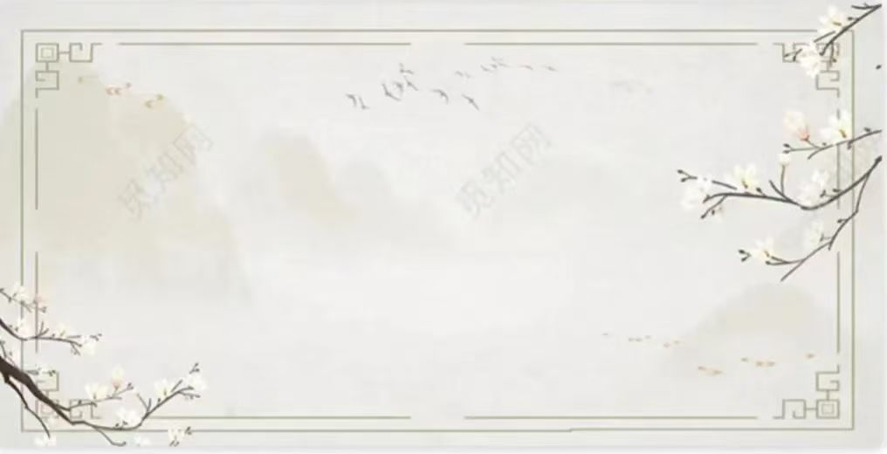
情境化教学问题链案例探析
Contribute to Our Community
浙江强基联盟2024年8月高三联考应用文
陕西省咸阳市礼泉县教研室 高小聪

Slide 3
Contents:
Ⅰ. 新时代党的教育方针
Ⅱ.《新课标》高考命题特征
Ⅲ. 情境化问题链审思
Ⅳ. 案例链接新高考、新教材
Ⅴ. 师生作品赏析

Slide 4
Ⅰ. 新时代党的教育方针
Ⅱ. 《新课标》的命题特征
教育必须为社会主义现代化建设服务、为人民服务，必须与生产劳动和社会实践相结合，培养德智体美劳全面发展的社会主义建设者和接班人。
--《中华人民共和国教育法》第五条(2021年4月29日，第十三届全国人大常委会第二十八次会议修改)
“核心价值金线”贯穿高考命题和评价的始终，“能力素养银线”成为高考命题和考查的重心，情境作为考查载体，是“金线”和“银线”的“串联线”。高考评价体系指导下的高考命题，呈现出“无价值不入题; 无思维不命题; 无情境不成题”的典型特征。使高考由“解答试题”转向“解决问题。
根本遵循

Slide 5
Ⅲ. 情境化问题链审思
所谓问题链，就是教师以教学目标为导向，以文本内容为基础，基于学生现有的知识与经验，将课本知识转化为具有逻辑性和层次性的一系列问题。其主要特征为各个层次的问题环环相扣，层层递进，彼此相互连接，无法割裂。

Slide 6
Ⅳ. 案例链接新高考、新教材（情境化问题链审思）
《教育部关于做好2024年普通高校招生工作的通知》
第9条是有关高考考试内容改革“深化考试内容改革。落实立德树人根本任务，将习近平新时代中国特色社会主义思想考查融入试题构建德智体美劳全面考查的内容体系。注重考查学生的必备知识、关键能力和学科素养，引导培养探索性、创新性思维品质。优化试卷结构和试题形式增强试题的应用性、探究性、开放性。......”
文体
英文报投稿
时态
一般现在时
人称
第一人称和第三人称
写作对象
同学们
浙江强基联盟2024年8月高三联考应用文
请你写一篇短文向校英文报“My Community and Me”栏目投稿，向同学们推荐一项适合在社区开展的志愿活动，内容包括：
○介绍这项活动；
○说明推荐理由。
注意:1.写作词数应为80左右:
2.请按如下格式在答题卡的相应位置作答。
Contribute to Our Community
标题：Contribute to Our Community
...
适合社区开展的志愿活动，
推荐活动(what) , 介绍活动(How) ，说明理由(why)
关键词
号召学生参与社区活动，增强主人翁意识、社会责任感，培养其团队精神......（德智体美劳）
写作目的
2024届广东六校第四次联考应用文—志愿者经历投稿；2019年全国Ⅰ卷应用文(申请做志愿者）；2019年全国II卷阅读B （做志愿者的意义）
链接高考
选必4 U4 Sharing
Reading& reading: Volunteering the bush
链接教材

Slide 7
导入性问题链：（Discuss in groups）
1. What’s a community? Have you join in any community voluntary activities?
2. What kinds of voluntary activities are fit to be carried out in the community?
Ⅳ. 案例链接新高考、新教材
（情境化问题链审思）
浙江强基联盟2024年8月高三联考应用文
请你写一篇短文向校英文报“My Community and Me”栏目投稿，向同学们推荐一项适合在社区开展的志愿活动，内容包括：
○介绍这项活动；
○说明推荐理由。
注意:1.写作词数应为80左右:
2.请按如下格式在答题卡的相应位置作答。
标题：Contribute to Our Community
...
探究性问题链&递进式问题连：
3. How is the voluntary activity/project carried out in the community? (its theme, volunteer service recipient, volunteer assignments ...) (Brief-introduction）
5. Why do you recommend the activity? (meanings)
总结式问题链:
6. What difference will the community voluntary activities make to us?

Slide 8
A community is a place where people live in homes that are located near one another.
Contribute to Our Community
What， How & Why
Para1. 推荐一项志愿者活动
Para2. 介绍活动及说明推荐理由
Para3. 呼吁积极参与
1. （准备工作）Equipped/ Armed with...(工具), and a determined mind/ spirit, we get down to doing...
1.The rose’s in her hand, the flavor in mine. The voluntary activities not only help others, but develop our confidence and responsibility.
1.Community Sports Meeting;
2.Community Film Night；
3.Community Reading Party；
4.Community Music Concert；
5.Community environmental Movement；
6.Waste Drop-off Day；
7. Community Planting Event；
8. Clean Your Plate Campaign/
Empty Plate Campaign;
...
2. （活动介绍）○The campaign involves varieties of activities, including ..., ..., and ...
○The activity features many a performances, such as...
○We participate in/ engage in various activities, like...
2. Participating in the community voluntary activities contributes to our address pressing social issues, promoting positive change and creating a sense of community.
3. (推荐理由）○The activity highlights/ enriches/...
○ The event not only entertains but also strenthens ...
○For one thing...; for another thing...

Slide 9
Ⅴ.师生作品赏析（学生作品）
Contribute to Our Community
Nowadays, environmental issues are becoming more and more serious day by day. Therefore, 1__________(deliver) a lecture on environmental protection 2______(one) a month is necessary and significant in the community.
This activity mainly consists of producing, posting and distributing 3____________(environment) propaganda posters, giving public lectures on 4______ to build up a healthy and eco-friendly community. More 5__________(importance), we guide the residents to sort out waste, save water and 6______(make) use of waste... This activity can provide a cleaner and 7_____(tidy) place of living, studying and working as well as enhance people’s 8___________(aware) of environmental protection.
To sum up, I think 9____ meaningful to carry out this volunteer activity in the community, so let us join hands 10__________(create) a pleasant community.
Delivering
once
environmental
how
importantly
make
tidier
awareness
it
to create

Slide 10
Ⅴ.师生作品赏析（学生作品）
Contribute to Our Community
With many young people working out of their homes, the community is mainly 1_________(populate) with the elderly and children. So I suggest 2________(carry) out a voluntary caring service campaign in the community 3__________(regular).
For the purpose of helping the left-behind elderly and children, the campaign 4__________(involve) giving the children guidance in studying, having a heart-to- heart talk with them, 5________(chat) with the elderly and doing some housework. The divided groups 6_________(perform) assigned tasks carefully, 7___________(summary) their own work and do our endeavour to serve better as much as possible.
Learning to share 8_______(society) responsibility is our young people’s duty;Having great empathy with others’ living situations makes us 9_______(will) to give a helping hand and contribute love and 10________ (warm) to our community.
populated
carrying
regularly
involves
chatting
perform
summarize
social
willing
warmth

Slide 11
Ⅴ.师生作品赏析（老师作品）
Contribute to Our Community
I recommend a volunteer activity of tutoring the kids at weekends, which is suitable 1__________(launch) in the community.
2_______(give) the volunteer teachers’ specialties and kid’s needs, we can pair with them to help them with 3___________(difficulty) in life and offer academic guidances, 4_________(range) from teaching them standard writing, reciting 5________(class) works,teaching them some learning skills, providing the kids 6______ psychological counseling to carrying out parents-child campaigns.
This activity is a triple-win situation for 7__________(we), the kids and parents in the community. It not only helps children 8_______(good) their studies but also enriches our life, getting rid of 9__________(electron) products as much as possible. Furthermore, it also contributes to 10_________(relief) parents of their worries.
to launch
Given
difficulties
ranging
classic
with
ourselves
better
electronic
relieving

Slide 12
Ⅴ.师生作品赏析(老师作品）
Contribute to Our Community
Based on a survey carried out among the residents in the community, the environmental clean-up campaign regularly I recommend 1____________(favor) by the majority.
2______(do)a thorough cleaning in designated public places, we are divided into groups to perform 3______________(vary) tasks as planned. Some are picking up litter; some 4___________（collect） useless stuff and putting stuff in order; some cutting trees and flowers; some 5_______(gift) for drawing paint some lovely and fragrant pictures on the wall... 6______ great efforts, the community 7_________(take) on a clean and pleasant look.
The rose’s in her hand, the flavor in 8______(I). As a member of the community, we should take an active part in such these voluntary activities. Not only can the 9__________(act) develop a sense of community and responsibility but 10___________(strength) team spirit.
is favored
To do
varied/various
collecting
gifted
With
will take
mine
activities
strengthen

Slide 13
学而不用则废，用而不学则滞。
—— 周海中

