Slide 1

B2U3 Who Am I?
Reading

Slide 2
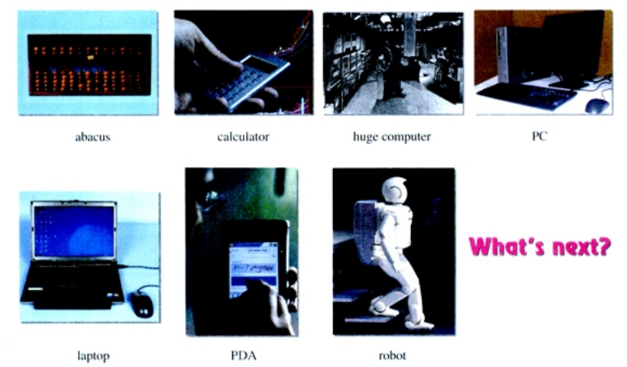
1. Can you tell the names of the following items?
2. What do they have in common?
The development of computer

Slide 3
Who Am “I”?
A computer.
1. What is the focus of each paragraph?
2. How are the focuses developed in the passage?
  Over time I have been changed quiet a lot.(Para.1)
  These changes only become possible as my memory improved.(Para.2)
  Since the 1970s many new applications have been found for me.(Para.3)
Notes:
Read the passage quickly and find out who I am?

Slide 4
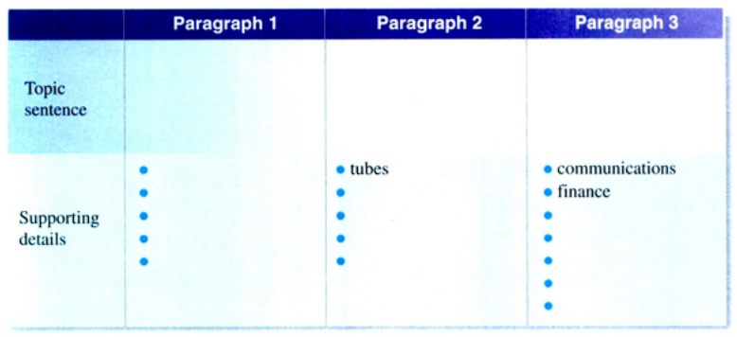
1. What are my changes?
2. How is my memory improved?
3. What are my new applications?
  These changed only become possible as my memory improved.
  Since the 1970s many new applications have been found for me.
  Over time I have been changed quiet a lot.
calculating machine
analytical machine
universal machine
PC
laptop
transistors
chips
network
Word Wide Web
trade
robots
mobile phones
medical operations
space rockets
providing a life of high quality

Slide 5
1. What is the result of each change?
2. Which is the most significant change? Why?
Over time I have been changed quite a lot. I began as a calculating machine in France in 1642. Although I was young I could simplify difficult sums. I developed very slowly and it took nearly two hundred years before I was built as an analytical machine by Charles Babbage. After I was programmed by an operator who used cards with holes, I could “think” logically and produce an answer quicker than any person. At that time it was considered a technological revolution and the start of my “artificial intelligence”. In 1936 my real father, Alan Turing, wrote a book about how I could be made to work as a “universal machine” to solve any difficult mathematical problem. From then on, I grew rapidly both in size and in brainpower. By the 1949s I had grown as large as a room, and I wondered if I would grow any larger. However, this reality also worried my designers. As time went by, I was make smaller. First as a PC (personal computer) and then as a laptop, I have been used in offices and homes since the 1970s.
Over time I have been changed quite a lot. I began as a calculating machine in France in 1642. Although I was young I could simplify difficult sums. I developed very slowly and it took nearly two hundred years before I was built as an analytical machine by Charles Babbage. After I was programmed by an operator who used cards with holes, I could “think” logically and produce an answer quicker than any person. At that time it was considered a technological revolution and the start of my “artificial intelligence”. In 1936 my real father, Alan Turing, wrote a book about how I could be made to work as a “universal machine” to solve any difficult mathematical problem. From then on, I grew rapidly both in size and in brainpower. By the 1949s I had grown as large as a room, and I wondered if I would grow any larger. However, this reality also worried my designers. As time went by, I was make smaller. First as a PC (personal computer) and then as a laptop, I have been used in offices and homes since the 1970s.

Slide 6
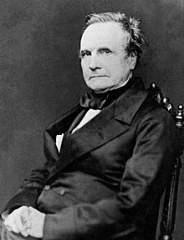
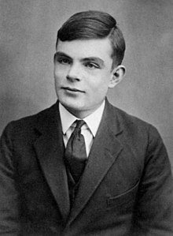
Who made great contributions to my changes? And How?
Considered by some to be a "father of the computer", ______________________ is credited with inventing the first mechanical computer.
Charles Babbage
Alan Turing
________________ is widely considered to be the father of theoretical computer science and artificial intelligence.
Later designers made computers smaller.
“I” am a c_________ of human wisdom.
creation

Slide 7
1. What is the result of my improved memory?
2. Which is the most significant improvement? Why?
These changes only became possible as my memory improved. First it was stored in tubes, then on transistors and later on very small chips. As a result I totally changed my shape. As I have grown older I have also grown smaller. Over time my memory has developed so much that, like an elephant, I never forget anything I have been told! And my memory became so large that even I couldn’t believe it! But I was always so lonely standing there by myself, until in early 1960s they gave me a family connected by a network. I was able to share my knowledge with others through the World Wide Web.
These changes only became possible as my memory improved. First it was stored in tubes, then on transistors and later on very small chips. As a result I totally changed my shape. As I have grown older I have also grown smaller. Over time my memory has developed so much that, like an elephant, I never forget anything I have been told! And my memory became so large that even I couldn’t believe it! But I was always so lonely standing there by myself, until in early 1960s they gave me a family connected by a network. I was able to share my knowledge with others through the World Wide Web.
“I” am a c_______________________________________ of human interaction.
connection(with super memory)
3.Why does the author compare my memory to an elephant?
An Elephant never forgets (The U.S.A.).
They share the same character—an amazing memory.
The camel never forgets an injury. (Greece)

Slide 8
1. What is the result of my new applications?
2. Which is the most significant application? Why?
Since the 1970s many new applications have been found for me. I have become very important in communication, finance and trade. I have also been put into robots and used to make mobile phones as well as help with medical operations. I have even been put into space rockets and sent to explore the Moon and Mars. Anyhow, my goal is to provide humans with a life of high quality. I am now truly filled with happiness that I am a devoted friend and helper of the human race!
Since the 1970s many new applications have been found for me. I have become very important in communication, finance and trade. I have also been put into robots and used to make mobile phones as well as help with medical operations. I have even been put into space rockets and sent to explore the Moon and Mars. Anyhow, my goal is to provide humans with a life of high quality. I am now truly filled with happiness that I am a devoted friend and helper of the human race!
New applications are significant as long as ___________________________________ .
they benefit the human race
“I” am a c______________ of the human race.
companion

Slide 9

Reflection
1. Who Am “I”?
“I” am a creation of human wisdom.
“I” am a connection(with super memory) of human interaction.
“I” am a companion of the human race.
2. Why does the author write in the first person view?
A. To vividly describe the development of computer by personification.
B. To make the basic knowledge of computer easy to understand.

Slide 10
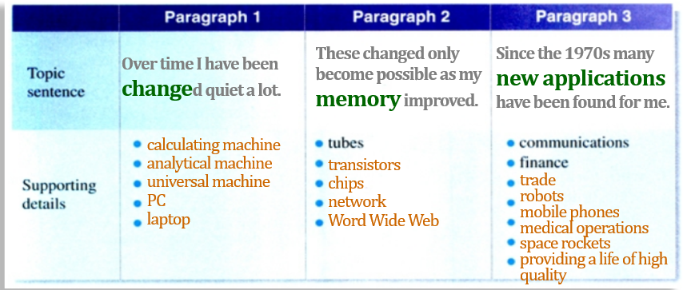
Retelling
Suppose you were a volunteer teacher in an international primary school , please introduce the computer’s development to the kids there. Please include the change, memory improvement and applications.
I am the computer. Over time I have been changed quite a lot.
When I was young…
At the time…
Over time…
As time went by…
By the time…
As a result…
From then on…
Now…
As I grow older…

Slide 11



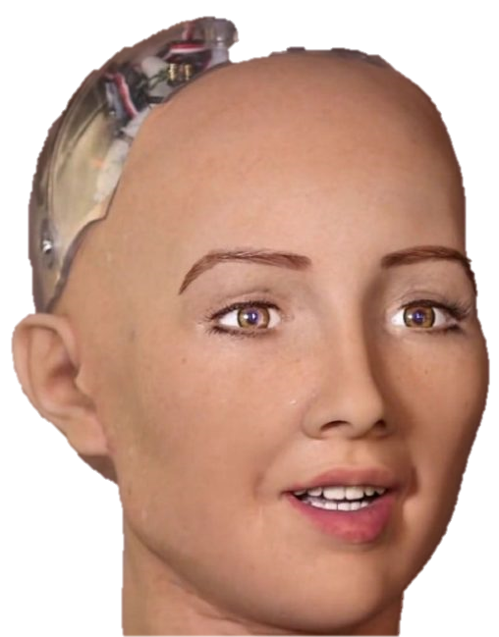
Further thinking
What other applications do you know?
a computer program that plays the board game Go
become the first computer Go program to beat a human professional Go player in October 2015
beat Lee Sedol, a 9-dan professional In March 2016
At the 2017 Future of Go Summit, its successor AlphaGo Master beat Ke Jie, the world No.1 ranked player at the time.
a social humanoid robot.
be activated on February 14, 2016 and made her first public appearance in mid-March 2016 in Austin, Texas, United States
be able to display more than 50 facial expressions
In October 2017, Sophia became the first robot to receive citizenship of any country.

Slide 12
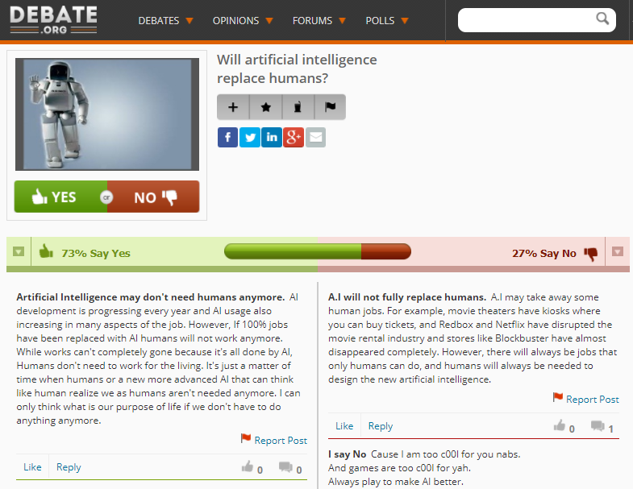
Clue 1: change—memory—application
Clue 2: creation—connection—companion
Clue 3: your thinking about the development

Slide 13
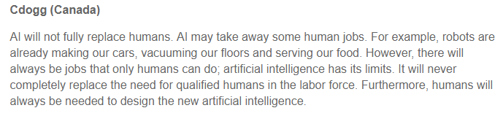
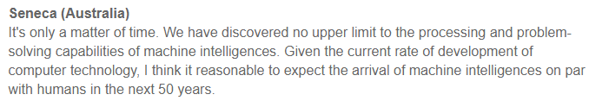

Slide 14
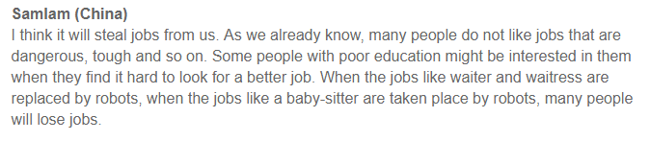
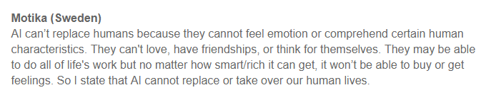
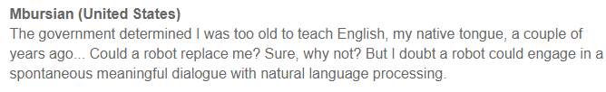

Slide 15
Assignment
Write a post on the topic Will AI replace human beings in the future? and submit it on the website Debate.org.
1. Make a claim first and then add sufficient evidence.
2. Advocate an attitude towards the development of the computer.

