Slide 1


感恩遇见，相互成就，本课件资料仅供您个人参考、教学使用，严禁自行在网络传播，违者依知识产权法追究法律责任。
更多教学资源请关注
公众号：溯恩英语
知识产权声明

Slide 2
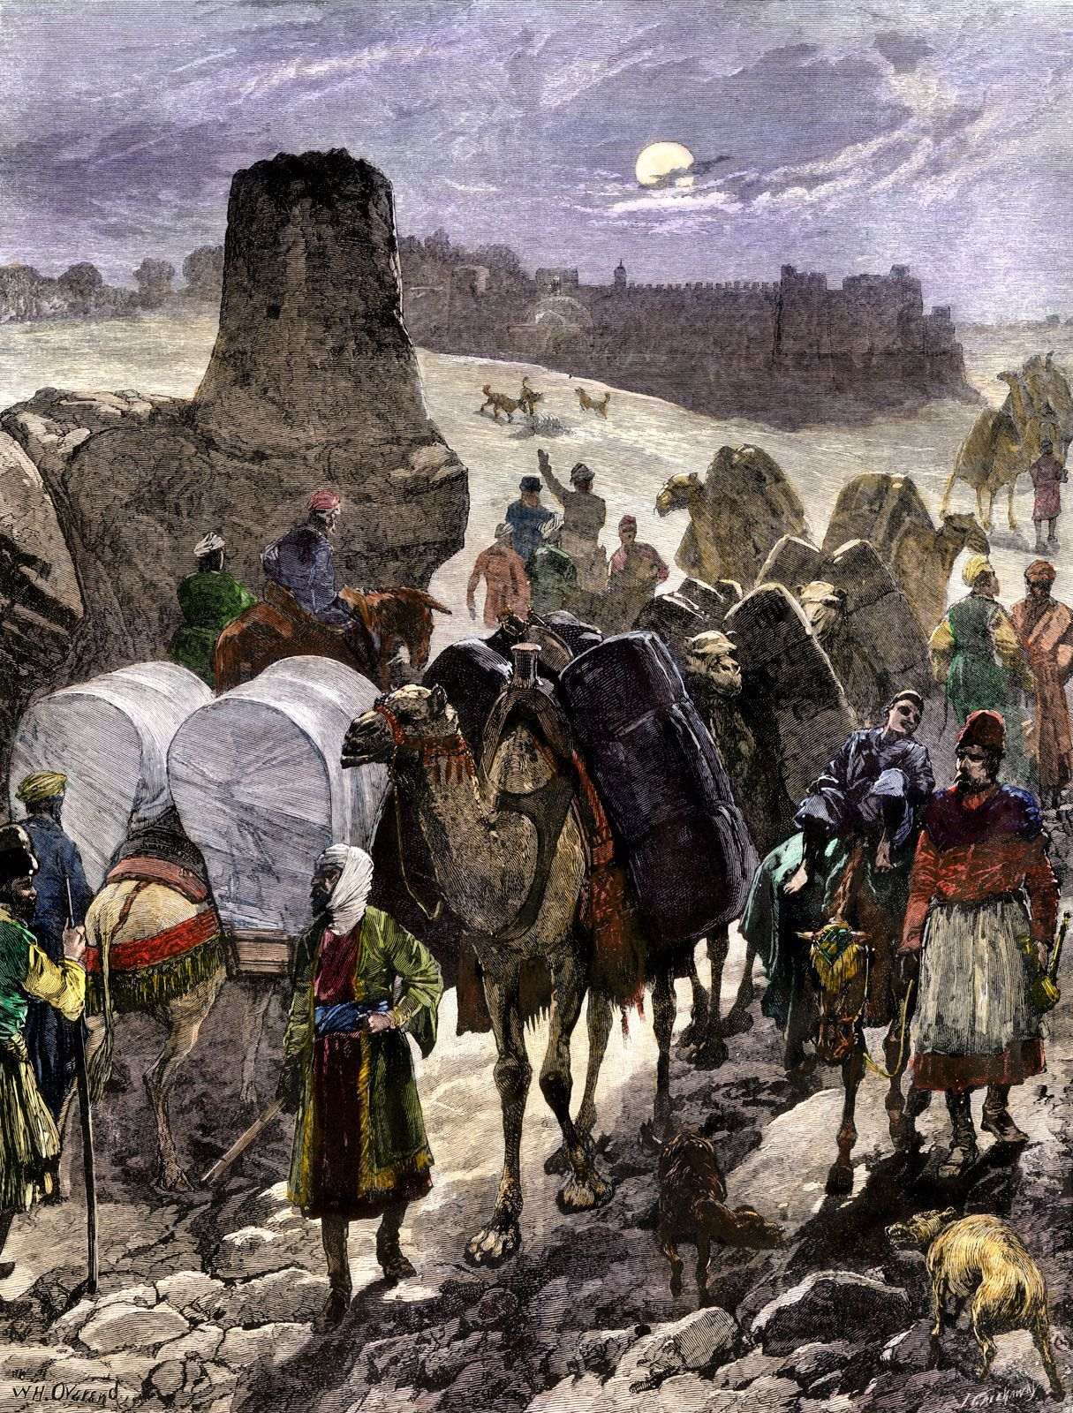

江浙高中发展共同体高三第一次适应性考试
跨越丝路的对话
浅谈应用文写作中的“读者意识”
海 亮 实 验 中 学 陈 虹

Slide 3
Step1 Lead in
What is the audience awarness?（读者意识）
Audience awareness refers to the writer's conscious effort to adapt content, style, and tone to the needs, expectations, and background of the target readers. It shifts the focus from "what I want to say" to "what my audience needs to hear."
避免“自说自话”
Importance
提高说服力和亲和力
符合英语写作习惯

Slide 4
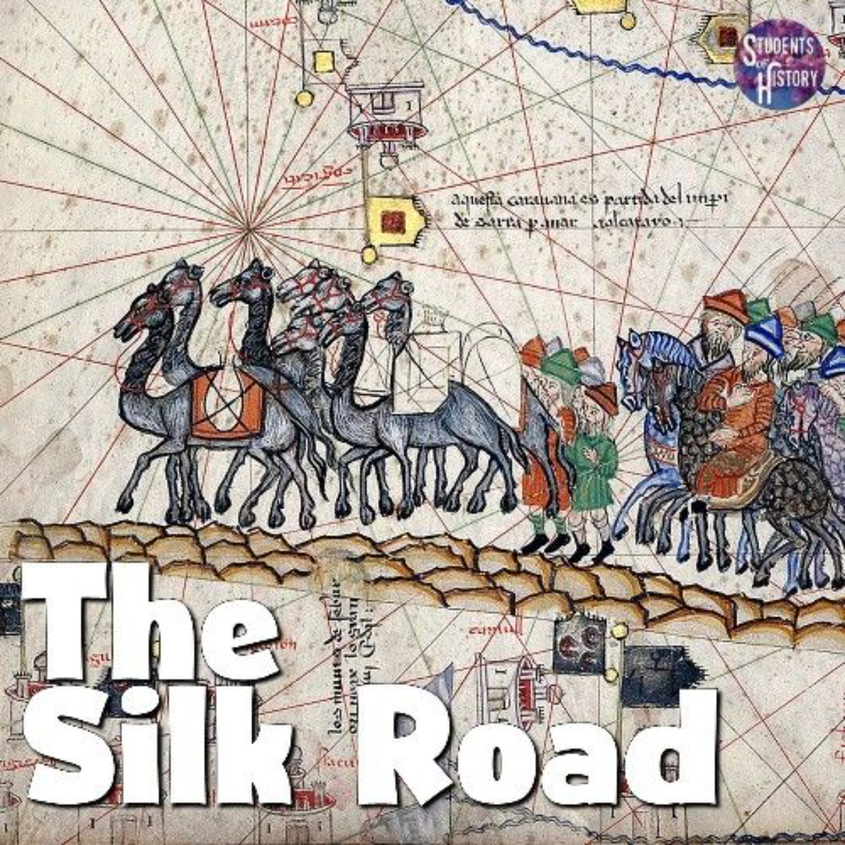
The 3 key points
Audience awarness
Cultural Context
Information Needs
Language & Tone

Slide 5

你校发起“Silk Road: Heritage in Innovation”国际青年项目，聚焦丝绸之路文化与现代科技的融合创新。作为项目负责人李华，给海外友好学校的学生写一封邮件：
（1）阐释项目核心；
（2）介绍项目活动；
（3）强调参与价值。
注意：1.写作词数应为80左右；2.请按如下格式在答题纸的相应位置作答。
Dear students,
---------------------------------------------------------------- Yours,
Li Hua
Step2 Case Analysis
审题
文体：信件
时态：一般现在时
人称：第二人称
要点：项目核心+项目活动+参与价值
主题：Silk Road: Heritage in Innovation
结构：Para 1(项目核心)
Para 2(活动+价值)
Para 3(邀请参加)
If you are an overseas student, what information do you hope this email will contain?

Slide 6
DO:Briefly explain "Silk Road"
Avoid: Assuming prior knowledge.
Cultural Context
Information Needs
Checklist: Core message (heritage + innovation), activities, value.
Language & Tone
Use "you-attitude"

Slide 7
Background
The Silk Road was an ancient network of trade routes (active from ~130 BCE to 1450 CE) connecting China to the Mediterranean. While famous for silk trade, it also exchanged goods (spices, glass, paper)、ideas (Buddhism, mathematics) and technologies (gunpowder, compass).It is the symbol of early globalization and cultural exchange. It is also the key to understanding East-West historical connections

Slide 8

你校发起“Silk Road: Heritage in Innovation”国际青年项目，聚焦丝绸之路文化与现代科技的融合创新。作为项目负责人李华，给海外友好学校的学生写一封邮件：
（1）阐释项目核心；
（2）介绍项目活动；
（3）强调参与价值。
注意：1.写作词数应为80左右；2.请按如下格式在答题纸的相应位置作答。
Dear students,
---------------------------------------------------------------- Yours,
Li Hua
Who is the reader?
身份特点：多数西方学生对"丝绸之路"仅有模糊概念，需用他们熟悉的参照物解释。
年龄特点：青少年对"科技+文化"的融合创新更感兴趣，而非单纯的历史知识
Which one is better?
The Silk Road is a historic trade route.
Imagine Marco Polo using VR – that’s how we’ll blend Silk Road heritage with AI!"
VS

Slide 9


你校发起“Silk Road: Heritage in Innovation”国际青年项目，聚焦丝绸之路文化与现代科技的融合创新。作为项目负责人李华，给海外友好学校的学生写一封邮件：
（1）阐释项目核心；
（2）介绍项目活动；
（3）强调参与价值。
注意：1.写作词数应为80左右；2.请按如下格式在答题纸的相应位置作答。
Dear students,
---------------------------------------------------------------- Yours,
Li Hua
Information Needs
突出读者能获得的独特体验（而非单纯介绍）。
例：You'll discover how ancient traders' ideas help modern inventions!"
You'll explore how history shapes future technology!"
You'll see how old travel ways meet new smart tools!
强调参与感（用"you"代替"we"）
例：You’ll co-create digital exhibits with global peers.
西方学生更看重"个人成长"而非"集体成就"，需调整说服逻辑。
例：Help us promote Chinese culture.
Develop your cross-cultural skills and stand out in future studies!

Slide 10
你校发起“Silk Road: Heritage in Innovation”国际青年项目，聚焦丝绸之路文化与现代科技的融合创新。作为项目负责人李华，给海外友好学校的学生写一封邮件：
（1）阐释项目核心；
（2）介绍项目活动；
（3）强调参与价值。
注意：1.写作词数应为80左右；2.请按如下格式在答题纸的相应位置作答。
Dear students,
---------------------------------------------------------------- Yours,
Li Hua
Language & Tone
语言风格的年轻化
句式：多用短句、设问、祈使句。
例："Love history? Crazy about tech? This is your golden ticket!"
词汇：增加动词（"explore, build, compete"）

Slide 11
Step3 Revision
从“读者意识”的角度分析下面这篇文章：
Dear students,
Our school is organizing a "Silk Road: Heritage in Innovation" project. It combines traditional culture and modern technology.
We have three activities,including a lecture about history,a group discussion, and the final presentation. The project will last two weeks in December. Many excellent teachers will join us.
This project is very meaningful for understanding Chinese culture. We hope you can come to China and participate. If interested, reply to this email.
Yours,
Li Hua
Problems
1.全篇"we/our"视角（出现5次），无"you"直接关联读者
2.文化术语未解释（读者不理解"Silk Road"的意义）
3.价值表述空洞（"very meaningful"无具体个人收益）
4.语言刻板（"excellent teachers""final presentation"像官方通知）

Slide 12
Step3 Revision
(After revision)
Dear Students,
I'm delighted to announce our "Silk Road: Heritage in Innovation" project,which will offer you a fascinating journey exploring how the ancient Silk Road - history's most famous trade network connecting East and West - continues to inspire modern technological innovation.
Through interactive sessions, you'll examine cultural heritage through digital lenses while collaborating with international peers on creative solutions. The experience will sharpen your cross-cultural communication skills and provide hands-on practice with digital preservation tools - valuable assets for your academic and professional development.
Join us in reimagining historical wisdom for tomorrow's world!
Yours,
Li Hua
写作视角
文化桥梁
利益具体化
活动可视化
情感共鸣

Slide 13
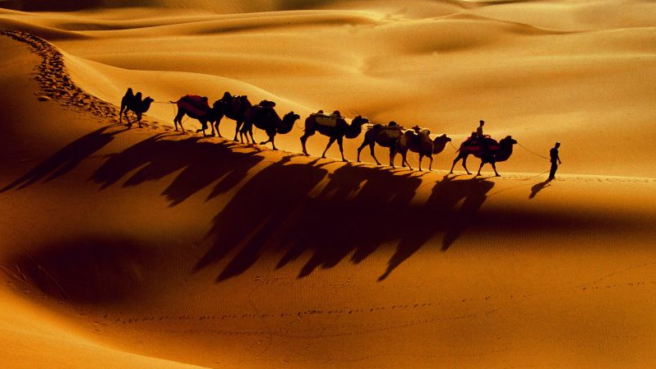
Step4 Conclusion
Readers need to know:
1.What is this article about?
2. Why does it concern me?
3. What should I do next?

Slide 14
参考范文
Dear students,
Our school has launched the “Silk Road: Heritage in Innovation” project, which ingeniously integrates the time-honored Silk Road culture with cutting-edge technology.
Activities include VR tours of historic sites, AI-driven cultural relic restoration workshops, and cross-border innovation contests. Not only will participating broaden your cultural horizons, but it will also equip you with future-ready tech skills.
Don’t miss this chance to become a cultural innovator!
Yours sincerely,
Li Hua

