Slide 1


感恩遇见，相互成就，本课件资料仅供您个人参考、教学使用，严禁自行在网络传播，违者依知识产权法追究法律责任。
更多教学资源请关注
公众号：溯恩高中英语
知识产权声明

Slide 2
浙江高考英语
阅读理解备考策略1
· 主旨大意
· 推理判断
· 词义猜测
· 细节理解
· 语篇连贯
鲁周焕
杭州市余杭高级中学

Slide 3
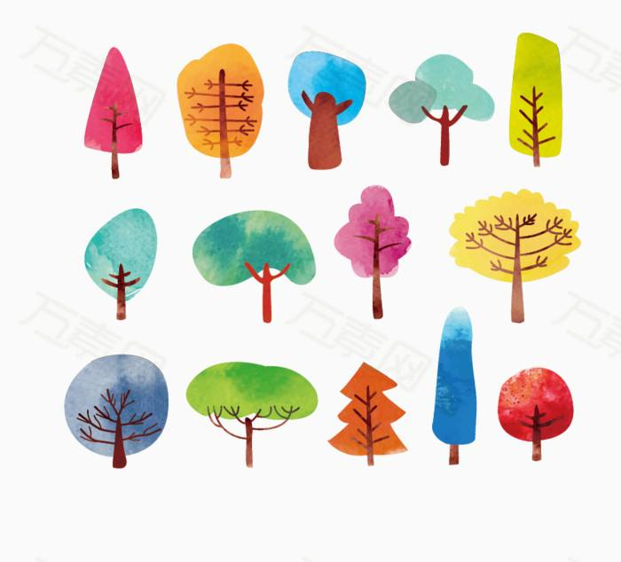
outline
怎么考？高考题的“变”与“不变”
怎么做？英语阅读理解题的解题策略
怎么办？后阶段复习方向和备考策略

Slide 4

一、高考题的“变”
对考生的词汇掌握要求变高
△ deliberately intentionally negotiate
vagueness commission corporate
△authoritarian autobiography adaptive
△respect gesture approach
考纲中相对出现频
率低、较复杂的单词
考纲词汇的变形
考纲词汇的熟词生义
考卷上标注中文的单词很多为考纲词汇！
·rural (农村的) ·route (路线) ·factor (因素)

Slide 5
2. 对考生的长难句分析能力要求变高
There’s always War and Peace, which I’ve covered some distance several times, only to get bogged down in the “War” part, set it aside for a while, and realize that I have to start over from the beginning again, having forgotten everyone’s name and social rank.
“The vagueness of the gesture meanings suggests either that the chimps have little to communicate, or we are still missing a lot of the information contained in their gestures and actions,” she said. “Moreover, the meanings seem to not go beyond what other animals convey with non-verbal communication. So, it seems the gulf remains.”
复杂的语法结构
抽象名词的运用

Slide 6
3. 对考生的语篇整体理解能力要求变高
2020-7 A 24. What’s this text?
A. A short story. B. An introduction to a book.
C. A play review. D. An advertisement for a theater.
2020-7. C. 29. How does Francisca Then explain her findings in paragraph 4?
A. By making a comparison. B. By using an expert’s words. C. By introducing a concept. D. By referring to another study.
2020-1. B. 26. Milwaukee’s way to de-ice streets may be an example of .
A. barking up the wrong tree. B. putting the cart before the horse. C. robbing Peter to pay Paul. D. killing two birds with one stone.
语篇类型多样化
命题角度更宏观

Slide 7
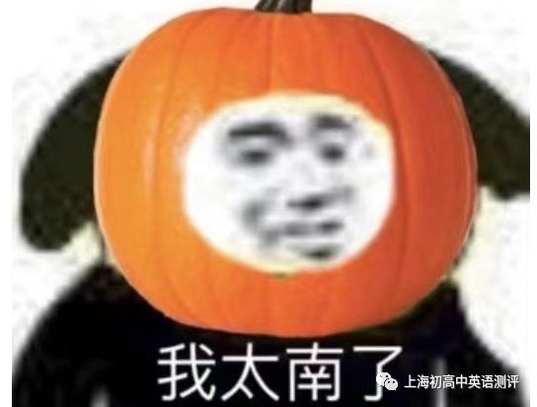
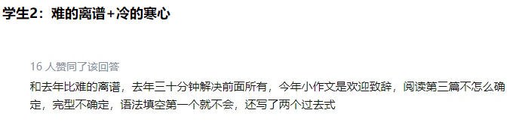
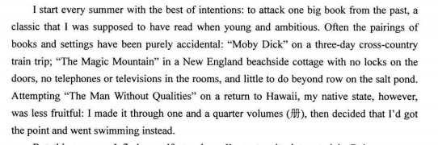
4. 对考生的临场应试心理素质要求变高
阅读理解难度像“过山车”

Slide 8
二、高考题的“不变”
题型、命题角度基本不变
2021-1 C 30. Which of the following is the best title for the text?
2020-7. C. 30. Which of the following is the best title for the text?
2020-1. C. 30. Which of the following is the best title for the text?
2. 选材初衷和出处不变
初衷：弘扬真善美；提倡读书；培育创新精神……
出处：外刊（比如Reader’s Digest，The New York Times，原版书籍）

Slide 9
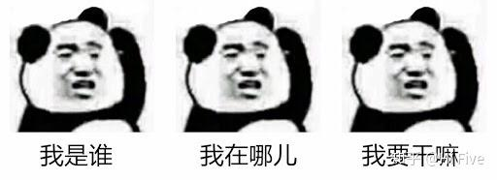
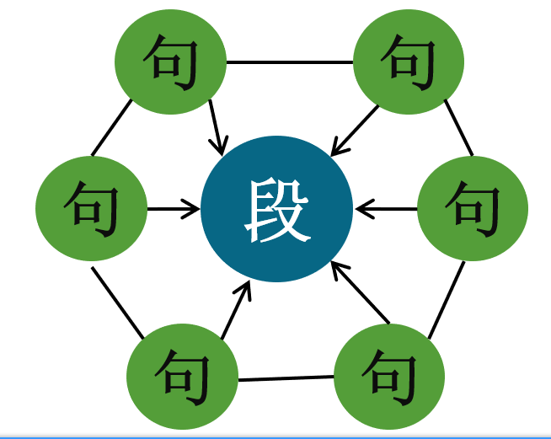
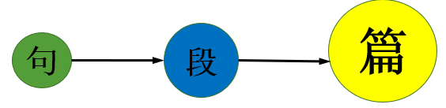
3. 阅读文章的方法不变
Moreover, the tendency for universities to monitor and shape student behavior runs up against another characteristic of young adults: the response to being controlled by their elders. If acceptable social behavior is too strictly defined and controlled, the insensitive or aggressive behavior that administrators are seeking to minimize may actually be encouraged. (2016年北京卷·D篇)

Slide 10
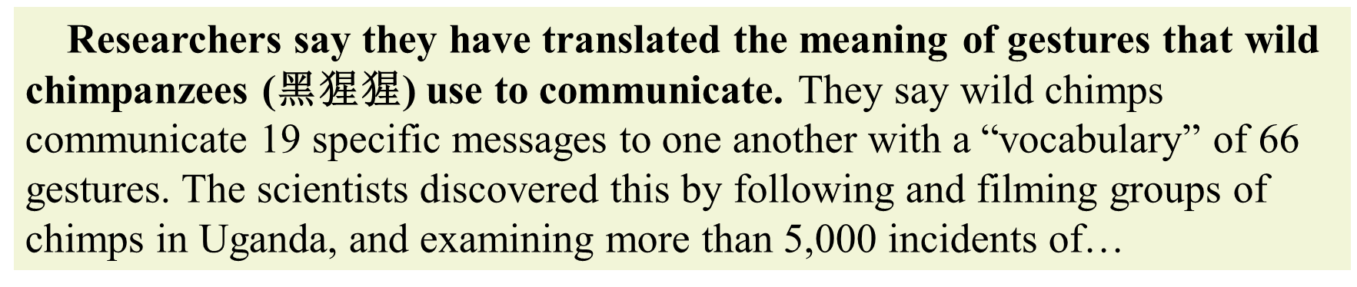
三、高考题的解题策略
我读的是篇什么类型的文章？（宏观角度）
▸记叙文：(教育意义)故事；人物传记
▸说明文：新闻报道；研究报告；介绍类说明文
▸议论文：立论文；驳论文
（1）心理期待：文章会讲什么？

Slide 11
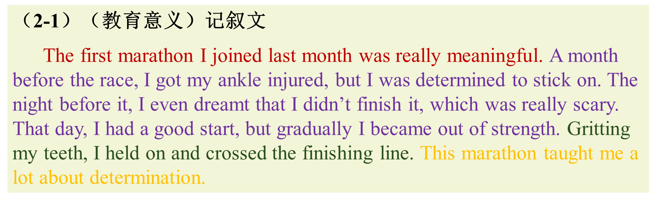
（2）不同类型文章的典型结构是什么？
（2-1）（教育意义）记叙文
The first marathon I joined last month was really meaningful. A month before the race, I got my ankle injured, but I was determined to stick on. The night before it, I even dreamt that I didn’t finish it, which was really scary. That day, I had a good start, but gradually I became out of strength. Gritting my teeth, I held on and crossed the finishing line. This marathon taught me a lot about determination.
点题→指向(5w)→进展→结局→回应
--What does the story mainly tell us?
--Which is the best title for the story?
从点题或回应去找

Slide 12
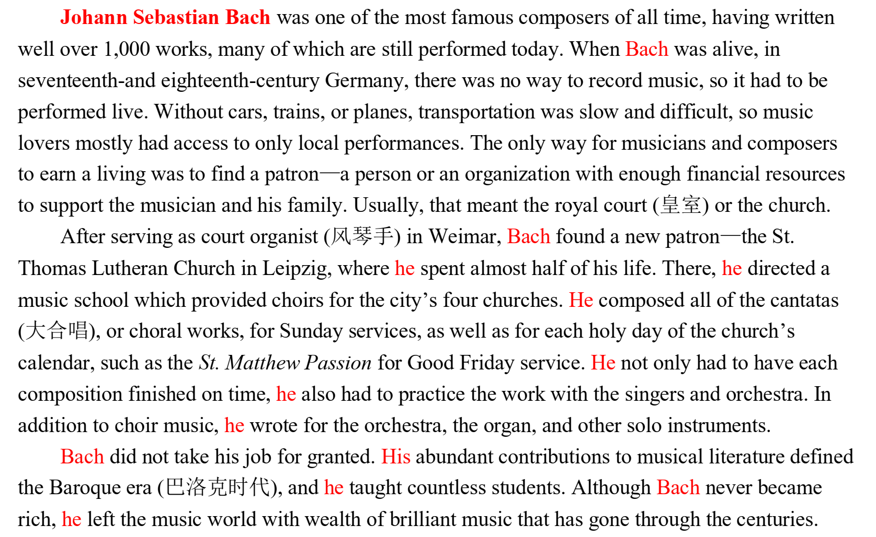
（2-2）人物传记
时代背景
人物生平
成就贡献
优点品质
--What’s the writer’s purpose in writing the text?
--Which is the best title for the story?
To remember/introduce
Name + Contribution

Slide 13
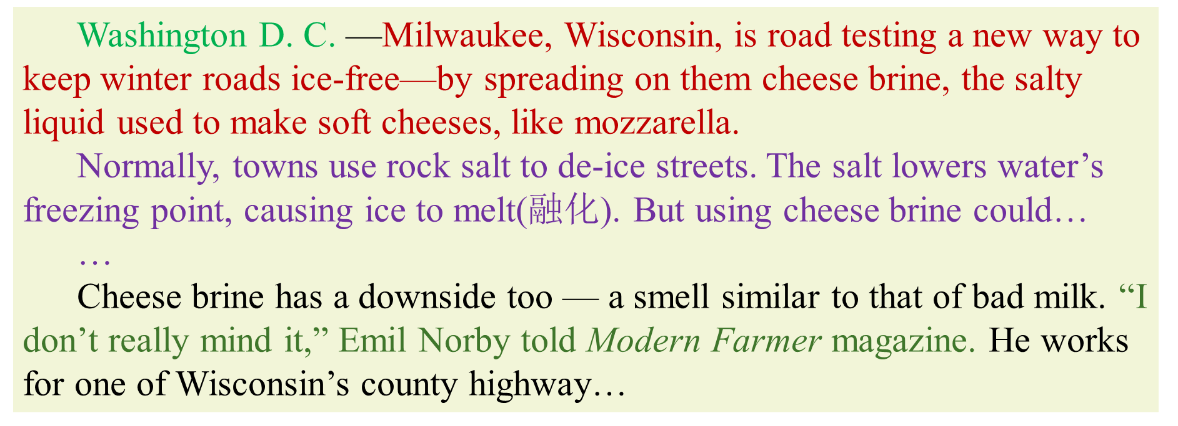
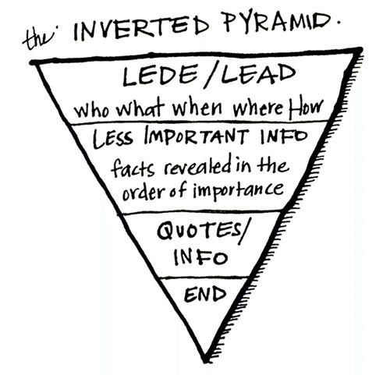
（2-3）新闻报道
标题→报道地点→导语→主体→评论
Washington D. C. —Milwaukee, Wisconsin, is road testing a new way to keep winter roads ice-free—by spreading on them cheese brine, the salty liquid used to make soft cheeses, like mozzarella.
Normally, towns use rock salt to de-ice streets. The salt lowers water’s freezing point, causing ice to melt(融化). But using cheese brine could…
…
Cheese brine has a downside too — a smell similar to that of bad milk. “I don’t really mind it,” Emil Norby told Modern Farmer magazine. He works for one of Wisconsin’s county highway…
--What’s the text mainly about?
--Which is the best title for the text?
找准导语部分

Slide 14
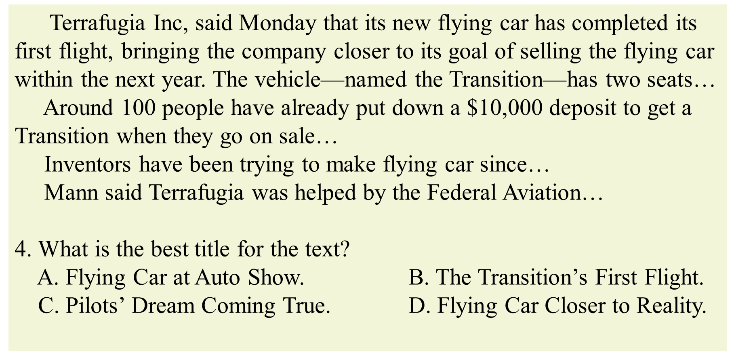
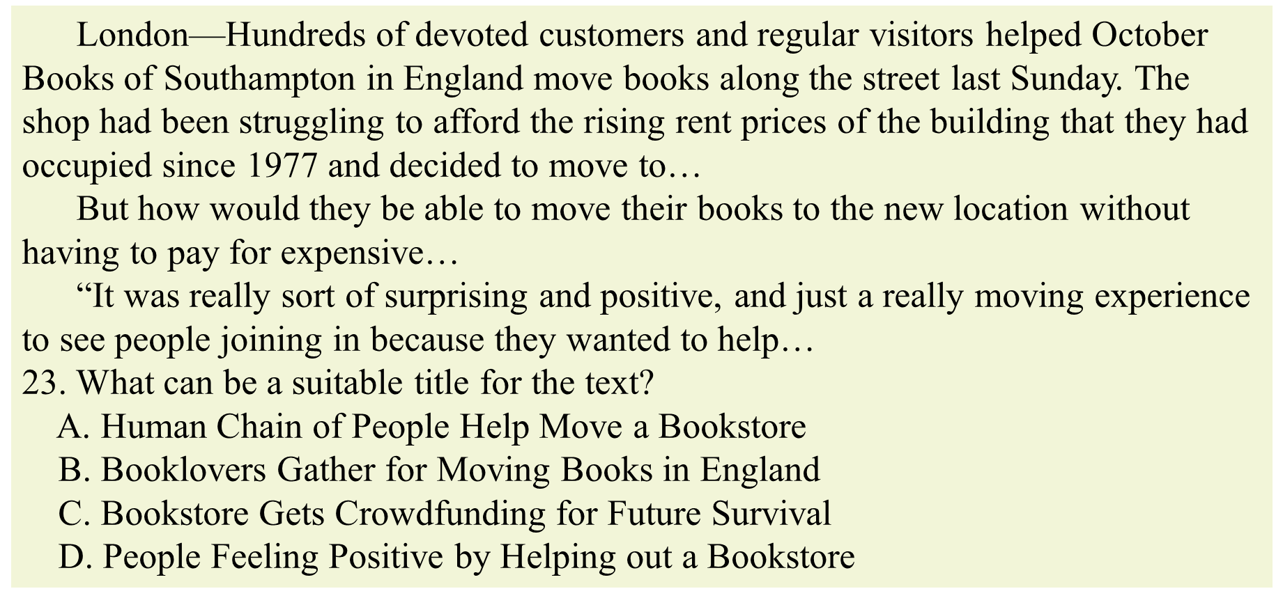

Slide 15
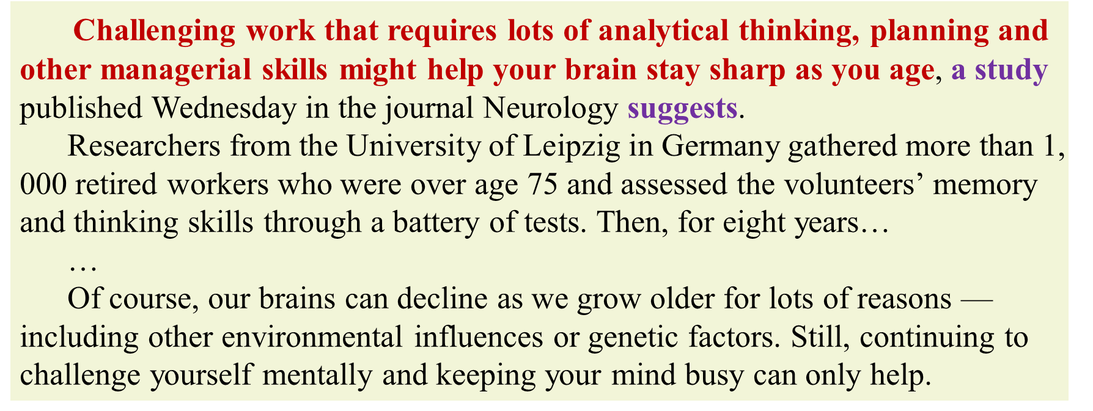
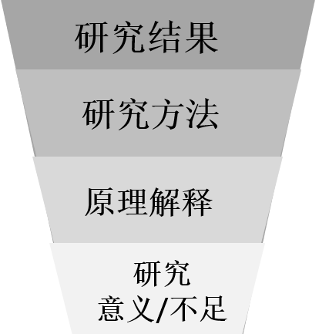
（2-4）科研报告
研究结果→研究方法→原理解释→研究意义/不足
Challenging work that requires lots of analytical thinking, planning and other managerial skills might help your brain stay sharp as you age, a study published Wednesday in the journal Neurology suggests.
Researchers from the University of Leipzig in Germany gathered more than 1, 000 retired workers who were over age 75 and assessed the volunteers’ memory and thinking skills through a battery of tests. Then, for eight years…
…
Of course, our brains can decline as we grow older for lots of reasons — including other environmental influences or genetic factors. Still, continuing to challenge yourself mentally and keeping your mind busy can only help.
A new study/research suggests/ discovers/reveals/finds…
by experiment/observation
survey
--Which is the best title for the text?
--How does the researchers prove their finding?
从研究结果去找

Slide 16
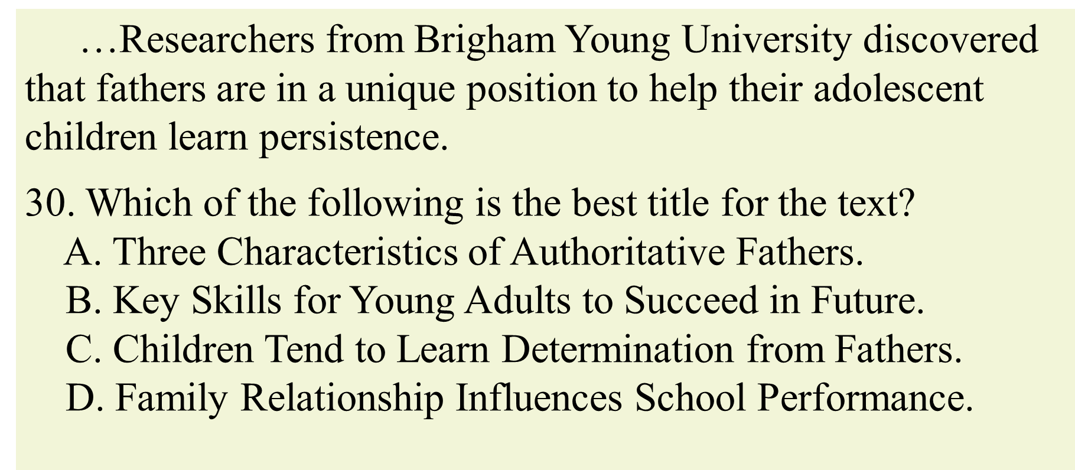
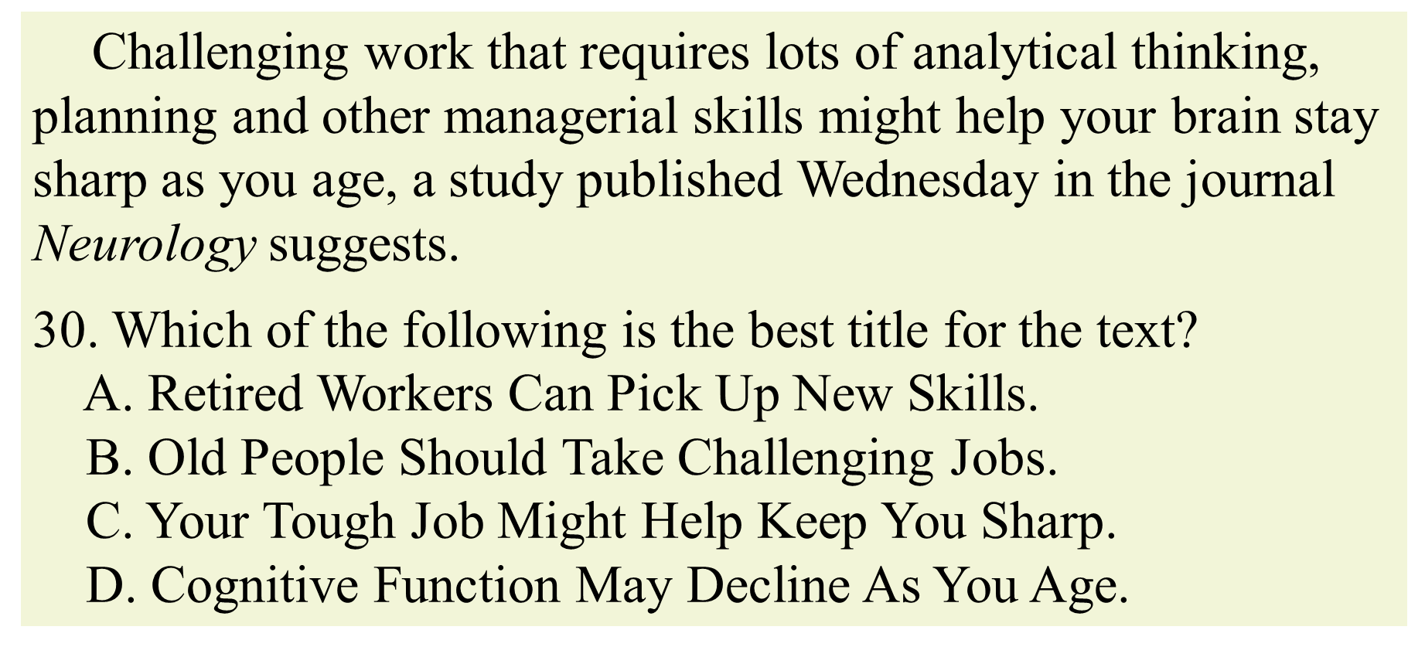
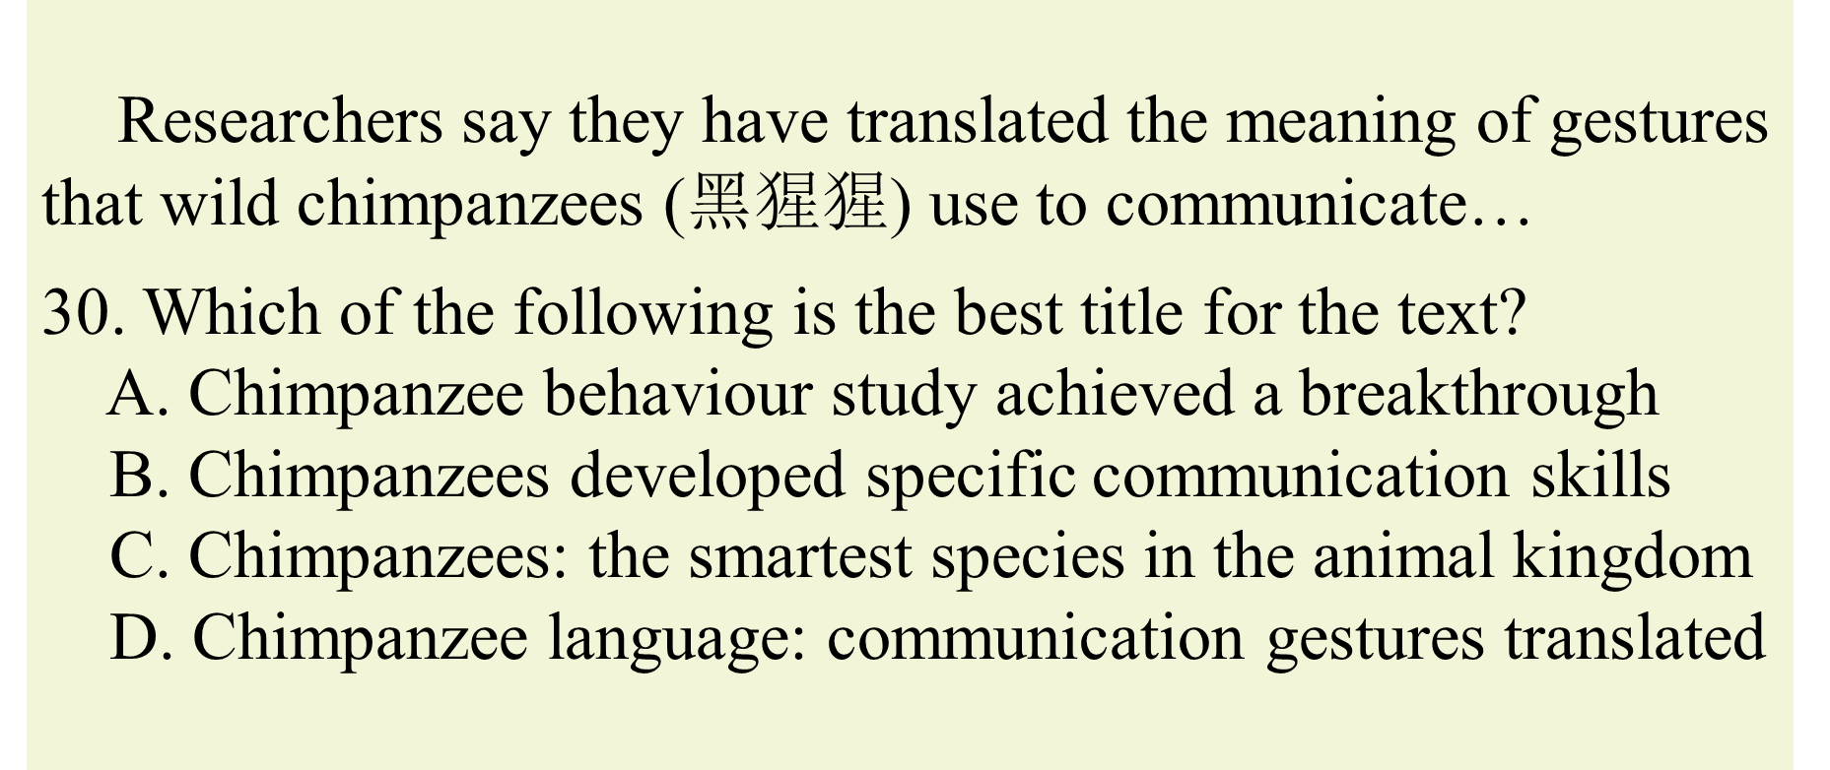

Slide 17
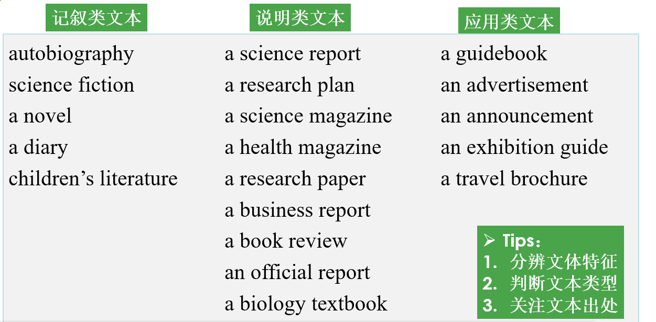
（3）这篇文章出自哪里？
2020.7 A 24. What’s this text?
2020.1 A 23. Where is the text probably from?
A popular magazine

Slide 18
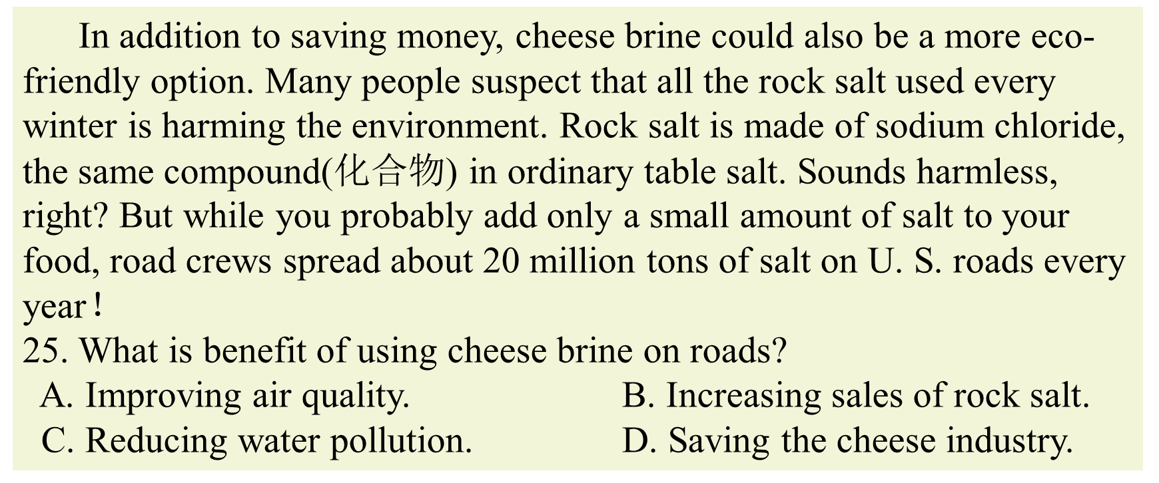
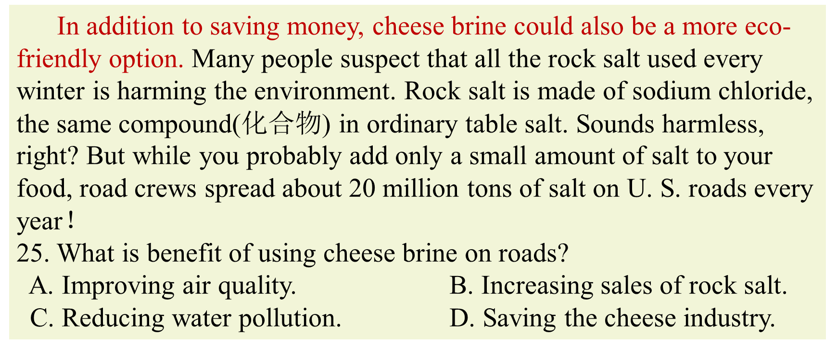
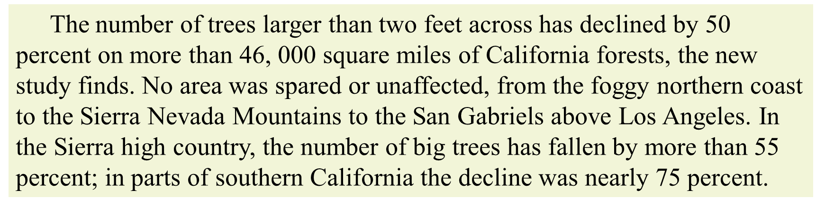
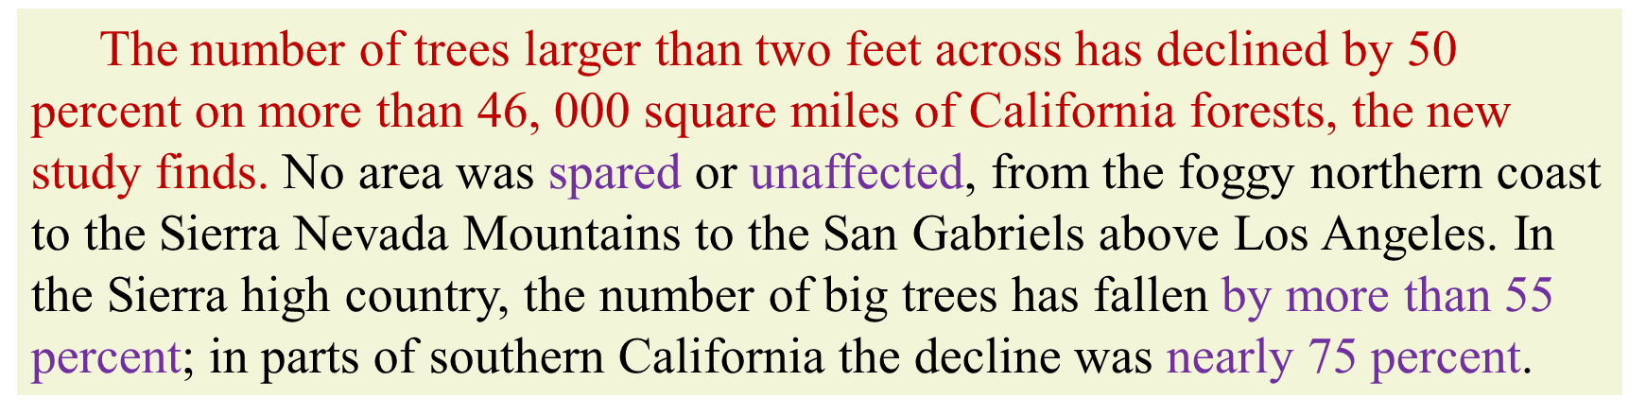
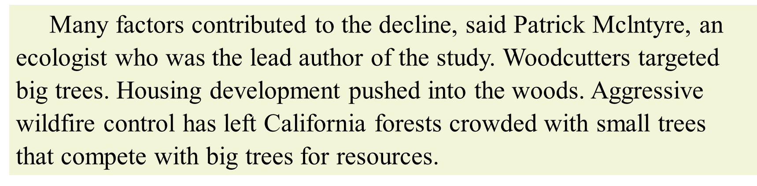
2. 我读的段落讲了什么？是如何展开的？（中观角度）
段落基本结构：topic sentence+supporting details+conclusion
（1）段落的中心大意
找段落主题句或过渡句
2019-6 C 27. 27. What is the second paragraph mainly about?
段落大意：The seriousness of big-tree loss in California.
段落大意：The cause/reason for big-tree loss in California.

Slide 19
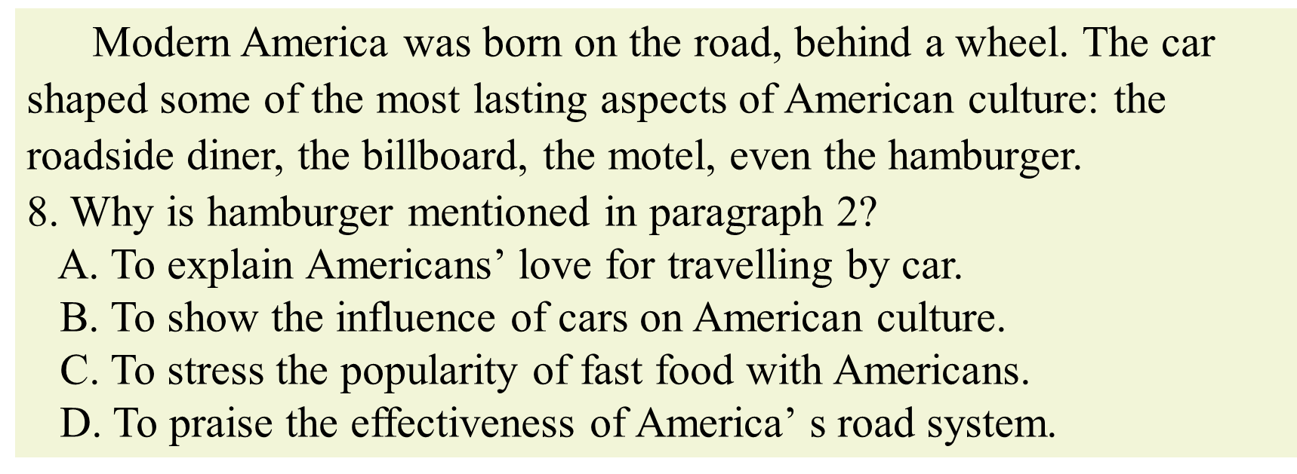
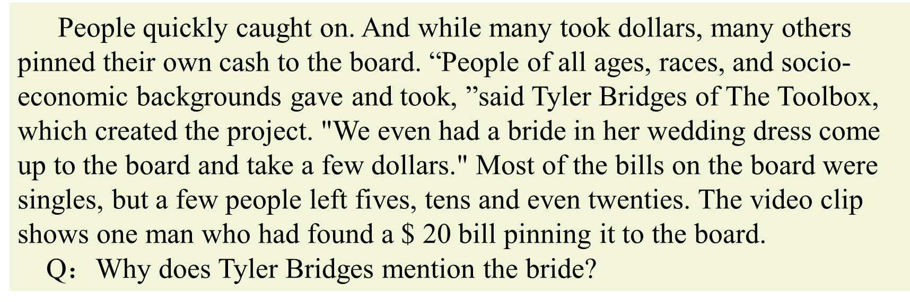
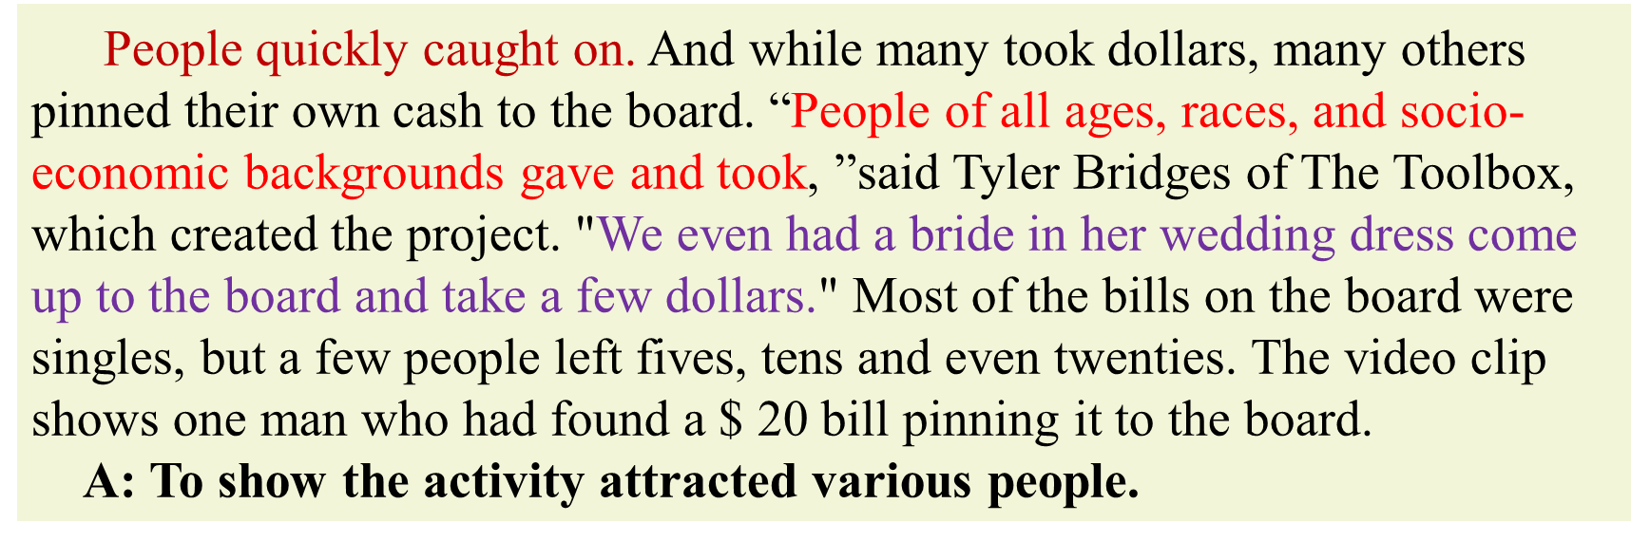
段落基本结构：topic sentence+supporting details+conclusion
（2）举例的作用
找段落主题句
2019-6 B 27. Why is…mentioned in paragraph X…?
What does XX want to show by mentioning…?

Slide 20
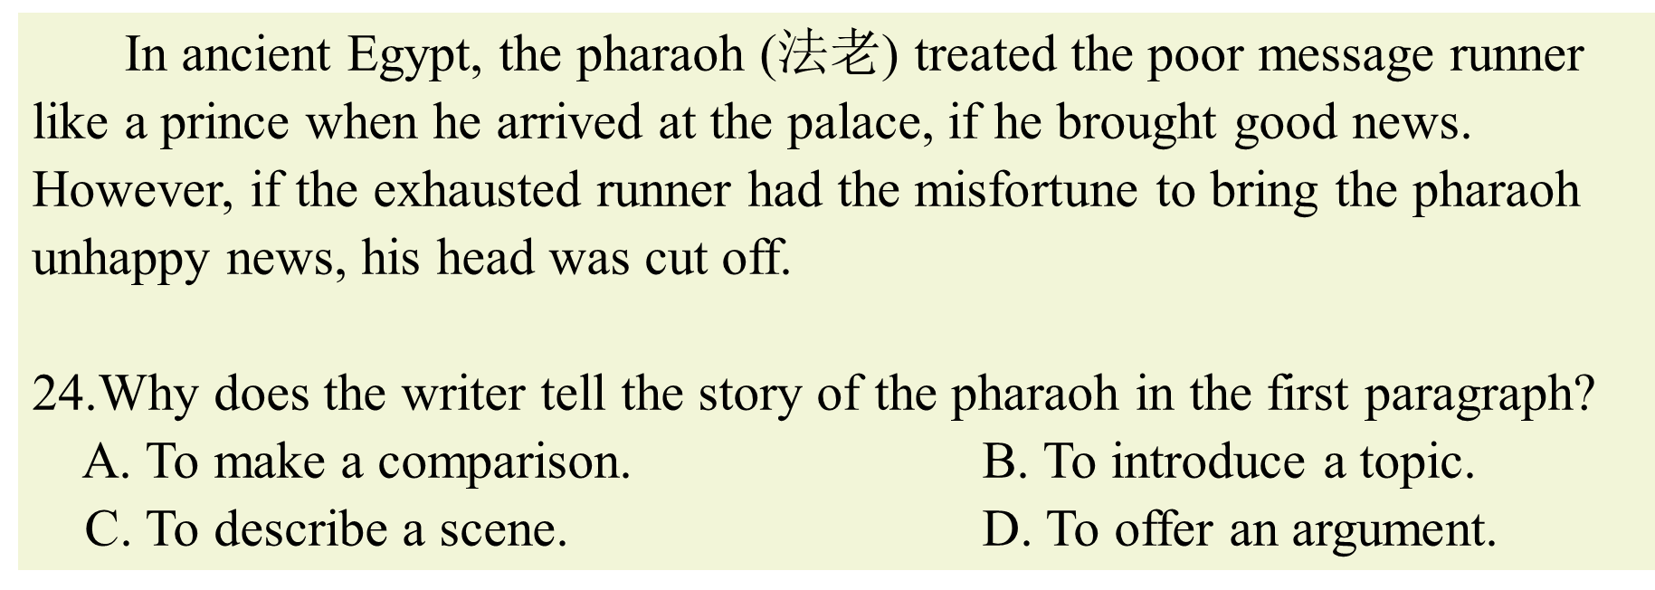
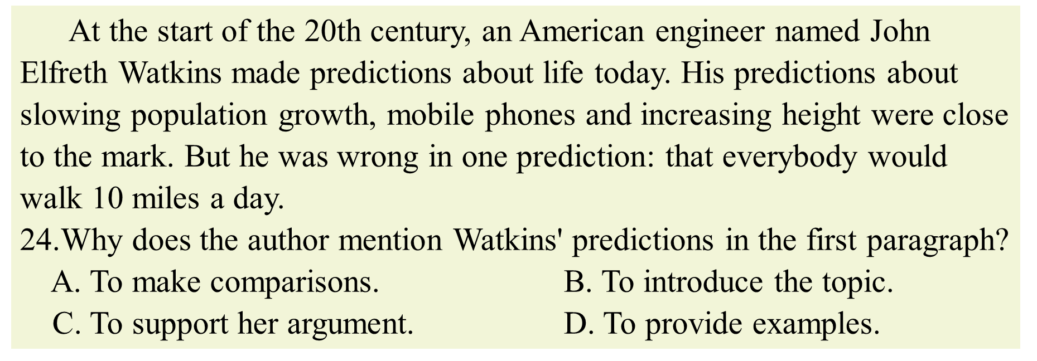
（3）段落的基本作用
首段引出主题(吸引读者)/尾段总结全文
2020-1 A 27. Why does the writer mention/describe XX in the first paragraph?
What’s the function of the first paragraph?

Slide 21
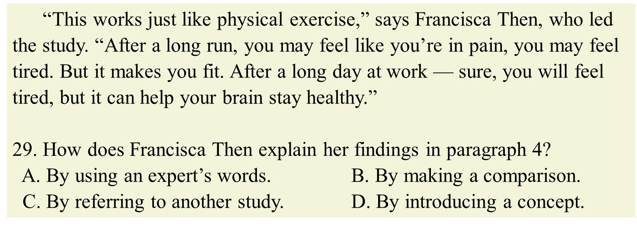
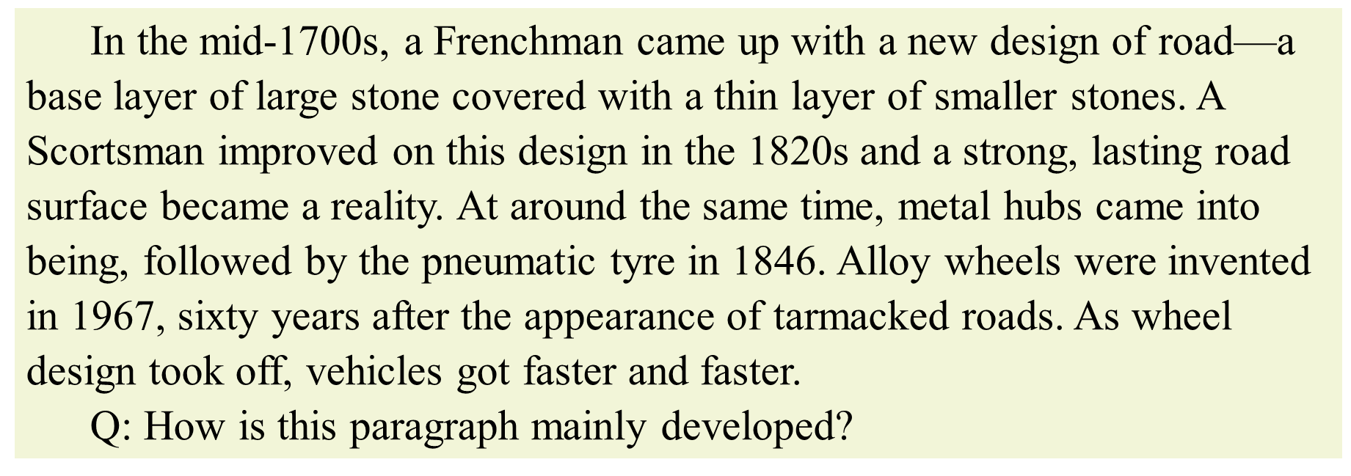
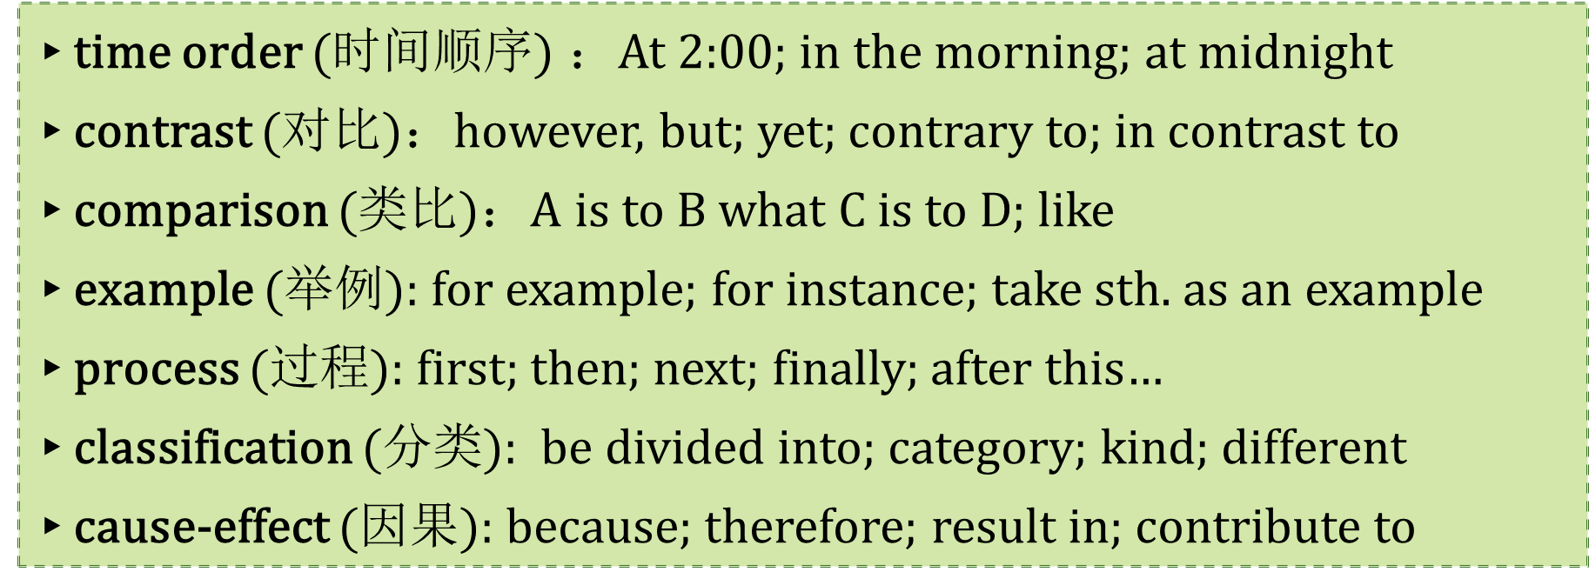
（4）段落的展开模式
找准信号词，明确段落展开模式
2020-7 C 29. How does XX explain… in paragraph 4?
How is the paragraph X mainly developed?

Slide 22
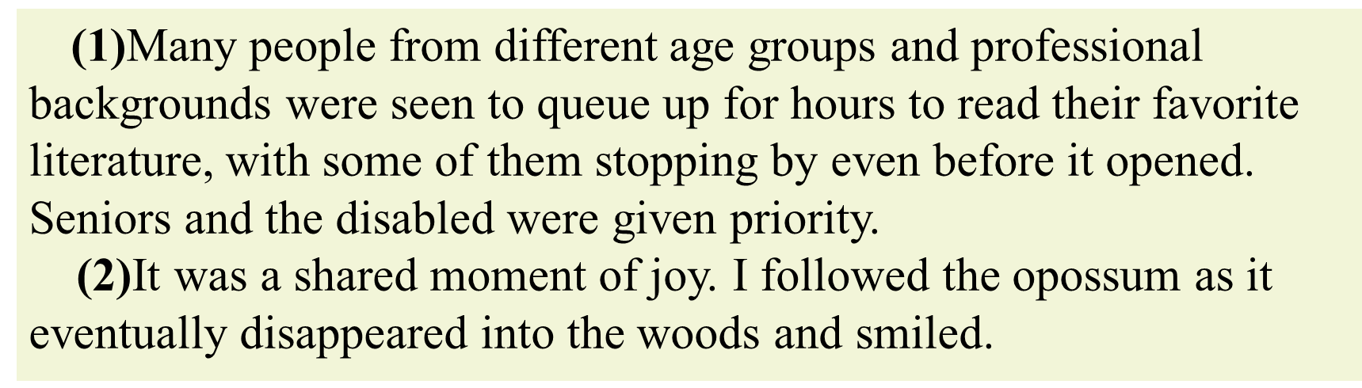
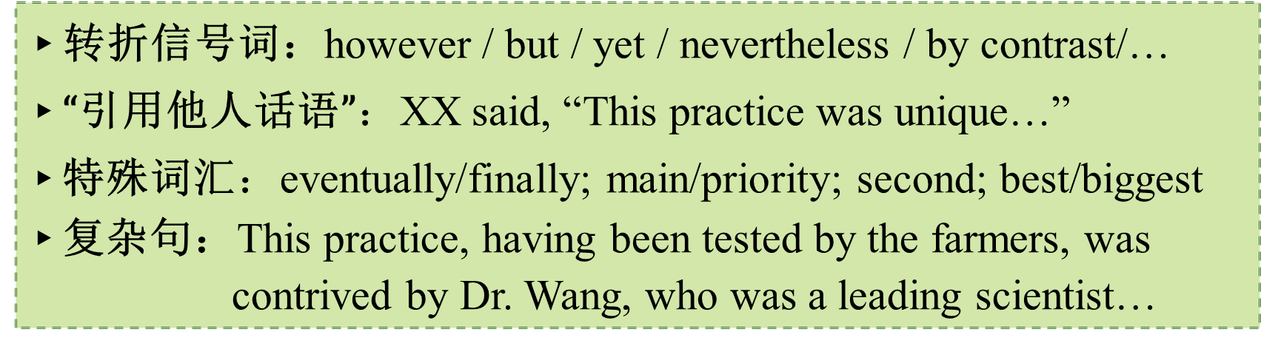
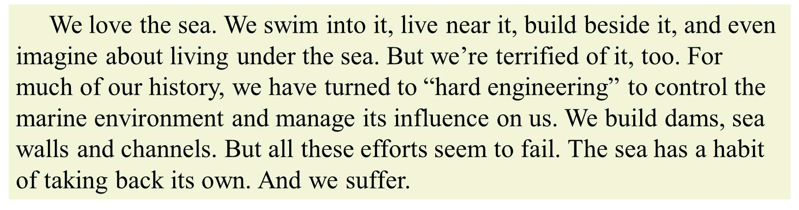
3.1. 我读的句子讲了什么？（微观角度）
1. What does the author seem to like about cherries?
2. Why do many parents limit electronic reading?
3. How was the author's first marathon?
4. According to Dr. Wang, the next step of the study is to .
细节理解题：指向明确
（1）细读重点句子

Slide 23
（2）定位答案所在句
定位题目关键词，对应答案所在句
1. What do we know about people in the 1960s?
具体时间
2. According to Dr. Wang, the next step of the study is to .
具体某人
3-1. What is surprising about the standard of the clothing industry?
3-2. Where did the opossum run finally?
限定性词汇
4. Who may worry about the move in Stepinac?
The first few weeks may bring some challenges. Stepinac officials expect some parental discomfort over dropping concrete books.

Slide 24
（3）理解“同义改写”确定答案
The first few weeks may bring some challenges. Stepinac officials expect some parental discomfort over dropping concrete books.
4. Who may worry about the move in Stepinac?
A. Officials. B. Technicians. C. Parents. D. Teachers.
This particular study examined 11 to 14-year-olds living in two-parents homes. Yet the researchers suggest that single parents still may play a role in teaching the benefits of persistence, which is an avenue of future research.(2020.1)
29. Which group can be a focus of future studies according to the researchers?
A. Single parents. B. Children aged from 11 to 14.
C. Authoritarian fathers. D. Mothers in two-parent homes.
Adam and Galinsky tested the effect of simply wearing a white lab coat on people's powers of attention. The idea is that white coats are associated with scientists, who are in turn thought to have close attention to detail. (2017.11)
26. Adam and Galinsky's experiment tested the effect of clothes on their
wearers’______.
A. insights B. movements C. attention D. appearance
▸选项比较简短时，答案与原文表达一致

Slide 25
The decline is not because we have all become lazy. Families are pressed for time, many with both parents working to pay for their house, often working hours not of their choosing, living in car-dependent neighborhoods with limited public transport.
25. What has caused the decrease in Australian children's physical activity?
A. Plain laziness. B. Health problems.
C. Lack of time. D. Security concerns.
To get the most out of reading these plays, try to picture the play on stage, with you, the reader, in the audience. The houselights dim (变暗). The curtains are about to open, and in a few minutes the action and dialogue will tell you the story.
23. What does the author suggest readers do while reading the plays?
A. Control their feelings. B. Apply their acting skills.
C. Use their imagination. D. Keep their audience in mind.
▸答案对原文适度替换（同义词替换）

Slide 26
For all of Bellevue’ s success, adaptive signals are not a cure-all for jammed roadways. Kevin Balke, a research engineer at the Texas A&M University Transportation Institute, says that while smart lights can be particularly beneficial for some cities, others are so jammed that only a sharp reduction in the number of cars on the road will make a meaningful difference. “It’s not going to fix everything, but adaptive signals have some benefits for smaller cities,” he says.
26. What does Kevin Balke say about adaptive signals?
A. They work better on broad roads.
B. They should be used in other cities.
C. They have greatly reduced traffic on the road.
D. They are less helpful in cities seriously jammed.
Cities usually have a good reason for being where they are, like a nearby port or river. People settle in these places because they are easy to get to and naturally suited to communications and trade. New York City, for example, is near a large harbour at the mouth of the Hudson River. Over 300 years its population grew gradually from 800 people to 8 million...
1. What attracted the early settlers to New York City?
A. Its business culture. B. Its small population.
C. Its geographical position. D. Its favourable climate.
Researchers from the University of Leipzig in Germany gathered more than 1, 000 retired workers who were over age 75 and assessed the volunteers’ memory and thinking skills through a battery of tests. Then, for eight years, the scientists asked the same group to come back to the lab
every 18 months to take the same sorts of tests.
28. Why did the scientists ask the volunteers to take the tests?
A. To assess their health status. B. To evaluate their work habits.
C. To analyze their personality. D. To measure their mental ability.
▸答案对原文的适度概括（specific→general）

Slide 27
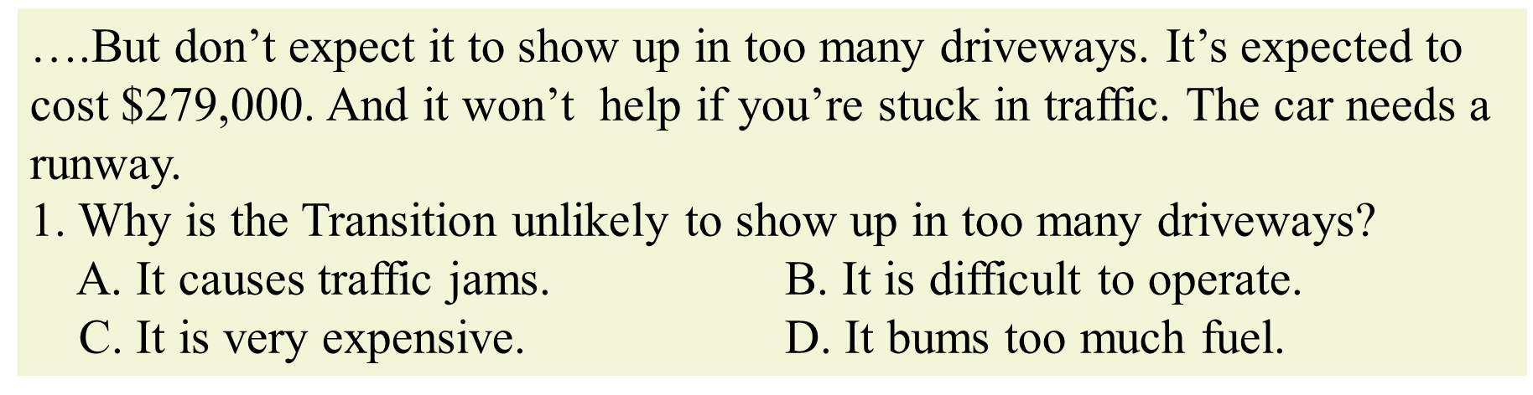
According to C, a leading professor for the experiment, “aaaaaaaaaaaaa
aaaaaabbbbaaaaaaaaaaaaaabbbbbaaaaaaaabbbbbaaa”.
25. What did C say about the experiment? (Multiple choice)
A. It was ABA. B. It should aaababb
C. It looks like ab. D. It means ccccccccc.
▸细节理解题：
1. 定位题干关键词（人/时间/地点/限定词…）
2. 根据题干关键词找到答案所在句；
3. 找到原文中的表达；
4. 找到答案选项中的“同义改写”。
千万不要对“同义改写”过于苛求

Slide 28
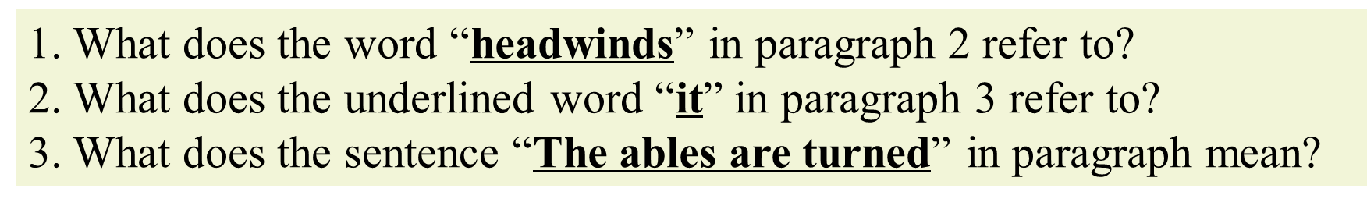
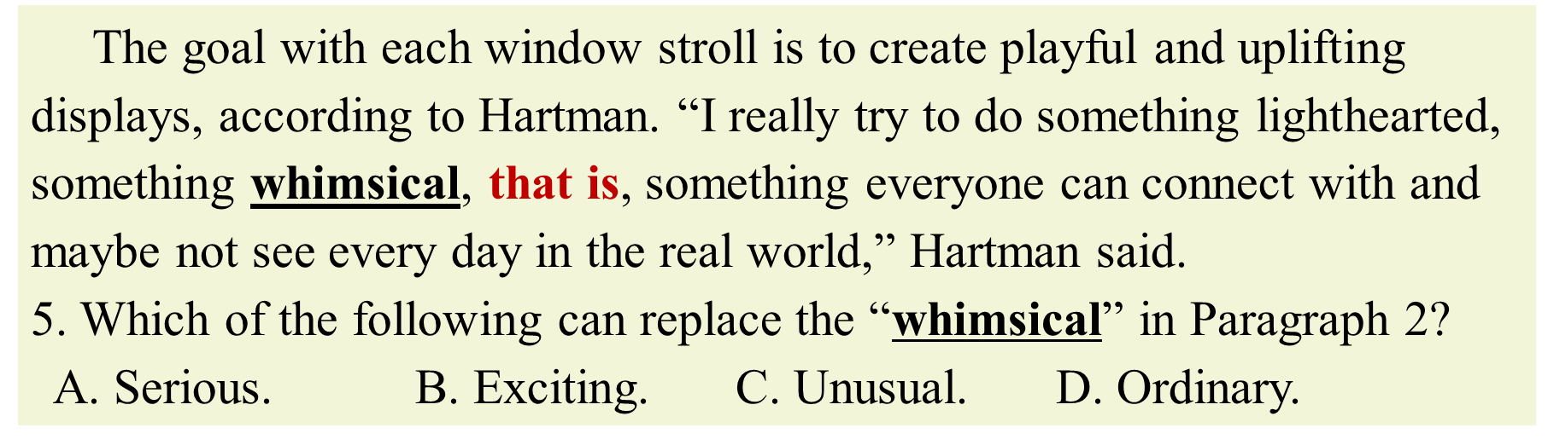
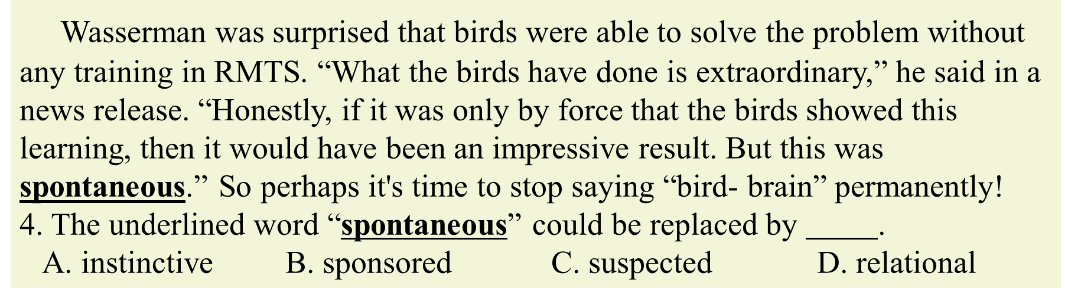
3.2 我读的句子讲了什么？（微观角度）
▸词义推断中关注前后信号词（转折；解释）

Slide 29
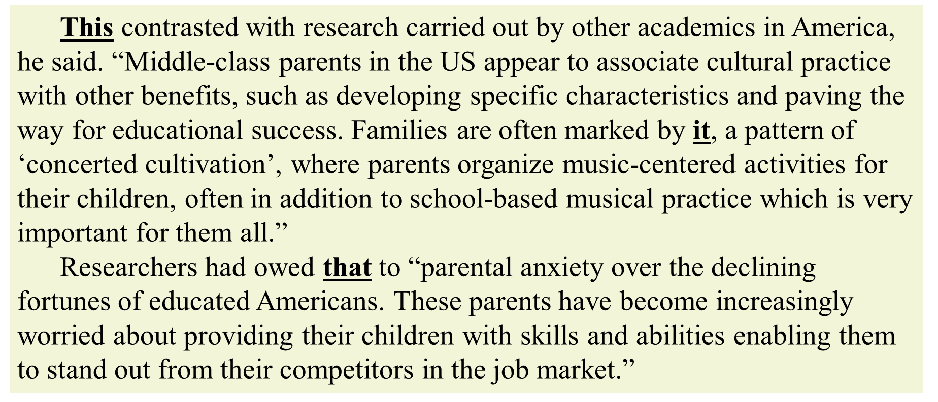
▸代词指代要关注代词的位置，并从本句或前句去找。

Slide 30
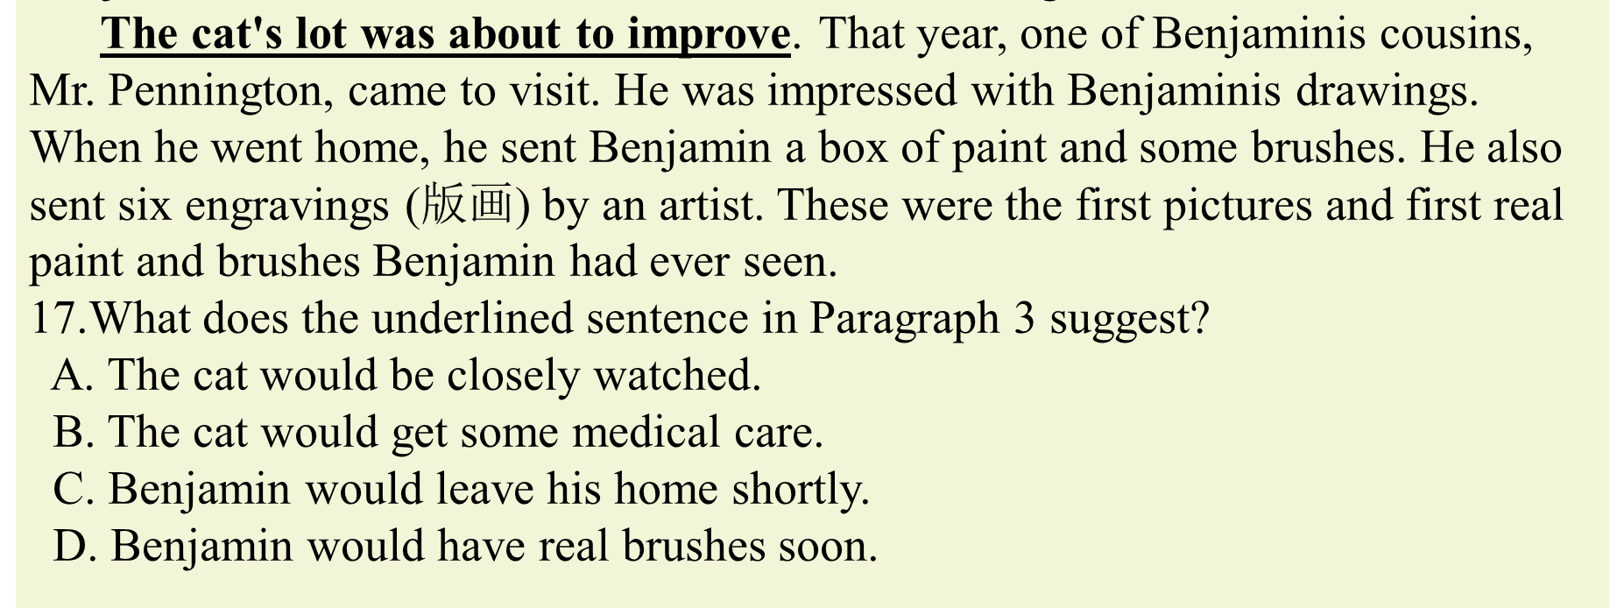
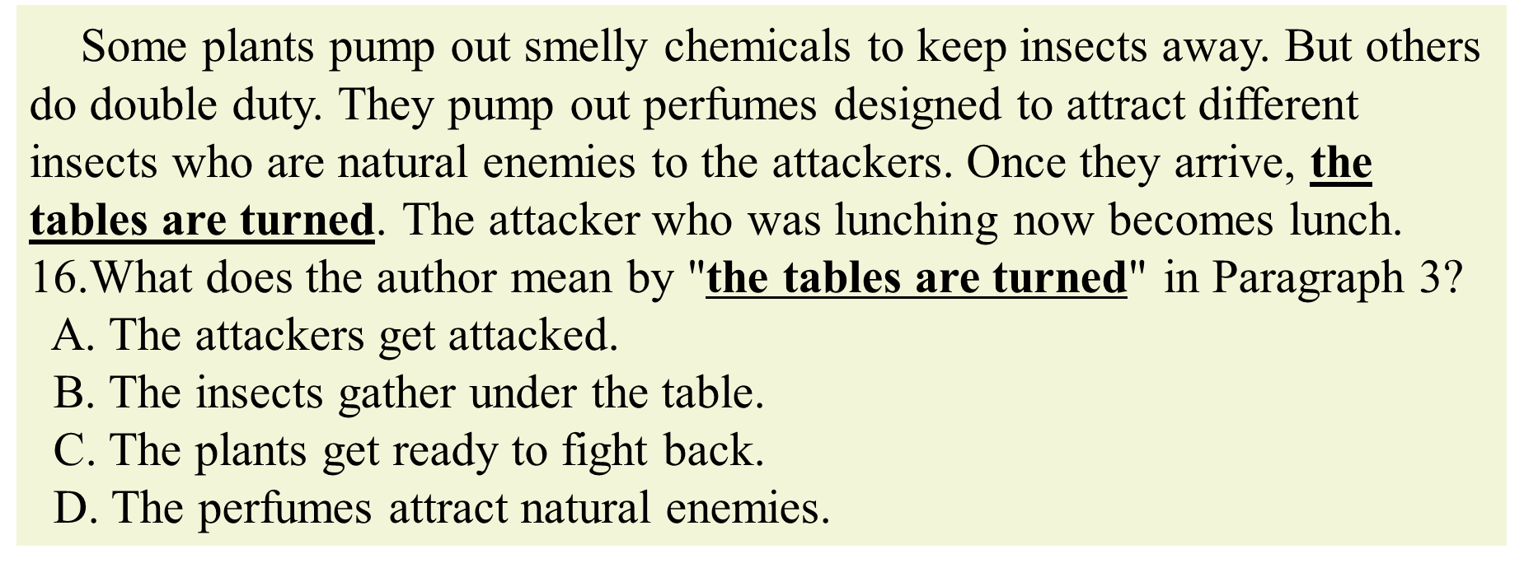
▸句意理解要先关注本意，然后从上下文看延伸意。

Slide 31

▸词义推断：请问❶处是什么？
· 看山是山
· 看雾也是山
▸代词指代：请问❷指代哪座山？
▸句意理解：请问❸处是什么？
3
2
1

Slide 32
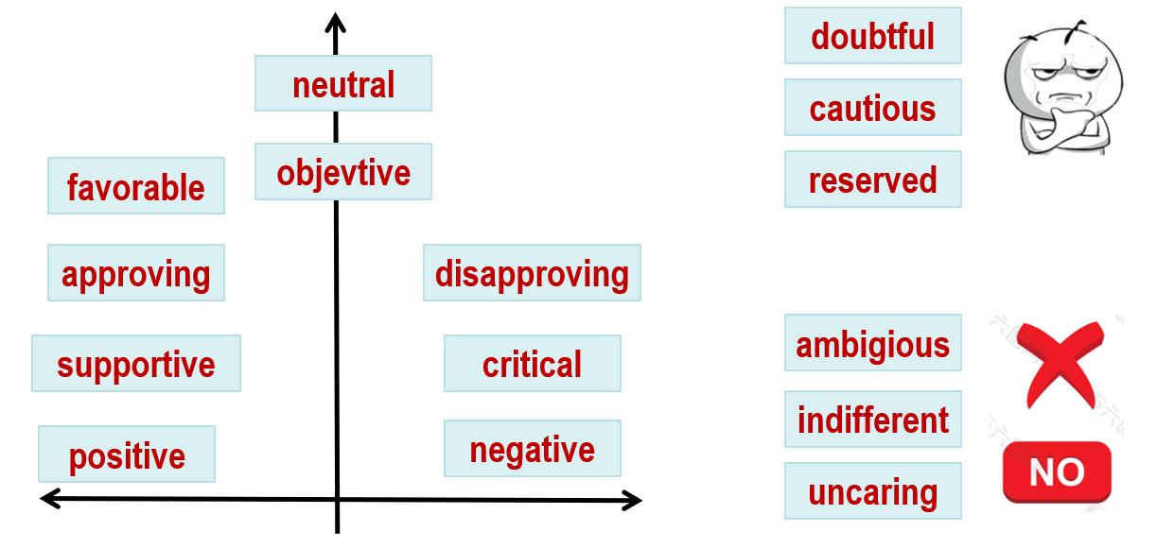
4. 游离于篇章、段落和句子的态度观点题
1. What’s the writer’s attitude towards the Yellowstone wolf project?
宏观态度观点：有态度/中立
2. What’s Friedman’s attitude towards America's future ?
微观态度观点：有态度

Slide 33
5. 任务型阅读：七选五
时间 | 2016.10 | 2017.6 | 2017.11 | 2018.6 | 2018.11 | 2019.6 | 2020.1 | 2020.7 | 2020.1
体裁 | 说明文 | 说明文 | 说明文 | 说明文 | 说明文 | 说明文 | 说明文 | 说明文 | 说明文
主题 | 青少年如何丰富生活 | 如何做接头随机采访 | 如何记住所读的内容 | 如何和新邻居相处 | 社交方式要因人而异 | 披头士乐队的发展及影响 | 世界水日及节约用水 | 我如何克服孤独 | 排队的原理和艺术
/ | 小标题 | 小标题 | 小标题 | 小标题 | / | / | / | / | /
1. 变：说明文类型逐渐由单一的How-to模式向多元模式发展；
2. 不变：考点仍旧设置在主旨句和过渡或细节注释上。

Slide 34
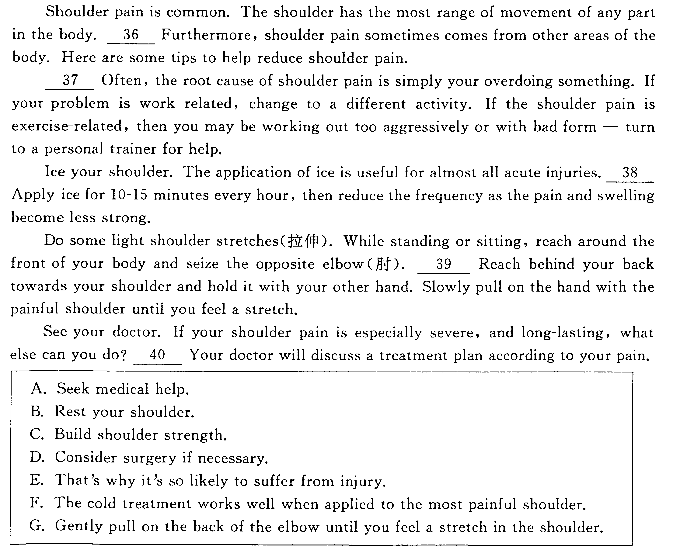
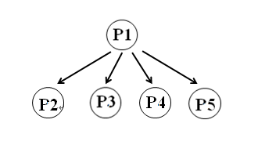
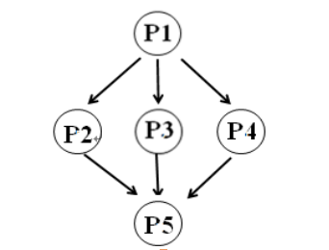
（1）明确语篇结构和语篇模式
（1-2）How-to类说明文
TOPIC SENTENCE
(Main Point)
Sub-
points
supporting details

Slide 35
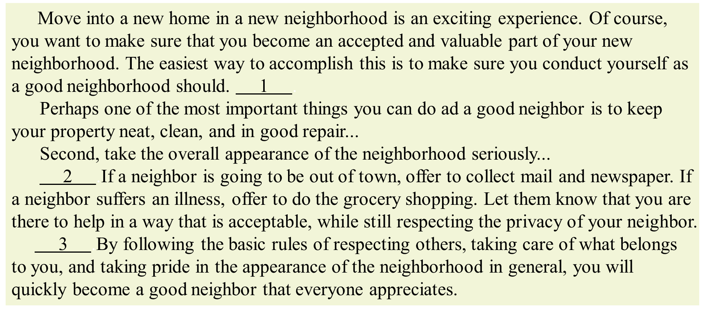
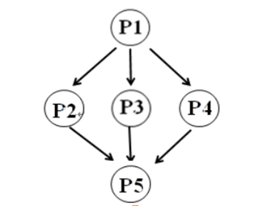
tips, advice, how to?
是否也有表示次序的信号词?
Conclusion
(总结性语句)

Slide 36
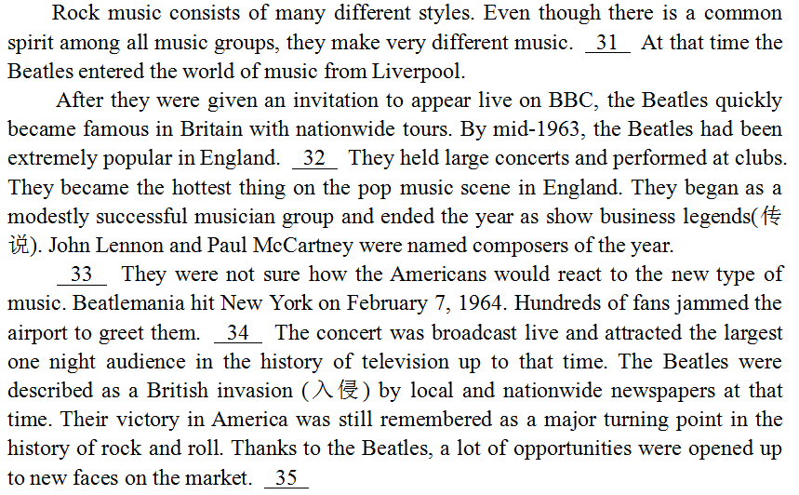

（1-2）其他说明文
时间
过程
因果
对比
定义
分类

Slide 37

（2）分析所给选项
前面有所指代
前面已经提到
后句讲原因
前面有所指代
后句讲概率
开启新的话题，强调重点

Slide 38


（3）分析设空位置
▸段落首空设空：考虑主题句
31 For example, farmers, who produce the food we eat, use water to make the plants grow. When we turn on a light or switch on a TV or a computer we use energy and we need water to produce this energy.
▸段落末句设空：考虑主题句或顺接句

Slide 39

1. 关注转折信号词：however, but
2. 关注并列信号词：some…the other
▸段落中设空
3. 关注解释信号词：that is, for example
4. 关注代词：it, this, that, these
5. 关注标点符号：，— ；
6. 关注特殊句式：排比句，祈使句

Slide 40


四、后阶段备考策略
1. 熟悉考纲词汇

Slide 41


2. 精做高考真题

Slide 42

3. 谨慎对待模拟题
▸以下类型阅读理解不做：
1. 中文注释文中很多；
2. 超纲词汇文中很多；
3. Which of the following
statements is TRUE or FALSE?
▸以下地区试卷好好做：
1. 杭州、温州、绍兴、嘉兴地区的大
市联考卷；
2. 顶级名校仿真卷、猜题卷；

Slide 43



4. 放弃“我觉得”这个理由
为什么我做阅读理解题总是出错？
学生：老师老师，我问下这道阅读题
为什么不选A？
老师：那你为什么选A呢？
学生：我觉得A…（省略一万字）
老师（内心OS）：
命题人

Slide 44
5. 多反思和分析
思
学有 所得
这篇是什么类型的文章？
篇章、段落、句子讲了什么？
这道题考我什么？应该如何解决？
这道题我为什么错？
我有没有自己总结的做题方法？

Slide 45


