Slide 1
感恩遇见，相互成就，本课件资料仅供您个人参考、教学使用，严禁自行在网络传播，违者依知识产权法追究法律责任。
更多教学资源请关注
公众号：溯恩英语
知识产权声明

Slide 2
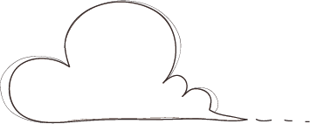
B3U2
Morals and Virtues
Language study

Slide 3
Read for language
1.指望别人解决他们的问题
2.乔装打扮
3. 撞上石头
4. 从地上爬起来
5. 被石头绊倒
6.一瘸一拐的走来
7.含着眼泪
8.尝试着做…
9.陷入绝望
10.让邻居免遭不测
11.从路上挪开它
12.使出全身力气
13.费了好大一番功夫
14.从树后面走出来
1.expect others to solve their problems
2. disguise oneself
3. crash into the stone
4. pick oneself up
5. trip over the stone
6. limp away
7. in tears
8. make an attempt to do sth.
9. in despair
10. keep their neighbors from harm
11. move it out of the way/road
12. with all one’s might
13. after a great deal of effort
14. step out from behind the tree

Slide 4
spilling
1. He ________ into the stone, _________ (spill) the milk everywhere.
crashed
-ing短语做结果状语
spill—spilled/spilt— spilled/spilt—spilling v.
to flow over the edge of a container by accident; to make liquid do this（使）洒出，泼出，溢出
覆水难收。
It’s no used crying over spilt milk.
2) He opened the curtains, letting the morning light spill into the room.
2. pick oneself up: to stand up again after you have fallen
（跌倒后）爬起来
他爬起来继续跑。
He just picked himself up and went on running.

Slide 5
3. After a while, a group of women came along,
each _________(balance) a pot of water on her head.
balancing
独立主格结构作伴随状语
After a while, a group of women came along, and
each balanced a pot of water on her head.
balance v. to put your body or something else into a position where it is steady and does not fall 使（在某物上）保持平衡；立稳
After a while, a group of women came along, _________ (balance) pots of water on their heads.
balancing

Slide 6
4. The girl pushed the stone with all her might.
great strength, energy or power
强大力量；威力

Slide 7
5. After a great deal of effort, she finally succeeded _______ moving it toe the side of the street.
in
a great/good deal of+ 不可数名词= much
All of these people gave me a great deal of information I had never heard of.
a great/good deal = much/a lot 作状语，修饰动词或比较级
We can learn a great deal from each other.
effort 1) u.n
2) c.n

Slide 8
6. 几个从句
1） Nothing good can come to a nation _______ people only complain and expect others to solve their problems.
whose
先行词nation在从句中作定语
=the nation’s people
2) This stone is a danger to anyone______ comes down the street after dark.
who
定语从句，先行词为代词anyone, those，关系词只能用who指人

Slide 9
3) A. He hid gold coins under the stone.
B. Imagine her surprise when she saw the gold coins _______ the stone had been.
where
where 引导地点状语从句，做状语
After the war, a new school was put up in the town.
After the war, a new school was put up _______ there had once been a theatre.
where
I have kept the pictures on the wall of the bedroom.
I have kept the pictures _______ I can see it every day.
where

Slide 10
Writing
Part 1
Basic information about the story
(title，type，main idea）
Part 2
How to write a review?
Your analysis of the story
(author's purpose，details，achievement of the purpose）
Part 3
Your opinion on the story
(like or not，reasons，whether to recommend or not）

Slide 11
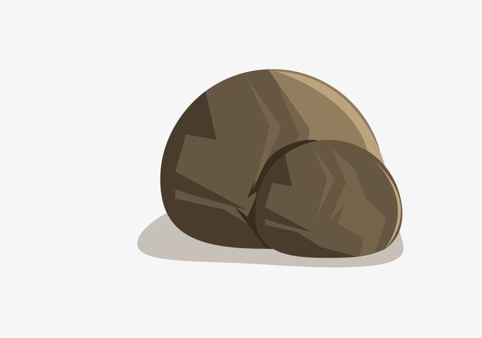
Read For Analysis
1. Why did the king carry out such an experiment?(thinking)
Sample1
The author described villagers' response clearly in the story to improve people's sense of responsibility and courage to accept challenges. I think the story was quite successful in achieving its purpose, and I have learned a lot from it.
person | Experience | Emotion | Response
milkman
woman
others
girl
To teach his villagers a lesson---take the responsibility, accept challenges
angry
picked himself up, went away
crashed into ...
2. What was the response from different people?(p21)
3. Did the king achieve his purpose? How do you know?
limped away in tears
tripped over ...
sad
Sample2
With the aim of improving people's sense of responsibility and courage to accept challenges in life, the author described different response to the stone clearly. I have the belief in its success due to the comparison between the reponse of the girl and the others, from which I have learned a lot.
nobody attempted to move the stone
Can you write the second para of your review?(use various sentence)
complained about ...
upset
tired, worried, surprised
succeeded in moving...
pushed…with all her might, wanted to...

Slide 12
Discussion
Sample
In my opinion, the “stone” in the story refers to the difficulties and challenges in our life, the “milkman” and the “woman” refer to those who don't care for others, while the “girl” refers to people who are responsible for others with a positive attitude to life. I believe I belong to the latter. I used to meet a moral dilemma where I had to make a choice whether to help the woman on the ground or not, and I chose to help, because I thought it was our responsibility to help people who are in need. And I will persist in my choice for the reason that an individual can also make a difference, making the world a better place.
Which kind of people are you ?
Which kind of people will you be?
(give examples)
What does “stone” refer to in life?
Difficulties/Challenges
Can you write the thrid para of your review?(use various sentences)
What kind of people do “milkman”, “woman” and “girl” refer to in life?
Do you think the king is wise? Why or why ont?
milkman, woman: passive, indifferent...
girl:responsible, positive, caring...

