Slide 1

感恩遇见，相互成就，本课件资料仅供您个人参考、教学使用，严禁自行在网络传播，违者依知识产权法追究法律责任。
更多教学资源请关注
公众号：溯恩高中英语
知识产权声明

Slide 2

2021年6月高考读后续写临门一脚
强化语篇分析，把握关键技能
情感主线是亮点/情节逻辑是基点/语言丰富是看点
常山一中 吴俊峰
Notes:
亮亮图文旗舰店https://liangliangtuwen.tmall.com

Slide 3

基于语义连贯，回扣主题意义
让主题思想插上腾飞的翅膀
01
规划宏观语篇模式的结构图

Slide 4
1
八次高考读后续写：对比分析
考试时间 | 2016.10 | 2017.06 | 2017.10 | 2018.06 | 2020.01 | 2020.07 | 2020.07(山东) | 2021.01
主旨大意 | 丛林逃生 | 狼口脱险 | 健忘妈妈旅行记 | 父子寻路 | 为狗找伴 | 和北极熊面对面 | 度过经济难关 | 南瓜卡头
篇章结构 | 问题--解决 | 问题--解决 | 概括--具体 | 问题--解决 | 问题--解决 | 问题--解决 | 问题--解决 | 问题--解决
 | “冲突-危机-解决模式”是读后续写常见的叙事结构
主题语境 | 人与自然 | 人与自然 | 人与社会 | 人与自然 | 人与社会 | 人与自然 | 人与社会 | 人与社会
场景特点 | 丛林、直升机、外套 | 夏日下午、自行车、汽车等 | 开车旅行探亲、沿途风光 | 农场、河流、兔子、骑马 | 人与狗的相互陪伴 | 营地、相机、直升机 | 经济危机、社区、爆米花、 | 厨房、相机
情感态度 | 亲情 | 友情 | 亲情 | 亲情 | 亲情 | 亲情 | 人间真情 | 亲情
思维特点 | 平衡限定性与开放性、逻辑性思维与创造性思维、理顺与顺理的关系
读后续写的考查越来越重视对于语篇意识相关的宏观组织层面的考查：语篇类型、整体结构、主题意义、主线逻辑、推理判断以及语篇背后隐含的作者意图等，尤其是续写内容思想性的考查（回扣主题，思想升华）。

Slide 5
1
-1
规划宏观语篇模式结构图——拉波夫（Labov,1927）关于叙事结构的分析模式
点题 | 叙述者在叙述故事前对故事的简要概括。
指向 | 叙述者在故事的开始对时间、地点、人物及其活动或环境的描述。（铺垫）
进展 | 故事本身的发生、事态的发展。
结局 | 一系列事件的结束，故事的结果或结局，包括人物的下场、目的的实现或失败等。
回应 | 在故事的结尾、用一两句话来接应主题，使听者对叙述有一个完整的了解，对故事有一个有头有尾的满意感。
评议 | 叙述者对故事发生的原因、故事的要点、叙述故事的目的、动作或人物等的评论。也可表达叙述者对某种情况的看法、态度。评议可用来制造悬念，增强故事的吸引力和感染力。
捕捉伏笔和铺垫
善于发现接应点
续
写
一个完整的叙述的开始点是指向，接着是进展，然后是结局，最后是回应，评议渗透在进展和结局之中。
当然、并不是所有的叙事结构都包括上述完整的六个部分。

Slide 6
1
-1
Labov‘s model of narrative structure
Dimensions | Narrative Elements | Content | Your Roles | Examples(2021.01 Zhejiang NCEE)
what | Abstract （概述） | title, beginning | level-top designer 顶层设计师 | I couldn't remove my head from the pumpkin
what | Orientation （发生） | characters, setting, objects | setting investigator 背景调查员 | Pumpkin carving at Halloween； a family traditional competetion
what | Complicating action （矛盾激化） | elaborative detail | conflict mediator 冲突调解员 | getting out was going to be less straightforward than getting in.
how | Evaluation （评判） | character's thoughts and feelings | character portrayer 角色描绘师 | My excitement was short-lived; I had not acted so foolishly
how | Result /resolution（结局） | corresponding resolution | plot magician 剧情魔术师 | My head was finally released.
why | Coda （尾声） | memory, wish, decision | theme explorer 主题探索者 | a reminder, a captured memorable moment, a recollection of festival happiness, colored by hearty human interactions

Slide 7
1
-2
捕捉原文伏笔和铺垫_{（隐喻/语义链）}—— 前后呼应，升华主题
段落的主题，与文章的主题有合理的逻辑关系。
主
主题是文章的“魂”，贯穿于文章的始末。
“魂”
领悟文章主旨并进行准确点题，篇首的内容在篇末再次被提及并附加新的信息，使文章主题高度融合。
题

Slide 8
1
-2
捕捉原文伏笔和铺垫_{（隐喻/语义链）}—— 前后呼应，升华主题
Appealing Endings?
合情合理，出人意料
寓情于景，情景交融
设置悬念，留白想象
合理推断，拔高立意
情感真挚，激发共鸣
① 以人物活动为接应点
——性格冲突、内心矛盾
②以情节发展为接应点
——矛盾悬念 ，有效解决
③以环境描写为接应点
——环境相同，心境不同
1. 深谙隐喻之道，读懂言外之意；
2. 主题升华即语义链的末端（神经末梢），
是基于语境的语义延展，撩拨心弦，自然舒畅，
无需名言警句，忌脱离语境的高大上。

Slide 9
1
-2
捕捉原文伏笔和铺垫_{（隐喻/语义链）}—— 前后呼应，升华主题
① 以人物活动为接应点——性格冲突、内心矛盾
原文首段： I had an interesting childhood: It was filled with surprise and amusements, all because of my mother-loving, sweet, and yet absent-minded and forgetful. One strange family trip we took when I was eleven tells a lot about her.（2017年11月浙江省高考试题读后续写）
✍续写结尾： This thrilling, memorable trip reminded every now and then that Mom was not all about an absent-minded, forgetful person, but was someone who was fully aware of how to add color to daily life. It dawned on me that once we explored, life would embrace you.
☝由反求正，反弹琵琶，既回扣全文，又通过与健忘妈妈旅行的经历，感知妈妈人格魅力，人物形象反转：妈妈是一位给我们带来多彩的生活，教会我们人生道理。

Slide 10
1
-2
捕捉原文伏笔和铺垫_{（隐喻/语义链）}—— 前后呼应，升华主题
① 以人物活动为接应点——性格冲突、内心矛盾
原文首段：“I’m going to miss you so much, Poppy,” said the tall, thin teenager. He bent down to hug his old friend goodbye. He stood up, hugged his parents, and smiled, trying not to let his emotions get the better of him.（2020年1月浙江省高考试题读后续写）
✍续写结尾： The boy beamed while hugging both dogs: “I don't know if I should feel thrilled for having a new puppy or sad because Poppy has found a new best friend!”.
☝由表及里，对男孩子来说“Poppy找到新朋友是喜是忧？”，由自己离家求学，引发思考离别的意义，反映内心的触动和成长。

Slide 11
1
-2
捕捉原文伏笔和铺垫_{（隐喻/语义链）}—— 前后呼应，升华主题
②以情节发展为接应点——矛盾悬念 ，有效解决
原文首段：One fall, my wife Elli and I had a single goal：to photograph polar bears. We were staying at a research camp outside “the polar bear capital of the world” - the town of Churchill in Manitoba，Canada. （2020年7月浙江省高考试题读后续写）
✍续写结尾：After we calmed down, the locals told us that the bears were losing their homes and food because of human activities and climate changes. On the way back home, I checked the precious pictures in the camera, lost in thought.
☝由一及众，由个人经历及“a single goal—拍照” ，联想到“a big goal—人类活动对动物生存环境的负面影响”，摄影家的责任到每个人的责任，紧扣主题适当呼吁，留白想象“lost in thought”，升华到“环境保护”大主题。

Slide 12
1
-2
捕捉原文伏笔和铺垫_{（隐喻/语义链）}—— 前后呼应，升华主题
②以情节发展为接应点——矛盾悬念 ，有效解决
原文首段：The Meredith family lived in a small community. As the economy was in decline, some people in the town had lost their jobs. Many of their families were struggling to make ends meet. People were trying to help each other meet the challenges.（2020年7月山东省高考试题读后续写）
✍续写结尾：Although it was a hard time and people were tightening their belts, Bernard's business worked out quite well and everyone was ready to buy one pack to support him. .... It turned out that their efforts not only helped a brother in need, but also gave themselves the sweet taste of helping others.
☝由事及理，由 “帮助小男孩卖爆米花” 讲述 “只要乐于助人，就总有办法摆脱困境，且内心幸福”的道理，起到画龙点睛，拔高立意，传递正能的效果。

Slide 13
1
-2
捕捉原文伏笔和铺垫_{（隐喻/语义链）}—— 前后呼应，升华主题
③以环境描写为接应点 ——环境相同，心境不同
原文首段：As Mac pedaled along alone，he thought fondly of his wife and two young daughters at home．He hoped to show them this beautiful place someday.（2017年6月浙江省高考试题读后续写）
✍续写结尾：On the way home, night breeze made him at ease and he couldn’t wait to share his experience with his wife and daughters and show the kindness of the world.
☝由点到面，骑车遇狼，同伴解救，呼应首段，并使主题的境界得到提升 “分享经历传播正能和互帮互助人间大爱”。

Slide 14
1
-2
捕捉原文伏笔和铺垫_{（隐喻/语义链）}—— 前后呼应，升华主题
③以环境描写为接应点 ——环境相同，心境不同
原文首段：Five years ago, I had a nine-to-five job, and I usually commuted(通勤) to work by bus. Those long tiring hours of travelling were always annoying. But one day, it was healing.（2021年3月浙江省名校协作体 读后续写）
✍续写：The woman took some cheese bread to the old man and said "Don't worry. All is going well." It amazed me that what random actions of kindness could mean to the people who received it. From that day I was not annoyed at the long tiring hours of travelling home any more. I felt healed, enjoying every moment commute to work.
☝由此及彼，尽管捉襟见肘、左支右绌，遭遇偷窃，经历痛苦和挣扎，该妇女依然相信善良，相信世间温情，释放着温暖和善意，她也用这份温情完成了自我救赎，治愈healing世人（包括作者）。

Slide 15
基于叙事特征，深度解读语篇
让逻辑思维插上腾飞的翅膀
02
搭建中观语篇意识的脚手架

Slide 16


2
-1
The Conflict-Crisis-Resolution Model
“冲突-危机-解决模式”是读后续写常见的叙事结构，包括故事的开始、发展、高潮和结束。解读叙事元素和结构，结合文本分析和解读故事背景、人物性格、铺垫（伏笔）、悬念、冲突和首尾呼应，帮助学生明晰这些叙事元素的概念和应用，从而快速提升写作素养。
Beginning
Ending
-Resolution
Development
Climax
Setting
(故事背景)
personal character
(人物性格)
Conflict
(冲突)
Inclusio
(首尾呼应)
Foreshadowing
(伏笔)
develop the plot logically and rationally
Suspense
(悬念)

Slide 17
2
-1
解读叙事元素，推进情节逻辑
顺 implant
components → → → → → → →→ → composition
故事背景 setting 人物性格 personal character
冲突 conflict 铺垫 foreshadowing
悬念 suspense 首尾呼应 inclusio
implant
理顺叙事元素， 顺理协同成章
叙事元素
components
composition

Slide 18
2
-1
基于叙事特征，深度解读语篇（2021.01：南瓜卡头）
① Pumpkin(南瓜) carving at Halloween is a family tradition. We visit a local farm every October. In the pumpkin field, I compete with my three brothers and sister to seek out the biggest pumpkin. My dad has a rule that we have to carry our pumpkins back home, and as the eldest child I have an advantage - I carried an 85 -pounder back last year.
②This year, it was hard to tell whether my prize or the one chosen by my 14-year. Old brother, Jason, was the winner. Unfortunately we forgot to weigh them before taking out their insides, but I was determined to prove my point. All of us were hard at work at the kitchen table, with my mom filming the annual event. I'm unsure now why I thought forcing my head inside the pumpkin would settle the matter,but it seemed to make perfect sense at the time.
③ With the pumpkin resting on the table, hole uppermost,I bent over and pressed my head against the opening.At first I got jammed just above my eyes and then, as I went on with my task,unwilling to quit,my nose briefly prevented entry. Finally I managed to put my whole head into it，like a cork（软木塞）forced into a bottle.I was able to straighten up with the huge pumpkin resting on my shoulders.
④My excitement was short-lived.The pumpkin was heavy. "I'm going to set it down, now,"I said,and with Jason helping to support its weight,I bent back over the table to give it somewhere to rest. It was only when I tried to remove my head that I realized getting out was going to be less straightforward than getting in.When I pulled hard, my nose got in the way.I got into a panic as I pressed firmly against the table and moved my head around trying to find the right angle, but it was no use."I can't get it out!" I shouted, my voice sounding unnaturally loud in the enclosed space.
Para.1 I was stuck for five or six minutes though it felt much longer._____ _
Para.2 That video was posted online the Monday before Halloween.____ ___

Slide 19
2
-1
Narrative elements and structure（2021.01：南瓜卡头）
叙事元素和结构 | 故事背景 setting | Pumpkin carving; at Halloween; a family traditional competetion.
 | 人物性格 personal character | I : competitive, determined My parents: affectionate
 | 冲突 conflict | ① I thought forcing my head inside the pumpkin would settle the matter, but it seemed to make perfect sense at the time. ② It was only when I tried to remove my head that I realized getting out was going to be less straightforward than getting in.
 | 铺垫 foreshadowing | ①My excitement was short-lived. ②with my mom filming the annual event.
 | 悬念 suspense | it was hard to tell whether my prize or the one chosen by my 14-year-old brother, Jason, was the winner.
 | 首尾呼应 inclusio | Unfortunately we forgot to weigh them before taking out their insides, but I was determined to prove my point.

Slide 20
2
-1
基于叙事特征，深度解读语篇（2021.01：南瓜卡头）—— conflict（冲突）
① Pumpkin(南瓜) carving at Halloween is a family tradition. We visit a local farm every October. In the pumpkin field, I compete with my three brothers and sister to seek out the biggest pumpkin. My dad has a rule that we have to carry our pumpkins back home, and as the eldest child I have an advantage - I carried an 85 -pounder back last year.
②This year, it was hard to tell whether my prize or the one chosen by my 14-year. Old brother, Jason, was the winner. Unfortunately we forgot to weigh them before taking out their insides, but I was determined to prove my point. All of us were hard at work at the kitchen table, with my mom filming the annual event. I'm unsure now why I thought forcing my head inside the pumpkin would settle the matter, but it seemed to make perfect sense at the time.
✍续写1：I was stuck for five or six minutes though it felt much longer. How I wished I had not acted so foolishly, making myself a laughing stock of my family!
✍续写2：Despite my unwillingness to admit it, I had made the most shameful and stupid mistake ever. I had no choice but to beg Janson to help me.
✍续写3：Then a mixture of sounds swam into my ears. My sister’s giggle, mom’s screaming, Jason’s spluttering_{听觉描写，隐喻的运用描述慌乱的场面} explanation, all were like hissing fires around me_{视觉描写，明喻的运用突出主人公焦灼不安的心情.}

Slide 21
2
-1
基于叙事特征，深度解读语篇（2021.01：南瓜卡头）—foreshadowing（铺垫）
① Pumpkin(南瓜) carving at Halloween is a family tradition. We visit a local farm every October. In the pumpkin field, I compete with my three brothers and sister to seek out the biggest pumpkin. My dad has a rule that we have to carry our pumpkins back home, and as the eldest child I have an advantage - I carried an 85 -pounder back last year.
②This year, it was hard to tell whether my prize or the one chosen by my 14-year. Old brother, Jason, was the winner. Unfortunately we forgot to weigh them before taking out their insides, but I was determined to prove my point. All of us were hard at work at the kitchen table, with my mom filming the annual event. I'm unsure now why I thought forcing my head inside the pumpkin would settle the matter, but it seemed to make perfect sense at the time.
✍续写1：... My head was finally released and it was then that I realized my mom had been filming the whole time.
The video was posted online the Monday before Halloween. When I logged in my Facebook I found myself dumbfounded by the abundant likes I received from those who had seen my video.
✍续写2：... Gasping for crisp air greedily with my newly-freed nose, I span around, only to see something more thrilling in store for me— Mom recorded everything!
The video was posted online the Monday before Halloween. Shares and likes surged dramatically, and soon everyone nearby was impressed by my “heroic” deed.

Slide 22
2
-1
基于叙事特征，深度解读语篇（2021.01：南瓜卡头）— suspense（悬念及解决）
②This year, it was hard to tell whether my prize or the one chosen by my 14-year. Old brother, Jason, was the winner. Unfortunately we forgot to weigh them before taking out their insides, but I was determined to prove my point. All of us were hard at work at the kitchen table, with my mom filming the annual event. I'm unsure now why I thought forcing my head inside the pumpkin would settle the matter, but it seemed to make perfect sense at the time.
④My excitement was short-lived.The pumpkin was heavy. "I'm going to set it down, now,"I said,and with Jason helping to support its weight,I bent back over the table to give it somewhere to rest. It was only when I tried to remove my head that I realized getting out was going to be less straightforward than getting in.When I pulled hard, my nose got in the way.I got into a panic as I pressed firmly against the table and moved my head around trying to find the right angle, but it was no use."I can't get it out!" I shouted, my voice sounding unnaturally loud in the enclosed space.
✍续写1：With the video gaining more and more popularity, I felt a mixture of embarrassing and satisfaction striking into my heart. Just at that moment, Jason tapped on my shoulder and admitted that I was the winner this year, followed by the applause of my whole family.
✍续写2： Down dashed my dad who got me to push my head farther into the pumpkin so that mom's hand could reach in and loosen my ponytail. My head was finally released and it was then that I realized my mom had been filming the whole time.

Slide 23
2
-1
基于叙事特征，深度解读语篇（2021.01：南瓜卡头）— inclusio（首尾呼应）
① Pumpkin(南瓜) carving at Halloween is a family tradition. We visit a local farm every October. In the pumpkin field, I compete with my three brothers and sister to seek out the biggest pumpkin. My dad has a rule that we have to carry our pumpkins back home, and as the eldest child I have an advantage - I carried an 85 -pounder back last year.
②This year, it was hard to tell whether my prize or the one chosen by my 14-year. Old brother, Jason, was the winner. Unfortunately we forgot to weigh them before taking out their insides, but I was determined to prove my point. All of us were hard at work at the kitchen table, with my mom filming the annual event. I'm unsure now why I thought forcing my head inside the pumpkin would settle the matter, but it seemed to make perfect sense at the time.
✍续写1： I was chatting merrily with Jason when someone knocked, “Trick or treat?” I opened the door stunned to see a kid bearing a huge delicately-carved pumpkin outside his head! I beamed and burst into chuckles. （风俗习惯和开心幽默，增加了故事的真实性和生动性）
✍续写2：Thanks to Mom, the video turned out to be a reminder, a captured memorable moment, a recollection of festival happiness, colored by hearty human interactions.（家庭比赛的意义，总结很透彻)
✍续写3：Though a little embarrassed, I soon totally forgot the “unforgettable” incident and set out for the trick-or-treating. I would like to take it as a treat to add joy and fun to this festive Halloween for everyone.（烟火气，是生活的最大底气，尴尬地自嘲，道出了满满的幸福感，生活是且走且歌且笑的一场旅行）

Slide 24
2
-2
激活话题词汇，设置问题驱动，构建写作支架（2020.07：和北极熊面对面）
① One fall, my wife Elli and I had a single goal: to photograph polar bears. We were staying at a research camp outside “the polar bear capital of the world”— the town of Churchill in Manitoba, Canada.
② Taking pictures of polar bears is amazing but also dangerous. Polar bears — like all wild animals should be photographed from a safe distance. When I'm face to face with a polar bear, I like it to be through a camera with a telephoto lens. But sometimes, that is easier said than done. This was one of those times.
③ As Elli and I cooked dinner, a young male polar bear who was playing in a nearby lake sniffed, and smelled our garlic bread.
④ The hungry beer followed his nose to our camp, which was surrounded by a high, wire fence. He pulled and bit the wire. He stood on his back legs and pushed at the wooden fence posts.
⑤ Terrified, Elli and I tried all the bear defense actions we knew. We yelled at the bear, hit pots hard, and fired blank shotgun shells into the air. Sometimes loud noises like these will scare bears off. Not this polar bear though — he just kept trying to tear down the fence with his massive paws (爪子).
⑥ I radioed the camp manager for help. He told me a helicopter was on its way, but it would be 30 minutes before it arrived. Making the best of this close encounter (相遇), I took some pictures of the bear.
⑦ Elli and I feared the fence wouldn't last through 30 more minutes of the bear's punishment. The camp manager suggested I use pepper spray. The spray burns the bears eyes, but doesn't hurt them. So I approached our uninvited guest slowly and, through the fence, sprayed him in the face. With an angry roar (吼叫), the bear ran to the lake to wash his eyes.
Paragraph 1： A few minutes later, the bear headed back to our camp. 。
Paragraph 2： At that very moment, the helicopter arrived. 。

Slide 25
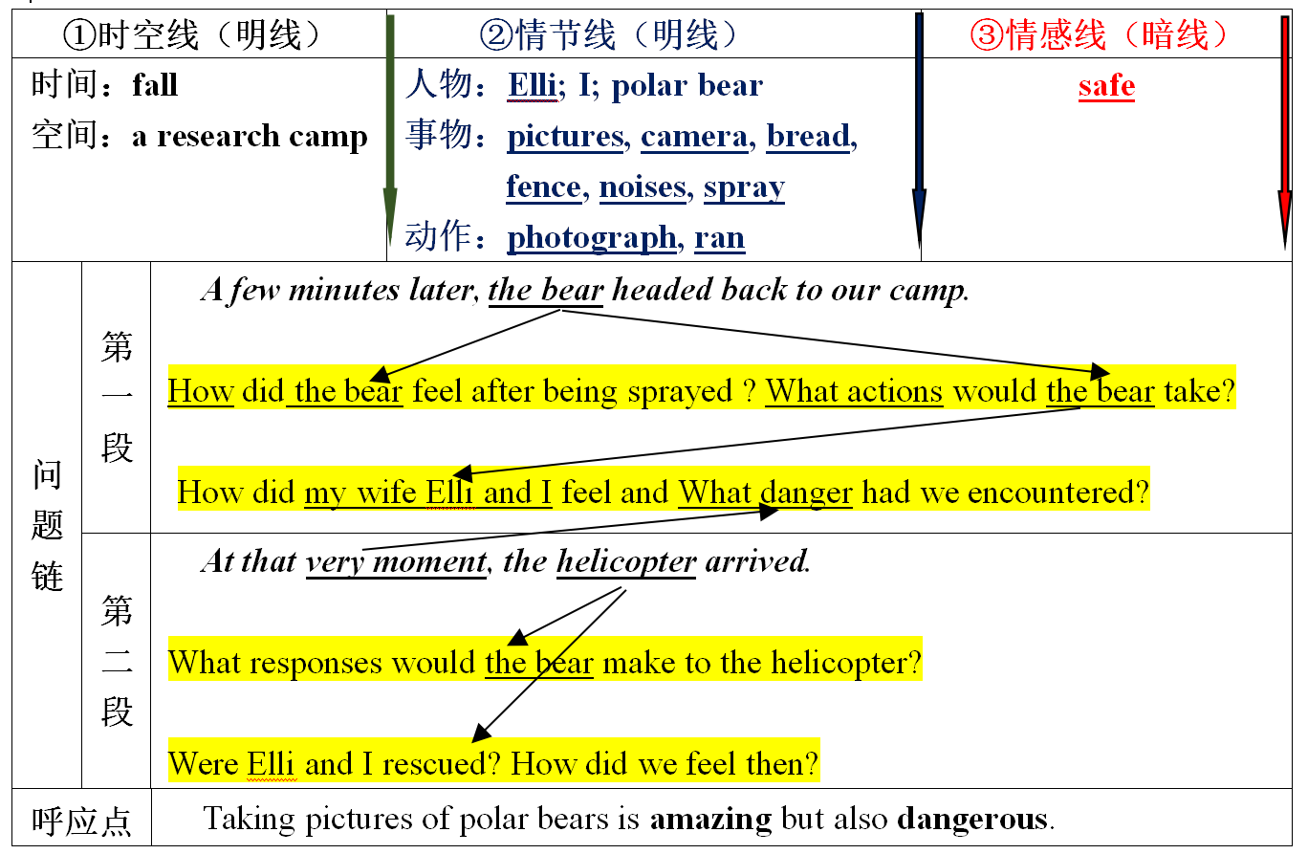
2
-2
激活话题词汇，设置问题驱动，构建写作支架 (点线面快速构思法)
“点线面”快速构思法，定位划线词出现的段落位置，并将划线单词和段首句进行分类，用三条线（语义链）来区分划线单词，激活话题词汇，形成语义链和语义场：时空线（明线），情节线（明线），情感线（暗线）帮助构思情节。设置问题链，建构写作支架和图式，以思维导图的形式帮助学生分析故事的要素和线索，合理创设续写情节。

Slide 26
2
-2
激活话题词汇，设置问题驱动，构建写作支架（2020.07：和北极熊面对面）
设置问题驱动，逻辑发展线索 ( Trace the clues )
根据段首句“the bear headed back to our camp”“At that very moment”可以推测故事情节：受辣椒喷雾袭击而暴怒的北极熊返回营地一定会对作者和他的妻子更疯狂地攻击，他们会想出什么样的办法来应对北极熊，以及等待救援的到来，作者会以第一人称视角描写双方惊险对峙的动作和心理活动。根据第二段段首句the helicopter arrived可知，直升机成功解救夫妻二人，经历了此次 amazing but dangerous拍摄之旅。
所以在角色连续、地点连线、时间延续的基础上，将故事分为熊的“受诱惑→擅闯→被驱逐→攻击→平息”五个情节发展阶段；相应地将Ellis & I 的情感变化分为“Amazed/calm (拍照)→terrified（熊擅闯）→worried/unstable（驱逐熊）→ uneasy/anxious (熊攻击)→ grateful(平息)”。

Slide 27
2
-2
激活话题词汇，设置问题驱动，构建写作支架（2020.07：和北极熊面对面）
激活话题词汇，细化必要行为（Specify the main actions）
A few minutes later, the bear headed back to our camp. With greater rage, the bear roared and tried to tear down the fence with all his might. I gathered up my courage and tried to spray him again. Unfortunately, he managed to escape and my heart froze in my chest. At this moment, Elli came up with a crazy idea and threw our garlic bread at the bear. To my great surprise, the bear stopped and bowed down to eat the bread. Seeing this, all of us let out a sigh of relief. Before long, however, the hungry bear finished eating and pushed the fence again. The fence was about to fall down!
对首句提供的基本情景和语场进行逻辑推进，“受辣椒喷雾袭击而暴怒的北极熊返回营地一定会对作者和他的妻子更疯狂地攻击”， 激活“攻击”话题词汇——With greater rage, the bear roared and tried to tear down the fence with all his might；managed to escape；stopped and bowed down ；pushed， 细腻的神态动作描写，增强文章的感染力。
作为续写的次要情节，可以根据情节的需要增加细节描写（环境描写、心理描写、外貌描写等），起到烘托环境气氛、刻画人物性格和揭示主题思想的作用。

Slide 28
2
-2
激活话题词汇，设置问题驱动，构建写作支架（2020.07：和北极熊面对面）
激活话题词汇，增加适当情感（Add proper emotions）：
At that very moment, the helicopter arrived. Shocked by the noises, the bear stopped and turned around. Seeing the people equipped with guns, he ran away and disapeared in the woods as if he knew who they were. We finally got our breath and Elli and I embraced tightly with still racing hearts. After we calmed down, the locals told us that the bears were losing their homes and food because of human activities and climate changes. On the way back home, I checked the precious pictures in the camera, lost in thought.
对首句提供的基本情景，可以渲染强化；小句关系，解释说明，补充拓展。
在写作支架的构建中，有一个划线词“safe”，一个非划线词“amazing” 属于情感类形容词，这篇文章的情感主线“dangerous →safe→amazing”非常明朗，在这条主线的带动下，习作者增加了“Shocked by the noises”→ “embraced tightly with still racing hearts”→ “lost in thought”
通过这些丰富自然的，淋漓尽致的情绪表达，让读者能更好地理解人物、事件和中心思想。

Slide 29
2
-3
段句逻辑关联，主位合理推进，语义清晰连贯（2020.07：和北极熊面对面）
语言学家普遍认为，一个句子可以划分为“主位(Theme)”和“述位(Rheme)”两大部分。主位是讲话的起点，通常是语法上的主语，一般表示已知信息。述位是围绕主位展开的部分，是对主位的叙述、描写和说明，一般表示引发的新信息。语篇的基本主位推进模式主要有四种：主位同一型、述位同一型、延续型和交叉型。
在语篇中，作者的行文思路就是如何向读者一步步传递重点信息，前后句子的主位和述位按照一定的内在语言规律不断地发生联系和变化，具体表现在句子的相互衔接和信息的演化推进，已知信息引发新信息，新信息又不断地成为已知信息，并以此为出发点再触发另一个新信息，也就是通常说的“前言搭后语”。随着各句主位的向前推进，整个语篇逐渐铺开，从而文章脉络畅通。
分析已知信息和新信息是如何衔接和挂钩，可帮助学生准确地把握语篇的内部逻辑关系和作者原始的思路轨迹，合理清晰的主位推进模式是语篇连贯的重要保证。叙述性语篇往往以人物、事件为话语中心内容，对人物、事件进行重点描写，较多地使用主位同一型推进模式(史金生等，2018)。即各小句主位相同，述位不同。

Slide 30
2
-3
段句逻辑关联，主位合理推进，语义清晰连贯（2018.06：父子寻路）
运用两个段首句信息，确定人物、事件（主位）为话语中心内容，在情节内容与发展方向上为后续事件出现、状态的形成作延展推进，确保整个故事情节发展的一致性和延续性、语篇的连贯性。
Suddenly a little rabbit jumped out in front of my horse.
“What a lovely rabbit!” I shouted with eyes glittering with terrific excitement. It was quite different from those I saw in our city, thus immediately stimulating my interest. Dad was also stunned by this special rabbit/creature, gawking at it motionlessly. “Daddy, let’s catch it as our pet!” I suggested, unexpectedly receiving his prompt agreement. Entirely forgetting what Uncle Paul had told us, we chased after that pretty rabbit, frantic with rapture. Unfortunately, so clever and swift was it that it disappeared in the forest before long. Not until then did we realize that the last ray of twilight was quickly disappearing among the numerous trees and we couldn’t find our track at all! We did get lost!
We had no idea where we were and it was getting dark.

Slide 31
2
-3
段句逻辑关联，主位合理推进，语义清晰连贯（2018.06：父子寻路）
运用两个段首句信息，确定人物、事件（主位）为话语中心内容，在情节内容与发展方向上为后续事件出现、状态的形成作延展推进，确保整个故事情节发展的一致性和延续性、语篇的连贯性。
Suddenly a little rabbit jumped out in front of my horse.
My horse was so afraid that it began running ferociously. I could feel the air hitting my face heavily and hear my dad’s hysterical cry from a distance. My heart was pumping wildly and my blood was pulsing through my veins. I pulled back the reins, distracted the horse and tried every means to stop the horse but in vain. After what seemed an eternity, my dad caught up with me breathlessly and managed to stop my horse. But we found that we were in distress, with no track beside us.
We had no idea where we were and it was getting dark.

Slide 32
2
-3
段句逻辑关联，主位合理推进，语义清晰连贯（2018.06：父子寻路）
运用两个段首句信息，确定人物、事件（主位）为话语中心内容，在情节内容与发展方向上为后续事件出现、状态的形成作延展推进，确保整个故事情节发展的一致性和延续性、语篇的连贯性。
We had no idea where we were and it was getting dark.
The bone-chilling wind howled fiercely like a wolf, making the darkness even more suffocating. “Dad, what can we do?” I threw my arms around him tightly, quivering and seized by stark horror. “All is going well!” Dad answered in a gentle voice, calm and mollified. We wandered in the scary forest and didn’t know what horrible thing would happen to us, hoping to find the way back. Suddenly, we heard the sound of water rolling down the river. We were over the moon and decided to follow the river. After a while, we heard the familiar sound of sheep and then caught sight of the farm house. The family were waiting for us in the distance. Seeing this, a radiant smile lit up both of our faces.

Slide 33
2
-3
段句逻辑关联，主位合理推进，语义清晰连贯（2018.06：父子寻路）
运用两个段首句信息，确定人物、事件（主位）为话语中心内容，在情节内容与发展方向上为后续事件出现、状态的形成作延展推进，确保整个故事情节发展的一致性和延续性、语篇的连贯性。
We had no idea where we were and it was getting dark.
The river beside us was still and serene under the last ray of sunshine but we didn’t have the mood to enjoy it. Suddenly, it occurred to us that there was also a river nearby the farm house. Realizing the river may be a guide back, our spirits soared and we began to trot briskly along the river. Just a few minutes later, catching sight of the silhouette of the house, I felt a feeling of relief and relaxation surging through me. I could picture Uncle Paul’s smiling face and our delicious supper and I thought to myself that our being lost added a special taste to my adventurous vacation which I would remember all my life.

Slide 34
基于具体语境，表达准确丰富
让语言描写插上腾飞的翅膀
03
创造微观语篇组织的表现力

Slide 35
3
创造微观语篇组织的表现力
基于语言“输入”理论和“输出”理论协同效应。
“读后续写最大的优势在于将语言的模仿和内容的创新有机结合，在于释放使用者想象力的同时提高其准确运用外语的能力”。（王初明，2012）
理论
依据
读后续写
能力
要求
将文本阅读和写作结合起来，基于具体语境，激发学生发挥想象力，提高学生在写作、结构以及想象方面的能力，形成发散思维模式。
评价
标准
把握短文语篇结构、关键信息及语言特点，有创造性思维能力，注意语言运用的准确性和丰富性（刘庆思、陈康，2016）。

Slide 36
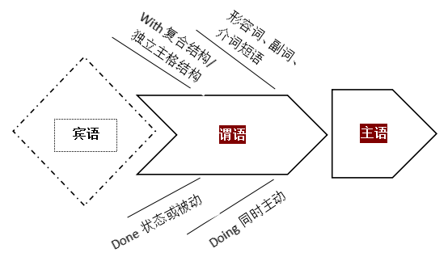
3
-1
名词和动词是续写语言之基
名词动词是续写语言之基，善用doing/done、形容词、副词、介词短语，做伴随状语，在关键处驻足，避免流水账，细化动作延缓过程，立体动感show出鲜活。

Slide 37
3
-1
名词动词是续写语言之基
1. 伊丽莎白手里拿着玫瑰花，慢慢走向沃尔夫，舞台灯光灼热，汗珠顺着伊丽莎白的脸上滴下来。
Clutching the roses, Elizabeth walked slowly towards Ms. Wolff，the stage lights
blazing hot and beads of perspiration trickling down Elizabeth's face.
_{现在分词做伴随状语}
_{两个独立主格结构}
在本句写作中，写作者创作了合适语境，准确使用非谓语动词（现在分词clutching做伴随状语，两个独立主格结构lights blazing和perspiration trickling），能让写作句子更简洁，段落更紧凑，层次更分明。
并善用形容词性短语（beads of）、副词（slowly，hot）、介词短语（towards, down），在关键处驻足，避免流水账，细化动作延缓过程，立体动感show出鲜活。

Slide 38
3
-1
名词和动词是续写语言之基
2.沃尔夫女士优雅地走向钢琴，坐到座位上，然后开始弹奏。她的手指在琴键上翩翩起舞。她时而摇摆, 时而点头, 乌黑发亮的马尾辫跟着起伏摆动。她的双脚在踏板间来回穿梭。
Ms. Wolff made her graceful way to the piano, took her seat and then began to play.
Her fingers danced across the keys. She swayed and nodded, and her shiny black
ponytail bobbed. Back and forth she raced her feet among the pedals.
三个并列谓语动词表一连串动作，说明舞台经验丰富，台风稳健.
拟人
动作描写细腻真实，生动形象
非谓语动词的使用并非越多越好。Too much is a burden！
“唯有动作描写, 人物才能立起来”，动词和名词是是描写生动性的根源。本段描写活用谓语动词，动作描写精准传神，观察细致细微，灵活运用简单句，复合句以及其它多种多样的句式结构和修辞，才能让文章显得错落有致，有层次感。

Slide 39


3
-2
体会课标单词的精妙——活用教材词汇，靶向高考写作
词本无意，意由境生。词汇的意义有理性意义和关联意义，其中关联意义包括：内涵意义（connotative meaning）；语体意义（stylistic meaning）；感情意义（affective meaning）；搭配意义（collective meaning）。
3.能把它与相应的实物或概念联系起来；
4.能以适当的语法形式应用它；
5.能以公认的方式读出它；
6.能正确地拼写出来；
7. 知道它以什么方式与其他词结合(即它的正确搭配形式)；
8. 了解它与词群中其他词的关系(即同义反义关系和上下文关系等)；
芬兰学者罗尔夫·帕尔姆伯格1986年在《英语教学论坛》杂志上撰文指出：真正认识一个外语词汇要求学习者做到：
1.能识别其口头与笔头形式；
2.能随时回忆起其词义及形式；
9. 明白它的内在含义及其关联意义，能将它用于合宜的语体及适当的语境中。

Slide 40
3
-2
体会课标单词的精妙——活用教材词汇，靶向高考写作
在读后续写命题过程中基本消除了超纲词汇和生僻表达，学生在读的过程中要体会原文中的措词用句、语篇基调以及情感线索，用原文的内容和语言风格来帮助读后的写作。从语言角度上看，我们要考虑写出的语言有没有传达意义？意义能否让读者接受？语言能否给人美的享受？
而熟练掌握，准确使用大纲重点词汇和短语做到表意清楚，语法无误，句型正确，这样效果会更好，语言风格更能体现续写文章与原文的连贯性和一体性。
有些学生在写作时为写而写，为了刻意追求所谓的高级词汇、短语或句式而盲目套用一些连自己都没有理解透的佶屈聱牙的“高大上”表达方式，造成语义、语境和逻辑的混乱，阅卷老师的不解，这是得不偿失的。
深挖教材和考纲词汇的关联意义，赏析词汇的精妙，是实现语言协同的重要路径。

Slide 41
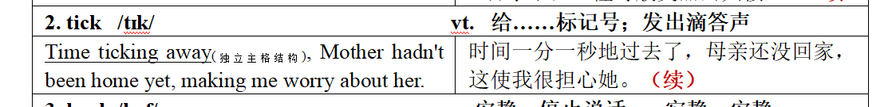
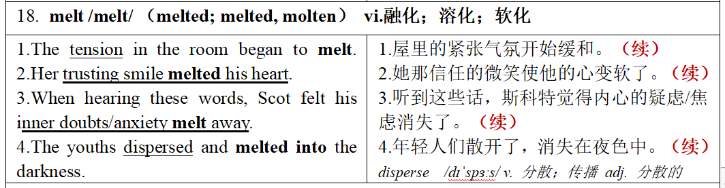
3
-2
体会课标单词的精妙——活用教材词汇，靶向高考写作
运用能打动你的语言表达--去打动读者/阅卷老师
M6U2单词
tick作为听觉的感官词(sensory words) 在叙述和描写中的运用能给人以极大地感染力
M6U2单词
melt本义为“固态物质熔化溶化为液态物质”，引申为“内心软化”含隐喻意义“坚硬冰冷的气氛或内心缓和变软”，形象生动。

Slide 42
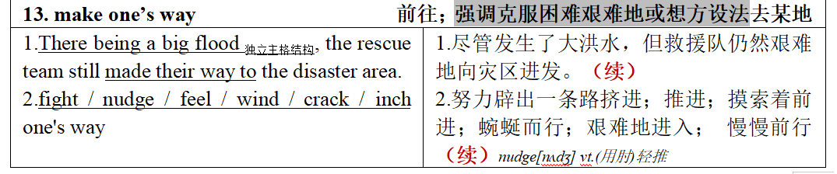
3
-2
体会课标单词的精妙——活用教材词汇，靶向高考写作
运用能打动你的语言表达--去打动读者/阅卷老师
M6U5单词
由词组“make one’s way 克服困难艰难地或想方设法去某地”所延展的“fight / nudge / feel / wind / crack / inch one's way”都是非常生动形象，想象丰富的描述性语言，尤其是crack one's way含隐喻表达，生动耐读； inch one's way中“inch”作动词，准确明了，画面感和代入感很强。

Slide 43
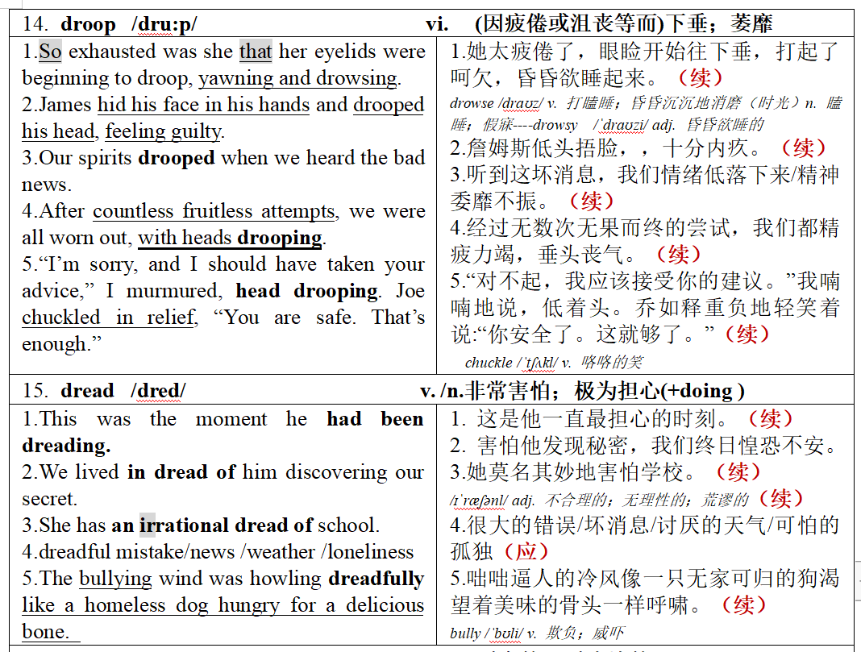
3
-2
体会课标单词的精妙——活用教材词汇，靶向高考写作
运用你能精准掌握的条件反射的语言表达--去征服考试
M6U2单词
M6U2单词

Slide 44
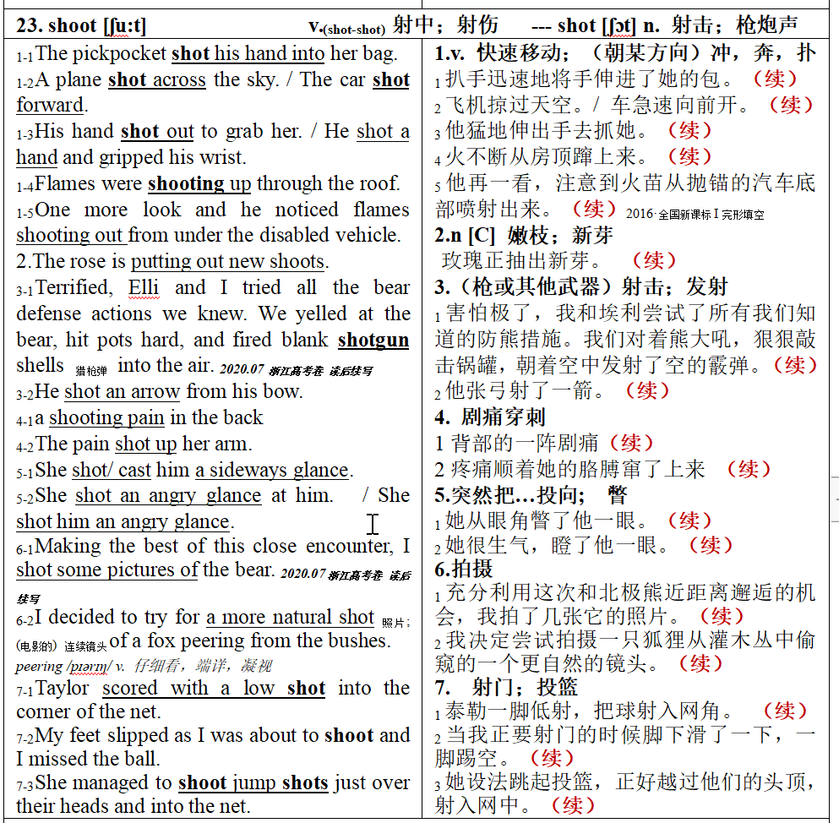
3
-2
体会课标单词的精妙——活用教材词汇，靶向高考写作
运用你能精准掌握的条件反射的语言表达--去征服考试
M6U2单词

Slide 45
3
-3
修辞学在读后续写语言中的妙用
能言是人天生具有的本领，而善言是后生的，是要通过学习、练习才能获得的。而修辞学就是研究善言的学问，探索讲话的艺术。修辞手段被看成是“语言的装饰”、“思想的装饰”，是恰当地选择一些修辞手段、修辞方法，增强语言表达的艺术。因此欲善言者，必先懂得善言之器，如此方可“文以足言”。
拟人personification
明喻
simile
暗/隐喻metaphor
排比parallelism
夸张hyperbole
常用的
修辞手法

Slide 46
3
-3
修辞学在读后续写语言中的妙用——含而不露的隐喻(语义上的修辞格)
情感隐喻式表达就是将各种情感心理直接隐喻成某种事物，然后用描述喻体的各种词语直接对情感心理进行描述。这种隐喻式表达与直陈式表达在语法、修辞上迥异，让读者有耳目一新的感觉。
01
情感是对手
情感的发生往往比较强烈，人们要与它斗争，犹如敌人或对手，但往往被它击败。这在语言使用中常表现为情感词汇与 fight(斗争)、get the better of(挫败)、get the best of(胜过)、prey(折磨)、struggle(搏斗)等词汇搭配使用。例如：
I am struggling with anger. 我怒火中烧。
He fought back his anger. 他克制住了愤怒。
Enthusiasm gets the better of me.我太激动了。
Boredom often gets the best of them.
他们常感到非常无聊。
His curiosity got the better of him. 他异常好奇。
Anger and bitterness had preyed upon me continually.我感到愤怒和痛苦。
情感是统治者
由于人们不能战胜情感，有时反而被其控制，所以情感被比作统治者，可以 oppress(压迫)人们，甚至deprive(剥夺)人们的某种能力。例如：
Worrying deprived him of sleep.
他焦虑万分，难以入睡。
Excitement deprived me of all power of speech.
我激动得什么话都说不出来。
Astonishment, apprehension and even horror oppressed her.
她感到心情抑郁，甚至惊恐不安。
02
——节选自“英语情感隐喻的几种情形”，《中小学英语教学与研究》

Slide 47
3
-3
修辞学在读后续写语言中的妙用——情感隐喻
从大量的写作实践来看，由于学生缺乏隐喻意识和知识，输出的语言非常平淡、苍白，不够形象，缺乏美感。在英语教学中，我们要变换不同的方式表达，突出隐喻的优势和魅力。
03
情感是液体
人体常被视为容器，情感因此被比作容器中的液体，如同wave/ flood的 surge/ sweep，有时 fill/brim（注满/盛满)容器，有时 overflow/ well(漫出/溢出）容器，在高温下甚至会boil(沸腾)。例如：
Panic surged up within him.他惶恐不安。
His heart is overlowing with joy.他满怀喜悦。
I could feel anger boiling up inside me.
我感到怒火中烧。
A wave of panic swept over her.
一阵惊恐袭上她的心头。
They have been immersed in the deep sorrow since then. 从那以后他们一直沉浸在悲伤中。
情感是人手
人们常被情感掌控，受其制约，因此情感常被比作一双无形巨手，人们被其grip/seize(牢牢抓握)，无处遁形，或处于其cover(覆盖)下，无能为力，有时甚至被其tear... into pieces(撕成碎片)。例如：
Fear gripped her heart. 她心中充满恐惧。
She was seized with jealousy. 她妒火中烧。
A feeling of panic seized her. 她突然惊慌失措。
Anxiety tore her into pieces. 她焦虑不安，身心憔悴。
Anger and bitterness covered upon me for weeks.
我好几周都沉浸在愤怒和痛苦中。
04

Slide 48
3
-3
修辞学在读后续写语言中的妙用——情感隐喻
我们要学会表达出隐喻的外在形式特征，而且要突现出隐喻“由此及彼”的认知功能，遵循可接受性原则、语言形象性原则、认知性原则。
05
情感是光线
情感和光线变化密切相关。在sunny(晴朗)、radiant(阳光灿烂)的天气，人们会感到开朗高兴，cloudy(阴云密布)或者 dark(光线晦暗)则让人心情阻塞、郁闷不快。例如：
Joy shone from his brow. 他喜上眉梢。
She was radiant with joy. 她喜气洋洋，容光焕发。
The boss is in a sunny mood today. 老板今天心情很好。
She has been in a dark mood this week.
她这周心情一直不好。
His face clouded over when he heard the news.
听了这个消息，他满脸愁云。
情感是动物
由于情感具有换然而至、悄无声息的特点，因此会像动物那样crawl/creep(爬动)。例如：
Happiness crawls up to the tips of his brows.
他喜上眉梢。
A slight feeling of fear slowly crept on him.
他慢慢感到一丝恐惧。
06

Slide 49
3
-3
修辞学在读后续写语言中的妙用——生动形象的明喻(语义上的修辞格)
明喻的表现形式各异但它们所起的修辞作用和语言效果无不生动、具体、形象，因而留给读者隽永深长、耐人寻味的艺术魅力。
1. Finally I managed to put my whole head into it，like a cork forced into a bottle.（2021年1月南瓜卡头-原文）
最后，我把整个头都塞了进去，就像塞进瓶子里的软木塞一样。
2. The house seemed quiet as a tomb without the boy living there.（2020.01为狗找伴-原文）
没有那个男孩住在那里，那房子似乎安静得像一座坟墓。
3. It looked like a beautiful woven blanket spread out upon the ground just for us.（2018.06父子寻路-原文）
它看起来就像一条美丽的编织毯子，为我们在地面上铺开。
4.“Where have you been? We saw your bicycle on the road. ”His friend asked and these words like a ray of sunshine warmed his heart. （2017.06 狼口脱险-续写）
“你到哪儿去了? 我们在路上看到你的自行车了。”他的朋友问，这些话像一缕阳光温暖了他的心。

Slide 50
3
-3
修辞学在读后续写语言中的妙用—— 栩栩如生的拟人(语义上的修辞格)
拟人是一种“静物动化、借物寓情、借物喻人”的修辞技巧，其作用是在于深刻地描写事物，充分地抒发感情。人们在情感强烈的时候，把情感融化在所描写的对象之中，使其对当时的情景产生真切的共鸣。把“物”刻画成“人”，使人们不仅看到了“物”一时的外部形态，而且重在表现某种思想、精神、情操等内在实质。
1. My excitement was short-lived.（2021年1月南瓜卡头-原文）
我的兴奋是短命的。
2. It was so peaceful and quiet and the colors of the brown rocks, the deep green pine trees, and the late afternoon sun mixed to create a magic scene. （2018.06父子寻路-原文）
这是如此平静和安静，棕色的岩石，深绿色的松树，傍晚的太阳混合在一起创造了一个神奇的景象。
3. One strange family trip we took when I was eleven tells a lot about her.（2017.10健忘妈妈旅行记-原文）
我11岁时的一次奇怪的家庭旅行告诉了我很多关于她的事情。
4. A bright red cloud enveloped the animal，and to Mac's relief，it fell back，shaking its head．（2017.06 狼口脱险-原文）
一片鲜红的雾笼罩着这只动物，它摇着头向后退去，使麦克松了一口气。
5. As night was beginning to fall, Jane was so tired that she had to stop for the night. （2016.10 丛林逃生-原文）
夜幕降临时，简太累了，只好停下来过夜。

Slide 51
3
-3
修辞学在读后续写语言中的妙用—— 言过其实的夸张(语义上的修辞格)
夸张的目的在于突出事物的本质，加强语言的感染力，激起人们的想象力，达到一种严肃而又滑稽的效果。
用于描写：基于实际·超越实际，增加文章的生动性、趣味性、可读性和艺术感染力。
用于说理：揭示事物的本质，突出事物的特征，生动形象地揭示事情的本质，从而引起读者强烈的认同感。
1. Not this polar bear though - he just kept trying to tear down the fence with his massive paws.（2020年7月和北极熊面对面-原文）
（这些措施）然而对这只北极熊不管用——它一直试图用巨大的爪子捣毁篱笆。
2. If a strange family showed up on her front doorsteps, Mom would have been delighted. She thinks everyone in the world as nice as she is. （2017.10健忘妈妈旅行记-原文）
如果一个陌生的家庭出现在她的前门台阶上，妈妈会很高兴的。她认为世界上每个人都和她一样好。
3. After what seemed like a century, John managed to break the pumpkin.（2021年1月南瓜卡头-续写）
似乎过了一个世纪，约翰终于打破了南瓜。
4. We were over the moon and decided to follow the river. （2018.06父子寻路-续写）
我们欣喜若狂，决定顺着河走。

Slide 52
3
-3
修辞学在读后续写语言中的妙用—— 气贯长虹的排比(结构上的修辞格)
排比就是把结构相同、语义并重、语气一致的词、词组或句子排列成串，形成一个整体。排比具有结构整齐、节奏明快、表达简练、语义突出的特点。使用排比手法的目的在于表达强烈的情感，突出所强调的内容，增强语言的气势。
用于写人，可使之形象逼真，栩栩如生；用于叙事，可使读者亲临其境，历历在目；用于抒情，可使读者感到情深意切，淋漓尽致；用于说理，可使语言具有说服力，有极强的煽动性。
1. Thanks to Mom, the video turned out to be a affectionate reminder, a captured memorable moment, a recollection of festival happiness, colored by hearty human interactions.（2021年1月南瓜卡头-原文）
多亏了妈妈，这段视频成为了一个温馨的提醒，一个难忘的瞬间，一个节日快乐的回忆，充满了真诚的人情互动。

Slide 53
3
-3
修辞学在读后续写语言中的妙用—— 结构完美的对照(结构上的修辞格)
对照，就是有意识地把意义相对的词语放在对称的结构中形成对照。对照既要求结构匀称整齐、又要求有意义相反的词语互相衬托，二者缺一不可。通过鲜明的对照，有力地揭示它们是一个整体的两个相反相成的侧面，暴露事物间的对立和矛盾，在读者脑海里形成强烈的反差，从而表达一个深层的题旨。从音、形、义三方面看，它音律节奏铿锵，形式整齐匀称，内容即适应于重复强调，又适应于反衬对照。
1. David and I were always a little nervous when using gas station bathrooms if Mom was driving while Dad slept: “ You stand outside the door and play lookout while I go, and I’ll stand outside the door and play lookout while you go.” （2017.10健忘妈妈旅行记-原文）
每次妈妈开车而爸爸睡觉时，大卫和我上加油站的洗手间总是有点紧张:“我去的时候，你站在门外帮我望风，你去的时候，我就站在门外帮你望风。”

Slide 54
3
-3
修辞学在读后续写语言中的妙用—— 语义深化的渐进(结构上的修辞格)
渐进在形式上，构成渐进至少要有三个语言单位，而且这些语言单位的结构要索基本相同；在内容上，构成的渐进各语言单位在意义上要有关联，且具有等次，即按照由小渐大，由浅渐深，由低渐高，由近渐远，由少渐多，由弱渐强，由轻渐重，层层递升，有次序地叙述，最后达到顶点。
渐进在表达上的主要作用是使阐述的思想步步深化，所抒发的感情层层推进，增强语言的说服力和感染力。
1. Much to my dismay, my dad and mom whispered, chuckled, giggled and finally burst into laughter. （2021年1月南瓜卡头-续写）
让我沮丧的是，爸爸妈妈低声说着，轻声笑着，咯咯笑着，最后哈哈大笑起来。
2. We yelled at the bear, hit pots hard, and fired blank shotgun shells into the air. （2020年7月和北极熊面对面-原文）
我们对着熊大喊大叫，狠狠地敲打盆罐，还向空中发射了空弹。

Slide 55
3
-3
修辞学在读后续写语言中的妙用—— 无声胜有声的拟声(音韵上的修辞格)
拟声是对客观世界的声音的模仿。拟声词不是客观世界声音的简单再现，而是按照某种语言的语音系统对客观世界的声音加以奉仿改造的结果，是客观世界的声音的固有节律和某种语言所特有的语言特点相结合的产物。
这种修辞格的运用能真实地表现事物的特点，渲染气氛，使人感受到事物的生动性及其内在的旋律，使人如闻其声、如见其人、如临其境。
1. Much to my dismay, my dad and mom whispered, chuckled, giggled and finally burst into laughter. （2021年1月南瓜卡头-续写）
让我沮丧的是，爸爸妈妈低声说着，轻声笑着，咯咯笑着，最后哈哈大笑起来。
2. The whir of the 's propellers scaring the bear away, the helicopter zoomed down and the rescuers rushed to us soon.（2020年7月和北极熊面对面-续写）whir /wɜː(r)/ v. 作呼呼声，呼呼作声地飞; 急速旋转 propeller /prəˈpelə(r)/ n. 螺旋桨；推进器
螺旋桨的轰鸣声把熊吓跑了，直升飞机急速下降，救援人员很快就赶到了我们这里。
3. Then the bear came our way, letting out a rumbling growl. （2020年7月和北极熊面对面-续写）
这时，那只熊向我们走来，发出隆隆的咆哮。

Slide 56
基于赏析运用，零失误快输出
让高考备考插上腾飞的翅膀
04
调整纵观考情分析的方向感

Slide 57
4
-1
读后续写的准确应试定位
尖子生：神形兼备炫出彩（23分），语言丰富，情节合理，逻辑严密，
传神的语言提亮表达方式，前后呼应耐人寻味。
中等生：稳打稳扎有亮点（20分），语言规范，线索清晰，逻辑合理，
精当的语言推进情节发展，起承转合一气呵成。
拐脚生：降低门槛求完整（15分），粗线条 ，重印象（书写）
准确的语言叙述完整故事， 在情在理通达顺畅。

Slide 58
4
-2
读后续写的备考策略
二考特点：经验较足、准确定位、多种预案（确保20+30分钟写作）
续写考前冲刺： 语言 ①语料库的熟练准确运用，浓缩读薄，
能驾驭，快产出，零失误；
② 真实的语料co-text, 实际发生时的语境含义
③ 动词四式，过去时的各种时态
情节 （叙事元素，逻辑衔接，思想共鸣）
王初明教授指出高考中的读后续写考题的短板在于互动较弱，提出要“内容引领语言使用”，在完全理解原文的基础之上进行续写，不断地参照对比原文，以拉平和作者之间的差距。

Slide 59
4
-3
高考续写语言风向标：“冲突-危机-解决模式”—— 语料积累
考试时间 | 2016.10 | 2017.06 | 2017.10 | 2018.06 | 2020.01 | 2020.07 | 2020.07 | 2021.01
主旨大意 | 丛林逃生 | 狼口脱险 | 健忘妈妈旅行记 | 父子寻路 | 为狗找伴 | 和北极熊面对面 | 度过经济难关 | 南瓜卡头
篇章结构 | 问题--解决 | 问题--解决 | 概括--具体 | 问题--解决 | 问题--解决 | 问题--解决 | 问题--解决 | 问题--解决
冲突-紧张害怕 | √ | √ | √ | √ | √ | √ |  | √
冲突-纠结后悔 | √ |  | √ |  |  |  |  | √
危机-疲惫沮丧 | √ | √ |  | √ |  | √ |  | √
危机-鼓励帮助思考努力 | √ | √ | √ | √ | √ | √ | √ | √
解决-开心激动 | √ | √ | √ | √ | √ | √ | √ | √
户外遇险 及获救 | √ | √ |  | √ |  | √
考前要强化语料的精心准备，真实语料来自真实训练中的真实体验，会赏析用，感动自己，打动评委；能驾驭，快产出，零失误。

Slide 60
4
-3
高考续写语言风向标：“高科技生活和社交模式”—— 多媒体社交
考试时间和主题 | 高考范例 |  | 你的真实语料积累
2020.07 拍照北极熊 | 充分利用这次和北极熊近距离邂逅的机会，我拍了几张它的照片。（原文） | ✍Making the best of this close encounter, I shot some pictures of the bear. | 会赏析用，感动自己，打动评委； 能驾驭，快产出，零失误
2021.01 南瓜卡头 | 1.人们让妈妈把视频放到YouTube上，到周三早上5点，我们就接到了早餐电视节目的电话，然后国际媒体开始播放这段视频，点击量达到了数十万。（续写） 2.这条消息立即走红。仅仅在几个小时内，就有数百个点赞和有趣的评论出现，显示出他们的热情。好奇的人们络绎不绝地过来和我们以及我心爱的南瓜合影留念。Jason很兴奋，妈妈也很高兴她的视频能这么火，也因此对拍摄视频更加狂热了。（续写） | ✍People asked Mom to put it on YouTube, and by Wednesday morning we were getting 5am calls from TV breakfast shows and then the international media – the video started racking up hundreds of thousands of views. ✍ It went viral immediately. Just within hours, hundreds of likes and funny comments appeared, showing their enthusiasm. Constant streams of curious people even came by to take photos with us and my prized pumpkin. Jason was really excited and Mom was glad that her video should become such a hit and thus grew even crazier about shooting videos.

Slide 61
4
高考预测——人与自我；人与社会（家庭篇：帮父母实现愿望）
2021.3 浙江十校联盟返校联考“The lost bolt失去的螺栓”
-4
①You'd think that after hearing Mom and Dad talk about The Trip for a year, I'd be eager to go. But I don't even want to think about it. “Aren't you excited?” asks Dad looking up from his laptop.“This is the trip of lifetime. I'll bet none of your friends will be driving across the United States this summer.”
②Exactly, I think. Nobody I know is going to pile into an old van, and drive from California to New York and back in 58 days. Fifty-eight days! That's practically my whole summer! But I know it's useless to protest（抗议）.
③When Dad was offered a summer off for the first time in his career, he said that he'd always dreamed of driving across the country. So now we're going. This is Dad's chance.
④I pick up my cat. Max, and bury my face in his fur. He paws at my ears playfully. Good-bye, summer vacation. Good-bye, diving at the lake. Good-bye to hanging out and doing absolutely nothing. Good-bye, Max. I'm going to miss this ball of fur. I put him down and laugh as he bats a button across the floor like a soccer player. He is interested in all small objects.
⑤The closer The Trip gets, the harder it is to ignore. Thick envelopes arrive from places like Indiana,Tennessee,and Arkansas. Night after night,Mom and Dad huddle around the computer, plotting every inch of our 8,000-mile journey.
⑥Three days after school gets out, The Trip is finally here. Everything is packed and ready to go. Mom says that we are supposed to leave at 9 a.m. But when Dad notices a wet spot under the van, I realize we won't be going anywhere for a while. Dad crawls under the van.Car parts spring up around the van like mushrooms.
⑦All of my friends from the neighbourhood gather in the front yard. “So when are you leaving?”they ask. “Anytime now,” I say, but inside I'm wondering how we're ever going to make it across the country when we can't even get down the driveway.
⑧ Minutes turn into hours. By the time Dad gives Mom the news, it's late afternoon.“I fixed the leak,”says Dad. “But now I can't find one of the fan bolts（螺栓）.” Mom organizes a search,but in vain.
Para1: Dad called the stores but none carried the bolt that fitted this old van. ___________________________________
Para2：Then it hit me. “Max!” I shouted, “Find Max!”_______ ______

Slide 62
4
高考预测——人与自我；人与社会（家庭篇：帮父母实现愿望）
2021.3 浙江十校联盟返校联考“The lost bolt失去的螺栓”
-4
①You'd think that after hearing Mom and Dad talk about The Trip for a year, I'd be eager to go. But I don't even want to think about it. “Aren't you excited?” asks Dad looking up from his laptop.“This is the trip of lifetime. I'll bet none of your friends will be driving across the United States this summer.”
②Exactly, I think. Nobody I know is going to pile into an old van, and drive from California to New York and back in 58 days. Fifty-eight days! That's practically my whole summer! But I know it's useless to protest.
③When Dad was offered a summer off for the first time in his career, he said that he'd always dreamed of driving across the country. So now we're going. This is Dad's chance.
 | 理顺叙事元素，读懂伏笔语言 | 顺理协同成章，呼应对应情节
Para 1 | But I didn't even want to think about it.（冲突） | 初始事件的功能在于触发故事最初的对立或冲突，打破了开端时的各种平衡，触发人物作出反应和尝试。
Para 2 | But I know it's useless to protest.（冲突）
✍续写1： Reservations would need to be canceled, destinations would be changed. My soul silently rejoiced. 预订需要取消，目的地会改变。我的内心暗自高兴。
✍续写2：Dad called the stores but none carried the bolt that fitted this old van. "Hadn't I been so careless, the bolts would not have been lost." Mom murmured with fierce frown.We rooting on the ground, the silence ruled us for a while. Although I didn't want to have this boring trip, I didn't want to see my dad and mom feel so sad. “要不是我那么粗心，螺栓就不会丢了。”妈妈皱着眉头低声说。我们站在地上，沉默统治了我们一会儿。虽然我不想有这个无聊的旅行，我不想看到我的爸爸妈妈感到那么难过。

Slide 63
高考预测——人与自我；人与社会（家庭篇：帮父母实现愿望）
2021.3 浙江十校联盟返校联考“The lost bolt失去的螺栓”
4
-4
①You'd think that after hearing Mom and Dad talk about The Trip for a year, I'd be eager to go. But I don't even want to think about it. “Aren't you excited?” asks Dad looking up from his laptop.“This is the trip of lifetime. I'll bet none of your friends will be driving across the United States this summer.”
②Exactly, I think. Nobody I know is going to pile into an old van, and drive from California to New York and back in 58 days. Fifty-eight days! That's practically my whole summer! But I know it's useless to protest.
③When Dad was offered a summer off for the first time in his career, he said that he'd always dreamed of driving across the country. So now we're going. This is Dad's chance.
 | 理顺叙事元素，读懂伏笔语言 | 顺理协同成章，呼应对应情节
Para 3 | He said that he'd always dreamed of driving across the country.（铺垫） | 初始事件的功能在于触发故事最初的对立或冲突，推动故事情节向纵深发展。
✍续写1：A gloom of depression crept on Dad's face. He threw his tools violently, roaring “I have been preparing our trip for months...” 父亲的脸上露出忧郁的神情。他猛地扔出工具，咆哮道:“我已经为我们的旅行准备了几个月了…… ”
✍续写2：His dream—The Trip of a Lifetime―was vanishing before his eyes. “So much for seeing everything from‘sea to shining sea_{隐喻},’ ” Dad shrugged his shoulder and forced a smile. 他的梦想“一生的旅行”在他眼前消失了。“就这样看整个美国了” 爸爸耸耸肩，无奈地笑了笑。

Slide 64
4
高考预测——人与自我；人与社会（家庭篇：帮父母实现愿望）
2021.3 浙江十校联盟返校联考“The lost bolt失去的螺栓”
-4
①You'd think that after hearing Mom and Dad talk about The Trip for a year, I'd be eager to go. But I don't even want to think about it. “Aren't you excited?” asks Dad looking up from his laptop.“This is the trip of lifetime. I'll bet none of your friends will be driving across the United States this summer.”
④I pick up my cat. Max, and bury my face in his fur. He paws at my ears playfully. Good-bye, summer vacation. Good-bye, diving at the lake. Good-bye to hanging out and doing absolutely nothing. Good-bye, Max. I'm going to miss this ball of fur. I put him down and laugh as he bats a button across the floor like a soccer player. He is interested in all small objects.
 | 理顺叙事元素，读懂伏笔语言 | 顺理协同成章，呼应对应情节
Para 4 | ①Good-bye, summer vacation. Good-bye, .... Good-bye to.. Good-bye, Max... （冲突） | ①消除对立或冲突、实现目标而不断反应和尝试的最新状态。
 | ②He batted a button across the floor like a soccer player. He was interested in all small objects.（铺垫） | ②在情节内容与发展方向上为后续事件出现、状态的形成作铺垫，确保整个故事情节发展的一致性和延续性。
✍续写：As our van chugged down the freeway, I thought this trip might not be so bad after all. Good-bye, regular old summer vacation. Hello... Trip of a Lifetime?
当我们的面包车在高速公路上嘎吱嘎吱地行驶时，我想这趟旅行可能还没那么糟糕。再见，平常的老暑假。你好……千载难逢的旅行?

Slide 65
4
高考预测——人与自我；人与社会（家庭篇：帮父母实现愿望）
2021.3 浙江十校联盟返校联考“The lost bolt失去的螺栓”
-4
④I pick up my cat. Max, and bury my face in his fur. He paws at my ears playfully. Good-bye, summer vacation. Good-bye, diving at the lake. Good-bye to hanging out and doing absolutely nothing. Good-bye, Max. I'm going to miss this ball of fur. I put him down and laugh as he bats a button across the floor like a soccer player. He is interested in all small objects.
 | 理顺叙事元素，读懂伏笔语言 | 顺理协同成章，呼应对应情节
Para 4 | ②He batted a button across the floor like a soccer player. He was interested in all small objects.（铺垫--解决路径） | ②在情节内容与发展方向上为后续事件出现、状态的形成作铺垫，确保整个故事情节发展的一致性和延续性。
✍续写：
...The Trip, was what Dad had always been dreaming of, just like Max’s craze/affection for small objects.
Then it hit me. “Max!” I shouted, “ Find Max!” Oh! How could I forget this? Who else could have a preference for the bolt than Max? I jumped excitedly.
加强训练第二段首句对故事情节的承接衔接作用

Slide 66
4
高考预测——人与自我；人与社会（家庭篇：帮父母实现愿望）
2021.3 浙江十校联盟返校联考“The lost bolt失去的螺栓”
-4
写作微技能: 抓住文章中心词，首尾呼应，主题升华
① No sooner had the van been fixed than father declared the start of The Trip. Amazingly, this time I didn’t resist/protest the adventure anymore. Somehow, I was looking forward to The Trip. I supposed that was probably because I was the hero who helped father find the bolt and realize his dream.
货车刚修好，父亲就宣布旅行开始。令人惊讶的是，这次我不再抗拒冒险了。不知为什么，我一直很期待这次旅行。我想那可能是因为我是那个帮助父亲找到螺栓并实现他梦想的英雄。
② Dad finally managed to fix the van and a fantastic 58-day vacation was unfolded before us, waiting for us to enjoy, explore and embrace.
爸爸终于修好了货车，一个奇妙的58天假期展现在我们面前，等待着我们去享受、探索和拥抱。
③ "Thank you, dear." Dad padded my head and said "Now we can go." The trip then started smoothly. You know, parents also have dreams, and what we can do is to hep them achieve their dreams with all favor.
“谢谢你,亲爱的。” 爸爸轻轻地拍了拍我的头说:“现在我们可以走了。”旅行开始得很顺利。你知道，父母也有梦想，我们能做的就是帮助他们实现他们的梦想。

Slide 67
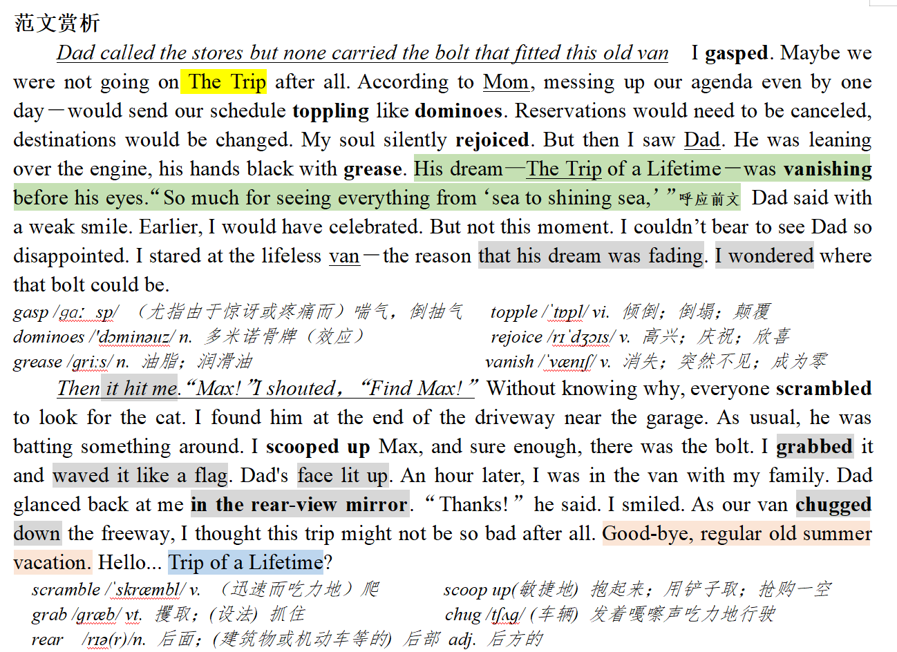
4
高考预测——人与自我；人与社会（家庭篇：帮父母实现愿望）
2021.3 浙江十校联盟返校联考“The lost bolt失去的螺栓”
-4

Slide 68
高考预测——人与自我；人与社会（学校篇：诚实做人）
2020.12 山水联盟考试“Honesty Won’t Let You Down 诚实不会让你失望”
4
-4
Honesty Won’t Let You Down
Asad was a 13-year-old boy who was very honest and hardworking. Recently, he had entered a new school so he had no friends yet, On Monday morning, he was nearly late for school. The night before, his family attended his cousin’s wedding and reached home late, which was why he couldn’t get up on time as usual.
At school, Asad could not pay attention to anything and wanted the bell to ring so that he could buy something to eat. After a few hours, when the bell rang, Asad quickly opened his schoolbag to find his money, but just then he remembered that he had left for school in a hurry in the morning and forgotten to take money, He looked under his books, hoping to find some money but there was nothing.
Not knowing what to do, he walked out of the classroom and sat on a bench in front of the canteen. He saw a few of his classmates there, among them was Fahad. He was one of the richest kids in his class but he was a very arrogant boy who thought everyone else was a loser. But as Asad was new, he didn’t know much about Fahad.
When he went towards Fahad and asked if he could borrow some money for his lunch, Fahad laughed a lot and said, “I knew you were a loser, maybe a beggar? "Fahad laughed out so loud that other kids also heard and made fun of the situation. He didn’t answer Fahad, and slowly walked back towards an empty bench.
When he reached the bench, he noticed something lying near it. It was a wallet. He picked it up and recognized it as Fahad's, as he remembered Fahad showing it to his friends and telling that his uncle bought it for him from the UK. There was quite a lot of money inside for a kid.
Para 1: At first, Asad wanted to Keep it a secret and punished Fahad.______ ________________
Para 2: Then Fahad said, “Why are you giving it back?”_______ _________________________

Slide 69
高考预测——人与自我；人与社会（学校篇：诚实做人）
2020.12 山水联盟考试“Honesty Won’t Let You Down 诚实不会让你失望”
4
-4
写作微技能: 理顺叙事元素，合理设置问题链
本文冲突点: “He was a very arrogant boy who thought everyone else was a loser（他是一个非常傲慢的男孩，认为其他人都是失败者）” “I knew you were a loser, maybe a beggar? " 两次提到“loser”, 与前文“honest”形成矛盾。标题统领全文“Honesty Won’t Let You Down”，并指向续写的方向和和评议主题意义，因此续写要首尾呼应，以 “not let down -- win the respect/dignity” 形成豹尾。
Para 1: At first, Asad wanted to keep it a secret and punished Fahad. _________________
➢ Q1. Did Asad change his mind at the last minute? What made him change his mind?
➢ Q2. What was his new idea?
➢ Q3. How did he give back the wallet and what was Fahad’s reaction?
➢ Q4. What happened before Fahad asked the question?
Para 2: Then Fahad said, “Why are you giving it back?”______________________________
➢ Q1.How did Asad explain the whole thing? And how did he feel?
➢ Q2. Did Fahad believe his explanation? And what did he do?
➢ Q3. Asad’s reflections./ What did they each learn from the incident?

Slide 70
高考预测——人与自我；人与社会（学校篇：诚实做人）
2020.12 山水联盟考试“Honesty Won’t Let You Down 诚实不会让你失望”
4
-4
写作微技能: 抓住文章中心词，首尾呼应，主题升华
A. 画龙点睛式： Being honest not only helped him win others’ trust but also made new friends in this new school, a brand new life beginning to unfold before him. 诚实不仅让他获得了别人的信任，也让他在这所新学校结识了新朋友，一个全新的生活开始在他面前铺开。
❖ Not until then did Fahad realize that not everyone is a loser. Honesty, a significant spirit in evernyone's soul, can let you up. 直到那时，法哈德才意识到，不是每个人都是失败者。诚实，是每个人灵魂中的重要精神，可以让你振作起来。
B.环境描写烘托式：Bathed in the warm noon sunshine, Asad couldn’t help smiling, glad that his simple honesty was rewarded with such a large circle of nice friends! 沐浴在中午温暖的阳光下，阿萨德不禁微笑，很高兴他朴素的诚实收获了这么大帮的朋友!
❖ Fahad treated Asad a lunch, "You deserve it, honest boy." The whole room bathed in happiness, with air being sweet. 法哈德请阿萨德吃了一顿午餐，“你应得的，诚实的孩子。”整个房间沐浴在幸福之中，空气清新。

Slide 71
高考预测——人与自我；人与社会（学校篇：诚实做人）
2020.12 山水联盟考试“Honesty Won’t Let You Down 诚实不会让你失望”
4
-4
写作微技能: 抓住文章中心词，首尾呼应，主题升华
C. 展望未来式：With more friends around, Asad was convinced that a brand new life based on honesty was waiting for him to explore, embrace and enjoy.有了更多的朋友，阿萨德确信一个基于诚实的全新生活正等着他去探索、拥抱和享受。
D.回首反思式：Looking back, Asad congratulated himself on making the right decision, which helped him turn over a chapter of life. 回首往事，阿萨德庆幸自己做出了正确的决定，这帮助他翻过了人生的一个篇章。
E.自然结局式：By being honest and saying the truth, not only did Asad get some money to buy lunch when Fahad lent him some, but he was also able to make new friends. Fahad’s life simultaneously changed with all his arrogance sinking without trace and he learned an important lesson that “Honesty won’t let you down.” 通过诚实和讲真话，阿萨德不仅得到了一些法哈借给他的钱去买午餐，他也能够结交新朋友。法哈德的生活同时改变了，他所有的傲慢消失得无影无踪，他学到了重要的一课，那就是“诚实不会让你失望。”

Slide 72
高考预测——人与自我；人与社会（学校篇：诚实做人）
2020.12 山水联盟考试“Honesty Won’t Let You Down 诚实不会让你失望”
4
-4
写作微技能: 突出心理、动作和神态描写——内心纠结
However, another voice popped up, urging him to give it back to Fahad, which made him feel torn. “I should
never keep the wallet at the cost of my honesty, and Fahad would be extremely embarrassed without any money in the presence of so many classmates!” Asad convinced himself.
然而，另一个声音响起来，敦促他把它还给法哈德，这让他感到很痛苦。“我不应该以我的诚实为代价来保存钱包，而法赫德在那么多同学面前身无分文会感到非常尴尬!”阿萨德说服了自己。
So thrilled and afraid was he that he couldn't pay attention to the teacher the moment he touched the wallet.
Only the money can capture his attention. "You were a loser!" a voice hovering over Asad's head. Suddently, it dawned on him that he was wrong and he was a really loser now.
他是如此的激动和害怕，以至于一碰到钱包他就不能注意到老师。只有钱才能吸引他的注意力。“你是个失败者!”一个声音在阿萨德的头上盘旋。突然，他意识到他错了，他现在是一个真正的失败者。

Slide 73
高考预测——人与自我；人与社会（学校篇：诚实做人）
2020.12 山水联盟考试“Honesty Won’t Let You Down 诚实不会让你失望”
4
-4
写作微技能: 高分开头，吸引眼球
分词A participle (-ing or--ed) : At first, Asad wanted to keep it a secret and punished Fahad. Having confirmed that no one was there, he quickly took out some money and put the wallet into his pocket with his heart bumping fiercely. It was the first time that he had felt so frightened. 在确认没有人后，他迅速掏出一些钱，把钱包放进口袋里，心猛地一跳。这是他第一次感到如此害怕。
独立主格结构: At first, Asad wanted to keep it a secret and punished Fahad. Excitement mingled with nervousness, he put the wallet into his pocket swiftly for the fear that someone might see it虚拟语气. 兴奋夹杂着紧张，他迅速地把钱包放进口袋里，生怕有人看见。
精彩对话+比喻：Then Fahad said,"Why are you giving it back?" "My conscience didn't allow me to keep it. Although you laughed at me, I should be honest to whoever you are." At that moment, a beam of sunlight shone into the room, brightening their heart and warming their souls. “我的良心不允许我保留它。虽然你嘲笑我，但我应该对你诚实，不管你是谁。”就在那一刻，一束阳光照进了房间，照亮了他们的心，温暖了他们的灵魂。
虚拟语气: At first, Asad wanted to keep it a secret and punished Fahad. “He deserves the punishment!” Asad thought to herself with rage. “Had he not laughed at me, I would certainly return it to him right away._{错综时间虚拟句+倒装}” “他活该!”阿萨德愤怒地想。“要不是他嘲笑我，我一定马上还给他。”

Slide 74
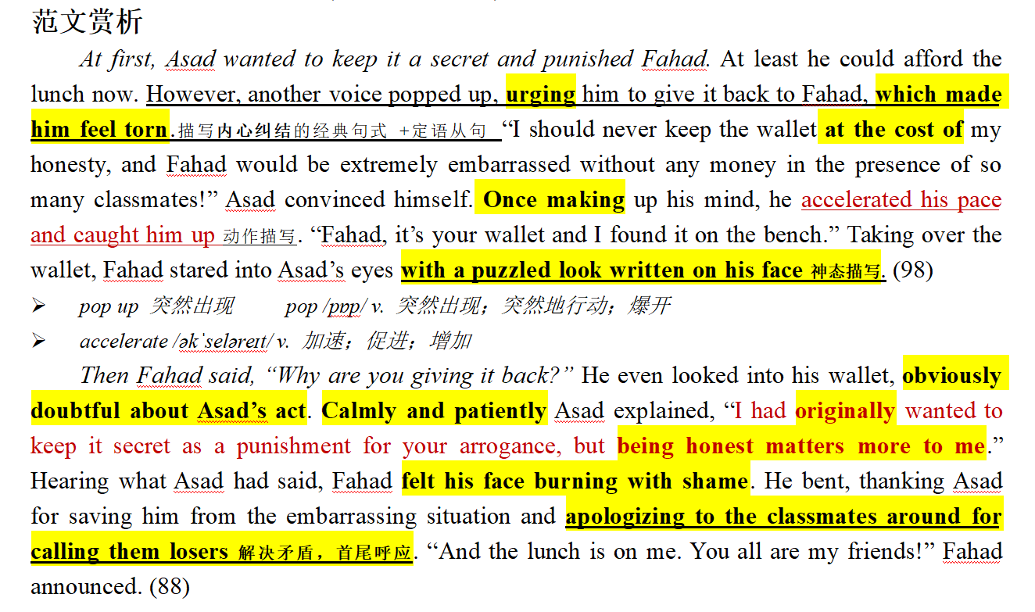
高考预测——人与自我；人与社会（学校篇：诚实做人）
2020.12 山水联盟考试“Honesty Won’t Let You Down 诚实不会让你失望”
4
-4

Slide 75

奇迹总在拼搏之后；成功蕴于进取之中。
——“溯恩高中英语”寄语高三考生
Wish you success!

