Slide 1
感恩遇见，相互成就，本课件资料仅供您个人参考、教学使用，严禁自行在网络传播，违者依知识产权法追究法律责任。
更多教学资源请关注
公众号：溯恩高中英语
知识产权声明

Slide 2
How to connect your writing with the given sentence in story completion?
鲁周焕
余杭高级中学

Slide 3
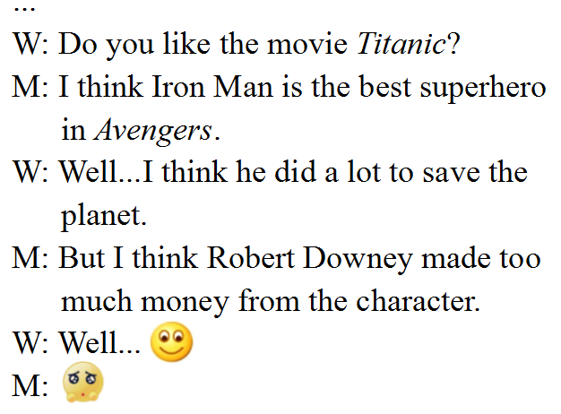
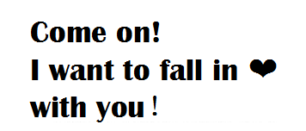

Slide 4
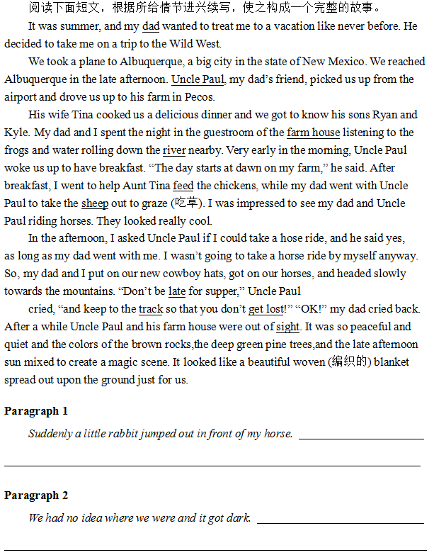
第二节 读后续写
♦Problems to be solved:
1. How to connect the given sentence
with the last sentence of the previous
paragraph?
2. How to connect the given sentence
with the following sentence?

Slide 5
Q: Do we have to connect the given sentence with the
last sentence of the previous paragraph? If so, how?
At that very moment, the helicopter arrived.
We had no idea where we were and it got dark.
A few weeks later, the boy arrived home from university.
We drove through several states and saw lots of great sights along the way.

Slide 6
Q: How to connect the given sentence with
the last sentence of the previous paragraph?
What kind of moment?
At that very moment, the helicopter arrived.
Which place?
We had no idea where we were and it got dark.
A few weeks later, the boy arrived home from university.
We drove through several states and saw lots of great sights along the way.
♦ words or phrases refering to sth ?
√ write clearly what the given sentence refers to ×no connection

Slide 7
Which version is better connected?
Q: Which version is better connected?
We had no idea where we were and it got dark.
1. We had no idea where we were and it got dark. We were totally at a loss what to
do next and unable to contain my emotion, I burst out crying...
2. We had no idea where we were and it got dark. The lovely trees and plants around
us turned into a horrible scene and the howling of wolves faintly echoed in the
forest .
3. We had no idea where we were and it got dark. “Sorry, my son. As a dad, I should
have predicted what would happen. It was me that was to blame for our
situation.” Dad said to me with tears brimming his eyes...

Slide 8
Q: How will you connect the
following sentence with the given sentence?
What did the helicopter do?
At that very moment, the helicopter arrived.
What kind of darkness?
We had no idea where we were and it got dark.
What did the boy do?
A few weeks later, the boy arrived home from university.
We drove through several states and saw lots of great sights along the way.
What were the great sights?

Slide 9
Q: Why do we connect the following sentence with the given sentence this way?
Q: How does the following writing connect with the given sentence?
1. At that very moment,the helicopter arrived. It hovered over the camp, its noise
disturbing the bear...
Specific description (v.)
Use Pronouns
2. A few weeks later, the boy arrived home from university. No sooner had he spotted
into the home than Poppy rushed towards him with its tail wagging...
3. We had no idea where we were and it got dark. The lovely trees and plants around
us turned into a horrible scene and the howling of wolves faintly echoed in the
forest .
Use Specific
Description
General description (adj./n.)
4. We drove through several states and saw lots of great sights along the way. From
the vast desert for endless miles to mountains with peaks peeping through mists
and clouds; from the breath-taking waterfall to magnificent historic sites, all of
these left us in awe and with deep depression.

Slide 10
Summary of this class
write clearly what’s sth.
no connection
words or phrases referring to sth?
We had no idea where we were and it got dark.
specific description(v.)
general description(adj./n.)
Use pronouns
Use specific description

Slide 11
Practice: connect your writing with the given sentence
no connection
specific: What did the other cyclists do?
A few minutes later, the other cyclists arrived.
connection: ask a question
“We have always lived here.” The man answered and
showed the Monk (道士) their splendid house.
general: describe the splendid house
no connection
specific: what did the neigbors do?
Luckily, some neighbors passing by
stopped and offered help.

