Slide 1
感恩遇见，相互成就，本课件资料仅供您个人参考、教学使用，严禁自行在网络传播，违者依知识产权法追究法律责任。
更多教学资源请关注
公众号：溯恩英语
知识产权声明

Slide 2
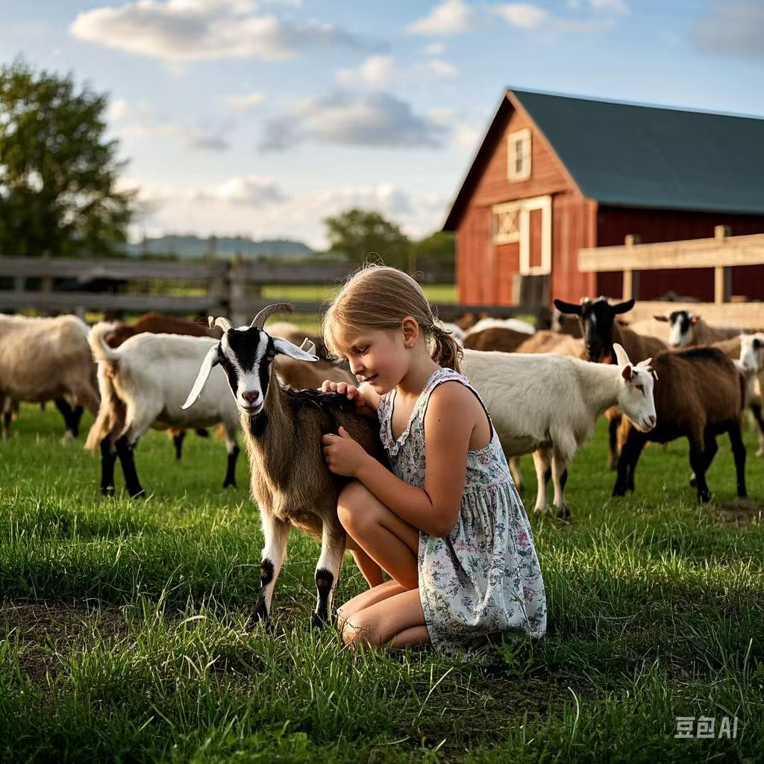
农场小帮手
---2025届-12金丽衢
人与自然动物篇
郑素红

Slide 3
Nala loved spending her school holidays on Grandma’s little farm! But this time, her granny was so sick, and couldn’t get out of bed!
“Don’t worry,” Nala told her granny, “I’ll look after everything!” She knew how to feed all the animals: it was easy! The chickens and ducks had pellets(丸). The horse had oats(燕麦). There was plenty of grass for the four sheep and the goat.
She could also water the vegetables and collect eggs from the chicken coop.
“What a great help you are,” Grandma said when Nala brought her a bowl of soup for lunch. “It’s no trouble!” Nala smiled.
“I’ll have to get up soon,” Grandma sighed. “Nanny will need milking.” Nanny the goat had to be milked every day. In fact, she would come outside and bleat (咩咩叫) when it was time! But Nala thought that her granny still looked pale and shaky......
“I can do it!” Nala said confidently. She hadn’t tried milking yet, but she had watched Grandma closely! Grandma would always put on her special dress and straw hat, get the bucket from the tool shed(棚), get Nanny to the milking shed, and get everything done.

Slide 4
When Nanny bleated to be milked, Nala went out to see her. She expected the goat to follow her to the milking shed like she did with Grandma, but the animal just stood there.
“Come on, Nanny,” Nala said. “I’m milking you today. Grandma’s sick, so we have to work together.”
Nanny just bleated impatiently, moving her feet uncomfortably.
“Maybe I need to speak more firmly,” Nala thought. “Now listen, Nanny. I want you to follow me to the milking shed, right now!” But Nanny trotted away across the yard!
“Hey, come back here!” Nala called. Nanny stopped and turned around. She didn’t like this little stranger. Grandma never yelled at her!
Para1:At that moment Nala had a think.
Para2:Just then, she spotted Grandma’s dresses and the straw hat hanging over a chair.

Slide 5
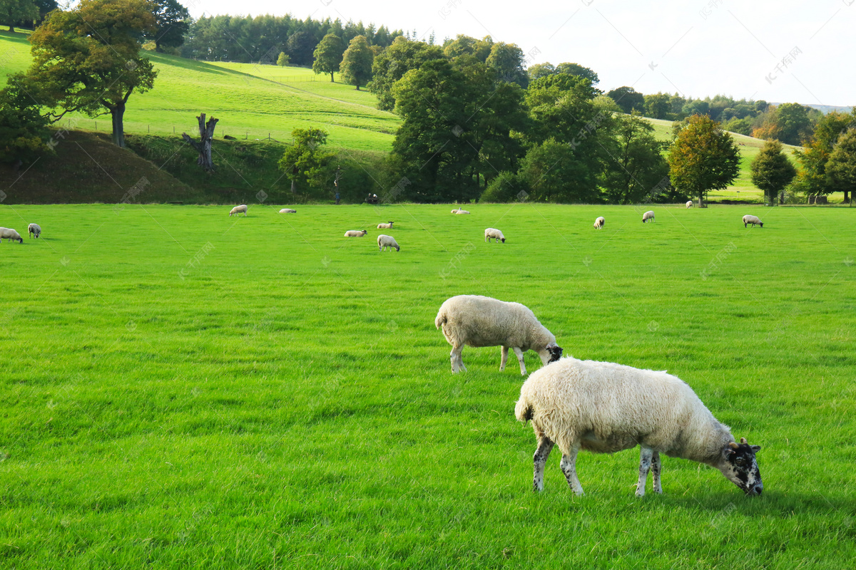
Read for elements
characters： Nala Nanny ( a goat) ( leading )
Grandma ( supporting)
2. narrative perspective: third-person
3. time：a school holiday
place： on her grandma’s little farm
Event : Grandma was ill and Nala ran errands on the farm . And she had difficulty in milking Nanny .

Slide 6
5.
story
line
Climax
Nala tried to get Nanny to the milking shed but Nanny trotted away across the yard!
Para1:At that moment Nala had a think.
Nala said confidently that she could milk Nanny. She hadn’t tried milking yet, but she had watched Grandma closely!
“I’ll have to get up soon,” Grandma sighed. “Nanny will need milking.”
Para2:Just then, she spotted Grandma’s dresses and the straw hat hanging over a chair.
Nala told her granny, “I’ll look after everything!”
Nala loved spending her school holidays on Grandma’s little farm! But this time, her granny was so sick, and couldn’t get out of bed!
background
Ending
Beginning

Slide 7
Read for clues and echoes
hidden clues | echoes
“Don’t worry,” Nala told her granny, “I’ll look after everything!” She knew how to feed all the animals: it was easy! The chickens and ducks had pellets(丸). The horse had oats(燕麦). There was plenty of grass for the four sheep and the goat. | “Grass!” she exclaimed, eyes sparkling with thrill! Nala flew towards the meadow, selected the most tender and juicy grass , grabbed a significant bunch and zoomed across the farm to the still-bleating goat. (反向表达一下山羊不吃Nala采摘的草 ） What disappointed Nala most was that Nanny turned a blind eye to the feast! Nala’s painstaking efforts ended up in failure!

Slide 8
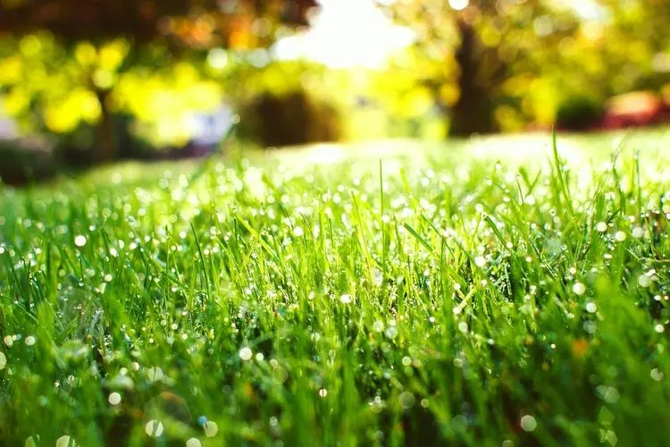
Read for clues and echoes
hidden clues | echoes
“I can do it!” Nala said confidently. She hadn’t tried milking yet, but she had watched Grandma closely! Grandma would always put on her special dress and straw hat, get the bucket from the tool shed(棚), get Nanny to the milking shed, and get everything done. | 3. Without any hesitation, Nala dashed to the chair, grabbed Grandma’s dresses and the straw hat and put them on as quickly as possible. Now Nala looked like a small version of her Granny! 4. An idea popped up in her head. “ Why not dress up as my dearest Granny!” Nala thought to herself.

Slide 9
Read for clues and echoes
hidden clues | echoes
“Come on, Nanny,” Nala said. “I’m milking you today. Grandma’s sick, so we have to work together.” Nanny just bleated impatiently, moving her feet uncomfortably. “Maybe I need to speak more firmly,” Nala thought. “Now listen, Nanny. I want you to follow me to the milking shed, right now!” But Nanny trotted away across the yard! | 5. The milking process went extremely smoothly, filling her heart with an overwhelming sense of achievement. 6.Seeing the familiar figure approaching, Nanny breathed a sigh of relief , following Nala to the milking shed and bleating merrily. 7. Reflecting on the way she treated Nanny, Nala realized that she needed a trick to deal with Nanny.

Slide 10
心理描写
神态描写
动作描写
外貌描写
环境描写
对话描写
语言
无灵主语
动作链
分词作状语
With 复合结构
独立主格
从句
倒装句
虚拟语气
强调句
长短句结合
考生构思情节的同时，要考虑合适的语言句式以及修辞

Slide 11
Plot the continuation story
Para1:At that moment Nala had a think.
Para2:Just then, she spotted Grandma’s dresses and the straw hat hanging over a chair.
Link1: What was the think( idea)? How did Nala feel?
Body: What did Nala do? How did Nanny react?
Link2: What was the result? How did Nala feel?
Link3: What did Nala do then? How did she feel?
Body: How did Nanny respond to Nala? How did Nala
accomplish milking ?
Ending: ①How was the relationship between Nala and Nanny now?
② What lesson did Nala learn from the experience?

Slide 12
Design link1
Para1:At that moment Nala had a think.
Link1A: (呼应原文最后一句：Grandma never yelled at her! 推知Nala 反思自己的做法） Frustrated as Nala was, she determined to coax Nanny with her favorite fresh grass / oats ( 燕麦也是羊爱吃的食物。）.
Link1B: : (呼应首句had a think 为叙事对象：） As she glanced at the lush grass, a brilliant idea hit her like a bolt of lightning!
“Grass!” she exclaimed, eyes sparkling with thrill!

Slide 13
Design link1
Para1:At that moment Nala had a think.
Link1 C: (原文最后一句：Grandma never yelled at her! 推知Nala 反思自己的做法）Realizing that she was kind of forceful with Nanny, Nala softened her voice and mimicked bleating, trying to attract Nanny’s attention.
Link1D: (呼应原文oats,羊也喜欢的食物） Nala decided to change her way to approach Nanny and went back to the barn to grab some delicious oats to tempt her.

Slide 14
Design link2
Para1:At that moment Nala had a think.
Para2:Just then, she spotted Grandma’s dresses and the straw hat hanging over a chair.
Link2 A: (呼应第二段所给句首句，暗示“Nala第一段想到的主意没有起作用”) Nala’s painstaking efforts ended up in failure! She was at her wit’s end ! Nanny still froze on her spot, refusing to follow Nala to the milking shed and bleating increasingly impatiently. “Nanny only trusts granny. ” Nala sighed heavily with a sinking heart, looking around blankly.
Link2B: ( 呼应原文Nanny 拒绝配合Nala）Nanny’s bleating became increasingly impatient, which upset Nala and gave Nala a hard blow.

Slide 15
Design link3
Para2:Just then, she spotted Grandma’s dresses and the straw hat hanging over a chair.
Link3A: ( dresses and the straw hat 是平时奶奶挤羊奶的日常装扮） An idea popped up in her head. “ Why not dress up as my dearest Granny!” Nala thought to herself.
Link3B: ( 呼应第一段Nanny 拒绝配合Nala） A spark of hope was reignited in Nala’s heart! Without any hesitation, Nala dashed to the chair, grabbed Grandma’s dresses and the straw hat and put them on as quickly as possible.

Slide 16
Design ending
Para2:Just then, she spotted Grandma’s dresses and the straw hat hanging over a chair.
Ending A: (提炼主题式) It dawned on Nala that treating animals is much like treating friends, both of which need understanding , thoughtfulness as well as patience.
Ending B: (情景式结尾) When Nala turned up in her granny’s bedroom with a bucket of milk, Granny cracked a radiant smile on her pale wrinkled face, giving Nala a thumbs-up for being a great help.

Slide 17
Para1:At that moment Nala had a think.
As she glanced at the lush grass, a brilliant idea hit her like a bolt of lightning! “Grass!” she exclaimed, eyes sparkling with thrill! Nala flew towards the meadow, selected the most tender and juicy grass , grabbed a significant bunch and zoomed across the farm to the still-bleating goat. What disappointed Nala most was that Nanny turned a blind eye to the feast! Nala’s painstaking efforts ended up in failure! She was at her wit’s end ! Nanny still froze on her spot, staring at Nala in a suspicious way and bleating increasingly impatiently. “Nanny only trusts granny. ” Nala sighed heavily with a sinking heart, looking around blankly.

Slide 18
Para2:Just then, she spotted Grandma’s dresses and the straw hat hanging over a chair. ） A spark of hope was reignited in Nala’s heart! Without any hesitation, Nala dashed to the chair, grabbed Grandma’s dresses and the straw hat and put them on as quickly as possible. Now Nala looked like a small version of her Granny! Seeing the familiar figure approaching, Nanny breathed a sigh of relief , following Nala to the milking shed and bleating merrily. “ Please be well-behaved, Nanny.” Nala soothed the goat , stroking her head softly and patiently. The milking process went extremely smoothly, filling her heart with an overwhelming sense of achievement.
When Nala turned up in her granny’s bedroom with a bucket of milk, Granny cracked a radiant smile on her pale wrinkled face, giving Nala a thumbs-up for being a great help.

Slide 19
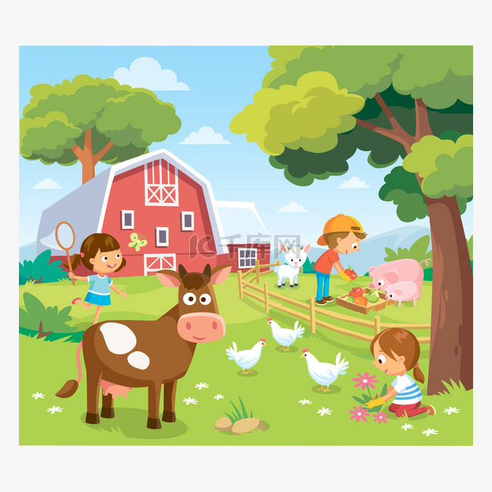
附：阅卷总体情况反馈
1.首先从审题上看，文本内容理解不清，对于had a think的理解不到位，认为是“想了一下”的意思，导致第一段的内容集中于内心的想法与情绪，没有尝试的描写。实际上at that moment就意味着had a think不应该是“想了一下”，而应该是“有了一个想法”。
2.行文逻辑性不强，第一段结尾有部分考生没写到“Nala回到工具棚”，甚至出现了在第一段就已经成功将Nanny引入挤奶棚的情节，与第二段逻辑衔接不够。部分考生在第二段开始就写向grandma求助，因为没能成功完成挤奶的任务而愧疚，也没提及装扮成grandma的样子来解决问题，表明学生未读出第二段首句的提示，缺乏解读文本意识。
3.因前面客观题较难，部分考生写作文的时间不够，仓促而就。
4.书写不规范，不整洁，涂改过多。
5.语言丰富性和准确性加强，语法错误较多。

Slide 20
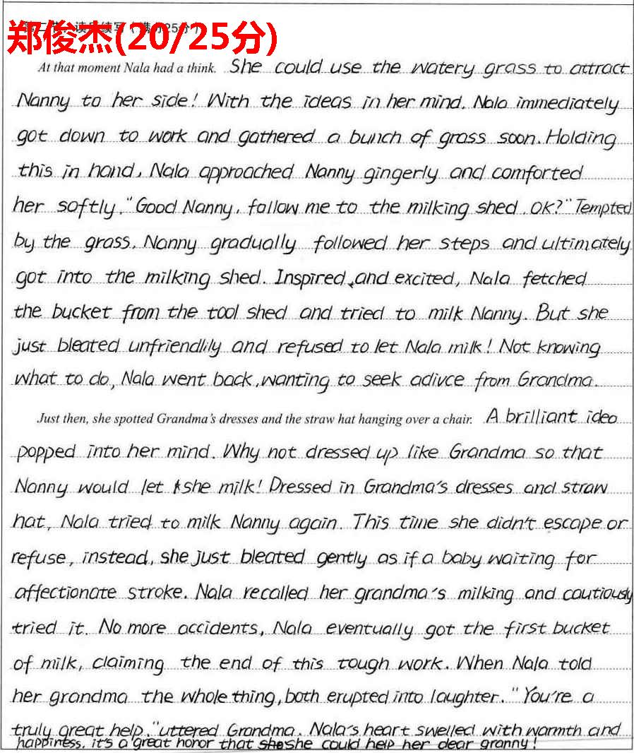
考生习作点评：
三处衔接紧凑，符合故事发展逻辑；第一段的情节设计非常有层次感：先用新鲜的草哄骗Nanny 到了挤奶棚，结果拒绝让Nala 挤奶，然后再想到向奶奶求助，自然地过度到第二段。情节构思非常巧妙。
句式多样丰富，非谓语，二连形；二连动等运用娴熟，表达自然。
回扣原文也很自然贴切。最后和奶奶说起这次趣事，情感流露非常到位。

Slide 21
续写微技能
其他各种说：（续：湖丽衢--辛辣友谊)
1. 咕哝着说 murmur
2.结结巴巴说 stutter
3.宣告：announce/declare
4. 保证：promise/assure/ guarantee
5. 建议：advise /propose/suggest；
6. 恳请 plead / beg / appeal to
7. 问与答：ask，answer回答/reply回复 / replied in a calm voice
8. 喊叫：cry out /call /
9. 大喊shout/yell
10. 尖叫scream
11. 惊叫（因高兴、愤怒、痛苦、惊讶等发生的喊叫）exclaim /
12. 发出特别响地声音 let out a surprisingly loud voice
13. 声嘶力竭地大叫shout at the top of one’s lungs / voice
14. 补充说道add
15. 继续说道 continue
16. 解释道explain
17. 陈述道state；
18. 抗议道protest
19. 哭诉道sob
20. 同意地说agree
21. 安慰道comfort /soothe/ console
22. 询问 inquire
23. 叹息道 sigh

Slide 22
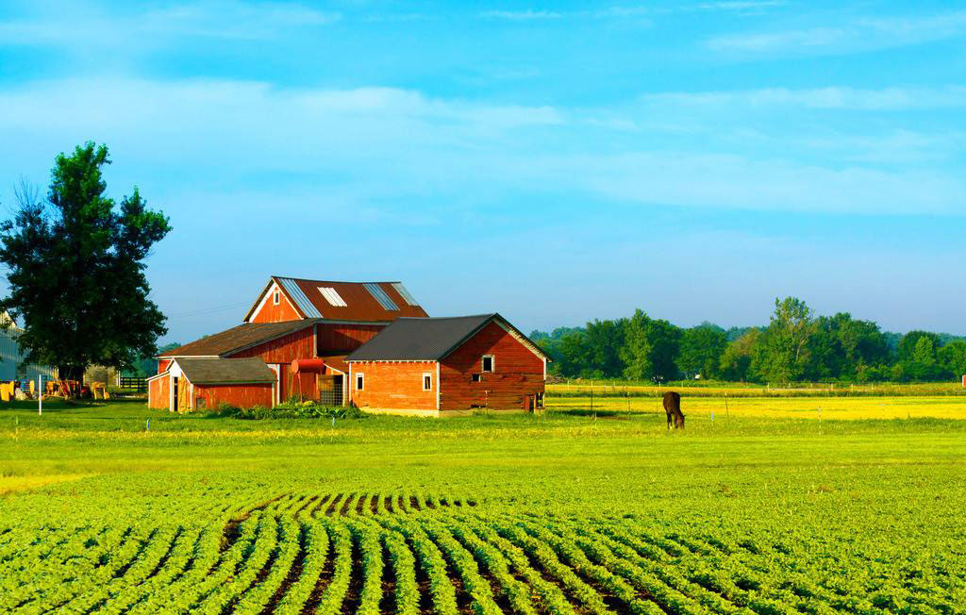
年长者的语料：
Staring at Little Nala affectionately, Granny eventually breathed a sigh of relief, realizing Nala literally grown up into an able farm help.
A radiant smile cracked on her wrinkled face as Nala announced that she had accomplished the seemingly-impossible milking mission.
Eye fixed on my mother’s weathered face, I held her calloused hands tightly, led her to the front of my classmates proudly and introduced my mother emotionally.
The old grey-headed man dragged his weary legs, with his bent back almost dropping to the ground.

