Slide 1
感恩遇见，相互成就，本课件资料仅供您个人参考、教学使用，严禁自行在网络传播，违者依知识产权法追究法律责任。
更多教学资源请关注
公众号：溯恩英语
知识产权声明

Slide 2
2025.1浙江首考 语法填空评析

Slide 3
目 录
01
02
03
04
语法填空考情分析
近三年首考真题回顾
题型命题趋势与特点
下阶段复习备考建议

Slide 4
语法填空考情分析
PART 01

Slide 5
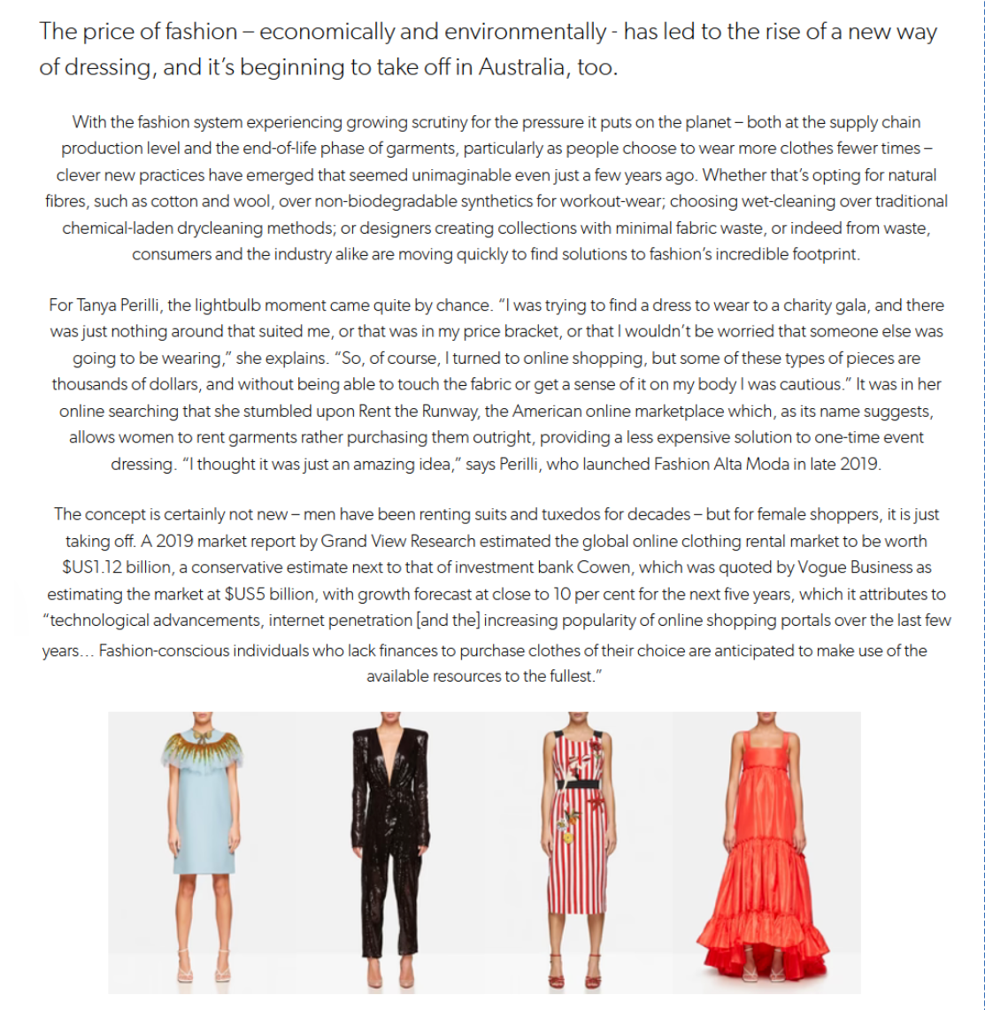
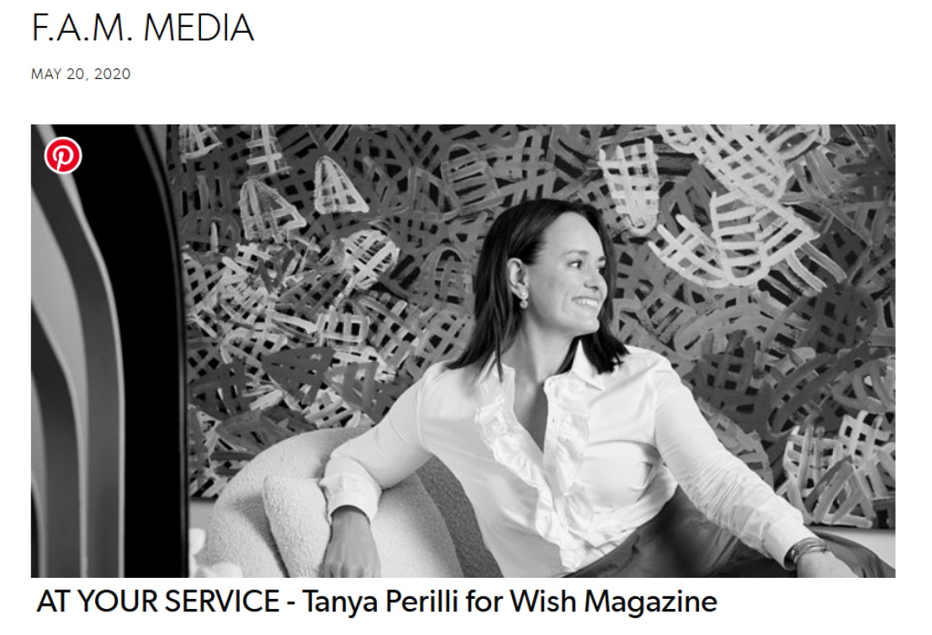
真题题源
https://www.fashionaltamoda.com.au/blogs/stories/wish-magazine

Slide 6
25.1浙江英语首考语法填空真题回顾
The price of fashion — economically and environmentally — has led to the rise of ___56___ new way of dressing, and it’s beginning to take off in Australia, too. As people now choose to wear more clothes fewer ___57___ (time), clothing rental services have become increasingly popular.
“I think it’s an amazing idea,” says Tanya Perilli, who owns a clothing rental shop. “Customers today look past the fact that something is secondhand and focus instead ___58___ the fact that they have something unique to wear ___59___ are not overstuffing their own wardrobes(衣柜) or contributing to landfill.”
Tanya’s shop offers fashion clothes for women ___60___ (rent) rather than purchase them outright, providing a less expensive ___61___ (solve) to one-time event dressing. The concept ___62___ (be) certainly not new — men have been renting good suits for decades — but for female shoppers, it is just taking off. This clothing-as-service model follows the broader societal movement towards shared economies.
Tanya is also looking beyond special-occasion dresses to less formal clothing, ___63___ she plans to package as capsule wardrobes and offer to travellers, such as those headed to weddings abroad, with a longer-term rental period. “I really want to make this work for ___64___ (people) lives today, and I know that doesn’t always mean ___65___ (return) a dress on the Monday after a special weekend,” she says.

Slide 7
25.1浙江英语首考语法填空答案与考点分析
题号 | 答案 | 考点
56 | a | 考察冠词，语篇第一次提到服装租赁这个新型的生活方式
57 | times | 考察可数名词复数形式，这里time表示次数，因此填复数
58 | on | 考察介词，由前面的focus可知搭配focus on
59 | and | 考察连词，前后内容是并列的关系，因此t填and
60 | to rent | 考察非谓语动词，offer sb to do sth的搭配可知填to rent
61 | solution | 考察动词性转换，由前文a less expensive可知填名词solution
62 | is | 考察谓语动词，由主语the concept并结合时态可知填is
63 | which | 考察定语从句，先行词是前文的衣物，做定语从句的宾语
64 | people’s | 考察名词所有格，由后文lives可知是people’s
65 | returning | 考察非谓语动词，mean doing sth表示意味着做某事

Slide 8
25.1浙江英语首考语法填空命题特点
话题时尚新颖，紧跟时代潮流，通过对新兴的服装租赁业的背景介绍、经营者的个人体验和该产业运营模式及未来展望等，倡导了绿色环保、资源共享的可持续发展的生活方式和生活理念，寓教育于具体情境之中。
语篇题目设置难度层次明显，考点覆盖了常见的语法考查点，例如冠词、连词、介词、非谓语动词、定语从句等。其中56、57、60、62、65几题难度系数相对较低，重在考察学生的基础知识和基本技能，考生总体得分率较高；61和64题需要学生绕一个弯，solve的名词形式是solution，是特殊变化，64题根据后文lives复数形式得出是“人们的生活”的意思，因此填写people’s；其中得分率较低的是58、59和63三题，58题较多学生只关注到横线前的instead忽略了语篇整体意义从而填写了of，59题部分学生未能发现前后是并列关系，误判成了定语从句，63题考查定语从句，部分学生未能厘清句子结构和句意，填写了连词。整体而言，该部分设问难度梯度分明，考察了学生综合语言运用能力。

Slide 9
近三年首考语法填空真题回顾
PART 02

Slide 10
[2023.1浙江首考语法填空]
During China’s dynastic period, emperors planned the city of Beijing 56 arranged the residential areas according to social classes. The term “hutong”, 57 (original)meaning “water well” in Mongolian, appeared first during the Yuan Dynasty.
In the Ming Dynasty, the center was the Forbidden City, 58 (surround)in concentric(同心的) circles by the Inner City and Outer City. Citizens of higher social classes 59 (permit) to live closer to the center of the circles. The large siheyuan of these high-ranking officials and wealthy businessmen often 60 (feature) beautifully carved and painted roof beams and pillars(柱子). The hutongs they formed were orderly, lined by 61 (space) homes and walled gardens. Farther from the center lived the commoners and laborers. Their siheyuan were far smaller in scale and 62 (simple)in design and decoration, and the hutongs were narrower.
Hutongs represent an important cultural element of the city of Beijing. Thanks to Beijing’s long history 63 capital of China, almost every hutong has its stories, and some are even associated with historic 64 (event). In contrast to the court life and upper-class culture represented by the Forbidden City, the Summer Palace, and the Temple of Heaven, the hutongs reflect 65 culture of grassroots Beijingers.
56.and 57. originally 58. surrounded 59. were permitted 60. featured
61. spacious 62.simpler 63. as 64. events 65. the

Slide 11
[2024.1浙江首考语法填空]
The shelves in most supermarkets are full of family-size this and multi-buy that. However, if you’re shopping for one, buying extra ___56___ (benefit) from price reductions doesn’t make sense. Either your shopping is then too heavy to carry home ___57___ you can’t use what you’ve bought while it’s still fresh.
Of course, shops are not charities — they price goods in the way ___58___ will make them the most money. If most of their customers are happy to buy larger quantities, that’s ___59___ they’ll promote. But that leaves the solo (单独) customers out of pocket and disappointed.
Many supermarkets are no longer doing “buy one get one free” promotions because of the ____60___ (criticize) that they lead to waste. Consumers prefer money off individual items. However, though it’s nice to get a few cents off a pack of sausages, it would help even more if they could sometimes ___61___ (offer) in smaller packs. Even the biggest sausage fan doesn’t want to eat them every day.
If your supermarket sells loose produce, then buying smaller quantities is easier. Over the last two years, some supermarkets ___62___ (start) selling chicken or salad in packs ___63___ (design) with two halves containing separate portions (份). Then, when you use one section, ___64___ other stays fresh.
Who knows, perhaps some of the more forward-looking ___65___ (one) may yet come out with a whole range of “just for you” pack sizes with special offers as well.
56. to benefit 57.or 58. that/which 59. what 60. criticism
61. be offered 62.have started 63. designed 64. the 65. ones

Slide 12
 |  |  | 三年首考语法填空考点对比分析
2023.1浙江首考
 |  |  | 2024.1浙江首考
 |  |  |  |  |  | 2025.1浙江首考
题号 | 答案 | 考点 | 题号 | 答案 | 考点 | 题号 | 答案 | 考点
56
 | and
 |  | 连词
 |  |  | 56
 |  |  |  | to benefit
 |  |  |  |  | 非谓语动词
 |  |  |  |  |  | 56
 |  |  |  |  |  |  | a
 |  |  |  |  |  |  |  | 冠词
57 | originally | 词性转换 | 57 | or | 连词 | 57 | times | 复数
58 | surrounded | 非谓语动词 | 58 | that/which | 定语从句 | 58 | on | 介词
59 | were permitted | 被动语态 | 59 | what | 表语从句 | 59 | and | 连词
60 | featured | 谓语动词 | 60 | criticism | 词性转换 | 60 | to rent | 非谓语
61 | spacious | 词性转换 | 61 | be offered | 被动语态 | 61 | solution | 词性转换
62 | simpler | 形容词比较级 | 62 | have started | 谓语动词 | 62 | is | 谓语动词
63 | as | 介词 | 63 | designed | 非谓语动词 | 63 | which | 定语从句
64 | events | 复数 | 64 | the | 冠词 | 64 | people’s | 所有格
65 | the | 冠词 | 65 | ones | 复数 | 65 | returning | 非谓语动词

Slide 13
题型命题趋势与特点
PART 03

Slide 14
命题趋势与特点一：灵活考查介词应用
语法填空对介词的考查除了固定的介词搭配之外，更要求学生基于研读原文、基于理解的基础上，对语篇所缺失的介词做出正确的合乎语法规则及文本逻辑的判断。
as
1. The Grasshouse stands 63.______ a great achievement in contemporary design, to house the plants of the southwestern part of China at the end of a path retracing(追溯) the steps along the Silk Road...(2024.6全国一卷)
2.There you will find them prepared differently---more dumpling and less soup, and the wrappers are pressed 60._____ hand rather than rolled. (2023.6全国一卷)
该题错误率较高，和stand搭配的短语有stand by, stand for等，考生容易根据固有记忆而忽略了对文本句意的理解，该句的意思是“动态温室是作为一项当代设计的最高成就而存在的”。
by
本句话的意思是“面皮是用手按压制作的而不是卷出来的”，根据句意填写介词by，by hand表示手工制作的，而和hand搭配的介词词组有很多，例如in hand, at hand等，考生如果没有对句意进行透彻理解容易填写错误。

Slide 15
拓展演练：在下列空格中填入恰当的介词
It is the most famous novel in Chinese literature and ____________ the country’s most successful cultural exports. (2024.10浙南名校联盟)
The impact of “Jian Cha” extends __________ its delicious taste ad visual beauty. (2025普通高校招生模拟卷)
The courtyard is paved with Old Hutong bricks recycled _________ the destroyed courtyards in the center of Nanjing. (2024.12高三T8联考)
The skateboarding community in Beijing has also taken me ______ surprise. (广东省2025届普通高中毕业班第二次调研考试)
among
beyond
from
by

Slide 16
命题趋势与特点二：关注一词多义、一词多性、熟词新义的考查
语法填空在文本和选项中更加关注一词多义、一词多性以及熟词新义的考查，考生在语篇阅读过程中，要结合上下文正确判断该词的词性和词义，否则会出现语句不通、词不达意的阅读效果。
1. Further, the Silk Route Garden around the greenhouse ___60____(walk) visitors through a journey influenced by the ancient Silk Road... (2024.6全国一卷)
2. These plants included modern Western _____62________(favourite) such as rosemary, lavender and fennel. (2024.6全国一卷)
以上两空都是24年全国一卷语法填空错误率较高的题目，主要原因是括号内所给提示词在文本中均是熟词新义，walk不是常见的不及物动词，而是作为及物动词使用，表示“陪护……走”, 在本句中做谓语动词，因此填walks; 第二句中favourite不是常见的形容词词性，而是作为名词使用，表示“最喜欢的事物”, 因此第一处应填写名词的复数形式。

Slide 17
拓展演练：在下列空格中填入所给提示词的恰当形式
This comparison helps them figure out how much weight they ‘ve lost during the hot months, hoping to gain sufficient weigh _____________(weather) the upcoming cold season. (2024.11浙江省9+1联盟高三期中考)
The 104-minute film, One Day on Earth, is a visual poem __________(star) everyone on the planet. (2024.11湖丽衢三地高三联考)
Historically, the Silk Road promoted cultural exchange between China and Italy, which ________________(evidence) by Marco Polo’s travels and the spread of Chinese Culture to Italy. (2024.11宁波市高三一模)
____________(feature) 31 pieces from 33 Italian artists, the exhibition presented a diverse range of creative expressions, reflecting Italy’s artistic evolution from the 1960s to today. (2024.11宁波市高三一模)
to weather
starring
was evidenced
Featuring

Slide 18
拓展演练：在下列空格中填入所给提示词的恰当形式
The straight passages on the ground level gradually turn into __________(wind) passage of the figure above. (2024.12高三T8联考)
The cultural-exchange between the two cities reached a new height in 2017 when Hangzhou Opera and Dance Drama Theater _________(stage) the show To Meet te Grand Canal in Nice, at the invitation of the Nice government. (2024.11杭州高三一模)
Porcelain has also been a carrier for cultural exchanges. Along with China’s silk and tea, porcelain was one of the commodities _______(trade) worldwide. (江苏省24届决胜新高考高三上学期10月联考)
10. For at least 50 years, they were grown as decorative plants, _______(prize) for their cheerfully bright color and... (24.11温州一模)
winding
staged
traded
prized

Slide 19
命题趋势与特点三：词性转换考查点难度增大
词性转换是语法填空的必考语法知识点之一，常见的有动词转名词、形容词转副词等。近几年来语法填空词性转换的考查难度逐渐增加，出现了对高中选择性必修教材中词性转换的考查，以及日常不常见的或考生较易拼写错误的词汇考查。
spacious
1. The hutongs they formed were orderly, lined by _________(space) homes and walled gardens. (2023.1浙江首考)
2. Many supermarkets are no longer doing “buy one get one free” pomotions because of the __________(criticize) that they lead to waste. (2024.1浙江首考)
3. ...to come to define much of the __________(rich) of gardening in England. (2024.6全国一卷)
criticism
richness
以上三空均考查了词性转换，考生在做题过程中不难判断出横线上应填写的词汇词性，但在拼写上错误较多，仅有少部分同学正确拼写这些单词，不少同学甚至写了“自创词汇”, 使得看似常见的词性转换的考点也成为了高考考场上的失分点。

Slide 20
拓展演练：在下列空格中填入所给提示词的恰当形式
Described by art ___________(enthusiastic) Zhang Yin, this unique event displayed the integration of Chinese tradition with Western modernity...(2024.11宁波一模)
It is characterized by slow, flowing movements that promote balance, _______________ (flexible) and relaxation. (2023.11宁波市一模）
Depicted in a __________(future), robotic and metallic style, the worker bee is flying through various landscapes, including...(2024.12浙江省五校联考)
You’ll never become fully conscious of how much you value it until you _________ (tear) apart from it. (2024.2新阵地第三次联考)
The __________(exhibit) include artworks from China and the US, antique documents, calligraphy and paintings and clothing, attracting more than 150,000 visitors from all over the world. (2023学年第一学期精诚联盟)
enthusiast
flexibility
futuristic
are torn
exhibits

Slide 21
拓展演练：在下列空格中填入所给提示词的恰当形式
While its historical and cultural landmarks awe visitors, it is the varied, mouthwatering selection of snacks that _______(true) captivates their hearts. (2024.11台州一模)
Having visited Hangzhou several times, Salles describes it as “a very well-organized and ____________(welcome) city”. (2024.11杭州一模)
The more you see the world from Gen Z’s perspective, the better you’ll understand how ridiculous it is to expect them to tackle the challenges we left behind by working tirelessly and without a ___________(complian) against one corporation or another...(2024.8浙江A9联盟高三返校考)
Some cities like Beijing hae launched all-in-one passes that allow travelers to pay for things like attraction admissions and public transit _____________(electronic). (2024.11金华十校高三模拟)
truly
welcoming
complaint
electronically

Slide 22
命题趋势与特点四：长难句、复杂句比重增多
相较于几年前的浙江卷，近几年语法填空的长难句和复杂句比例明显增加，甚至出现一句即为一段的情况，长难句和复杂句比重的增加，一定程度上加大了学生的阅读障碍和理解文本的难度，尤其是出现多个空格设置的长难句，学生更容易犯错，难以判断句子成分。
Xiao long bao(soup dumplings), those amazing constructions of decicate dumpling wrappers, encasing hot, _________(taste) soud and sweet, fresh meat, are far and away from my favourite Chinese street food. (2023.1浙江首考)
主语
同位语
非谓语动词-ing形式短语做后置定语，修饰wrappers
谓语
表语

Slide 23
拓展演练：判断下列句子的结构并在空格中填入所给提示词的恰当形式
The “Italian Contemporary Art and Artists on the Silk Road” exhibition, _______(hold) at the Grand Tang Mall in Xi’an, drew over 60,000 visitors during its 37-day run. (2024.11宁波一模)
在该句中，主语是_______________________________, 谓语是_______, 宾语是_______,时间状语是______________，_______(hold) at the Grand Tang Mall in Xi’an这部分作为_________修饰_________。
Nice,France and Hangzhou, China have been developing a unique bond since their official declaration ____ sister cities in 1998, connecting the two vibrant cultures separated by 9,300 kilometers through numerous _________(initiative). (2024.11杭州一模)
在该句中，主语是_______________________________, 谓语是_______, 宾语是_______,时间状语是______________， connecting the two vibrant cultures separated by 9,300 kilometers through numerous _________(initiative)这部分是句子的___________, 其中separated by 9,300 kilometers作为___________修饰__________。

Slide 24
命题趋势与特点五：动词考点增多
近几年高考中语法填空括号内动词考点明显增加，主要考查动词作为谓语动词、非谓语动词和动词词性转换。以2022年1月浙江卷为例，括号内的动词有6个，2023年6月全国一卷括号内动词有5个，其余年份括号内动词均在3-4个。随着长难句和复杂句比重的增加，考生更加需要提高分析句子成分的能力，需要准确判断句子的谓语动词和非谓语动词，否则容易造成较多失分。
He recalls a Nice food festival at the Dragon Hotel Hangzhou, where traditional food, such as salade nicoise--- ________(make) from tomatoes, hard-boiled egges and olives and dressed with olive oil, and pan bagnat, ______ sandwich made from whole wheat bread enclosing the classic salade nicoise, was served. (2024.11杭州一模)
made
a
该句是一句长难句，句子的基本成分是He recalls a Nice food festival at the Dragon Hotel Hangzhou，where引导了一句定语从句修饰先行词 a Nice food festival at the Dragon Hotel Hangzhou,先行词在从句中做地点状语。在这句定语中，基本结构是traditional food was served, such as...and...是举的两个食物例子， ________(make) from tomatoes, hard-boiled egges and olives and dressed with olive oil作后置定语修饰salade nicoise，是被动关系，因此填made；_____ sandwich作pan bagnat的同位语，这是文本第一次提到这个三明治，因此填a。

Slide 25
拓展演练：在下列空格中填入所给动词的恰当形式
Since March, the hashtag or Tianshui Malatang, referring to a popular type of street food, ______________(reveive) more than 140m views on Weibo, a social-media platform. (2024.11温州一模)
This will help imprive their internationally ____________(recognize) influence while boosting their global competitiveness. (2024.12金丽衢十二校联考)
The original Splash Mountain ride, which first opened at Disneyland in 1989, and at Disney World and Tokyo Disneyland in 1992, ___________(base) on characters from “Song of the south”.... (2024.12浙江省精诚联盟适应性联考)
Another fun fact: the hugely popular late-night TV programme “Wantan Night” was actually named after the wontons used in chifa, ________________(demonstrate) just how deeply rooted Chinese cuisin is in Peru. (2024.12嘉兴一模)
has received
recognized
was based
demonstrating

Slide 26
拓展演练：在下列空格中填入所给动词的恰当形式
The site is a living, ever-evolving project that waits _________________(experience) personally, as eac visit will give a different, individual journey. (2024.12高三T8联考)
This autumn, however, many are choosing to depart from tradition and instead shaking off the extra weight by eating what ______________(refer) to as qingshi, or literally, “light food”. (2024.11浙江9+1联盟高三期中考)
Certain people are believed __________________(bring) Buddhism into China during the Tang Dynasty(619-907), when there was a strong need to...(2023.10浙南名校联盟）
The guqin, along with the game of Go, calligraphy and painting, __________________ (expect) to be mastered by noblemen and scholars in ancient China. (2023.9嘉兴基测）
to be experienced
is referred
to have brought
was expected

Slide 27
下阶段复习备考建议
PART 04

Slide 28
不畏浮云遮望眼，只缘身在最高层。语法填空必须在理解文本的基础上进行，做题时需要“瞻前顾后”，而不是只着眼于空格前后的几个单词。
以不变应万变。语法填空必须遵循“读文本、析句意、理成分、判缺失、寻线索、填空格”的做题原则，遇到常见的谓语或非谓语动词考点时，可以通过一看时态，二看语态，三看主谓一致”及“一看搭配，二看主被动，三看时间点”的做题口诀；遇到长难句时可以借助“一辨二划三括”——辨句式，划成分，括修饰”的口诀，坚定自己的做题方法，破解各类语篇。
冰冻三尺，非一日之寒；滴水石穿，非一日之功。在日常学习中，必须加强自己的基本语言能力，夯实自己的基础，扎实掌握考纲内的词性转换和语法知识。
学而不思则罔，思而不学则殆。语法填空是对考生综合语言知识和语言运用能力的考查，日常学习中，同学们必须勤加练习、勤于思考，时常反思自己的学习行为，对自己的学情有清晰的认识和了解。

Slide 29
THANKS

