Slide 1

感恩遇见，相互成就，本课件资料仅供您个人参考、教学使用，严禁自行在网络传播，违者依知识产权法追究法律责任。
更多教学资源请关注
公众号：溯恩高中英语
知识产权声明

Slide 2

2023年新课标Ⅰ&Ⅱ卷英语读后续写
写作比赛
在冲突的解决中设计故事结局

Slide 3
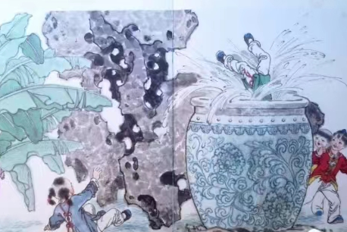
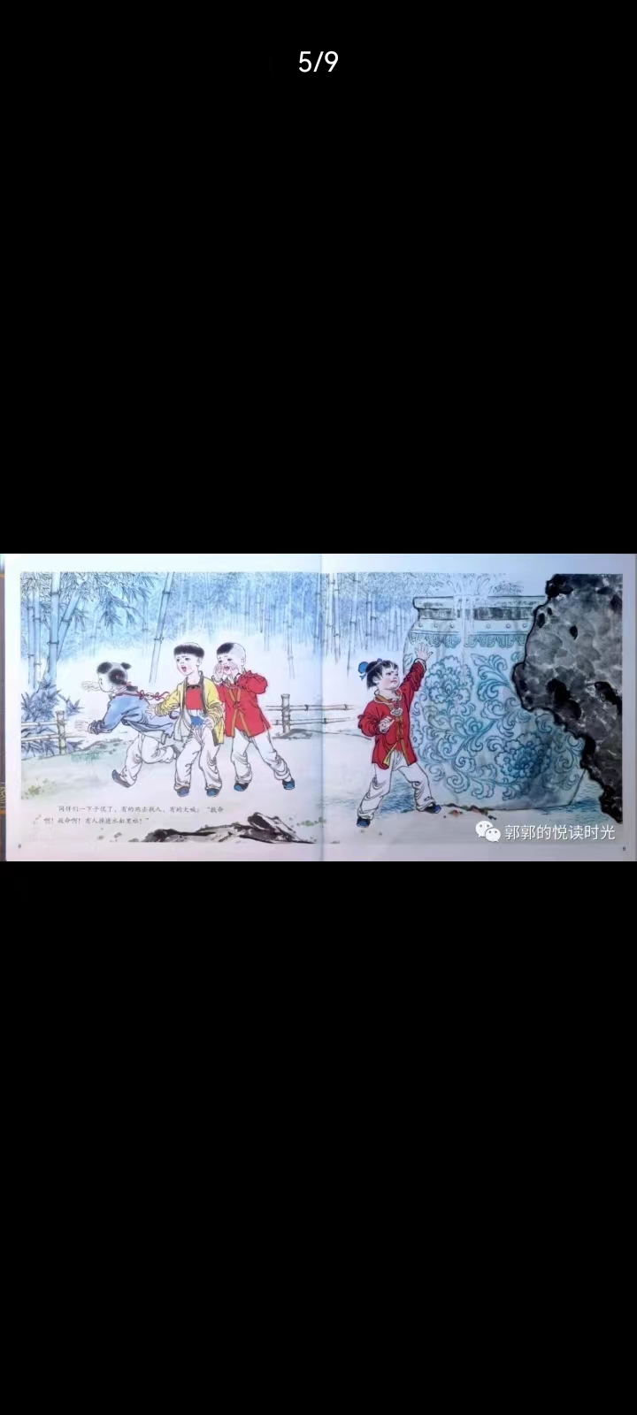
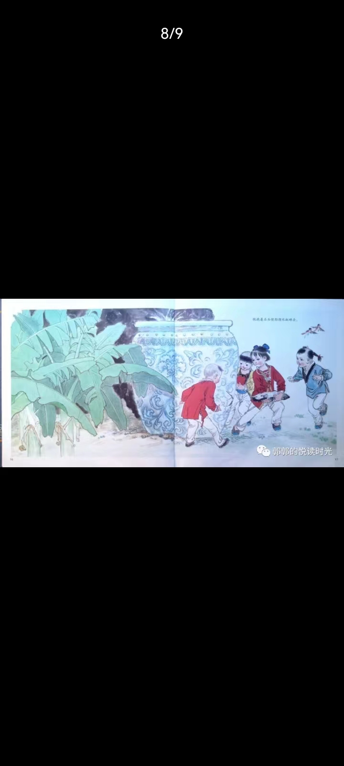
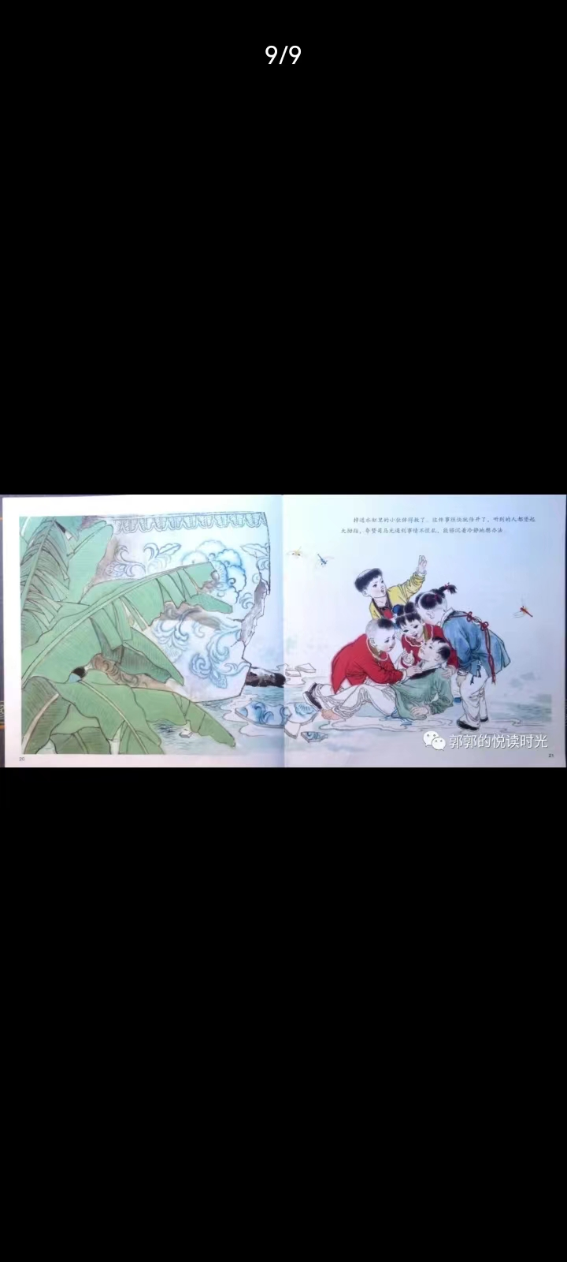
Conflicts in a story
conflict1
conflict2
solution
ending

Slide 4

第二节 （满分25分） 阅读下面材料，根据其内容和所给段落开头语续写两段，使之构成一篇完整的短文。 When I was in middle school, my social studies teacher asked me to enter a writing contest, I said no without thinking. I did not love writing. My family came from Brazil, so English was only my second language. Writing was so difficult and painful for me that my teacher had allowed me to present my paper on the sinking of the Titanic by acting out a play, where
I played all the parts. No one laughed harder than he did. So, why did he suddenly force me to do something at which I was sure to fail? His reply: “Because I love your stories. If you’re willing to apply yourself, I think you have a good shot at this.” Encouraged by his words, I agreed to give it a try. I chose Paul Revere’s horse as my subject. Paul Revere was a silversmith (银匠) in Boston who rode a horse at night on April 18, 1775 to Lexington to warn people that British soldiers were coming. My story would come straight from the horse’s mouth. Not a brilliant idea, but funny, and unlikely to be anyone ease's choice. What did the horse think, as sped through the night? Did he get tired? Have doubts? Did he want to quit? I sympathized immediately. I got tired. I had doubts. I wanted to quit. But, like Revere's horse, I kept going. I worked hard. I checked my spelling. I asked my older sister to correct my grammar. I checked out a half-dozen books on Paul Revere from the library. I even read a few of them. When I handed in the essay to my teacher, he read it, laughed out loud and said, “Great. Now, write it again.” I wrote it again, and again and again. When I finally finished it, the thought of winning had given way to the enjoyment of writing. If I didn’t win. I wouldn’t care. 注意：1.续写词数应为150个左右； 2.请按如下格式在答题卡的相应位置作答。
para.1 A few weeks later, when I almost forgot the contest, there came the news.
para.2 I went to my teacher’ office after the award presentation.
A few weeks later, when I almost forgot the contest, there came the mews. I went to my teacher’ office after the award presentation.

Slide 5
Read for conflicts
What was the conflict presented in this part?
What was the solution to the conflict?
1. When I was in middle school, my social studies teacher asked me to enter a writing contest, I said no without thinking. I did not love writing. My family came from Brazil, so English was only my second language. Writing was so difficult and painful for me that my teacher had allowed me to present my paper on the sinking of the Titanic by acting out a play, where I played all the parts. No one laughed harder than he did.
2. So, why did he suddenly force me to do something at which I was sure to fail? His reply: “Because I love your stories. If you’re willing to apply yourself, I think you have a good shot at this.” Encouraged by his words, I agreed to give it a try.
C1
--R1
A forced writing task
A doomed failure
A trying heart

Slide 6
Read for conflicts
What was the conflict presented in this part?
What was the solution to the conflict?
3. I chose Paul Revere’s horse as my subject. Paul Revere was a silversmith (银匠) in Boston who rode a horse at night on April 18, 1775 to Lexington to warn people that British soldiers were coming. My story would come straight from the horse’s mouth. Not a brilliant idea, but funny, and unlikely to be anyone ease's choice. 4. What did the horse think, as sped through the night? Did he get tired? Have doubts? Did he want to quit? I sympathized immediately. I got tired. I had doubts. I wanted to quit. But, like Revere's horse, I kept going. I worked hard. I checked my spelling. I asked my older sister to correct my grammar. I checked out a half-dozen books on Paul Revere from the library. I even read a few of them.
A unique idea
A self-suspicious mind
A working heart
C2
--R2
C1
--R1
A forced writing task
A doomed failure
A trying heart

Slide 7
Read for conflicts
What was the conflict presented in this part?
What was the solution to the conflict?
5. When I handed in the essay to my teacher, he read it, laughed out loud and said, “Great. Now, write it again.” I wrote it again, and again and again. When I finally finished it, the thought of winning had given way to the enjoyment of writing. If I didn’t win. I wouldn’t care.
5. When I handed in the essay to my teacher, he read it, laughed out loud and said, “Great. Now, write it again.” I wrote it again, and again and again. When I finally finished it, the thought of winning had given way to the enjoyment of writing. If I didn’t win. I wouldn’t care.
A unique idea
A self-suspicious mind
A working heart
C3
--R3
theme?
C2
--R2
A finished writing
A repeated requirement
A determined heart
Did “I” change during the process?
C1
--R1
Go beyond one’s limits
超越突破自我，
挑战无限可能！
A forced writing task
A doomed failure
A trying heart

Slide 8

Read for conflicts
What was the conflict presented in this part?
para.1 A few weeks later, when I almost forgot the contest, there came the news.
para.2 I went to my teacher’ office after
the award presentation.
A unique idea
A self-suspicious mind
A working heart
C3
--R3
C2
--R2
A finished writing
A repeated requirement
A determined heart
C4
C1
--R1
A forced writing task
A doomed failure
A trying heart

Slide 9
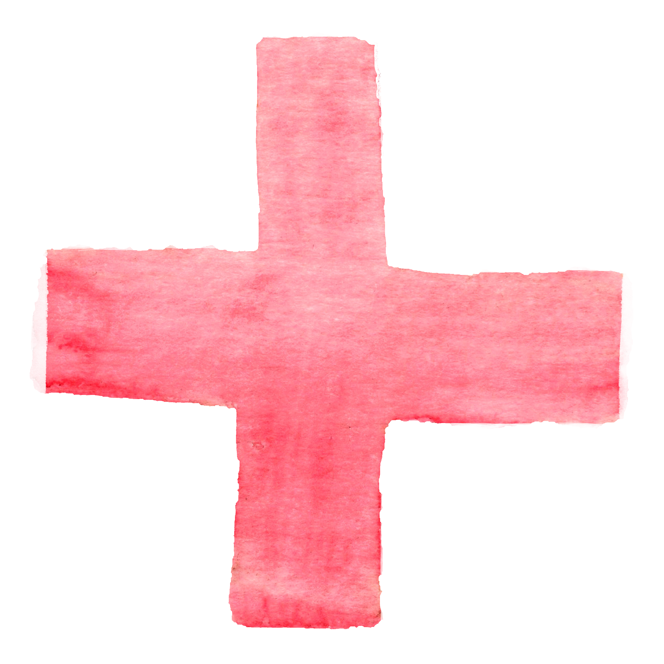

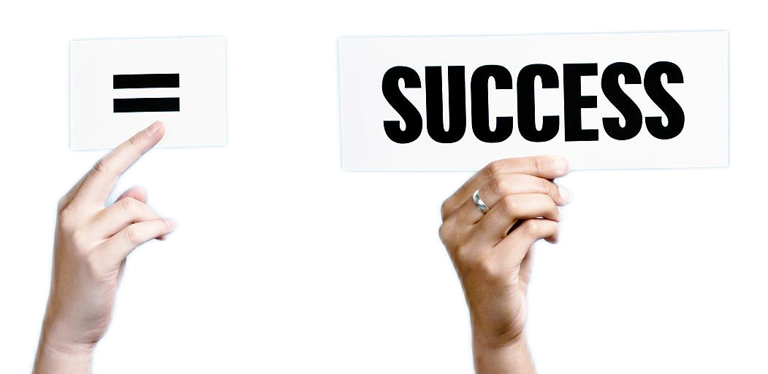
“Because I love your stories. If you’re willing to apply yourself, I think you have a good shot at this.” (para.2)
a talented writer
Not a brilliant idea, but funny, and unlikely to be anyone ease's choice. (para.3)
a creative essay
I kept going. I worked hard. I checked my spelling. I asked my older sister to correct my grammar. I checked out a half-dozen books on Paul Revere from the library. I even read a few of them. (para.4)
a devoted heart
clues
I wrote it again, and again and again. When I finally finished it, the thought of winning had given way to the enjoyment of writing. If I didn’t win. I wouldn’t care. (para.5)
a persistent
attitude

Slide 10
Plot a solution
para.1 A few weeks later, when I almost
forgot the contest, there came the news.
C3
--R3
[一]
生：得知获奖
[二]
生：经历授奖
C4
--R3
[三]
生：急于分享
C2
--R2
C1
--R1
para.2 I went to my teacher’office after the award
presentation.
An unexpected success
[一]
师：表达祝贺
[二]
生：表示感激
[三]
生：恍然大悟

Slide 11
para.1 A few weeks later, when I almost forgot the contest, there came the news.
scene1 得知获奖 | What did I do | How did I feel
打开I eagerly opened the letter
读I read the words again and again.
揉眼I rubbed my ears, my mouth widely open.
紧握I held the letter tight in my hands, palm sweating.
失语For a moment I was lost for words.
...
in disbelief
My heart raced with excitement.
I was overjoyed.
I couldn't believe my ears.
My heart pounding/thundering with excitement.
I couldn’t contain my excitement.
...

Slide 12
para.1 A few weeks later, when I almost forgot the contest, there came the news.
scene2 经历授奖 | What did I do | How did I feel
认真听listened attentively
坐端正sat tall
屏息held my breath
上台I walked up to the stage
...
filling me with a sense of pride and accomplishment
with a mix of nervousness and excitement
I felt a surge of pride and joy
...

Slide 13
para.1 A few weeks later, when I almost forgot the contest, there came the news.
scene3 急于分享 | What did I do | How did I feel
回荡My teacher’s words echoed in my mind.
回忆Memories of my teacher
inspired and encouraged me
to write resurfaced.
回想The cheers rose in the hall brought me back to the days when my teacher tirelessly helped revise my essay.
...
overwhelmed with gratitude
overflowing with gratefulness
...

Slide 14
para.2 I went to my teacher’office after the award presentation.
scene1 表达祝贺 | What did my teacher do | How did I feel
拥抱He welcomed me with open arms and a wide smile
自豪地看His eyes sparkled with pride as he looked up at me
兴奋地说"Congratulations! I knew you had it in you," he exclaimed
轻声说he whispered in my ear, "I knew you had the talent in writing."
...
barely containing my excitement
I couldn't help but feel grateful for my teacher's unwavering support.
...

Slide 15
para.2 I went to my teacher’office after the award presentation.
scene2 表示感激 | What did I do | How did I feel
展示奖状I handed him the award certificate
不断感谢I showered him with heartfelt gratitude
表示认可 I expressed my gratitude for his guidance, acknowledging that his faith in my storytelling had opened up new doors and possibilities.
投怀送抱So thrilled was I that I threw myself at him the moment
I entered the office.
...
my heart brimming with gratitude
felt extremely grateful for the teacher who had seen the potential within me even when I couldn't see it myself
...

Slide 16
para.2 I went to my teacher’office after the award presentation.
scene3恍然大悟 | What did I do | What did I realize
in a flash, I understood...
it suddenly occurred to me...
it struck/hit me that...
it dawned on me that...
it was exactly at that moment that I came into the enlightenment that
...
It was my teacher who tirelessly “forced” me to discover my passion for writing and my confidence in myself and my ability to succeed in what I once thought impossible.
Besides the cup, I earned a valuable lesson: anything is possible with dedication, hard work, and the unwavering support of those who believe in you.
...

Slide 17
下水作文
C4
A unique idea
A self-suspicious mind
A working heart
A few weeks later, when I almost forgot the contest, there came the news. When I was reading at home, I received an unexpected call, informing me of my success in the writing contest and the date of an award presentation ceremony. Hearing the words, I stood there in awe, a mixture of disbelief and excitement washing over me. It took several minutes before I pulled myself back. Soon, the red-letter day arrived. Filled with anticipation and pride, I stepped onto the stage when my name was called. The big hall burst out loud cheering and clapping. At that moment, the joy that surged through me was indescribable, and I couldn't wait to share the news with my teacher.
冲突的调和
C3
--R3
C2
--R2
C4
--R4
A finished writing
A repeated requirement
A determined heart
An unexpected success
C1
--R1
A forced writing task
A doomed failure
A trying heart
人物为适应冲突的调和发生的变化（从不自信、迷惘到自豪、自信、坚定）

Slide 18
下水作文
I went to my teacher’ office after the award presentation. After a gentle knock on the door, I entered and found him immersed in grading papers. He looked up from his desk, eyes sparkling with satisfaction. "Congratulations! You made it!" he exclaimed with genuine pride. Overwhelmed by gratitude, I expressed my heartfelt thanks for his unwavering support and belief in my capacities. He beamed and reminded me of keep on writing. This time, I nodded willingly. For I’ve known the true value of the contest was not just about winning, but the journey of self-discovery and the growth in confidence as well as the newfound passion for writing I had gained along the way.
A unique idea
A self-suspicious mind
A working heart
C3
--R3
C2
--R2
冲突的解决
C4
--R4
A finished writing
A repeated requirement
A determined heart
An unexpected success
A genuine congratulation
A kind of self-development
C1
--R1
人物在冲突解决后实现自我的提升（心怀感恩、爱上写作、不惧挑战、砥砺奋进。）
A forced writing task
A doomed failure
A trying heart

Slide 19
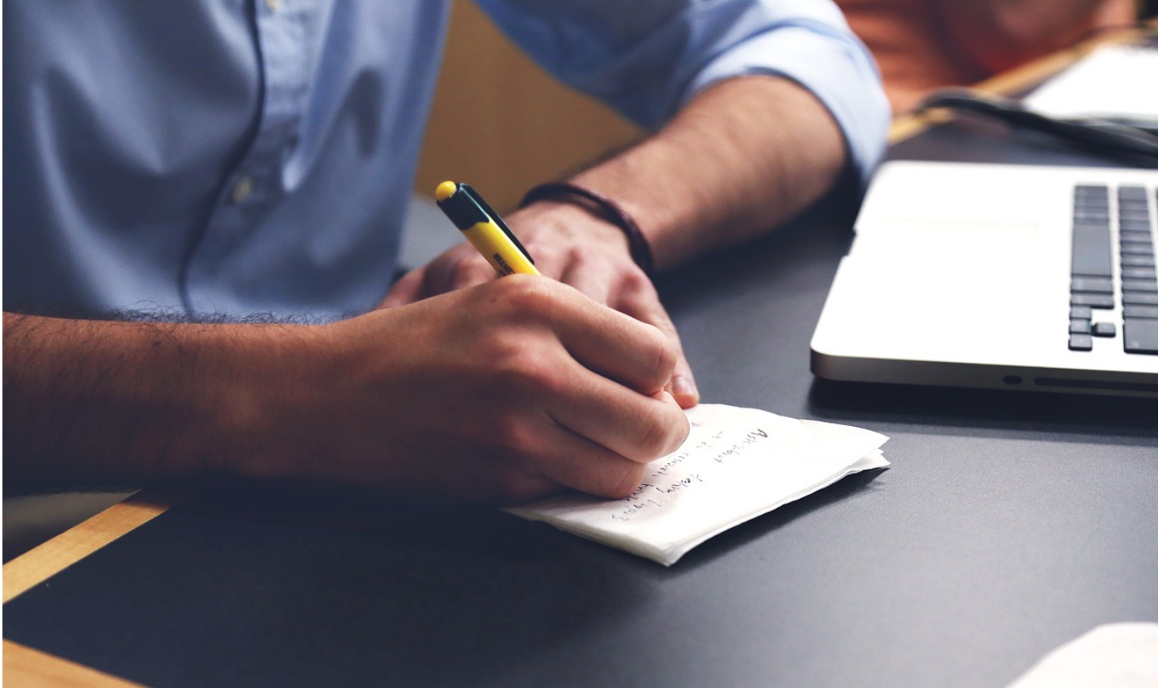
Thank you!

